Slide 1

BEGINNING SUNDAY, SEPTEMBER 6, 2026
A New Sunday for Youth
The updated Sunday class schedule and the new For the Strength of Youth curriculum
● Classes every week ● 25-minute lessons ● One FSY chapter each month
An introduction for youth, parents, and leaders
Notes:
Welcome everyone. Beginning Sunday, September 6, 2026, the Sunday class schedule changes in wards and branches around the world, and Young Women classes and Aaronic Priesthood quorums begin a brand-new curriculum built on the updated For the Strength of Youth guide. Today we'll walk through what changes, why, and how to be ready.

Slide 2



OUR PURPOSE TODAY
Three Things to Take Home
How to use the new FSY guide
1
Each month's chapter gives us eternal truths, invitations, and promised blessings — the heart of every Sunday lesson.
How to use the new magazine
2
The monthly FSY magazine carries each Sunday's lesson and brings the theme home to your family all month.
How the youth can participate
3
These classes are discussions, not lectures — every youth can share, teach, testify, and lead.
Notes:
Set the frame for the whole meeting: by the end, everyone should know three things — how to use the new FSY guide, how to use the new magazine, and how the youth themselves participate in these new weekly classes. Everything in the video and the slides that follow ties back to one of these three.

Slide 3
VIDEO · PART 1
Start → 7:23
Insert the video here — Insert → Video → This Device
Then trim this copy: Playback → Trim Video → End Time 7:23
Insert once, then copy–paste the same video onto the other PART slides
(it stays one embedded copy). Set Start: Automatically. Delete this text box.
When it pauses: discuss, then ask — “Why do you think the FSY guide is structured this way?”

Slide 4
THE NEW YOUTH CURRICULUM
The Heart of It: The FSY Guide
Young Women classes and Aaronic Priesthood quorums study the updated For the Strength of Youth: A Guide for Making Choices — discussing eternal truths from the guide and the scriptures that help youth live as lifelong disciples of Jesus Christ.
Each chapter contains “eternal truths, invitations, and promised blessings.”
12
1
4
Emily Belle Freeman · Young Women General President
chapters in the
updated guide
chapter studied
each month
Sunday lessons build
on that chapter
The guide will “help young men and young women focus on Christ, know His doctrine, and listen to the Spirit.”
The First Presidency wrote that the guide helps youth “build a solid foundation for making choices to stay on the path that leads to eternal life.”
Timothy L. Farnes · Young Men General President
Notes:
The updated FSY guide has 12 chapters — one for each month of the year. All youth, everywhere in the world, study the same chapter in the same month. Each chapter is built around eternal truths, invitations, and promised blessings. The four Sunday lessons of the month all build on that one chapter, so youth get to go deep rather than rushing past.

Slide 5
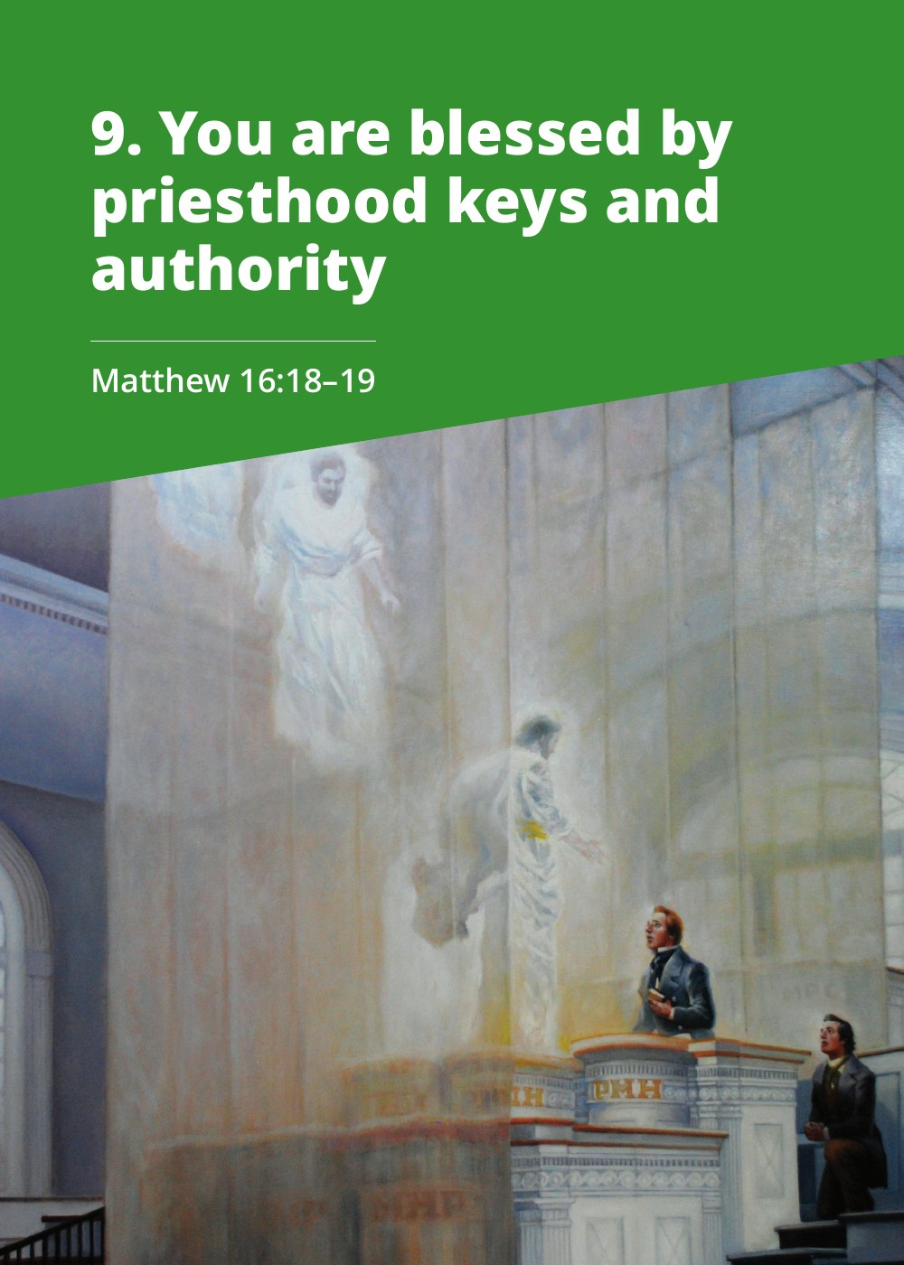
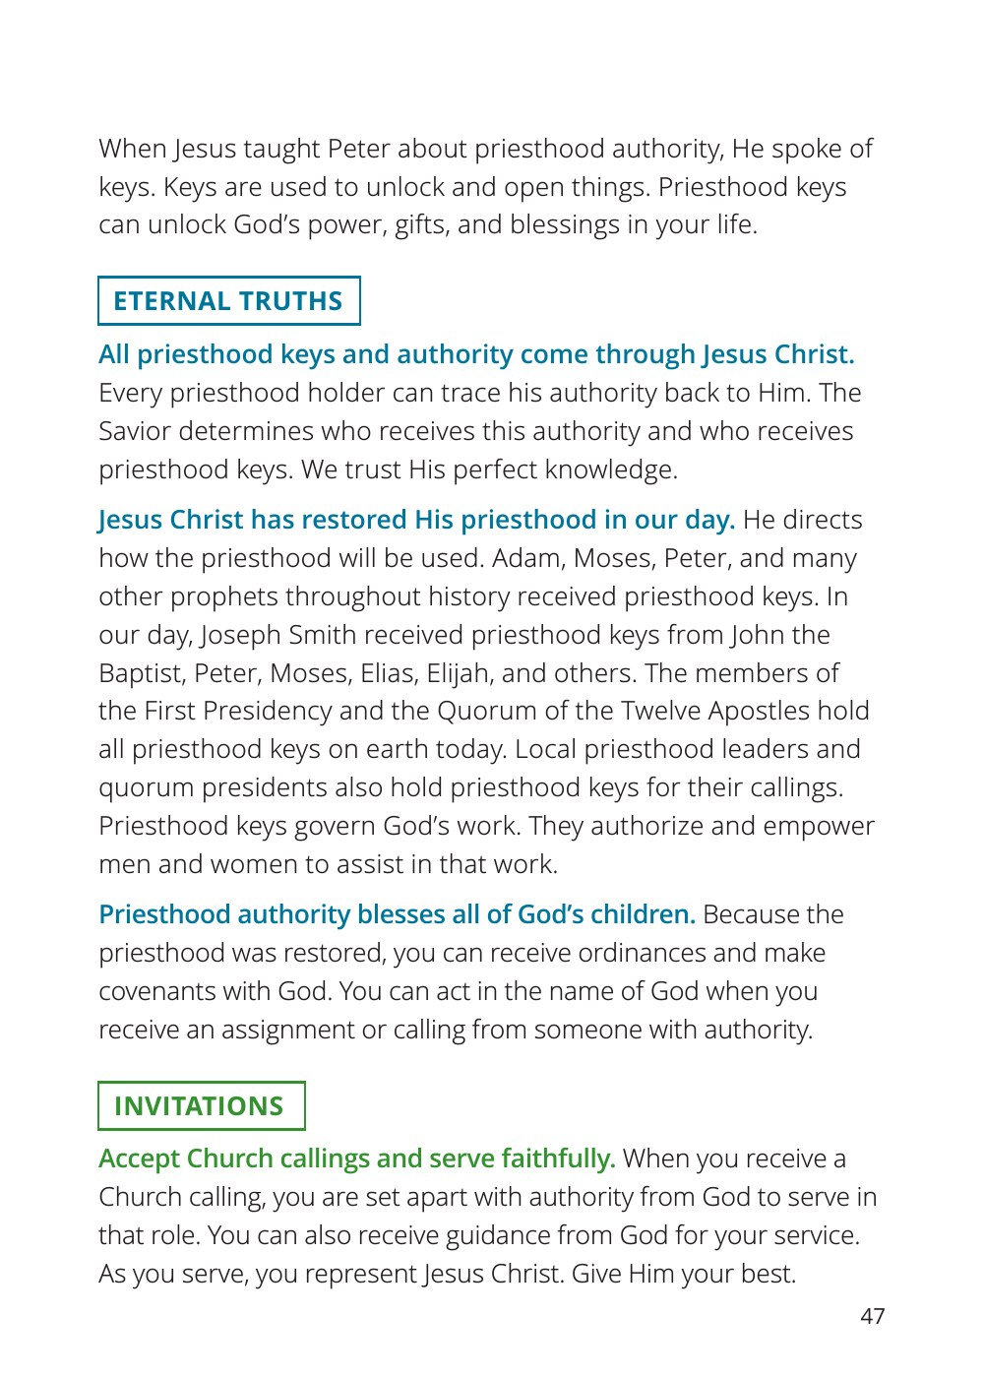
FROM THE UPDATED FSY GUIDE
Chapter 9 in the Guide — Pages 46–47
© Intellectual Reserve, Inc. For the Strength of Youth: A Guide for Making Choices — shown for Church instruction.
Notes:
This is the actual chapter youth study this September, straight from the updated guide. Every chapter opens the same way: a title, an anchor scripture, and then the eternal truths it teaches. This is what youth should read before September 6.

Slide 6
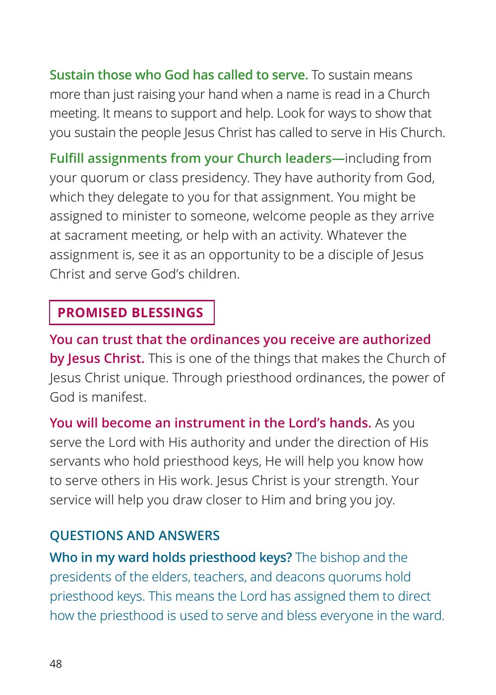
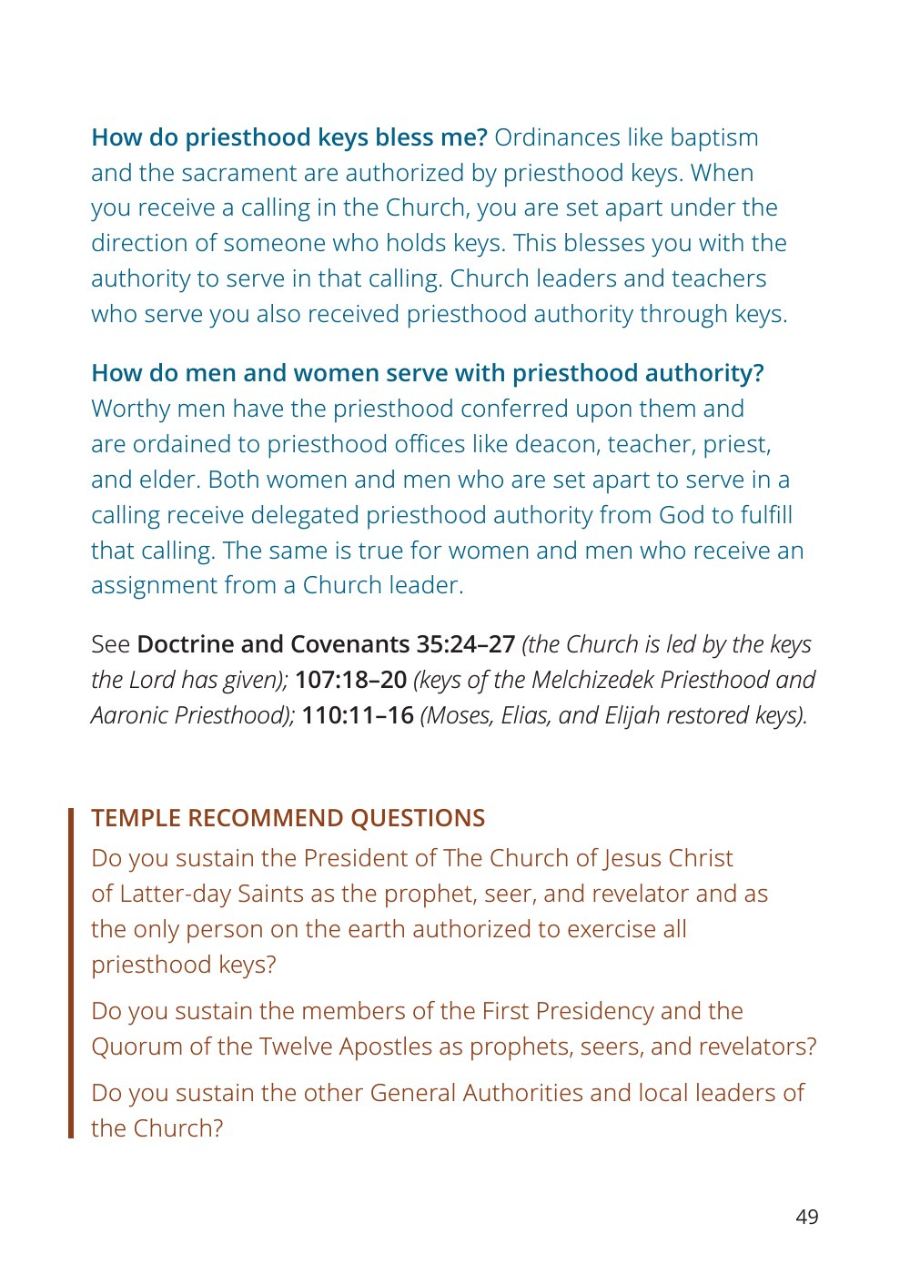
FROM THE UPDATED FSY GUIDE
Chapter 9 in the Guide — Pages 48–49
© Intellectual Reserve, Inc. For the Strength of Youth: A Guide for Making Choices — shown for Church instruction.
Notes:
The rest of the chapter shows the structure every month will follow: eternal truths, invitations to act on them, and promised blessings — plus questions and answers. Point out that this same three-part pattern is what the Sunday lessons and the magazine build on.

Slide 7
VIDEO · PART 2
7:23 → 10:00
Insert the video here — Insert → Video → This Device
Then trim this copy: Playback → Trim Video → Start Time 7:23, End Time 10:00
Insert once, then copy–paste the same video onto the other PART slides
(it stays one embedded copy). Set Start: Automatically. Delete this text box.
When it pauses: talk through how the Sundays are structured (next slides).

Slide 8



THE ANNOUNCEMENT
More Than a Schedule Change
Announced March 30, 2026
The First Presidency announced changes to the Sunday class meeting schedule along with a new curriculum for youth.
Together, these changes create simple and meaningful ways to grow closer to Jesus Christ and feel more connected to Him and each other.
Begins September 6, 2026
The first Sunday under the new schedule. Classes meet every week in wards and branches worldwide.
Centered on the FSY guide
Youth lessons draw on the updated For the Strength of Youth: A Guide for Making Choices and the scriptures.
Changes to the Sunday Class Meeting Schedule and Instruction
ChurchofJesusChrist.org
Notes:
On March 30, 2026, the First Presidency announced these changes. The Church has emphasized that this is more than a schedule change — the stated purpose is to create simple and meaningful ways to grow closer to Jesus Christ and to each other. Keep that purpose front and center today.

Slide 9


EVERY SUNDAY · TWO HOURS
The New Sunday Schedule
60
MIN
5
MIN
25
MIN
5
MIN
25
MIN
Sacrament Meeting
Transition
Sunday School
Transition
YW & AP Quorums
Unchanged — up to 60 minutes
All ages · Come, Follow Me
FSY guide lessons
Primary (ages 3–11)
Adults
Meets for 55 minutes after sacrament meeting every week — a short opening, 20 minutes of singing time, then classes with Come, Follow Me.
Also meet weekly: Sunday School, then Relief Society and elders quorum, where lessons discuss messages from the most recent general conference.
Notes:
Walk through the two hours: sacrament meeting is unchanged. Then a five-minute transition, 25 minutes of Sunday School for everyone, another five-minute transition, and 25 minutes of Young Women classes and Aaronic Priesthood quorums. Primary children have their own 55-minute block, and adults follow the same weekly pattern with Relief Society and elders quorum.

Slide 10

AT A GLANCE
What's Different?
UNTIL NOW
BEGINNING SEPTEMBER 6
Classes alternated: Sunday School on 1st and 3rd Sundays; quorums and classes on 2nd and 4th
Every organization meets every Sunday
Two 25-minute classes after sacrament meeting
One 50-minute class each week
YW & AP lessons come from the new FSY-guide curriculum
Youth lessons drew on recent general conference messages
Relief Society & elders quorum discuss general conference messages
Notes:
Since 2019 the second hour alternated week to week. Now every class and quorum meets every single Sunday, in shorter 25-minute lessons. For youth this means twice as many chances each month to learn and grow together — and a brand-new curriculum written just for them.

Slide 11



ONE CHAPTER, FOUR SUNDAYS
The Rhythm of Each Month
FAST SUNDAY
SECOND SUNDAY
THIRD SUNDAY
LAST SUNDAY
Study the chapter
Go deeper
Keep exploring
YW & AP focus
Youth read and discuss the month's FSY chapter — its truths, invitations, and promised blessings.
Lessons explore the doctrine behind the monthly theme in the scriptures and the words of prophets.
Youth continue the theme, ask questions, share experiences, and apply it to their own lives.
Young Women and Aaronic Priesthood quorums each have a lesson written just for them.
And every week: youth Sunday School continues to study the scriptures with Come, Follow Me, and the FSY magazine adds monthly stories and articles on the same theme.
Notes:
Here's the rhythm of a month. Fast Sunday, youth study the chapter itself. The second and third Sundays go deeper into the doctrine behind it. On the last Sunday, Young Women and Aaronic Priesthood quorums each get a lesson written specifically for them. Meanwhile Sunday School keeps everyone in the scriptures with Come, Follow Me, and the FSY magazine carries the same theme into the home.

Slide 12



WHAT A LESSON LOOKS LIKE · FROM THE SEPTEMBER FSY MAGAZINE
Inside a Fast Sunday Lesson
1
2
3
4
Choose an eternal truth
Read a scripture together
Share a personal story
Testify
Pick a truth from the chapter and share thoughts and questions about it.
Find verses that support it — what message does God have for you in it?
An experience living this truth, or a promised blessing the Lord has kept.
Share what you know from your own experience and what the Spirit has taught you.
Then: repeat with another truth as time allows — and each fast Sunday, choose an invitation from the guide (or one of your own) to live that month.
Notes:
This pattern comes straight from the September FSY magazine's fast Sunday lesson. September's chapter is 'You Are Blessed by Priesthood Keys and Authority,' pages 46 through 49 of the guide. Notice how simple and repeatable it is: truth, scripture, story, testimony — then youth choose an invitation to actually live during the month. Youth themselves can lead any of these steps.

Slide 13
VIDEO · PART 3
10:00 → 12:00
Insert the video here — Insert → Video → This Device
Then trim this copy: Playback → Trim Video → Start Time 10:00, End Time 12:00
Insert once, then copy–paste the same video onto the other PART slides
(it stays one embedded copy). Set Start: Automatically. Delete this text box.
When it pauses: look at the last-Sunday lessons (next slide).

Slide 14
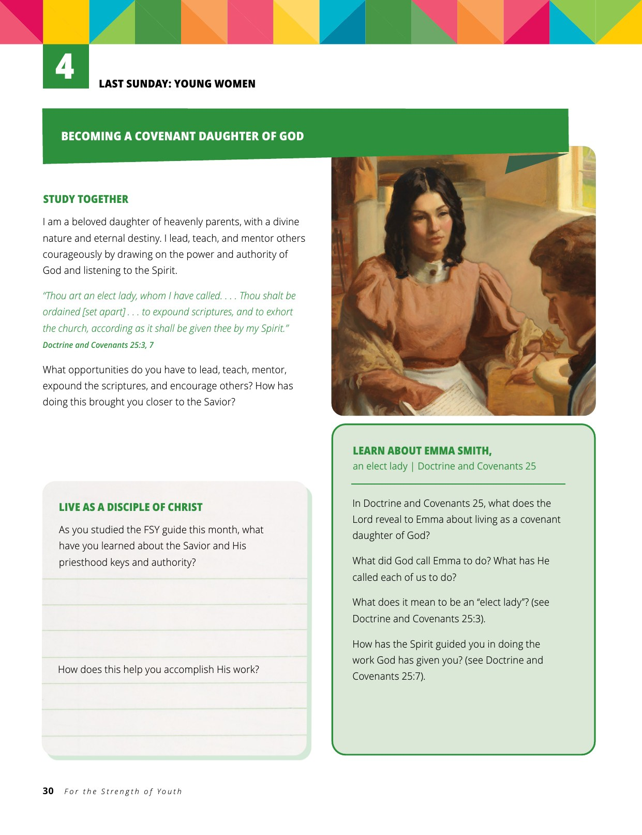
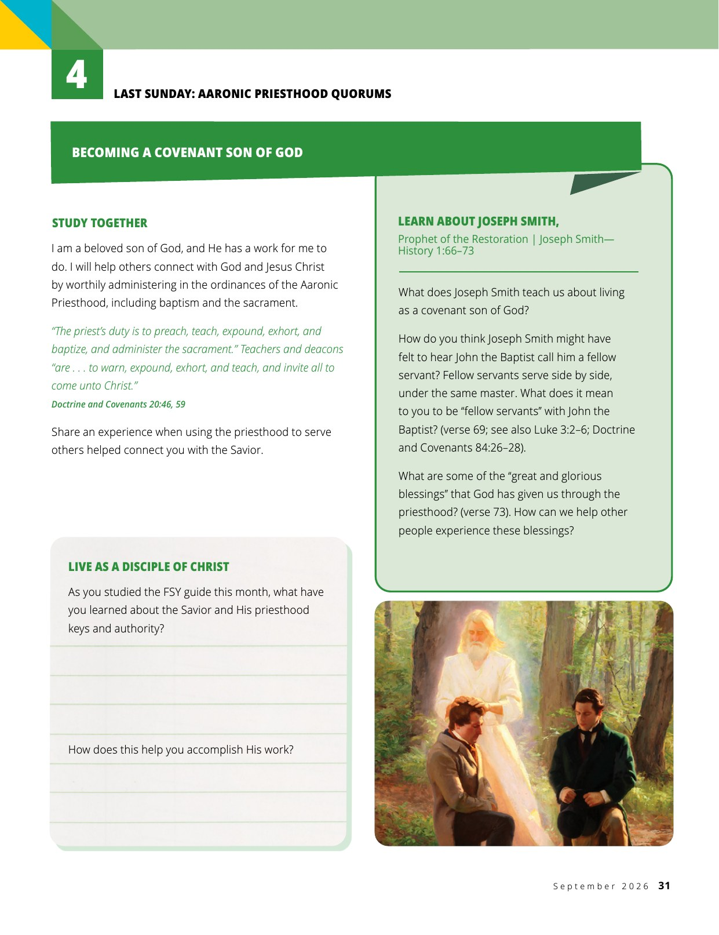
FROM THE SEPTEMBER FSY MAGAZINE
Last Sunday: Young Women & Aaronic Priesthood
© Intellectual Reserve, Inc. For the Strength of Youth magazine, September 2026 — shown for Church instruction.
Notes:
The last Sunday splits: Young Women study Emma Smith, an 'elect lady' (D&C 25); Aaronic Priesthood quorums study Joseph Smith's account of John the Baptist (JS—History 1:66–73). Both end with the 'Live as a Disciple of Christ' journal.

Slide 15
VIDEO · PART 4
12:00 → 18:30
Insert the video here — Insert → Video → This Device
Then trim this copy: Playback → Trim Video → Start Time 12:00, End Time 18:30
Insert once, then copy–paste the same video onto the other PART slides
(it stays one embedded copy). Set Start: Automatically. Delete this text box.
When it pauses: discuss, then walk through September and the magazine (next slides).

Slide 16

SEPTEMBER 2026 · THE FIRST MONTH
“You Are Blessed by Priesthood Keys and Authority”
SEP 6
Fast Sunday — study the chapter
MATTHEW 16:19
FSY guide pages 46–49: discuss its truths and choose an invitation to live.
“And I will give unto thee the keys of the kingdom of heaven …”
SEP 13
The restoration of the priesthood
How the Savior blesses us through both priesthoods — D&C 13; 107:18–20; 84:20–21.
The month's anchor scripture
THE CHAPTER'S ETERNAL TRUTHS
SEP 20
Priesthood keys
What keys are and what they unlock — D&C 13; 27:12–13; 110:11–16.
All priesthood keys and authority come through Jesus Christ.
Jesus Christ has restored His priesthood in our day.
Covenant daughters and sons of God
SEP 27
Priesthood authority blesses all of God's children.
YW learn from Emma Smith (D&C 25); quorums from Joseph Smith (JS—History 1:66–73).
Notes:
September's theme is 'You Are Blessed by Priesthood Keys and Authority' — pages 46 to 49 of the FSY guide, anchored in Matthew 16. The chapter teaches three eternal truths (on the slide), invites youth to accept callings and serve faithfully, sustain those God has called, and fulfill assignments from leaders, and promises that they can trust their ordinances are authorized by Jesus Christ and will become instruments in the Lord's hands. The magazine's closing question for the month: how would your life be different if the priesthood hadn't been restored? Third Sunday: youth fill out a table mapping D&C 13, 27, and 110 to the heavenly messengers and keys restored. Last Sunday: Young Women study Emma Smith in D&C 25; Aaronic Priesthood quorums study Joseph Smith—History 1:66-73. Midweek activity ideas from the magazine: the One-Match Fire Challenge, and A Flashlight and God's Priesthood Power. Encourage youth to read the chapter before September 6.

Slide 17
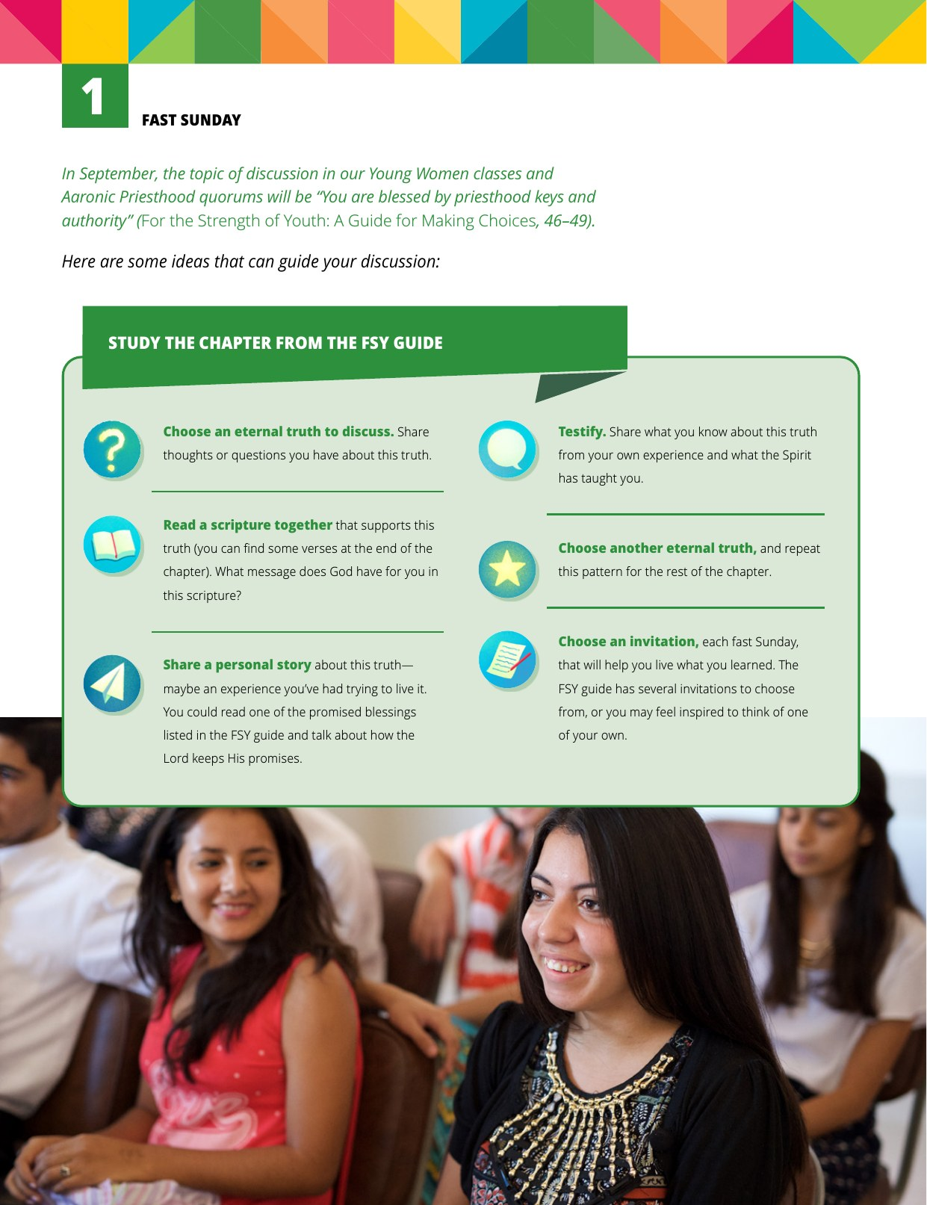
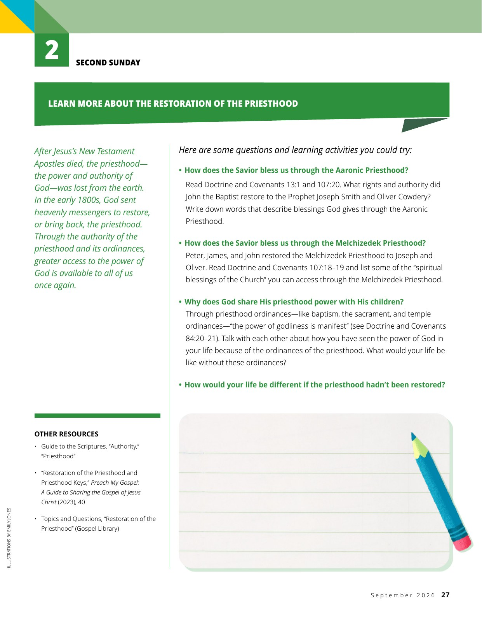
FROM THE SEPTEMBER FSY MAGAZINE
Fast Sunday & Second Sunday
© Intellectual Reserve, Inc. For the Strength of Youth magazine, September 2026 — shown for Church instruction.
Notes:
These are the actual lesson pages youth and leaders will open each Sunday — walk through the fast-Sunday study pattern on the left and the restoration questions on the right.

Slide 18
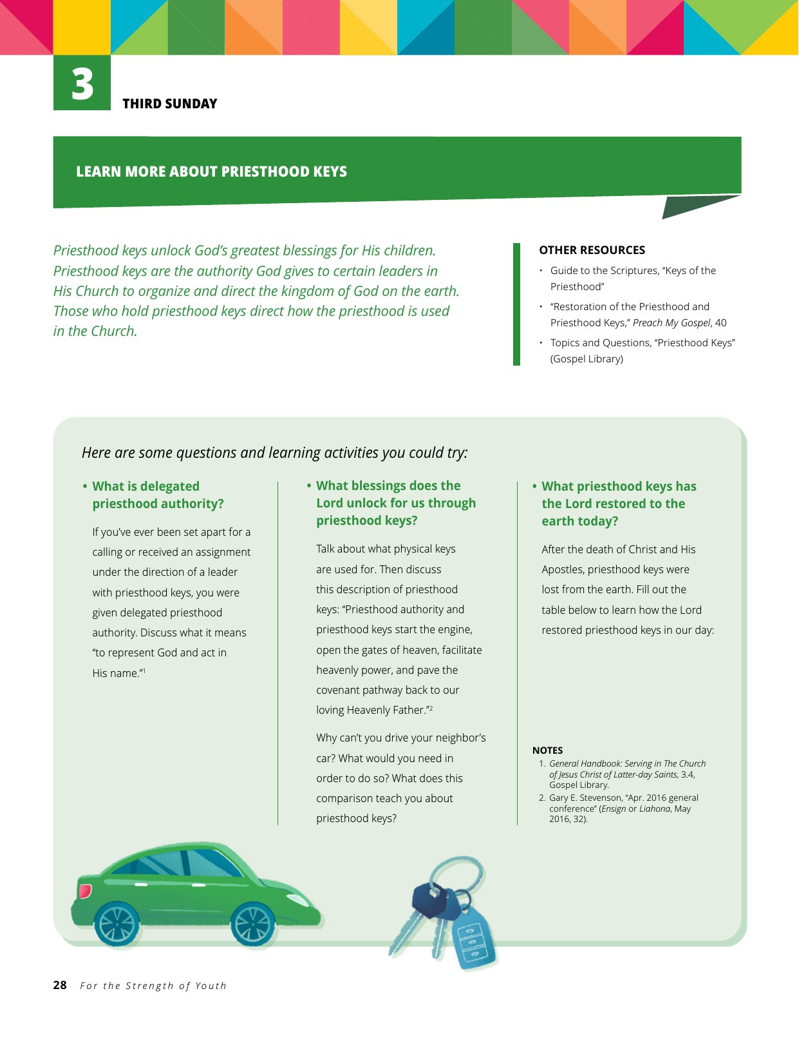
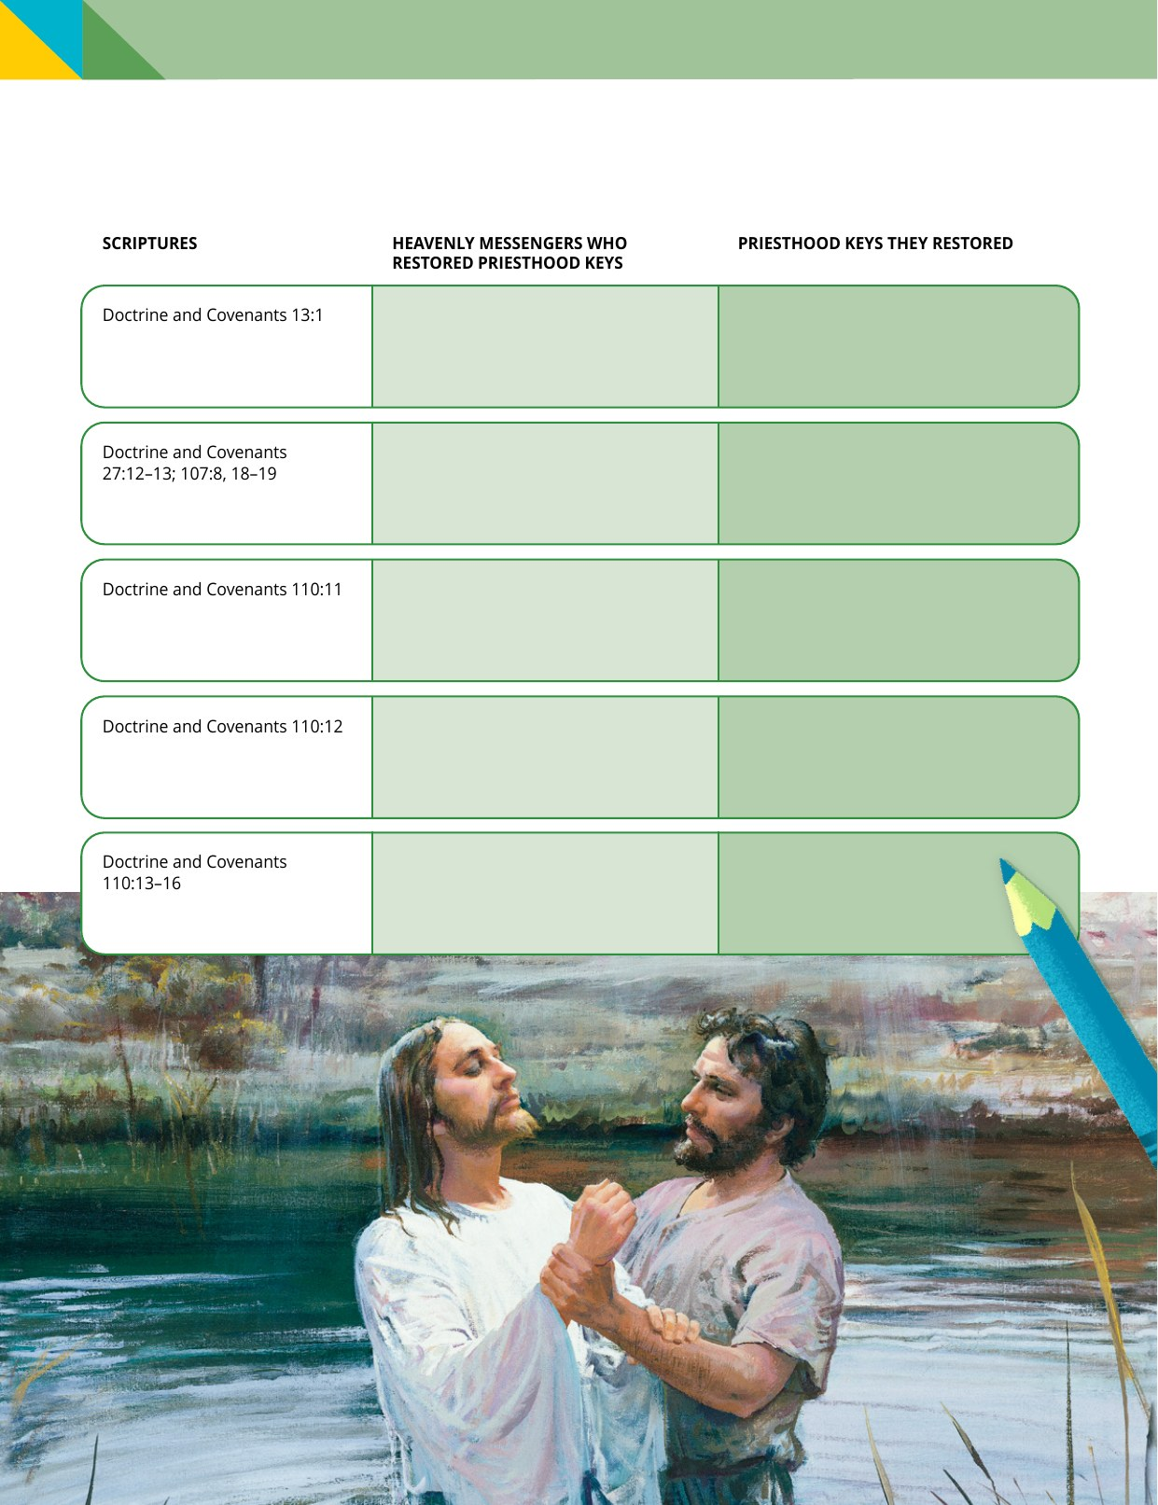
FROM THE SEPTEMBER FSY MAGAZINE
Third Sunday: Priesthood Keys
© Intellectual Reserve, Inc. For the Strength of Youth magazine, September 2026 — shown for Church instruction.
Notes:
The third-Sunday spread: the car-keys analogy on the left, and on the right the fill-in table where youth map D&C 13, 27, and 110 to the heavenly messengers and the keys they restored.

Slide 19
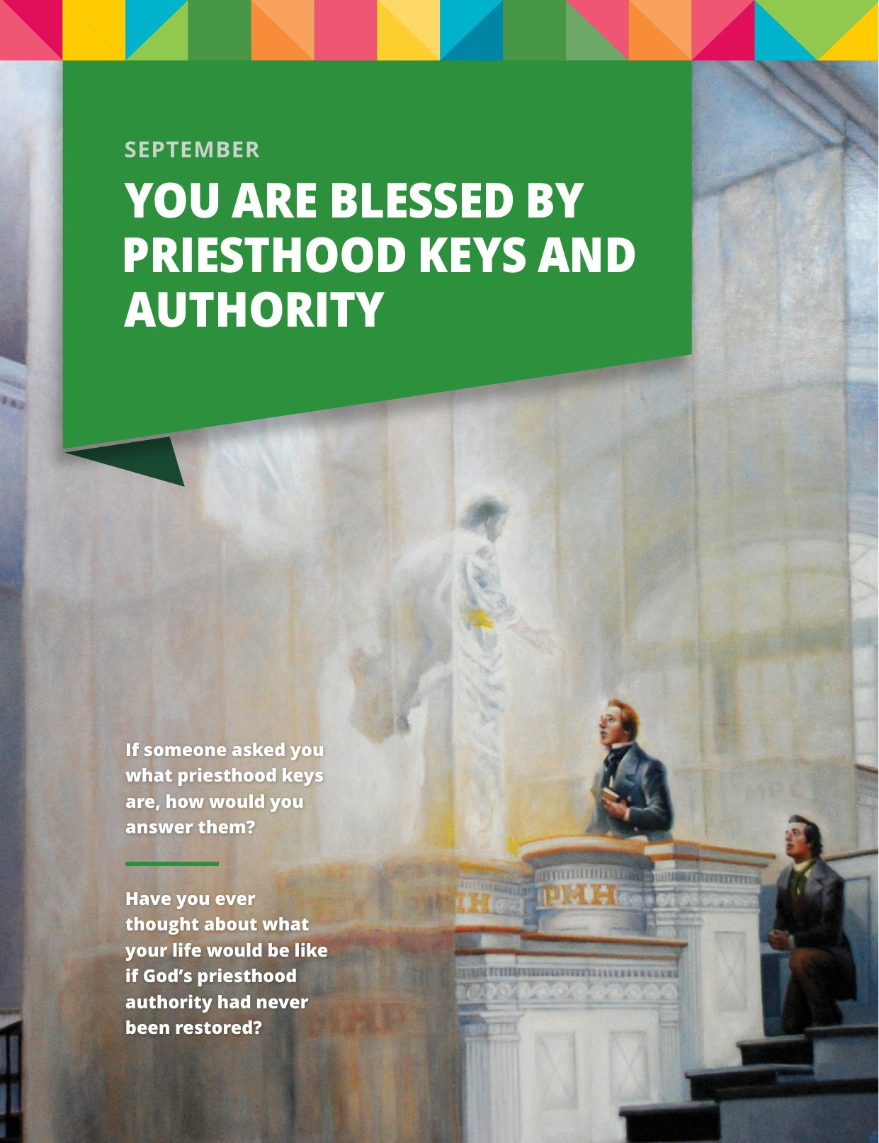
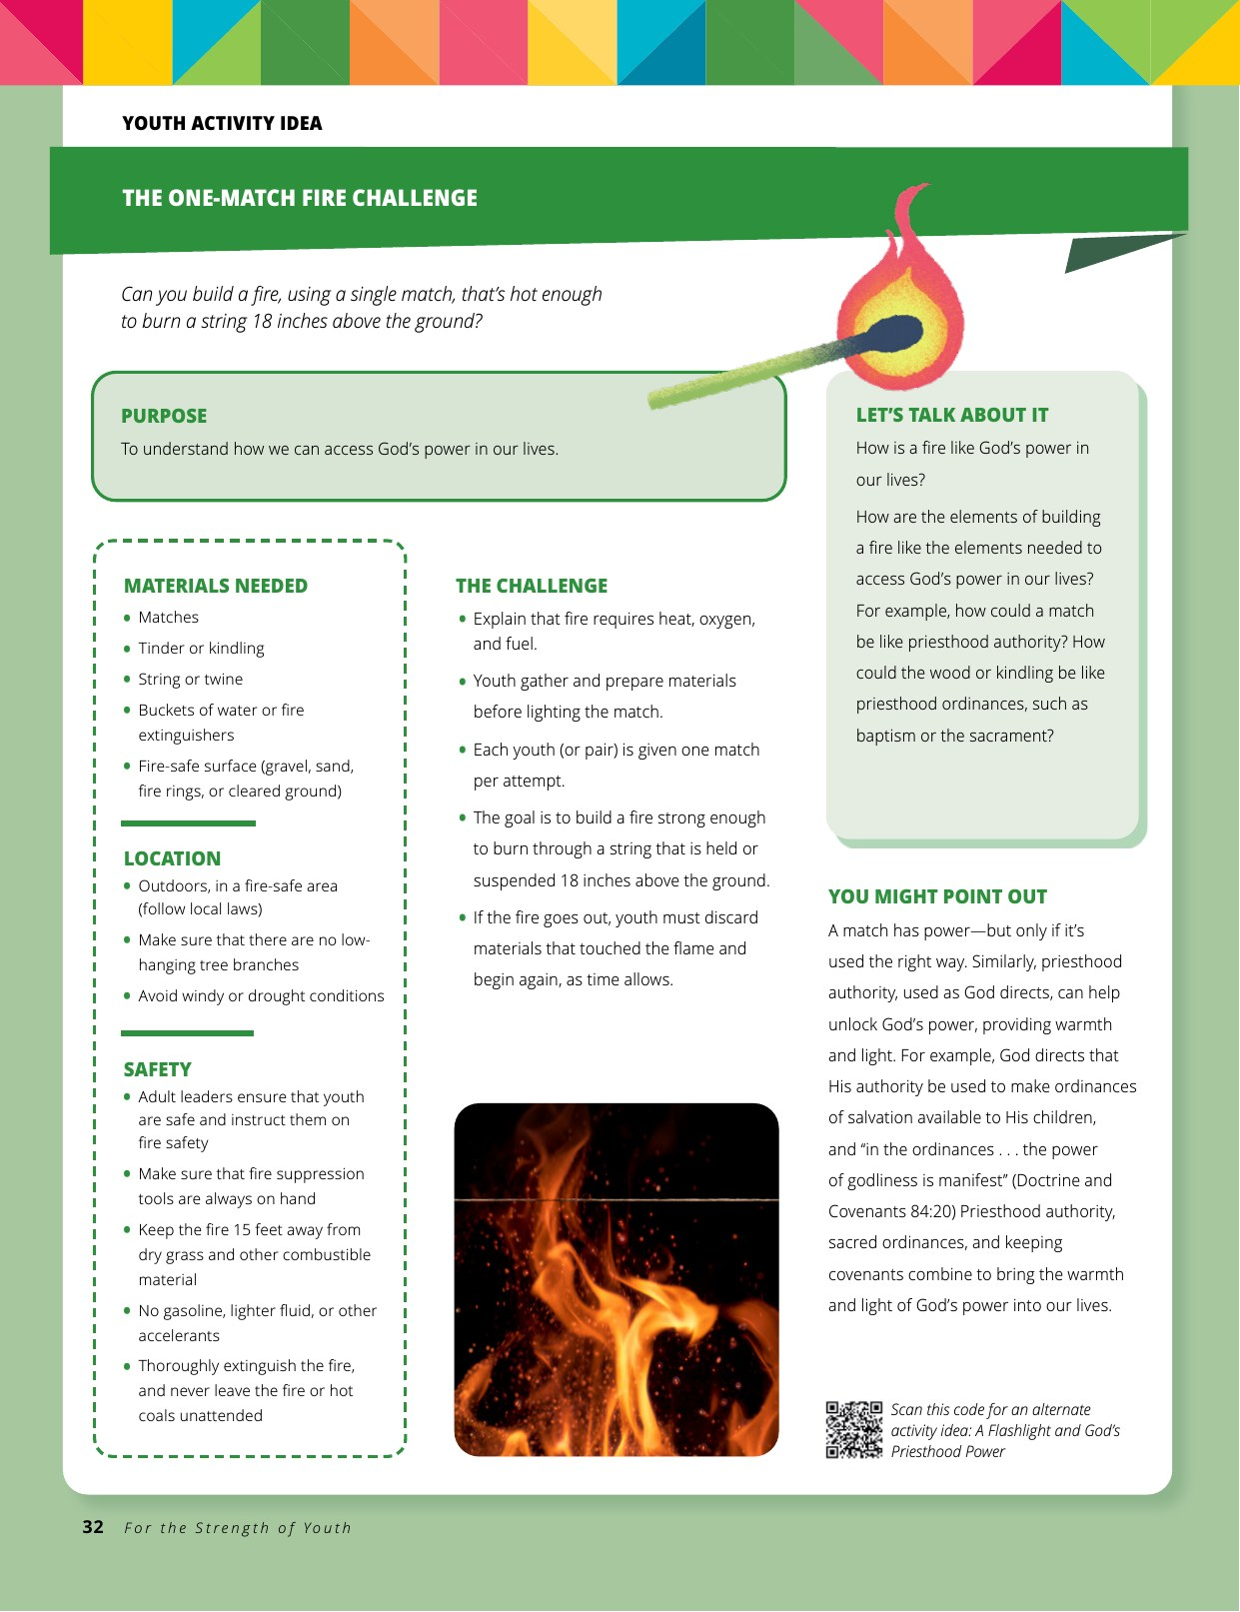
FROM THE SEPTEMBER FSY MAGAZINE
The Month Opener & a Midweek Activity
© Intellectual Reserve, Inc. For the Strength of Youth magazine, September 2026 — shown for Church instruction.
Notes:
The September opener with the month's two framing questions, and the One-Match Fire Challenge — a ready-made midweek activity that ties into the theme.

Slide 20
VIDEO · PART 5
18:30 → End (≈22:00)
Insert the video here — Insert → Video → This Device
Then trim this copy: Playback → Trim Video → Start Time 18:30 (play to the end)
Insert once, then copy–paste the same video onto the other PART slides
(it stays one embedded copy). Set Start: Automatically. Delete this text box.
When it ends: ask — “What statements stood out to you?” Then the discussion questions.

Slide 21
PAUSE AND DISCUSS
Let's Talk About It
1
2
3
How will we be blessed by the updated FSY guide and the new Sunday curriculum?
Doctrine and Covenants 88:122 teaches that all may speak and all may be edified. How can we make our classes places where everyone feels uplifted?
How can we use the new schedule and guides to build stronger relationships in our quorums and classes?
Adapted from the official fifth-Sunday instruction outline, August 30, 2026
Notes:
These three questions come straight from the Church's official fifth-Sunday outline. Give youth and parents time to actually answer — this discussion is the point of the meeting. On question two, you might read Doctrine and Covenants 88:122 aloud together first.

Slide 22



RESOURCES
Where to Find Everything
FSY Guide
FSY Magazine
Gospel Library
Sunday Website
For the Strength of Youth: A Guide for Making Choices — in the Gospel Library app and in print.
Monthly stories and articles on each theme. One free print subscription per household.
The FSY lessons for every Sunday, plus Come, Follow Me — all in the Gospel Library app.
Instructional videos, the implementation guide, and answers to common questions.
magazines.ChurchofJesusChrist.org
sunday.ChurchofJesusChrist.org
For parents: the same guide, magazine, and lessons at home make Sunday classes an easy, natural topic for family conversation all month long.
Notes:
Everything is free and already available. The guide and every Sunday lesson are in Gospel Library. Every household can get one free print subscription to the FSY magazine at magazines.ChurchofJesusChrist.org. And sunday.ChurchofJesusChrist.org has the instructional videos and implementation guide. Parents: having the same materials at home is the superpower here.

Slide 23


BEFORE SEPTEMBER 6
An Invitation
Youth
Read September's chapter — “You Are Blessed by Priesthood Keys and Authority” — and come ready to share.
Parents
Sign up for the free FSY magazine and ask about each week's lesson around the dinner table.
Leaders
Watch the instructional videos and prepare with the lesson materials in Gospel Library.
“… simple and meaningful ways to grow closer to Jesus Christ and feel more connected to Him and each other.”
Sources: “Changes to the Sunday Class Meeting Schedule and Instruction (2026)” and For the Strength of Youth, September 2026 — ChurchofJesusChrist.org
Notes:
Close with the invitations: youth, read the September chapter before next Sunday. Parents, get the magazine and keep the conversation going at home. Leaders, watch the videos and prepare. End with your testimony that this change is about growing closer to Jesus Christ — every single week.

