Slide 1

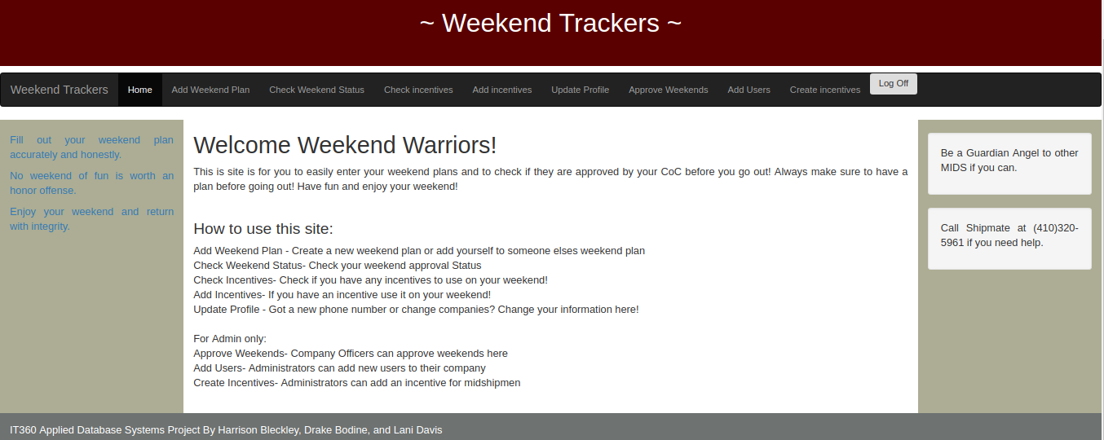
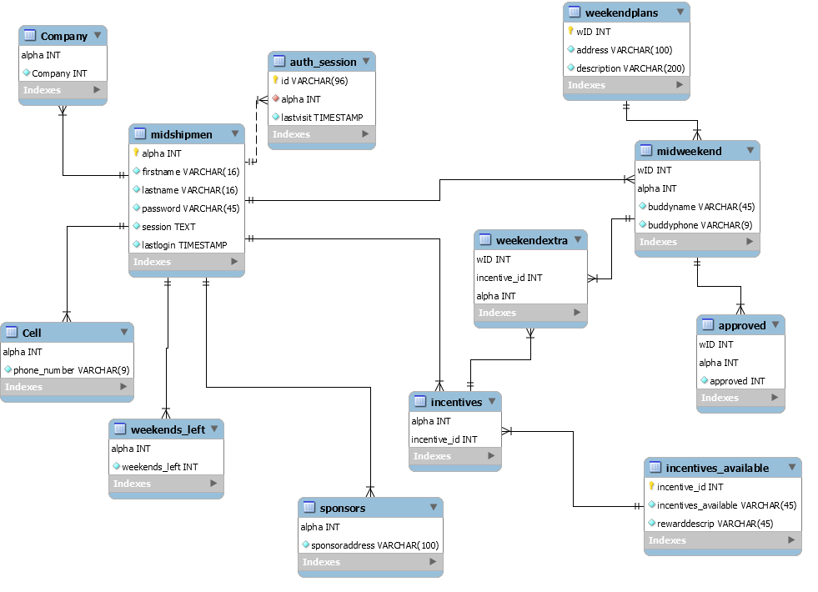
IT360 Applied Database Systems: Weekend Tracker
Team: 2/C Harrison Bleckley, 1/C Drake Bodine, and 1/C Lani Davis
Features
Add a Weekend Plan or Join a Friend’s
Use and Track Incentives/Weekends
CO can easily view and approve weekends
Easy addition of new midshipmen or incentives
Update your information without an administrator
Motivation
We will build a website in order to track weekends and submit weekend plans to the chain of command in order to replace the current method of google form. This will allow midshipmen to more easily submit their weekend plans for approval as well as allow the Chain of Command to easily track where midshipmen are going, if they are using incentives, and approve the weekend list in a timely manner.
High Level Overview of the Database
IT360
Introduces the principles underlying Database Management Systems (DBMS) with a special emphasis on system structure and function when integrated with web-based database applications.

