Slide 1
旅游英语选读 题海1
1610真题

Slide 2
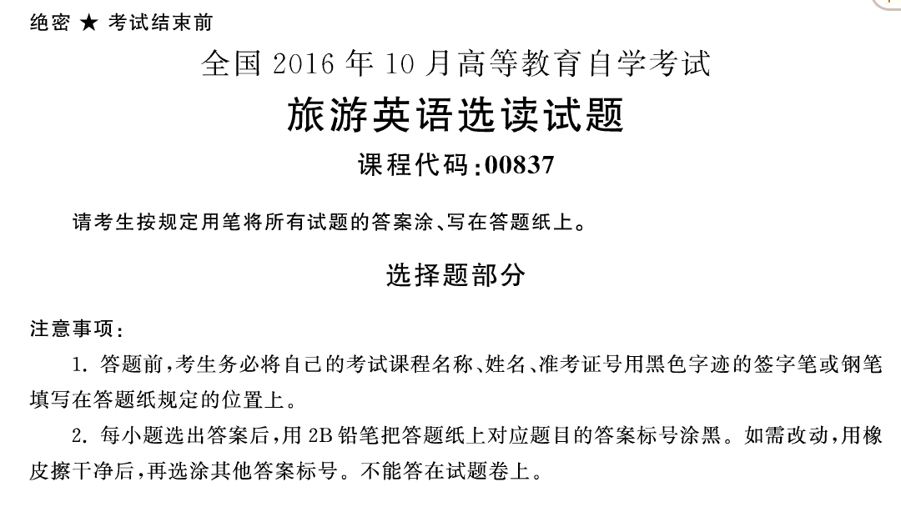

Slide 3
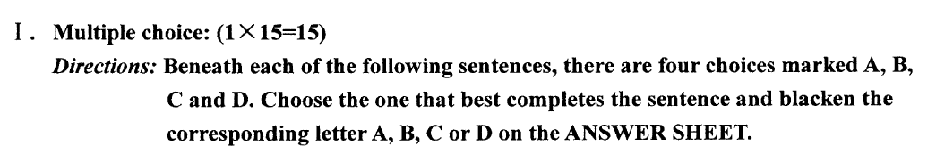
WTO defines Tourism as “tourism comprises the activities of persons travelling to and staying in places outside their usual environment for not more than ______ for leisure, business and other purpose.”
one consecutive year
Two consecutive years
6 consecutive months
18consecutive months
Notes:
世界旅游组织给旅游的定义为：旅游是指人们为了休闲、公务和其他目的而离开常住地到其他地方并在那里连续居住不超过一年的活动。

Slide 4
2. Standardization and ________ are very clear characteristics of package tours offered on a large scale.
Flexibility
Individuality
Richness
Rigidity
Notes:
标准化和严格性是大规模包价旅游的显著特征。

Slide 5
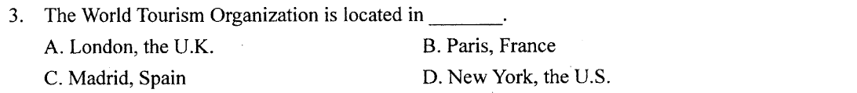
Notes:
通过让人们意识到自己的需求不足，促使人们把需求转化为愿望，这正是旅游宣传促销人员要做的工作。

Slide 6
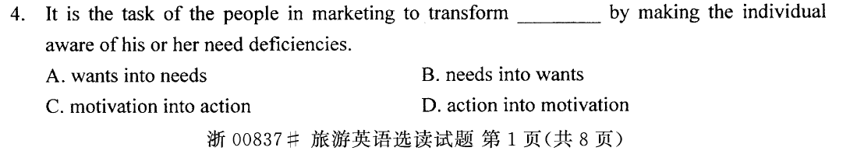
Notes:
通过让人们意识到自己的需求不足，促使人们把需求转化为愿望，这正是旅游宣传促销人员要做的工作。

Slide 7
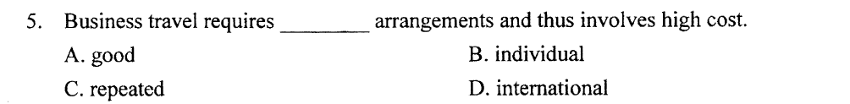
Notes:
商务旅游需要进行单独安排，因此花费较高。

Slide 8
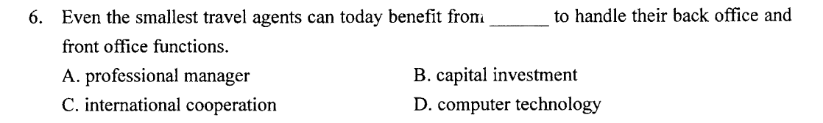
Notes:
即使是最小的旅行代理商如今也能利用计算机技术处理其后台和前台的功能，从中得到益处。

Slide 9
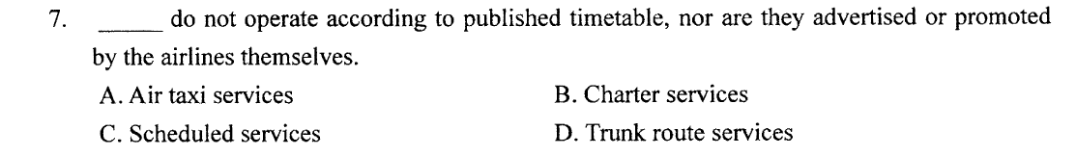
Notes:
包机服务不按照既定的时间表运行，它们也不通过航空公司大肆宣扬或搞促销。

Slide 10
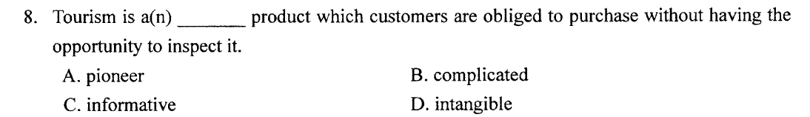
Notes:
旅游是一种无形产品，顾客不得不在没有机会审视它的情况下购买。

Slide 11
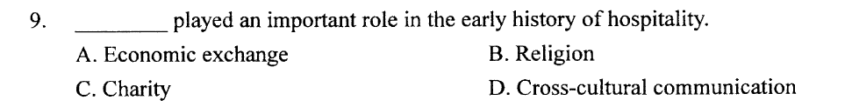
Notes:
宗教在饭店业的早期历史中起着极其重要的作用。

Slide 12
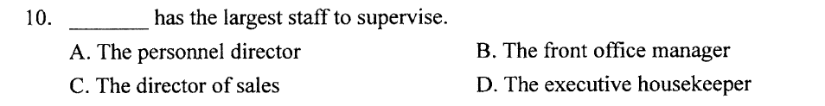
Notes:
客房部主管管理的员工人数最多。

Slide 13
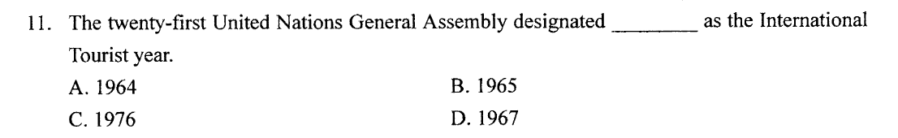
Notes:
第21届联合国大会把1967年确定为国际旅游年。

Slide 14
12. Thoughtless tourists contribute to ________ by littering in areas such as picnic sites.
visual pollution
air pollution
noise pollution
water pollution
Notes:
那些不自觉的游客也会通过在野餐场所等地点乱抛垃圾而导致视觉污染。

Slide 15
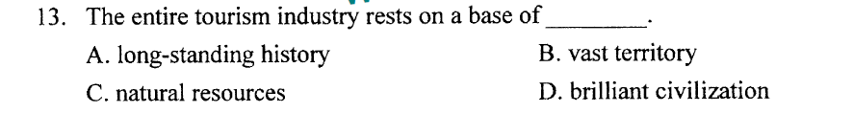
Notes:
整个旅游业是以自然资源为基础的。

Slide 16
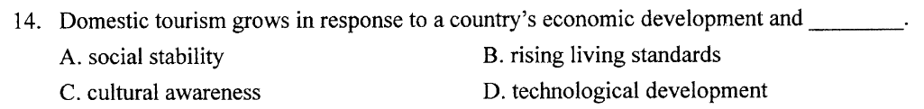
Notes:
与一个国家的经济发展和生活水平的提高相适应，国内旅游业也会相应地发展。

Slide 17
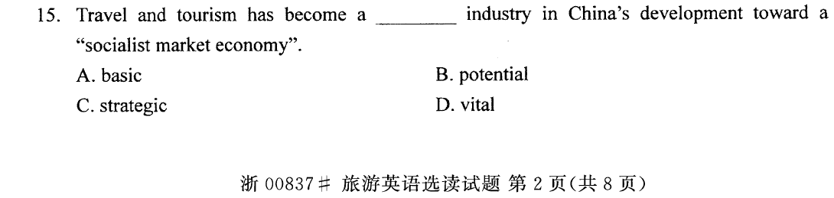
Notes:
在中国朝着“社会主义市场经济”发展的过程中，旅游业已成为一项战略产业。

Slide 18
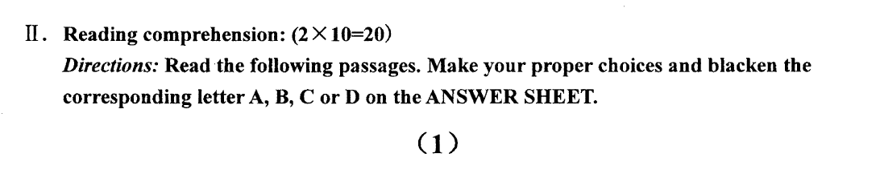

Slide 19
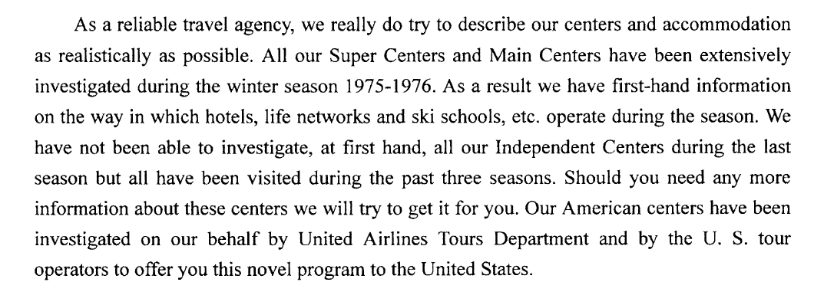

Slide 20
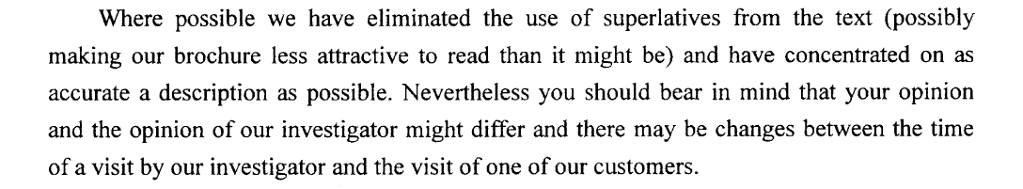

Slide 21
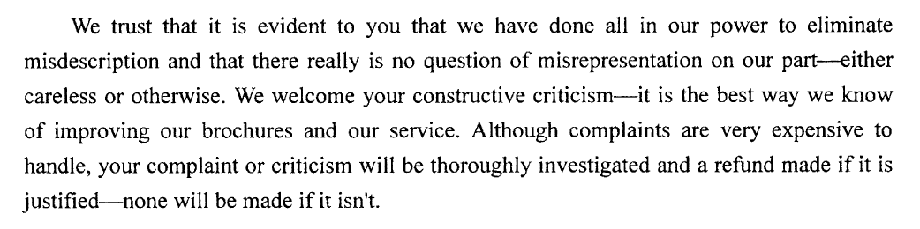

Slide 22
16. The firm claims that all its winter sports centers have been the recent target of ________.
a program of personal visits
Intensive enquiries about facilities
Attempts to increase hotel accommodation
An improved information service
Notes:
题干：该公司声称，其所有冬季体育中心最近都是以（ ）为目标。公司宣称，解析：由第一段最后一句可知，文中提及的旅行社向游客推出了一个新的旅游项目。故选A。

Slide 23
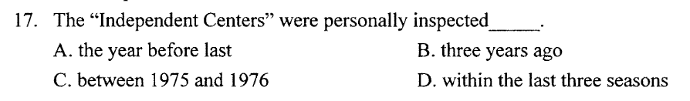
Notes:
题干：“独立中心”接受了视察（ ）。解析：由第一段第四句可知，所有的独立中心都已经在过去的三个季节里接受了视察。故选D。

Slide 24
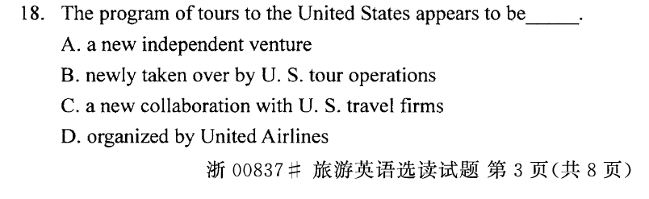
Notes:
题干：美国旅游计划似乎是与美国旅游公司（ ）。解析：由第一段最后一句可知，美国联合航空公司旅游部和一些美国旅游公司视察了该旅行社的美国中心，以便该旅行社推出美国之旅这一新项目，所以这一项目看上去是该旅行社与美国旅游公司之间的一项合作。故选C。

Slide 25
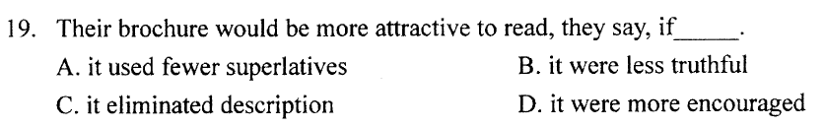
Notes:
题干：他们说，如果（ ），他们的小册子会更有吸引力。解析：由第二段第一句可知，我们在宣传册中减少了“最”字眼的使用（这可能使我们的宣传册不那么吸引人），并且我们尽量注意描述的精确性。所以，反过来可推出，如果我们的宣传册没有那么精确，那么真实，将会更有吸引力。故选B。

Slide 26
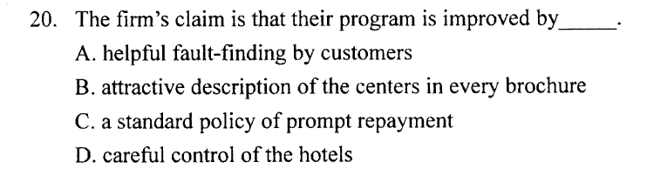
Notes:
题干：该公司声称，他们的程序是通过（ ）得到改进的。解析：由第三段第二句可知，建设性的批评是我们改善宣传册和服务的最好方式。故选A。

Slide 27
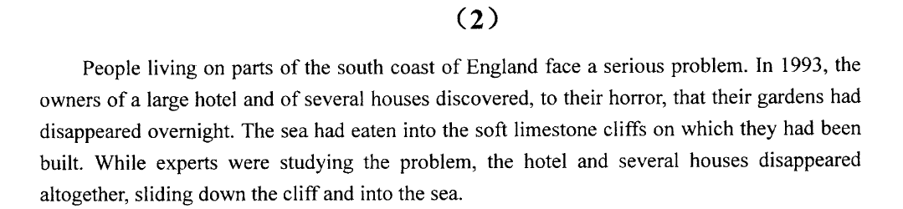

Slide 28
Erosion of the white cliffs along the south coast of England has always been a problem but it has become more serious in recent years. Dozens of homes have had to be abandoned as the sea has crept farther and farther inland. Experts have studied the areas most affected and have drawn up a map for local people, forecasting the year in which their homes will be swallowed up by the hungry sea.

Slide 29
Angry owners have called on the Government to erect sea defenses to protect their homes. Government surveyors have pointed out that in most cases, this is impossible. New sea walls would cost hundreds of millions of pounds and would merely make the waves and currents go further along the coast, shifting the problem from one area to another. The danger is likely to continue, they say, until the waves reach an inland area of hard rock which will not be eaten as limestone is. Meanwhile, if you want to buy a cheap house with an uncertain future, apply to a house agent in one of the threatened areas on the south coast of England. You can get a house for a knockdown price but it may turn out to be a knockdown home.

Slide 30
1.What is the cause of the problem that people living on parts of the south coast of England face?（ ）
A:The disappearance of hotels, houses and gardens.
B:The experts' lack of knowledge.
C:The rising of the sea level.
D:The washing-away of limestone cliffs.
Notes:
题干：居住在英格兰南部海岸部分地区的人们面临的问题是什么？解析：选项A是住在英国南海岸的人面临的问题，选项B文中没有提及，选项D中washing-away表达不正确。由第二段中的farther and farther inland和the hungry sea可推测，海平面上升导致海水漫过石灰岩峭壁，吞噬了人们的房屋。故选C。

Slide 31
2.The erosion of the white cliffs in the south of England（ ）.
A:will soon become a problem for people living in central England
B:has now become a threat to the local residents
C:is quickly changing the map of England
D:can be stopped if proper measures are taken
Notes:
题干：英格兰南部白色悬崖的侵蚀（ ）。解析：由第二段可知，在英国南海岸，白色峭壁被海水侵蚀的问题先前已经存在，这些年变得更加严重。许多房子不得不被遗弃，并且专家为当地人绘制了一幅地图，为当地人预告何时他们的房子将被吞没。故选B。

Slide 32
3.The experts' study on the problem of erosion can（ ）.
A:lead to its eventual solution
B:provide an effective way to slow it down
C:help to prevent it from worsening
D:warn people whose homes are in danger
Notes:
题干：专家们关于侵蚀问题的研究可以（ ）。解析：由第二段最后一句可知，专家能做的只是为当地人预告何时他们的房子将被吞没。故选D。

Slide 33
4.It is not feasible to build sea defenses to protect against erosion because（ ）.
A:it is too costly and will endanger neighbouring areas
B:the government is too slow in taking action
C:they will be easily knocked down by waves and currents
D:house agents along the coast do not support the idea
Notes:
题干：建造防御工事以防止侵蚀是不可行的，因为（ ）。解析：由第三段第三句可知，建造防海墙是不可行的，需要花费许多英镑，并且仅仅是将海浪河海流沿海岸线推向更远的地方，把问题从一个区域转到另一个区域。故选A。

Slide 34
5.According to the author, when buying a house along the south coast of England, people should（ ）.
A:be aware of the competitive price
B:guard against being cheated by the house agent
C:take the quality of the house into consideration
D:examine the house and its surrounding carefully before making a decision
Notes:
题干：据作者说，在英格兰南部海岸买房子时，人们应该（ ）。解析：由第三段最后两句可知，你可以在英国南海岸以较低的价格买一座房子，但结果可能是这座房子会被海水吞没。所以，在买英国南海岸沿岸的房子前应该仔细检查房子及周边环境。故选D。

Slide 35
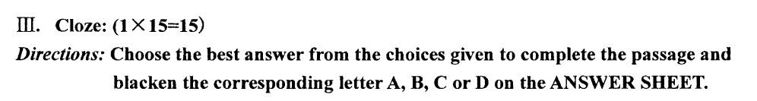
It is always interesting to visit another country, especially for those who have never traveled abroad. Foreign __1 __ can be educational for anyone __ 2 __ he is interested enough to make preparations beforehand. Learning the language of a new country would be __ 3 __ for the traveler, but the benefits（好处） of such an effort would become clear at once __ 4 __ his arrival. It may not seem __ 5 __ to him when he comfortably stays at home, but knowing __ 6 __ to order a meal or rent a room is necessary for the newcomer in a strange place. Without knowing the language, it is very difficult for the stranger to __ 7 __ the people of the new country and their customs. Of course, in our small world, __ 8 __ is often possible to __ 9 __ someone who understands our own language, __ 10 __ this is only second-best for the traveler. To be sure, he can __ 11 __ places and things without the use of a language, but places and things are not the __ 12 __ of any country. To get the greatest benefit __ 13 __ a trip to another country, it is __ 14 __ important for the visitor to have an understanding of the __ 15 __.

Slide 36
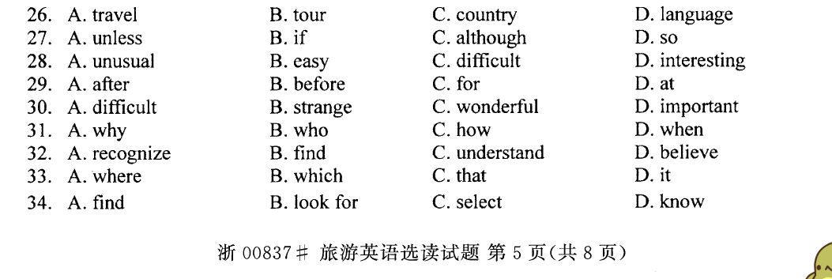
It is always interesting to visit another country, especially for those who have never traveled abroad. Foreign __1 __ can be educational for anyone __ 2 __ he is interested enough to make preparations beforehand. Learning the language of a new country would be __ 3 __ for the traveler, but the benefits（好处） of such an effort would become clear at once __ 4 __ his arrival.
Notes:
1. 由上文可知，该句紧密承接上一句，说的应该是国外旅行。tour通常指短途旅行。 country和language上文都未曾涉及，故排除。故选A。
2. 根据上文和逻辑常识可知，只有一个人很感兴趣地提前做准备，国外旅行才会有教育意义。故选B。
3. 由后半句中的but, benefits和effort可知，空格处应该填一个表示“困难”的词。故选C。
4. 答案：AA:afterB:beforeC:forD:at主知识点：第八节 介词和介词短语(Preposition & Prepositional Phrases)副知识点1：难度：中偏易

Slide 38
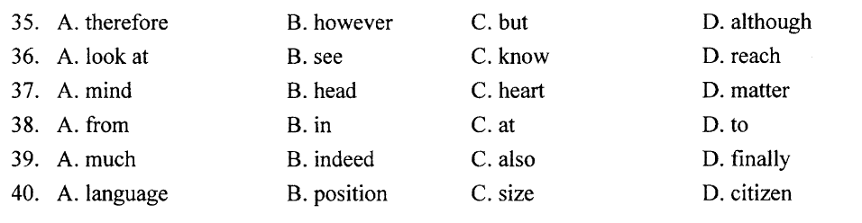

Slide 39
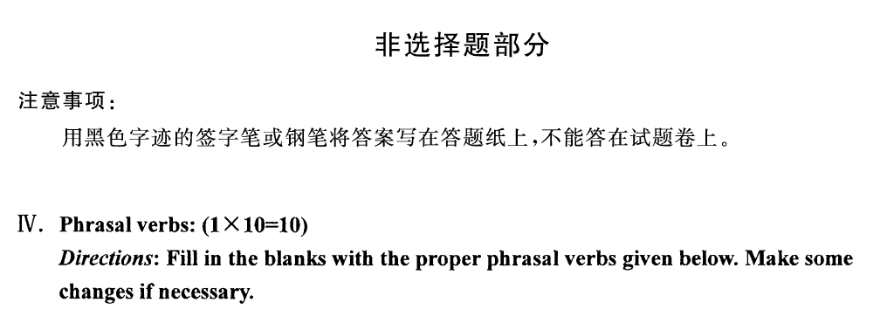


Slide 40
1. As a new global practice of flexible production, the travel and leisure industry and rapidly outpaced the manufacturing sector in adopting flexible production.
2. The United States Travel and Tourism Administration is the prime government agency in the United States the promotion of tourism.
3. The idea of self-esteem such ideas as the need to exhibit strength, achievement, mastery, competence, and independence.
4. As a network of travel agents was in place, the airlines setting up their own chain of direct sales offices in favor of appointing agents to handle their sales.
5.Operators must also establish a policy for their brochure distribution to the agents. If equal supplies of brochures every agent, many copies will be wasted.
6.In a "frequent flyer" programs, passengers purchasing airline tickets extra free travel, according to the mileage covered.
7.The increased popularity of the automobile a more random pattern of travel movements, opened up new destinations and spurred the development of networks of new automobile-oriented facilities and services.
8.One of the primary responsibilities of a manager is to assemble a team to running the hotel.
9.China, a variety of tourism resources, witness an astonishing growth of tourism over the last decade.
10.To improve their national economy, the governments of many developing countries the development of international tourism in their strategic tourism planning recently.

Slide 41
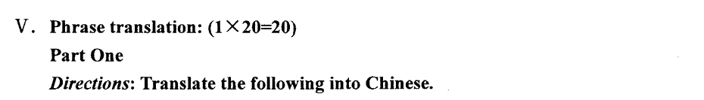
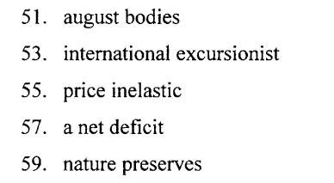
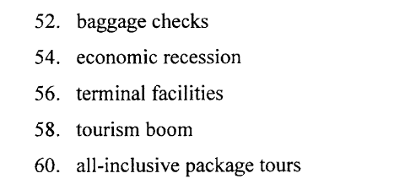

Slide 42

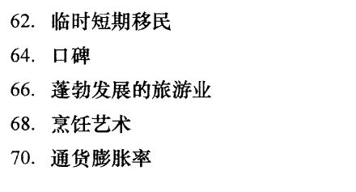
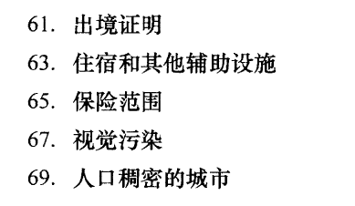

Slide 43

71. Along with the numerous opportunities, however, China will continue to encounter strong challenges. China’s tourist industry is not as effective as it could be in the face of powerful international competition. Asia as a whole sees Europe and North America as its main tourist-generating markets. All of the tourist destinations in the region vie with each other for the same markets with similar products. Although China has many advantages in its diversity of tourist resources, these may not be brought into full play due to inadequate facilities, tight transportation, inflexible business operations, ineffective promotion, and undesirable service. Other Asian countries and areas are more competitive in this region owing to their successful economies, well-developed tourism infrastructure, quick access to information, flexible business operations, wide international connections, and effective promotion with the help of powerful regional tourist associations.

Slide 44
With the increase in the number of tourists to resort areas, the demand for accommodation was on the rise, especially in peak seasons. Increasingly, people found it difficult to make reservations from year to year to obtain space in a popular hotel at a certain time of the year. In order to be guaranteed space, guests began prepaying for rooms for a specified time of the year ahead to ensure they would obtain the space they wanted at the hotel of their choice. As the concept of prepayment of hotel rooms grew, organizations were established to handle the coordination of this between the guests and the hotels.

