Slide 1
旅游英语选读 题海2

Slide 2
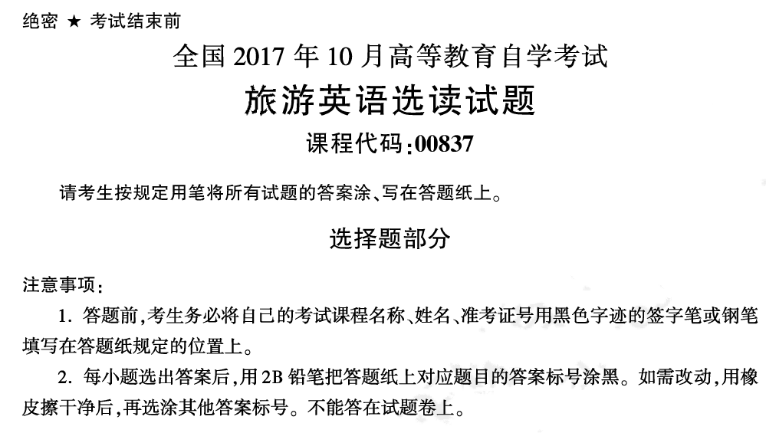

Slide 3
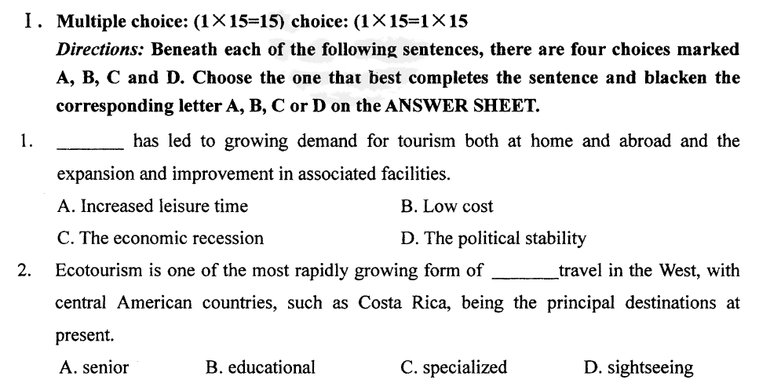

Slide 4
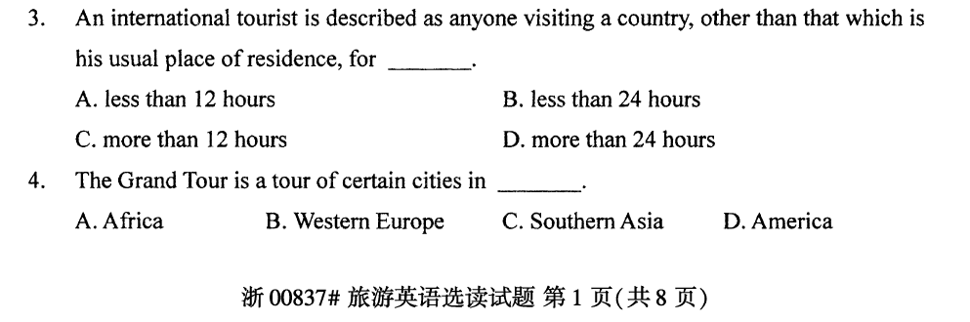

Slide 5
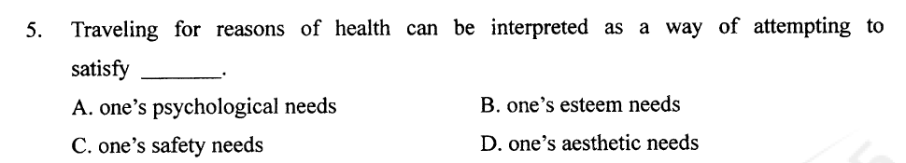
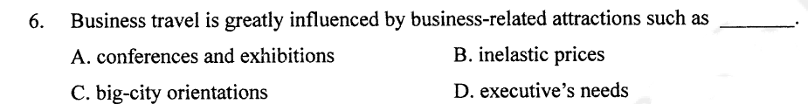

Slide 6
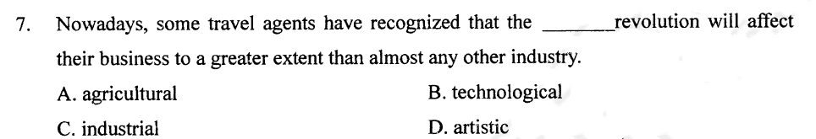
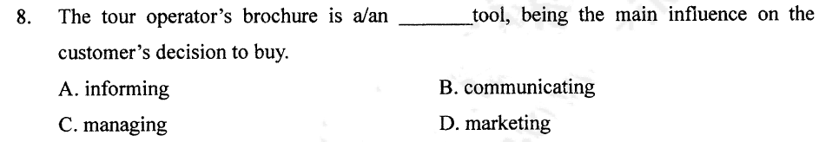

Slide 7
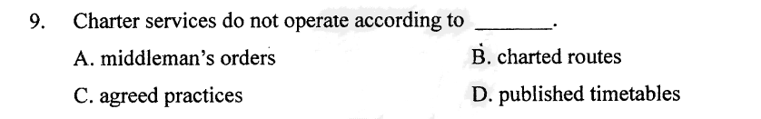
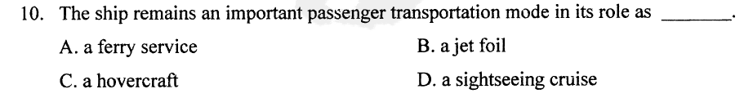

Slide 8
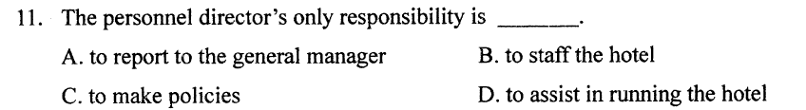
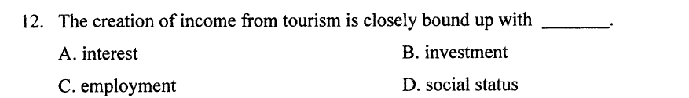
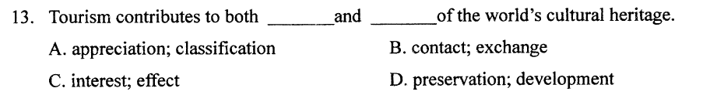

Slide 9
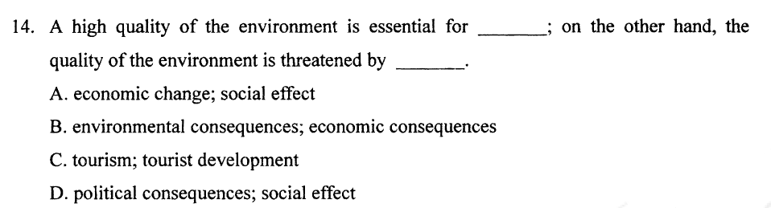
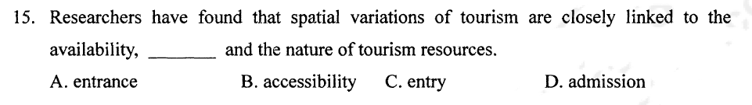

Slide 10
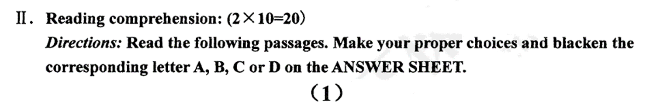
America's most famous woman is the Goddess of Liberty, i. e. the Statue of Liberty. It was first conceived in 1865 by Edouard de Laboulaye and designed by another Frenchman, Frederic Bartoldi. They wanted to honor liberty and friendship. It was hoped that the monument would be completed by 1876 when America celebrated its centennial. Fund raising and the manufacture of the Statue in France went slowly. It was 1885 when the 214 crates containing the Statue reached New York. Americans were initially embarrassed for they had not raised the money to pay for the erection of the base. Fund raising by popular subscription (捐款) was behind schedule. One fund raising method used was to have popular Americans write letters which were then auctioned off (拍卖). Mark Twain wrote a "tongue-in-cheek" letter suggesting that Miss Liberty didn't deserve a statue. The base and statue, together 272 feet tall, were completed in 1886. From a technical standpoint, the Statue is a marvel. The inner structure was designed by the French engineer, Alexandre Eiffel. His design for the stressed copper skin of the Statue anticipated (超前) many of the principles utilized in modern aircraft. After a century, the monument began to show signs of getting worse in conditions. Just as Frenchmen had created the statue, so it was with restoration. A Frenchman noted the decay, and both French and American craftsmen and contributions brought about the renewal of the Statue in time for its centennial. Liberty is still popular in France and the United States.

Slide 11
1.How many years passed away from the conception of the Statue to its completion? （）
A:11 years
B:16 years
C:20 years
D:21 years

Slide 12
2. Mark Twain's letter about the Statue of Liberty （）.
A:represented a serious question as to the need for the Statue
B:was a put-on by a humorist
C:raised a great deal of money
D:played a joke on the French

Slide 13
3.French engineering genius is seen in the Statue of Liberty in （）.
A: design of its base
B:design of its stressed covering
C:locating the Statue without disturbing harbor traffic
D:keeping the flame lit

Slide 14
4.The Statue of Liberty's development embarrassed Americans in the 1880s because （）.
A:it took them so long to raise the money
B:it was clear the Statue was mislocated
C:its design was tasteless
D:they felt it a waste of money to build the Statue

Slide 15
5.Among the following statements, which one is NOT true concerning the restoration of the statue? （）
A:The restoration took place a century later after its completion.
B:It was a Frenchman who noticed the need of the restoration.
C:Frenchmen built and restored the Statue for the Americans
D:Both French and American people worked together to restore the Statue.

Slide 16
The most interesting architectural phenomenon of the 1970s was the enthusiasm for refurnishing older building. Obviously, this was not an entirely new phenomenon. What is new is the whole scale in reusing the past, in recycling, in adaptive rehabilitation (更新). A few trial efforts, such as Ghirardelli Square in San Francisco, proved their financial feasibility in the 1960s, but it was in the 1970s, with strong government support through tax incentives and rapid depreciation (贬值), as well as growing interest in ecology issues, that recycling became a major factor on the urban scene. One of the most comprehensive ventures was the restoration and transformation of Boston's eighteenth century Faneuil Hall and the Quincy Market, designed in 1742. This section had fallen on hard times, but beginning with the construction of a new city hall immediately nearby, it has returned to life with the intelligent reuse of these fine old buildings under the design leadership of Benjamin Thompson. He has provided a marvelous setting for dining, shopping, professional office, and simply walking. Butler Square, in Minneapolis, serves as an example of major changes in its complex of offices, commercial space, and public amenities carved out of a massive pile designed in 1906 as a hardware warehouse. The exciting interior timber structure of the building was highlighted by cutting light courts through the interior and adding large skylights. San Antonio, Texas, offers a big object lesson for numerous other cities combating urban decay. Rather than bringing in the bulldozers(推土机), San Antonio’s leaders rehabilitated existing structures, while simultaneously cleaning up the San Antonio River, which runs through the business district.

Slide 17
1.The main idea of the passage is （）.
A:during the 1970s, old buildings in many cities were recycled for modern use
B:recent interest in ecology issues has led to the cleaning up of many rivers
C:the San Antonio example shows that bulldozers are not the right way to fight urban
D:strong government support has made adaptive rehabilitation a reality in Boston

Slide 18
2.According to the passage, Benjamin Thompson was the designer of a project in （）.
A:Boston
B:San Francisco
C:Minneapolis
D:San Antonio

Slide 19
3.The space at Quincy Market is now used as （）.
A:Boston's new city hall
B:sports and recreational facilities
C:commercial and industrial warehouses
D:restaurants, offices, and stores

Slide 20
4.What is the author's opinion of the San Antonio’s project? （）
A:It is clearly the best of the projects discussed
B:It is a good project that could be copied by other cities
C:The extensive use of bulldozers made the project unnecessarily costly
D:The work done on the river was more important than the work done on the buildings

Slide 21
5.The passage states that the San Antonio project differed from those in Boston and Minneapolis in that （）.
A:it consisted primarily of new buildings
B:it occurred in the business district
C:it involved the environment as well as buildings
D:it was designed to combat urban city

Slide 22
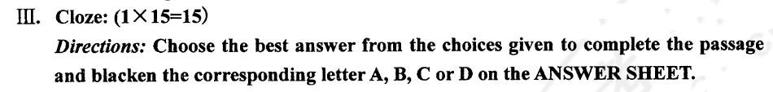
The United States is well-known for its network of major highways designed to help a driver get from one place to another in the shortest possible time． 26 these wide modern roads are generally smooth and well maintained, with 27 sharp curves and many straight sections, a direct route is not always the most 28 one．Large highways often pass 29 scenic areas and interesting small towns．Furthermore, these highways generally 30 large urban center which means that they become crowded with 31 traffic during rush hours, 32 the “fast、 direct” way becomes a very slow route．However, there is 33 always another route to take 34 you are not in a hurry．Not far from the relatively new “superhighways”, there are often older, 35 heavily traveled roads which go through the countryside． 36 of these are good two lane roads; others are uneven roads 37 through the country．Through these less direct routes, longer and slower, they generally go to places 38 the air is clear and the scenery is beautiful, and the driver may have a 39 to get a fresh, clean 40 of the world．

Slide 23
1. A.Although B.Since C.Because D.Therefore
3. A.little B.few C.much D.many
5. A.terrible B.possible C.enjoyable D.reasonable
6. A.to B.into C.over D.by
7. A.lead B.connect C.collect D.provide
8. A.large B.fast C.light D.heavy
9. A.when B.for C.but D.that
10. A.yet B.still C.almost D.quite
11. A.unless B.if C.as D.since
13. A.and B.less C.more D.or
14. A.All B.Several C.Lots D.Some
15. A.driving B.crossing C.curving D.traveling
18. A.there B.when C.which D.where
19. A.space B.period C.chance D.spot
20. A.view B.variety C.visit D.virtue

Slide 24
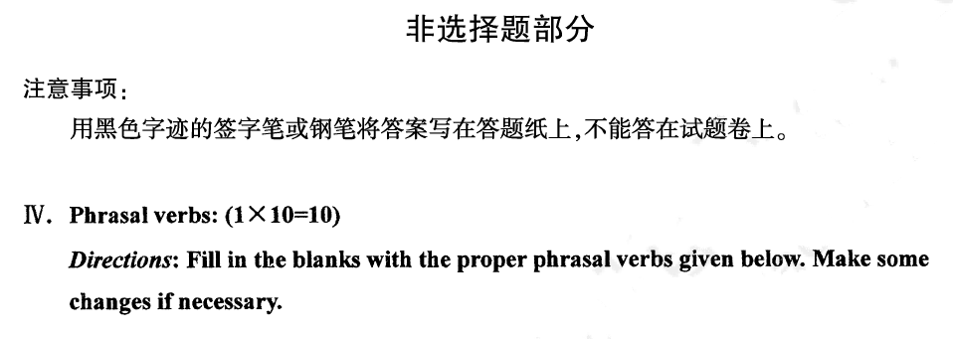
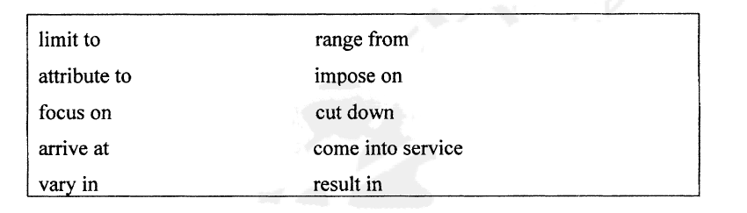

Slide 25
1.
We have to our expenses on food.
2.
The car accident four deaths.
3.
The government has decided to a tax personal income.
4.
He didn't know what decision the meeting would finally .
5.
When did double-deckers ?
6.
Sometimes they their students' poor comprehension a lack of intelligence.
7.
Hotels size and comfort.
8.
Our holidays two weeks a year.
9.
Today's presentation will marketing research.
10.
The ages of this class 18 to 22.

Slide 26
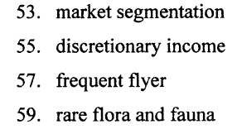
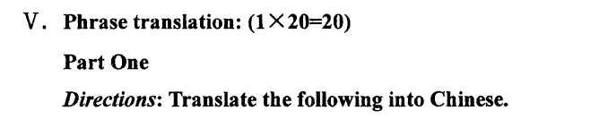

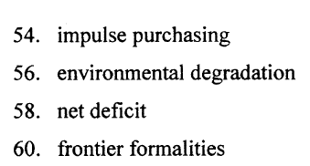

Slide 27
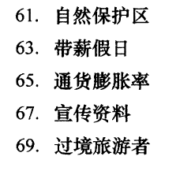
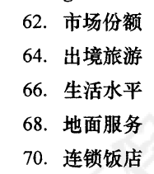


Slide 28

There are many types of accommodations. The least expensive type of accommodation is hostel. Hostels are dorm-like accommodations with shared bathroom facilities, and possibly, a shared kitchen. Originally they are established only for younger travelers. The bed & breakfast concept, also known as B&B, is usually family homes with one or more guest rooms and generally with a shared bathroom. B&Bs offer a unique environment, but they do not offer the variety of activities and guest services found in other types of accommodations. A motel is often a one or two storied building that mainly offers service for motorists. Cars are parked in front of the building. Hotels come in all shapes and sizes and guest services and activities vary widely from one hotel to another.

Slide 29
The application of the Internet over the past few decades has been transforming the way that products and services are distributed to customers. Tourism and hospitality are of no exception. Tourists have started to purchase airline tickets and make hotel or tour reservations online. Aside from desktop computers, mobile devices such as smart-phones and tablets are heavily used by travelers to book travel-related products and services. Under the traditional distribution model, travelers rely heavily on traditional travel agencies, to buy the products provided by suppliers (e.g. hotels and airlines) via global distribution systems (GDS). Using the Internet, travelers can now directly get travel information and make their bookings via the websites of suppliers.

