Slide 1
3.1第一节 现象分析类(The Analysis of Phenomenon)
英语写作
精 讲 5

Slide 2
3.2第二节 对比议论类(Argumentative)
300字作文
现象分析类
对比议论类
解决问题类

Slide 3
3.3第三节 解决问题类(Problem Solving)
英语写作
补全段落
列提纲
300字作文
3 300字作文
大作文

Slide 4
英语写作
补全段落
列提纲
300字作文
3 300字作文
2016年10月真题 | A role model is someone who inspires us in our life and makes us want to be better. Write a 300-word expository essay about the qualities of your role model. 偶像能够给予我们鼓励，你的偶像具备哪些特质？
2016年04月真题 | Some people claim love is the most important in a happy marriage, while others believe money plays a decisive role. What is your opinion? 幸福婚姻中是爱情重要还是钱重要？
2015年10月真题 | In their spare time, some people prefer staying at home enjoying themselves and some like going out for fun. Which do you prefer? 闲暇时你喜欢宅在家自得其乐还是出去玩？
2015年04月真题 | Nowadays a lot of freshman are escorted by their family to the university on the enrollment day. Express your views on the phenomenon. 评论大学新生由父母护送去注册报到的现象。

Slide 5
英语写作
补全段落
列提纲
300字作文
3 300字作文
2014年10月真题 | The mobile phone is one of the most important inventions in the modern society. What effects does the mobile phone have on our lives? Discuss the effects. 讨论手机对生活的影响。
2014年04月真题 | People are more and more concerned about the environment. State your opinion about what we can do as individuals to improve our environment. 人们越来越关心环境，我们作为个人如何改善我们的环境？
2013年10月真题 | Some people enjoy playing sports individually while others love to play in groups. Which do you prefer? 你喜欢一个人运动还是和别人一起？说出你的理由。
2013年01月真题 | Academic dishonesty in all levels of education has been a hotly debated topic in the previous decade. Students cheat in examinations and papers; even some famous professors cheat in their academic works. What do you think are the major causes of academic dishonesty? expressing your views with the title given, What Has Caused Academic Dishonesty? 命题作文：是什么促使大量“学术造假”的发生？

Slide 6
英语写作
补全段落
列提纲
300字作文
3 300字作文
现象分析类作文
对比议论类作文
解决问题类作文
对比议论
现象分析
解决问题

Slide 7
英语写作
补全段落
列提纲
300字作文
2013-2018作文类别分析
考察类型 | 特点
现象分析类【40%】 | 给出一个社会上比较流行的现象【多为不太好的现象】请你分析和评论。 例：评论大学新生由父母护送去注册报到的现象。 （15-04）
对比议论类【40%】 | 给出一个话题，针对这一话题有两种不同的观点，让你给出你的看法。 例：闲暇时你喜欢宅在家自得其乐还是出去玩？
环境保护类【20%】 | 针对环境问题，给出一些对策或呼吁大家保护环境 例：人们越来越关心环境，我们作为个人如何改善我们的环境？说说你的观点。

Slide 8
英语写作
补全段落
列提纲
300字作文
3 300字作文
高分写作的三个维度
语言
结构
内容
1
2
3

Slide 9
英语写作
补全段落
列提纲
300字作文
3 300字作文
三个目标 | 内容
语言目标 | ①语法正确 ②意义准确 ③变换句型句式（长短句结合）
结构目标： | ①三段式结构或五段式结构 ②使用信号词，段落主题句。
内容目标： | ①逻辑总分总（提出观点—— 论证观点——重申观点） ②有明确主题（体现在主题句上）且切题。

Slide 10
写作变身大法
1. 换单词
例：I think--I decide, argue, believe; In my view, In my point of view.....
困难：difficulty-- ?

Slide 11
写作变身大法
1. 换单词
例：I think--I decide, argue, believe; In my view, In my point of view.....
困难：difficulty--barrier, obstacle

Slide 12
写作变身大法
1. 换单词
例：I think--I decide, argue, believe; In my view, In my point of view.....
困难：difficulty--barrier, obstacle
2. 活用词性转化
例：blind optimism--blindly optimistic

Slide 13
写作变身大法
1. 换单词
例：I think--I decide, argue, believe; In my view, In my point of view.....
困难：difficulty--barrier, obstacle
2. 活用词性转化
例：blind optimism--blindly optimistic; solve the problem--solution/answer to the problem

Slide 14
写作变身大法
1. 换单词
例：I think--I decide, argue, believe; In my view, In my point of view.....
困难：difficulty--barrier, obstacle
2. 活用词性转化
例：blind optimism--blindly optimistic; solve the problem--solution/answer to the problem
depend on--be dependent on

Slide 15
写作变身大法
1. 换单词
例：I think--I decide, argue, believe; In my view, In my point of view.....
困难：difficulty--barrier, obstacle
2. 活用词性转化
例：blind optimism--blindly optimistic; solve the problem--solution/answer to the problem
depend on--be dependent on； be able to do--have the ability to do

Slide 16
写作变身大法
1. 换单词
例：I think--I decide, argue, believe; In my view, In my point of view.....
困难：difficulty--barrier, obstacle
2. 活用词性转化
例：blind optimism--blindly optimistic; solve the problem--solution/answer to the problem
depend on--be dependent on； be able to do--have the ability to do
I think she is a beautiful girl.---I have the thought that she is a beautiful girl.

Slide 17
写作变身大法
1. 换单词
例：I think--I decide, argue, believe; In my view, In my point of view.....
困难：difficulty--barrier, obstacle
2. 活用词性转化
例：blind optimism--blindly optimistic; solve the problem--solution/answer to the problem
depend on--be dependent on； be able to do--have the ability to do
I think she is a beautiful girl.---I have the thought that she is a beautiful girl.
3. 换句式
例：There is one thought in my mind that she is a beautiful girl.
There is one thought lingering/going on in my mind that she is a beautiful girl.
（运用从句、非谓语动词或其他语法形式）

Slide 18
写作变身大法
♥形容词替换大法：形容词=of +名词
如：important → of great importance different → of great difference
beautiful → of amazing beauty wise → of outstanding wisdom

Slide 19
写作变身大法
♥形容词替换大法：形容词=of +名词
如：important → of great importance different → of great difference
beautiful → of amazing beauty wise → of outstanding wisdom
例：There is one thought lingering/going on in my mind that she is a beautiful girl.
=There is one thought lingering/going on in my mind that she is a girl of amazing beauty.
The meeting is very important.=The meeting is of great importance.

Slide 20
写作变身大法
4. 非人主语（让物作主语）
例：occur to sb （主意或想法突然）浮现于脑海
① it occurs to sb to do sth
It never seems to occur to my children to contact me. 我的孩子们似乎从来都想不到和我联系
② it occurs to sb (that)
It had never occurred to him that he might be falling in love with her. 他从未想到自己可能会爱上她
hit 突然想起
It hit me that I had a chance. 我突然意识到我可以有所选择
=An idea hits me that I had a chance.

Slide 21
写作变身大法
5. 学会添加过渡词，将文章内容串联在一起
过渡词常见分类：时间、空间、层次、逻辑（详见课件下载区“词汇总结”）
时间：now, then, afterwards之后，以后....
空间：far from, in front of...
层次：in the first place, in addition.....
逻辑：because, if.....

Slide 22
写作变身大法
This day is a sunny day. I went to the suburbs by bike. I was very happy. The scenery was very beautiful. I took many pictures. There were many beautiful flowers.
In the morning, with the sunshine sparkling over the field, I bicycled to the suburbs merrily.
A great number of colorful flowers swinging with the soft wind, which really feasted my eyes, I can't help taking a lot of pictures of this breath-taking scenery.

Slide 23
写作常见误区
1. 从句过多---长短句相结合原则

Slide 24

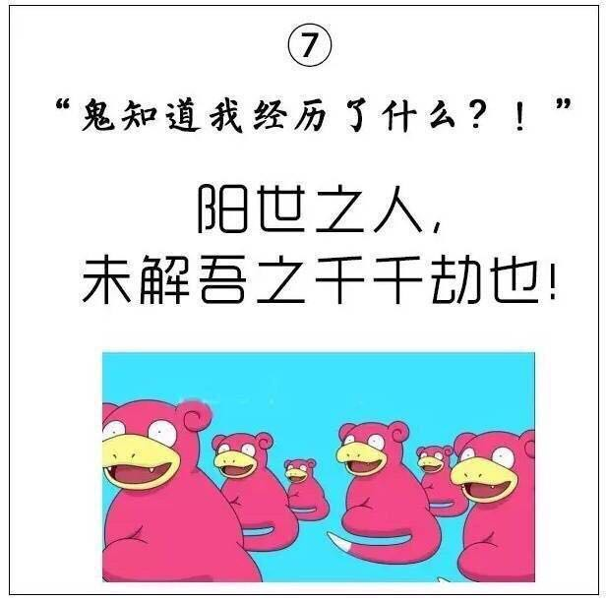
写作常见误区
1. 从句过多---长短句相结合原则
2. 中文草稿太复杂--学会简化自己的中文草稿、不要直译

Slide 25
写作常见误区
1. I did everything I could do
2. You have no idea what I have been through.

Slide 26
【万能凑字大法】
【使用说明】任何句子上面都能套用的神奇句型！实在没什么亮点的短句子上面可以套用！
清：It is clear that ...
明：It is obvious that ...
疑：There is no doubt that ...
否：No one can deny ...
不用：Needless to say, ...
走：It goes without saying that ...

Slide 27
300字作文
现象分析类
对比议论类
解决问题类
3.1 现象分析类
特点：给出一个社会上比较流行的现象【多为不太好的现象】请你分析和评论。
根据近10年真题，这类作文可以分为两大类：自命题作文和命题作文
作文类别 | 观点 | 论据 | 结论
自命题作文 | 题干暗示观点 | 支撑观点 | 重申观点
命题作文 | 题目就是观点 | 支撑观点 | 重申观点

Slide 28
300字作文
现象分析类
对比议论类
解决问题类
3.1 现象分析类
【典型例题】
①Nowadays a lot of freshmen are escorted by their family to the university on the enrollment day. Express your views on the phenomenon. （2015.04）
评论大学新生由父母护送去学校注册报到的现象。
②Academic dishonesty in all levels of education has been a hotly debated topic in the previous decade. Students cheat in examinations and papers; even some famous professors cheat in their academic works. What do you think are the major causes of academic dishonesty? expressing your views with the title given, What Has Caused Academic Dishonesty?
是什么促使大量“学术造假”的发生？（1301真题）（命题作文）

Slide 29
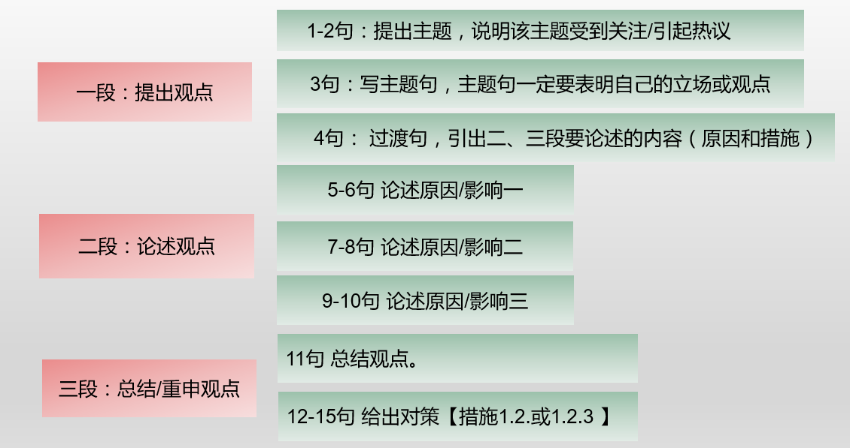
300字作文
现象分析类
对比议论类
解决问题类
3.1 现象分析类

Slide 30
300字作文
现象分析类
对比议论类
解决问题类
3.1 现象分析类
【经典模板】
一段：①These days there is a growing tendency for 人 to 动词原形
最近，…做…有日益增长的趋势。
备 选 ：It is not uncommon these days for 人 to 动词原形
② If this trend continues to develop without curbs, it may lead to many
curb n. 控制措施
unexpected a. 意想不到的
top concern 最关心的问题
unexpected consequences.
如果任由这一趋势继续发展，可能会导致一些意想不到的结果。
③Therefore, seeking the causes of it and finding out the solutions should be our top concern/top priority.
因此，找到导致这一现象的原因和解决措施使我们首要关心的。

Slide 31
300字作文
现象分析类
对比议论类
解决问题类
3.1 现象分析类
练习：请写出下面两篇自命题作文的第一段。
①Nowadays a lot of freshmen are escorted by their family to the university on the enrollment day. Express your views on the phenomenon. （2015.04）
评论大学新生由父母护送去学校注册报到的现象。
②Many young people choose to overwork in order to make more money; however, persistent overwork will affect their health in the long run. What is your opinion on this? (2012.10)
许多年轻人为了赚钱而过度工作，但是长远来看，这样做会影响他们的健康。你怎么看？

Slide 32
①Nowadays a lot of freshmen are escorted by their family to the university on the enrollment day. Express your views on the phenomenon. （2015.04）
300字作文
现象分析类
对比议论类
解决问题类
【经典模板】
一段：①These days there is a growing tendency for 人 to 动词原形
最近，…做…有日益增长的趋势。
备 选 ：It is not uncommon these days for 人 to 动词原形
② If this trend continues to develop without curbs, it may lead to many unexpected consequences.
如果任由这一趋势继续发展，可能会导致一些意想不到的结果。
③Therefore, seeking the causes of it and finding out the solutions should be our top concern/top priority.
因此，找到导致这一现象的原因和解决措施使我们首要关心的。

Slide 33
300字作文
现象分析类
对比议论类
解决问题类
3.1 现象分析类
1504真题
Para.1
①These days, there is a growing tendency for college freshmen to be escorted by their parents to the university in the enrollment day.
②If this trend continues to develop without curbs, it may lead to many unexpected consequences.
③Therefore, seeking the causes of it and finding out the solutions should be our top concern.

Slide 34
②Many young people choose to overwork in order to make more money; however, persistent overwork will affect their health in the long run. What is your opinion on this?
300字作文
现象分析类
对比议论类
解决问题类
【经典模板】
一段：①These days there is a growing tendency for 人 to 动词原形
最近，…做…有日益增长的趋势。
备 选 ：It is not uncommon these days for 人 to 动词原形
② If this trend continues to develop without curbs, it may lead to many unexpected consequences.
如果任由这一趋势继续发展，可能会导致一些意想不到的结果。
③Therefore, seeking the causes of it and finding out the solutions should be our top concern/top priority.
因此，找到导致这一现象的原因和解决措施使我们首要关心的。

Slide 35
300字作文
现象分析类
对比议论类
解决问题类
3.1 现象分析类
1210真题
Para.1
①It is not uncommon these days for many young people to work overtime for the purpose of earning money, but persistent overwork will affect their health in the long run.
②If this trend continues to develop without curbs, it may lead to many unexpected consequences.
③Therefore, seeking the cause of it and finding out the solutions should be our top concern.

Slide 36
300字作文
现象分析类
对比议论类
解决问题类
二 段 ：
① There are numerous causes of this trend and I would explore only a few of the most important ones here. 要解释这种趋势，有许多原因，我从其中最重要的三个原因来阐释。
备 选 1：This phenomenon is a result of many factors and the most significant ones include 名词__, ___名词 ; __名词__.
备 选 2：Dozens of reasons may explain the emergence of the phenomenon, but the most obvious ones are as follows.
②First and foremost, 名词__ have a great influence on 名词__, which leads to the fact that ___句子___.
③Furthermore, _______ may also explain the popularity of this phenomenon.
其次，XX 也可以解释这种现象为什么这么流行。
④ Last but not least , _________ is closely related to________.
最后也是最重要的， …与XX 也是有关的。

Slide 37
300字作文
现象分析类
对比议论类
解决问题类
3.1 现象分析类
练习：请写出下面自命题作文的第二段。
①Nowadays a lot of freshmen are escorted by their family to the university on the enrollment day. Express your views on the phenomenon. （2015.04）

Slide 38
300字作文
现象分析类
对比议论类
解决问题类
1504真题 Para.2
① There are numerous causes of this trend and I would explore only a few of the most important ones here.
② First and foremost, the”one-child”policy has a great influence on Chinese parents' parenting style, which leads to the fact that the child becomes the apple of their parents' eyes.
③ Parents tend to protect their children all the time, ignoring the fact that their children have already become grown-ups.
语言点：① the apple of one's eyes 某人的掌上明珠
② 经典句型：现在分词做伴随状语

Slide 39
300字作文
现象分析类
对比议论类
解决问题类
3.1 现象分析类
现在分词做伴随状语：
①许多人认为工作是生活的重心，忽视了家庭的重要性。
A large number of people consider that work is the center of life, ignoring/neglecting the significance of family.
②作为父母的掌上明珠，许多孩子都过度依赖父母。
Being the apple of their parents' eyes, many children are over dependent on their parents.

Slide 40
300字作文
现象分析类
对比议论类
解决问题类
③ Secondly, being accustomed to the protection from parents, most of children are afraid of or incapable of doing things independently, which may also explain the popularity of this phenomenon.
其次，习惯了来自父母的保护，大部分孩子害怕或失去独立办事的能力，这也可以解释 这种现象为什么这么流行。
④ Last but not least, parents escorting their children to college is closely related to the social environment in China where children are less mature and independent than their European counterpart though they've already reached the age of eighteen.
最后也是最重要的，这与中国的社会环境密切相关：中国孩子没有欧洲孩子那么成熟独立，尽管他们早已过了18岁。

Slide 41
300字作文
现象分析类
对比议论类
解决问题类
三段：
① There are some measures as follows which can be taken to improve the situation.
可以采取一些措施来改善这一情况。
备选：When all the factors are examined, we may safely come to the conclusion that _____句子______.
With the efforts from _______ , a better result can be achieved.
当审视过所有因素后，我们可以有根据地得出结论 ______ 。
② On the one hand/In the first place, ( 措 施一)
③ On the other hand/ In the second place, ( 措 施 二 )
④ The world will be a better place if we make joint efforts to put an end to the phenomenon.
如果我们一起努力终结这种现象，世界将会变得更好。
按字数要求，至少要写15个句子，平均每句话15到20个词。

Slide 42
300字作文
现象分析类
对比议论类
解决问题类
1504真题 Para.3
① There are some advices as follows which can be given to the parents and children to improve the situation.
② On the one hand, parents should change their parenting styles, admitting the fact that their children will be mature one day and need to achieve the independence.
③ On the other hand, children should keep one thing in mind that the path of growth is full of challenges and it is the challenges that will make one stronger. Overcoming them independently will benefit one a lot.
④ The world will be a better place if we make joint efforts to put an end to the situation.

