Slide 1

高级英语
基础精讲二
1.7.2上册第七课第2段

Slide 2
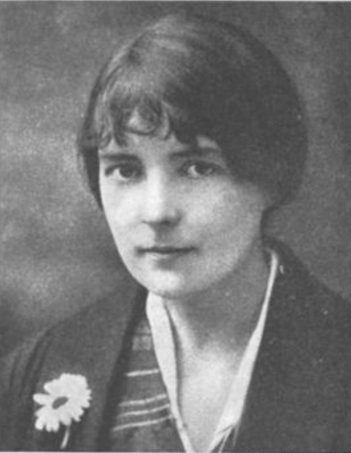
1.7.2上册第七课第2段
1.1.1.7布里尔小姐（Miss Brill）
Miss Brill
布里尔夫人
Catherine Mansfield
凯瑟琳 曼斯菲尔德

Slide 3
1.7.2上册第七课第2段
二、高级英语课文精讲——上册 Lesson 7
Para 2：There were a number of people out this afternoon, far more than last Sunday. And the band（乐队） sounded louder and gayer（快乐的）. That was because the Season（演出季） had begun. For although the band played all the year round（全年） on Sundays, out of season it was never the same. It was like someone playing with only the family to listen; it didn’t care how it played if there weren’t any strangers present（出席的）.

Slide 4
1.7.2上册第七课第2段
二、高级英语课文精讲——上册 Lesson 7
Para 2：There were a number of people out this afternoon, far more than last Sunday. And the band（乐队） sounded louder and gayer（快乐的）. That was because the Season（演出季） had begun. For although the band played all the year round（全年） on Sundays, out of season it was never the same. It was like someone playing with only the family to listen; it didn’t care how it played if there weren’t any strangers present（出席的）.
今天下午出来的人很多，比上星期日多多了，而且乐队演奏得也好像更加响亮、欢快。那是因为演出季节开始了。尽管乐队每逢星期日都演奏，但不是演出季节时总是不太一样。就好像一个人只演奏给家里人听那样，没有陌生人在场，演得怎样都没关系。

Slide 5
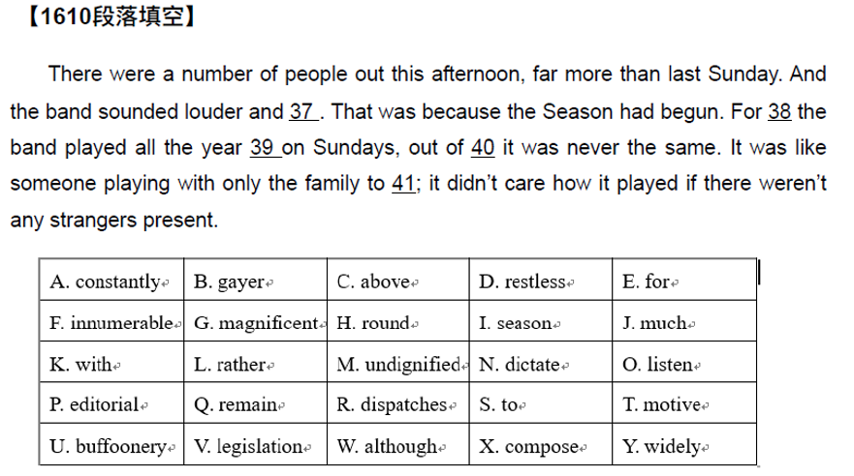
1.7.2上册第七课第2段
练习

Slide 6
1.7.2上册第七课第2段
二、高级英语课文精讲——上册 Lesson 7
Para 2：Wasn’t the conductor（指挥） wearing a new coat, too? She was sure it was new. He scraped（刮，蹭） with his foot and flapped（拍动） his arms like a rooster（公鸡） about to crow（打鸣）, and the bandsmen sitting in the green rotunda（原形大厅，圆亭） blew out their cheeks（脸颊） and glared at（盯着） the music. Now there came a little “flutey”（长笛般的） bit – very pretty! – a little chain of bright drops. She was sure it would be repeated（重复）. It was; she lifted（举起，抬起） her head and smiled.

Slide 7
1.7.2上册第七课第2段
二、高级英语课文精讲——上册 Lesson 7
Para 2：Wasn’t the conductor（指挥） wearing a new coat, too? She was sure it was new. He scraped（刮，蹭） with his foot and flapped（拍动） his arms like a rooster（公鸡） about to crow（打鸣）, and the bandsmen sitting in the green rotunda（原形大厅圆亭） blew out their cheeks（脸颊） and glared at（盯着） the music. Now there came a little “flutey”（长笛般的） bit – very pretty! – a little chain of bright drops. She was sure it would be repeated（重复）. It was; she lifted（举起，抬起） her head and smiled.
指挥不也穿了一件新上衣吗？她肯定那是新的。他像一只正要鸣叫的公鸡那样一只脚蹭着地，摆动着双臂。坐在绿色圆亭里的乐队成员们鼓起两腮，眼睛盯着乐谱。这时传来“长笛般”柔和清亮的一小段音乐——十分悦耳——一长串活泼的急降。她知道这一段一定会重复出现的。是的，重复了，她抬起头来笑了。

Slide 8
1.7.5上册第七课第5段
二、高级英语课文精讲——上册 Lesson 7
Para 5：The old people sat on the bench（长椅）, still as statues（雕像）. Never mind（没关系）, there was always the crowd（人群） to watch. To and fro（来来回回）, in front of the flower-beds and the band rotunda, the couples（一对） and groups paraded（游行）, stopped to talk, to greet, to buy a handful of flowers from the old beggar（乞丐） who had his tray（托盘） fixed to（固定） the railings（栏杆）. Little children ran among them, swooping（猛冲） and laughing; little boys with big white silk（丝绸） bows under their chins（下巴）; little girls, little French dolls, dressed up in velvet（丝绒） and lace（蕾丝）.

Slide 9
1.7.5上册第七课第5段
二、高级英语课文精讲——上册 Lesson 7
Para 5：The old people sat on the bench（长椅）, still as statues（雕像）. Never mind（没关系）, there was always the crowd（人群） to watch. To and fro（来来回回）, in front of the flower-beds and the band rotunda, the couples（一对） and groups paraded（游行）, stopped to talk, to greet, to buy a handful of flowers from the old beggar（乞丐） who had his tray（托盘） fixed to（固定） the railings（栏杆）. Little children ran among them, swooping（猛冲） and laughing; little boys with big white silk（丝绸） bows under their chins（下巴）; little girls, little French dolls, dressed up in velvet（丝绒） and lace（蕾丝）.
那两个老人坐在座位上，仍像雕像一样一声不响。没关系，总有许多人可看。在花圃前和乐队所在的圆亭前，成双成对或三五成群的人们来回漫步，时而停下来交谈、打招呼，或从一个把花盘捆在栏杆上的老乞丐手里买上一把花。孩子们在他们中间奔跑着，打闹着，大声笑着，男孩子们下巴底下戴着大个的白色丝绸蝴蝶领结，女孩子们打扮得就像法国玩具娃娃，穿着丝绸带花边的衣服。
Notes:
Parade游行庆祝，游行示威
Bow蝴蝶结

Slide 10
1.7.5上册第七课第5段
二、高级英语课文精讲——上册 Lesson 7
Para 5：And sometimes a tiny staggerer（蹒跚） came suddenly rocking（摇晃） into the open from under the trees, stopped, stared（睁大眼睛）, as suddenly sat down “flop（扑通一声）” until its small high-stepping mother, like a young hen, rushed scolding（责怪） to its rescue（拯救）. Other people sat on the benches and green chairs, but they were nearly always the same, Sunday after Sunday, and —Miss Brill had often noticed—there was some-thing funny about nearly all of them. They were odd（古怪的）, silent, nearly all old, and from the way they stared they looked as though they‘d just come from dark little rooms or even—-even cupboards（橱柜）!

Slide 11
1.7.5上册第七课第5段
二、高级英语课文精讲——上册 Lesson 7
Para 5：And sometimes a tiny staggerer（蹒跚） came suddenly rocking（摇晃） into the open from under the trees, stopped, stared（睁大眼睛）, as suddenly sat down “flop（扑通一声）” until its small high-stepping mother, like a young hen, rushed scolding（责怪） to its rescue（拯救）. Other people sat on the benches and green chairs, but they were nearly always the same, Sunday after Sunday, and —Miss Brill had often noticed—there was some-thing funny about nearly all of them. They were odd（古怪的）, silent, nearly all old, and from the way they stared they looked as though they‘d just come from dark little rooms or even—-even cupboards（橱柜）!
有时一个刚刚学步的小家伙突然从树下摇摇晃晃地走出来，在空地上停下，睁大眼睛张望着，突然“扑通”一下坐在地上，直到他娇小的母亲高抬着脚步像只小母鸡一样一边责备着一边冲过去把他救起。另外一些人坐在长凳上或是绿色的椅子上，但一个又一个星期日，几乎总是同样的一些人，而且布里尔小姐常常注意到他们几乎所有的人身上都有一些奇怪之处。他们古怪、沉默，几乎都很老。看他们睁大眼睛的样子，好像是刚从黑暗的小屋子里出来，甚至——甚至是刚从小橱柜里出来。
Notes:
Open（名词）空地，户外，野外

Slide 12
1.7.8上册第七课第8段
二、高级英语课文精讲——上册 Lesson 7
Para 8：Two young girls in red came by（路过） and two young soldiers（士兵） in blue met them, and they laughed and paired（成对） and went off arm in arm. Two peasant（农民） women with funny straw（稻草） hats passed, gravely（严肃地）, leading beautiful smoke-colored donkey. A cold, pale（苍白的） nun（修女） hurried by. A beautiful woman came along（走来） and dropped her bunch（束） of violets（紫罗兰）, and a little boy ran after to hand them to her, and she took them and threw them away as if they‘d been poisoned（往…放毒）.

Slide 13
1.7.8上册第七课第8段
二、高级英语课文精讲——上册 Lesson 7
Para 8：Two young girls in red came by（路过） and two young soldiers（士兵） in blue met them, and they laughed and paired（成对） and went off arm in arm. Two peasant（农民） women with funny straw（稻草） hats passed, gravely（严肃地）, leading beautiful smoke-colored donkey. A cold, pale（苍白的） nun（修女） hurried by. A beautiful woman came along（走来） and dropped her bunch（束） of violets（紫罗兰）, and a little boy ran after to hand them to her, and she took them and threw them away as if they‘d been poisoned（往…放毒）.
两个穿红色衣服的年轻姑娘从附近走过，两个穿蓝色军装的年轻土兵同她们相遇。他们高声笑着分成两对挽臂而去。两个戴着可笑草帽的农妇神情庄重地牵着漂亮的暗灰色的毛驴走了过去。一个冷冰冰的，面色苍白的修女匆匆走过。一个美貌的女人向这边走来，将一束紫罗兰掉在地上，一个小男孩追上去把花递还给她，她接过去后又扔掉了，仿佛花被放了毒似的。
Notes:
Mule骡子，越境贩毒者

Slide 14
1.7.8上册第七课第8段
二、高级英语课文精讲——上册 Lesson 7
Para 8：Dear me! Miss Brill didn‘t know whether to admire（称赞） that or not! And now an ermine（貂皮） toque（无边女帽） and a gentleman in grey met just in front of her. He was tall, stiff（拘谨的）, dignified, and she was wearing the ermine toque she’d bought when her hair was yellow. Now everything, her hair, her face, even her eyes, was the same color as the shabby（破旧的） ermine, and her hand, in its cleaned glove, lifted to dab（抹） her lips（嘴唇）, was a tiny yellowish（微黄色的） paw（爪子）. Oh, she was so pleased to see him —delighted! She rather thought they were going to meet that afternoon.

Slide 15

1.7.8上册第七课第8段
一、高级英语课文精讲——上册 Lesson 7
Toque 无边女帽

Slide 16
1.7.8上册第七课第8段
二、高级英语课文精讲——上册 Lesson 7
Para 8：Dear me! Miss Brill didn‘t know whether to admire（称赞） that or not! And now an ermine（貂皮） toque（无边女帽） and a gentleman in grey met just in front of her. He was tall, stiff（拘谨的）, dignified, and she was wearing the ermine toque she’d bought when her hair was yellow. Now everything, her hair, her face, even her eyes, was the same color as the shabby（破旧的） ermine, and her hand, in its cleaned glove, lifted to dab（抹） her lips（嘴唇）, was a tiny yellowish（微黄色的） paw（爪子）. Oh, she was so pleased to see him —delighted! She rather thought they were going to meet that afternoon.
天哪，布里尔小姐真不知道该不该称赞这种行为。现在一个戴貂皮无沿帽的女人和一个穿灰衣服的先生正好在她面前相遇了。他身材高大、神态拘谨、举止庄重，而她戴的貂皮无沿帽是在她的头发是黄色时买的。而现在她的一切，头发，脸，甚至眼睛都和这顶破旧的貂皮帽一样颜色苍白了。她抬起来轻抹嘴唇的那只戴着洗过的手套的手是只发黄的爪子。哈！她见到他真是太高兴了——太愉快了！她觉得他们是定好下午会面的。

Slide 17
1.7.11上册第七课第11段
二、高级英语课文精讲——上册 Lesson 7
Para 11-16：Just at that moment a boy and a girl came and sat down where the old couple had been. They were beautifully dressed; they were in love. The hero and heroine, of course, just arrived from his father‘s yacht（游艇）. And still soundlessly singing, still with that trembling（颤抖的） smile, Miss Brill prepared to listen.
"No, not now," said the girl. "Not here, I can't."
“But why? Because of that stupid old thing at the end there?” asked the boy. “Why does she come here at all —who wants her? Why doesn‘t she keep her silly old mug（脸） at home?"
“It‘s her fu-fur（毛皮制品） which is so funny,” giggled（咯咯地笑） the girl. "It's exactly like a fried whiting."
“Ah, be off with you!” said the boy in an angry whisper（低语，耳语）. Then: "Tell me, ma petite chere —"
"No, not here, “said the girl. "Not yet."

Slide 18
1.7.11上册第七课第11段
二、高级英语课文精讲——上册 Lesson 7
Para 11-16：这个时候一对青年男女走过来坐在刚才那对老夫妻坐的地方。他们衣着鲜亮，正在恋爱。当然男女主人公刚刚从他父亲的游艇上下来。布里尔小姐仍然在无声地唱着歌，仍带着颤抖的微笑，她准备好听他们的谈话。
“不行，现在不行，”姑娘说道，“别在这里，我不能。”
“可是为什么？是因为坐在那一头的那个愚蠢的老家伙吗？”小伙子问。 “她为什么要到这里来——谁需要她？她为什么不把她那副愚蠢的尊容留在家里？”
“她的那条皮围巾太滑稽了。”姑娘哈哈地笑着说，“和一条炸鲤鱼完全一样。”
“嘿，去你的吧！”小伙子生气地低语道。接着又说：“告诉我，小心肝——”
“不，别在这里，”姑娘说道，“先别这样。”

Slide 19
1.7.17上册第七课第17段
二、高级英语课文精讲——上册 Lesson 7
Para 17：On her way home she usually bought a slice（薄片） of honey-cake at the baker‘s（面包店）. It was her Sunday treat（乐趣）. Sometimes there was an almond（杏仁） in her slice, sometimes not. It made a great difference. If there was an almond it was like carrying home a tiny present —a surprise—something that might very well not have been there. She hurried on the almond Sundays and struck the match（火柴） for the kettle（水壶） in quite a dashing（劲头十足的） way.

Slide 20
1.7.17上册第七课第17段
二、高级英语课文精讲——上册 Lesson 7
Para 17：On her way home she usually bought a slice（薄片） of honey-cake at the baker‘s（面包店）. It was her Sunday treat（乐趣）. Sometimes there was an almond（杏仁） in her slice, sometimes not. It made a great difference. If there was an almond it was like carrying home a tiny present —a surprise—something that might very well not have been there. She hurried on the almond Sundays and struck the match（火柴） for the kettle（水壶） in quite a dashing（劲头十足的） way.
在回家的路上她总是要在面包店买上一块蜂蜜蛋糕。这是她星期日的特殊享受。有时候买的蛋糕里有粒杏仁，有时候没有。有没有大不一样。如果有杏仁，就像是带回家一个小小的礼物——一份惊喜——一个本来很可能没有的东西。在有杏仁的那些星期日，她总是匆匆赶回家，精神抖擞地划火柴点火烧水。

Slide 21
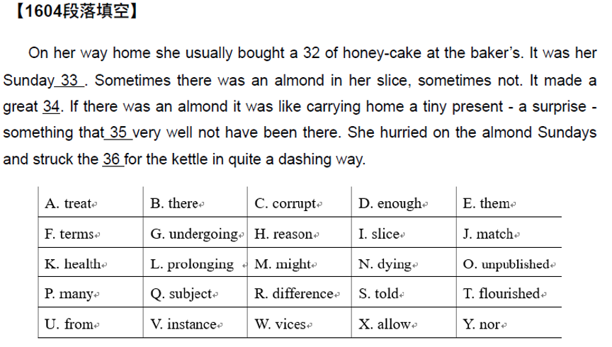
1.7.17上册第七课第17段
练习

Slide 22
1.7.18上册第七课第18段
目录
一、课文带读
二、题型介绍——单项选择

Slide 23
1.7.18上册第七课第18段
一、课文带读
二、题型介绍——单项选择

Slide 24
1.7.18上册第七课第18段
1、单项选择
2、阅读理解
3、英译汉
高级英语
4、写作
5、选词填空
6、汉译英

Slide 25
1.7.18上册第七课第18段
1、单项选择
2、阅读理解
3、英译汉
高级英语
4、写作
5、选词填空
6、汉译英

Slide 26
1.7.18上册第七课第18段
二、题型介绍——单项选择
1. A surprising percentage of the population are computer（ ）.
A:illegal
B:irritable
C:illiterate
D:irregular

Slide 27
1.7.18上册第七课第18段
二、题型介绍——单项选择
1. A surprising percentage of the population are computer（ ）.
A:illegal 非法的
B:irritable 易怒的，暴躁的
C:illiterate 文盲的
D:irregular 不规则的

Slide 28
1.7.18上册第七课第18段
二、题型介绍——单项选择
1. A surprising percentage of the population are computer（ ）.
A:illegal 非法的/非法移民，非法劳工
B:irritable 易怒的，暴躁的
C:illiterate 文盲的/文盲
D:irregular 不规则的/不规则的物体
答案：C
译文：对电脑不了解的人在人口占据了惊人的比例

Slide 29
1.7.18上册第七课第18段
二、题型介绍——单项选择
2. Whether women should spend more time outside home has long been the subject of heated （ ） within the medical profession.
A: debate 辩论
B: quarrel 争吵
C: dispute 纠纷
D: conflict 冲突
答案：A
译文：妇女是否应该在家外多呆些时间一直是医学界争论不休的话题。
Notes:
debate : 通常指经过仔细组织和计划的个人或团体之间的辩论。
quarrel : 普通用词，既可指言词激烈的争吵，也可指温和的言词上的不和。
dispute : 普通用词，侧重指长时间，言词激烈，针锋相对的争辩。
conflict : 指双方坚持已见、互不妥协，怀有敌意的争论，多暗示分歧极为严重，有时用语言无法解决，只得诉诸武力。

Slide 30
1.7.18上册第七课第18段
二、题型介绍——单项选择
3. Players are likely to be （ ） by the game's slow pace and fishy subject matters.
A:put out
B:put down
C:put up
D:put off

Slide 31
1.7.18上册第七课第18段
二、题型介绍——单项选择
3. Players are likely to be （ ） by the game's slow pace and fishy subject matters.
A:put out 熄灭，出版
B:put down 记下，写下
C:put up 举高
D:put off 使…失去兴趣
答案：D
译文：玩家很可能因为游戏的慢节奏和可疑的主题问题而失去兴趣。
可疑的

Slide 32
1.7.18上册第七课第18段
二、题型讲解——单项选择
4. She had the ( ) to believe the law did not apply to her.
A:dignity
B:interest
C:patience
D:arrogance

Slide 33
1.7.18上册第七课第18段
二、题型讲解——单项选择
4. She had the ( ) to believe the law did not apply to her.
A:dignity 尊严
B:interest 兴趣
C:patience 耐心
D:arrogance 傲慢
答案：D
译文：她傲慢的认为法律不适用于她。
Notes:
Dignify使有尊严
Dignified庄重的，有尊严的
Undignified 没有尊严的，不体面的

Slide 34

谢谢观看
See You
1.7.18上册第七课第18段

