Slide 1

高级英语
基础精讲三
1.10.25上册第十课第25段

Slide 2
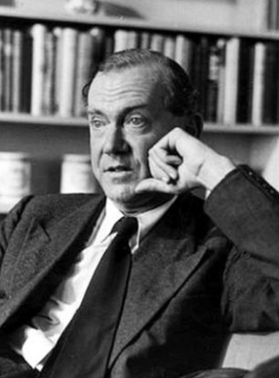
1.1.1.10第十个人（The Tenth Man）
1.10.25上册第十课第25段
目录
The Tenth Man
第十个人
格雷厄姆 格林

Slide 3
1.10.25上册第十课第25段
一、高级英语课文精讲——上册 Lesson 10
Para 25：“As you wish,” the lorry（货运汽车） driver said. “Anybody beat Voisin? Here goes. “He thrust（强行推入） his hand into the shoe and made careful excavations（挖掘） as though he had one particular scrap（小片） of paper in mind. He drew one out, opened it, and gazed at（凝视） it with astonishment（惊讶）. He said, "This is it.” He sat down and felt for a cigarette, but when he got it between his lips he forgot to light it.

Slide 4
1.10.25上册第十课第25段
一、高级英语课文精讲——上册 Lesson 10
Para 25：“As you wish,” the lorry（货运汽车） driver said. “Anybody beat Voisin? Here goes.“ He thrust（强行推入） his hand into the shoe and made careful excavations（挖掘） as though he had one particular scrap（小片） of paper in mind. He drew one out, opened it, and gazed at（凝视） it with astonishment（惊讶）. He said, "This is it.” He sat down and felt for a cigarette, but when he got it between his lips he forgot to light it.
“就按你说的办。”卡车司机说道，“有人排在维尔森前面吗？我先抽。”他用手在鞋子里小心地掏，就像是要掏到他心里想要的那张。他抽出一张，打开，怔怔地看着，然后说了声：“完了。”他坐下来，摸出一支香烟放到嘴里，却忘了点火。

Slide 5
1.10.26上册第十课第26段
一、高级英语课文精讲——上册 Lesson 10
Para 26：Chavel was filled with a huge and shameful（羞耻的） joy（快乐）. It seemed to him that already he was saved —twenty - nine men to draw and only two marked papers left. The chances had suddenly grown in his favor from ten to one to—fourteen to one: the greengrocer（水果蔬菜商） had drawn a slip（小纸片） and indicated（表示） carelessly and without pleasure that he was safe. Indeed（确实） from the first draw any mark of pleasure was taboo（禁忌）: one couldn‘t mock（嘲笑） the condemned（宣判） man by any sign of relief（放松）.

Slide 6
1.10.26上册第十课第26段
一、高级英语课文精讲——上册 Lesson 10
Para 26：Chavel was filled with a huge and shameful（羞耻的） joy（快乐）. It seemed to him that already he was saved —twenty - nine men to draw and only two marked papers left. The chances had suddenly grown in his favor from ten to one to—fourteen to one: the greengrocer（水果蔬菜商） had drawn a slip（小纸片） and indicated（表示） carelessly and without pleasure that he was safe. Indeed（确实） from the first draw any mark of pleasure was taboo（禁忌）: one couldn‘t mock（嘲笑） the condemned（宣判） man by any sign of relief（放松）.
查维尔心中充满了巨大而又令他感到羞耻的快乐。看来自己得救了。剩下二十九个人抽签，而只有两张带有记号的纸条。抽中死签的可能性突然变得对他有利，从10比1变成了14比1。经营蔬菜水果的商人也抽了一张，然后漫不经心、毫无表情地示意自己平安无事。的确，从抽 第一张签时人们就忌讳任何喜形于色的表现，一个人不能以任何宽慰的举动去嘲弄注定要死的人。

Slide 7
1.10.27上册第十课第27段
一、高级英语课文精讲——上册 Lesson 10
Para 27：Again a dull disquiet（不安） —it couldn‘t yet be described as a fear—extended（扩大） its empire（帝国） over Chavel’s chest（胸口）. It was like a constriction（压迫）: he found himself yawning（打哈欠） as the sixth man drew a blank（空白的） slip, and a sense of grievance（不满） nagged（困扰） at his mind when the tenth man had drawn—it was the one they called Janvier—and the chances were once again the same as when the draw started.

Slide 8
1.10.27上册第十课第27段
一、高级英语课文精讲——上册 Lesson 10
Para 27：Again a dull disquiet（不安） —it couldn‘t yet be described as a fear—extended（扩大） its empire（帝国） over Chavel’s chest（胸口）. It was like a constriction（压迫）: he found himself yawning（打哈欠） as the sixth man drew a blank（空白的） slip, and a sense of grievance（不满） nagged（困扰） at his mind when the tenth man had drawn—it was the one they called Janvier—and the chances were once again the same as when the draw started.
查维尔胸中有一种隐隐约约的不安——还不是恐惧，像是一种压抑感。当第六个人抽到空白纸条时，他发现自己在打哈欠；当第十个人——就是大家称作雅维耶的那个人抽完签后，他的心中又充满了某中怨愤的情绪。现在抽中死签的机会同开始时一样了。
Notes:
Dull 隐约的，
grievance英 [ˈɡriːvəns] 美 [ˈɡriːvəns] 不满

Slide 9
1.10.27上册第十课第27段
一、高级英语课文精讲——上册 Lesson 10
Para 27：Some men drew the first slip which touched their fingers; others seemed to suspect（怀疑） that fate（命运） was trying to force on them a particular slip and when they had drawn one a little way from the shoe would let it drop again and choose another. Time passed with incredible（不可思议的） slowness, and the man called Voisin sat against the wall with the unlighted cigarette in his mouth paying them no attention at all.

Slide 10
1.10.27上册第十课第27段
一、高级英语课文精讲——上册 Lesson 10
Para 27：Some men drew the first slip which touched their fingers; others seemed to suspect（怀疑） that fate（命运） was trying to force on them a particular slip and when they had drawn one a little way from the shoe would let it drop again and choose another. Time passed with incredible（不可思议的） slowness, and the man called Voisin sat against the wall with the unlighted cigarette in his mouth paying them no attention at all.
有的人抽出他们手指碰到的第一张纸条；有的人似乎怀疑命运企图将某一张纸条强加于他们，所以他们刚刚从鞋里抽出一点，就又扔回去，再另换一张。时间过得很慢，令人难以置信。那个叫做维尔森的人靠墙坐着，嘴里叼着仍未点燃的香烟，对一切都不再在意。

Slide 11
1.10.28上册第十课第28段
一、高级英语课文精讲——上册 Lesson 10
Para 28：The chances had narrowed（变狭窄） to one in eight when the elderly clerk（职员） —his name was Lenotre—drew the second slip. He cleared his throat（喉咙） and put on his pince-nez（夹鼻眼镜） as though he had to make sure he was not mistaken. "Ah, Monsieur Voisin," he said with a thin undecided smile, "May I join you?"

Slide 12
1.10.28上册第十课第28段
一、高级英语课文精讲——上册 Lesson 10
Para 28：The chances had narrowed（变狭窄） to one in eight when the elderly clerk（职员） —his name was Lenotre—drew the second slip. He cleared his throat（喉咙） and put on his pince-nez（夹鼻眼镜） as though he had to make sure he was not mistaken. "Ah, Monsieur Voisin," he said with a thin undecided smile, "May I join you?"
就在生存的机会逐渐变小，抽中死签的可能性达到八分之一时，一个叫做勒诺特的上年纪的职员抽中了第二张死签。他清了清喉咙，戴上夹鼻眼镜，好像要确认自己没有看错。“喂，维尔森先生，我能加入吗？”他带着淡淡的微笑说道。

Slide 13
1.10.28上册第十课第28段
一、高级英语课文精讲——上册 Lesson 10
Para 28：This time Chavel felt no joy even though the elusive（难以解释的） odds were back again overwhelmingly（势不可挡地） in his favor（对…有利） at fifteen to one; he was daunted（威吓） by the courage of common men. He wanted the whole thing to be over as quickly as possible: like a game of cards which has gone on too long, he only wanted someone to make a move and break up the table. . Lenotre, sitting down against the wall next to Voisin, turned the slip over: on the back was a scrap of writing.

Slide 14
1.10.28上册第十课第28段
一、高级英语课文精讲——上册 Lesson 10
Para 28：This time Chavel felt no joy even though the elusive（难以解释的） odds were back again overwhelmingly（势不可挡地） in his favor（对…有利） at fifteen to one; he was daunted（威吓） by the courage of common men. He wanted the whole thing to be over as quickly as possible: like a game of cards which has gone on too long, he only wanted someone to make a move and break up the table. Lenotre, sitting down against the wall next to Voisin, turned the slip over: on the back was a scrap of writing.
令人难以琢磨的机会再次以绝对对查维尔有利的优势朝他走来，抽中死签的可能性只有十五分之一，可他这次却没有丝毫欣慰，他被普通百姓的勇气所震撼，他想让这一切尽快结束，就像一副扑克玩得太久了，他只希望有人离开牌桌，结束牌局。勒诺特在维尔森身边靠墙坐下，他翻过纸条，背面是信中的一点内容

Slide 15
1.10.29上册第十课第29段
一、高级英语课文精讲——上册 Lesson 10
Para 29-30：“Your wife?" Voisin said.
“My daughter,” Lenotre said. “Excuse me.” He went over to his roll of bedding（铺盖卷） and drew out a writing pad（便签本）. Then he sat down next to Voisin and began to write, carefully, without hurry, a thin legible（清晰可读的） hand. The odds were back to ten to one.

Slide 16
1.10.29上册第十课第29段
一、高级英语课文精讲——上册 Lesson 10
Para 29-30：“Your wife?" Voisin said.
“My daughter,” Lenotre said. “Excuse me.” He went over to his roll of bedding（铺盖卷） and drew out a writing pad（便签本）. Then he sat down next to Voisin and began to write, carefully, without hurry, a thin legible（清晰可读的） hand. The odds were back to ten to one.
“是你妻子的？”维尔森问道。
“是我女儿的。”勒诺特答道，“请原谅”他起身走到自己的铺盖处，抽出一本便笺，回到维尔森身边开始写起来。他不慌不忙，认认真真地写下一串纤细而清晰的字迹。这时中死签的概率又回到了10比1。

Slide 17
1.10.31上册第十课第31段
一、高级英语课文精讲——上册 Lesson 10
Para 31：From that point the odds seemed to move toward Chavel with a dreadful（可怕的） inevitability（必然性）: nine to one, eight to one; they were like a pointing finger. The men who were left drew more quickly and more carelessly: they seemed to Chavel to have some inner（内部的） information —to know that he was the one.

Slide 18
1.10.31上册第十课第31段
一、高级英语课文精讲——上册 Lesson 10
Para 31：From that point the odds seemed to move toward Chavel with a dreadful（可怕的） inevitability（必然性）: nine to one, eight to one; they were like a pointing finger. The men who were left drew more quickly and more carelessly: they seemed to Chavel to have some inner（内部的） information —to know that he was the one.
从那时起，对查维尔来说，抽中死签的可能性似乎以一种不可避免的可怕趋势发生着变化。 9比1，8比1，抽中死签的可能性好像指向了他。剩下的人抽得越来越快，越来越随便。在查维尔看来，他们似乎都知道了某种秘密，知道他会抽到死签。

Slide 19
1.10.31上册第十课第31段
一、高级英语课文精讲——上册 Lesson 10
Para 31：When his time came to draw there were only three slips left , and it appeared to Chavel a monstrous（骇人的） injustice that there were so few choices left for him. He drew one out of the shoe and then feeling certain that this one had been willed（想某事发生） on him by his companions（同伴） and contained the penciled cross he threw it back and snatched（一把抓起） another.

Slide 20
1.10.31上册第十课第31段
一、高级英语课文精讲——上册 Lesson 10
Para 31：When his time came to draw there were only three slips left , and it appeared to Chavel a monstrous（骇人的） injustice that there were so few choices left for him. He drew one out of the shoe and then feeling certain that this one had been willed（想某事发生） on him by his companions（同伴） and contained the penciled cross he threw it back and snatched（一把抓起） another.
轮到他抽签时，只剩下了3张纸，留给他的机会这么少，在他看来真是不公平。他从鞋中抽出一张，接着又认定这是同伴的意志强加给他的，一定有十字。于是他把它放回去，另抽了一张。
Notes:
Appear to 看起来，seem

Slide 21
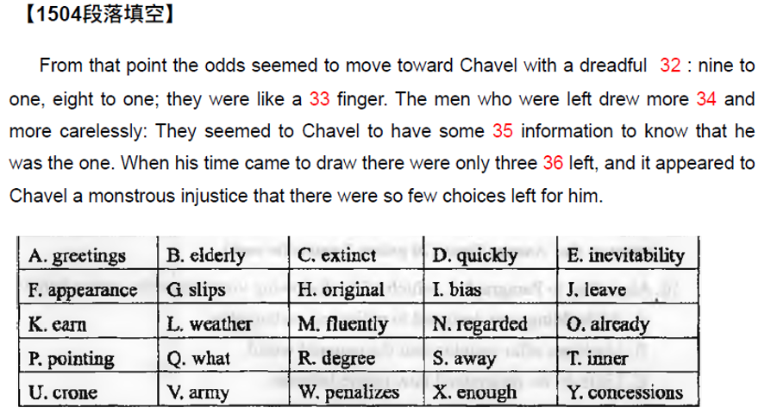
1.10.31上册第十课第31段
练习

Slide 22
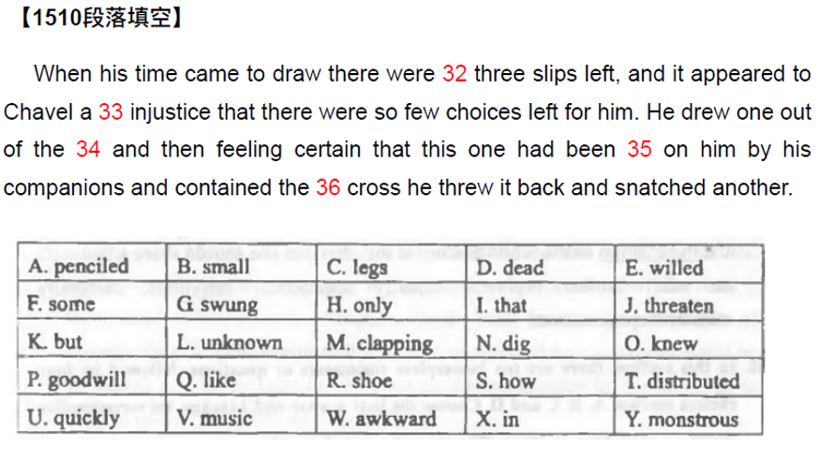
1.10.31上册第十课第31段
练习

Slide 23
1.10.32上册第十课第32段
一、高级英语课文精讲——上册 Lesson 10
Para 32-35：
“You looked, lawyer（律师）,” one of the two men exclaimed（惊叫）, but the other quieted him.
"He didn't look. He's got the marked one now."
“No,” Chavel said, “no.” He threw the slip upon the ground and cried, “I never consented（同意） to the draw. You can't make me die for the rest of you. . .
They watched him with astonishment but without enmity（敌意）. He was a gentleman. They didn‘t judge him by their own standards: he belonged to an unaccountable（不可理解的） class and they didn’t at first even attach the idea of cowardice（懦弱） to his actions.

Slide 24
1.10.32上册第十课第32段
一、高级英语课文精讲——上册 Lesson 10
Para 32-35：
“You looked, lawyer（律师）,” one of the two men exclaimed（惊叫）, but the other quieted him.
"He didn't look. He's got the marked one now."
“No,” Chavel said, “no.” He threw the slip upon the ground and cried, “I never consented（同意） to the draw. You can't make me die for the rest of you. . .
They watched him with astonishment but without enmity（敌意）. He was a gentleman. They didn‘t judge him by their own standards: he belonged to an unaccountable（不可理解的） class and they didn’t at first even attach the idea of cowardice（懦弱） to his actions.
“律师，你偷看了。”剩下的两个人中有一个大声说道，但另一个让他安静下来。
“他没有偷看，他抽到的是有记号的。”
“不，不。”查维尔把纸条扔到地上，开始大叫：“我从来就没有同意，你们不能让我替别人去死。”
大家惊讶地看着他，但并没有敌意。他是一个出身高贵的人。人们没有用自己的标准去衡量他，因为他属于一个别人难以理解的阶层。人们甚至不觉得他这是懦弱的表现。
Notes:
cowardice英 [ˈkaʊədɪs] 美 [ˈkaʊərdɪs] 懦弱

Slide 25
1.10.36上册第十课第36段
一、高级英语课文精讲——上册 Lesson 10
Para 36-37：“Listen,” Chavel implored（恳求） them. He held out the slip of paper and they all watched him with compassionate（同情的） curiosity. "I'll give a hundred thousand francs to anyone who'll take this.“
He took little rapid（快速的） steps from one man to another, showing each man the bit of paper as if he were an attendant at an auction. "A hundred thousand francs," he implored, and they watched him with a kind of shocked pity: he was the only rich man among them and this was a unique situation.

Slide 26
1.10.36上册第十课第36段
一、高级英语课文精讲——上册 Lesson 10
Para 36-37：“Listen,” Chavel implored（恳求） them. He held out the slip of paper and they all watched him with compassionate（同情的） curiosity. "I'll give a hundred thousand francs to anyone who'll take this.“
He took little rapid（快速的） steps from one man to another, showing each man the bit of paper as if he were an attendant（服务员） at an auction（拍卖会）. “A hundred thousand francs,” he implored, and they watched him with a kind of shocked pity: he was the only rich man among them and this was a unique（独特的） situation.
“听我说，”查维尔一边哀求，一边举起那张纸条。大家既惊奇又好奇地看着他。“谁接受这张纸条，我就给他10万法郎。”
他快速移动着小步地从一个人面前走到另一个人面前，朝每一个人展示那张小纸条，好像是拍卖会上的服务员。 “10万法郎。”他恳求道。人们感到震惊，同样又感到一丝怜悯：他是他们之中惟一的有钱人，这是与众不同之处。

Slide 27
1.10.37上册第十课第37段
一、高级英语课文精讲——上册 Lesson 10
Para 37：They had no means of comparison and assumed（认为） that this was a characteristic（特点） of his class, just as a traveler stepping off the liner（邮轮） at a foreign port for luncheon（午餐） sums up a nation‘s character forever in the wily（狡猾的） businessman who happens to share the table with him.

Slide 28
1.10.37上册第十课第37段
一、高级英语课文精讲——上册 Lesson 10
Para 37：They had no means of comparison and assumed（认为） that this was a characteristic（特点） of his class, just as a traveler stepping off the liner（邮轮） at a foreign port for luncheon（午餐） sums up a nation‘s character forever in the wily（狡猾的） businessman who happens to share the table with him.
人们无法去比较，只能认定这就是他那个阶层的特点，这犹如一个在异国港口下船就餐的旅游者能从一个碰巧与他同桌的狡猾商人身上总结出该国的国民性格。

Slide 29
1.10.38上册第十课第38段
1、单项选择
2、阅读理解
3、英译汉
高级英语
4、写作
5、选词填空
6、汉译英

Slide 30
1.10.38上册第十课第38段
1、单项选择
2、阅读理解
3、英译汉
高级英语
4、写作
5、选词填空
6、汉译英

Slide 31
1.10.38上册第十课第38段
二、题型讲解——选词填空
1. 扫视选项，确定词性，对每个词有印象。
2. 观察空格处
3. 用过的词划掉
选词填空解题步骤

Slide 32
1.10.38上册第十课第38段
二、题型讲解——选词填空
1. 扫视选项，确定词性，对每个词有印象。
2. 观察空格处
3. 用过的词划掉
选词填空解题步骤

Slide 33
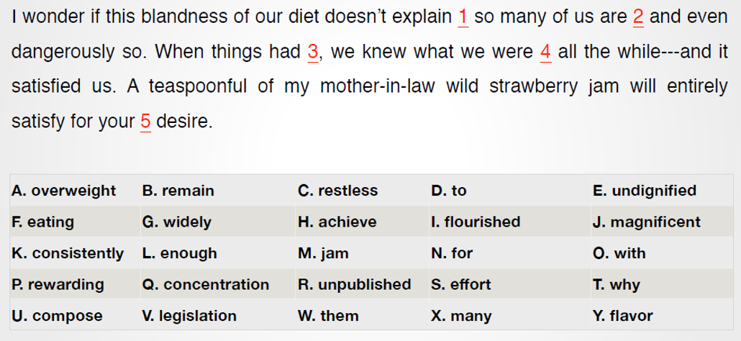
1.10.38上册第十课第38段
二、题型讲解——选词填空

Slide 34
1.10.38上册第十课第38段
二、题型讲解——选词填空
1. 扫视选项，确定词性，对每个词有印象。
2. 根据语法，判断所需词性
3. 用过的词划掉
选词填空解题步骤

Slide 35
1.10.38上册第十课第38段
二、题型讲解——选词填空
2. 观察空格处，判断所需词性
1. 并列情况：选择空格处的并列词相同词性及感情色彩的词
2. 情态动词、动词不定式to、表示强调do后接动词原形
3. 如果空格后是一个句子，考虑连词（and、but、so…）和引导词（what, which, that, if…）
4. 介词后接名词

Slide 36
1.10.38上册第十课第38段
二、题型讲解——选词填空
1. 扫视选项，确定词性，对每个词有印象。
2. 观察空格处，判断所需词性
3. 用过的词划掉
选词填空解题步骤

Slide 37
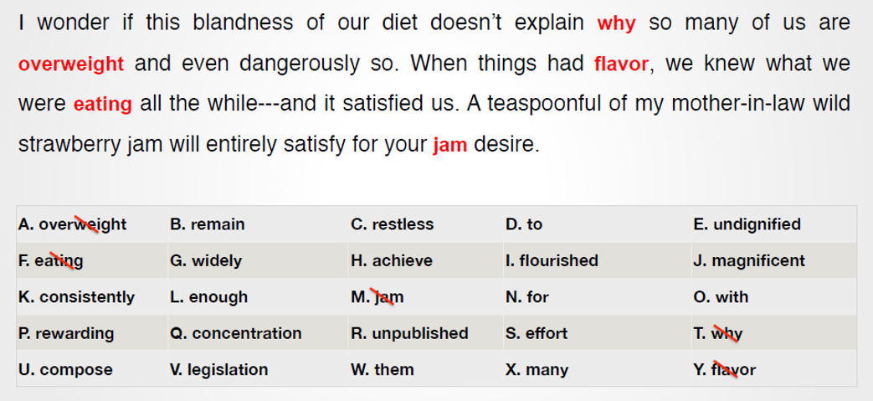
1.10.38上册第十课第38段
二、题型讲解——选词填空

Slide 38
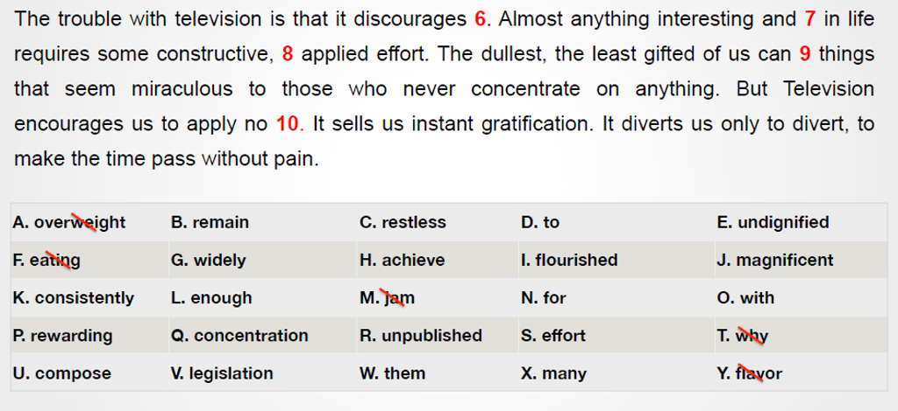
1.10.38上册第十课第38段
二、题型讲解——选词填空

Slide 39
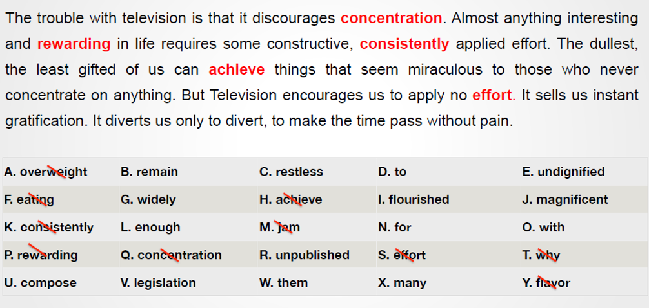
1.10.38上册第十课第38段
二、题型讲解——选词填空

Slide 40
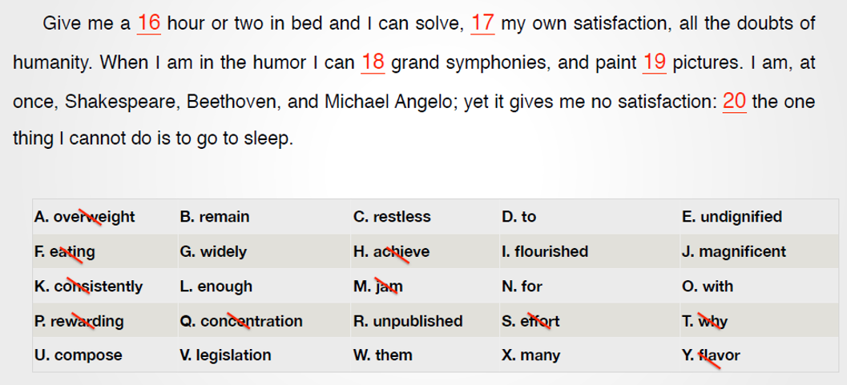
1.10.38上册第十课第38段
二、题型讲解——选词填空

Slide 41
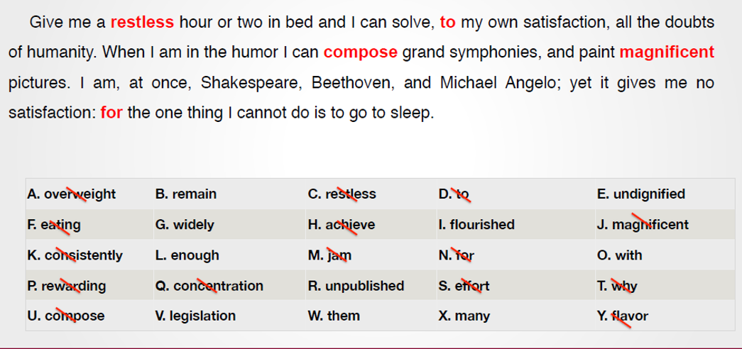
1.10.38上册第十课第38段
二、题型讲解——选词填空
Notes:
Humor 幽默，心情 in the humor有兴趣
Grand壮丽的，宏伟的 magnificent宏伟的，壮丽的

Slide 42
1.10.38上册第十课第38段
译文：
只要我躺在床上有一两个小时睡不着觉，我就能令自己满意地解决人类一切的疑虑。如果我有兴致的话，我可以谱写出宏伟的交响乐，描绘出壮丽的画卷。我可以立刻变成莎士比亚、贝多芬和米开朗基罗。但这一切仍无法令我满意，因为我还是无法入睡。
Notes:
上册第7课

Slide 43
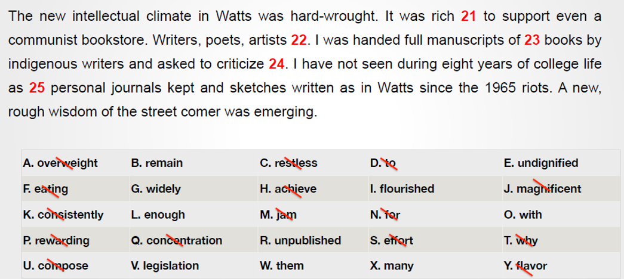
1.10.38上册第十课第38段
二、题型讲解——选词填空

Slide 44
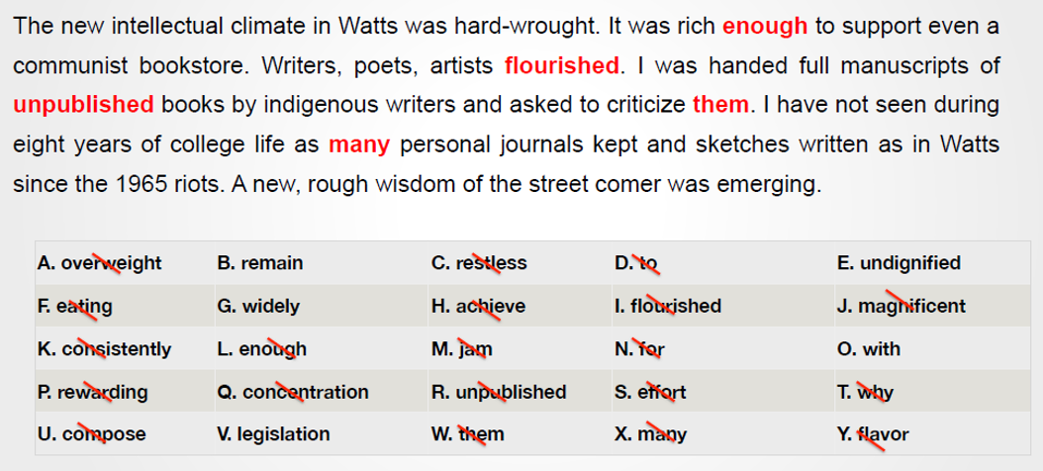
1.10.38上册第十课第38段
二、题型讲解——选词填空

Slide 45
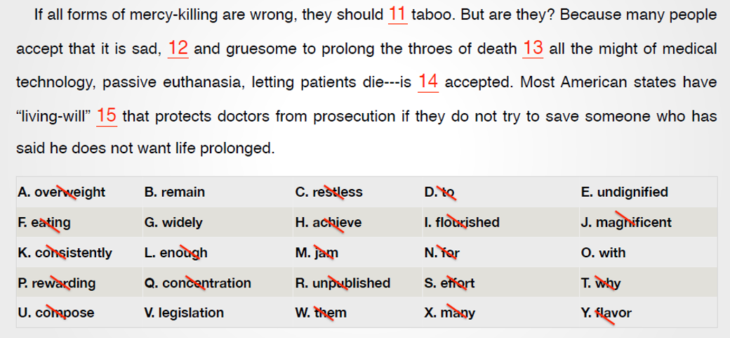
1.10.38上册第十课第38段
二、题型讲解——选词填空
Notes:
Mercy 仁慈
euthanasia英 [ˌjuːθəˈneɪziə] 美 [ˌjuːθəˈneɪʒə] 安乐死

Slide 46
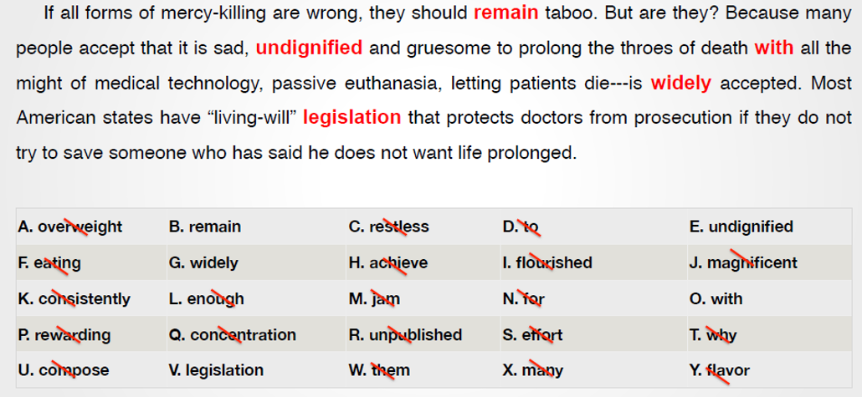
1.10.38上册第十课第38段
二、题型讲解——选词填空
Notes:
Gruesome令人厌恶的
Throes 剧痛（特指死亡时）
Might 力量

Slide 47
1.10.38上册第十课第38段
译文：
如果所有形式的安乐死都是错误的，那就应该统统列入禁止之列。可情况果真如此吗？许多人都认为依靠医学技术来延续生命带给人的痛苦是令人悲哀、可憎可恶的，完全不顾人的尊严，因此被动的安乐死——让病人自行死亡——被人们普遍接受。美国大多数州都有关于“活遗嘱”的法规，为医生提供保护。如果医生没有尽力救助曾声明不想延续生命的病人，不会为此受到起诉。
Notes:
上册lesson 4

Slide 48
谢谢观看
See You
1.10.38上册第十课第38段

