Slide 1

高级英语
基础精讲五
1.2.1上册第二课第1段

Slide 2
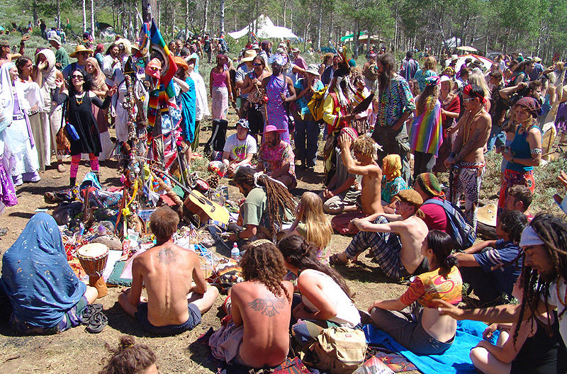
1.1.1.2年轻人的四种选择（Four Choices for Young People）
1.2.1上册第二课第1段
Four Choices For Young People
年轻人的四种选择

Slide 3
1.2.1上册第二课第1段
一、高级英语课文精讲——上册 Lesson 2
Para 1：Shortly before his graduation, Jim Binns, president of the senior class（毕业班） at Stanford University（斯坦福大学）, wrote me about some of his misgivings（顾虑，疑虑）. “More than any other generation（一代人）,” he said, “our generation views the adult world with great skepticism（怀疑主义）… there is also an increased tendency（倾向） to reject（拒绝排斥） completely that world.”

Slide 4
1.2.1上册第二课第1段
一、高级英语课文精讲——上册 Lesson 2
Para 1：Shortly before his graduation, Jim Binns, president of the senior class（毕业班） at Stanford University（斯坦福大学）, wrote me about some of his misgivings（顾虑，疑虑）. “More than any other generation（一代人）,” he said, “our generation views the adult world with great skepticism（怀疑主义）… there is also an increased tendency（倾向） to reject（拒绝排斥） completely that world.”
在毕业前不久，斯坦福大学四年级主席吉姆 宾司给我写了一封信，信中谈及他的一些不安。他写道：“与其他任何一代人相比，我们这一代人在看待成人世界时抱有更大的疑虑……同时越来越倾向于全盘否定成人世界。”

Slide 5
1.2.2上册第二课第2段
一、高级英语课文精讲——上册 Lesson 2
Para 2：Apparently（显然地） he speaks for a lot of his contemporaries（同代人）. During the last few years, I have listened to scores of（许多） young people, in college and out, who were just as nervous about the grown world. Roughly（大体上）, their attitude might be summed up（总结） about like this: “The world is in pretty much of a mess, full of injustice（不公平）, poverty, and war. The people responsible are, presumably（大概）, the adults who have been running（运营，管理） thing. If they can’t do better than that, what have they got to teach our generation? That kind of lesson we can do without.”

Slide 6
1.2.2上册第二课第2段
一、高级英语课文精讲——上册 Lesson 2
Para 2：Apparently（显然地） he speaks for a lot of his contemporaries（同代人）. During the last few years, I have listened to scores of（许多） young people, in college and out, who were just as nervous about the grown world. Roughly（大体上）, their attitude might be summed up（总结） about like this: “The world is in pretty much of a mess, full of injustice（不公平）, poverty, and war. The people responsible are, presumably（大概）, the adults who have been running（运营，管理） thing. If they can’t do better than that, what have they got to teach our generation? That kind of lesson we can do without.”
很明显，他的话代表了许多同龄人的看法。在过去的几年里，我倾听过许多年轻人的谈话，他们有的还在大学读书，有的已经毕业，他们对于成人的世界同样感到不安。大致来说，他们的态度可归纳如下：“这个世界乱糟糟的，到处充满了不平等、贫困和战争。对此该负责的大概应是那些管理这个世界的成年人吧。如果他们不能做得比这些更好，他们又能拿什么来教育我们呢？这样的教导，我们根本不需要。

Slide 7
1.2.3上册第二课第3段
一、高级英语课文精讲——上册 Lesson 2
Para 3：These conclusions strike（给…留下印象） me as reasonable, at least from their point of view. The relevant（相关的） question for the arriving generation is not whether our society is imperfect (we can take that for granted), but how to deal with（应对） it. For all its harshness（残酷） and irrationality（非理性）, it is the only world we’ve got. Choosing a strategy to cope with（应对） it, then, is the first decision young adults have to make, and usually the most important decision of their lifetime. So far as I have been able to discover, there are only four basic（基本的） alternatives（可供选择的事物）:

Slide 8
1.2.3上册第二课第3段
一、高级英语课文精讲——上册 Lesson 2
Para 3：These conclusions strike（给…留下印象） me as reasonable, at least from their point of view. The relevant（相关的） question for the arriving generation is not whether our society is imperfect (we can take that for granted), but how to deal with（应对） it. For all its harshness（残酷） and irrationality（非理性）, it is the only world we’ve got. Choosing a strategy to cope with（应对） it, then, is the first decision young adults have to make, and usually the most important decision of their lifetime. So far as I have been able to discover, there are only four basic（基本的） alternatives（可供选择的事物）:
我觉得这些结论合情合理，至少从他们的角度来看是这样的。对成长中的一代人来说，相关的问题不是我们的社会是否完美（我们认为那是理所当然的），而是应该如何去应付它。尽管这个社会严酷而不合情理，但它毕竟是我们惟一拥有的世界。因此，选择一个办法去应付这个社会是刚刚步入成年的年轻人必须作出的第一个决定，这通常是他们一生中最重要的决定。根据我的发现，他们的基本选择只有四种：
Notes:
So far as 就 而言

Slide 9
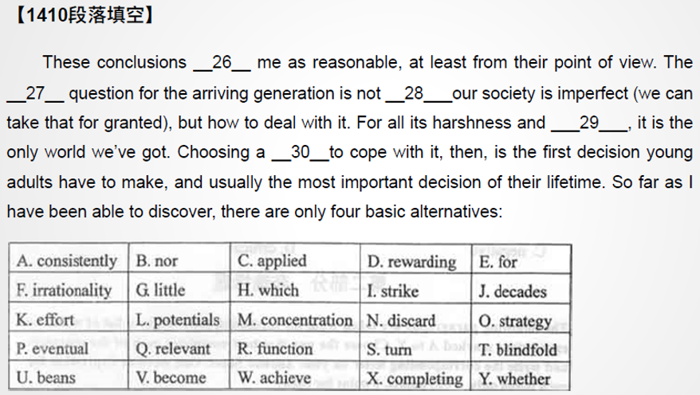
1.2.3上册第二课第3段
练习

Slide 10
1.2.4上册第二课第4段
一、高级英语课文精讲——上册 Lesson 2
Para 4-6：
Strategy 1：Drop Out
Some of us find this distasteful（令人不愉快的） – an undignified kind of life. But for the poor in spirit（精神）, with low levels of both energy and pride, it may be the least intolerable（不可忍受的） choice available.
Strategy 2：Flee
Ever since civilization began, certain individuals have tried to run away from（逃离） it in hopes of finding a simpler, more pastoral（田园的）, and more peaceful life.

Slide 11
1.2.4上册第二课第4段
一、高级英语课文精讲——上册 Lesson 2
Para 4-6：
Strategy 1：Drop Out
Some of us find this distasteful（令人不愉快的） – an undignified kind of life. But for the poor in spirit（精神）, with low levels of both energy and pride, it may be the least intolerable（不可忍受的） choice available.
我们中的一些人对此很厌恶——认为这种生活方式很不光彩。但对于那些卑微、懒惰又缺乏自尊的人来说，这也许是可行的最容易忍受的选择了
Strategy 2：Flee
Ever since civilization began, certain individuals have tried to run away from（逃离） it in hopes of finding a simpler, more pastoral（田园的）, and more peaceful life.
自文明诞生以来，就有人企图逃避文明社会，希望寻求一种更为朴素、更富田园风情、更为宁静的生活。
Notes:
Tolerant主动
Tolerable 被动
Idyllic 田园诗般的，美丽无暇的

Slide 12
1.2.7上册第二课第7段
一、高级英语课文精讲——上册 Lesson 2
Plot a Revolution
Para 7：This strategy is always popular among those who have no patience with the tedious（冗长的） working of the democratic（民主的） process or who believe that basic institutions（制度） can only be changed by force. It attracts some of the more active and idealistic（理想主义的） young people of every generation. To them it offers a romantic appeal, usually symbolized by some dashing（潇洒的） and charismatic（有魅力的） figure（人物）.
Para 8：It has the even greater appeal of simplicity（简单）: “Since this society is hopelessly bad, let’s smash（打碎） it and build something better on the ruins（废墟）.”

Slide 13
1.2.7上册第二课第7段
一、高级英语课文精讲——上册 Lesson 2
Plot a Revolution
Para 7：This strategy is always popular among those who have no patience with the tedious（冗长的） working of the democratic（民主的） process or who believe that basic institutions（制度） can only be changed by force. It attracts some of the more active and idealistic（理想主义的） young people of every generation. To them it offers a romantic appeal, usually symbolized by some dashing（潇洒的） and charismatic（有魅力的） figure（人物）.
Para 8：It has the even greater appeal of simplicity（简单）: “Since this society is hopelessly bad, let’s smash（打碎） it and build something better on the ruins（废墟）.”
在对民主进程单调乏味的运作方式毫无耐心或相信只有武力才能改变基本社会制度的那些人中，这一策略颇受欢迎。它吸引了每一代年轻人中那些更为活跃和更具理想主义的人。对他们来说，这种策略具有浪漫的吸引力，通常以某位魅力非凡且令人振奋的人物为其象征。
这一策略简单明了并具有更大的吸引力：“既然这个社会已经无可救药，那就让我们砸碎它，在它的废墟上面建一个更好的社会。”

Slide 14
1.2.9上册第二课第9段
一、高级英语课文精讲——上册 Lesson 2
Para 9：Some of my best friends have been revolutionists, and a few of them have led reasonably satisfying lives. These are the ones whose revolutions did not come off（成功）; they have been able to keep on cheerfully plotting their holocausts（大屠杀） right into their senescence（衰老）. Others died young, in prison or on the barricades（障碍，壁垒）. But the most unfortunate are those whose revolutions have succeeded. They lived in bitter disillusionment（理想破灭）, to see the establishment they had overthrown（推翻） replaced by a new one, just as hard-faced（冷酷的） and stuffy（保守的）.

Slide 15
1.2.9上册第二课第9段
一、高级英语课文精讲——上册 Lesson 2
Para 9：Some of my best friends have been revolutionists, and a few of them have led reasonably satisfying lives. These are the ones whose revolutions did not come off（成功）; they have been able to keep on cheerfully plotting their holocausts（大屠杀） right into their senescence（衰老）. Others died young, in prison or on the barricades（障碍，壁垒）. But the most unfortunate are those whose revolutions have succeeded. They lived in bitter disillusionment（理想破灭）, to see the establishment they had overthrown（推翻） replaced by a new one, just as hard-faced（冷酷的） and stuffy（保守的）.
我最好的朋友中有些是革命者，他们中的一些人过得相当满足。这部分人其实是那些革命并未成功的人，他们可以继续兴高采烈地策划大屠杀，直至老态龙钟。另外一些人年纪轻轻就死了，死在监狱里或街垒旁。但最不幸的是那些革命成功的人。他们极度失望，看到他们推翻的权力机构又被新机构所替代，而新机构依旧是那样冷酷，那样毫无生机。
Notes:
Establishment 机构，旅馆
Stuffy闷热的，古板的，保守的

Slide 16
1.2.12上册第二课第12段
一、高级英语课文精讲——上册 Lesson 2
Try to Change the World Gradually, One Clod（泥块） at a Time
Para 12：At first glance（一瞥）, this course is far from inviting（吸引人的）. It lacks glamour（魅力）. It promises no quick results. It depends on the exasperating（令人愤怒的） and uncertain instruments of persuasion（劝说） and democratic decision making. It demands patience, always in short supply（供给）. About all that can be said for it is that it sometimes works – that in this particular（特定的） time and place it offers a better chance for remedying（改正） some of the world’s outrages（愤慨，暴行） than any other available strategy.

Slide 17
1.2.12上册第二课第12段
一、高级英语课文精讲——上册 Lesson 2
Try to Change the World Gradually, One Clod（泥块） at a Time
Para 12：At first glance（一瞥）, this course is far from inviting（吸引人的）. It lacks glamour（魅力）. It promises no quick results. It depends on the exasperating（令人愤怒的） and uncertain instruments of persuasion（劝说） and democratic decision making. It demands patience, always in short supply（供给）. About all that can be said for it is that it sometimes works – that in this particular（特定的） time and place it offers a better chance for remedying（改正） some of the world’s outrages（愤慨，暴行） than any other available strategy.
一步一步改变社会
乍一看，这一过程毫无吸引力。它缺乏魅力，并且见效很慢。它依靠劝说和民主决策这些令人恼火且不可靠的方法来实现。它需要耐心，可我们却总是缺乏耐心。它惟一的好处是有时这方法行得通——在这个特定的时间和地点，它比其他的任何策略都更有可能制止世界上的某些恶行。

Slide 18
1.2.13上册第二课第13段
一、高级英语课文精讲——上册 Lesson 2
Para 13：So at least the historical evidence（证据） seems to suggest. When I was graduating from college, my generation also found the world in a mess. The economic machinery（机器） had broken down（失败） almost everywhere: In this country nearly a quarter（四分之一） of the population was out of work. A major war was seemed all too likely. As a college newspaper editor（编辑） at that time, I protested（反抗） against this just as vehemently（激烈地） as student activists are protesting today.

Slide 19
1.2.13上册第二课第13段
一、高级英语课文精讲——上册 Lesson 2
Para 13：So at least the historical evidence（证据） seems to suggest. When I was graduating from college, my generation also found the world in a mess. The economic machinery（机器） had broken down（失败） almost everywhere: In this country nearly a quarter（四分之一） of the population was out of work. A major war was seemed all too likely. As a college newspaper editor（编辑） at that time, I protested（反抗） against this just as vehemently（激烈地） as student activists are protesting today.
至少历史事实似乎证明了这一点。我大学毕业的时候，我们这一代人也发现世界乱得一团糟。几乎所有地方的经济机构都已崩溃，在美国几乎四分之一的人口失业。一场大战似乎在所难免。当时作为校报编辑，对这些我曾经猛烈地抗议过，像今天的学生积极分子一样。

Slide 20
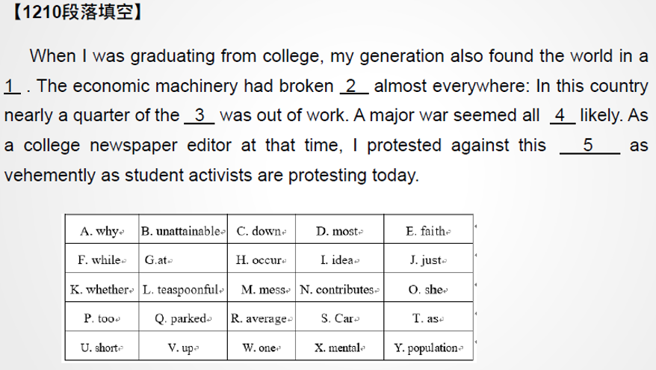
1.2.13上册第二课第13段
练习

Slide 21
1.2.14上册第二课第14段
目录
一、题型讲解——英译汉
二、课文带读（上册 Lesson 7）

Slide 22
1.2.14上册第二课第14段
You share rose and get fun.

Slide 23
1.2.14上册第二课第14段
You share rose and get fun.
高级：予人玫瑰，手有余香。

Slide 24
1.2.14上册第二课第14段
You share rose and get fun.
高级：予人玫瑰，手有余香。
中级：分享玫瑰，收获快乐。

Slide 25
1.2.14上册第二课第14段
You share rose and get fun.
高级：予人玫瑰，手有余香。
中级：分享玫瑰，收获快乐。
低级：鱼香肉丝盖饭。

Slide 26
1.2.14上册第二课第14段
一、英译汉
1. 划分意群
英译汉
2. 意群翻译
3. 得意忘形

Slide 27
1.2.14上册第二课第14段
一、英译汉
1. 划分意群
英译汉
2. 意群翻译
3. 得意忘形

Slide 28
1.2.14上册第二课第14段
一、英译汉
1. 划分意群
按照以下六种标志划分
① 标点符号
② 介词短语
③ 连词
④ 非谓语动词
⑤ 引导词
⑥ 固定搭配

Slide 29
1.2.14上册第二课第14段
一、英译汉
1. 划分意群
But what this country doesn‘t know is that America has created a monster in the form of millions of fighting men who have been taught to deal in violence, and who have been given a chance to die for the biggest nothing in history.

Slide 30
1.2.14上册第二课第14段
一、英译汉
1. 划分意群
But what this country doesn‘t know is that America has created a monster in the form of millions of fighting men who have been taught to deal in violence, and who have been given a chance to die for the biggest nothing in history.

Slide 31
1.2.14上册第二课第14段
一、英译汉
1. 划分意群
英译汉
2. 意群翻译
3. 得意忘形

Slide 32
1.2.14上册第二课第14段
一、英译汉
2. 意群翻译
But what this country doesn‘t know is that America has created a monster in the form of millions of fighting men who have been taught to deal in violence, and who have been given a chance to die for the biggest nothing in history.

Slide 33
1.2.14上册第二课第14段
一、英译汉
1. 划分意群
英译汉
2. 意群翻译
3. 得意忘形

Slide 34
1.2.14上册第二课第14段
一、英译汉
3. 得意忘形
But what this country doesn‘t know is that America has created a monster in the form of millions of fighting men who have been taught to deal in violence, and who have been given a chance to die for the biggest nothing in history.

Slide 35
1.2.14上册第二课第14段
一、英译汉
3. 得意忘形
But what this country doesn‘t know is that America has created a monster in the form of millions of fighting men who have been taught to deal in violence, and who have been given a chance to die for the biggest nothing in history.
但是这个国家不知道的是，美国已经以数百万个战斗人员形成一种可怕的力量，这些战斗人员受过从事暴力的训练，并被赋予一个机会去为人类历史最大的虚无而死。（被赋予一个毫无意义地去牺牲的机会）

Slide 36
1.2.14上册第二课第14段
练习
1. They belong to churches, even though they attend somewhat less frequently, and they want their children to have religious instruction.（0810）

Slide 37
1.2.14上册第二课第14段
练习
1. They belong to churches, even though they attend somewhat less frequently, and they want their children to have religious instruction.（0810）
尽管他们去教堂的次数没有从前多，但是他们仍然信教，也希望孩子接受宗教教育。
Notes:
Somewhat有点

Slide 38
1.2.14上册第二课第14段
练习
2. One of the more depressing things about being poor in America is the endless waiting in welfare or unemployment lines.（0801）

Slide 39
1.2.14上册第二课第14段
练习
2. One of the more depressing things about being poor in America is the endless waiting in welfare or unemployment lines.（0801）
在美国使穷人更加沮丧的事情之一就是没完没了地排队等候领取福利和失业救济金。

Slide 40
1.2.14上册第二课第14段
练习
3. An experienced immigration professional identifies what type of information can be supplied that is most likely to favorably impress the visa officer considering the application.（0710）

Slide 41
1.2.14上册第二课第14段
练习
3. An experienced immigration professional identifies what type of information can be supplied that is most likely to favorably impress the visa officer considering the application.（0710）
有经验的移民公司的专业人员能确认提供哪些信息，最有可能给受理申请的签证官留下良好的印象。

Slide 42
1.2.14上册第二课第14段
练习
4. But where does one find good conversation these days? Certainly not in the presence of the television set, which consumes half the average Americans nonsleeping, nonworking hours.（0610）

Slide 43
1.2.14上册第二课第14段
练习
4. But where does one find good conversation these days? Certainly not in the presence of the television set, which consumes half the average Americans nonsleeping, nonworking hours.（0610）
但是现在哪里找良好的交流方式？当然不是在电视上，看电视耗费掉了一般的美国人除睡眠和工作之外的半数的时间。

Slide 44
1.2.14上册第二课第14段
目录
一、题型讲解——英译汉
二、课文带读（上册 Lesson 7）

Slide 45
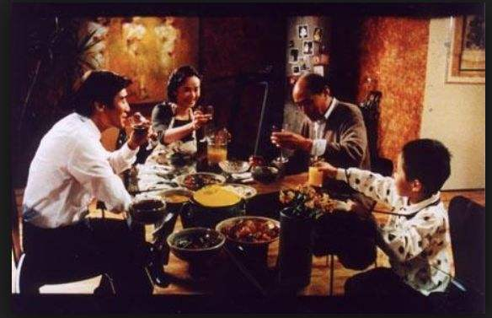
谢谢观看
See You
1.2.14上册第二课第14段

