Slide 1

高级英语
基础精讲六
1.14.1上册第十四课第1段
Notes:
可口可乐 1886年
百事可乐1903年

Slide 2
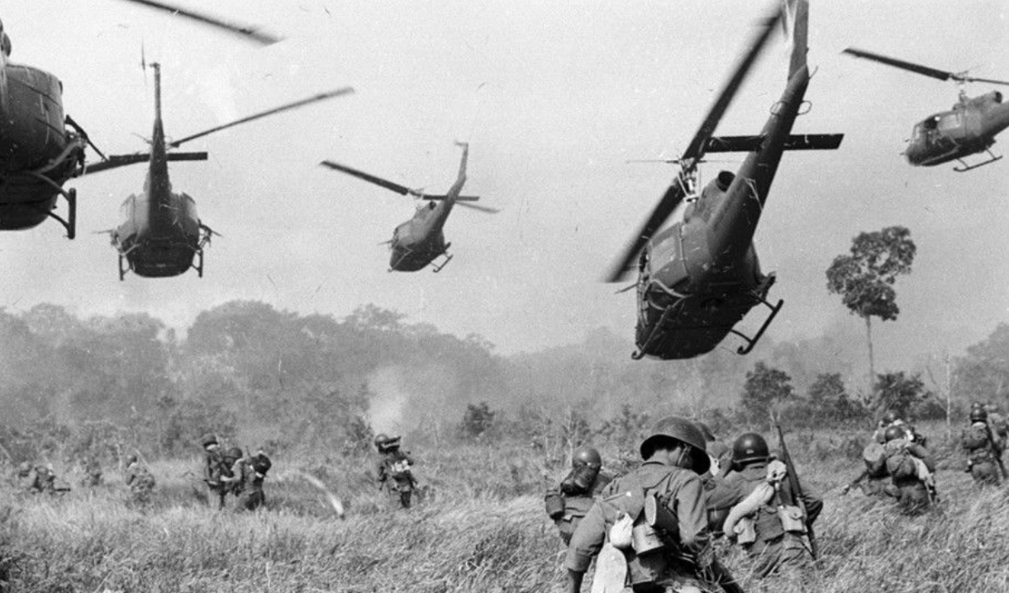
1.1.1.14我想告诉您(I Would Like to Tell You Something)
1.14.1上册第十四课第1段
I Would Like to Tell You Something
我想告诉你

Slide 3
1.14.1上册第十四课第1段
一、高级英语课文精讲——上册 Lesson 14
Para 1：I would like to tell you something about what veterans（老兵）are doing in this country, and about our feeling now that we’ve come back from a war we didn't really want to fight.
我们从一场我们并不想打的战争中返回家园，我想告诉你们退伍军人正在这个国家里做些什么，告诉你们我们的感受。

Slide 4
1.14.2上册第十四课第2段
一、高级英语课文精讲——上册 Lesson 14
Para 2：A little over a week ago we held an investigation（调查） in Detroit where over 150 honorably（光荣地） discharged（解雇） veterans, many of them highly decorated（装饰）, testified（作证） to war crimes committed（犯罪） in Indochina —not isolated（孤立的） incidents, but crimes committed on a day-to-day basis with the full awareness of officers at all levels of command.

Slide 5
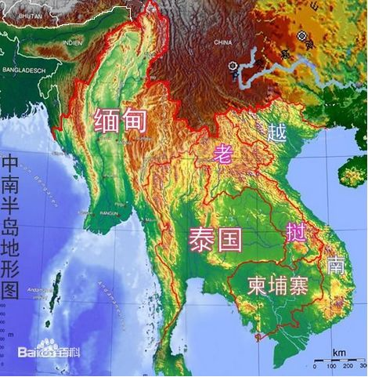
1.14.2上册第十四课第2段
一、高级英语课文精讲——上册 Lesson 14

Slide 6
1.14.2上册第十四课第2段
一、高级英语课文精讲——上册 Lesson 14
Para 2：A little over a week ago we held an investigation（调查） in Detroit where over 150 honorably（光荣地） discharged（解雇） veterans, many of them highly decorated（装饰）, testified（作证） to war crimes committed（犯罪） in Indochina —not isolated（孤立的） incidents, but crimes committed on a day-to-day basis with the full awareness of officers at all levels of command.
一个多星期以前，我们在底特律进行了一次调查，在那里，150多名光荣退伍的老兵，其中许多人曾被授予各种高级勋章，为在印度支那犯下的战争罪行做证——这些罪行并不是孤立的事件，而是每天都在发生，并且各级军官对此都十分清楚。
Notes:
Discharge解雇，离开，释放
On a basis

Slide 7
1.14.3上册第十四课第3段
一、高级英语课文精讲——上册 Lesson 14
Para 3：The investigation was not staged（举行） so that veterans could spill out（说出） their hearts or purge（净化） their souls; it was done to prove that the policy of the United States in Indochina is tantamount（相等的） to genocide（种族灭绝） and that not only the soldiers are responsible for what is happening, but that everyone here in America who has allowed the brutalization（兽性，残忍性） and de-personalization（丧失人性） to go on is responsible.

Slide 8
1.14.3上册第十四课第3段
一、高级英语课文精讲——上册 Lesson 14
Para 3：The investigation was not staged（举行） so that veterans could spill out（说出） their hearts or purge（净化） their souls; it was done to prove that the policy of the United States in Indochina is tantamount（相等的） to genocide（种族灭绝） and that not only the soldiers are responsible for what is happening, but that everyone here in America who has allowed the brutalization（兽性，残忍性） and de-personalization（丧失人性） to go on is responsible.
这次调查并不是为了让那些老兵倾吐他们心中多年以来积蓄已久的感情或是消除他们心灵的负罪感，而是为了证实美国在印度支那的政策无异于种族灭绝，不仅仅是美国士兵应对那里发生的一切负责，还有每一个允许这种暴行和冷漠继续下去的美国人。
Notes:
Be tantamount to= be equal to等同于

Slide 9
1.14.3上册第十四课第3段
一、高级英语课文精讲——上册 Lesson 14
Para 3：The __________ was not staged so that veterans could spill out their hearts or ________their souls; it was done to prove that the policy of the United States in Indochina is __________ to ___________and that not only the soldiers are responsible for what is happening, but that everyone here in America who has allowed the __________and de-personalization to go on is responsible.
A. brutalization B. genocide C. tantamount D. purge E. investigation

Slide 10
1.14.3上册第十四课第3段
一、高级英语课文精讲——上册 Lesson 14
Para 3：The investigation was not staged so that veterans could spill out their hearts or purge their souls; it was done to prove that the policy of the United States in Indochina is tantamount to genocide and that not only the soldiers are responsible for what is happening, but that everyone here in America who has allowed the brutalization and de-personalization to go on is responsible.
A. brutalization B. genocide C. tantamount D. purge E. investigation

Slide 11
1.14.3上册第十四课第3段
一、高级英语课文精讲——上册 Lesson 14
Para 3：It was done also to show that you don‘t start making things right by prosecuting（起诉） William Galley, no matter how guilty（内疚的） he may be; you also prosecute the men who encouraged the situation. It was done to show that there is not just one Mylai but countless（无数的） Mylais and they are continuing every single day. There was an almost total press blackout（封锁） on the testimony（证词） of those veterans.

Slide 12
1.14.3上册第十四课第3段
一、高级英语课文精讲——上册 Lesson 14
Para 3：It was done also to show that you don‘t start making things right by prosecuting（起诉） William Galley, no matter how guilty（内疚的） he may be; you also prosecute the men who encouraged the situation. It was done to show that there is not just one Mylai but countless（无数的） Mylais and they are continuing every single day. There was an almost total press blackout（封锁） on the testimony（证词） of those veterans.
这次调查的目的还想告诉大家，不管威廉 凯利的罪行有多大，仅仅起诉他是错误的，还应该起诉那些造成这种局面的人。这次调查还告诉大家不是只有一个迈莱，而是有无数个迈莱，类似的事件每天都在发生。那些老兵的证词差不多遭到彻底的封锁。

Slide 13
1.14.9上册第十四课第9段
一、高级英语课文精讲——上册 Lesson 14
Para 9：But what this country doesn‘t know is that America has created a monster in the form of millions of fighting men who have been taught to deal in（从事） violence（暴力）, and who have been given a chance to die for the biggest nothing in history. We have returned to this country with a sense of anger and betrayal（背叛） which nobody has yet grasped（理解）. We’re angry about the same things you are in terms of（就…而言） policy—a little angrier because our lives were the things used to test those policies.

Slide 14
1.14.9上册第十四课第9段
一、高级英语课文精讲——上册 Lesson 14
Para 9：But what this country doesn‘t know is that America has created a monster in the form of millions of fighting men who have been taught to deal in（从事） violence（暴力）, and who have been given a chance to die for the biggest nothing in history. We have returned to this country with a sense of anger and betrayal（背叛） which nobody has yet grasped（理解）. We’re angry about the same things you are in terms of（就…而言） policy—a little angrier because our lives were the things used to test those policies.
但是这个国家不知道它将几百万个战斗人员制造成一种可怕的力量，他们受过从事暴力的训练，并被赋予一个史上最无意义的去牺牲的机会。我们满怀愤怒和被出卖的感觉回到了这个国家，这一点许多人至今还不明白。就政策而言，我们对同样的事情也感到愤怒——甚至更强烈些，因为用来检验这些政策的东西是我们的生命。

Slide 15
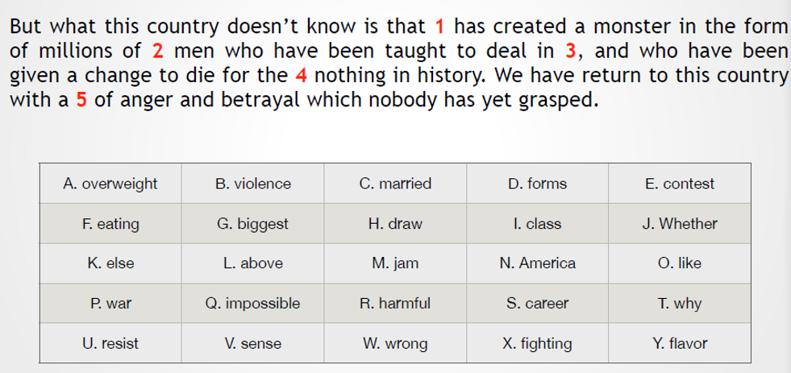
1.14.9上册第十四课第9段
练习

Slide 16
1.14.13上册第十四课第13段
一、高级英语课文精讲——上册 Lesson 14
Para 13：Our anger goes beyond the simple policy matters. It goes into the fact that all the things we were told about Vietnam（越南） we found untrue when we got there. We found that too often American men were dying in those rice paddies（稻田） from want of support from our so-called allies（联盟）. We saw first hand the money—your taxes（税钱）—squandered（浪费） by a corrupt（腐败的） dictatorial（独裁的） regime（政权，政体）. We saw that Agnew had a one-sided（片面的） idea of who was kept free by the flag, as blacks provided the highest percentage of casualties（伤亡人数）.

Slide 17
1.14.13上册第十四课第13段
一、高级英语课文精讲——上册 Lesson 14
Para 13：Our anger goes beyond the simple policy matters. It goes into the fact that all the things we were told about Vietnam（越南） we found untrue when we got there. We found that too often American men were dying in those rice paddies（稻田） from want of support from our so-called allies（联盟）. We saw first hand the money—your taxes（税钱）—squandered（浪费） by a corrupt（腐败的） dictatorial（独裁的） regime（政权，政体）. We saw that Agnew had a one-sided（片面的） idea of who was kept free by the flag, as blacks provided the highest percentage of casualties（伤亡人数）.
使我们愤怒的不仅是简单的政策问题，而是等我们到了越南才发现有关越南的一切都是假的。我们发现很多时候美国士兵因为得不到所谓盟军的帮助而死于那些稻田里。我们亲眼看到你们纳税人的钱被一个迅速惨败的独裁政权大肆挥霍。我们还看到阿格纽在有关美国保卫的是谁的自由这一问题上的看法是片面的，因为死伤人员中黑人所占的比例最高。
Notes:
Go into 被用在
dictatorial英 [ˌdɪktəˈtɔːriəl] 美 [ˌdɪktəˈtɔːriəl]

Slide 18
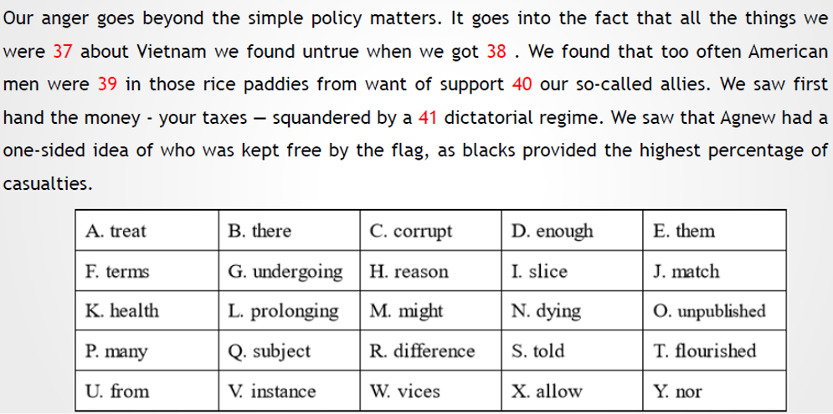
1.14.13上册第十四课第13段
练习

Slide 19
1.14.18上册第十四课第18段
一、高级英语课文精讲——上册 Lesson 14
Para 18：We will also be returning our war medals to Congress（国会） and be demanding that the judiciary（司法部） of this country rule on the Massachusetts bill（法案） which calls for the declaration（宣布） that the Vietnam war is unconstitutional（违宪的）. We are asking for the support of all sections（部分） of the peace movement because we do not feel that this is a time to be dormant（静止的）. The war is part and parcel（包裹） of everything that we are trying to communicate to people of this country. The problem of Vietnam is not just the problem of war and diplomacy（外交）; it's a problem of the very basic American idealism that we are trying to question.

Slide 20
1.14.18上册第十四课第18段
一、高级英语课文精讲——上册 Lesson 14
Para 18：We will also be returning our war medals to Congress（国会） and be demanding that the judiciary（司法部） of this country rule on the Massachusetts bill（法案） which calls for the declaration（宣布） that the Vietnam war is unconstitutional（违宪的）. We are asking for the support of all sections（部分） of the peace movement because we do not feel that this is a time to be dormant（静止的）. The war is part and parcel（包裹） of everything that we are trying to communicate to people of this country. The problem of Vietnam is not just the problem of war and diplomacy（外交）; it's a problem of the very basic American idealism that we are trying to question.
我们还要将军功章还给国会，并要求美国的司法部门就宣布越南战争是违反宪法的马萨诸塞法案作出裁决。我们请求和平运动的所有部门支持我们，因为我们认为这不是保持沉默的时候。战争是我们要对这个国家的人们说明的一切事情的核心。越南的问题不仅仅是战争和外交，而是我们对美国最根本的理想主义产生了怀疑。
Notes:
Rule裁决，判定
Section 部门，部分

Slide 21
1.14.18上册第十四课第18段
一、高级英语课文精讲——上册 Lesson 14
Para 18：We will also be returning our war medals to Congress and be demanding that the judiciary of this country rule on the Massachusetts _______ which calls for the declaration ______ the Vietnam war is unconstitutional. We are asking for the support of all sections of the peace movement _________ we do not feel that this is a time to be ________. The war is part and parcel of everything that we are trying to communicate to people of this country. The problem of Vietnam is not just the problem of war and __________; it's a problem of the very basic American idealism that we are trying to question.
A. that B. because C. diplomacy D. dormant E. bill

Slide 22
1.14.18上册第十四课第18段
一、高级英语课文精讲——上册 Lesson 14
Para 18：We will also be returning our war medals to Congress and be demanding that the judiciary of this country rule on the Massachusetts bill which calls for the declaration that the Vietnam war is unconstitutional. We are asking for the support of all sections of the peace movement because we do not feel that this is a time to be dormant. The war is part and parcel of everything that we are trying to communicate to people of this country. The problem of Vietnam is not just the problem of war and diplomacy; it's a problem of the very basic American idealism that we are trying to question.
A. that B. because C. diplomacy D. dormant E. bill

Slide 23
1.14.19上册第十四课第19段
目录
一、课文带读（上册 Lesson 10）
二、题型讲解——写作题

Slide 24
1.14.19上册第十四课第19段
目录
一、课文带读（上册 Lesson 10）
二、题型讲解——写作题

Slide 25
1.14.19上册第十四课第19段
二、题型讲解——写作题
Why do you think some people choose to work from home?
1. 确定个人观点

Slide 26
1.14.19上册第十四课第19段
二、题型讲解——写作题
Why do you think some people choose to work from home?
1. 确定个人观点
I prefer to believe that working from home has more advantages than working outside. There are some reasons.

Slide 27
1.14.19上册第十四课第19段
二、题型讲解——写作题
Why do you think some people choose to work from home?
1. 确定个人观点
I prefer to believe that working from home has more advantages than working outside. There are some reasons.
If I am given an opportunity of working from home, I will not hesitate for a moment about taking it. Millions of reasons can explain my choice.

Slide 28
1.14.19上册第十四课第19段
二、题型讲解——写作题
Why do you think some people choose to work from home?
2. 提出支持论点的论据

Slide 29
1.14.19上册第十四课第19段
二、题型讲解——写作题
Why do you think some people choose to work from home?
2. 提出支持论点的论据
First，I will not have to spend two or three hours on the subway every day any more, because I can work just after having breakfast at home. Second, it appeals to me that I will own an independent room and work alone so that I can enjoy the quietness of working. Third, working from home gives me enough time to accompany my family.

Slide 30
1.14.19上册第十四课第19段
二、题型讲解——写作题
3. 注意事项
① 词数要足够——建议写90-110词

Slide 31
1.14.19上册第十四课第19段
二、题型讲解——写作题
3. 注意事项
① 词数要足够——建议写90-110词
② 卷面整洁，字迹工整——写错了轻轻划一下

Slide 32
1.14.19上册第十四课第19段
二、题型讲解——写作题
3. 注意事项
① 词数要足够——建议写90-110词
② 卷面整洁，字迹工整——写错了轻轻划一下
③ 完成后检查单词拼写和语法——单数第三人称，时态等问题

Slide 33

谢谢观看
See You
1.14.19上册第十四课第19段

