Slide 1

高级英语
基础精讲八
1.9.1上册第九课第1段

Slide 2
1.1.1.9电视的毛病(The Trouble with Television)
1.9.1上册第九课第1段
一、高级英语课文精讲——上册 Lesson 9
Para 1：It is difficult to escape the influence of television. If you fit the statistical（统计学的） averages, by the age of 20 you will have been exposed（暴露） to at least 20,000 hours of television. You can add 10,000 hours for each decade you have lived after the age of 20. The only things Americans do more than watch television are work and sleep.

Slide 3
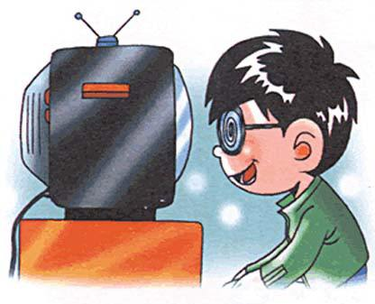
1.9.1上册第九课第1段
一、高级英语课文精讲——上册 Lesson 9
Para 1：It is difficult to escape the influence of television. If you fit the statistical（统计学的） averages, by the age of 20 you will have been exposed（暴露） to at least 20,000 hours of television. You can add 10,000 hours for each decade you have lived after the age of 20. The only things Americans do more than watch television are work and sleep.
要摆脱电视的影响是困难的，假如统计学的平均数字适用于你的话，那么你到20岁的时候就至少看过2万个小时的电视了，从那以后每生活10年就会增加1万小时。美国人只有在工作和睡眠上花时间比看电视更多。

Slide 4
1.9.2上册第九课第2段
一、高级英语课文精讲——上册 Lesson 9
Para 2：Calculate for a moment what could be done with even a part of those hours. Five thousand hours, I am told, are what a typical（典型的） college undergraduate spends working on a bachelor‘s degree（学士学位）. In 10,000 hours you could have learned enough to become an astronomer（天文学家） or engineer. You could have learned several languages fluently（流利地）. If it appealed to（吸引） you, you could be reading Homer in the original（原始的） Greek or Dostoyevsky in Russian. If it didn't, you could have walked around the world and written a book about it.
Notes:
bachelor 学士/单身汉 master 硕士 doctor 博士
Astronomer 天文学家 astronaut 宇航员 astrology 占星术 astronomy 天文学
荷马史诗 陀思妥耶夫斯基《罪与罚》
Calculate 计算 calculator 计算器 calculation 计算（n）
宾语从句 what could be done
插入语 I am told
Typical 典型的，有代表性的，type 种类，打字，特点
Undergraduate （未获得大学学位的）大学生 graduate 毕业生
Spend 花费 spend time on sth/ （in）doing sth
③ astronomer 天文 engineer 工程师，engine 引擎
④fluently 流利地
⑤ appeal to 对。。。有吸引力 appeal 要求，有吸引力 appealing appealed
Original 原始的，最初的 origin 起源，由来，来历

Slide 5
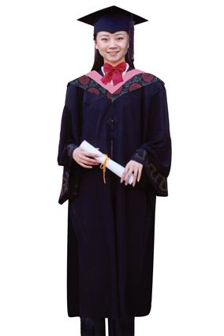
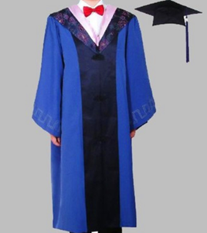
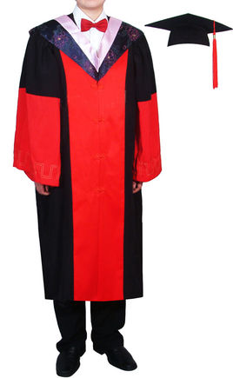
1.9.2上册第九课第2段
bachelor
master
doctor

Slide 6
1.9.2上册第九课第2段
一、高级英语课文精讲——上册 Lesson 9
Para 2：Calculate for a moment what could be done with even a part of those hours. Five thousand hours, I am told, are what a typical（典型的） college undergraduate spends working on a bachelor‘s degree（学士学位）. In 10,000 hours you could have learned enough to become an astronomer（天文学家） or engineer. You could have learned several languages fluently（流利地）. If it appealed to（吸引） you, you could be reading Homer in the original（原始的） Greek or Dostoyevsky in Russian. If it didn't, you could have walked around the world and written a book about it.
稍微计算一下，使用这些时间的一部分能够做些什么。听说一个大学生仅用5000小时就可以获得学士学位。在1万个小时内你能学成一个天文学家或工程师，流利掌握几门外语。如果你感兴趣的话，你可能读希腊原文的荷马史诗或俄文版的陀思妥耶夫斯基的作品；如果对此不感兴趣，那你可以徒步周游世界，撰写一本游记。
Notes:
bachelor 学士/单身汉 master 硕士 doctor 博士
Astronomer 天文学家 astronaut 宇航员 astrology 占星术 astronomy 天文学
荷马史诗 陀思妥耶夫斯基《罪与罚》
Calculate 计算 calculator 计算器 calculation 计算（n）
宾语从句 what could be done
插入语 I am told
Typical 典型的，有代表性的，type 种类，打字，特点
Undergraduate （未获得大学学位的）大学生 graduate 毕业生
Spend 花费 spend time on sth/ （in）doing sth
③ astronomer 天文 engineer 工程师，engine 引擎
④fluently 流利地
⑤ appeal to 对。。。有吸引力 appeal 要求，有吸引力 appealing appealed
Original 原始的，最初的 origin 起源，由来，来历

Slide 7
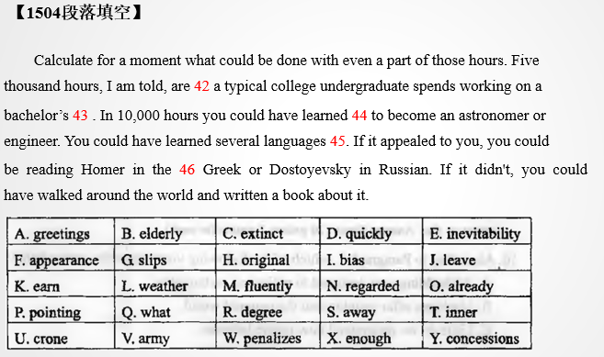
1.9.2上册第九课第2段
一、高级英语课文精讲——上册 Lesson 9
Notes:
bachelor 学士/单身汉 master 硕士 doctor 博士
Astronomer 天文学家 astronaut 宇航员 astrology 占星术 astronomy 天文学
荷马史诗 陀思妥耶夫斯基《罪与罚》
Calculate 计算 calculator 计算器 calculation 计算（n）
宾语从句 what could be done
插入语 I am told
Typical 典型的，有代表性的，type 种类，打字，特点
Undergraduate （未获得大学学位的）大学生 graduate 毕业生
Spend 花费 spend time on sth/ （in）doing sth
③ astronomer 天文 engineer 工程师，engine 引擎
④fluently 流利地
⑤ appeal to 对。。。有吸引力 appeal 要求，有吸引力 appealing appealed
Original 原始的，最初的 origin 起源，由来，来历

Slide 8
1.9.3上册第九课第3段
一、高级英语课文精讲——上册 Lesson 9
Para 3：The trouble with television is that it discourages concentration. Almost anything interesting and rewarding in life requires some constructive（有建设性的）, consistently（始终如一地） applied effort. The dullest, the least gifted of us can achieve things that seem miraculous（奇迹般的） to those who never concentrate on anything. But television encourages us to apply no effort. It sells us instant gratification（即时满足）. It diverts（使欢愉） us only to divert, to make the time pass without pain.

Slide 9
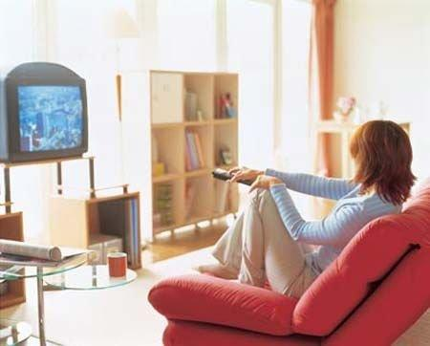
1.9.3上册第九课第3段
一、高级英语课文精讲——上册 Lesson 9
Para 3：The trouble with television is that it discourages concentration. Almost anything interesting and rewarding in life requires some constructive（有建设性的）, consistently（始终如一地） applied effort. The dullest, the least gifted of us can achieve things that seem miraculous（奇迹般的） to those who never concentrate on anything. But television encourages us to apply no effort. It sells us instant gratification（即时满足）. It diverts（使欢愉） us only to divert, to make the time pass without pain.

Slide 10
1.9.3上册第九课第3段
一、高级英语课文精讲——上册 Lesson 9
Para 3：The trouble with television is that it discourages concentration. Almost anything interesting and rewarding in life requires some constructive（有建设性的）, consistently（始终如一地） applied effort. The dullest, the least gifted of us can achieve things that seem miraculous（奇迹般的） to those who never concentrate on anything. But Television encourages us to apply no effort. It sells us instant gratification（即时满足）. It diverts（使欢愉） us only to divert, to make the time pass without pain.
电视的问题在于它分散了人们的注意力。生活中几乎一切有趣的、能给人以满足的事都需要一定的建设性的、持之以恒的努力。即使是我们中间那些最迟钝、最没有天赋的人也能做出一些事来，而这些事使那些从来不在任何事情上专心致志的人感到像是奇迹一般。但电视鼓励我们不做出任何努力，它向我们兜售即时的满足，它给我们提供娱乐，使我们只想娱乐，让时间在毫无痛苦中消磨掉。

Slide 11
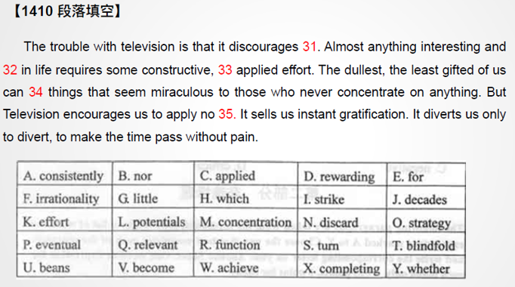
1.9.3上册第九课第3段
一、高级英语课文精讲——上册 Lesson 9

Slide 12
1.9.4上册第九课第4段
一、高级英语课文精讲——上册 Lesson 9
Para 4：Television‘s variety（多样化） becomes a narcotic（麻醉剂） , nor a stimulus. Its serial（系列的）, kaleidoscopic（变化多样的） exposures force us to follow its lead. The viewer is on a perpetual（不间断的） guided tour: 30 minutes at the museum, 30 at the cathedral, 30 for a drink, then back on the bus to the next attraction —-except on television., typically, the spans（时间段） allotted（分配） are on the order of minutes or seconds, and the chosen delights are more often car crashes and people killing one another. In short, a lot of television usurps（夺取） one of the most precious of all human gifts, the ability to focus your attention yourself, rather than just passively（被动地） surrender（投降） it.

Slide 13
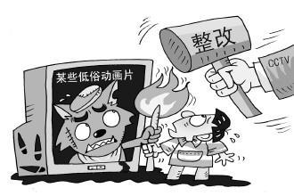
1.9.4上册第九课第4段
一、高级英语课文精讲——上册 Lesson 9
Para 4：Television‘s variety（多样化） becomes a narcotic（麻醉剂） , nor a stimulus. Its serial（系列的）, kaleidoscopic（变化多样的） exposures force us to follow its lead. The viewer is on a perpetual（不间断的） guided tour: 30 minutes at the museum, 30 at the cathedral, 30 for a drink, then back on the bus to the next attraction —-except on television., typically, the spans（时间段） allotted（分配） are on the order of minutes or seconds, and the chosen delights are more often car crashes and people killing one another. In short, a lot of television usurps（夺取） one of the most precious of all human gifts, the ability to focus your attention yourself, rather than just passively（被动地） surrender（投降） it.
Notes:
Various多种多样的

Slide 14
1.9.4上册第九课第4段
一、高级英语课文精讲——上册 Lesson 9
Para 4：Television‘s variety（多样化） becomes a narcotic（麻醉剂） , nor a stimulus. Its serial（系列的）, kaleidoscopic（变化多样的） exposures force us to follow its lead. The viewer is on a perpetual（不间断的） guided tour: 30 minutes at the museum, 30 at the cathedral, 30 for a drink, then back on the bus to the next attraction —-except on television, typically, the spans（时间段） allotted（分配） are on the order of minutes or seconds, and the chosen delights are more often car crashes and people killing one another. In short, a lot of television usurps（夺取） one of the most precious of all human gifts, the ability to focus your attention yourself, rather than just passively（被动地） surrender（投降） it.
电视节目的多样化成了一种麻醉剂而不是促进思考的因素。它那系列的、多变的画面引着我们跟着它走。观众无休无止地跟着导游游览：参观博物馆30分钟，看大教堂30分钟，喝饮料30分钟，然后上车去下一个参观点，只是电视的特点是时间分配以分秒计算，而所选择的内容却多为车祸和人们的互相残杀。总之许多电视节目取代了人类最可贵的一种才能，即主动集中自己的注意力，而不是被动地奉送注意力。
Notes:
Except 连词 只是，
Delights令人高兴的事

Slide 15
1.9.9上册第九课第9段
一、高级英语课文精讲——上册 Lesson 9
Para 9：I believe that TV‘s appeal to the short attention span is not only inefficient（低效的） communication but decivilizing（降低文化） as well. Consider the casual（随便的） assumptions that television tends to cultivate: that complexity must be avoided, that visual stimulation is a substitute（替代物） for thought, that verbal（语言的） precision is an anachronism（过时的事物或思想）. It may be old-fashioned, but I was taught that thought is words, arranged（排列，布置） in grammatically precise（精确的） ways.

Slide 16
1.9.9上册第九课第9段
一、高级英语课文精讲——上册 Lesson 9
Para 9：I believe that TV‘s appeal to the short attention span is not only inefficient（低效的） communication but decivilizing（降低文化） as well. Consider the casual（随便的） assumptions that television tends to cultivate: that complexity must be avoided, that visual stimulation is a substitute（替代物） for thought, that verbal（语言的） precision is an anachronism（过时的事物或思想）. It may be old-fashioned, but I was taught that thought is words, arranged（排列，布置） in grammatically precise（精确的） ways.
我认为，电视迎合观众注意力跨度短的做法不仅会造成交流不畅，而且还会降低文化水平。想一想电视要达到的那些极不慎重的原则吧：必须避免复杂性，用视觉刺激来代替思考，语言的精确早已是不合时宜的要求。它可能已过时，但我所受的教育告诉我思想就是语言，是按准确的语法规则组织起来的。
Notes:
Civil 公民的
Civilize 使文明 使开化
Decivilize 使丧失文明

Slide 17
1.9.11上册第九课第11段
一、高级英语课文精讲——上册 Lesson 9
Para 11：Literacy（读写能力） may not be an inalienable（不可剥夺的） human right, but it is one that the highly literate Founding Fathers might not have found unreasonable or even unattainable. We are not only not attaining it as a nation, statistically speaking, but we are falling further and further short of（达不到） attaining it. And, while I would not be so simplistic as to suggest that television is the cause, I believe it contributes and is an influence.

Slide 18
1.9.11上册第九课第11段
一、高级英语课文精讲——上册 Lesson 9
Para 11：Literacy（读写能力） may not be an inalienable（不可剥夺的） human right, but it is one that the highly literate Founding Fathers might not have found unreasonable or even unattainable. We are not only not attaining it as a nation, statistically speaking, but we are falling further and further short of（达不到） attaining it. And, while I would not be so simplistic as to suggest that television is the cause, I believe it contributes and is an influence.
能读写可能算不上是一项不可剥夺的人权，但是我们学识渊博的开国元勋们并不感到它是不合理的或者甚至是达不到的。从统计数字上看，我们的国家不仅未达到人人能读写的程度，而且离这一目标越来越远。尽管我不会天真到认为电视是造成这一情况的原因，但我却相信它起了一定的作用，是有影响的。

Slide 19
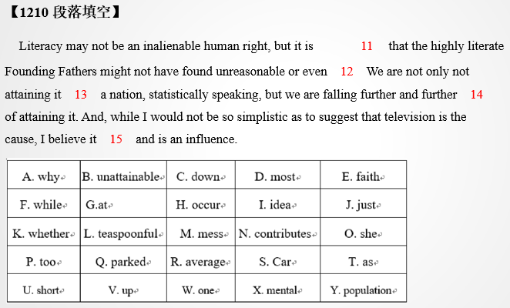
1.9.11上册第九课第11段
一、高级英语课文精讲——上册 Lesson 9

Slide 20
1.9.12上册第九课第12段
一、高级英语课文精讲——上册 Lesson 9
Para 12：Everything about this nation —the structure of the society, its forms of family organization, its economy, its place in the world— has become more complex, not less. Yet its dominating（主导的） communications instrument, its principal（主要的） form of national linkage（联系）, is one that sells neat resolutions to human problems that usually have no neat resolutions. It is all symbolized in my mind by the hugely successful art form that television has made central to the culture, the 30-second commercial: the tiny drama of the earnest（认真的) housewife who finds happiness in choosing the right toothpaste.

Slide 21
1.9.12上册第九课第12段
一、高级英语课文精讲——上册 Lesson 9
It is all symbolized in my mind by the hugely successful art form that television has made central to the culture, the 30-second commercial: the tiny drama of the earnest（认真的) housewife who finds happiness in choosing the right toothpaste.

Slide 22
1.9.12上册第九课第12段
一、高级英语课文精讲——上册 Lesson 9
It is all symbolized in my mind by the hugely successful art form that television has made central to the culture, the 30-second commercial: the tiny drama of the earnest（认真的) housewife who finds happiness in choosing the right toothpaste.
在我的心目中，那30秒钟一个的商业广告：一位家庭主妇因选对了牙膏而感到幸福的那小小的戏剧性场面就是这一切的象征。电视已使这极其成功的艺术形式成为我们文化不可缺少的一个部分了。

Slide 23
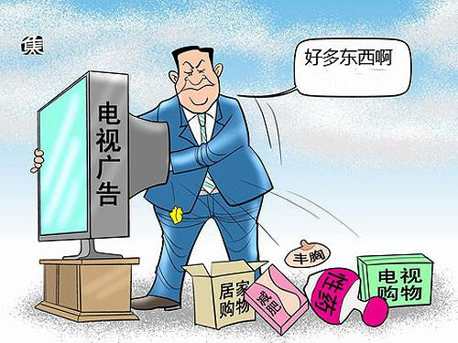
1.9.12上册第九课第12段
一、高级英语课文精讲——上册 Lesson 9
It is all symbolized in my mind by the hugely successful art form that television has made central to the culture, the 30-second commercial: the tiny drama of the earnest（认真的) housewife who finds happiness in choosing the right toothpaste.
在我的心目中，那30秒钟一个的商业广告：一位家庭主妇因选对了牙膏而感到幸福的那小小的戏剧性场面就是这一切的象征。电视已使这极其成功的艺术形式成为我们文化不可缺少的一个部分了。

Slide 24
1.9.12上册第九课第12段
一、高级英语课文精讲——上册 Lesson 9
Para 12：Everything about this nation —the structure of the society, its forms of family organization, its economy, its place in the world— has become more complex, not less. Yet its dominating（主导的） communications instrument, its principal（主要的） form of national linkage（联系）, is one that sells neat resolutions to human problems that usually have no neat resolutions. It is all symbolized in my mind by the hugely successful art form that television has made central to the culture, the 30-second commercial: the tiny drama of the earnest（认真的) housewife who finds happiness in choosing the right toothpaste.
美国的一切：社会结构、家庭组织形式、经济、在世界上的地位，都变得更为复杂，而不是相反。然而其占主导地位的传播媒介，全国联系的主要方式，却在人类存在的问题上推销简单的解决方式，而这些问题通常是没有简单的解决方式的。在我的心目中，那30秒钟一个的商业广告：一位家庭主妇因选对了牙膏而感到幸福的那小小的戏剧性场面就是这一切的象征。电视已使这极其成功的艺术形式成为我们文化不可缺少的一个部分了。

Slide 25
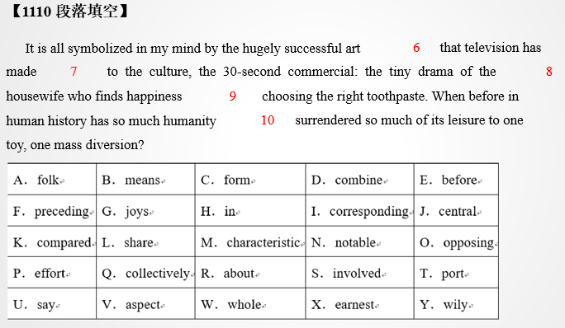
1.9.12上册第九课第12段
一、高级英语课文精讲——上册 Lesson 9

Slide 26
1.9.13上册第九课第13段
目录
一、课文带读（下册 Lesson 11）
二、阅读理解高频单词

Slide 27
1.9.13上册第九课第13段
一、课文带读（下册 Lesson 11）
二、阅读理解高频单词

Slide 28
1.9.13上册第九课第13段
二、阅读理解高频单词
1. Horror ['hɒrə] n. 惊骇；惨状；极端厌恶；令人恐怖的事物
E.g. The horror story is less easily defined, perhaps because other types of fiction so often use the trappings of terror to enhance their plots.（2012年1月)
恐怖故事定义起来不那么容易，可能是因为其他类型的小说常常采用恐怖手法来增强情节的吸引力。

Slide 29
1.9.13上册第九课第13段
二、阅读理解高频单词
2. execute ['eksɪkjuːt] vt. 实行；执行；处死
E.g. In the United States a person who should’ve been executed might be set free after only 20 years’ imprisonment.（2012年10月）
在美国，一个本应该被处死的人，在20年监禁之后，就可以被释放。

Slide 30
1.9.13上册第九课第13段
二、阅读理解高频单词
3. torrent ['tɒr(ə)nt] n. 奔流；倾注；迸发；连续不断
E.g. A pitcher? You want to draw water from the torrent? （2010年10月)
一个大水罐？你想要从急流中取水吗？
E.g. Girl of the silent torrent, give me one of your clay pitchers. I shall draw pictures on it. （2010年10月)
急流边的女孩儿，把你的黏土罐给我一个，我要在上面画画。

Slide 31
1.9.13上册第九课第13段
二、阅读理解高频单词
4. reform [rɪ'fɔːm] n. 改革，改良；改正vt. 改革，革新；重新组成vi. 重组；改过
adj. 改革的；改革教会的
E.g. In order to continue the good for which this program was intended, we have to pursue the reforms that allow for appropriate oversight. （2011年10月)
为了让这一项目继续给人们造福，我们必须进行可以实施适当监管的改革。

Slide 32
1.9.13上册第九课第13段
二、阅读理解高频单词
5. ghost [gəʊst] n. 鬼，幽灵vt. 作祟于；为人代笔vi. 替人代笔
E.g. Charles Dickens used the vehicle of an old-fashioned ghost story to tell “A Christmas Carol”, but that book is not a horror story. （2012年1月)
查尔斯狄更斯用一个过时的鬼故事作为工具来讲述《圣诞欢歌》，但是那本书并不是恐怖小说。

Slide 33
1.9.13上册第九课第13段
二、阅读理解高频单词
6. adopt [ə'dɒpt] vt. 采取；接受；收养；正式通过vi. 采取；过继
E.g. They wanted the group to acknowledge the problems and adopt radical reforms. （2011年10月)
官员们希望组织正视这些问题并采取根本变革。

Slide 34
1.9.13上册第九课第13段
二、阅读理解高频单词
7. corporation [kɔːpə'reɪʃ(ə)n] n. 公司；法人（团体）；社团；市政当局
E.g. The officials of Alaska native corporations gathered to discuss the reform proposals. （2011年10月)
阿拉斯加当地企业官员聚集到一起来讨论改革提案。

Slide 35
1.9.13上册第九课第13段
二、阅读理解高频单词
8. vampire ['væmpaɪə] n. 吸血鬼；[脊椎] 吸血蝙蝠
E.g. No single tale brings all of these elements together so well as the vampire legend, an ancient folk superstition. （2012年1月)
没有哪一种故事像吸血鬼传说--一个古老的民间迷信--那样把这些元素集合在一起。

Slide 36
1.9.13上册第九课第13段
二、阅读理解高频单词
9. boredom ['bɔːdəm] n. 厌倦；令人厌烦的事物
E.g. Work is desirable, first and foremost, as a preventive of boredom, for the boredom that a man feels when he is doing necessary though uninteresting work is as nothing in comparison with the boredom that he feels when he has nothing to do with his days. （2011年10月)
首先，作为防止无聊的手段，工作是可取的。因为与终日无所事事百无聊赖相比，从事必要而乏味的工作所感受的无聊就算不了什么了。

Slide 37
1.9.13上册第九课第13段
二、阅读理解高频单词
10. commend [kə'mend] vt. 推荐；称赞；把…委托vi. 称赞；表扬
E.g. While engaged in a conversation with a commended stranger, we become more sincere and graceful. （2014年10月)
当我们与一个备受赞扬的陌生人谈话时，我们会变得更加真诚和优雅。

Slide 38
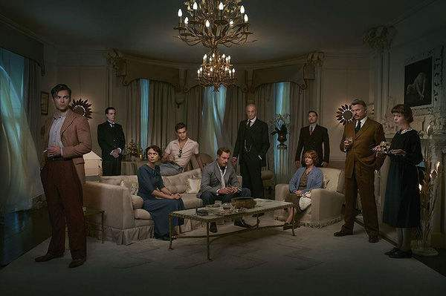
谢谢观看
See You
1.9.13上册第九课第13段

