Slide 1
Title slide + image
Gait Detection using Wrist-worn IMUs for Home
Rehabilitation of Stroke Patients
Hendrik Böckenhauer Tatiana Orlovskaia
Supervised by dr. Herwin Horemans & dr. Arkady Zgonnikov
Notes:
Structure:
Intro + motivation
Relavant work
Methodology : signal processing + ML
Results
Discussion + conclusion
Today we will be talking about ….

Slide 2
TU Delft
Create/edit a Hyperlink TO A SLIDE
1
Go to the tab ‘Insert’ and click on the button ‘Shapes’. Choose the shape ‘Rectangle’ and drag the mouse over the slide to create a shape.
Shapes
2
Drag the shape over the menu button and scale the shape as large as the button. Click with the right mouse button on the shape and choose ‘Edit shape’.
01
02
03
Size and position…
Motivation
Approach
Algorithms
Edit shape…
3
Click on the paint bucket icon, click on ‘Shape Fill’ and drag the ‘Transparency’ slider to 100%. Now the shape is completely transparent.
Transparency
100%
4
Click on the transparent shape and use the shortcut Ctrl + K to add a hyperlink. At the left side of the window, click on ‘Place in this document’ and select the preferred slide in the list. Then click on ‘OK’.
04
05
06
Results
Discussion
Conclusion
5
Copy the transparent shape and repeat step 4. Do this for all menu buttons.
Want to know more? Go to the tab 'SLIDEBUILDER’ and click on the button ‘Inspiration'
Inspiration
Notes:
Introduce the structure of the presentation ?

Slide 3
Motivation
Stroke is a prevalent cause of disability
Functional arm use in stroke rehabilitation
Home rehabilitation
Accessibility of wrist worn sensors vs leg-worn
Towards@HomeRehabilitation
Direct feedback during the day
End of the day analysis
sensors
Notes:
Many of you are probably familiar with the towards@home application but to recap, it is

Slide 4
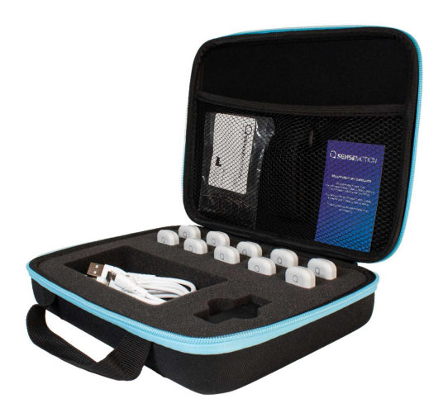
Approach
Literature review of existing algorithms and datasets
Recording data
Self recorded
Stroke patients from Rijndam
Adapt existing algorithms
[1] QSense Motion. QSense Motion Capture Platform: User Manual. url: https://qsense-motion.com/downloads/User-Manual-QSense.pdf.

Slide 5
Approach: Existing Algorithms
Looking for: IMUs on wrist
Wide Range of Gait Detection Algorithms available:
Signal Processing based
Machine Learning based
Multiple sensor locations
Shortlist most relevant:
ElderNet, Straczkiewicz, Kheirkhanan, Hickey

Slide 6
Approach: Existing Datasets
Looking for: IMUs on wrist, subjects performing ADL
Wide Range of Gait Datasets available:
Healthy subjects
Subjects with diagnosis of condition (PD)
Multiple sensor locations
Annotated
We shortlist most relevant:
WISDM, WearGait, HMP, BioCliTe

Slide 7
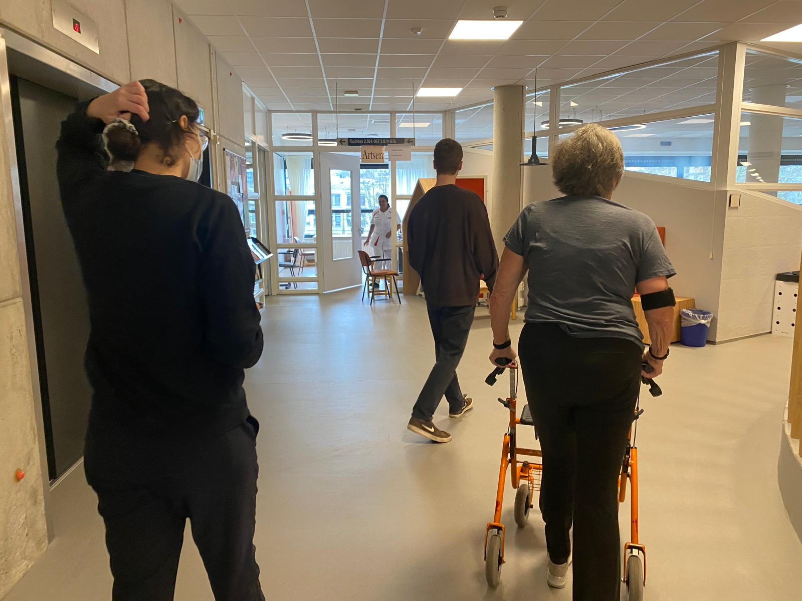
Approach: Recorded Data
Self recorded:
Normal walking
Edge cases (10)
Using handrail, simulating stroke, using phone, using crutches or cane
Mixed tests
Several alternating activities
Including washing hands, reading a magazine, drawing, vacuuming
Clinical:
5 patients in total
Patient 2 left out for analysis
Mixed test of alternating walking\non-walking activities
Activities adjusted for mobility level of the patient
Included washing hands, making a puzzle, watering plants, using arm exercise machine
Free living: stroke patients, ADLs in the kitchen

Slide 8
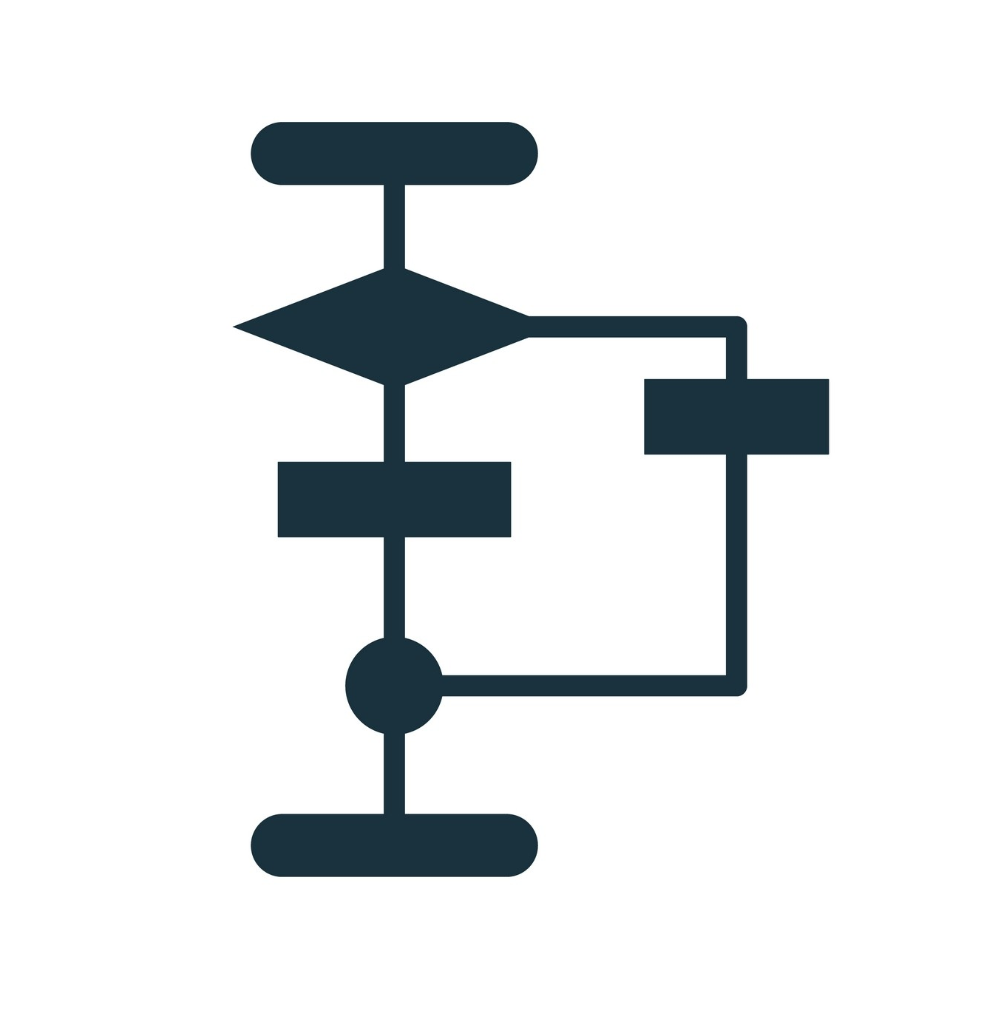
Algorithms
ML methods:
ElderNet
StrokeNet
Signal Processing:
Straczkiewicz
Hickey
Kheirkhahan

Slide 9
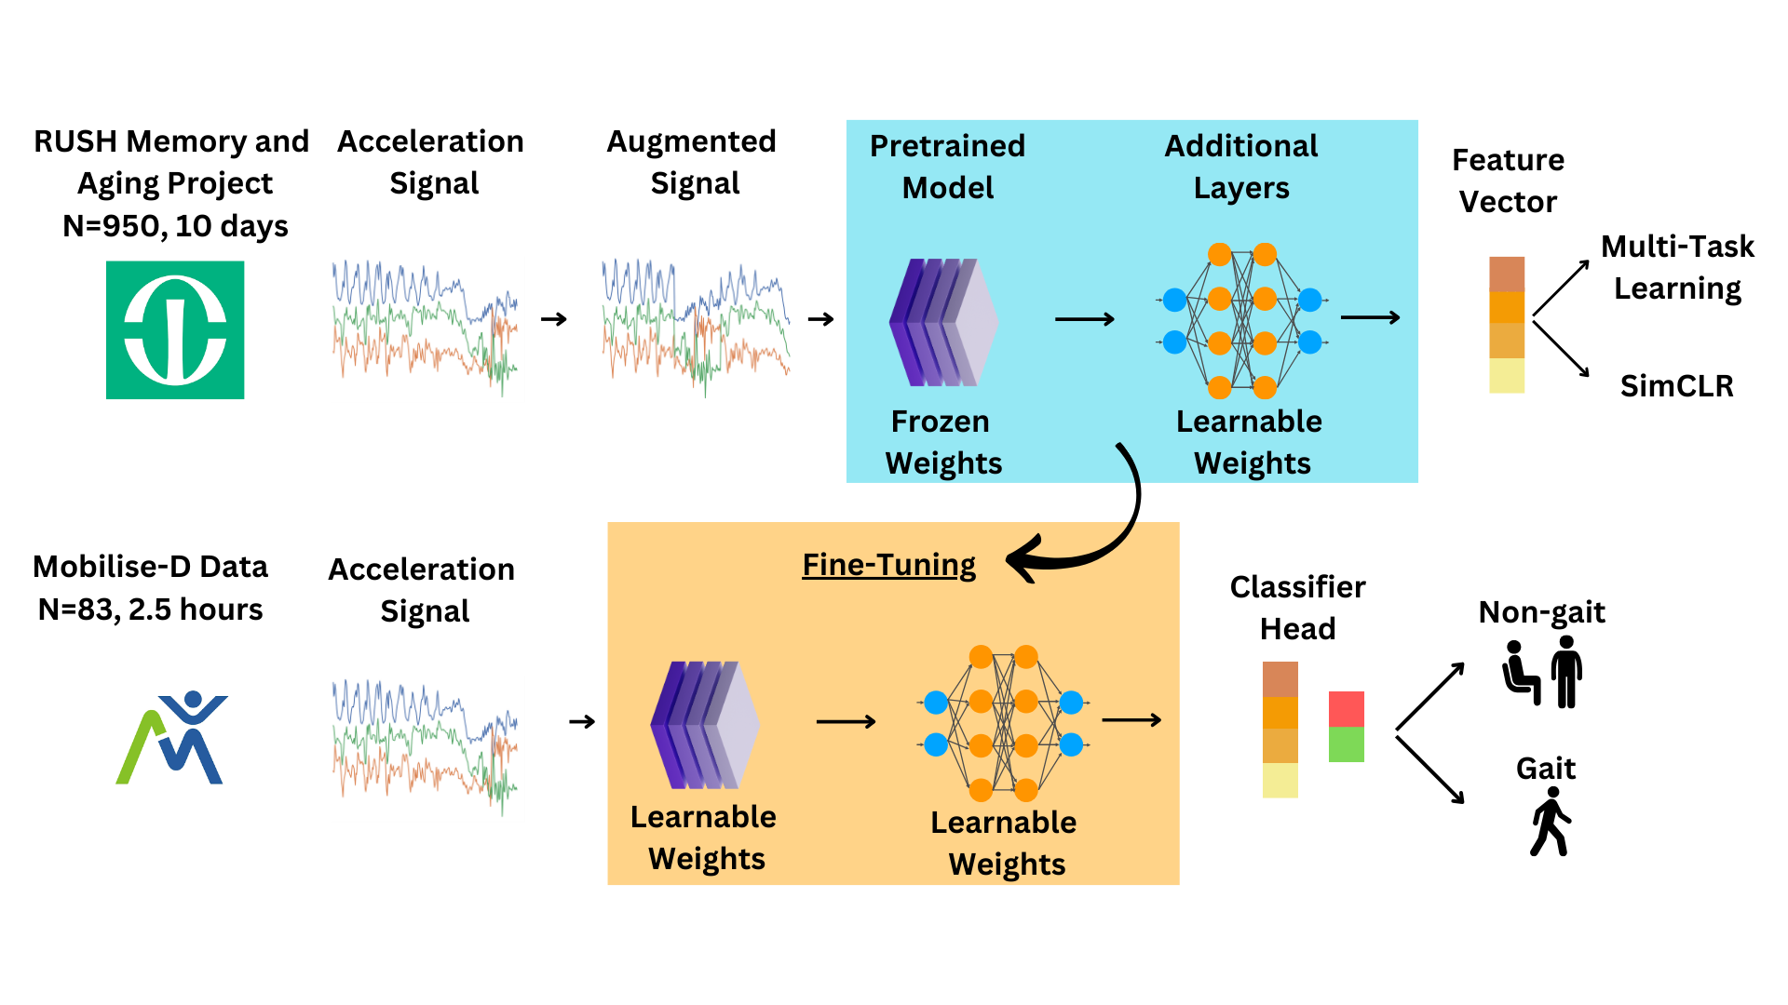
Algorithms: ML Approaches - ElderNet
ElderNet:
Existing deep-learning approach on acceleration data from wrist-worn sensors
Optimised for elderly + impaired walk
UK BioBank SSL Model Include RUSH MAP Fine-tune on Mobilise-D
1D CNN: 5 layers
Input: 10s windows
Output: softmax probability of gait
If prob > threshold GAIT
Fig: ElderNet development pipeline (credit: YonBrand)

Slide 10
Algorithms: ML Approaches - StrokeNet
StrokeNet - Modification of ElderNet:
Motivation: Specialise model to stroke gait
Remove last (downsampling) layer shorter input windows
Retrain on self-recorded data Stroke- and sensor-specific
Obtain new weights for the classifier head
2s windows with 1s stride
If prob > threshold GAIT

Slide 11
Algorithms: Signal Pro. - Straczkiewicz
"One-size fits most" signal processing based:
Continuous Wavelet Transform: decompose Tri-axial accelerations
Amplitude threshold, step frequency discriminator, temporal continuity of dominant frequency
Necessary adaptations:
Simplified, real-time
FFT on 2s window with 1s stride
Amplitude, power and frequency thresholding
Threshold Optimisation on self-recorded mixed data

Slide 12
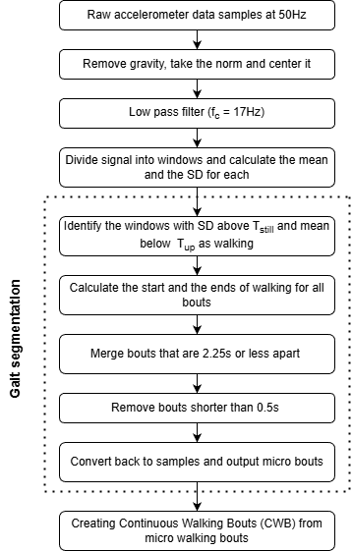
Algorithms: Signal Pro. - Hickey
Originally developed for lower back position
Threshold based
Mean per window
STD per window
Tuned to wrist worn position
Further tuned on the recorded data

Slide 13
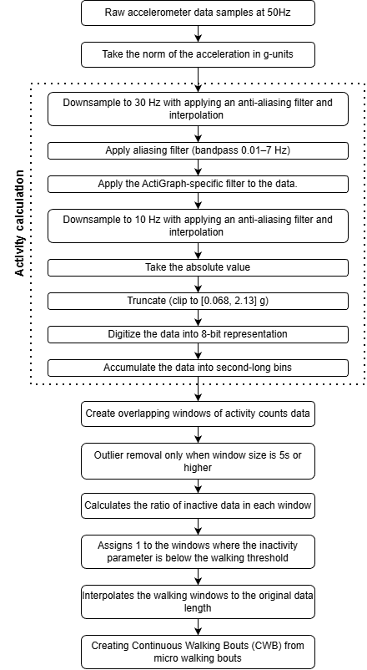
Algorithms: Signal Pro. - Kheirkhahan
Adaptive walking detection per 12s window
Originally for hip postion
Adjusted to wrist position
Based on activity count
Uses overlapping window approach
Tuned of the self recorded data
STD threshold check added in tuning

Slide 14
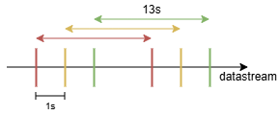
Algorithms: Signal Pro. - Real-time approach
No knowledge of future data
2s buffer added at the beginning and the end
13s total
Walking predictions are used to overwrite the previous windows predictions
Data from the two wrist can be fused

Slide 15
Results
Cross dataset comparison
Clinical trials results
Wrist fusion
StrokeNet
Realtime implementation

Slide 16
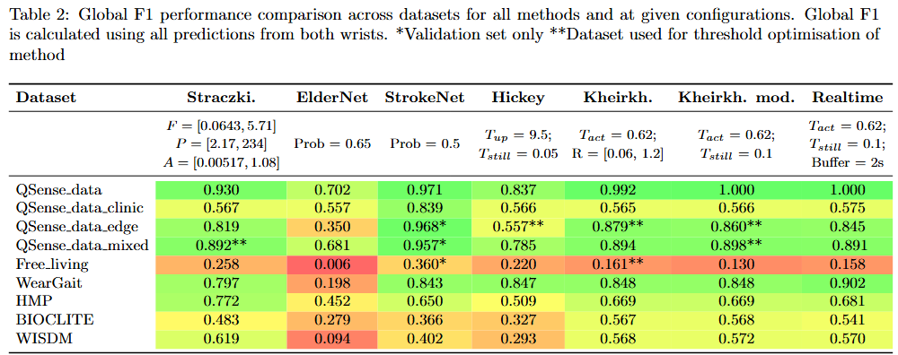
Cross Dataset comparison
F1 = performance metric for imbalanced datasets
Mixed results for all algos – likely due to subject differences + test setup (sampling freq)

Slide 17
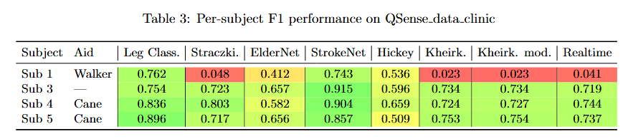
Results of Clinical Tests
Evaluation set: gives best indication of performance + generalisability
StrokeNet: best performing (outperforms Leg), good performance on patient with walker
Signal processing: good performance, unable to detect gait with walker

Slide 18
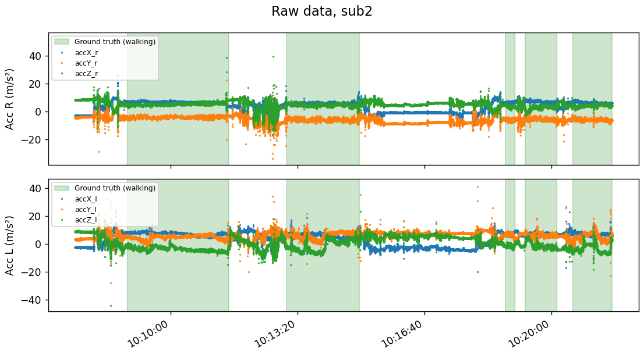
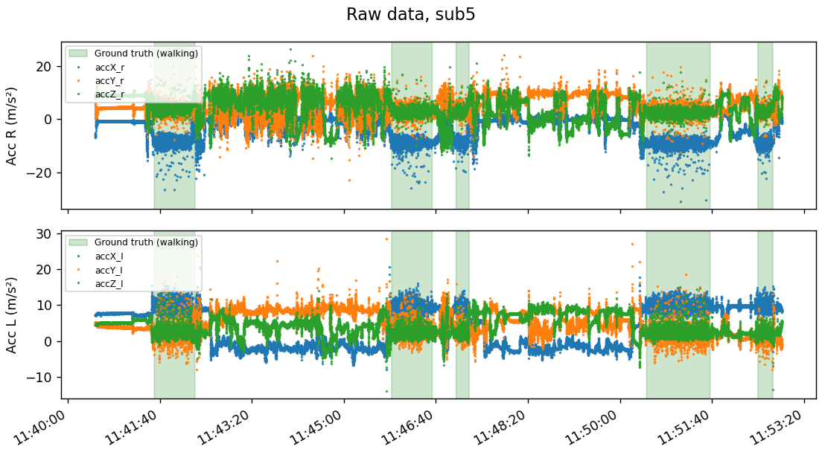
Results of Clinical Tests – Walker
Walker present
Stable during walking
No walker present
Noisy during walking

Slide 19
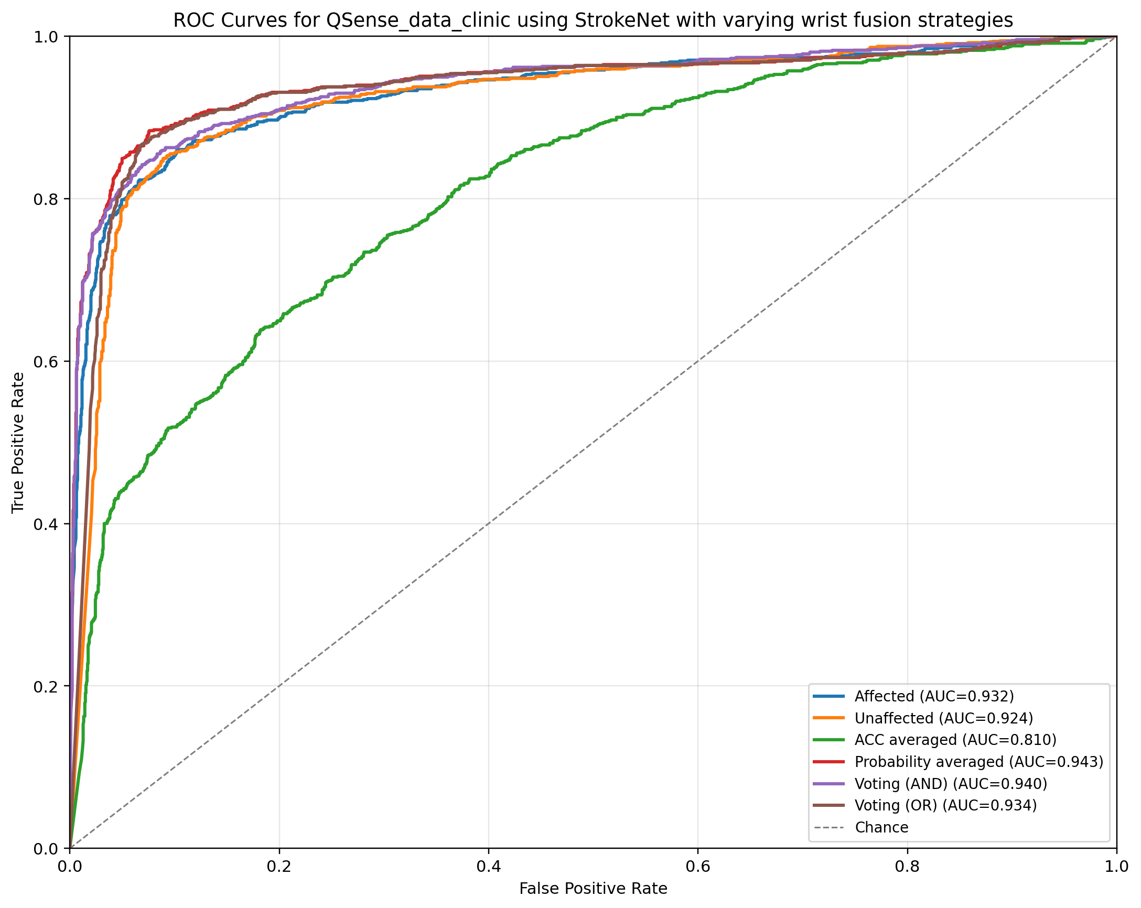
Fusion of wrists – StrokeNet
Strategies:
Unaffected
Affected
Acceleration average
Probability average
Voting AND
Voting OR
Best performing:
Probability average
F1 = 0.87 @ p = 0.5

Slide 20
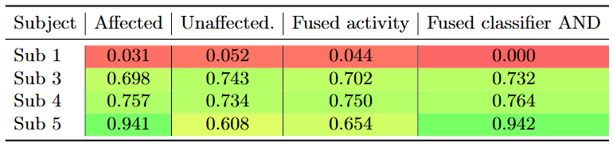
Fusion of wrists – Kheirkhahan
Improved performance for classification fusion
Outperforms single wrist classification
Without subject 1, F1 score of 0.81

Slide 21
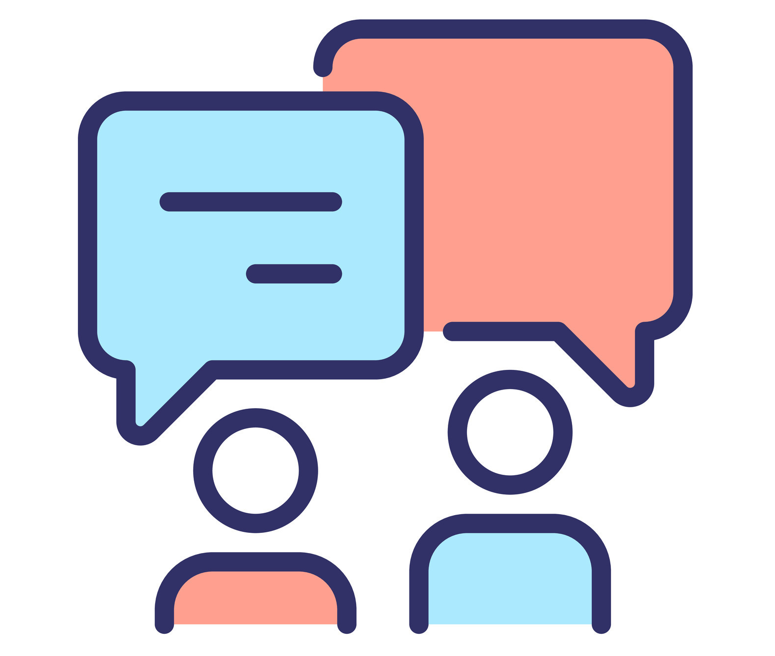
Discussion
Real-time vs End-of-day
Faulty and Insufficient data
StrokeNet improvements
Kheirkhahan improvements

Slide 22
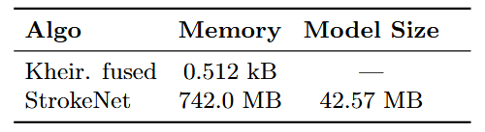
Real-time vs End-of-day
Real-time: runs onboard sensor to give real-time feedback to patient
Computational size limit ~ 20 kB
Processing time < window size
Only use current and previous window data
End-of-day: Data of day uploaded for therapist to run energy analysis locally
No limitations

Slide 23
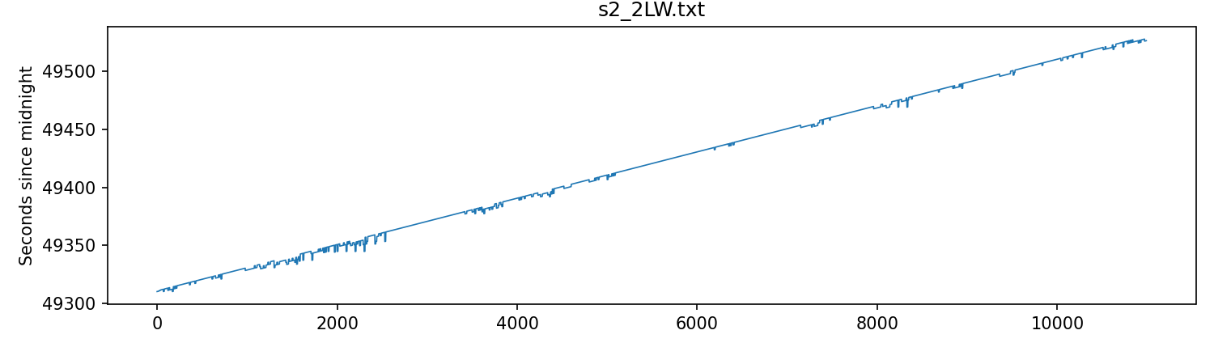
Faulty and Insufficient Data
Timestamps repeated
Discarded when preprocessing
Discontinuities → less full windows
4 clinical trials evaluated
1 walker, 1 unsupported, 2 with cane
Further tests necessary for complete analysis

Slide 24
Limitations & Improvements
StrokeNet:
With more data retrain again
Perform hyperparameter optimisation
Kheirkhahan realtime:
Inability to detect walking with a walker → evaluate the effect on the energy
Difficulty with rhythmic motion → optimise for the needed frequencies

Slide 25

Conclusion
End-of-day: StrokeNet (F1 = 0.87)
Best fusion: Prob. Average
Real-time: Kheirkhahan (F1 = 0.81)
Best fusion: AND
Cannot detect gait with walker
Recommendations:
Further testing on the target demographic

Slide 26
Afsluiter
Thank you for your attention

Slide 27
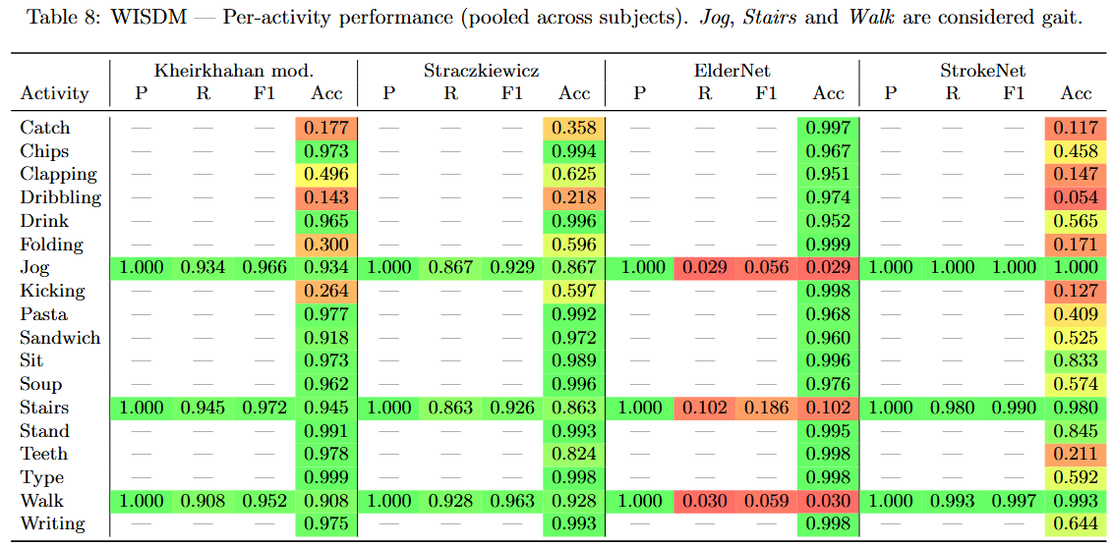
Public Datasets – WISDM (20 Hz):
WISDM: 51 healthy participants, 18 activities for 3 minutes, smartphone and smartwatch

Slide 28
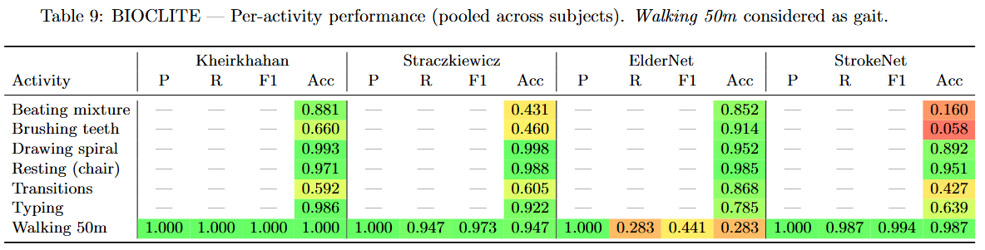
Public Datasets – BioCliTe (50 Hz):
BioCliTe: 20 healthy subjects, 7 activities ~ 5 min, smartwatch

Slide 29
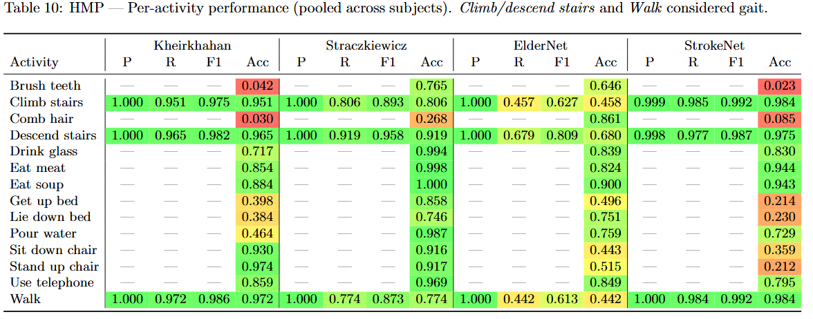
Public Datasets – HMP (32 Hz):
HMP: 16 healthy volunteers, 14 Activities ~ sec-min, single wrist-worn accelerometer

Slide 30
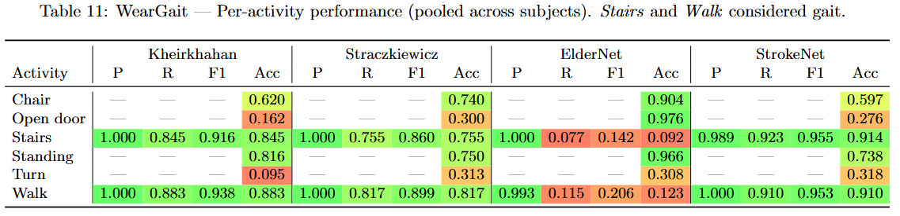
Public Datasets - WearGait:
WearGait: 33 PD + 19 age-matched controls, multiple sensors (wrist incl.), 6 activities ~ 3 min

Slide 31
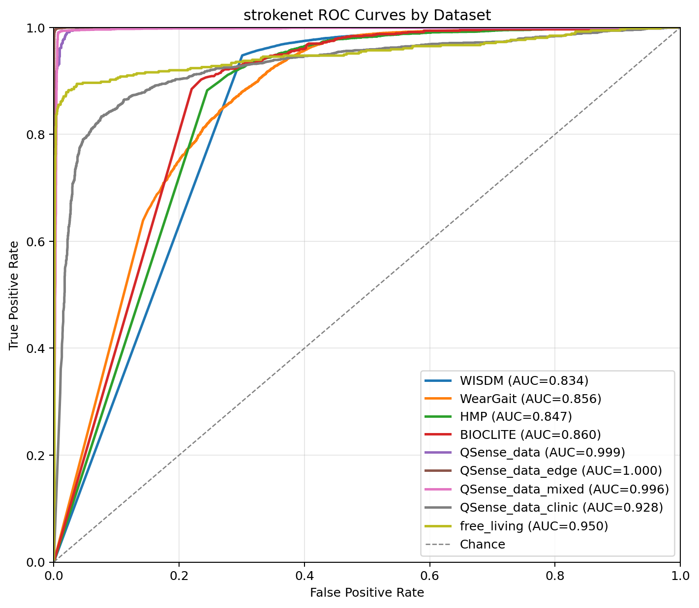
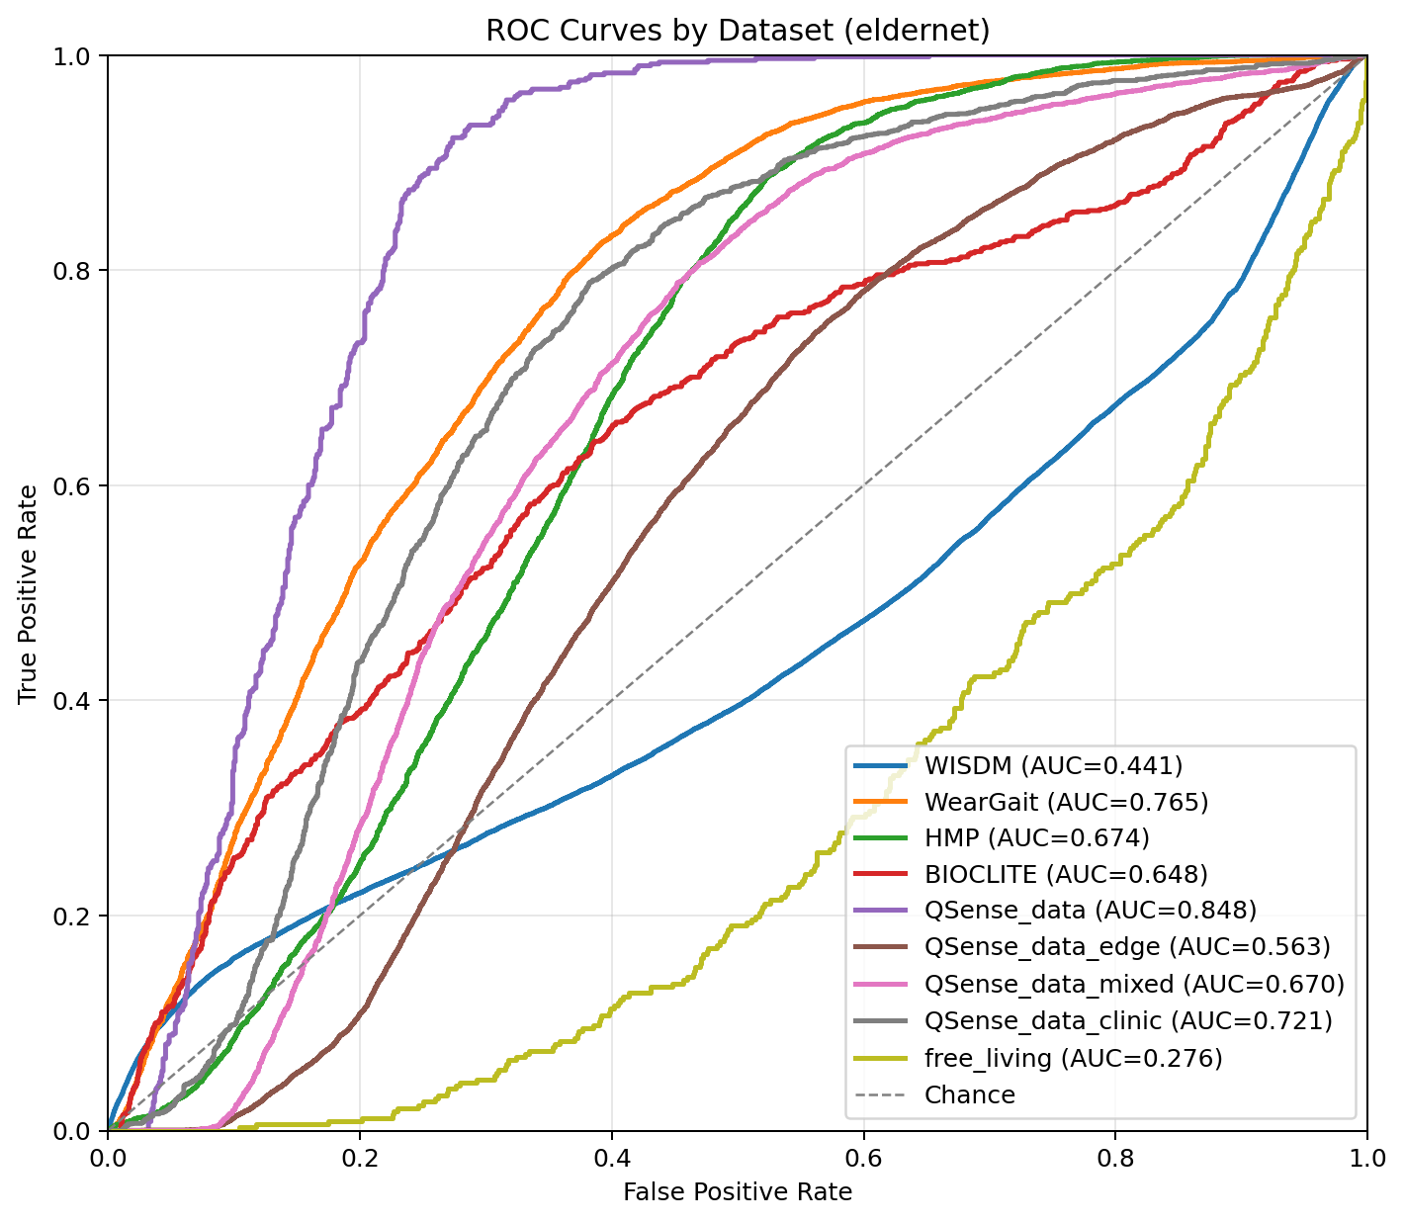
ROC curves

