Slide 1
Psychology Today Webscrape

Slide 2

Best selling … in the world!
Time magazine ALL-TIME top 100 nonfiction
Millions of copies sold!

Slide 3
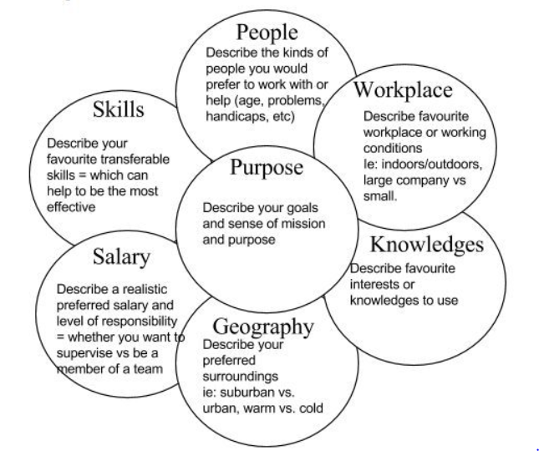
The Flower exercise:

Slide 4


Slide 5

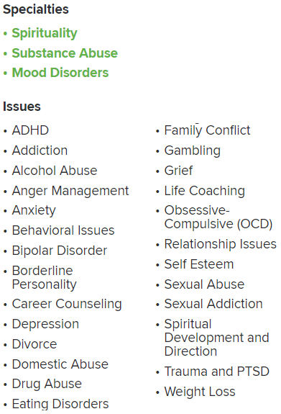

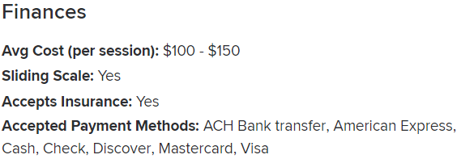

Sample profile … (used without permission)

Slide 6
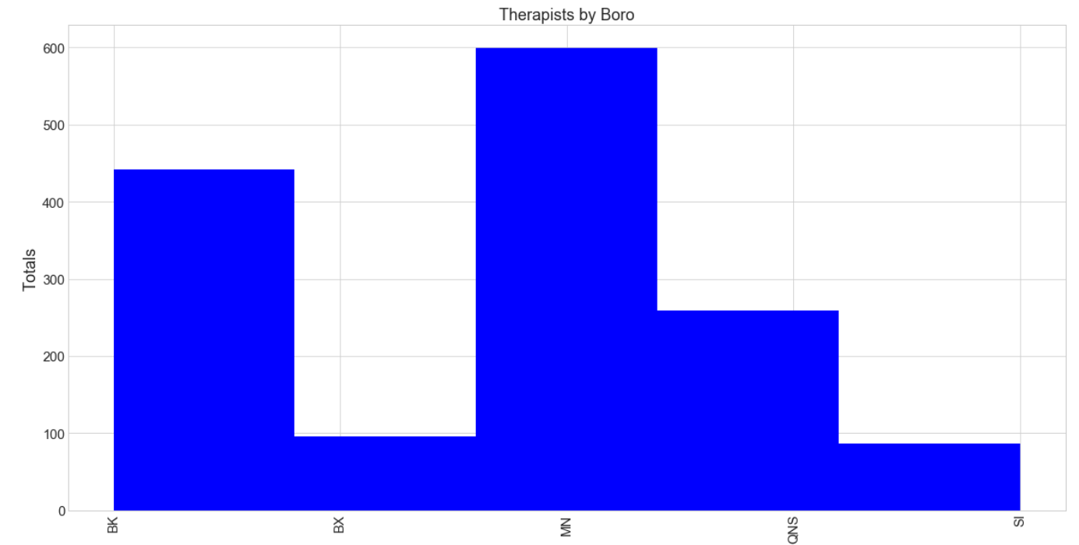

Slide 7
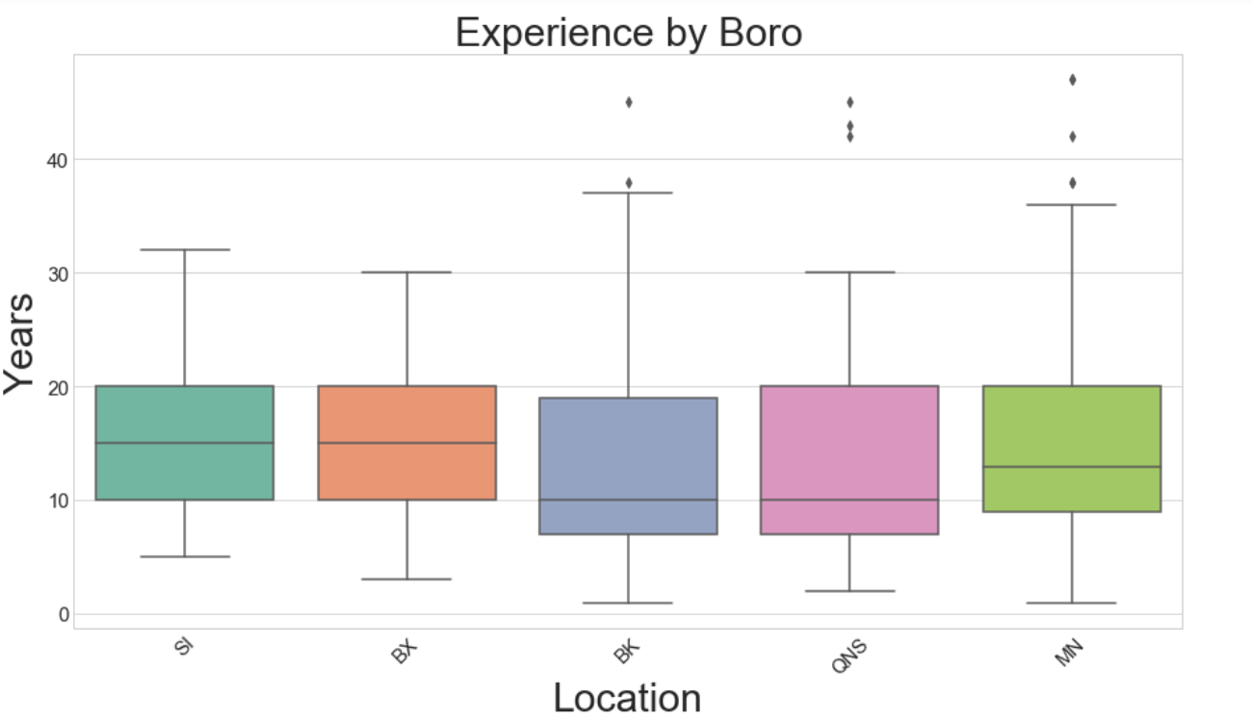

Slide 8
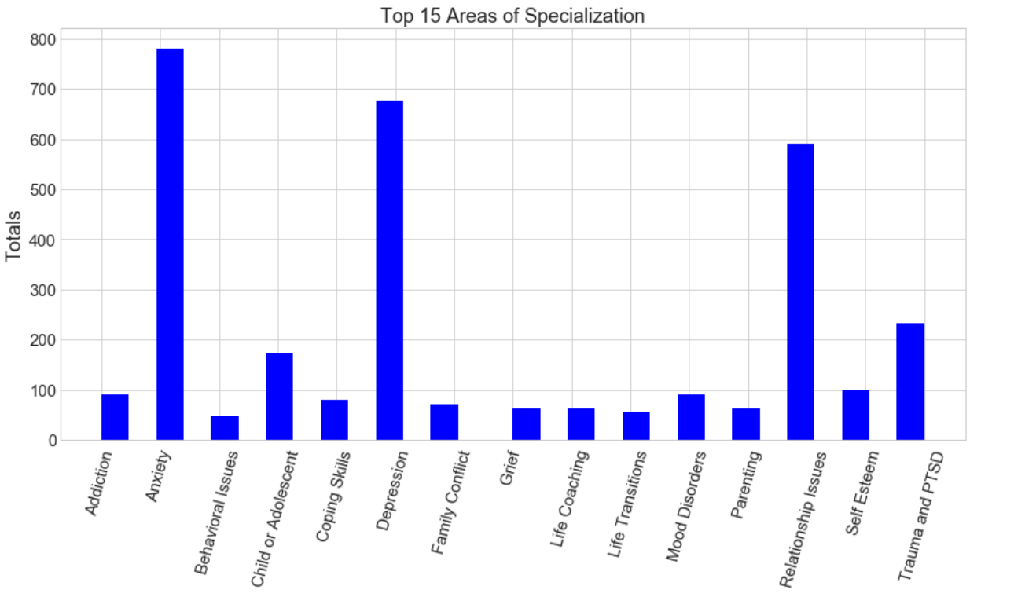

Slide 9
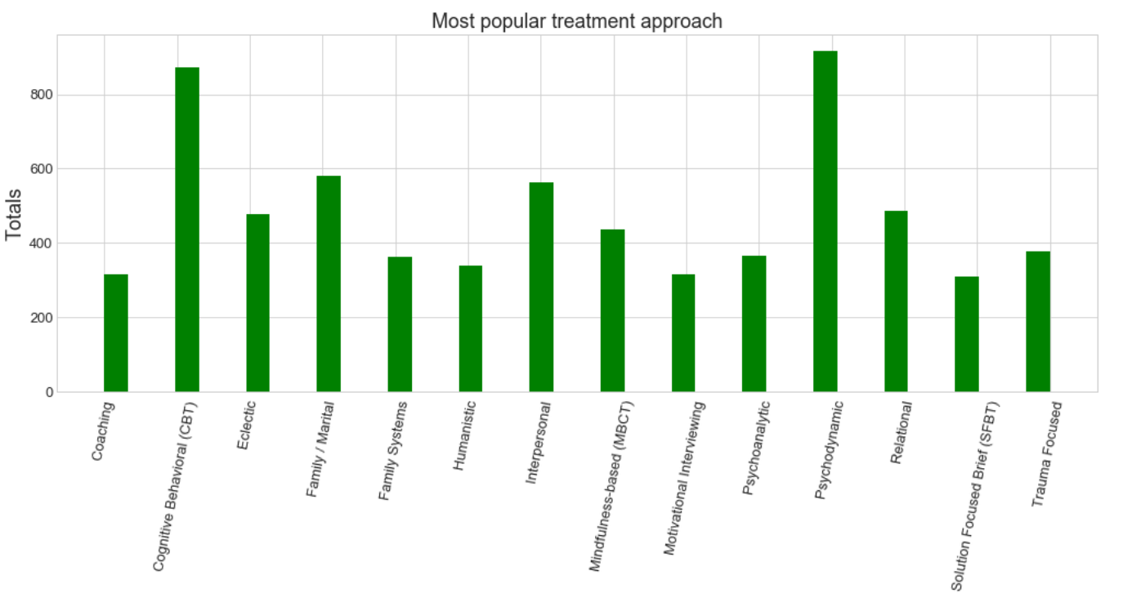

Slide 10


Slide 11
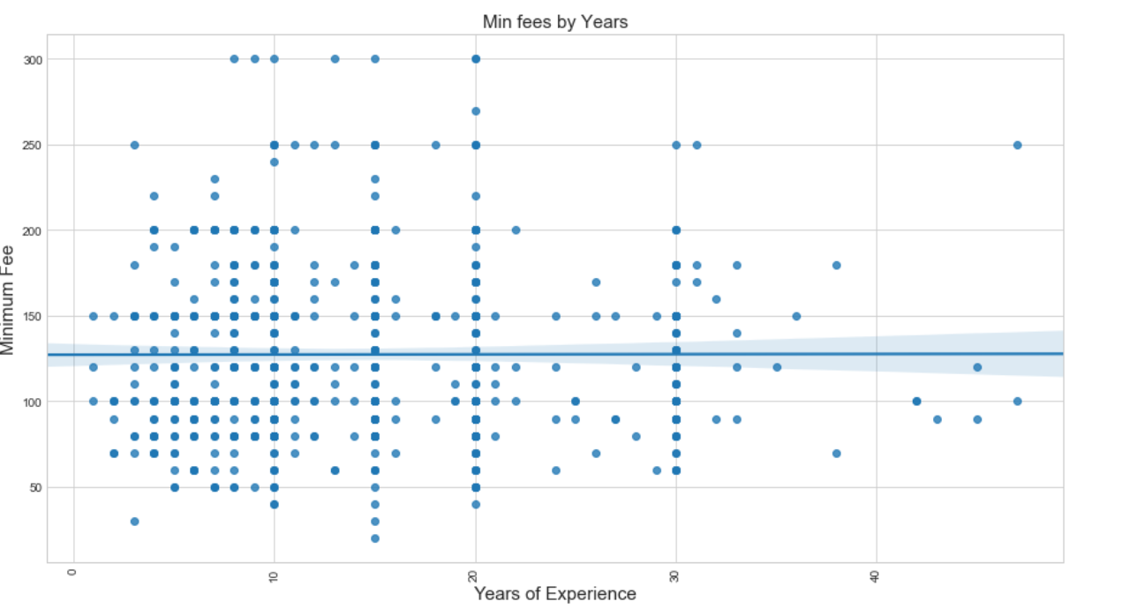

Slide 12
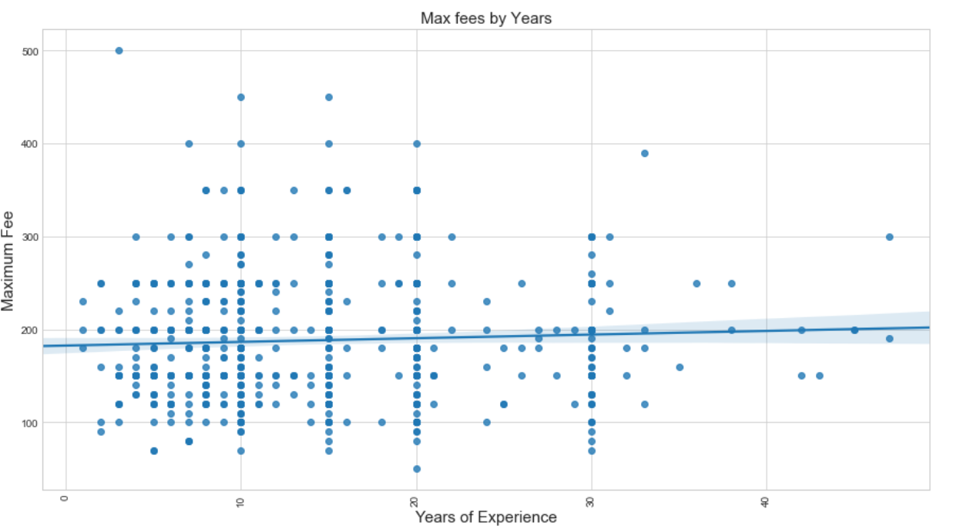

Slide 13
