Slide 1
Custom UIViews from CALayers
Heath Borders (@heathborders)
Senior Software Engineer
Asynchrony Solutions (@asynchrony)
St. Louis, MO
http://asolutions.com

Slide 2
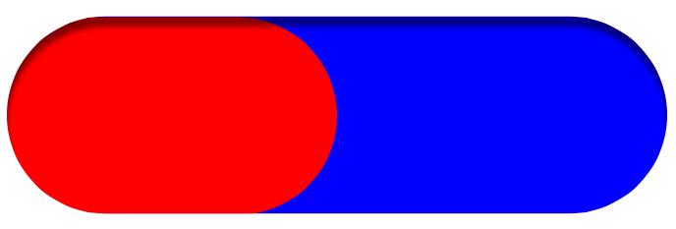
Create a Progress View

Slide 3
Simplest Way
Get 3 Images
  Background, Completion, Shadow
Fixed size, colors :(
  Can mitigate with -[UIImage resizableImageWithCapInsets:]
Booooooring :(

Slide 4
More Fun Way
Use 2 CAShapeLayers
  For the Background, Completion
Set a shadow on one and mask it out

Slide 5
CAShapeLayer
Draws using a CGPath
Use UIBezierPath as an easy way to create your CGPath

Slide 6
Shadows
Just some properties on CALayer
  @property CGColorRef shadowColor
  @property float shadowOpacity
    I don't know why this isn't a CGFloat
  @property CGSize shadowOffset
  @property CGFloat shadowRadius

Slide 7
Live Coding
Coding from scratch
Don't worry. I practiced, and I have a series of granular git commits to back me up.
Follow along:
  git clone https://github.com/hborders/HBProgressView.git

Slide 8
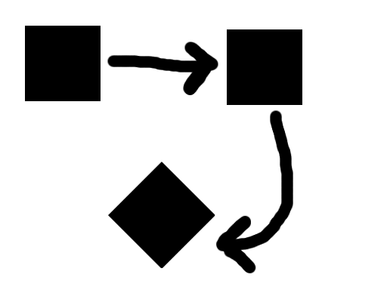
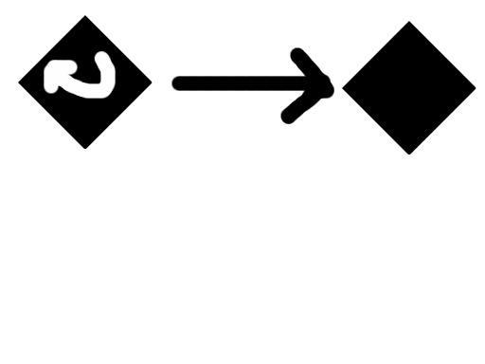
AffineTransform
Move, Scale, Rotate
Order Matters!
Translate then rotate
(Assuming we start at the origin)
Rotate then translate
(Assuming we start at the origin)

Slide 9
More Live Coding

Slide 10
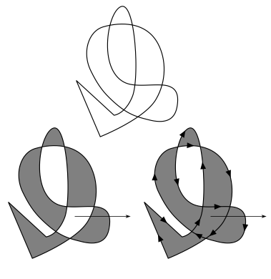
Inside or Outside?
Even-Odd vs. Non-Zero Winding

Slide 11
Next Steps
Make completionFactor animatable
  https://github.com/briancoyner/Core-Animation-Pie-Chart
Try Other CoreAnimation Demos
  https://github.com/bobmccune/Core-Animation-Demos
Try Some Quartz Demos
  (not directly CoreAnimation related, but this is cool)
  https://github.com/tapharmonic/QuartzDemos

