Slide 1
Building Android with Maven
Heath Borders
Staff Engineer, Jive Software
@heathborders

Slide 2

Roadmap
Why not Ant?
Why not gradle?
Why Maven?
How to Maven
Limitations of Maven

Slide 3

Why not Ant?
Eclipse and IntelliJ’s default build system

Slide 4
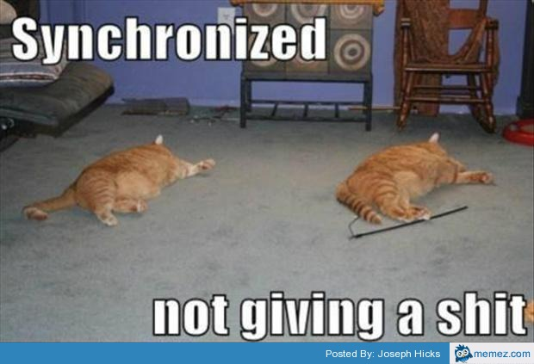
Why not Ant?
Eclipse, IntelliJ didn’t synchronize with build.xml changes
Need to set up Ivy for dependency management

Slide 5

Why not gradle?
Should know groovy
Can’t run individual robolectric tests from IntelliJ.
http://youtrack.jetbrains.com/issue/IDEA-120298

Slide 6

Why gradle?
New Hotness
Supports multiple build variants
Supports groovy
Default for Android Studio
Supports Maven dependencies

Slide 7
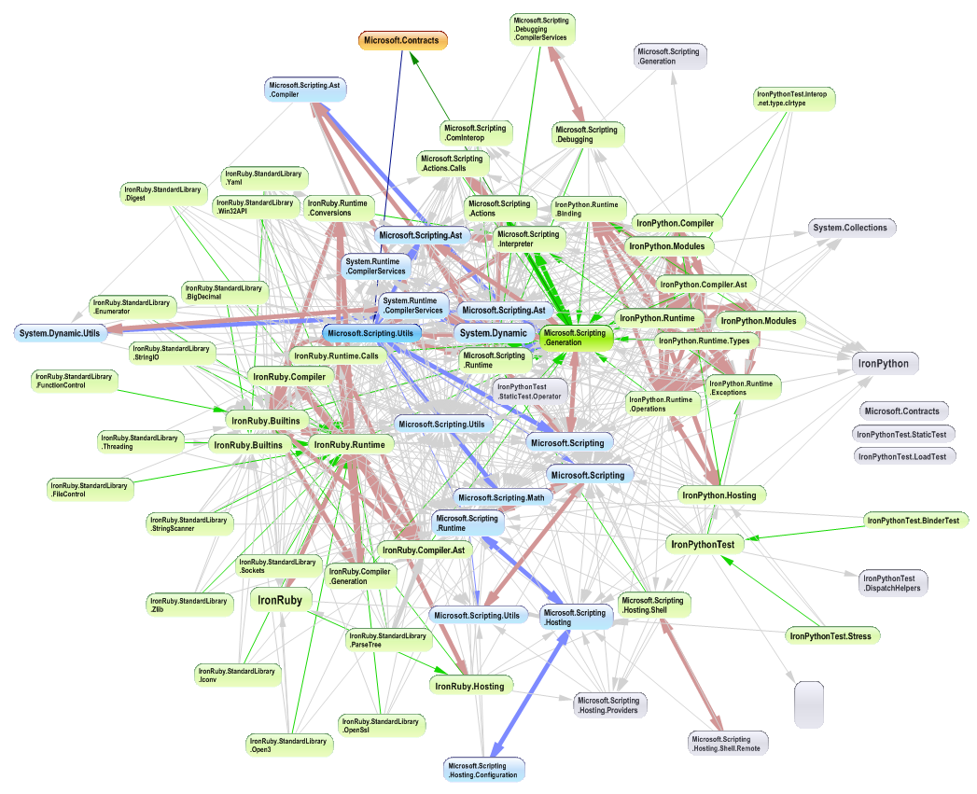
Why Maven?
Automatic Dependency Management
<dependency>
<groupId>org.springframework.android</groupId>
<artifactId>spring-android-rest-template</artifactId>
<version>1.0.1.RELEASE</version>
</dependency>

Slide 8

Why Maven?
Well established, supported
Everything is a plugin
Great IntelliJ Support
Great Android plugin
Decent Android archetypes

Slide 9
How to Maven Basics
Install Maven 3.1.1 (Latest)
mvn --version
Maven Android Deployer
https://github.com/mosabua/maven-android-sdk-deployer
Maven Android Archetypes
https://github.com/akquinet/android-archetypes
Review pom.xml and update dependencies to match maven-android-deployer
https://github.com/akquinet/android-archetypes/issues/62

Slide 10
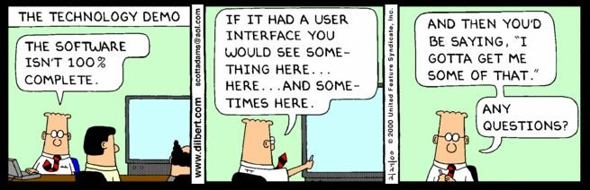
Demo

Slide 11
How to Maven: Libraries
Simplest: prebuilt and exist on maven central
IntelliJ doesn’t consume all aar projects
http://youtrack.jetbrains.com/issue/IDEA-120696
Harder: mavenized, not on maven central
Harderer: unmavenized
Must replicate project’s build in maven.

Slide 12

Demo

Slide 13
How to Maven: Testing
Robolectric
Can be run as part of apk pom
Instrumentation Tests
See android-maven-plugin samples
https://code.google.com/p/maven-android-plugin/wiki/Samples

Slide 14

Demo

Slide 15
Limitations of Maven
Doesn’t work well with Eclipse
m2eclipse is missing plugins for some Android goals
Downloads the internet
IntelliJ support is only ok

Slide 16

Questions???

