Slide 1
CENG351 FALL 2016 Programming Assignment 1 Recitation
ALPEREN DALKIRAN

Slide 2
OUTLINE
JAVA
MySQL
Case Study (Ceng Premiere League)

Slide 3
JAVA Technology
Java technology is a programming language and a platform.
Java Programming language:
1.James Gosling at Sun Microsystems (1995)
2.Core component of Sun Microsystems' Java platform.
3.Now supported by Oracle Corporation.
4.As of 2016, Java is one of the most popular programming language.

Slide 4
JAVA Programming Language
An overview of the software development process.

Slide 5
JAVA Programming Language

Slide 6
Java Platform
Java Platform has two components:
1.Java Virtual Machine
2.The Java Application Programming Interface(API)

Slide 7
Java
Object Oriented programming language.
Install JVM to run java classes.
Install JDK to develop java programs.

Slide 8
Download JDK

Slide 9
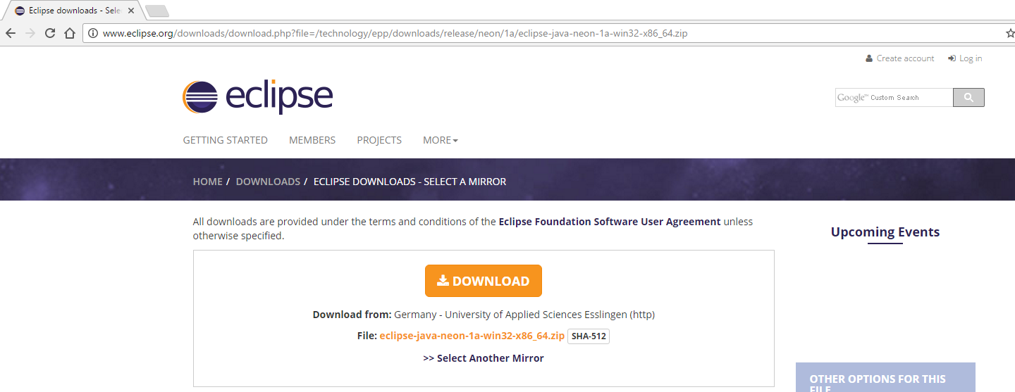
Download Eclipse

Slide 10
Object Oriented Programming Concepts
An Object has state(attributes) and behavior(methods) and model the real-World objects.
Getting and setting state through methods is known as Data Encapsulation.
A Class is the prototype from which an object is created.
Inheritance: A class can inherit its state and behavior from its super class.
An Interface is a contract, a class has to obey when the class implements the interface.
Package: A namespace for organizing classes and interfaces.

Slide 11
Object Oriented Programming Concepts
Polymorphism is the ability of an object to take on many forms.
The most common use of polymorphism in OOP occurs when a parent class reference is used to refer to a child class object.
A class can extend only one class, but implement many interfaces.

Slide 12
MySQL
MySQL, the most popular Open Source SQL database management system.
MySQL is developed, distributed, and supported by Oracle Corporation.

Slide 13
MySQL
MySQL databases are relational.
1.Data is in separate tables.
2.You set up rules for governing the relationships between different data fields:
e.g.:
one-to-one,
one-to-many,
many-to-many
unique,
required or
optional

Slide 14
How to connect to MySQL Server through Java Class?
You need a MySQL username and password.
You need to specify hostname and port of the MySQL server you are trying to connect.
You need to add jar file of mysql-connector-java-5.1.37-bin.jar to your java Project in order to connect to MySQL server through a java class.

Slide 15
CASE STUDY
Ceng Premiere League(CPL)
Schema
Team(name:char(20), city:char(20), color1:char(10), color2:char(10)),
Player(number:integer, teamname:char(20), name:char(30), age:integer, position:char(3)),
MatchResult(teamhome:char(20), teamaway:char(20), scorehome:integer, scoreaway:integer, week:integer),
HaveGoal(number:integer, teamname:char(20), week:integer, numberofgoals:integer),
CardShown(number:integer, teamname:char(20), week:integer, isred:boolean).

Slide 16
Add Jar File for MySQL Connection

Slide 17
Thank you for listening.
Any Questions?

Slide 18
References:
https://docs.oracle.com/javase/tutorial/
http://dev.mysql.com/doc/refman/5.7/en/tutorial.html
http://www.oracle.com/technetwork/java/javase/downloads/jdk8-downloads-2133151.html
http://www.tutorialspoint.com/java/

