Slide 1
STATEFLOW TO LUSTRE
Defining and translating a safe subset of Simulink/Stateflow into Lustre.
Verimag verion Vs Automaton version.
Hamza BOURBOUH
ISAE / ONERA / NAZA Ames

Slide 2
Plan
1. Abstract
2. A safe subset of Stateflow
2.1 A short description of Stateflow
2.2 The interpretation algorithm
2.3 Semantic issues with Stateflow
3. Simple conditions identifying a “safe” subset of Stateflow
4. Lustre and automaton
5. Translation into Lustre
5.1 Encoding of states Verimag version
5.2 Translation into Automaton : First Version.

Slide 3
1. Abstract
STATEFLOW is problematical for synchronous languages because of its unbounded behavior so we propose analysis techniques to define a subset of STATE-FLOW for which we can define a synchronous semantics. We go further and define a “safe” subset of STATEFLOW which elides features which are potential sources of errors in STATEFLOW designs.

Slide 4
2. A safe subset of Stateflow
A short description of Stateflow
The interpretation algorithm
Semantical issues with Stateflow

Slide 5
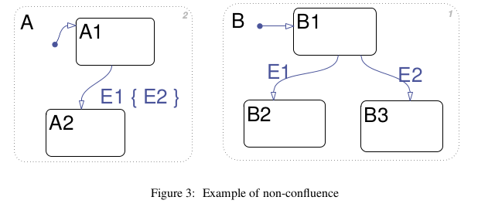
2.1 A short description of Stateflow

Slide 6
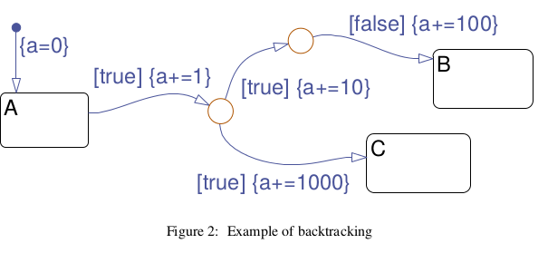
2.1 A short description of Stateflow
A transition can be a complex (possibly cyclic) flow graph made of segments joining connective junctions.

Slide 7
2.1 A short description of Stateflow
Each segment can bear a complex label with the following syntax (all fields are optional):
E[C]{Ac }/At
where E is an event, C is the condition (i.e., guard), Ac is the condition action and At is the transition action. Ac and At are written in the action language of STATEFLOW , which contains assignments, emissions of events, and so on. Actions written in the action language can also annotate states. A state can have an entry action, a during action, an exit action and on event E actions, where E is an event.

Slide 8
2.2 The interpretation algorithm
Search for active states: in order to impose determinism upon Stateflow semantics, the search for active states is performed from top to bottom and from left to right,
Search for valid transitions: transitions are searched according to the 12 o’clock rule. when the transition is multi-segment, the condition actions of each segment are executed while searching and traversing the transition graph.
Execute a valid transition: execute the exit action of the source state, set the source state to inactive, execute the transition actions of the transition path, set the destination state to active and finally execute the entry action of the destination state.
Idling: when an active state has no valid output transitions an active state performs its during action and the state remains active.
Termination: occurs when there are no active states.

Slide 9
2.2 The interpretation algorithm
It should be emphasized that each of the executions runs to completion and this makes the behavior of the overall algorithm very complex. In particular, when any of the actions consists of broadcasting an event, the interpretation algorithm for that event is also run to completion before execution proceeds. This means that the interpretation algorithm is recursive and uses a stack. However, as we will see, the stack does not store the full state, which leads to problems of side effect (Backtracking without “undo” example). Also, without care, the stack may overflow (Non-termination and stack overflow example).

Slide 10
2.3 Semantic issues with Stateflow
Non-termination and stack overflow
Backtracking without “undo”
Dependence of semantics on graphical layout
early return logic

Slide 11
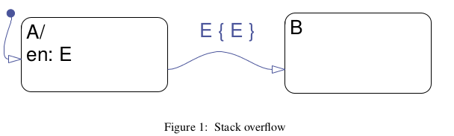
Non-termination and stack overflow
When the default state A is entered event E is emitted in the entry action of A. E results in a recursive call of the interpretation algorithm and since A is active its outgoing transition is tested. Since the current event E matches the transition event (and because of the absence of condition) the condition action is executed, emitting E again. This results in a new call of the interpretation algorithm which repeats the same sequence of steps until stack overflow.

Slide 12
Backtracking without “undo”
An example of such a behavior is generated by the model shown in Figure 2. The final value of variable a when state C is entered will be 1011 and not 1001 as might be expected. This is because when the segment with condition “false” is reached, the algorithm backtracks without “undoing” the action “a+=10”.

Slide 13
Dependence of semantics on graphical layout
A and B are parallel states. When event E1 arrives, if A is explored first, then E2 will be emitted and the final global state will be (A2, B3). But if B is explored first then the final global state will be (A2, B2). Thus, parallel states in STATEFLOW do not enjoy the property of confluence.

Slide 14
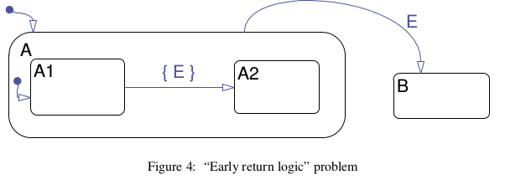
early return logic
When event E is emitted, the interpretation algorithm is called recursively. Parent state A is active, thus, its outgoing transition is explored and, since event E is present, the transition is taken. This makes A inactive, and B active. When the stack is popped and execution of the previous instance of the interpretation algorithm resumes, state A1 is not active anymore, since its parent is no longer active.

Slide 15
3 Simple conditions identifying a “safe” subset of Stateflow
In this section we present a sufficient number of simple conditions for avoiding error-prone models such as those discussed previously.
Absence of multi-segment loops: If no graph of junctions and transition segments contains a loop (a condition which can easily be checked statically) then the model will not suffer from non-termination problems referred previously.
Notation : An event E is said to be triggering a state s if the state has a “on event E: A” action or an outgoing transition which can be triggered by E . E is said to be emitted in s if it appears in the entry, during, exit or on-event action of s, or in the condition or transition action of one of the outgoing transitions of s.

Slide 16
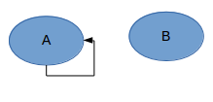
Acyclicity in the graph of triggering and emitted events
We draw a graph where nodes are the states and transitions between two nodes (v, v') exist iff state v can emit event E which can then trigger state v' , but only if v and v' can be active at the same time. If the graph above has no directed cycle then the model will not suffer from stack overflow problems.
Example fig1 :
E is emitted in A and triggering A.

Slide 17
Absence of assignments in intermediate segments:
In order to avoid side effects due to lack of “undo”, we can simply check that all variable assignments in a multi-segment transition appear either in transition actions (which are executed only once a destination state has been reached) or in the condition action of the last segment (whose destination is a state and not a junction). This ensures that even in case the algorithm backtracks, no variable has been modified. An alternative is to avoid backtracking altogether.

Slide 18

Checks for confluence: (see fig3)
A simple solution is to check that in the aforementioned graph of triggering and emitted events, there is no edge v→v' such that v belongs to A and v' to B or vice-versa.
In this example E2 is emitted in A1 and triggering B1.

Slide 19
Checks for “early return logic”:(fig4)
To ensure that our model is free of “early return logic” problems, we can check that for every state s and each of its outgoing transitions having a triggering event, this event is not emitted somewhere in s. In this example E is triggering A1 (because the event field is empty) and is emitted in A1 (because it appears in the condition action).

Slide 20
4. Lustre and automaton
Syntaxe :
[declaration of types and external functions]
node name (declaration of input flows)
returns (declaration of output flows)
[var declaration of local flows]
let
[assertions]
system of equations defining once each local flow and output depending on them and the inputs.
tel
[other nodes]

Slide 21
4. Lustre and automaton
Operator pre :
Memorization of the precedent value of a flow or a set of flows :
let X be the flow (X0, X1,..., Xn,...)
Then pre(X) is the flow (nil,X0, X1,..., Xn,...)
Operator → :
Initialization of a flow.
Let X be the flow (X0, X1,...,Xn,...) and Y the flow (Y0, Y1,..., Yn, …)
then Y → X is the flow (Y0,X1,...,Xn,...).

Slide 22
4. Lustre and automaton
Operator when :
Let X be a flow and B a Boolean flow (assimilated to a clock) of same clock.
The equation Y = X when B
defines a flow Y, of same type than X, and of clock B
  Y is present When B is true
  Y is absent when B is false or when B and X are absent.

Slide 23
4. Lustre and automaton
Operator current :
Let X be a flow and B a Boolean flow (assimilated to a clock) of same clock.
The equation Y = X current B
defines a flow Y, of same type than X, and of clock the clock of B
  Y is present When B is true
  When Y is present, Y is equal to X if X is present and to the previous value of X otherwise.

Slide 24
4. Lustre and automaton
Recapitulation :
B | False | true | false | true | false | false | true | true
X | x0 | x1 | x2 | x3 | x4 | x5 | x6 | x7
Y | y0 | y | y2 | y3 | y4 | y5 | y6 | y7
pre(X) | nil | x0 | x1 | x2 | x3 | x4 | x5 | x6
Y →pre(X) | y0 | x0 | x1 | x2 | x3 | x4 | x5 | x6
Z = X when B |  | x1 |  | x3 |  |  | x6 | x7
T=current(Z) | nil | x1 | x1 | x3 | x3 | x3 | x6 | x7
pre(Z) |  | nil |  | x1 |  |  | x3 | x6
0 → pre(Z) |  | 0 |  | x1 |  |  |  | x6

Slide 25
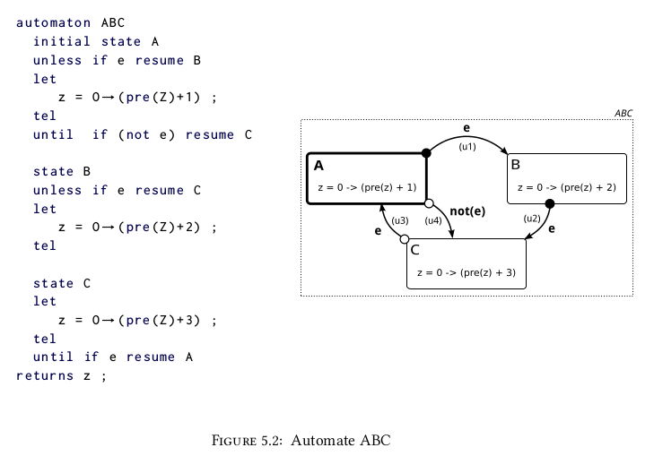
4. Lustre and automaton
Automaton :

Slide 26
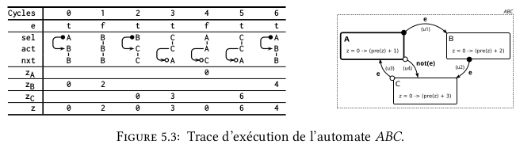
4. Lustre and automaton
Automaton :
Unless E : if E then go directly to destination state and execute It;
else execute the source state (in this case next state is the Current state state).
Until E : execute source state ; if E then next state will be the Destination of the transition;
else next state is the current state.
Sel : selected state. Act : actual state (where we will execute equation). Nxt : selected state for next clock.

Slide 27
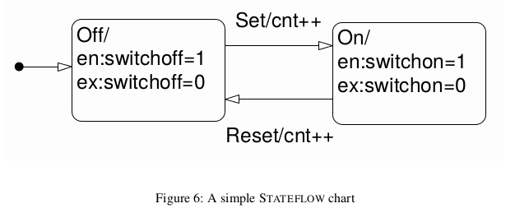
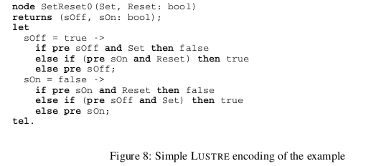
5. Translation into Lustre

Slide 28
5.1 Encoding of states
This code is semantically correct for a system consisting only of states but it is difficult to incorporate the imperative actions attached to both states and transitions in STATEFLOW . For example, if the above code had included the entry actions in the states then all the values referenced by the action code would have to be updated in each branch of the if-then tree. So the number of values being updated can become large and if more than one state updates the same value then causality loops could arise.

Slide 29
5.1 Encoding of states
Inspecting the code in Figure 8 the state update equation for each state consists of:
• An initialization value computed from default transitions (true for sOff),
• a value for each outgoing transition (Set for sOff),
• an exit clause ((pre sOff and Set) for sOff),
• an entry clause ((pre sOn and Reset) for sOff) and
• a no-change value (pre sOff).
Explicitly separating these components allows us to insert the action code at the correct point in the computation of a reaction.

Slide 30
5.1 Encoding of states Verimag version
the code has been split into several sections.
• Initial values. These are the initial values for all variables, false for states and the initial value from the data dictionary for STATEFLOW variables.
• Transition validity. In this section the values for the transitions are computed. For convenience in the translator these are actually calls to predefined nodes generated in advance from the transitions’ events and actions. Note that the test for the activity of the source state is included in the transition’s validity test.
• State exits. Any states which are true and have a valid outgoing transition are set to false.
• Exit actions. The code for any exiting state’s exit actions is computed. This section also includes during actions for states which remain active and on actions also for active states.
• Transition actions. The code for the transition actions is executed. Note that the exiting state’s value is false while this occurs.
• State entries. Any states which are false and have a valid incoming transition are set to true.
• Entry actions. Entering states action code is executed with the state’s variable now true.

Slide 31
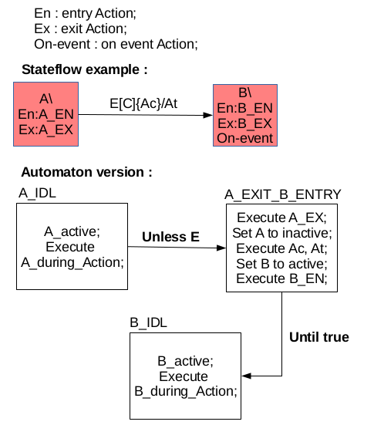
5.2 Translation into Automaton : First Version.

Slide 32
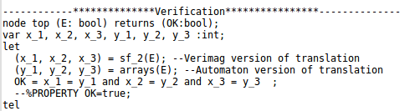
5.2 Translation into Automaton : First Version.
The following examples are translated into our Automaton version and compared to Verimag Version. They have the same behavior and tested using our Lustrec compiler (top node).

Slide 33
Switch Example

Slide 34
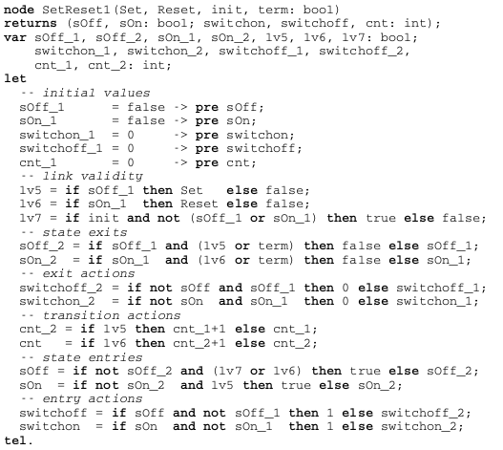
Switch example in Lustre (Verimag version)

Slide 35
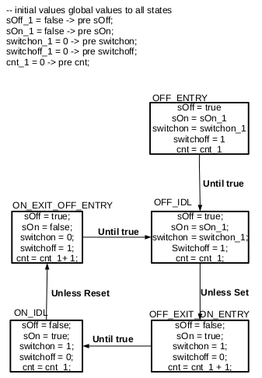
Switch example in Automaton version

Slide 36
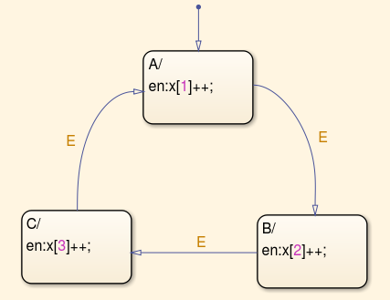
Arrays Example
In this example we use three integer outputs x1, x2 and x3 instead of an array x int^3.

Slide 37
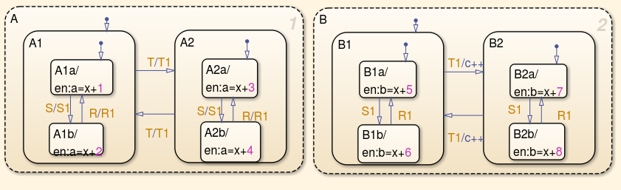
Events Example
This example is not yet completely tested. The output “a” is tested and valid.

