Slide 1
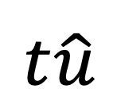
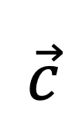
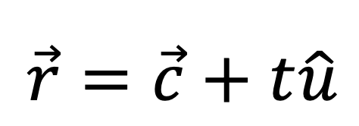
Line
$$t\hat{u}$$
$$\vec{c}$$
$$\vec{r}=\vec{c}+t\hat{u}$$
Origin

