Slide 1
Machine learning in physics Jupyter lab

Slide 2
Installation of miniconda3
Go to website: https://www.anaconda.com/docs/getting-started/miniconda/install
Download the installer for your operating system and follow the prompts to install miniconda3. Then…
Create a miniconda3 environment (e.g, here named mlp)
conda create -n mlp (use conda env remove –n mlp to remove it)
Activate environment conda activate mlp
Install packages:
conda install pytorch

Slide 3
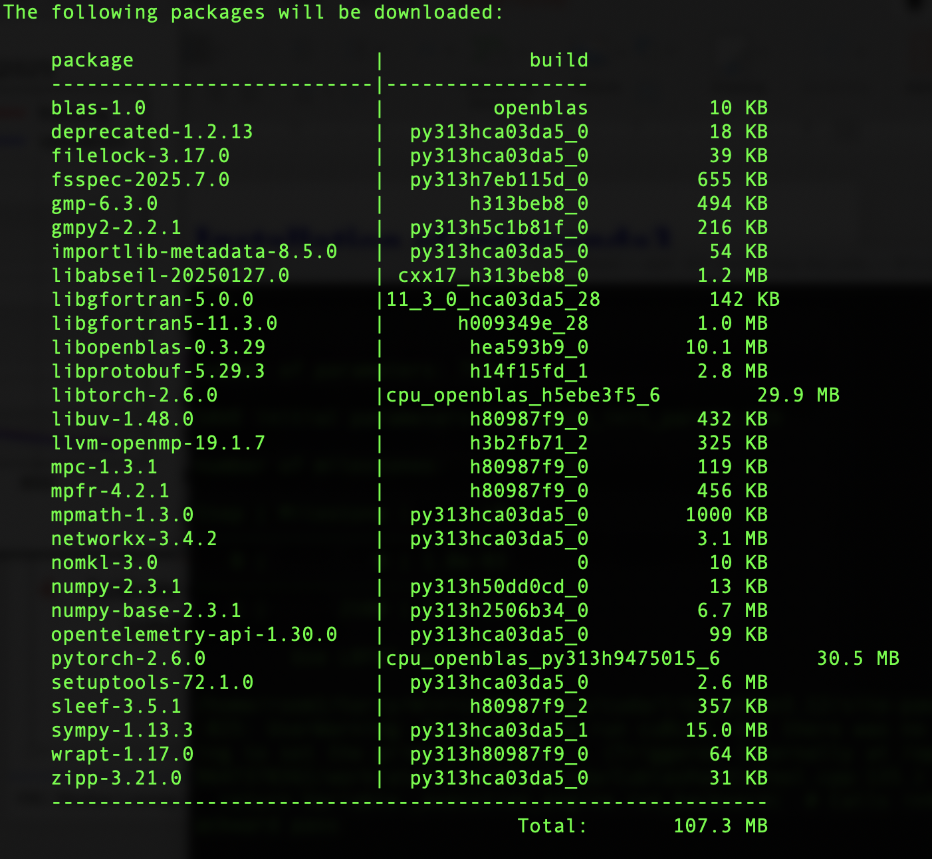
Installation of miniconda3
For
PyTorch,
check for
pytorch
numpy
sympy

Slide 4
Installation of miniconda3
Then install packages:
conda install jupyterlab
conda install matplotlib
conda install pandas
conda install scipy
conda install scikit-learn
conda install ffmpeg
Launch jupyterlab At the prompt in a terminal window, enter the command
jupyter lab
and iconize the window

Slide 5
Installation of miniconda3
Download the the following notebooks from canavs:
test.ipynb
python_minimum_part1.ipynb
python_minimum_part2.ipynb
Test your installation by executing the notebooks in the order listdd, cell by cell.

