Slide 1
Machine learning in physics Tutorial 1

Slide 2
Installation of miniconda3
Go to website: https://www.anaconda.com/docs/getting-started/miniconda/install
Download the installer for your operating system and follow the prompts to install miniconda3. Then…
Create a miniconda3 environment (e.g., here named mlp)
conda create -n mlp (use conda env remove –n name to remove the environment “name”.)
Activate environment conda activate mlp
Install packages:
conda install pytorch

Slide 3
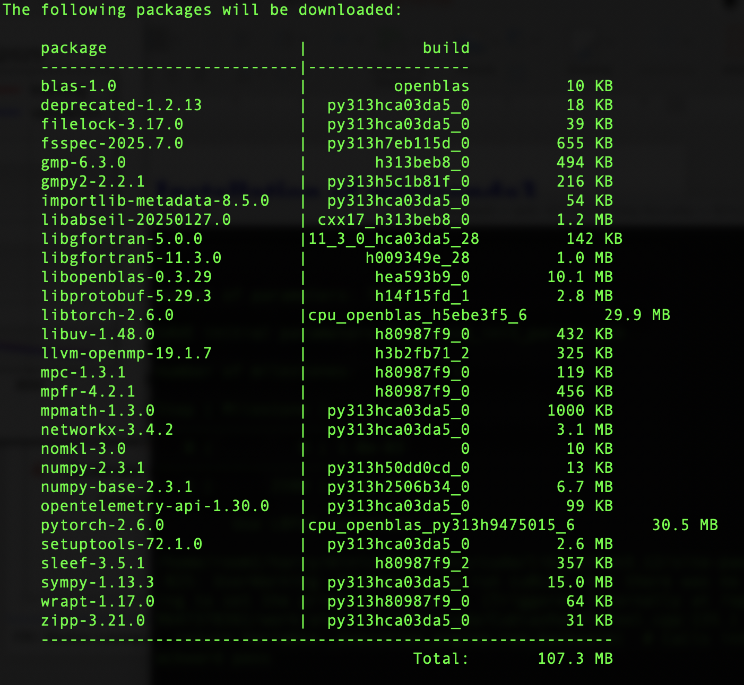
Installation of miniconda3
For
PyTorch,
check for
pytorch
numpy
sympy

Slide 4
Installation of miniconda3
Then install packages:
conda install jupyterlab
conda install matplotlib
conda install pandas
conda install scipy
conda install scikit-learn
conda install ffmpeg
conda install tqdm
Launch jupyterlab In a terminal, which can be iconized afterwards, use the command
jupyter lab

Slide 5
Tutorial 1
Download the following notebooks from canvas:
test.ipynb
python_minimum_part1.ipynb
python_minimum_part2.ipynb
tutorial01.ipynb
Test your installation by executing the test.ipynb notebook.
Then go through the python minimum tutorials line-by-line and try to understand what each line or set of lines does.
Then work through tutorial01.ipynb before the next class.

