Slide 1
Machine Learning In PHYsics FoundationS 2
Harrison B. Prosper
PHY 6938 Fall 2024

Slide 2
Recap: AI, ML, and DL
Artificial Intelligence
Algorithms that cause machines to exhibit human- or super-human-level intelligence.
Machine Learning
Algorithms for modeling data
Deep Learning
ML using (large) neural networks

Slide 3
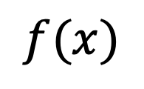

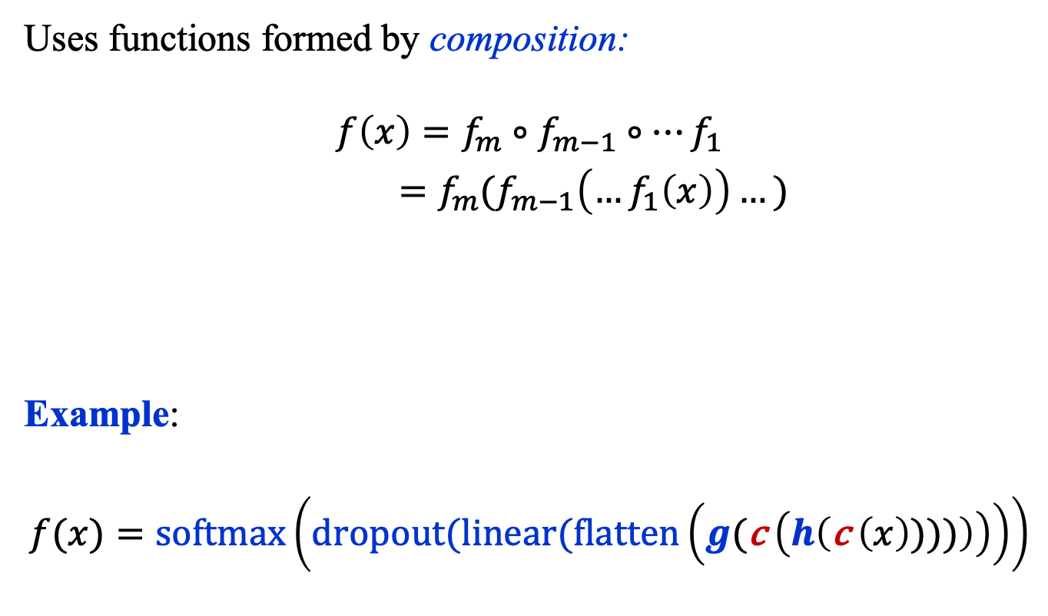



Recap: Deep Learning
Uses functions formed by composition:
$$f\left(x\right)=f_{m}∘f_{m−1}∘…f_{1}$$
$=f_{m}(f_{m−1}\left(…f_{1}\left(x\right)\right)…)$
Example:
$$f(x)=\text{softmax}\left(dropout(linear(flatten\left(g(\text{c} \left(h\left(\text{c} \left(x\right))))\right)\right)\right)\right)$$
$$f(x)$$
…
$$x$$
$$f_{m}$$
$$f_{m−1}$$
$$f_{1}$$

Slide 4
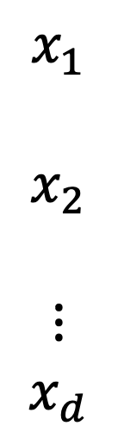
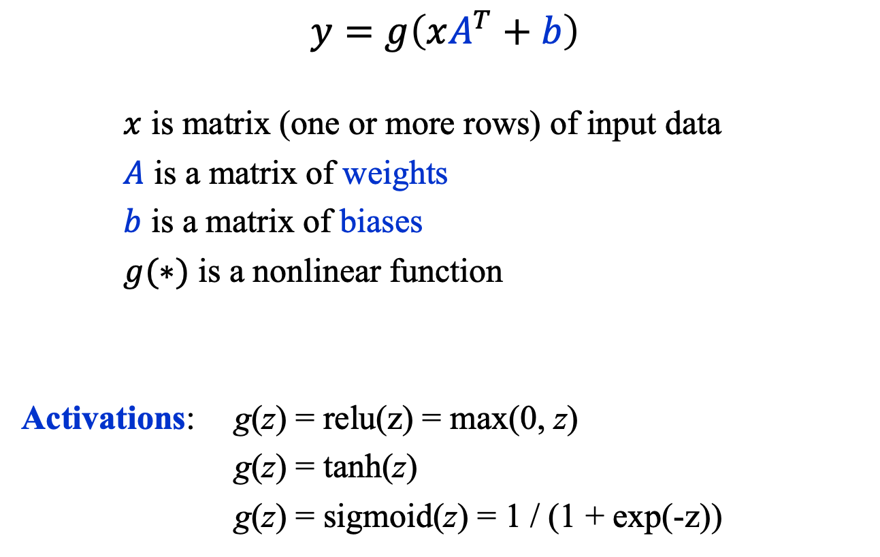



Recap: The Perceptron
$$y=g\left(xA^{T}+b\right)$$
$x$ is matrix (one or more rows) of input data
$A$ is a matrix of weights
$b$ is a matrix of biases
$g(∗)$ is a nonlinear function
Activations: g(z) = relu(z) = max(0, z)
g(z) = tanh(z)
g(z) = sigmoid(z) = 1 / (1 + exp(-z))
$$x_{1}$$
$$x_{2}$$
$$⋮$$
$$x_{d}$$
$$y$$
$$g$$
$$A, b$$
https://news.cornell.edu/stories/2019/09/professors-perceptron-paved-way-ai-60-years-too-soon

Slide 5
Multi-Node perceptron

Slide 6

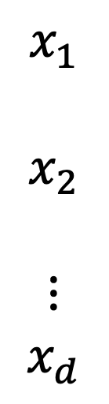
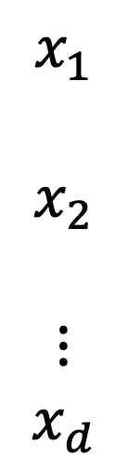






Multi-Node Perceptron
$$x_{1}$$
$$x_{2}$$
$$⋮$$
$$x_{d}$$
$$g\left(z\right)=\text{relu}(z)$$
$$y_{1}=g\left(xA_{1}^{T}+b_{1}\right)$$
Example:
$$A_{1}=\left(2,−3, 1\right), b_{1}=−5$$
$$y_{2}=g\left(xA_{2}^{T}+b_{2}\right)$$
$$A_{2}=\left(1, 2, 3\right), b_{2}=−4$$
$$y_{1}$$
$$g$$
$$A_{1}, b_{1}$$
$$x_{1}$$
$$x_{2}$$
$$⋮$$
$$x_{d}$$
$$y_{2}$$
$$g$$
$$A_{2}, b_{2}$$

Slide 7
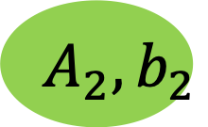



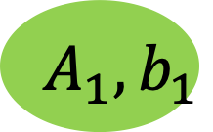


Multi-Node Perceptron
A multi-node perceptron is often drawn as follows,
computed sequentially: $z=xA^{T}+b$
$y =g\left(z\right)$ and, usually, the
activation function $g\left(z\right)$is applied elementwise, that is, to every element of its matrix input. (Demo)
$$x_{1}$$
$$x_{2}$$
$$⋮$$
$$x_{d}$$
$$y_{1}$$
$$g$$
$$A_{1}, b_{1}$$
$$y_{2}$$
$$g$$
$$A_{2}, b_{2}$$

Slide 8
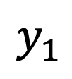








Multi-Node Perceptron
Consider the task of modeling the data triplets $D=\left\{{\left(x_{1},x_{2},y\right)}_{i=1}^{N}\right\}$ with a function of the form
$y=f\left(x_{1},x_{2},ω\right)$. Let’s try a 2-input 4-node perceptron with $g\left(z\right)=zσ\left(z\right)$,
where,
$$σ\left(z\right)=\frac{1}{\left(1+e^{−z}\right)}$$
$zσ(z)$ is called a silu.
$ω$ are free parameters.
$$y_{1}$$
$$y_{2}$$
$$x_{1}$$
$$x_{2}$$
$$y_{3}$$
$$y_{4}$$
$$g$$
$$A, b$$
$$≡$$

Slide 9
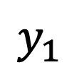
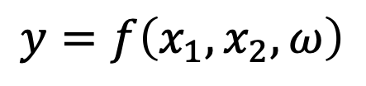


Multi-Node Perceptron
Then, let’s feed the output of the first perceptron into a 4-input 1-node perceptron:
$$y_{1}$$
$$y=f\left(x_{1}, x_{2}, ω\right)$$
$$y_{2}$$
$$x_{1}$$
$$x_{2}$$
$$y_{3}$$
$$y_{4}$$
$$g$$
$$A, b$$
$$≡$$

Slide 10
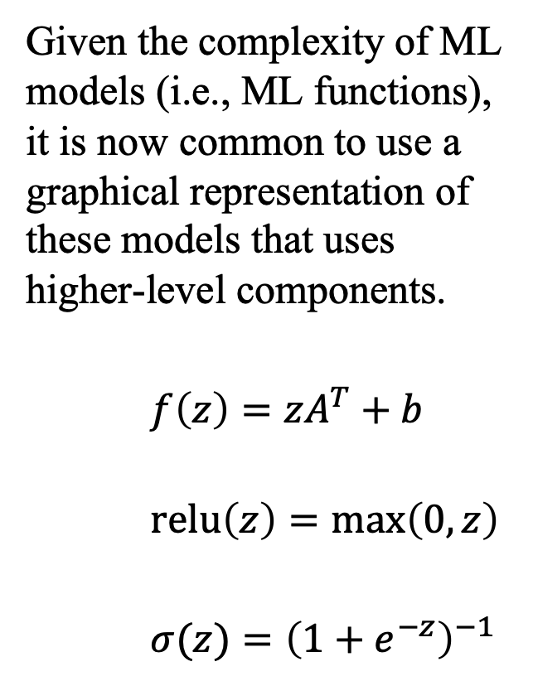

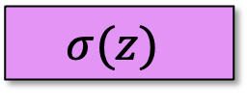

Multi-Node Perceptron
Given the complexity of ML models (i.e., ML functions), it is now common to use a graphical representation of these models that uses higher-level components.
$f\left(z\right)=zA^{T}+b$
$\text{relu}\left(z\right)=\text{max}\left(0, z\right)$
$σ(z)={\left(1+e^{−z}\right)}^{−1}$
output
$$σ(z)$$
Layer 2
Linear(4, 1)
$$\text{relu}(z)$$
Layer 1
Linear(2, 4)
$$x$$

Slide 11
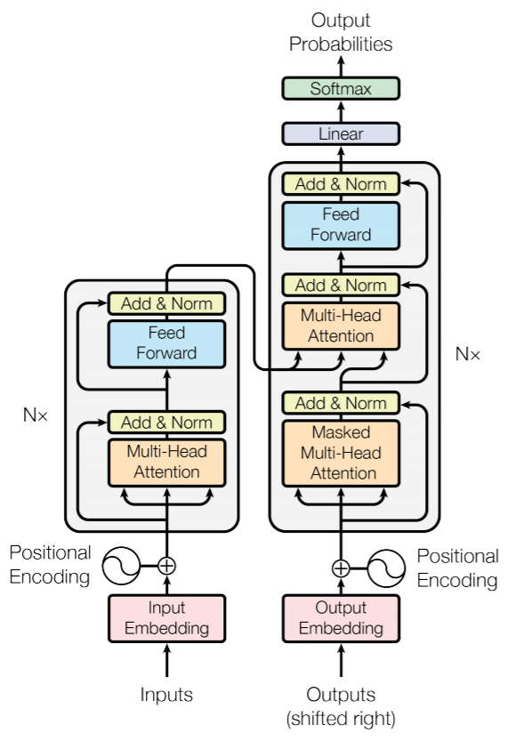
Multi-Node Perceptron
Here, for example, is a graphical representation of transformer, the model that powers ChatGPT.
There are 2 x 96 of these “layers”!

Slide 12
Loss functions

Slide 13
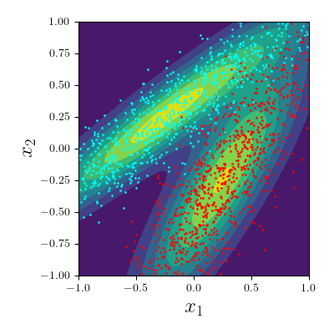
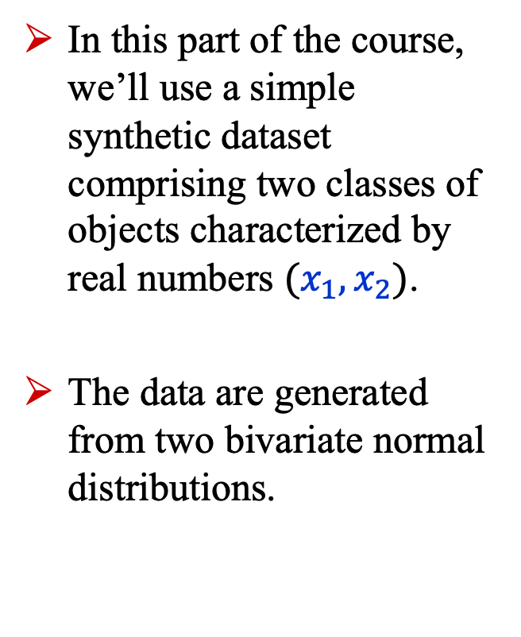
2D Dataset
In this part of the course, we’ll use a simple synthetic dataset comprising two classes of objects characterized by real numbers $(x_{1},x_{2})$.
The data are generated from two bivariate normal distributions.

Slide 14
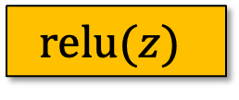
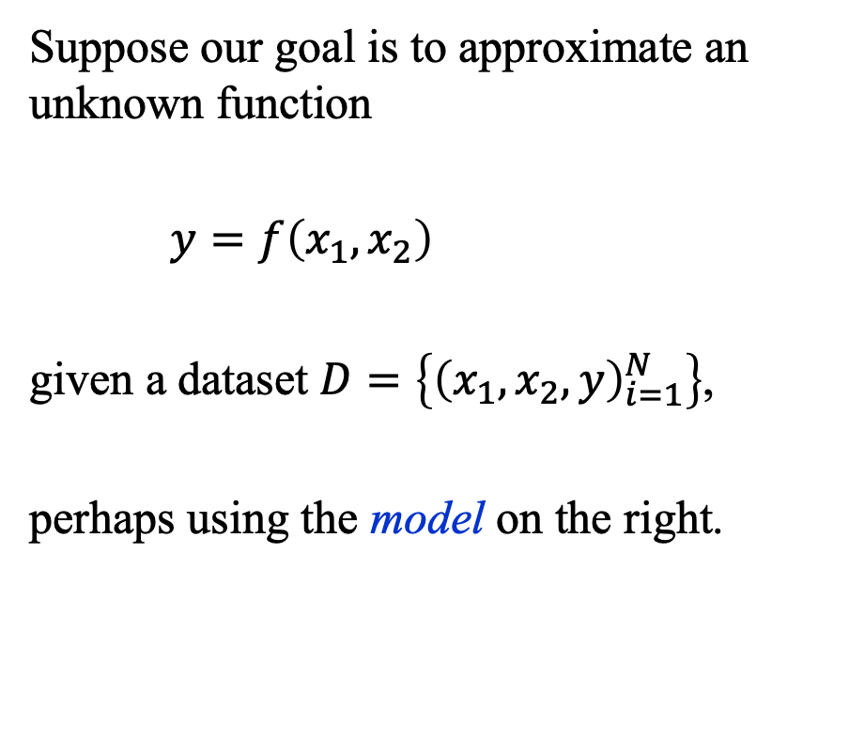


Loss Functions
Suppose our goal is to approximate an unknown function
$y=f\left(x_{1},x_{2}\right)$
given a dataset $D=\left\{{\left(x_{1},x_{2},y\right)}_{i=1}^{N}\right\}$,
perhaps using the model on the right.
output
$$σ(z)$$
Linear(4, 1)
$$\text{relu}(z)$$
Linear(2, 4)
$$x$$

Slide 15
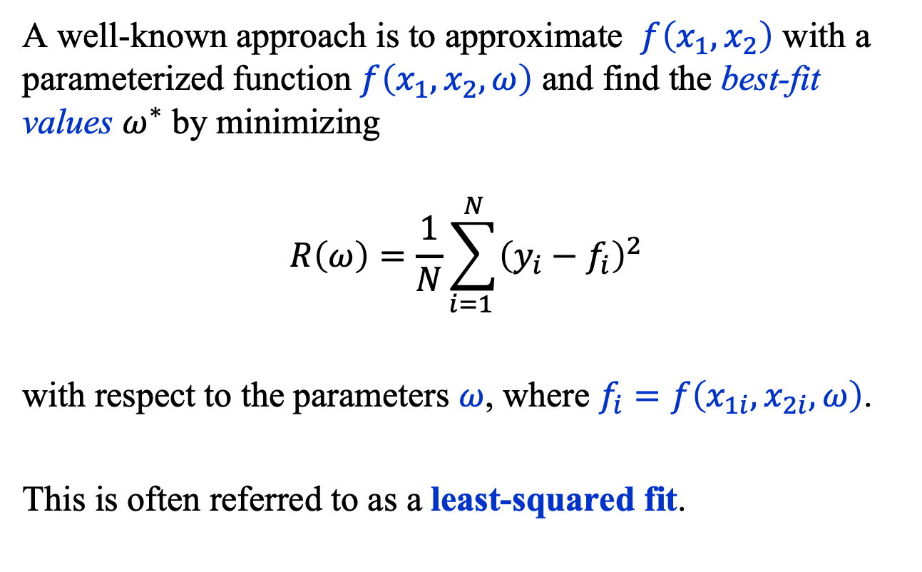
Loss Functions
A well-known approach is to approximate $f\left(x_{1},x_{2}\right)$ with a parameterized function $f\left(x_{1},x_{2},ω\right)$ and find the best-fit values $ω^{∗}$ by minimizing
$$R\left(ω\right)=\frac{1}{N}\sum_{i=1 }^{N}{{\left(y_{i}−f_{i}\right)}^{2}}$$
with respect to the parameters $ω$, where $f_{i}=f\left(x_{1i}, x_{2i},ω\right)$.
This is often referred to as a least-squared fit.

Slide 16
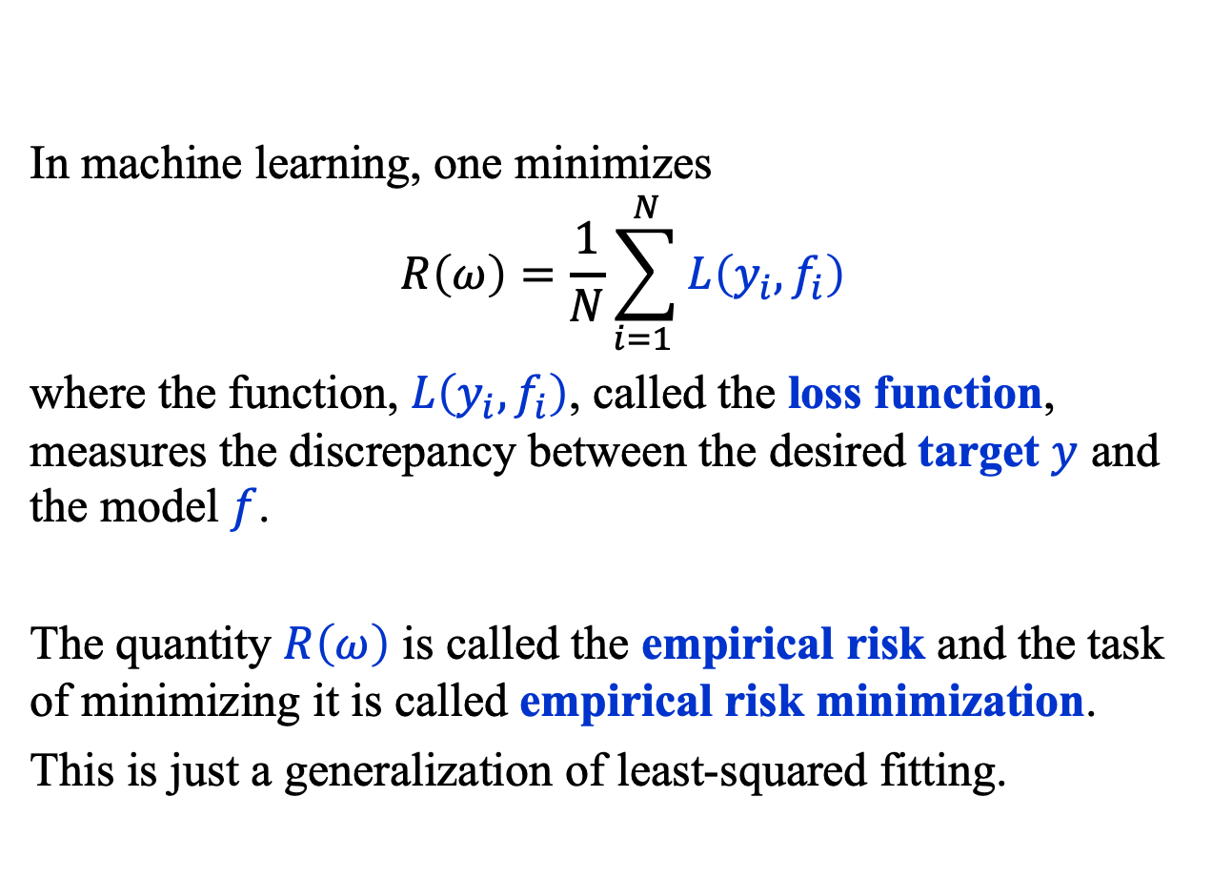
Loss Functions
In machine learning, one minimizes
$$R\left(ω\right)=\frac{1}{N}\sum_{i=1 }^{N}{L\left(y_{i}, f_{i}\right)}$$
where the function, $L\left(y_{i}, f_{i}\right)$, called the loss function, measures the discrepancy between the desired target $y$ and the model $f$.
The quantity $R\left(ω\right)$ is called the empirical risk and the task of minimizing it is called empirical risk minimization.
This is just a generalization of least-squared fitting.

Slide 17
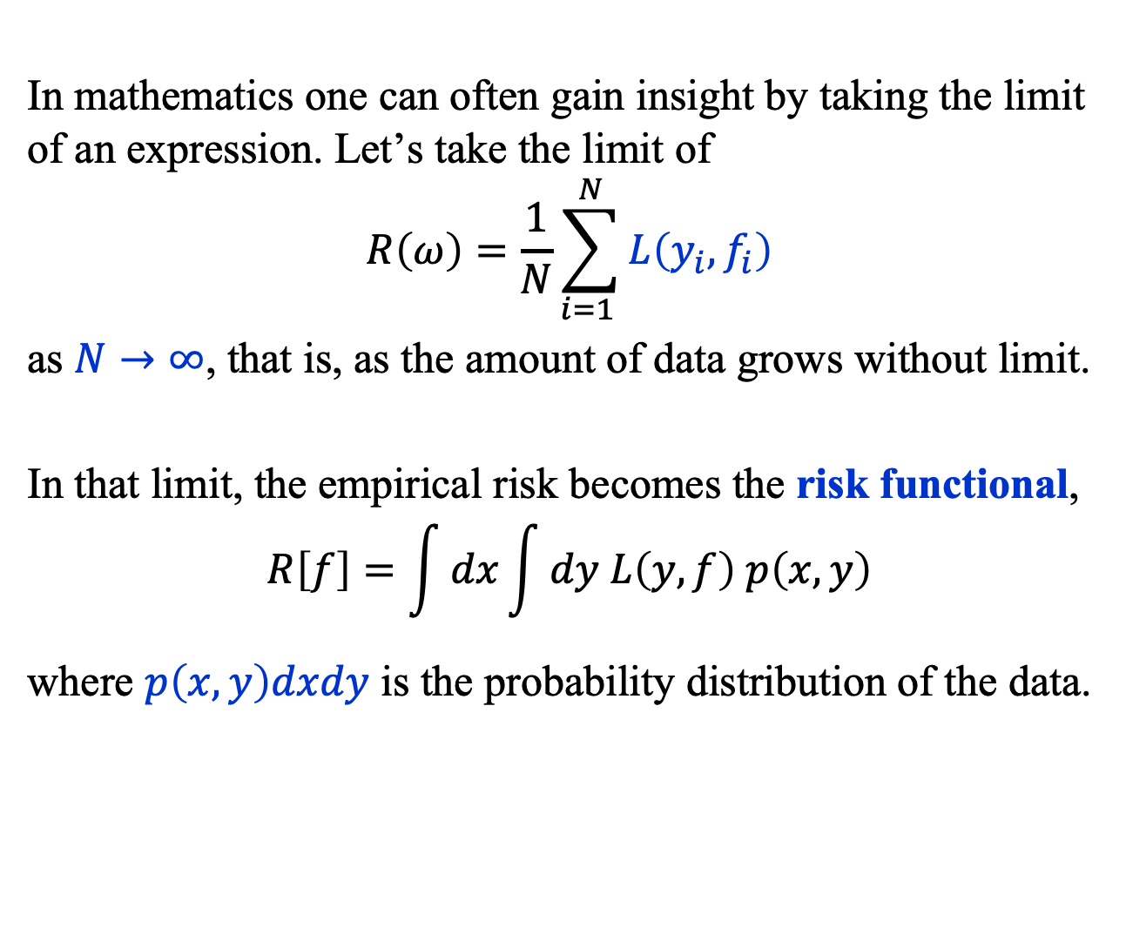
Risk Functional
In mathematics one can often gain insight by taking the limit of an expression. Let’s take the limit of
$$R\left(ω\right)=\frac{1}{N}\sum_{i=1 }^{N}{L\left(y_{i}, f_{i}\right)}$$
as $N→∞$, that is, as the amount of data grows without limit.
In that limit, the empirical risk becomes the risk functional,
$$R\left[f\right]=\int{dx}\int{dy L\left(y, f\right) p\left(x, y\right)}$$
where $p\left(x, y\right)dxdy$ is the probability distribution of the data.

Slide 18
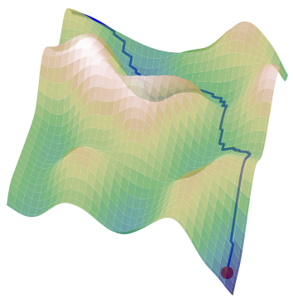
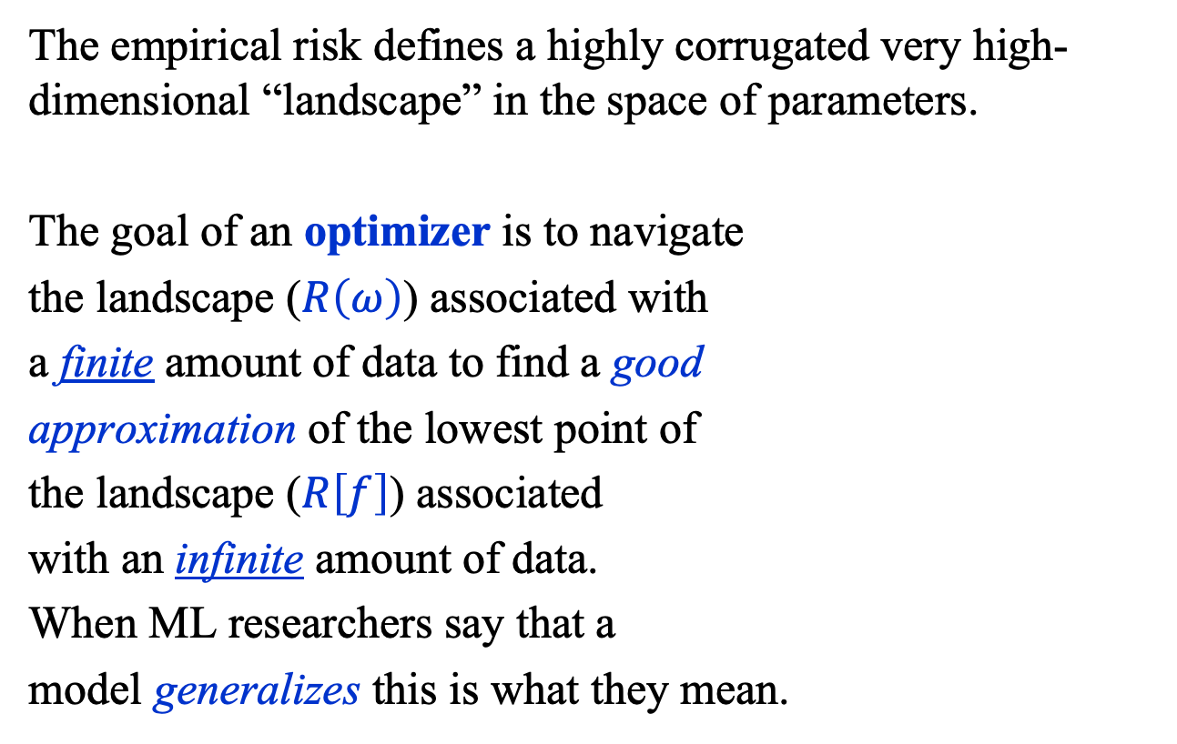
Risk Functional: Landscape
The empirical risk defines a highly corrugated very high-dimensional “landscape” in the space of parameters.
The goal of an optimizer is to navigate
the landscape ($R\left(ω\right)$) associated with
a finite amount of data to find a good
approximation of the lowest point of
the landscape ($R\left[f\right]$) associated
with an infinite amount of data.
When ML researchers say that a
model generalizes this is what they mean.

Slide 19
Summary
We described the multi-node perceptron and how machine learning models are represented graphically.
We illustrated the calculation of the output of a perceptron.
We discussed the generalization of least-squared fitting to empirical risk minimization.

