Slide 1
Machine learning in physics Lab 02 / Tutorial 2

Slide 2
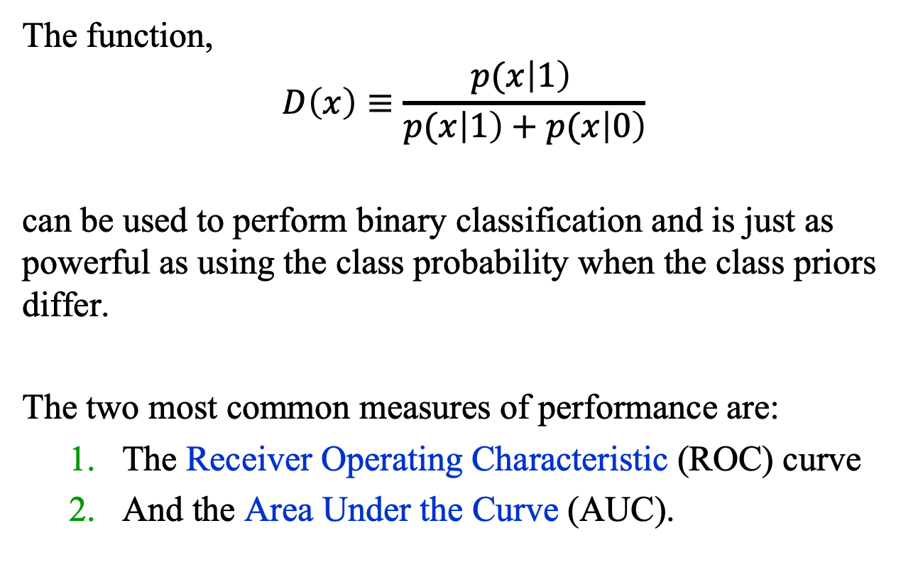
Recap
The function,
$$D\left(x\right)≡\frac{p(x\left|1\right) }{p(x\left|1\right)+p(x\left|0\right)}$$
can be used to perform binary classification and is just as powerful as using the class probability when the class priors differ.
The two most common measures of performance are:
The Receiver Operating Characteristic (ROC) curve
And the Area Under the Curve (AUC).

Slide 3
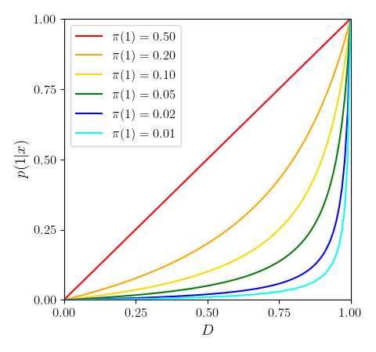

Recap
$$p\left(1 \right| x)=\frac{D(x) π(1)}{D(x)π(1)+(1−D(x))(1−π\left(1\right))}$$
The dependence of $p\left(1 \right| x)$
on $D(x$) for different values
of the prior $π(1)$.

Slide 4
Lab02: ROC and AUC

