Slide 1
Machine learning in physics Foundations 3

Slide 2
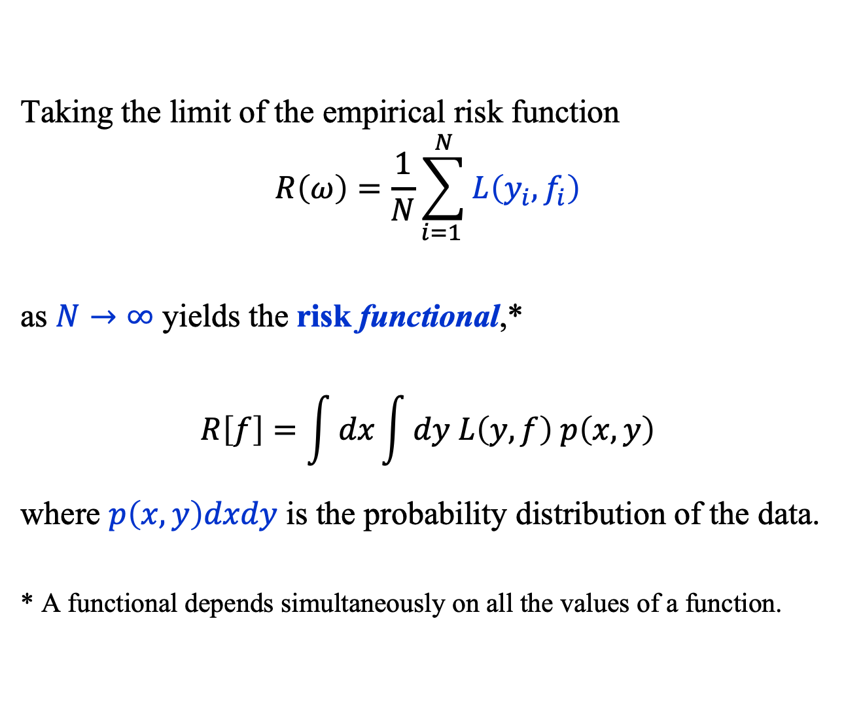
Recap: Risk Functional
Taking the limit of the empirical risk function
$$R\left(ω\right)=\frac{1}{N}\sum_{i=1 }^{N}{L\left(y_{i}, f_{i}\right)}$$
as $N→∞$ yields the risk functional,*
$$R\left[f\right]=\int{dx}\int{dy L\left(y, f\right) p\left(x, y\right)}$$
where $p\left(x, y\right)dxdy$ is the probability distribution of the data.
* A functional depends simultaneously on all the values of a function.

Slide 3
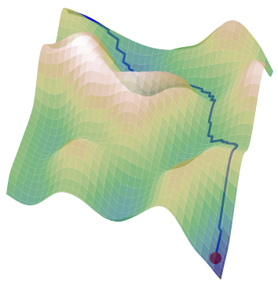
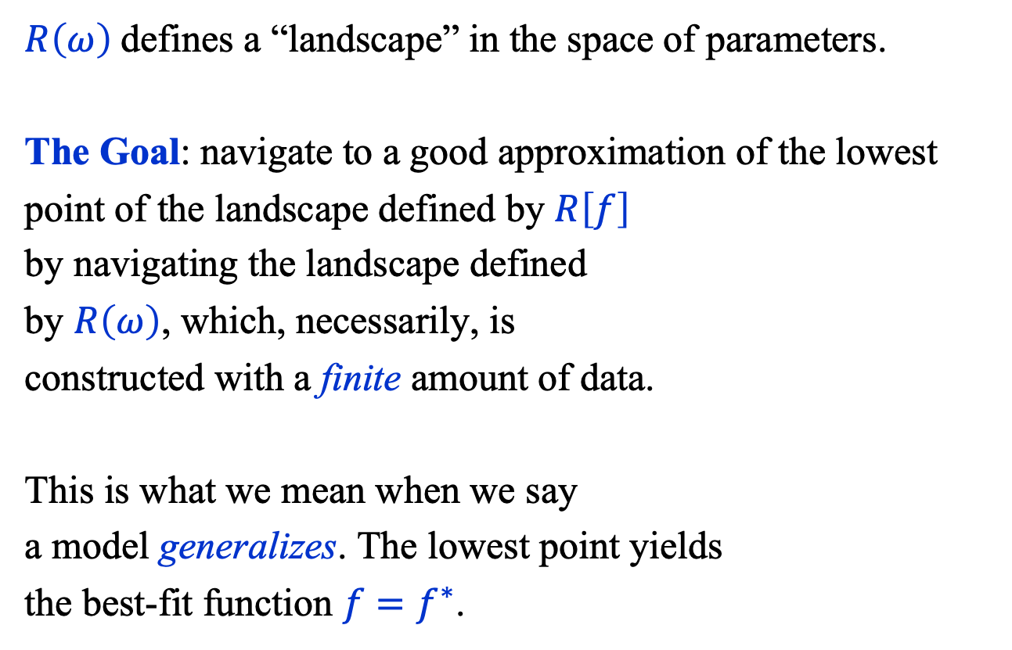
Recap: Risk Functional Landscape
$R\left(ω\right)$defines a “landscape” in the space of parameters.
The Goal: navigate to a good approximation of the lowest
point of the landscape defined by $R\left[f\right]$
by navigating the landscape defined
by $R\left(ω\right)$, which, necessarily, is
constructed with a finite amount of data.
This is what we mean when we say
a model generalizes. The lowest point yields
the best-fit function ${f=f}^{∗}$.

Slide 4

finding the best-fit function ${f=f}^{∗}$

Slide 5
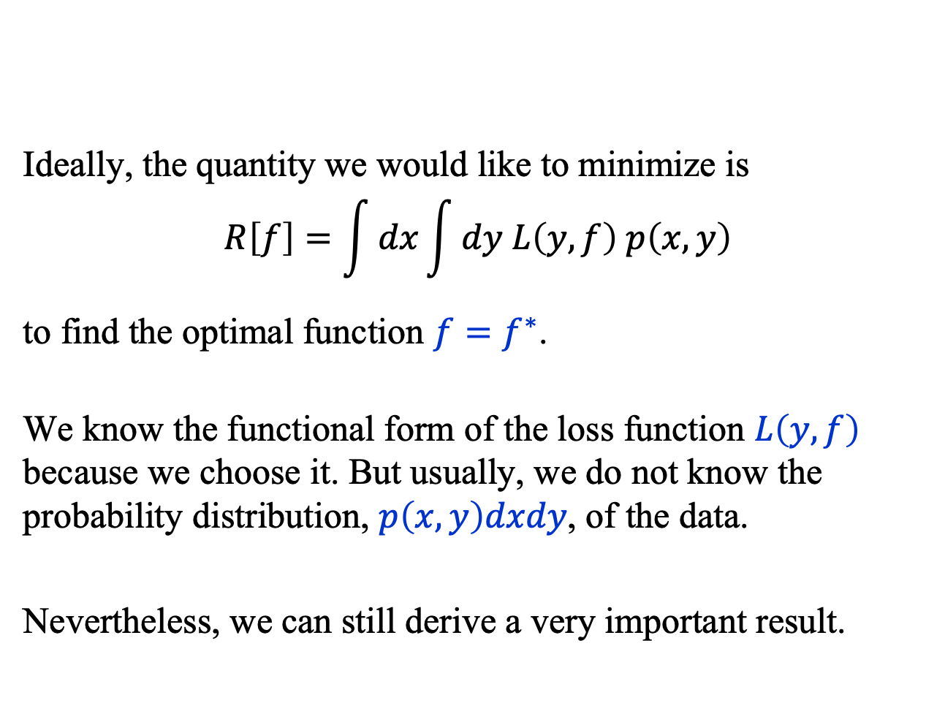
Finding the Best-Fit Function
Ideally, the quantity we would like to minimize is
$$R\left[f\right]=\int{dx}\int{dy L\left(y, f\right) p\left(x, y\right)}$$
to find the optimal function ${f=f}^{∗}$.
We know the functional form of the loss function $L\left(y, f\right)$ because we choose it. But usually, we do not know the probability distribution, $p\left(x, y\right)dxdy$, of the data.
Nevertheless, we can still derive a very important result.

Slide 6
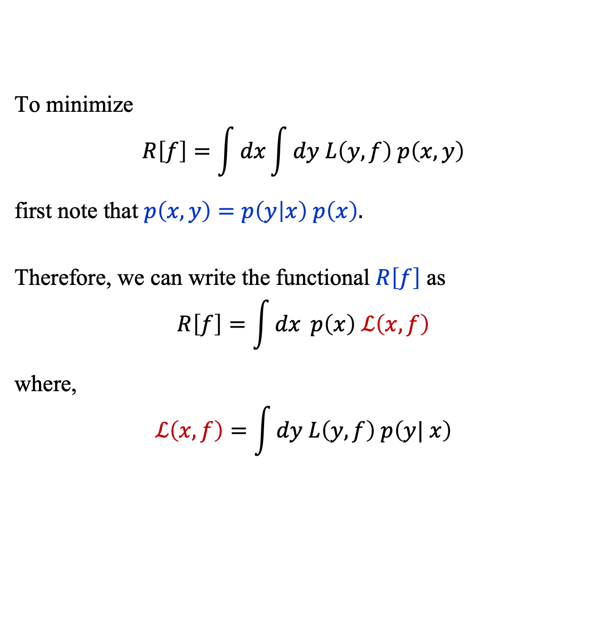
Finding the Best-Fit Function
To minimize
$$R\left[f\right]=\int{dx}\int{dy L\left(y, f\right) p\left(x, y\right)}$$
first note that $p\left(x, y\right)=p\left(y | x\right) p\left(x\right).$
Therefore, we can write the functional $R\left[f\right]$ as
$$R\left[f\right]=\int{dx} p\left(x\right) ℒ\left(x, f\right)$$
where,
$$ℒ\left(x, f\right)=\int{dy L\left(y, f\right) p\left(y| x\right)}$$

Slide 7
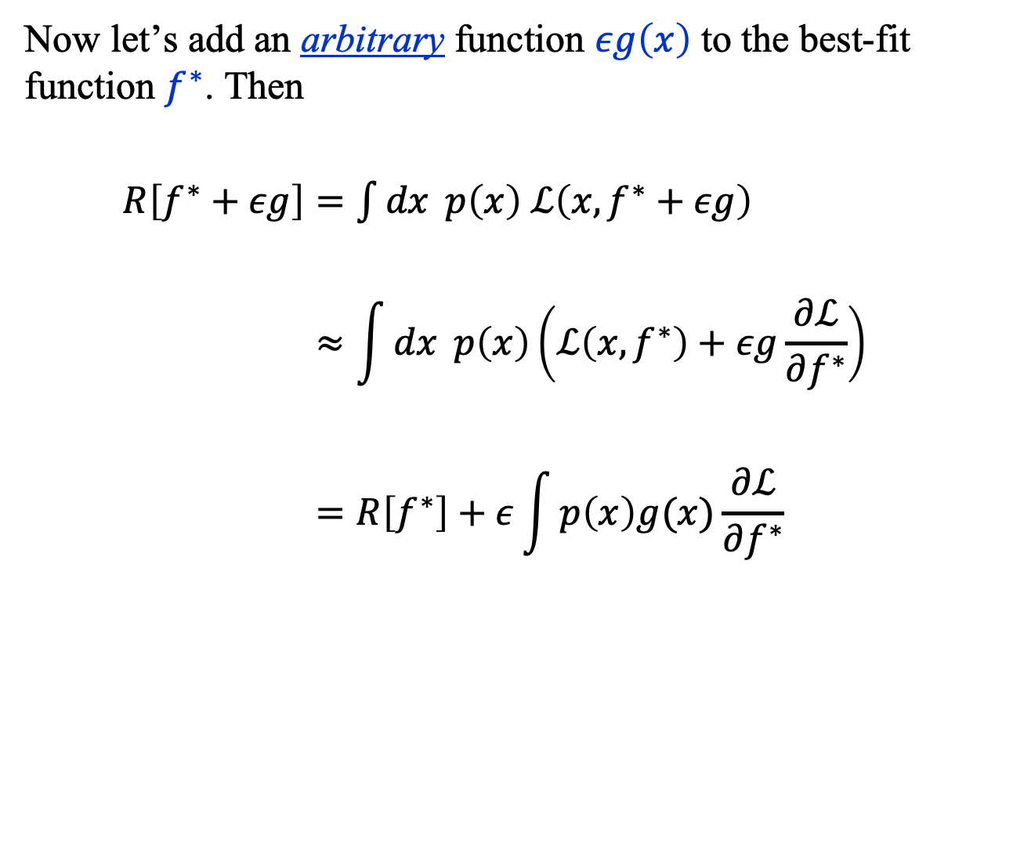
Finding the Best-Fit Function
Now let’s add an arbitrary function $εg\left(x\right)$ to the best-fit function $f^{∗}$. Then
$R\left[f^{∗}+εg\right]=\int{dx} p\left(x\right) ℒ\left(x, f^{∗}+εg\right)$
$$≈\int{dx} p\left(x\right)\left(ℒ\left(x, f^{∗}\right)+εg\frac{∂ℒ}{∂f^{∗}}\right)$$
$$=R\left[f^{∗}\right]+ε\int{p\left(x\right)g(x)\frac{∂ℒ}{∂f^{∗}}}$$

Slide 8
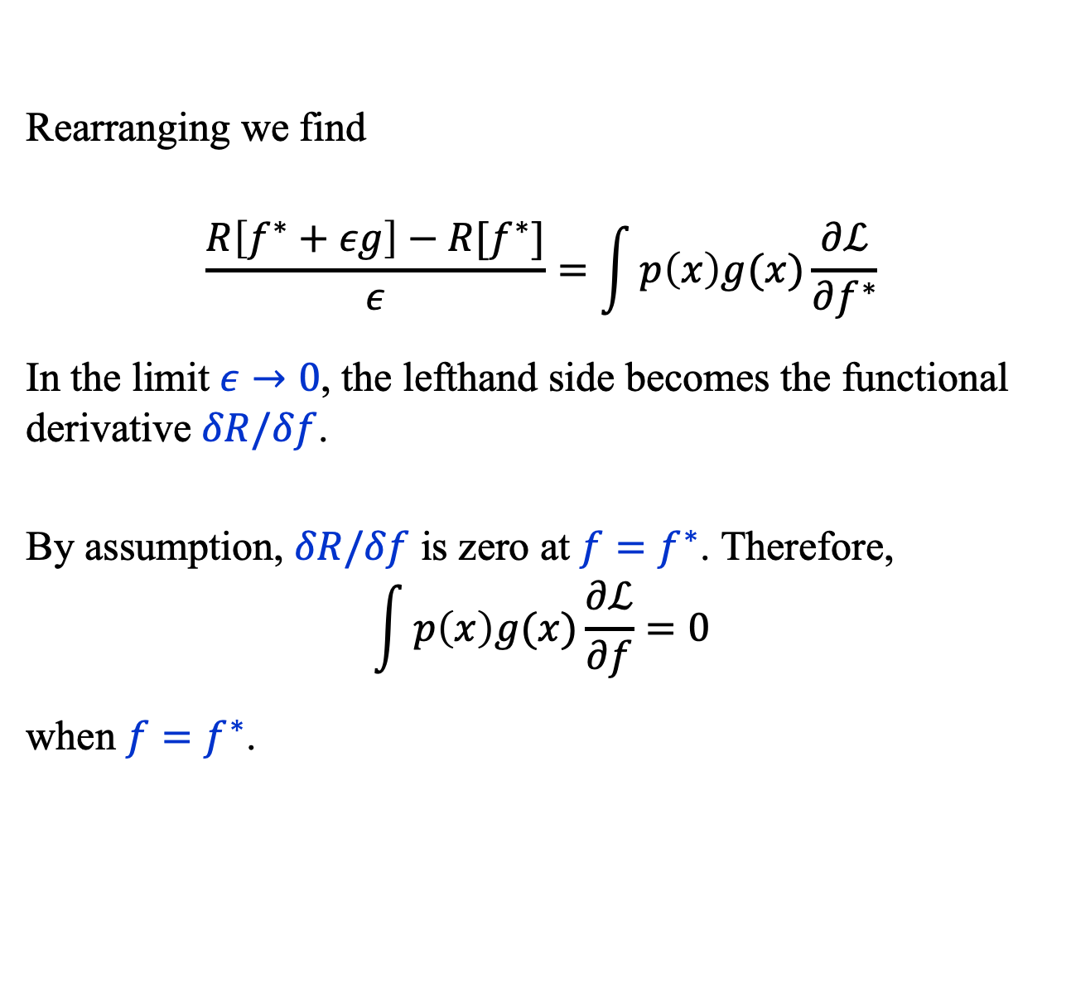
Finding the Best-Fit Function
Rearranging we find
$$\frac{R\left[f^{∗}+εg\right]−R[f^{∗}]}{ε}=\int{p\left(x\right)g(x)\frac{∂ℒ}{∂f^{∗}}}$$
In the limit $ε→0$, the lefthand side becomes the functional derivative $δR/δf$.
By assumption, $δR/δf$ is zero at $f=f^{∗}$. Therefore,
$$\int{p\left(x\right)g(x)\frac{∂ℒ}{∂f}}=0$$
when $f=f^{∗}$.

Slide 9
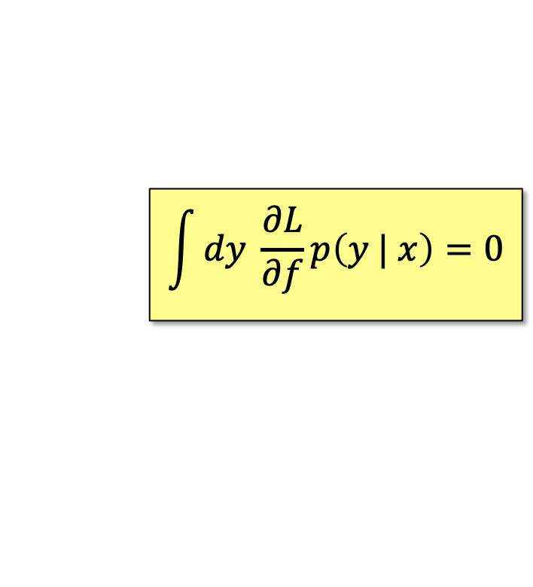
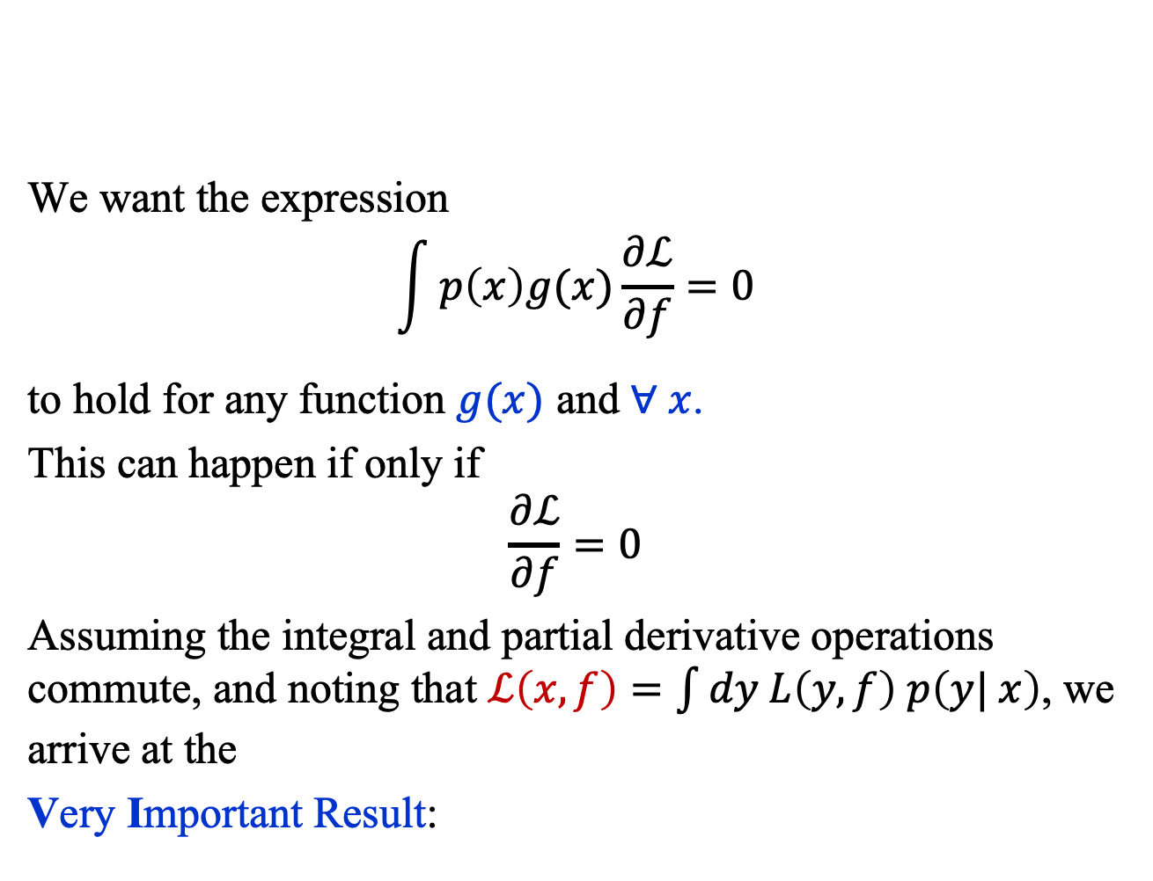
Finding the Best-Fit Function
We want the expression
$$\int{p\left(x\right)g(x)\frac{∂ℒ}{∂f}}=0$$
to hold for any function $g(x)$ and $∀ x$.
This can happen if only if
$$\frac{∂ℒ}{∂f}=0$$
Assuming the integral and partial derivative operations commute, and noting that $ℒ\left(x, f\right)=\int{dy L\left(y, f\right) p\left(y| x\right)}$, we arrive at the
Very Important Result:
$$\int{dy \frac{∂L}{∂f}p\left(y | x\right)=0}$$

Slide 10

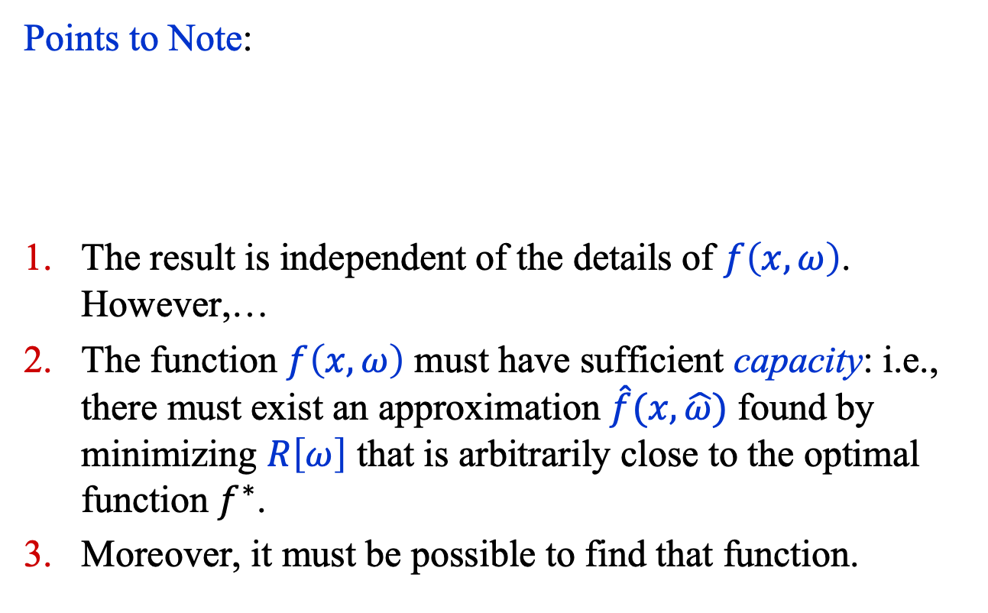
Finding the Best-Fit Function
Points to Note:
The result is independent of the details of $f\left(x,ω\right)$. However,…
The function $f\left(x,ω\right)$ must have sufficient capacity: i.e., there must exist an approximation $\hat{f}(x,\hat{ω})$ found by minimizing $R\left[ω\right]$ that is arbitrarily close to the optimal function $f^{∗}$.
Moreover, it must be possible to find that function.
$$\int{dy \frac{∂L}{∂f}p\left(y | x\right)=0}$$

Slide 11
Minimization in practice

Slide 12

Minimization in Practice
The minimization of $R\left(ω\right)$is typically done by moving in the direction of steepest descent. The algorithms used are variations of Stochastic Gradient Descent.
Algorithm
At the current point $ω_{j}$, compute a noisy approximation to the gradient of $R\left(ω\right)≈\frac{1}{n}\sum_{i=1}^{n}{L\left(y_{i}, f_{i}\right)}$ by using a batch of training data, where $n≪N$.
Move to the next position $ω_{j+1}$ in the landscape using
$$ω_{j+1}=ω_{j}−η∇R$$

Slide 13

Minimization in Practice
Why does the algorithm
$$ω_{j+1}=ω_{j}−η∇R$$
work?
Consider
$$R\left(ω_{j+1}\right)=R\left(ω_{j}−η∇R \right)$$
$=R\left(ω_{j}\right)− η∇R∙∇R+O(η^{2})$
If the $O(η^{2})$ can be neglected, and
given that the $O(η)$ term is always
negative, it follows that
$R\left(ω_{j+1}\right)<R\left(ω_{j}\right)$.

Slide 14
Common loss functions

Slide 15
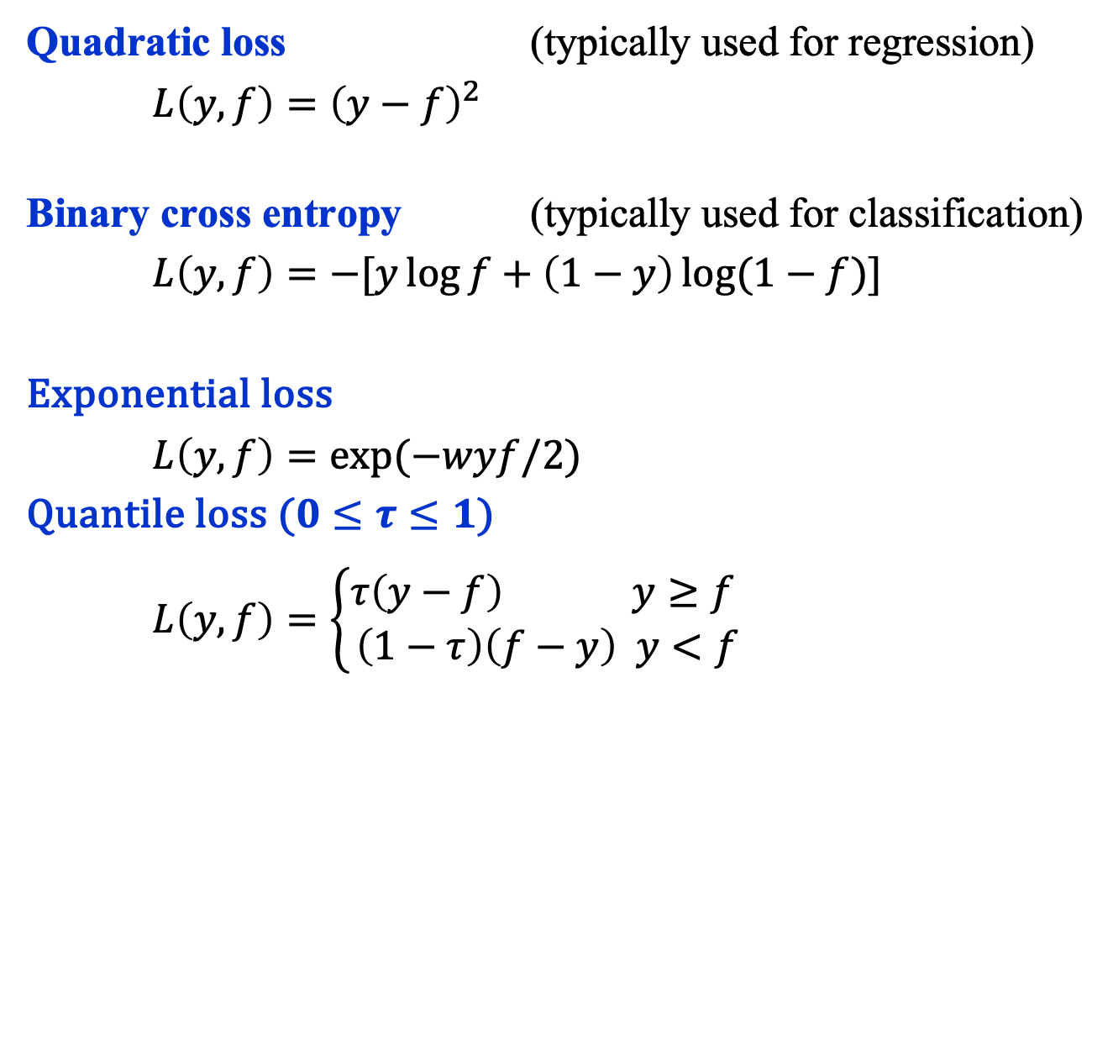
Common Loss Functions
Quadratic loss (typically used for regression)
$L\left(y, f\right)={\left(y−f\right)}^{2}$
Binary cross entropy (typically used for classification)
$L\left(y, f\right)=−[y\log{f+\left(1−y\right)\log{(1−f)}}]$
Exponential loss
$L\left(y, f\right)=\exp{(−wyf/2)}$
Quantile loss ($0≤τ≤1$)
$L\left(y, f\right)=\left\{\begin{aligned}τ\left(y−f\right) y≥f \\ \left(1−τ\right)\left(f−y\right) y<f\end{aligned}\right.$

Slide 16
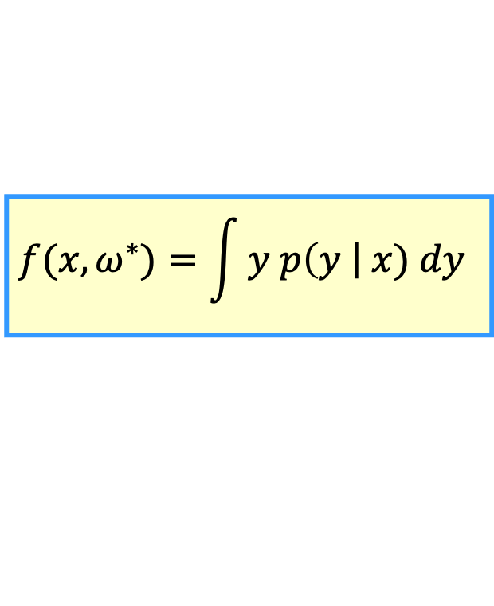
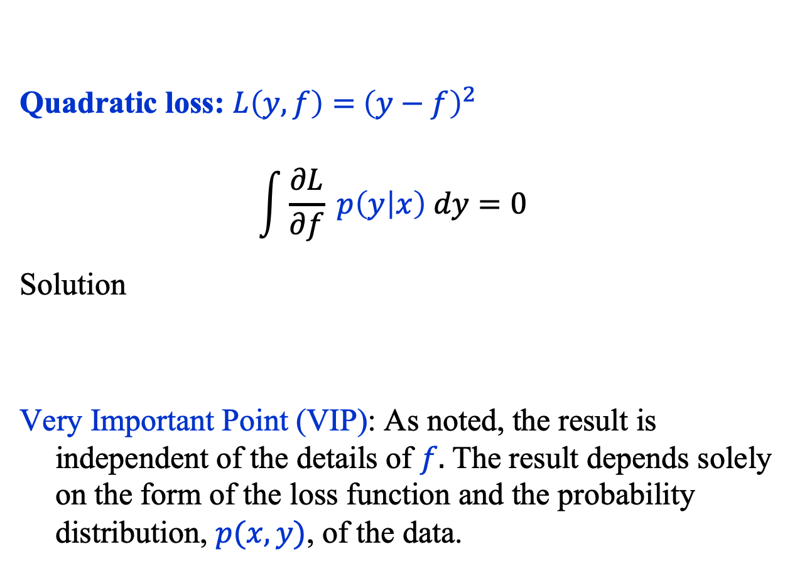
Common Loss Functions
Quadratic loss: $L\left(y, f\right)={ \left(y−f\right)}^{2}$
$$\int{\frac{∂L}{∂f} p\left(y | x\right) dy=0}$$
Solution
Very Important Point (VIP): As noted, the result is independent of the details of $f.$ The result depends solely on the form of the loss function and the probability distribution, $p(x, y)$, of the data.
$$f(x, ω^{∗})=\int{y p\left(y \right| x) dy}$$

Slide 17
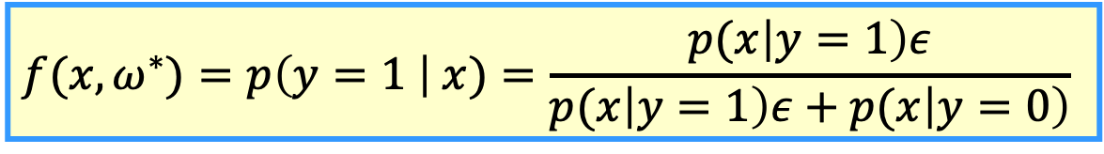
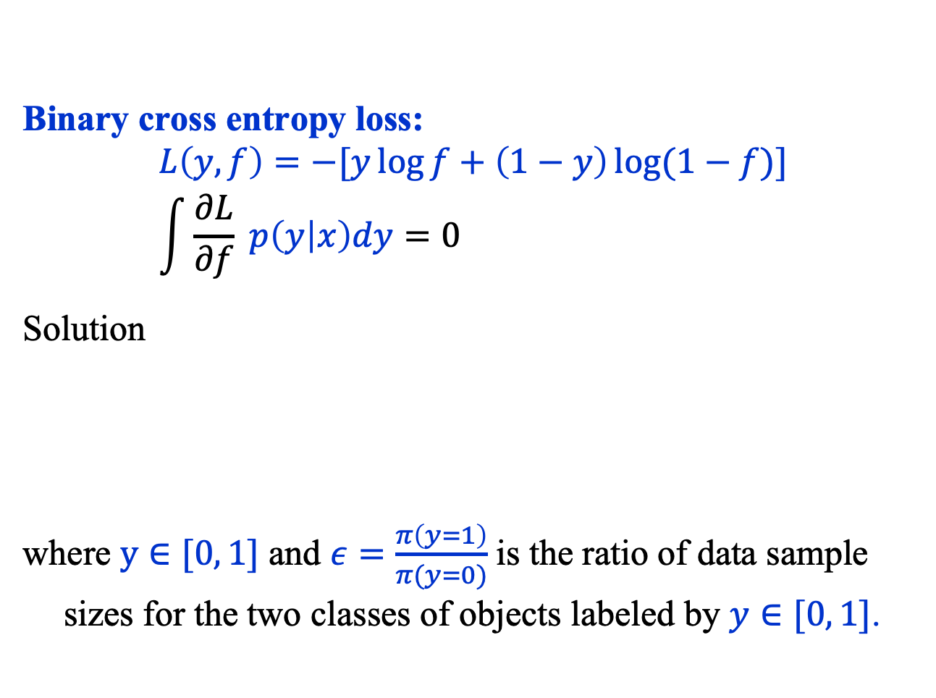
Common Loss Functions
Binary cross entropy loss:
$$L\left(y, f\right)=−[y\log{f+\left(1−y\right)\log{(1−f)}}] \\ \int{\frac{∂L}{∂f} p\left(y | x\right)dy=0}$$
Solution
where $y∈[0, 1]$ and $ε=\frac{π\left(y=1\right)}{π(y=0)}$ is the ratio of data sample sizes for the two classes of objects labeled by $y∈[0, 1]$.
$$f(x, ω^{∗})=p\left(y=1 \right| x)=\frac{p(x\left|y=1\right)ε}{p(x\left|y=1\right)ε+p(x\left|y=0\right)}$$

Slide 18
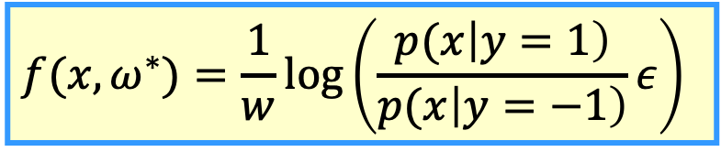
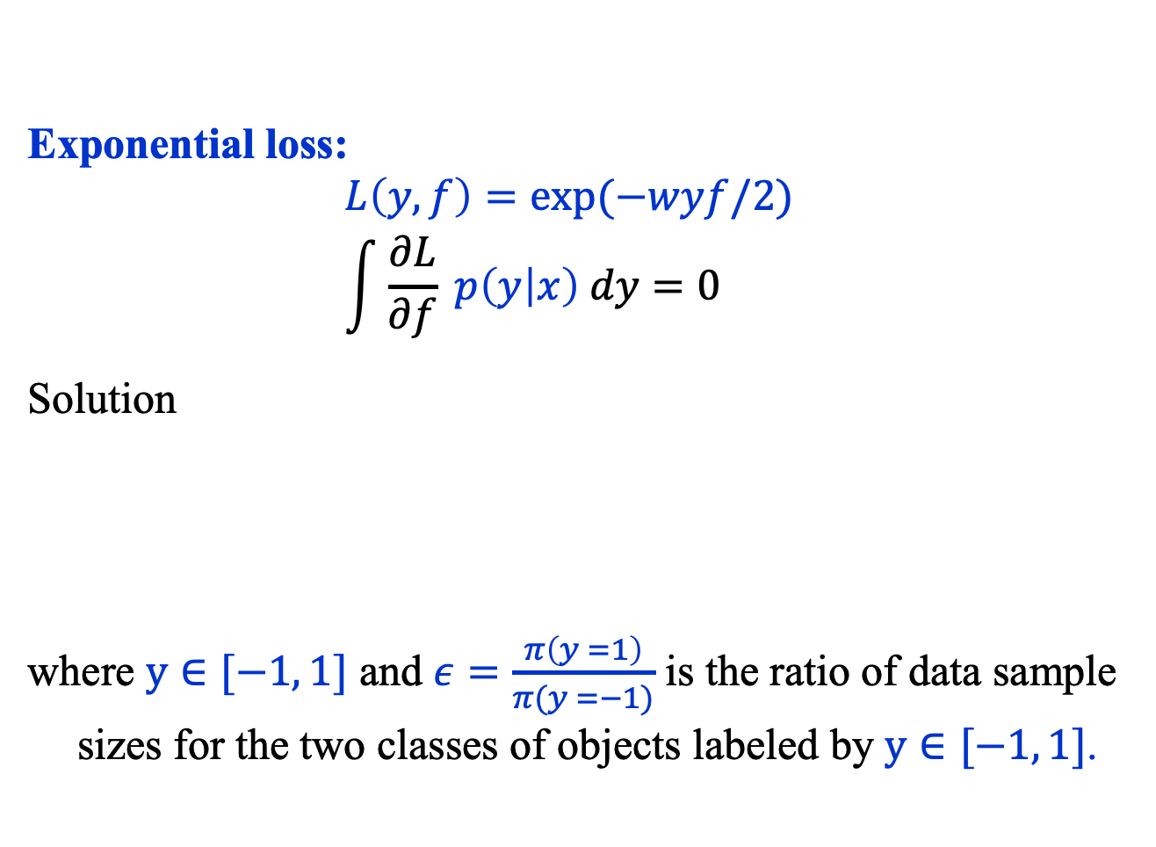
Common Loss Functions
Exponential loss:
$$L\left(y, f\right)=\exp{(−wyf/2)} \\ \int{\frac{∂L}{∂f} p\left(y | x\right) dy=0}$$
Solution
where $y∈[−1, 1]$ and $ε=\frac{π\left(y =1\right)}{π(y =−1)}$ is the ratio of data sample sizes for the two classes of objects labeled by $y∈[−1, 1]$.
$$f(x, ω^{∗})=\frac{1}{w}\log\left(\frac{p(x\left|y=1\right)}{p(x\left|y=−1\right)}ε\right)$$

Slide 19
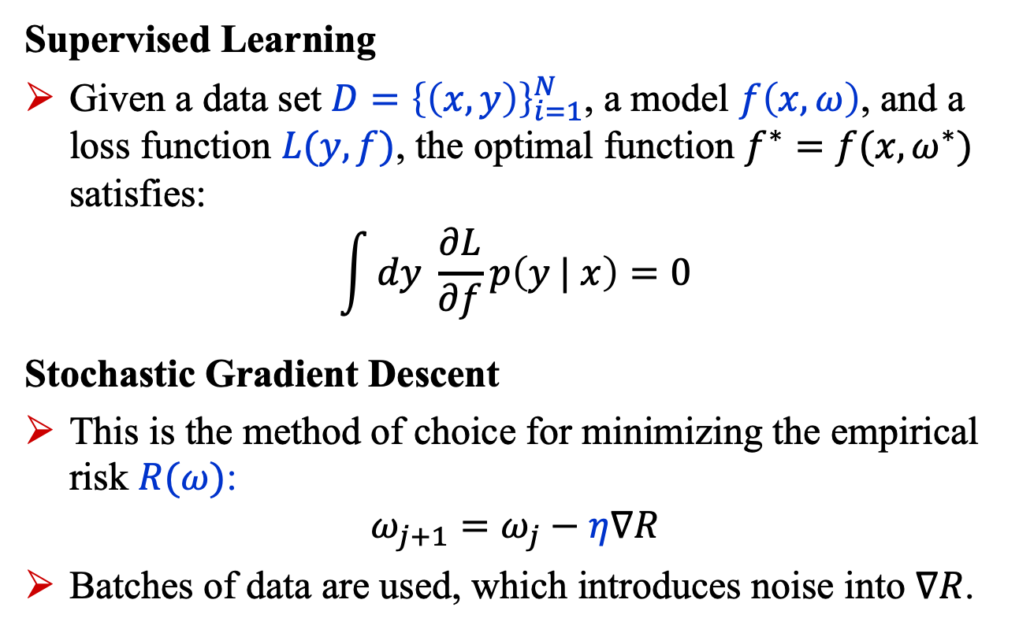
Summary
Supervised Learning
Given a data set $D={\left\{\left(x,y\right)\right\}}_{i=1}^{N}$, a model $f\left(x,ω\right)$, and a loss function $L(y, f)$, the optimal function $f^{∗}=f(x,ω^{∗})$ satisfies:
$$\int{dy \frac{∂L}{∂f}p\left(y | x\right)=0}$$
Stochastic Gradient Descent
This is the method of choice for minimizing the empirical risk $R(ω)$:
$$ω_{j+1}=ω_{j}−η∇R$$
Batches of data are used, which introduces noise into $∇R$.

