Slide 1
Machine learning in physics Tutorial 1 / Part 2

Slide 2
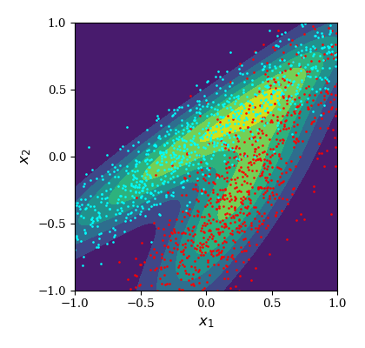








Recap
output
$$σ(z)$$
Task: Build a classifier to classify points in a 2-sample dataset:
Linear(15, 1)
$$\text{L}\text{ayerNorm}(15)$$
$$\text{s}\text{i}\text{lu}()$$
Linear(15, 15)
$$\text{L}\text{ayerNorm}(15)$$
$$\text{s}\text{i}\text{lu}()$$
Linear(15, 15)
$$\text{L}\text{ayerNorm}(15)$$
$$\text{s}\text{i}\text{lu}()$$
Linear(2, 15)
$$x$$

Slide 3
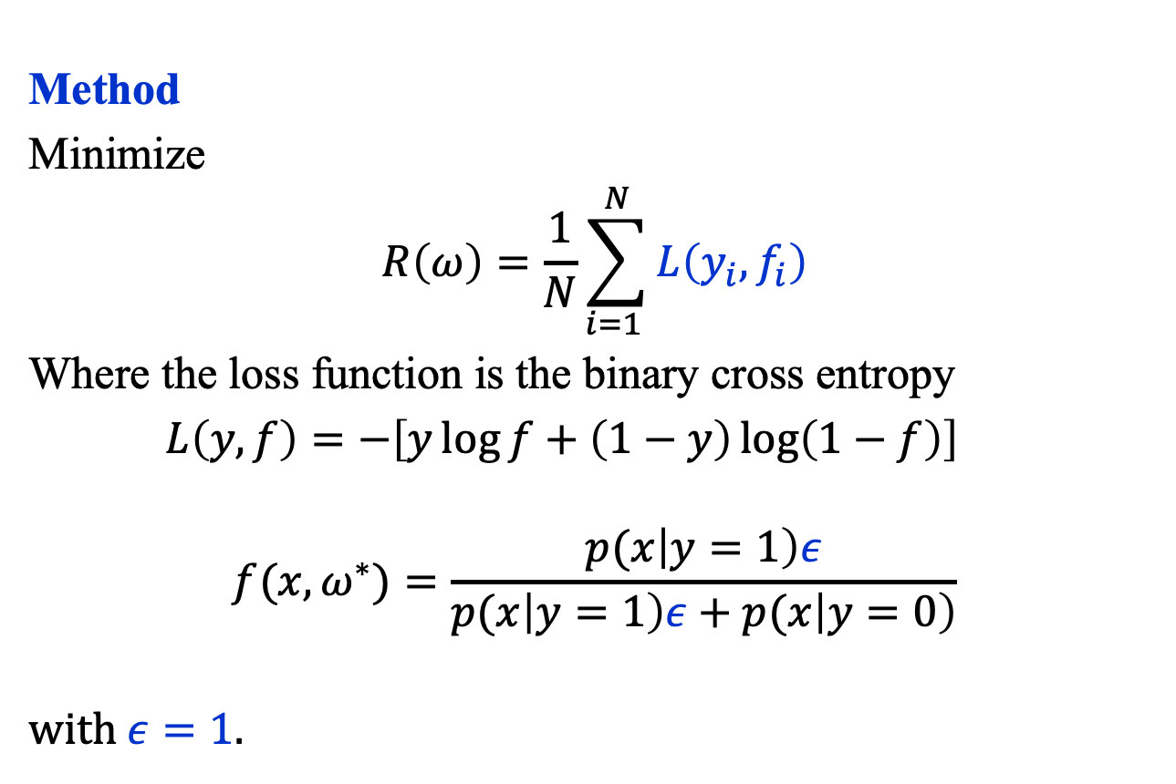
Recap
output
$$σ(z)$$
Method
Minimize
$$R\left(ω\right)=\frac{1}{N}\sum_{i=1 }^{N}{L\left(y_{i}, f_{i}\right)}$$
Where the loss function is the binary cross entropy
$L\left(y, f\right)=−\left[y\log{f+\left(1−y\right)\log\left(1−f\right)}\right]$ $$f(x, ω^{∗})=\frac{p(x\left|y=1\right)ε}{p(x\left|y=1\right)ε+p(x\left|y=0\right)}$$
with $ε=1$.
Linear(15, 1)
$$\text{L}\text{ayerNorm}(15)$$
$$\text{s}\text{i}\text{lu}()$$
Linear(15, 15)
$$\text{L}\text{ayerNorm}(15)$$
$$\text{s}\text{i}\text{lu}()$$
Linear(15, 15)
$$\text{L}\text{ayerNorm}(15)$$
$$\text{s}\text{i}\text{lu}()$$
Linear(2, 15)
$$x$$

Slide 4

Recap: Dataset
Sample 1
$$μ_{1}=\left(0.25, −0.25\right)$$
$$cov_{1}=\left(\begin{matrix}0.20 & 0.24 \\ 0.24 & 0.40\end{matrix}\right)$$
Sample 2
$$μ_{2}=\left(−0.10, 0.10\right)$$
$$cov_{2}=\left(\begin{matrix}0.60 & 0.40 \\ 0.40 & 0.30\end{matrix}\right)$$

