Slide 1
Machine learning in physics convolutional neural networks

Slide 2


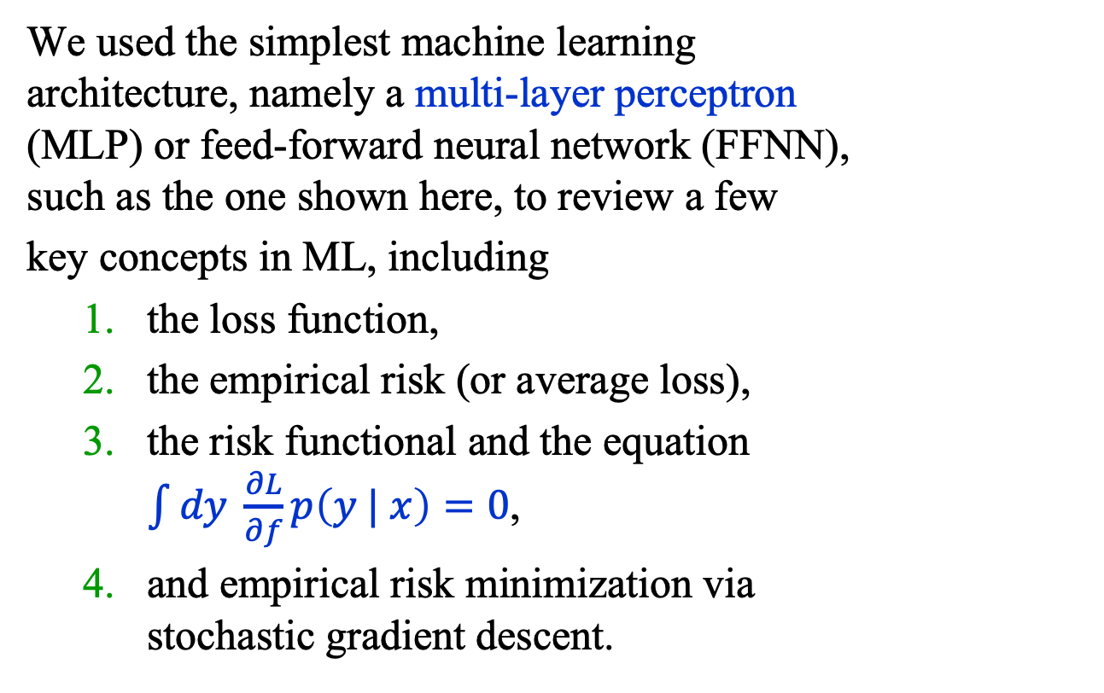






Recap
output
$$σ(z)$$
We used the simplest machine learning architecture, namely a multi-layer perceptron (MLP) or feed-forward neural network (FFNN), such as the one shown here, to review a few
key concepts in ML, including
the loss function,
the empirical risk (or average loss),
the risk functional and the equation $\int{dy \frac{∂L}{∂f}p\left(y | x\right)=0}$,
and empirical risk minimization via stochastic gradient descent.
Linear(15, 1)
$$\text{L}\text{ayerNorm}(15)$$
$$\text{s}\text{i}\text{lu}()$$
Linear(15, 15)
$$\text{L}\text{ayerNorm}(15)$$
$$\text{s}\text{i}\text{lu}()$$
Linear(15, 15)
$$\text{L}\text{ayerNorm}(15)$$
$$\text{s}\text{i}\text{lu}()$$
Linear(2, 15)
$$x$$

Slide 3
Introduction
The plan for the next several lectures is to introduce the following machine learning models:
Convolutional neural networks (CNN)
Autoencoder (AE)
Physics-informed neural networks (PINN)
Flow and diffusion models
Graph neural networks (GNN)
Transformer neural networks (TNN)
We shall try to understand each class of models using a simple example.

Slide 4
Introduction
A great deal of our behavior is guided by our ability to interpret visual data in real time.
This ability is now available in everyday machines. Indeed, there exist image recognition systems that are superhuman in their abilities.
The breakthrough that has allowed such advances is the convolutional neural network (CNN) and its many, many, variations.
Our focus this week is CNNs for image classification.

Slide 5
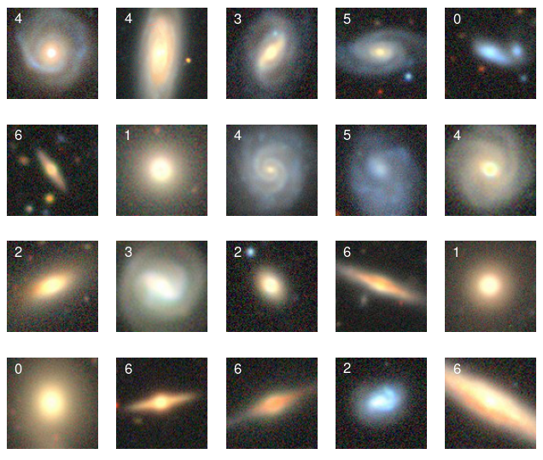
Introduction
Here are images of
20 galaxies from the
Galaxy 10 DECals
Dataset at the astroNN
website.
Goal: classify galaxies using images like these.
https://astronn.readthedocs.io/en/stable/galaxy10.html

Slide 6
Introduction
Data set
Our data set comprises 12,600 images divided into 7 galaxy morphology classes with 1800 galaxies per class.
Each 3-channel image is cropped to 96 x 96 pixels.

Slide 7
Introduction
Since this is a multi-class problem, we cannot use the binary cross entropy loss. Instead, we use its generalization, called the cross-entropy loss.

Slide 8
cross entropy

Slide 9
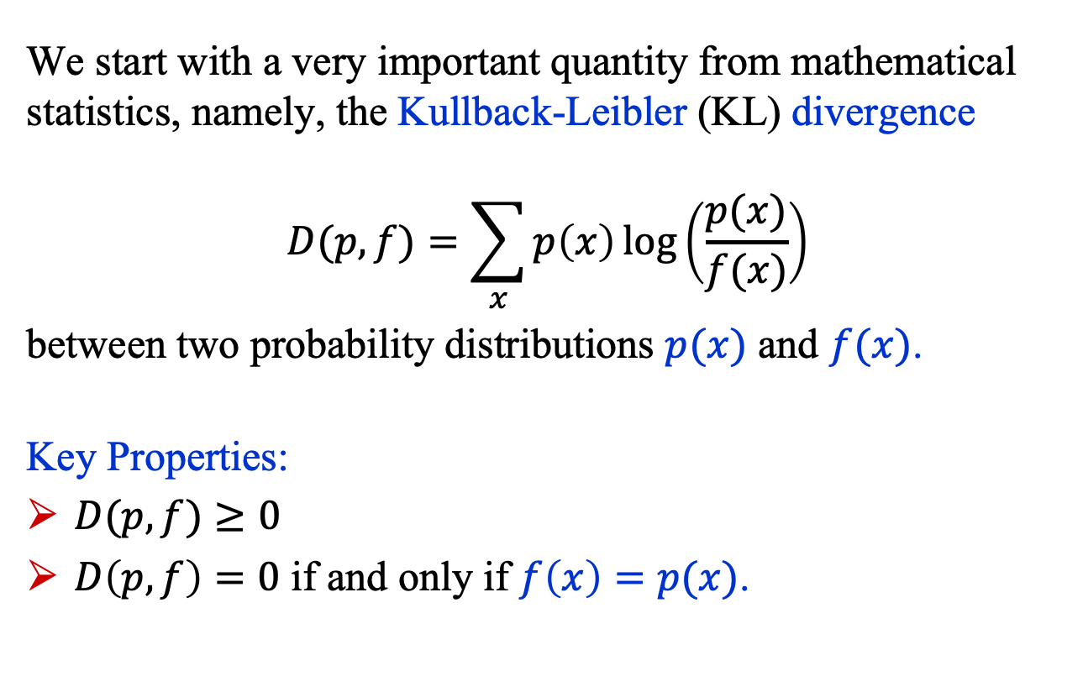
What is Cross Entropy?
We start with a very important quantity from mathematical statistics, namely, the Kullback-Leibler (KL) divergence
$$D(p,f)=\sum_{x}{p\left(x\right)\log\left(\frac{p(x)}{f(x)}\right)}$$
between two probability distributions $p(x)$ and $f(x)$.
Key Properties:
$D(p,f)≥0$
$D\left(p,f\right)=0$ if and only if $f\left(x\right)=p(x)$.

Slide 10
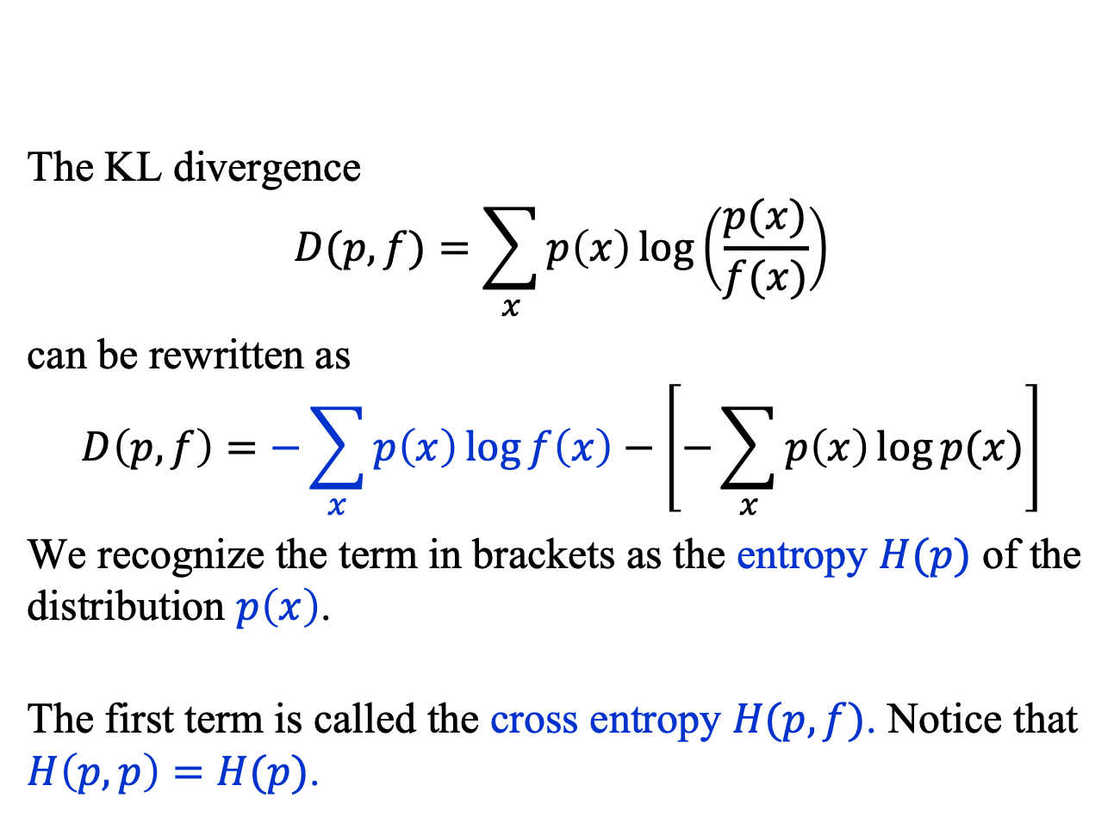
What is Cross Entropy?
The KL divergence
$$D(p,f)=\sum_{x}{p\left(x\right)\log\left(\frac{p(x)}{f(x)}\right)}$$
can be rewritten as
$$D\left(p,f\right)=−\sum_{x}{p\left(x\right)\log{f\left(x\right)}}−\left[−\sum_{x}{p\left(x\right)\log{p(x)}}\right]$$
We recognize the term in brackets as the entropy $H(p)$ of the distribution $p\left(x\right)$.
The first term is called the cross entropy $H(p, f)$. Notice that $H\left(p, p\right)=H(p)$.

Slide 11
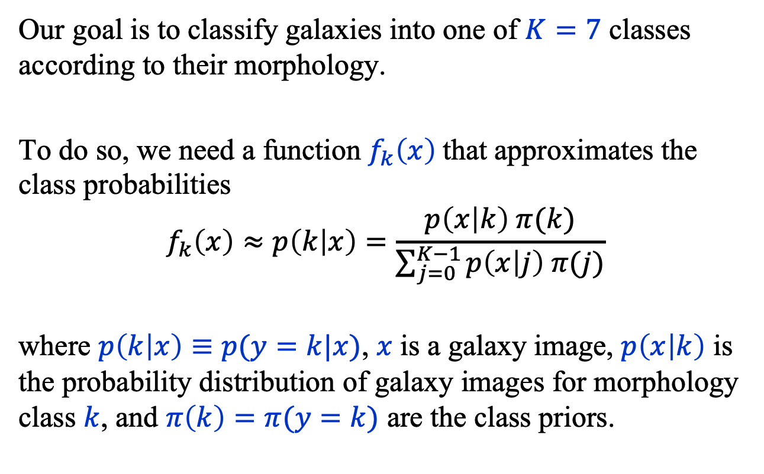
Cross Entropy Loss
Our goal is to classify galaxies into one of $K=7$ classes according to their morphology.
To do so, we need a function $f_{k}\left(x\right)$that approximates the class probabilities
$$f_{k}\left(x\right)≈p\left(k | x\right)=\frac{p\left(x | k\right) π(k)}{\sum_{j=0}^{K−1}{p\left(x | j\right) π(j)}}$$
where $p\left(k | x\right)≡p(y=k|x)$, $x$ is a galaxy image, $p\left(x | k\right)$ is the probability distribution of galaxy images for morphology class $k$, and $π\left(k\right)=π(y=k)$ are the class priors.

Slide 12
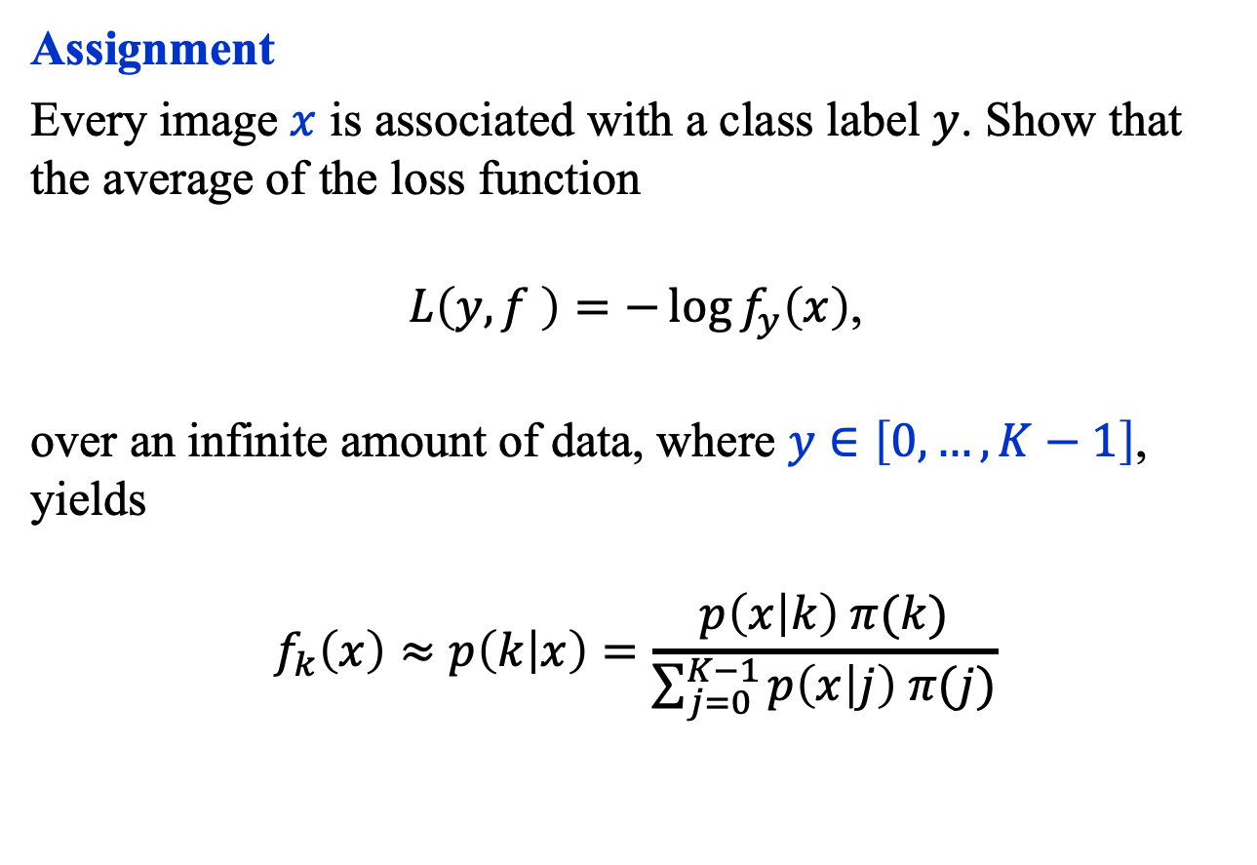
Cross Entropy Loss
Assignment
Every image $x$ is associated with a class label $y$. Show that the average of the loss function
$L\left(y,f \right)=−\log{f_{y}\left(x\right)}$,
over an infinite amount of data, where $y∈\left[0,…,K−1\right]$, yields
$$f_{k}\left(x\right)≈p\left(k | x\right)=\frac{p\left(x | k\right) π(k)}{\sum_{j=0}^{K−1}{p\left(x | j\right) π(j)}}$$

Slide 13
Convolutional neural networks (CNN)

Slide 14
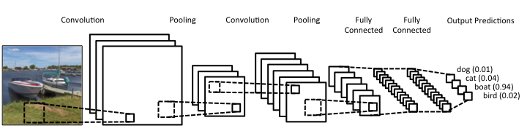
Convolutional Neural Network
Convolutional neural networks (CNN) are functions that code 2D (or 3D) data and classify objects using their coded representations via a fully-connected neural network.
The key insight that underpins CNNs is the approximate translational invariance of natural images.
Source: https://www.clarifai.com/technology

Slide 15
CNN
A standard CNN comprises three types of processing layers: 1. convolution, 2. pooling, and 3. classification.
Convolution layers The input to a layer is convolved with one or more matrices using element-wise products that are then summed. In this example, the convolution compresses the image from 5 x 5 to a to a 3 x 3 matrix.

Slide 16
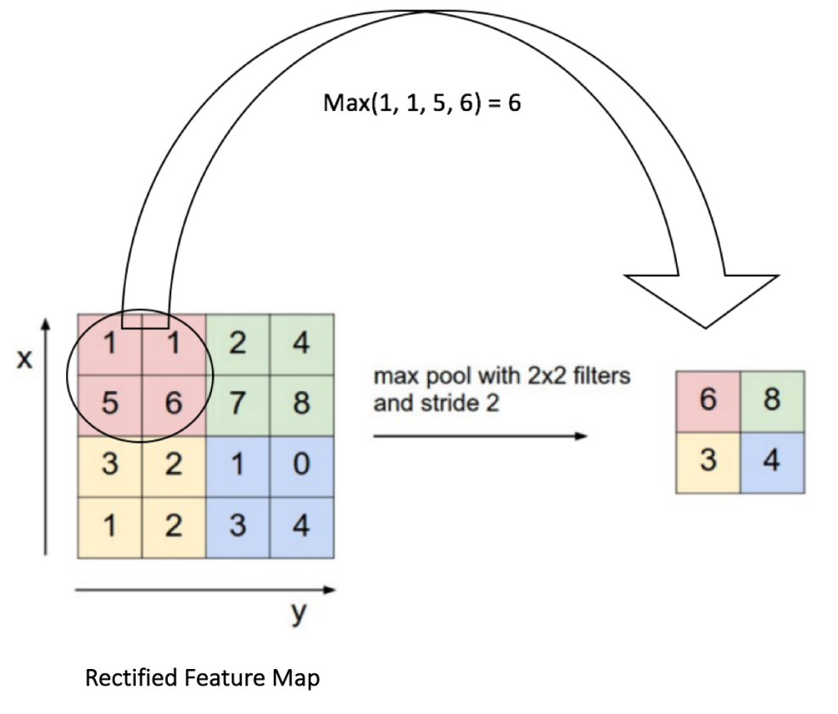
CNN
Pooling Layers After convolution, and a pixel-by-pixel non-linear map (using, e.g., the function y = max(0, x) = ReLU(x)), a coarse-graining of the layer is performed. Here, called max pooling in which the maximum values within a series of small windows are selected and become the output of a pooling layer.

Slide 17

CNN
3. Classification Layers After an alternating sequence of convolution and pooling layers, the outputs go to a fully-connected neural network whose outputs approximate the class probabilities: $$p\left(k | x\right)=p\left(x | k\right)π(k)/\sum_{j=0}^{K−1}{p\left(x | j\right)π(\text{j})}$$

Slide 18
Tutorial 4: Our Model
Conv2d(out, in)
(13, 6, 6)
(9, 12, 12)
(6, 24, 24)
(4, 48, 48)
(3, 96, 96)

Slide 19
Summary
Convolutional neural networks have revolutionized image interpretation and are now used in many applications.
The model exploits the fact that natural images are often locally approximately translation invariant.
The convolutions automatically extract features from images that can later be used to interpret them.

