Slide 1
Machine learning in physics Autoencoders

Slide 2
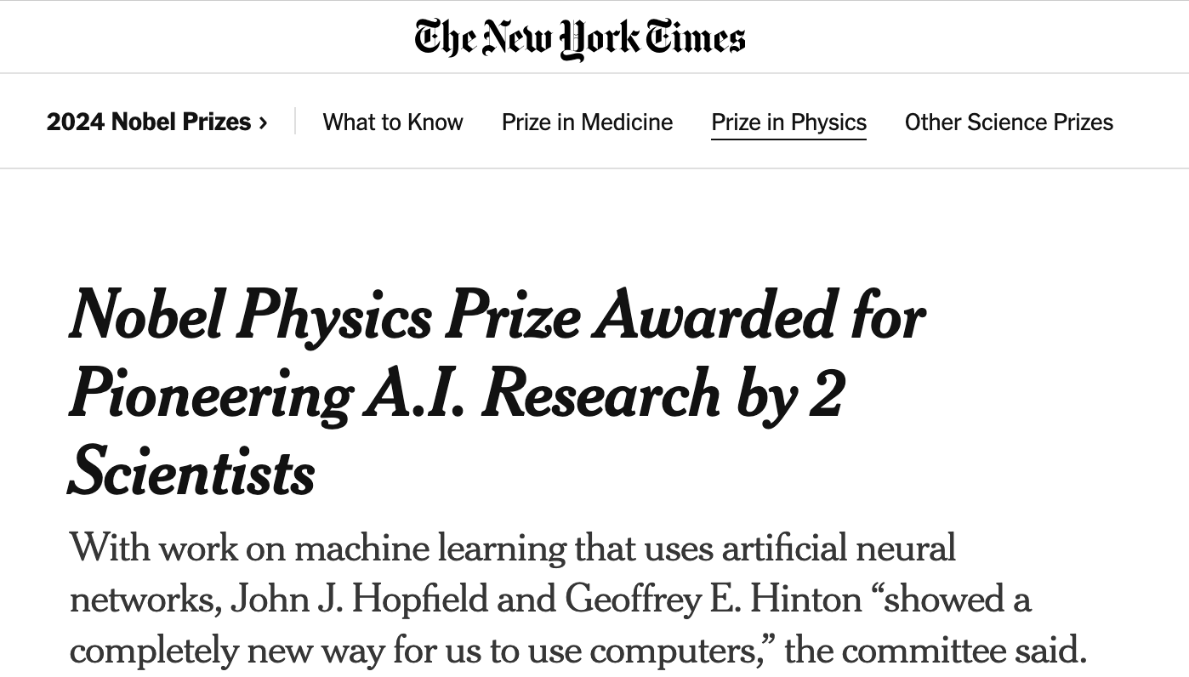
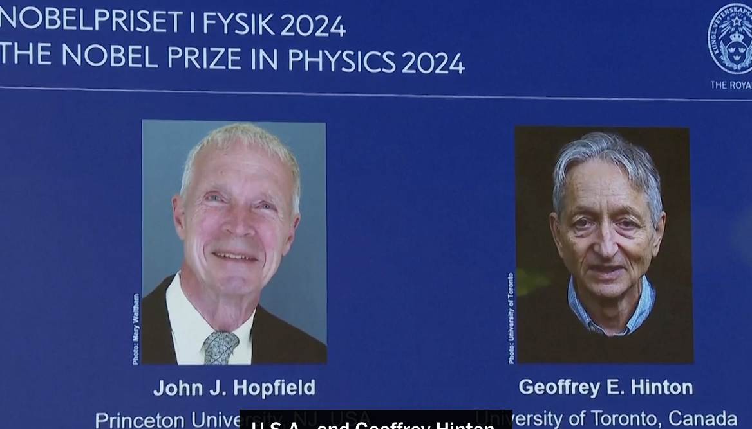
Oct. 8, 2024

Slide 3
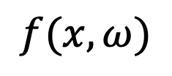

Recap
$$f(x, ω)$$
Last time, we studied convolutional neural
networks (CNN) and their use in image
classification.
Softmax
Linear(468,7)
ReLU()
ReLU()
MaxPool2d(2,2)
MaxPool2d(2,2)
Conv2d(9,13,3,1,1)
Conv2d(4,6,3,1,1)
ReLU()
ReLU()
MaxPool2d(2,2)
MaxPool2d(2,2)
Conv2d(6,9,3,1,1)
Conv2d(3,4,3,1,1)
$$x$$

Slide 4
Introduction
This week we introduce a neural network called an:
Convolutional neural networks (CNN)
Autoencoder (AE)
Physics-informed neural networks (PINN)
Flow and diffusion models
Graph neural networks (GNN)
Transformer neural networks (TNN)

Slide 5
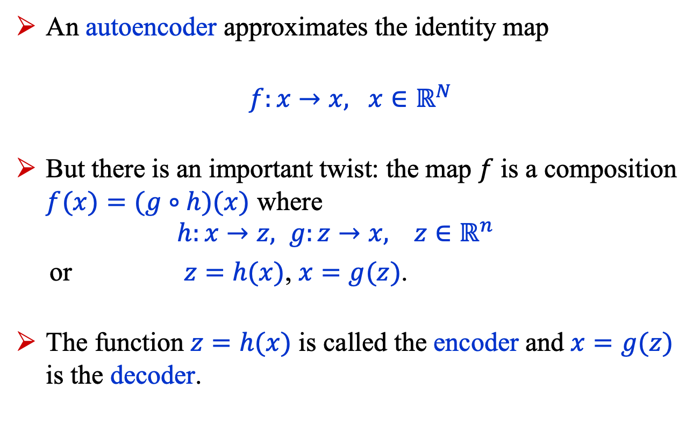
Introduction
An autoencoder approximates the identity map
$f:x→x, x∈ℝ^{N}$
But there is an important twist: the map $f$ is a composition $f(x)=(g∘h)(x)$ where $h:x→z, g:z→x, z∈ℝ^{n}$
or $z=h(x)$, $x=g(z)$.
The function $z=h(x)$ is called the encoder and $x=g(z)$ is the decoder.

Slide 6

Introduction
The space $ℝ^{n}$ is called the latent space.
Typically, $n≪N$.
The encoder compresses the input data $x$
$z=h(x)$ $x=g(z)$
$z∈ℝ^{n}$
in an unsupervised manner, that is, the labels are the data $x$.

Slide 7
Introduction
Autoencoders have multiple applications including:
Data compression
Lossy compression
Structure detection
Anomaly detection
Noise removal
Our example this week focuses on structure detection.

Slide 8
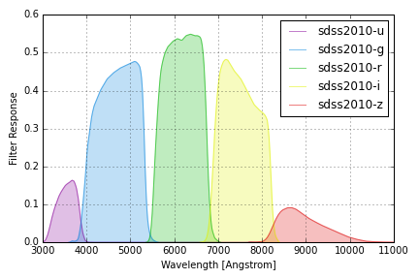
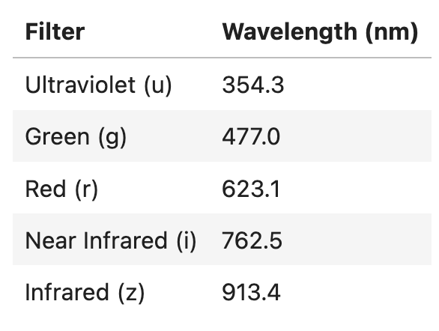
Introduction
We’ll use an autoencoder
to search for structure in
stellar color data from the
Sloan Digital Sky Survey (SDSS)*.
The data are fluxes measured in five filters:
*https://www.sdss.org/

Slide 9
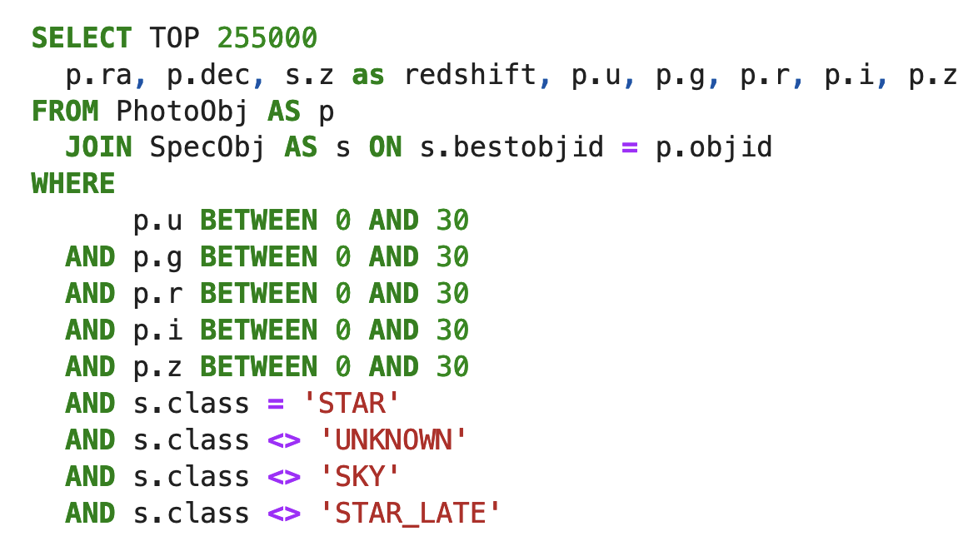
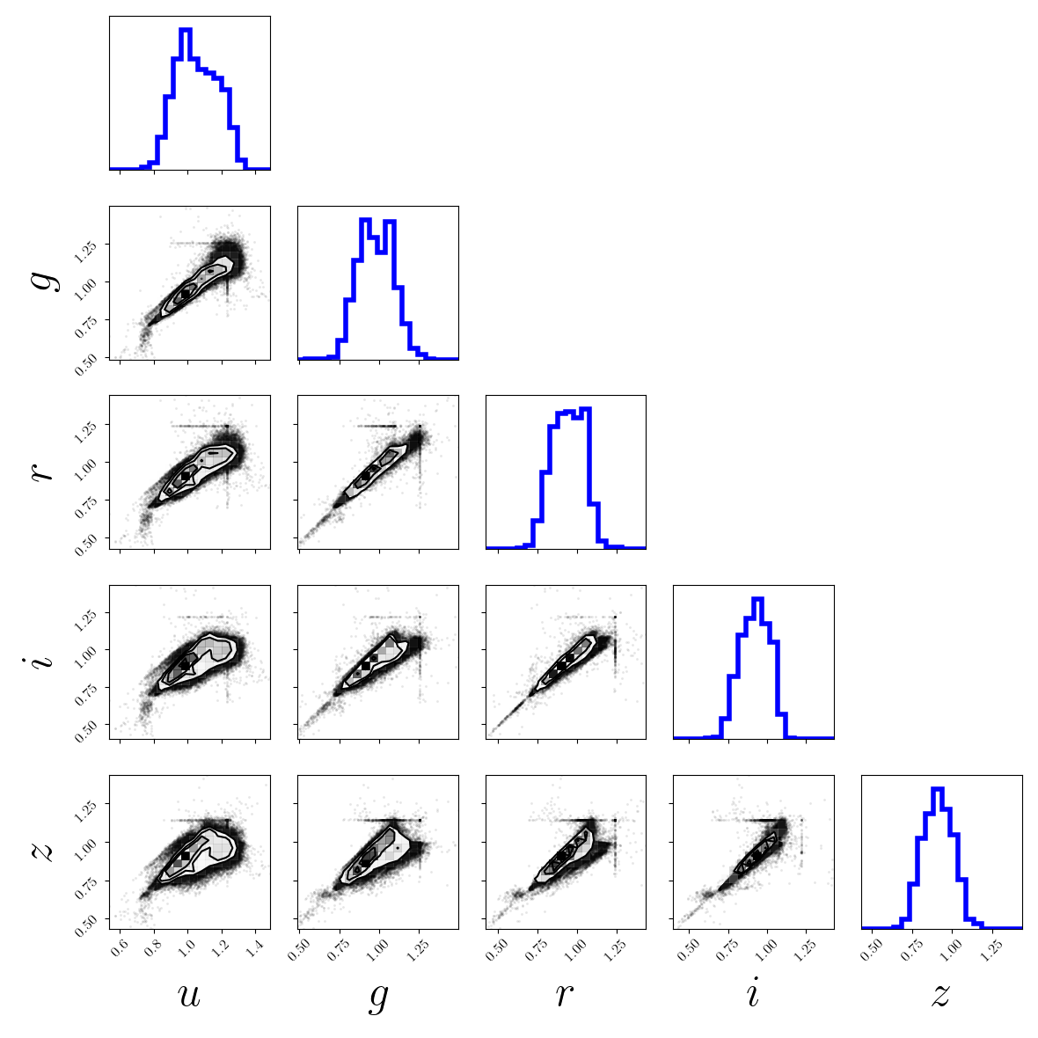
Introduction
SDSS Dataset (https://cas.sdss.org/dr18/SearchTools/sql)
We use data from 255,000 stars, as displayed below, extracted using the SQL command:
The plot shows no obvious
structure, but maybe there is!

Slide 10
AUtoencoder

Slide 11
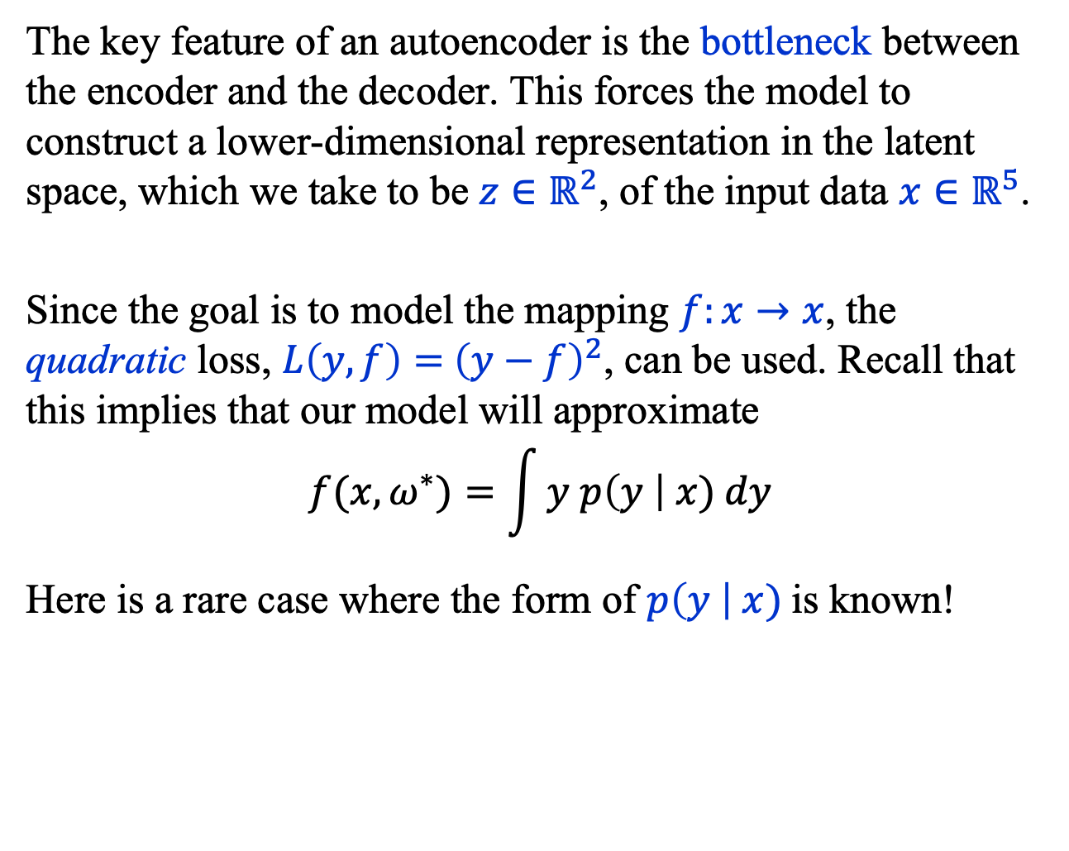
Autoencoder
The key feature of an autoencoder is the bottleneck between the encoder and the decoder. This forces the model to construct a lower-dimensional representation in the latent space, which we take to be $z∈ℝ^{2}$, of the input data $x∈ℝ^{5}$.
Since the goal is to model the mapping $f:x→x$, the quadratic loss, $L\left(y, f\right)={ \left(y−f\right)}^{2}$, can be used. Recall that this implies that our model will approximate
$$f(x, ω^{∗})=\int{y p\left(y \right| x) dy}$$
Here is a rare case where the form of $p\left(y \right| x)$is known!

Slide 12
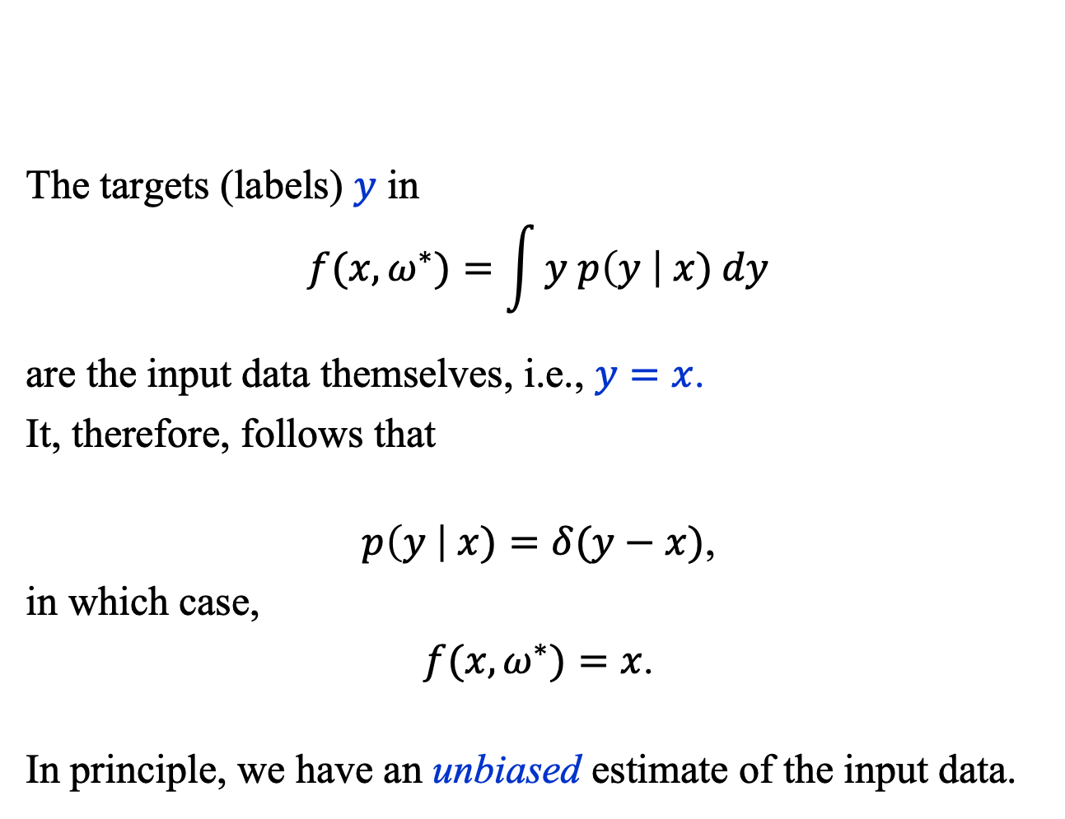
Autoencoder
The targets (labels) $y$ in
$$f(x, ω^{∗})=\int{y p\left(y \right| x) dy}$$
are the input data themselves, i.e., $y=x$.
It, therefore, follows that
$p\left(y \right| x)=δ(y−x)$,
in which case,
$f(x, ω^{∗})=x$.
In principle, we have an unbiased estimate of the input data.

Slide 13
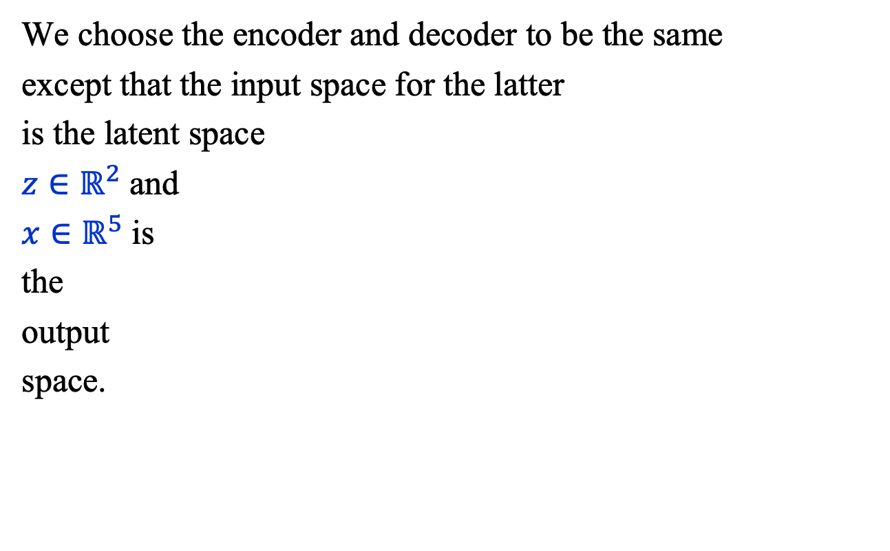
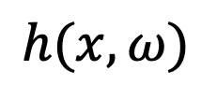
AE Model: Encoder
$$h(x, ω)$$
We choose the encoder and decoder to be the same
except that the input space for the latter
is the latent space
$z∈ℝ^{2}$ and
$x∈ℝ^{5}$ is
the
output
space.
Linear(40, 2)
LayerNorm(40)
LayerNorm(40)
SiLU()
SiLU()
Linear(40, 40)
Linear(40, 40)
LayerNorm(40)
LayerNorm(40)
SiLU()
SiLU()
Linear(40, 40)
Linear(5, 40)
$$x$$

Slide 14
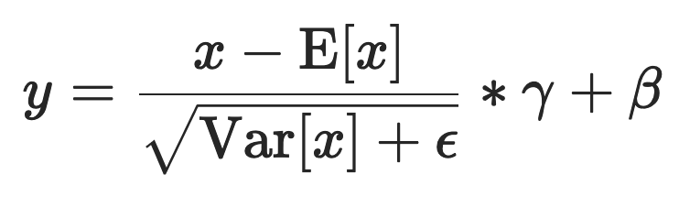
AE Model: Program View
H_NODES = 40
encoder = nn.Sequential(
nn.Linear( 5, H_NODES), nn.SiLU(), nn.LayerNorm(H_NODES),
nn.Linear(H_NODES, H_NODES), nn.SiLU(), nn.LayerNorm(H_NODES),
nn.Linear(H_NODES, H_NODES), nn.SiLU(), nn.LayerNorm(H_NODES),
nn.Linear(H_NODES, H_NODES), nn.SiLU(), nn.LayerNorm(H_NODES),
nn.Linear(H_NODES, 2),
)
decoder = nn.Sequential(
nn.Linear( 2, H_NODES), nn.SiLU(), nn.LayerNorm(H_NODES),
nn.Linear(H_NODES, H_NODES), nn.SiLU(), nn.LayerNorm(H_NODES),
nn.Linear(H_NODES, H_NODES), nn.SiLU(), nn.LayerNorm(H_NODES),
nn.Linear(H_NODES, H_NODES), nn.SiLU(), nn.LayerNorm(H_NODES),
nn.Linear(H_NODES, 5)
)

Slide 15
AE Model: Program View
class AutoEncoder(nn.Module):
def __init__(self, encoder, decoder):
# call constructor of base (or super, or parent) class
super(AutoEncoder, self).__init__()
self.encoder = encoder
self.decoder = decoder
def forward(self, x):
y = self.encoder(x)
y = self.decoder(y)
return y

Slide 16
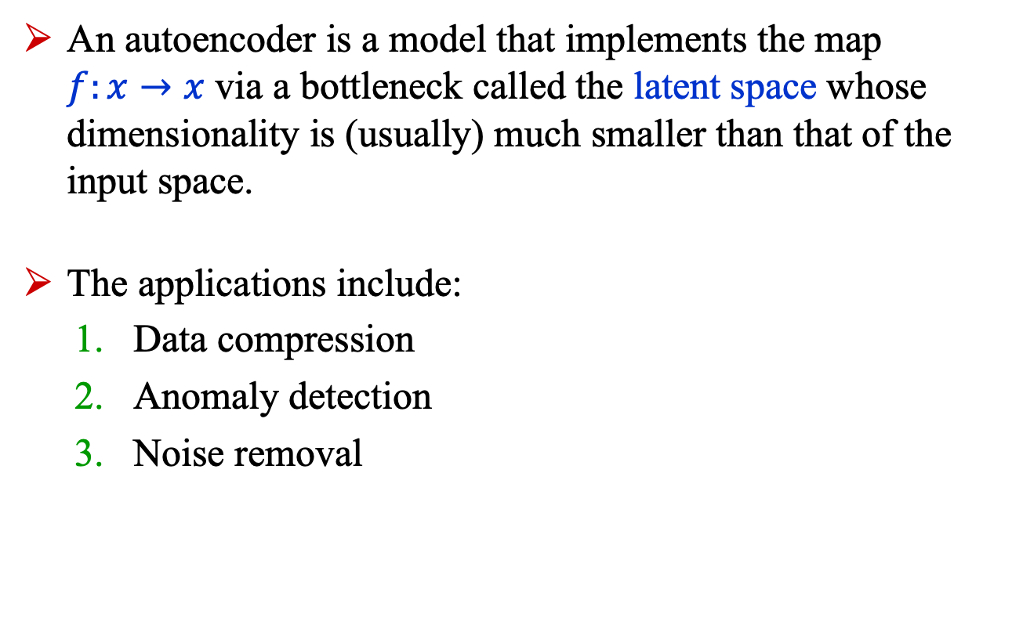
Summary
An autoencoder is a model that implements the map $f:x→x$ via a bottleneck called the latent space whose dimensionality is (usually) much smaller than that of the input space.
The applications include:
Data compression
Anomaly detection
Noise removal

