Slide 1
Machine learning in physics Flow and diffusion models

Slide 2
Introduction
Convolutional neural networks (CNN)
Autoencoder (AE)
Physics-informed neural networks (PINN)
Flow and diffusion models
Graph neural networks (GNN)
Transformer neural networks (TNN)

Slide 3
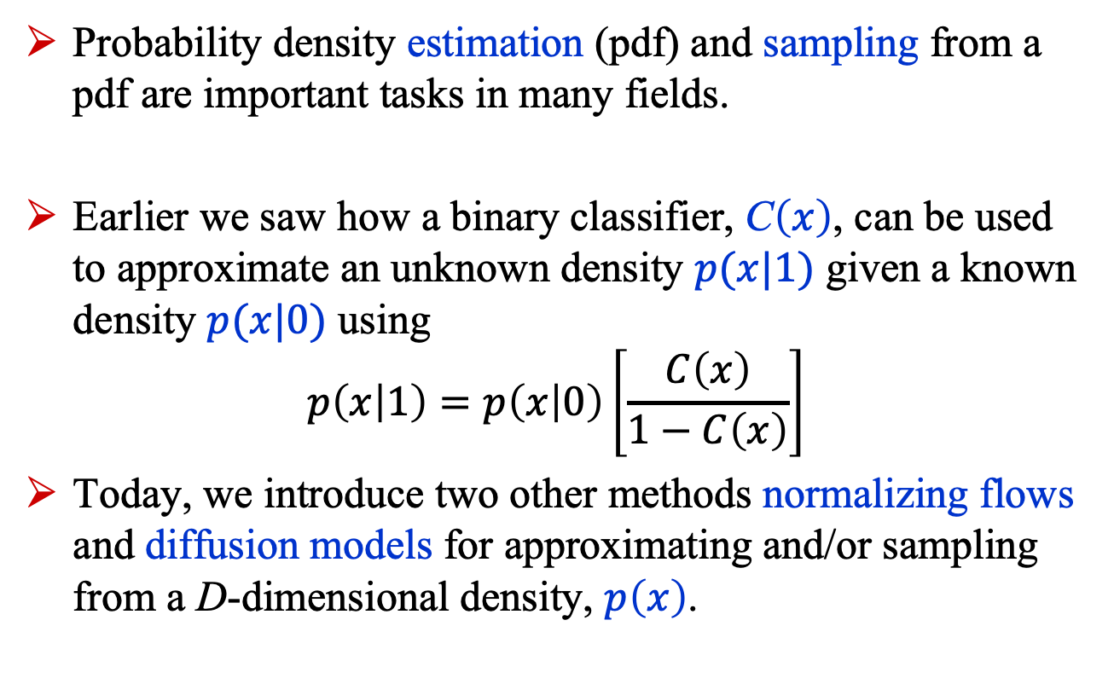
Introduction
Probability density estimation (pdf) and sampling from a pdf are important tasks in many fields.
Earlier we saw how a binary classifier, C$\left(x\right)$, can be used to approximate an unknown density $p(x|1)$ given a known density $p(x|0)$ using
$$p\left(x | 1\right)=p\left(x | 0\right)\left[\frac{C\left(x\right)}{1−C\left(x\right)}\right]$$
Today, we introduce two other methods normalizing flows and diffusion models for approximating and/or sampling from a D-dimensional density, $p\left(x\right)$.

Slide 4
Normalizing flows

Slide 5
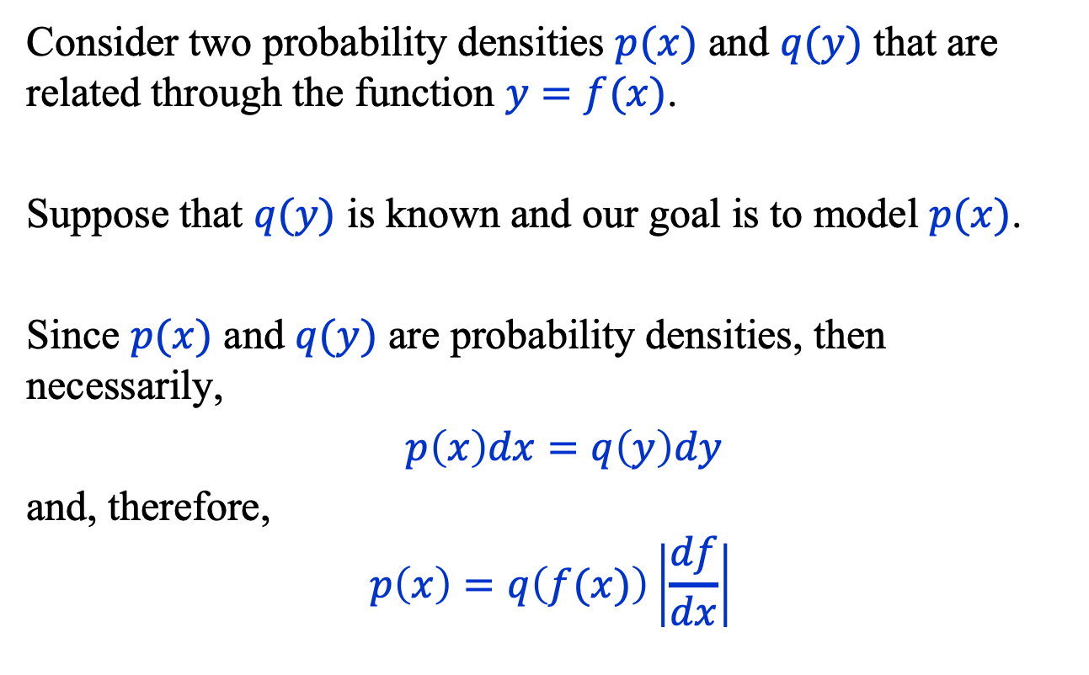
Change of Variables
Consider two probability densities $p(x)$ and $q(y)$ that are related through the function $y=f(x)$.
Suppose that $q(y)$ is known and our goal is to model $p(x)$.
Since $p(x)$ and $q(y)$ are probability densities, then necessarily,
$p\left(x\right)dx=q\left(y\right)dy$
and, therefore,
$$p\left(x\right)=q\left(f(x)\right)\left|\frac{df}{dx}\right|$$

Slide 6
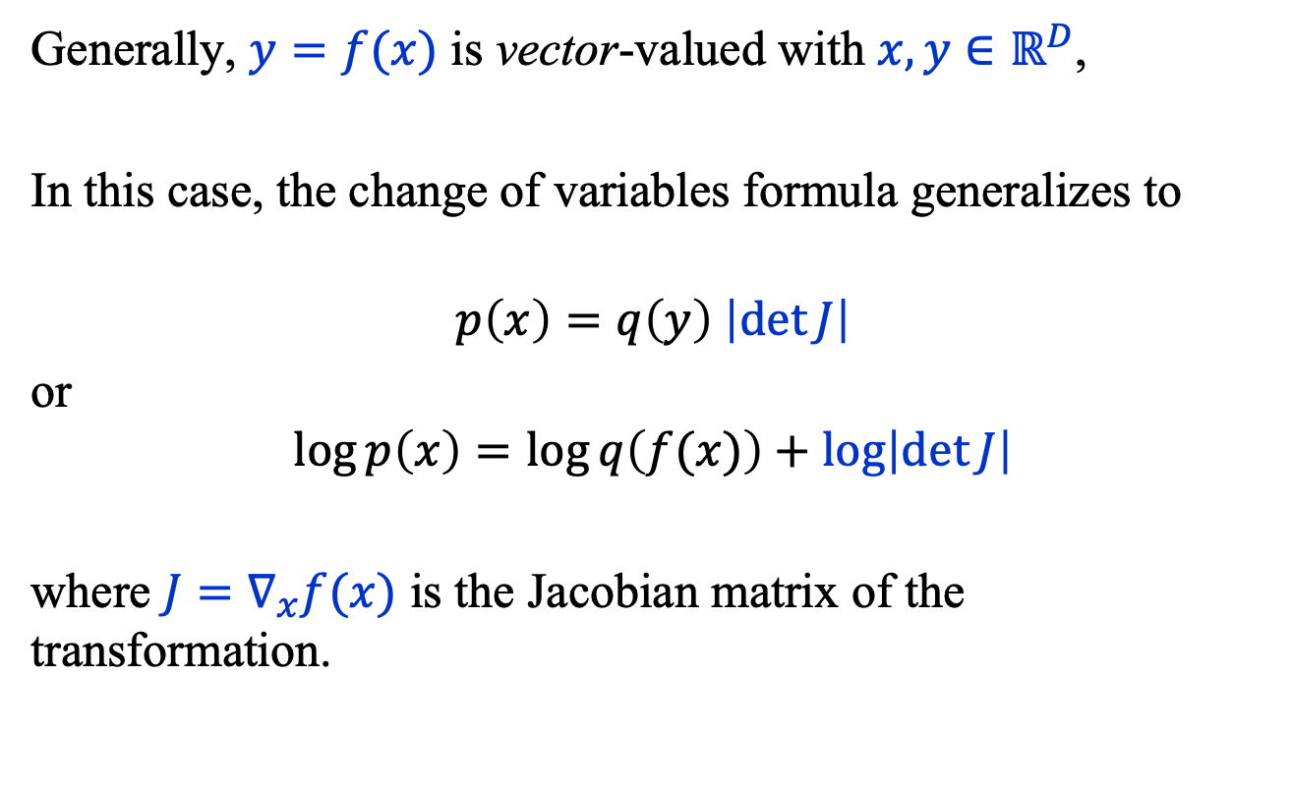
Change of Variables
Generally, $y=f(x)$ is vector-valued with $x, y∈ℝ^{D}$,
In this case, the change of variables formula generalizes to
$$p\left(x\right)=q\left(y\right) \left|\det{J}\right|$$
or
$$\log{p\left(x\right)}=\log{q\left(f(x)\right)}+\log\left|\det{J}\right|$$
where $J=∇_{x}f(x)$ is the Jacobian matrix of the transformation.

Slide 7
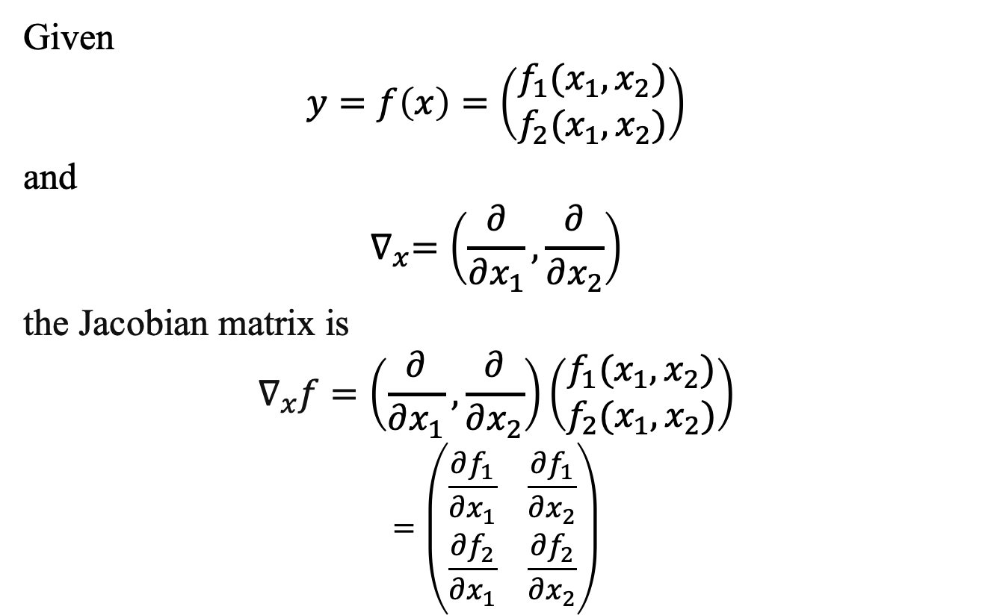
Change of Variables: Example
Given
$$y=f\left(x\right)=\left(\begin{matrix}f_{1}(x_{1}, x_{2}) \\ f_{2}(x_{1},x_{2})\end{matrix}\right)$$
and
$$∇_{x}=\left(\frac{∂}{∂x_{1}}, \frac{∂}{∂x_{2}}\right)$$
the Jacobian matrix is
$$∇_{x}f=\left(\frac{∂}{∂x_{1}}, \frac{∂}{∂x_{2}}\right)\left(\begin{matrix}f_{1}(x_{1}, x_{2}) \\ f_{2}(x_{1},x_{2})\end{matrix}\right)$$
$$=\left(\begin{matrix}\frac{∂f_{1}}{∂x_{1}} & \frac{∂f_{1}}{∂x_{2}} \\ \frac{∂f_{2}}{∂x_{1}} & \frac{∂f_{2}}{∂x_{2}}\end{matrix}\right)$$

Slide 8

Normalizing Flows
codomain $y=f(x)$ domain
A normalizing flow is a way to approximate the function $f(x)$ by modeling the latter as a conjunction of bijections $f_{i}$.
$$f\left(x\right)=f_{n}∘f_{n−1}∘…f_{1}$$
$=f_{n}(f_{n−1}\left(…f_{1}\left(x\right)\right)…)$
(A bijection is a one-to-one invertible function.)

Slide 9


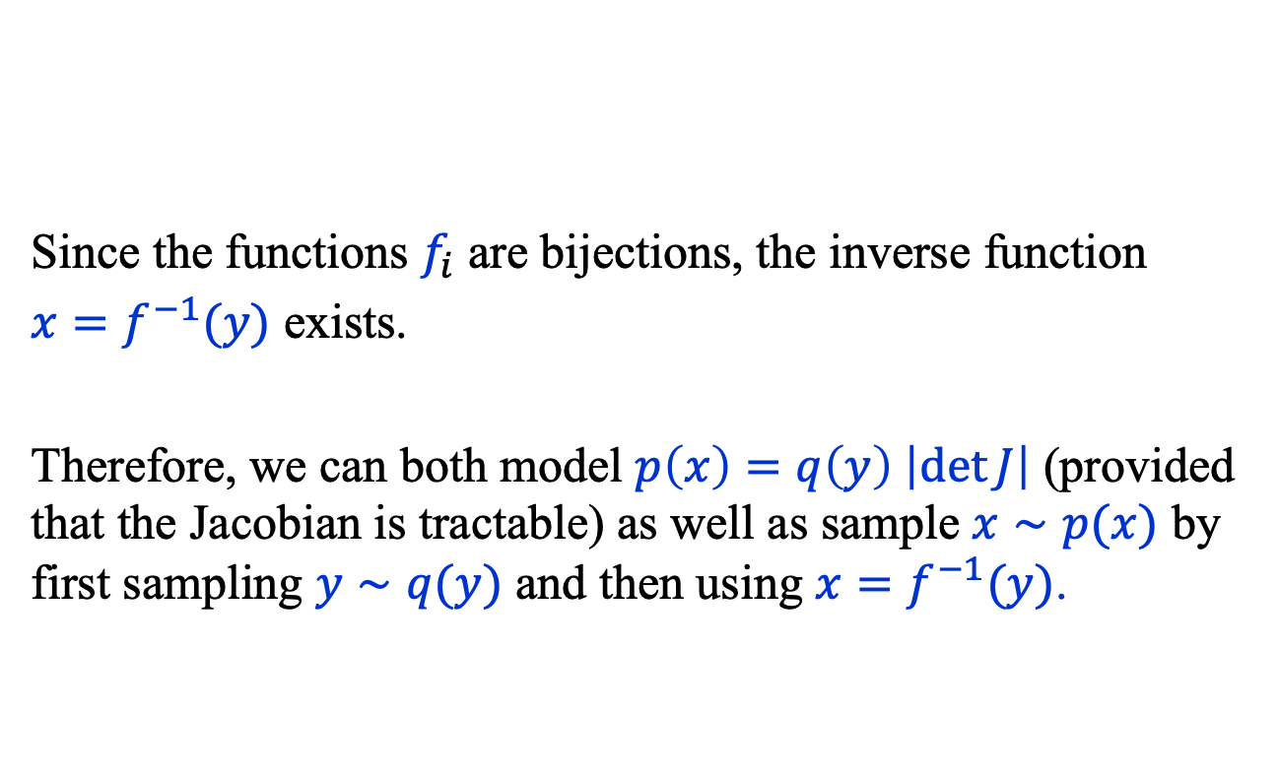



Normalizing Flows
Since the functions $f_{i}$ are bijections, the inverse function
$x=f^{−1}(y)$ exists.
Therefore, we can both model $p\left(x\right)=q\left(y\right) \left|\det{J}\right|$ (provided that the Jacobian is tractable) as well as sample $x∼p(x)$ by first sampling $y∼q(y)$ and then using $x=f^{−1}(y)$.
$$y$$
…
$$x$$
$$f_{n}$$
$$f_{n−1}$$
$$f_{1}$$

Slide 10
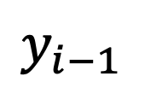
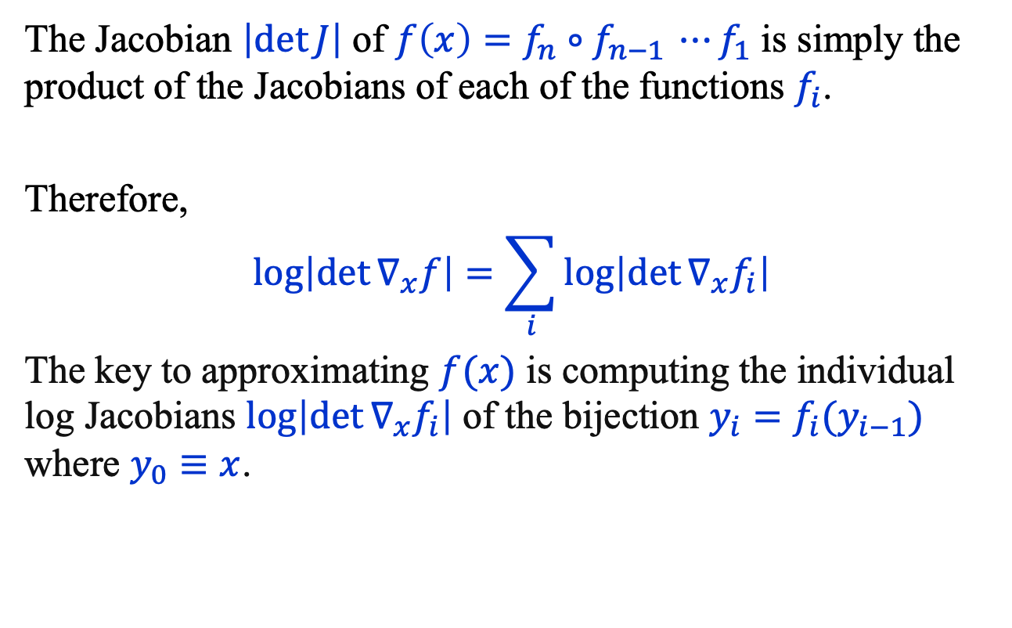
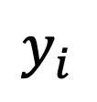

Normalizing Flows
The Jacobian $\left|\det{J}\right|$ of $f\left(x\right)=f_{n}∘f_{n−1 }⋯f_{1}$ is simply the product of the Jacobians of each of the functions $f_{i}$.
Therefore,
$$\log\left|\det{∇_{x}f}\right|=\sum_{i}{\log\left|\det{∇_{x}f_{i}}\right|}$$
The key to approximating $f(x)$ is computing the individual log Jacobians $\log\left|\det{∇_{x}f_{i}}\right|$ of the bijection $y_{i}=f_{i}(y_{i−1})$ where $y_{0}≡x$.
$$y_{i}$$
$$f_{i}$$
$$y_{i−1}$$

Slide 11
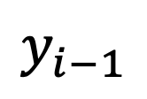
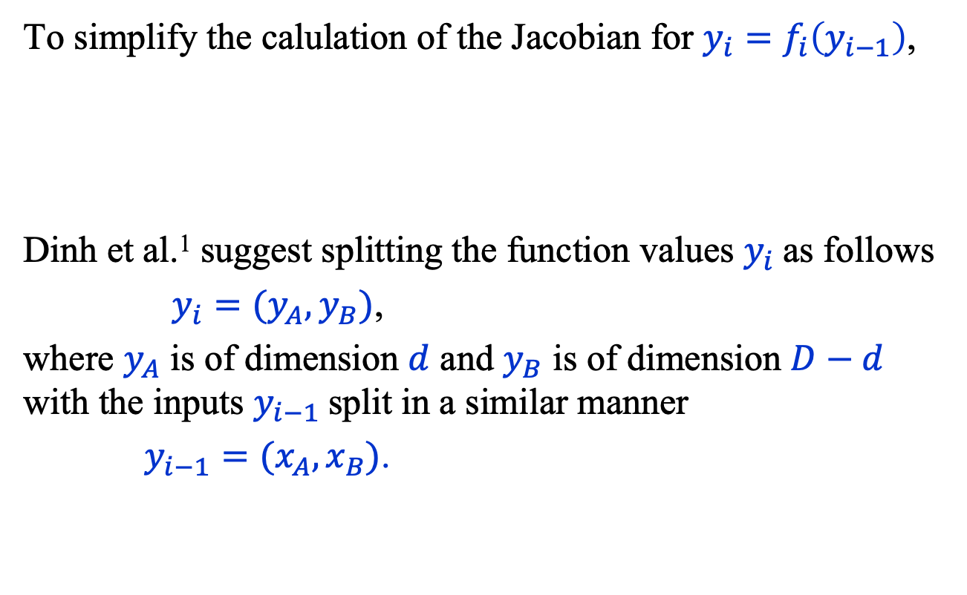
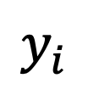

Normalizing Flows: Bijection
To simplify the calulation of the Jacobian for $y_{i}=f_{i}\left(y_{i−1}\right)$,
Dinh et al.¹ suggest splitting the function values $y_{i}$as follows
$y_{i}=(y_{A}, y_{B})$,
where $y_{A}$ is of dimension $d$ and $y_{B}$ is of dimension $D−d$ with the inputs $y_{i−1}$split in a similar manner
$y_{i−1}=(x_{A}, x_{B})$.
$$y_{i}$$
$$f_{i}$$
$$y_{i−1}$$
Laurent Dinh, Jascha Sohl-Dickstein, and Samy Bengio, Density Estimation using Real NVP,
https://arxiv.org/abs/1605.08803

Slide 12
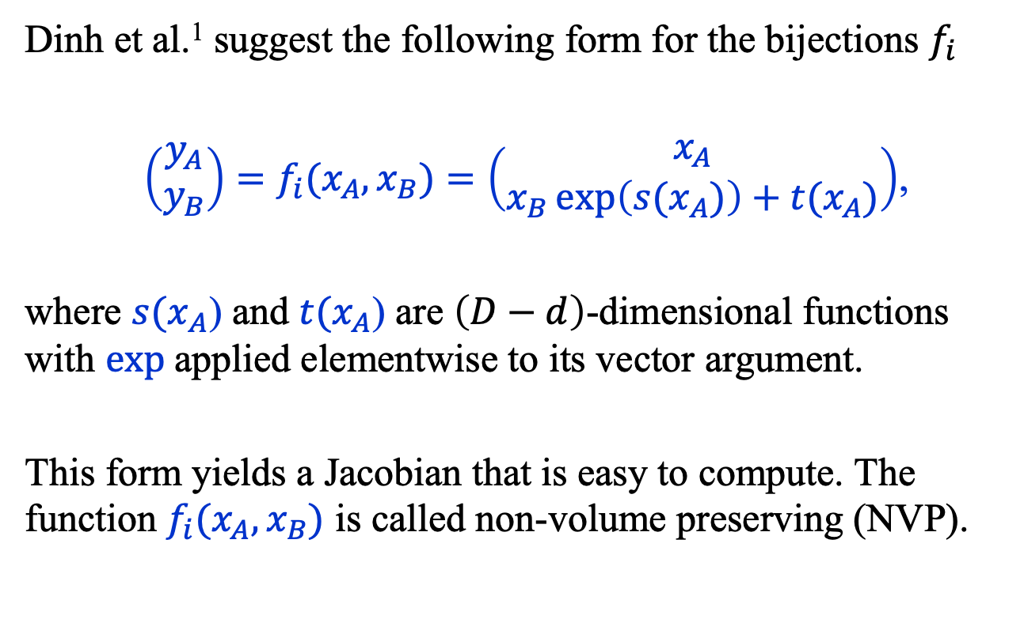
Normalizing Flows: Bijection
Dinh et al.¹ suggest the following form for the bijections $f_{i}$
$\left(\begin{matrix}y_{A} \\ y_{B}\end{matrix}\right)=f_{i}(x_{A}, x_{B})=\left(\begin{matrix}x_{A} \\ x_{B}\exp\left({s(x}_{A})\right)+t(x_{A})\end{matrix}\right)$,
where ${s(x}_{A}$) and $t(x_{A}$) are $\left(D−d\right)$-dimensional functions with $exp$applied elementwise to its vector argument.
This form yields a Jacobian that is easy to compute. The function $f_{i}(x_{A}, x_{B})$ is called non-volume preserving (NVP).
Laurent Dinh, Jascha Sohl-Dickstein, and Samy Bengio, Density Estimation using Real NVP,
https://arxiv.org/abs/1605.08803

Slide 13
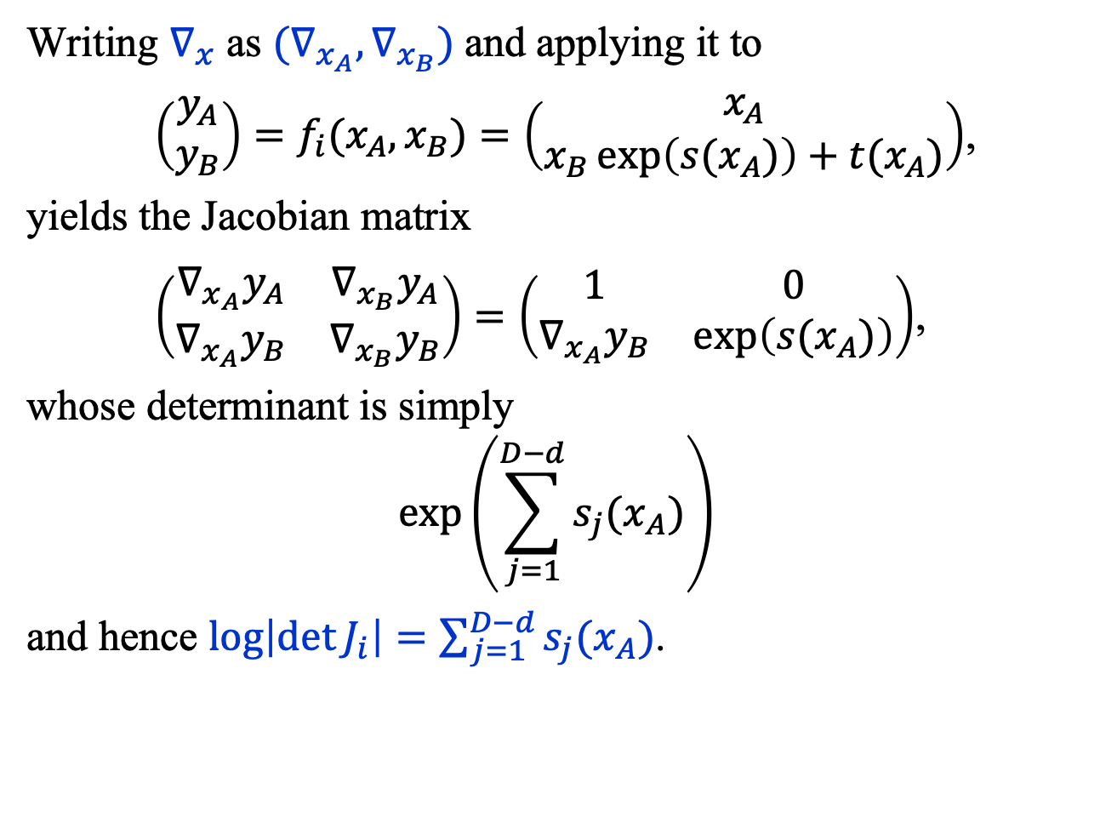
Normalizing Flows: Jacobian
Writing $∇_{x}$ as $(∇_{x_{A}}, ∇_{x_{B}})$and applying it to
$\left(\begin{matrix}y_{A} \\ y_{B}\end{matrix}\right)=f_{i}(x_{A}, x_{B})=\left(\begin{matrix}x_{A} \\ x_{B}\exp\left({s(x}_{A})\right)+t(x_{A})\end{matrix}\right)$,
yields the Jacobian matrix
$\left(\begin{matrix}∇_{x_{A}}y_{A} & ∇_{x_{B}}y_{A} \\ ∇_{x_{A}}y_{B} & ∇_{x_{B}}y_{B}\end{matrix}\right)=\left(\begin{matrix}1 & 0 \\ ∇_{x_{A}}y_{B} & \exp\left({s(x}_{A})\right)\end{matrix}\right)$,
whose determinant is simply
$$\exp\left(\sum_{j=1}^{D−d}{{s_{j}(x}_{A}})\right)$$
and hence $\log\left|{\det{J}}_{i}\right|=\sum_{j=1}^{D−d}{{s_{j}(x}_{A}})$.

Slide 14

Normalizing Flows: Pseudocode
The pseudocode that follows is inspired by François Fleuret’s excellent course on deep learning https://fleuret.org/dlc/, where the quantities $s$ and $t$, which are intrinsically $\left(D−d\right)$-dimensional functions, are modeled with D-dimensional tensors by using a mask, b.

Slide 15
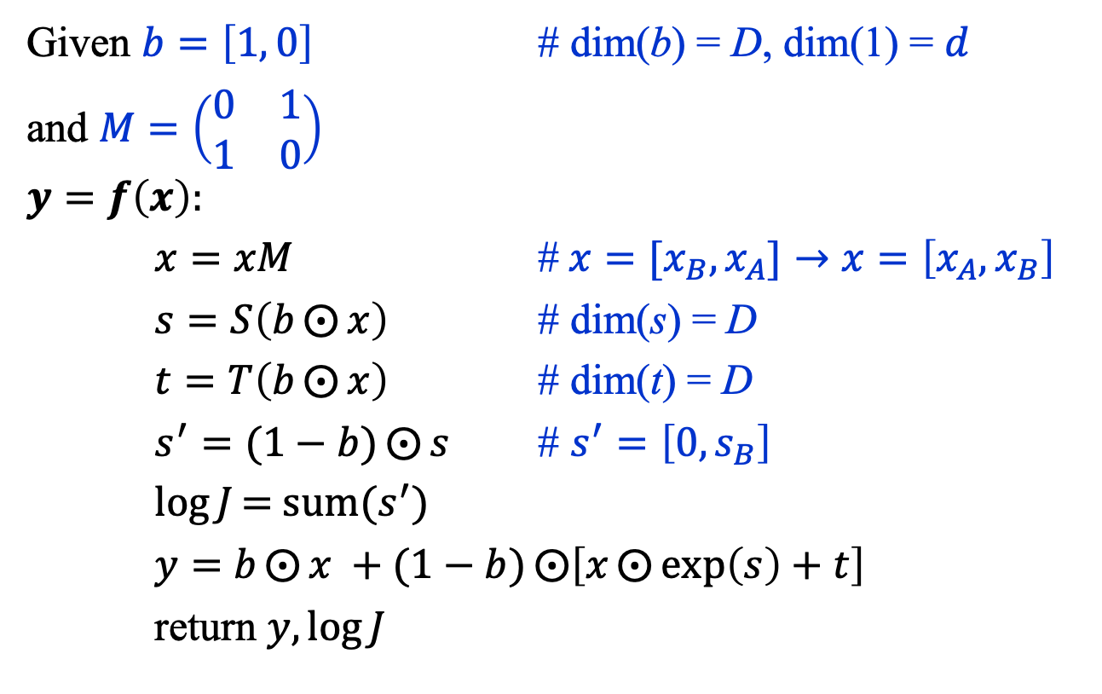

Normalizing Flows: $y=f_{i}(x)$
Given $b=\left[1, 0\right]$ # dim(b) = D, dim(1) = $d$
and $M=\left(\begin{matrix}0 & 1 \\ 1 & 0\end{matrix}\right)$
$$y=f\left(x\right):$$
$x=xM$ #${ x=[x}_{B}, x_{A}]→x=\left[x_{A}, x_{B}\right]$
$s=S\left(b⨀{x}\right)$ # dim(s) = D
$t=T\left(b⨀{x}\right)$ # dim(t) = D
$s^{′}=(1−b)⨀{s}$ # $s^{′}=\left[0, s_{B}\right]$
$\log{J}\text{= }\text{sum}(s^{′})$
$y=$ $b⨀{x} +(1−b)⨀{\left[x⨀{\exp\left(s\right)+t}\right]}$
return $y,\log{J}$
François Fleuret, https://fleuret.org/dlc/

Slide 16
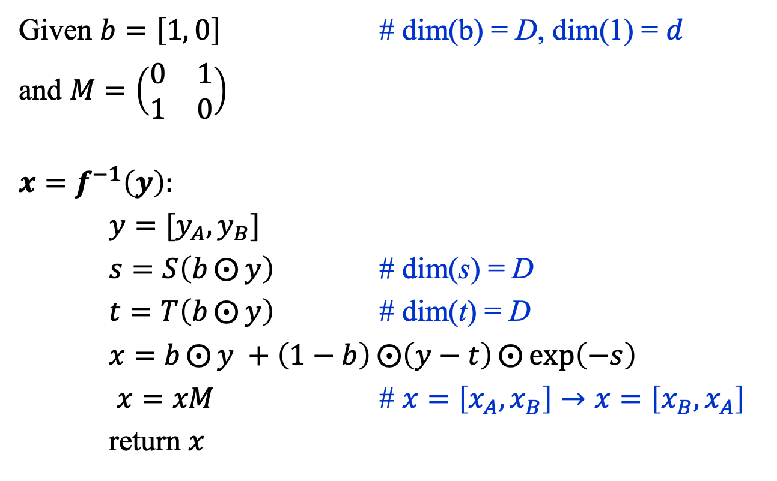

Normalizing Flows: $x=f_{i}^{−1}(y)$
Given $b=\left[1, 0\right]$ # dim(b) = D, dim(1) = $d$
and $M=\left(\begin{matrix}0 & 1 \\ 1 & 0\end{matrix}\right)$
$$x=f^{−1}\left(y\right):$$
${y=[y}_{A}, y_{B}]$
$s=S\left(b⨀{y}\right)$ # dim(s) = D
$t=T\left(b⨀{y}\right)$ # dim(t) = D
$x=$ $b⨀{y} +\left(1−b\right)⨀{\left(y−t\right)⨀{\exp\left(−s\right)}}$
$x=xM$ # $x=\left[x_{A}, x_{B}\right]→x=\left[x_{B}, x_{A}\right]$
return $x$
François Fleuret, https://fleuret.org/dlc/

Slide 17
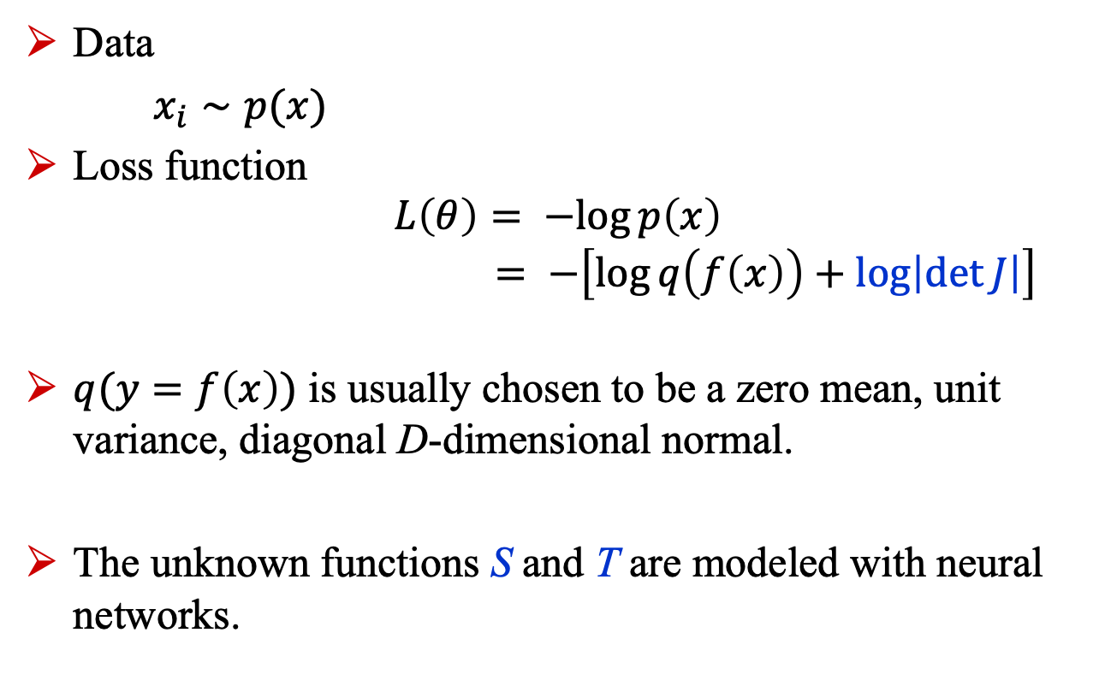
Normalizing Flows: Training
Data
$x_{i}∼p(x)$
Loss function $L\left(θ\right)= −log{p\left(x\right)}$ $= −\left[\log{q\left(f\left(x\right)\right)}+\log\left|\det{J}\right|\right]$
$q(y=f\left(x\right))$ is usually chosen to be a zero mean, unit variance, diagonal D-dimensional normal.
The unknown functions S and T are modeled with neural networks.

Slide 18
Diffusion models

Slide 19
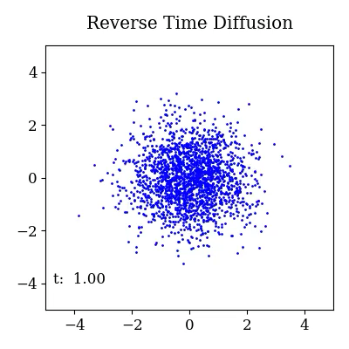
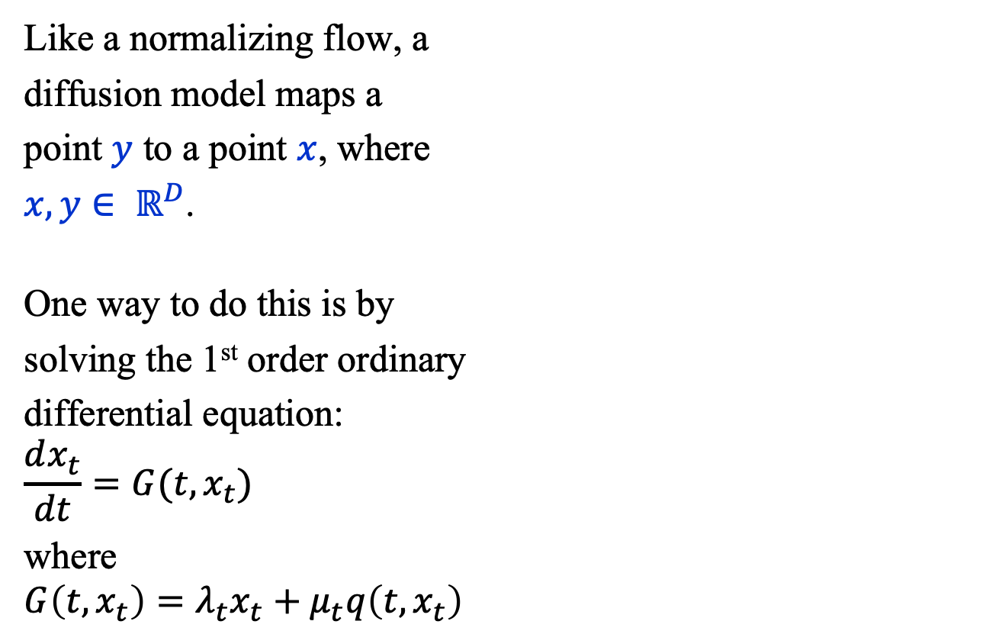
Diffusion Model
Like a normalizing flow, a
diffusion model maps a
point $y$ to a point $x$, where
$x, y∈ ℝ^{D}$.
One way to do this is by
solving the 1st order ordinary
differential equation:
$$\frac{dx_{t}}{dt}=G(t, x_{t})$$
where
$$G\left(t, x_{t}\right)=λ_{t}x_{t}+μ_{t}q\left(t, x_{t}\right)$$

Slide 20
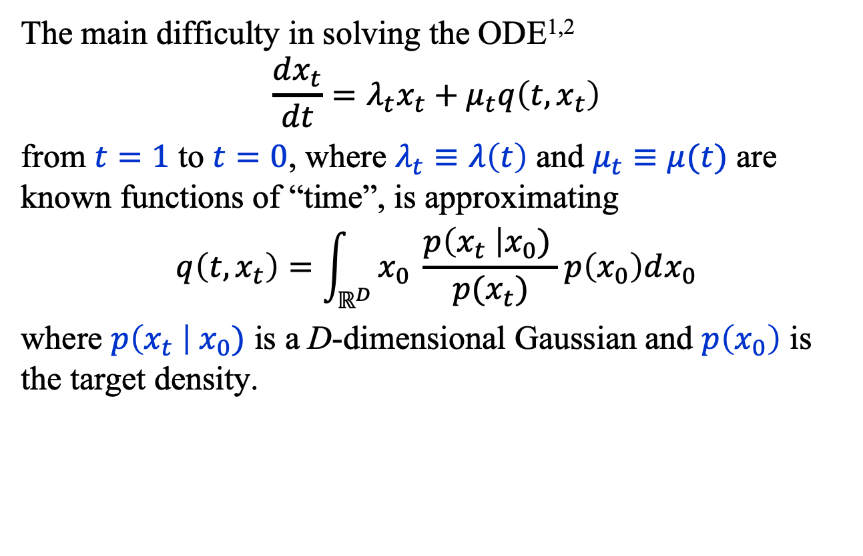
Diffusion Model
The main difficulty in solving the ODE^{1,2}
$$\frac{dx_{t}}{dt}=λ_{t}x_{t}+μ_{t}q\left(t, x_{t}\right)$$
from $t=1$ to $t=0$, where $λ_{t}≡λ\left(t\right)$ and $μ_{t}≡μ(t)$ are known functions of “time”, is approximating
$$q\left(t, x_{t}\right)=\int_{ℝ^{D}}{x_{0} \frac{p\left(x_{t} \right|x_{0}) }{p(x_{t})}p\left(x_{0}\right)dx_{0}}$$
where $p\left(x_{t} \right|{ x}_{0})$ is a D-dimensional Gaussian and $p\left(x_{0}\right)$ is the target density.
Cheng Lu†, Yuhao Zhou†, Fan Bao†, Jianfei Chen†, Chongxuan Li‡, Jun Zhu, DPM-Solver: A Fast ODE Solver for Diffusion Probabilistic Model Sampling in Around 10 Steps*, arXiv:2206.00927v3, 2022.
Yanfang Lui, Minglei Yang, Zezhong Zhang, Feng Bao, Yanzhao Cao, and Guannan Zhang, Diffusion-Model-Assisted Supervised Learning of Generative Models for Density Estimation, arXiv:2310.14458v1, 2023

Slide 21
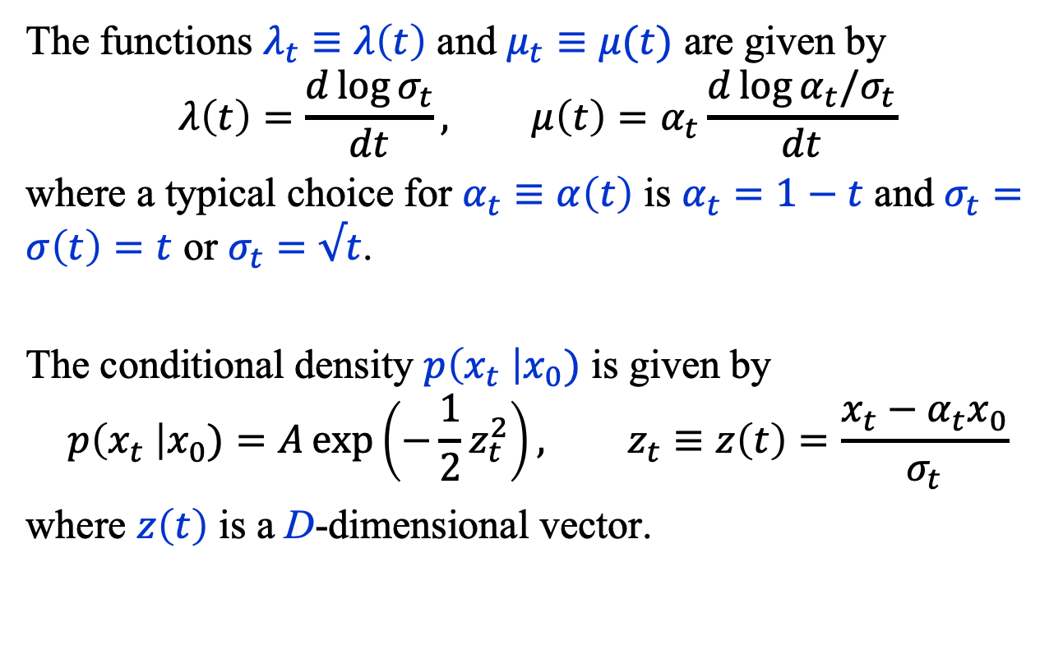
Diffusion Model
The functions $λ_{t}≡λ\left(t\right)$ and $μ_{t}≡μ(t)$ are given by
$$λ\left(t\right)=\frac{d\log{σ_{t}}}{dt}, μ\left(t\right)=α_{t}\frac{d\log{{α_{t}/σ}_{t}}}{dt}$$
where a typical choice for $α_{t}≡α\left(t\right)$ is $α_{t}=1−t$ and $σ_{t}=σ\left(t\right)=t$ or $σ_{t}=√t$.
The conditional density $p\left(x_{t} \right|x_{0})$ is given by
$$p\left(x_{t} \right|x_{0})=A\exp\left(−\frac{1}{2}z_{t}^{2}\right), z_{t}≡z\left(t\right)=\frac{x_{t}−α_{t}x_{0}}{σ_{t}}$$
where $z\left(t\right)$ is a D-dimensional vector.

Slide 22
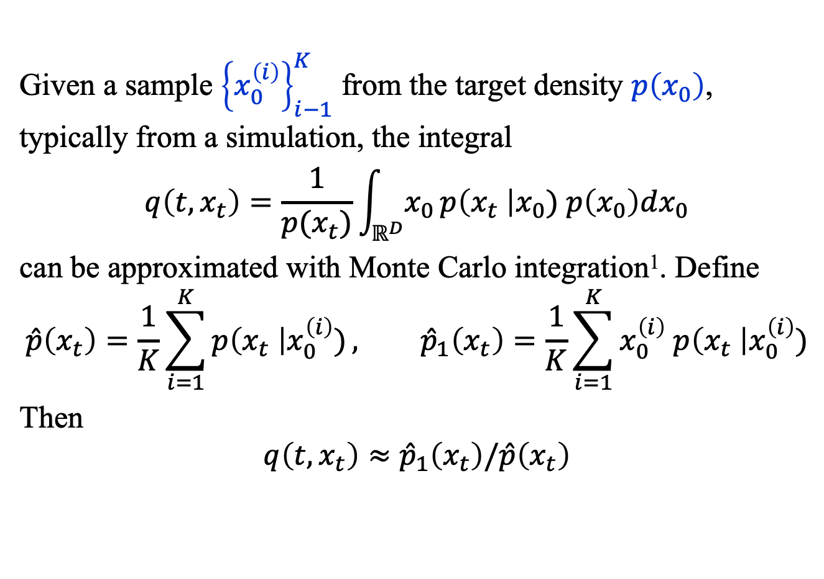
Diffusion Model
Given a sample ${\left\{x_{0}^{\left(i\right)}\right\}}_{i−1}^{K}$ from the target density $p\left(x_{0}\right)$, typically from a simulation, the integral
$$q\left(t, x_{t}\right)=\frac{1}{p(x_{t})}\int_{ℝ^{D}}{x_{0 }p\left(x_{t} \right|x_{0}) p\left(x_{0}\right)dx_{0}}$$
can be approximated with Monte Carlo integration¹. Define
$$\hat{p}\left(x_{t}\right)=\frac{1}{K}\sum_{i=1}^{K}{p\left(x_{t} \right|x_{0}^{\left(i\right)})}, {\hat{p}}_{1}\left(x_{t}\right)=\frac{1}{K}\sum_{i=1}^{K}{x_{0}^{\left(i\right)} p\left(x_{t} \right|x_{0}^{\left(i\right)})}$$
Then
$$q\left(t, x_{t}\right)≈{\hat{p}}_{1}\left(x_{t}\right)/\hat{p}\left(x_{t}\right)$$
Yanfang Lui, Minglei Yang, Zezhong Zhang, Feng Bao, Yanzhao Cao, and Guannan Zhang, Diffusion-Model-Assisted Supervised Learning of Generative Models for Density Estimation, arXiv:2310.14458v1, 2023

Slide 23
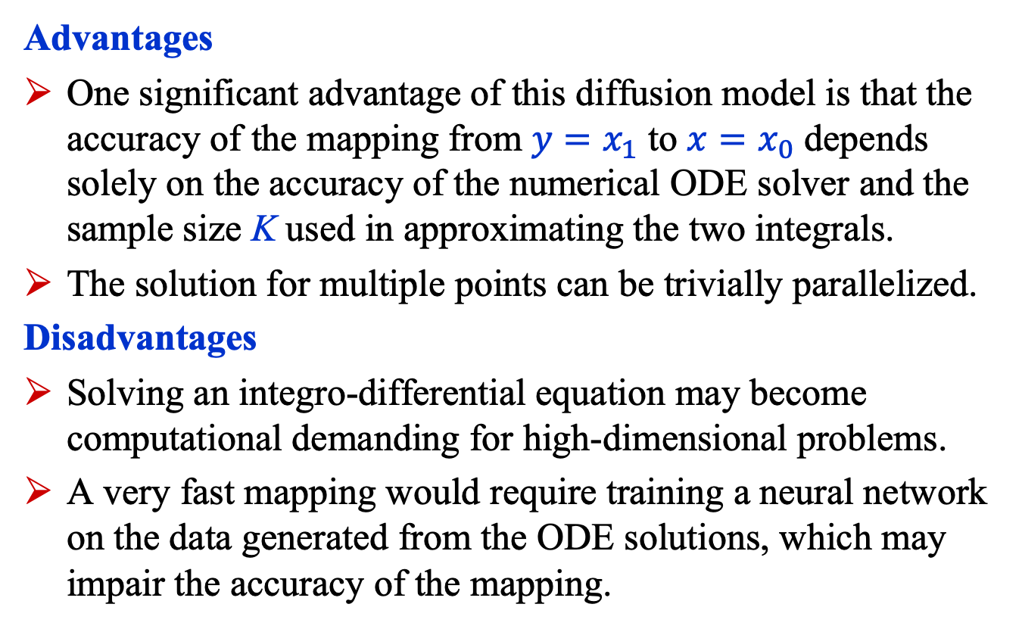
Diffusion Model
Advantages
One significant advantage of this diffusion model is that the accuracy of the mapping from ${y=x}_{1}$ to $x=x_{0}$ depends solely on the accuracy of the numerical ODE solver and the sample size K used in approximating the two integrals.
The solution for multiple points can be trivially parallelized.
Disadvantages
Solving an integro-differential equation may become computational demanding for high-dimensional problems.
A very fast mapping would require training a neural network on the data generated from the ODE solutions, which may impair the accuracy of the mapping.

Slide 24
Summary
Finding good approximations to multidimensional probability densities is an important task in many fields.
Normalizing flows have been shown to yield satisfactory results, though they may not scale well to very high-dimensional problems.
Diffusion models can be used to map a point sampled from a Gaussian to another sampled from a desired target density. We briefly described a method that “simply” requires solving an ODE.

