Slide 1
Machine learning in physics Foundations 5

Slide 2
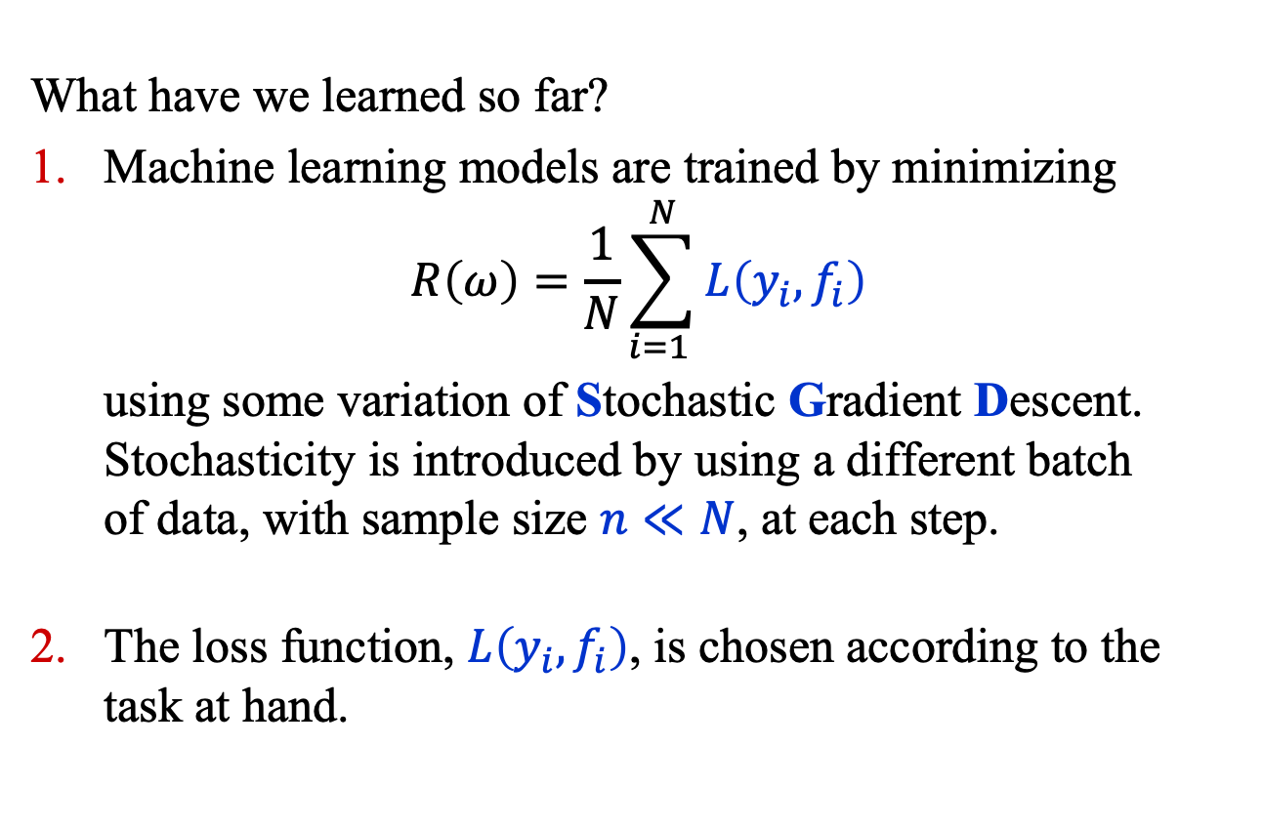
Recap
What have we learned so far?
Machine learning models are trained by minimizing
$$R\left(ω\right)=\frac{1}{N}\sum_{i=1 }^{N}{L\left(y_{i}, f_{i}\right)}$$
using some variation of Stochastic Gradient Descent. Stochasticity is introduced by using a different batch of data, with sample size $n≪N$, at each step.
The loss function, $L\left(y_{i}, f_{i}\right)$, is chosen according to the task at hand.

Slide 3
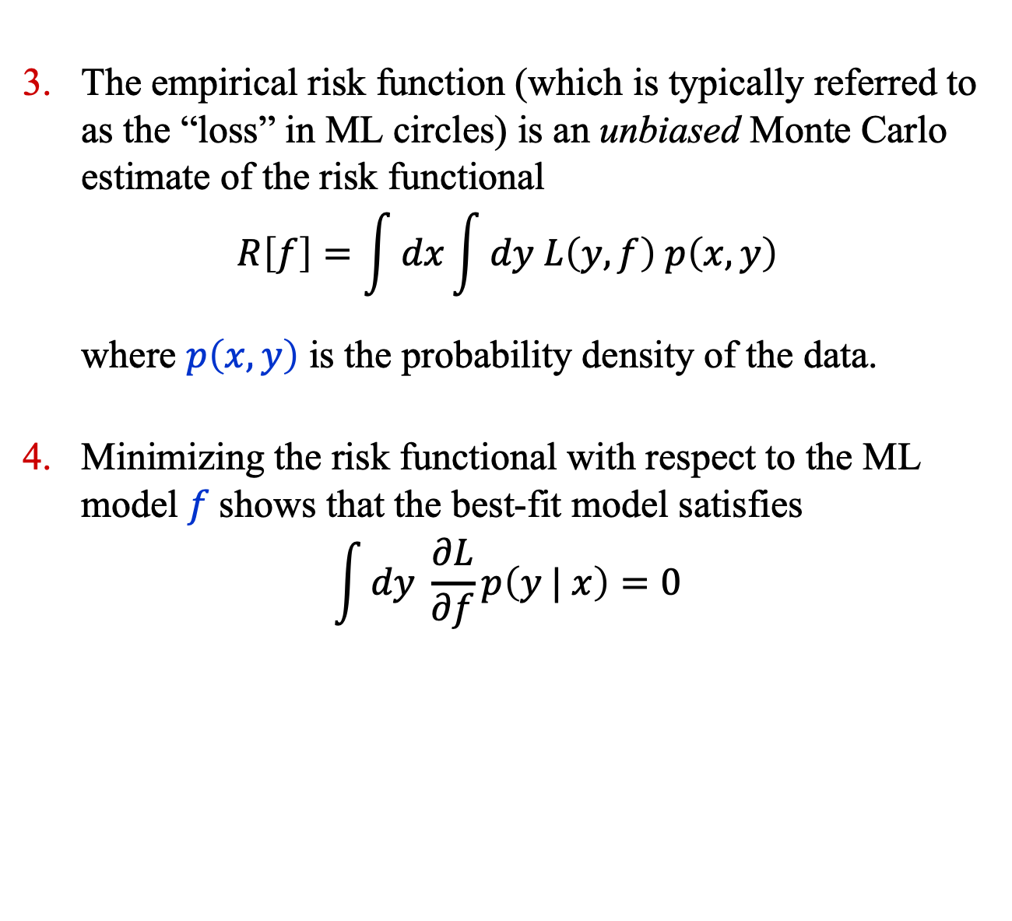
Recap
The empirical risk function (which is typically referred to as the “loss” in ML circles) is an unbiased Monte Carlo estimate of the risk functional
$$R\left[f\right]=\int{dx}\int{dy L\left(y, f\right) p\left(x, y\right)}$$
where $p\left(x, y\right)$ is the probability density of the data.
Minimizing the risk functional with respect to the ML model $f$shows that the best-fit model satisfies
$$\int{dy \frac{∂L}{∂f}p\left(y | x\right)=0}$$

Slide 4
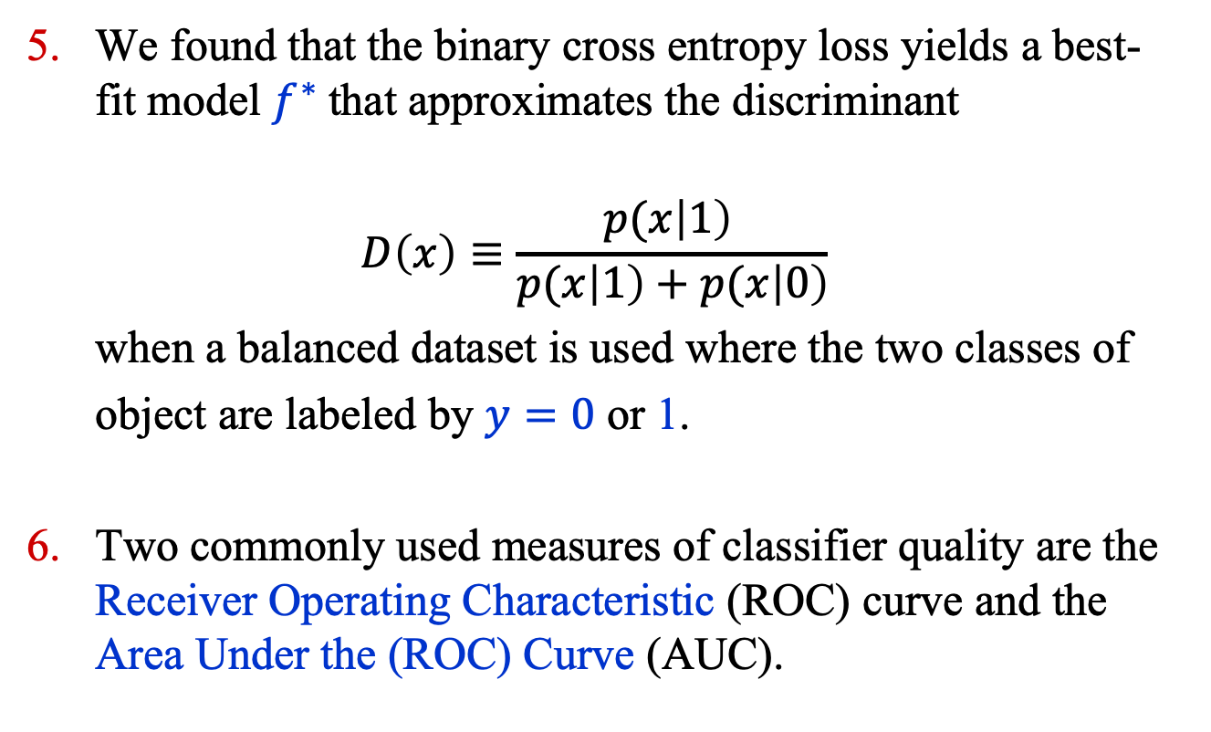
Recap
We found that the binary cross entropy loss yields a best-fit model $f^{∗}$that approximates the discriminant
$$D\left(x\right)≡\frac{p(x\left|1\right) }{p(x\left|1\right)+p(x\left|0\right)}$$
when a balanced dataset is used where the two classes of
object are labeled by $y=0$ or 1.
Two commonly used measures of classifier quality are the Receiver Operating Characteristic (ROC) curve and the Area Under the (ROC) Curve (AUC).

Slide 5
Classifier Performance

Slide 6
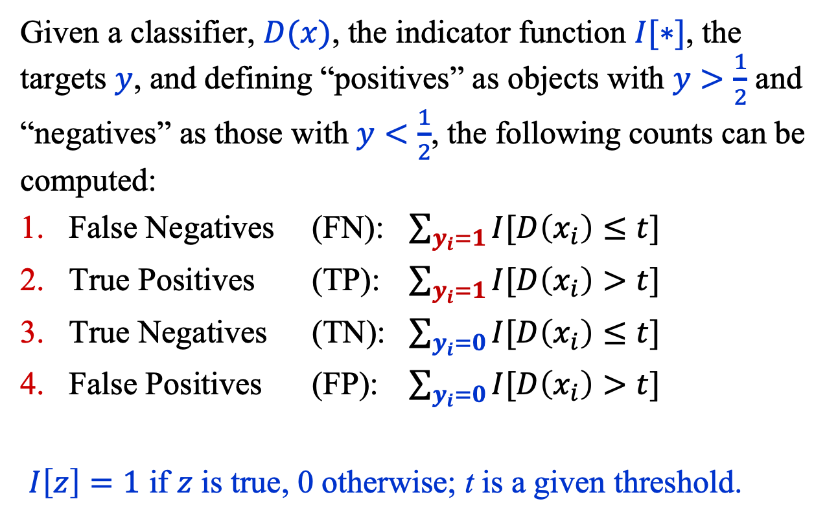
Classifier Performance: Counts
Given a classifier, $D(x)$, the indicator function $I[∗]$, the targets $y$, and defining “positives” as objects with $y>\frac{1}{2}$ and “negatives” as those with $y<\frac{1}{2}$, the following counts can be computed:
False Negatives (FN): $\sum_{y_{i}=1}{I[D\left(x_{i}\right)≤t}]$
True Positives (TP): $\sum_{y_{i}=1}{I[D\left(x_{i}\right)>t}]$
True Negatives (TN): $\sum_{y_{i}=0}{I[D\left(x_{i}\right)≤t}]$
False Positives (FP): $\sum_{y_{i}=0}{I[D\left(x_{i}\right)>t}]$
$I\left[z\right]=1$ if $z$ is true, 0 otherwise; t is a given threshold.

Slide 7
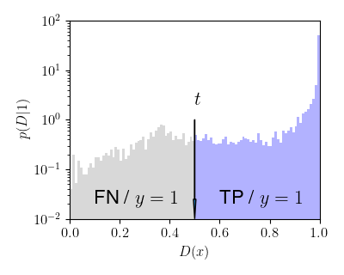
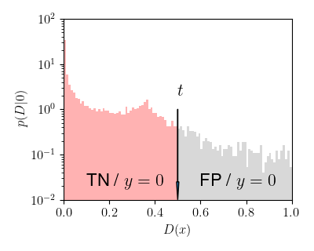
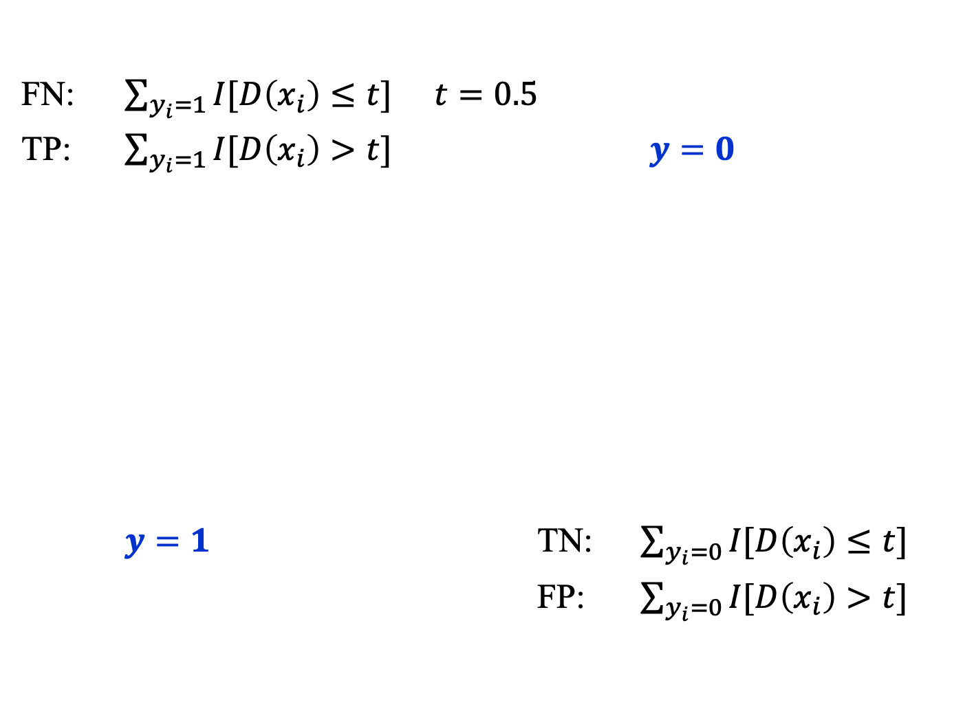
Classifier Performance: Counts
FN: $\sum_{y_{i}=1}{I[D\left(x_{i}\right)≤t}]$ $t=0.5$
TP: $\sum_{y_{i}=1}{I[D\left(x_{i}\right)>t}]$ $y=0$
$y=1$ TN: $\sum_{y_{i}=0}{I[D\left(x_{i}\right)≤t}]$
FP: $\sum_{y_{i}=0}{I[D\left(x_{i}\right)>t}]$

Slide 8
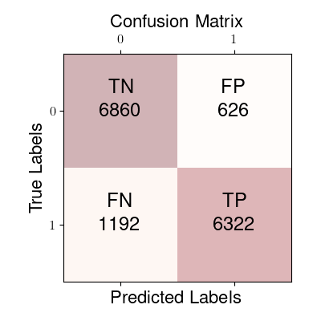
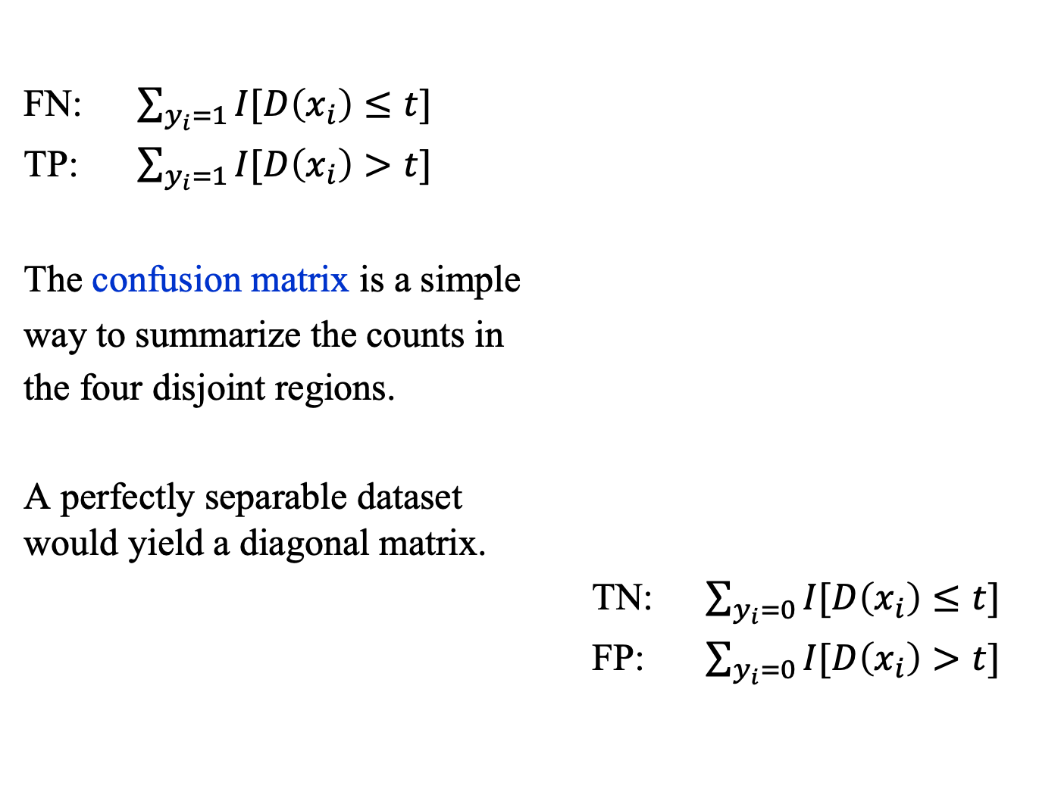
Confusion Matrix
FN: $\sum_{y_{i}=1}{I[D\left(x_{i}\right)≤t}]$
TP: $\sum_{y_{i}=1}{I[D\left(x_{i}\right)>t}]$
The confusion matrix is a simple
way to summarize the counts in
the four disjoint regions.
A perfectly separable dataset would yield a diagonal matrix.
TN: $\sum_{y_{i}=0}{I[D\left(x_{i}\right)≤t}]$
FP: $\sum_{y_{i}=0}{I[D\left(x_{i}\right)>t}]$

Slide 9
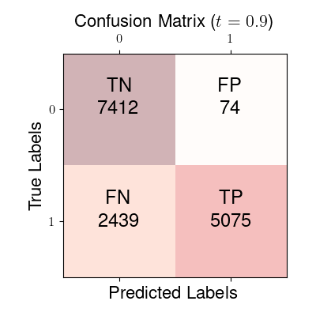
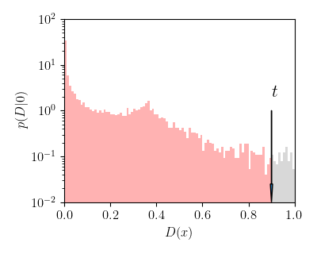
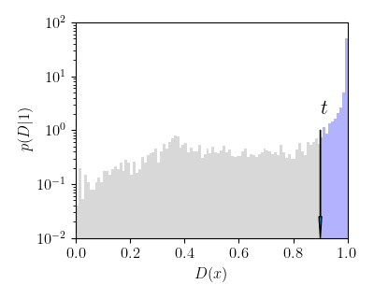

Confusion Matrix ($t=0.9$)

Slide 10

Accuracy, Precision, Recall
Accuracy = (TP + TN) / (FN + TP + TN + FP)
Precision = TP / (TP + FP) $P(y=1|D>t)$
Recall = TP / (FN + TP)
True Positive Rate (TPR) = TP / (FN + TP) $P(D>t|1)$
False Positive Rate (FPR) = FP / (TN + FP) $P(D>t|0)$

Slide 11
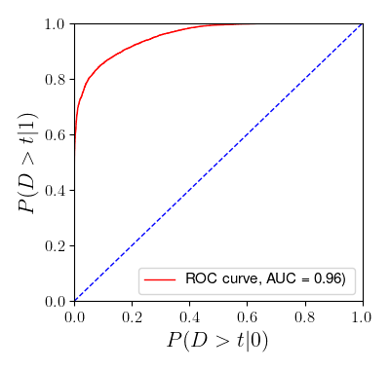

ROC and AUC
The ROC curve is a plot of TPR vs. FPR, that is,
$$P\left(D>t | 1\right) \text{vs}\text{.} P(D>t|0)$$
where (usually)
$$D(x)=\frac{p(x\left|1\right) }{p(x\left|1\right)+p(x\left|0\right)}$$

Slide 12
Beyond Classification

Slide 13
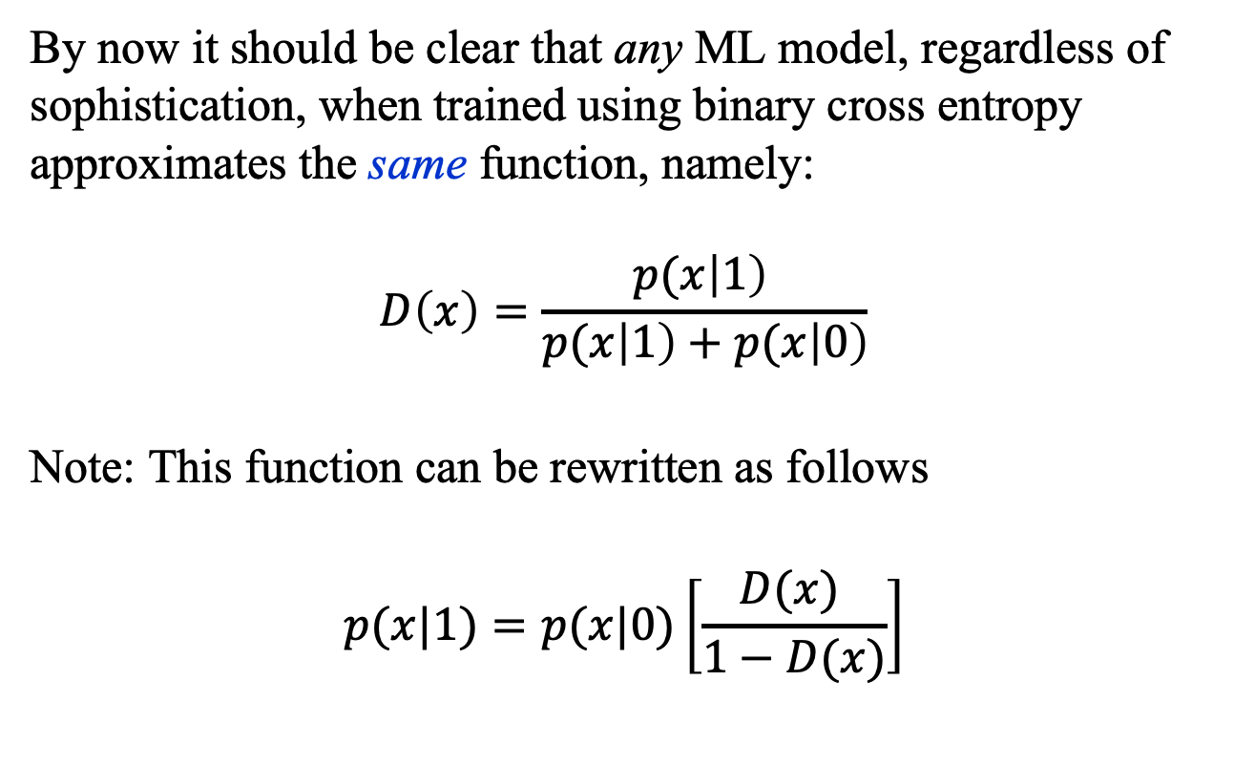
Beyond Classification
By now it should be clear that any ML model, regardless of sophistication, when trained using binary cross entropy approximates the same function, namely:
$$D\left(x\right)=\frac{p(x\left|1\right) }{p(x\left|1\right)+p(x\left|0\right)}$$
Note: This function can be rewritten as follows
$$p(x|1)=p(x|0)\left[\frac{D(x) }{1−D(x)}\right]$$

Slide 14
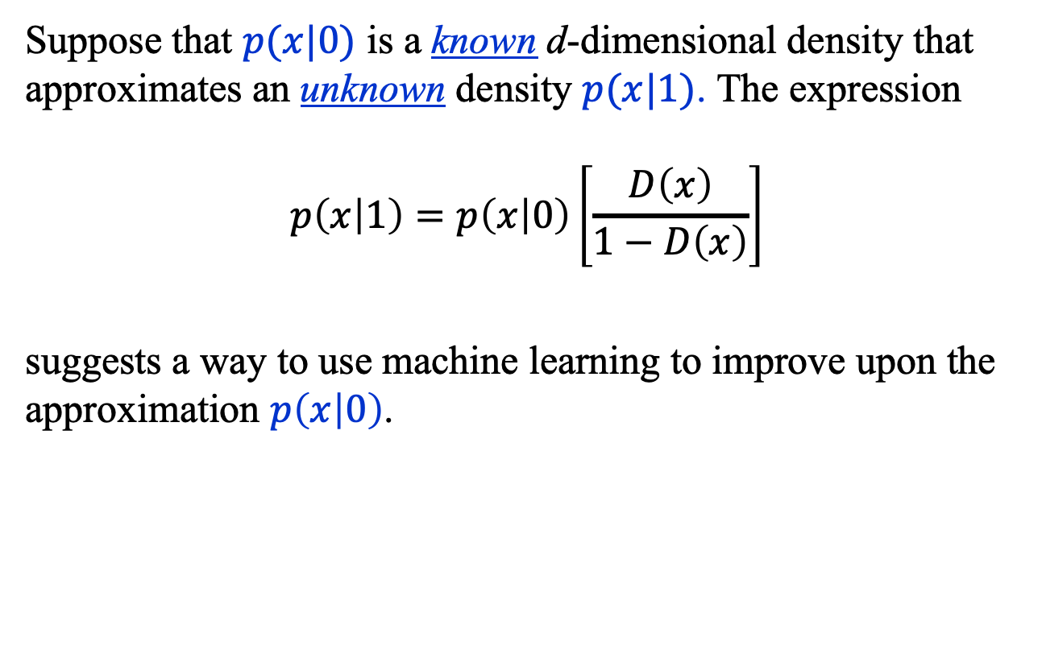
Beyond Classification
Suppose that $p(x|0)$ is a known d-dimensional density that approximates an unknown density $p(x|1)$. The expression
$$p\left(x | 1\right)=p\left(x | 0\right)\left[\frac{D\left(x\right)}{1−D\left(x\right)}\right]$$
suggests a way to use machine learning to improve upon the approximation $p\left(x | 0\right)$.

Slide 15
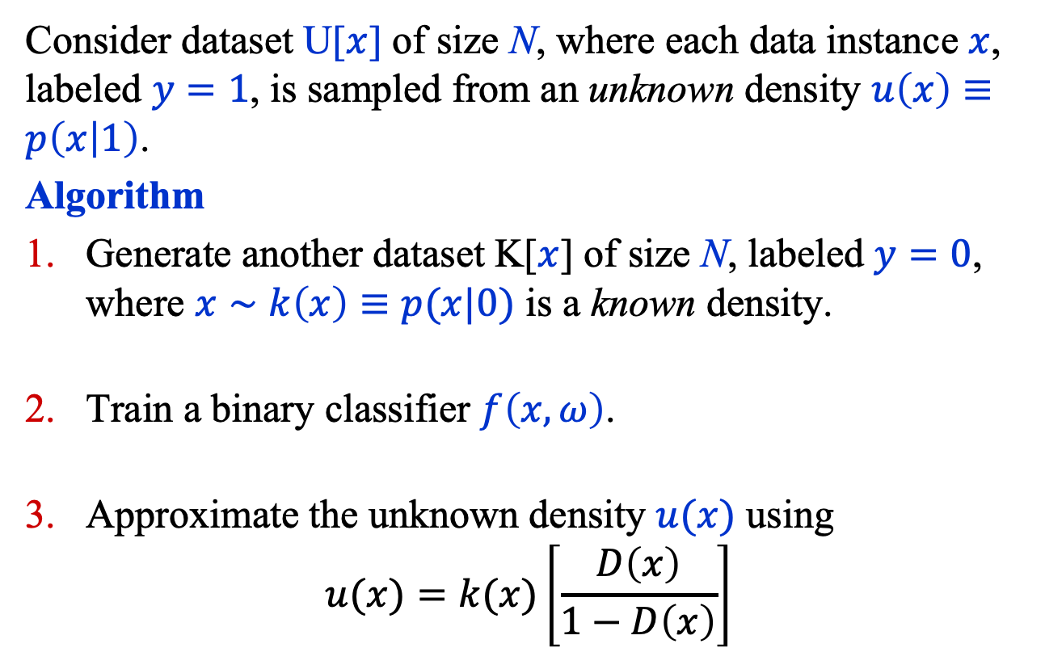
Density Estimation
Consider dataset U[$x$] of size N, where each data instance $x$, labeled $y=1$, is sampled from an unknown density $u\left(x\right)≡p\left(x | 1\right)$.
Algorithm
Generate another dataset K[$x$] of size N, labeled $y=0$, where $x∼k\left(x\right)≡p(x|0)$ is a known density.
Train a binary classifier $f\left(x, ω\right)$.
Approximate the unknown density $u(x)$ using
$$u(x)=k(x)\left[\frac{D\left(x\right)}{1−D\left(x\right)}\right]$$

Slide 16
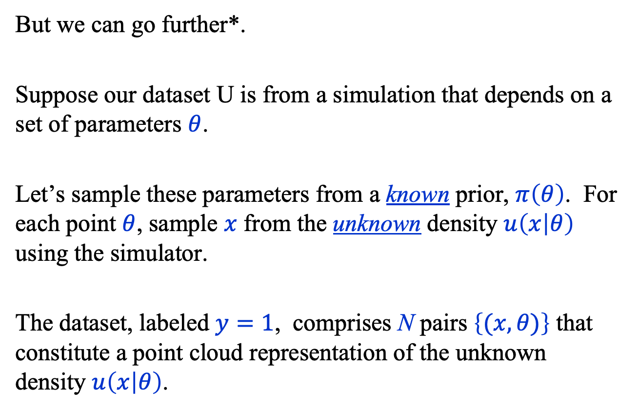
Conditional Density Estimation
But we can go further*.
Suppose our dataset U is from a simulation that depends on a set of parameters $θ$.
Let’s sample these parameters from a known prior, $π\left(θ\right)$. For each point $θ$, sample $x$ from the unknown density $u\left(x | θ\right)$ using the simulator.
The dataset, labeled $y=1$, comprises N pairs $\left\{(x, θ)\right\}$ that constitute a point cloud representation of the unknown density $u\left(x | θ\right)$.
* Baldi, P., Cranmer, K., Faucett, T. et al.
Parameterized neural networks for high-energy physics.
Eur. Phys. J. C 76, 235 (2016).

Slide 17
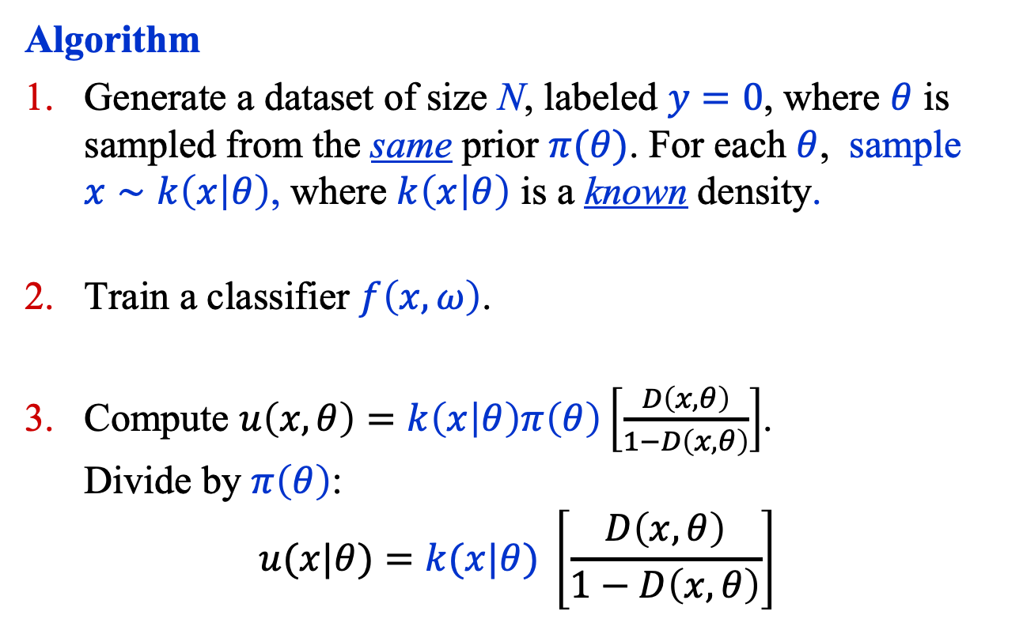
Conditional Density Estimation
Algorithm
Generate a dataset of size N, labeled $y=0$, where $θ$ is sampled from the same prior $π(θ)$. For each $θ$, sample $x∼k\left(x | θ\right)$, where $k\left(x | θ\right)$ is a known density.
Train a classifier $f\left(x, ω\right)$.
Compute $u\left(x, θ\right)=k\left(x | θ\right)π\left(θ\right)\left[\frac{D\left(x, θ\right)}{1−D\left(x, θ\right)}\right]$. Divide by $π\left(θ\right)$:
$$u(x|θ)=k(x|θ) \left[\frac{D\left(x, θ\right)}{1−D\left(x, θ\right)}\right]$$

Slide 18
Summary
In addition to the ROC curve and the AUC, the performance of a classifier can be characterized with several other numbers including:
False Negatives (FN)
True Positives (TP)
True Negatives (TN)
False Positives (FP)
A classifier can be used to improve the approximation of a probability density by exploiting the fact that we know what a classifier approximates.

