Slide 1
Machine learning in physics Foundations 4

Slide 2



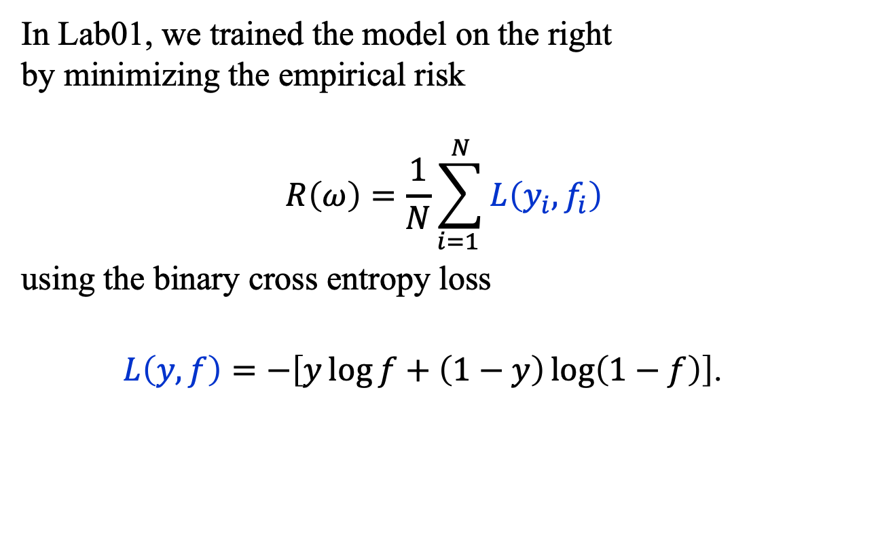





Recap
output
$$σ(z)$$
In Lab01, we trained the model on the right by minimizing the empirical risk
$$R\left(ω\right)=\frac{1}{N}\sum_{i=1 }^{N}{L\left(y_{i}, f_{i}\right)}$$
using the binary cross entropy loss
$L\left(y, f\right)=−\left[y\log{f+\left(1−y\right)\log\left(1−f\right)}\right]$.
Linear(15, 1)
$$\text{L}\text{ayerNorm}(15)$$
$$\text{s}\text{i}\text{lu}()$$
Linear(15, 15)
$$\text{L}\text{ayerNorm}(15)$$
$$\text{s}\text{i}\text{lu}()$$
Linear(15, 15)
$$\text{L}\text{ayerNorm}(15)$$
$$\text{s}\text{i}\text{lu}()$$
Linear(2, 15)
$$x$$

Slide 3
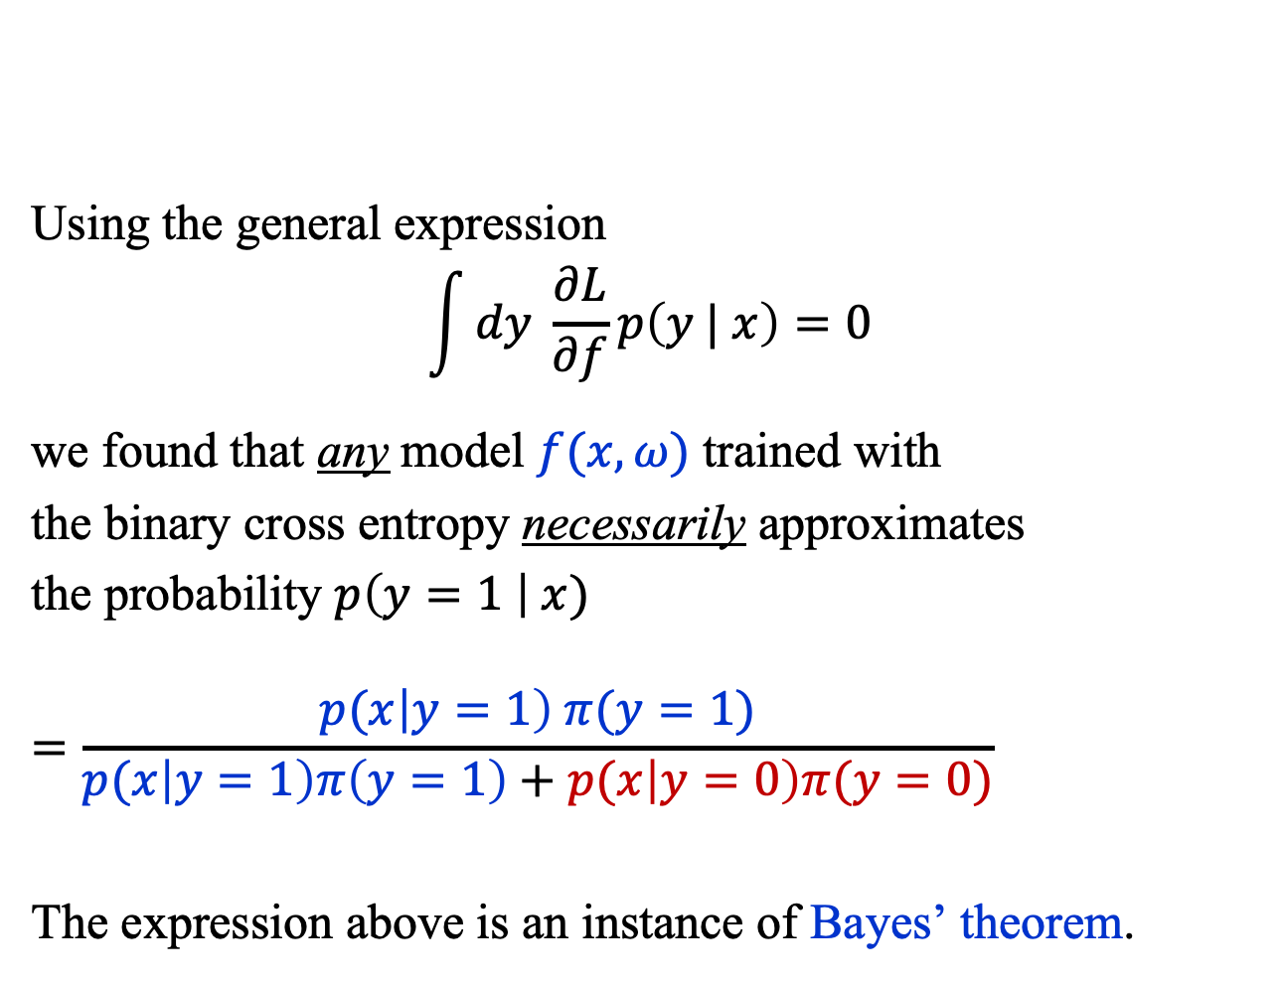
Recap
output
$$σ(z)$$
Using the general expression
$$\int{dy \frac{∂L}{∂f}p\left(y | x\right)=0}$$
we found that any model $f(x, ω)$ trained with
the binary cross entropy necessarily approximates
the probability $p\left(y=1 \right| x)$
$$=\frac{p(x\left|y=1\right) π(y=1)}{p(x\left|y=1\right)π\left(y=1\right)+p(x\left|y=0\right)π(y=0)}$$
The expression above is an instance of Bayes’ theorem.
Linear(15, 1)
$$\text{L}\text{ayerNorm}(15)$$
$$\text{s}\text{i}\text{lu}()$$
Linear(15, 15)
$$\text{L}\text{ayerNorm}(15)$$
$$\text{s}\text{i}\text{lu}()$$
Linear(15, 15)
$$\text{L}\text{ayerNorm}(15)$$
$$\text{s}\text{i}\text{lu}()$$
Linear(2, 15)
$$x$$

Slide 4
binary classifiers

Slide 5
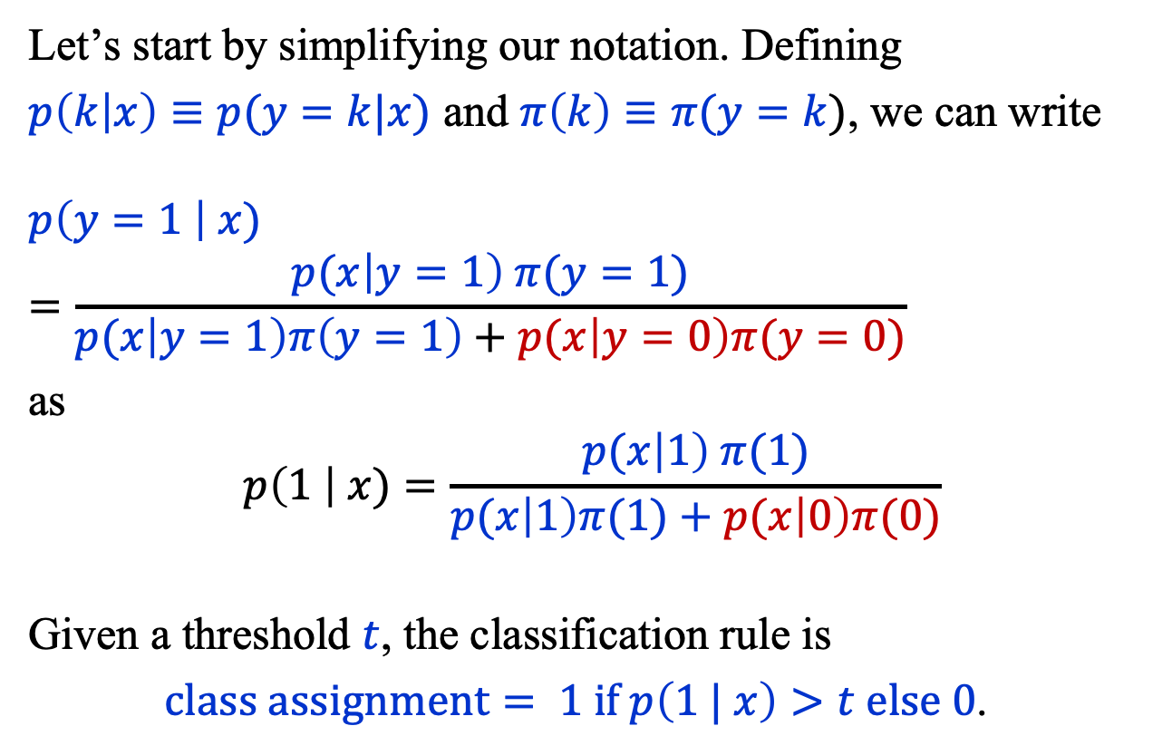
Binary Classifiers
Let’s start by simplifying our notation. Defining
$p\left(k | x\right)≡p(y=k|x)$ and $π\left(k\right)≡π(y=k)$, we can write
$$p\left(y=1 \right| x)$$
$$=\frac{p(x\left|y=1\right) π(y=1)}{p(x\left|y=1\right)π\left(y=1\right)+p(x\left|y=0\right)π(y=0)}$$
as
$$p\left(1 \right| x)=\frac{p(x\left|1\right) π(1)}{p(x\left|1\right)π(1)+p(x\left|0\right)π(0)}$$
Given a threshold $t$, the classification rule is
$\text{class} \text{assignment}= 1 \text{if} p\left(1 | x\right)>t \text{else} 0$.

Slide 6

Binary Classifiers
Let us pause for a moment to ask the following question.
In what sense is the rule
$\text{class} \text{assignment}= 1 \text{if} p\left(1 | x\right)>t \text{else} 0$
optimal?

Slide 7
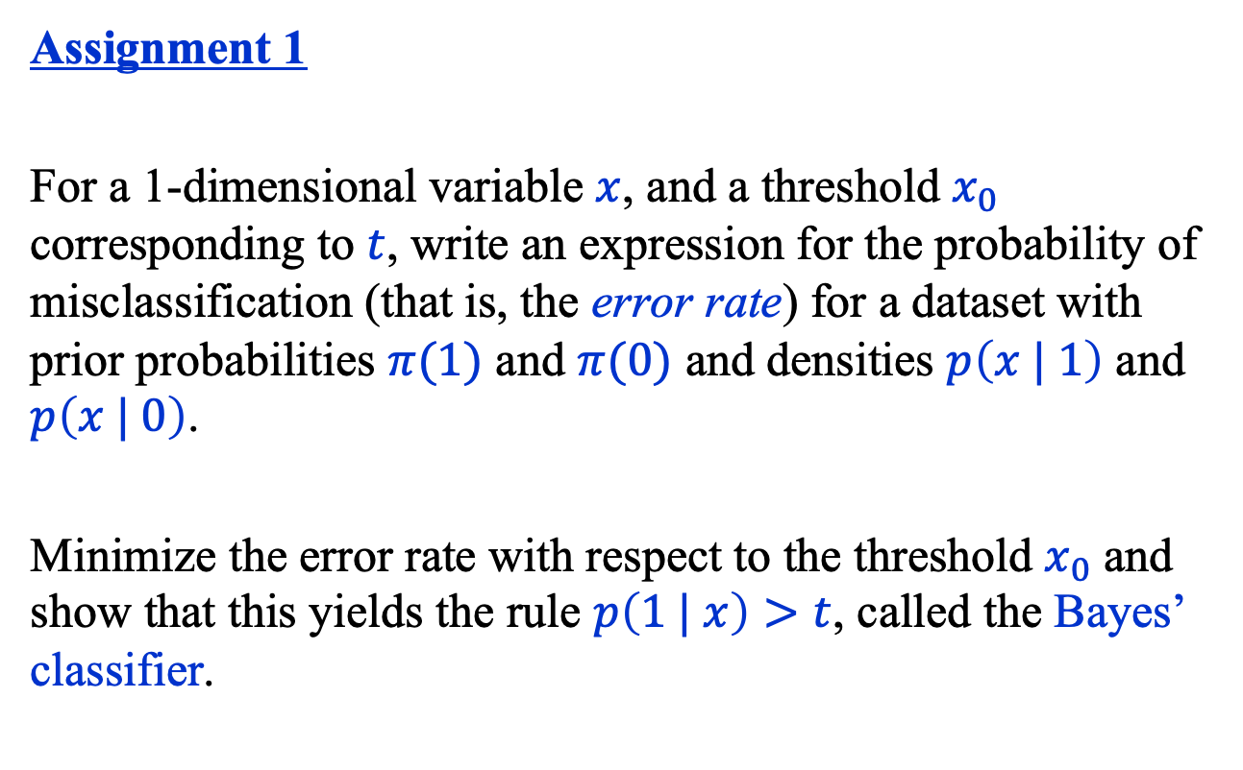
Binary Classifiers
Assignment 1
For a 1-dimensional variable $x$, and a threshold $x_{0}$ corresponding to $t$, write an expression for the probability of misclassification (that is, the error rate) for a dataset with prior probabilities $π(1)$ and $π(0)$ and densities $p\left(x | 1\right)$ and $p\left(x | 0\right)$.
Minimize the error rate with respect to the threshold $x_{0}$ and show that this yields the rule $p\left(1 | x\right)>t$, called the Bayes’ classifier.

Slide 8
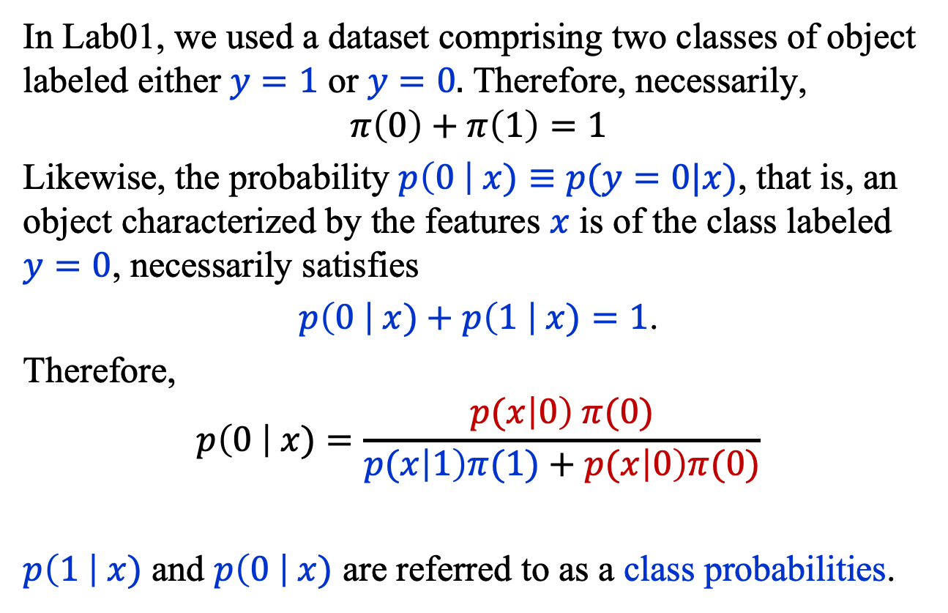
Binary Classifiers
In Lab01, we used a dataset comprising two classes of object labeled either $y=1$ or $y=0.$ Therefore, necessarily,
$$π\left(0\right)+π\left(1\right)=1$$
Likewise, the probability $p\left(0 \right| x)≡p(y=0|x)$, that is, an object characterized by the features $x$ is of the class labeled $y=0$, necessarily satisfies
$p\left(0 \right| x)+p\left(1 \right| x)=1$.
Therefore,
$$p\left(0 \right| x)=\frac{p(x\left|0\right) π(0)}{p(x\left|1\right)π(1)+p(x\left|0\right)π(0)}$$
$p\left(1 \right| x)$ and $p\left(0 \right| x)$ are referred to as a class probabilities.

Slide 9
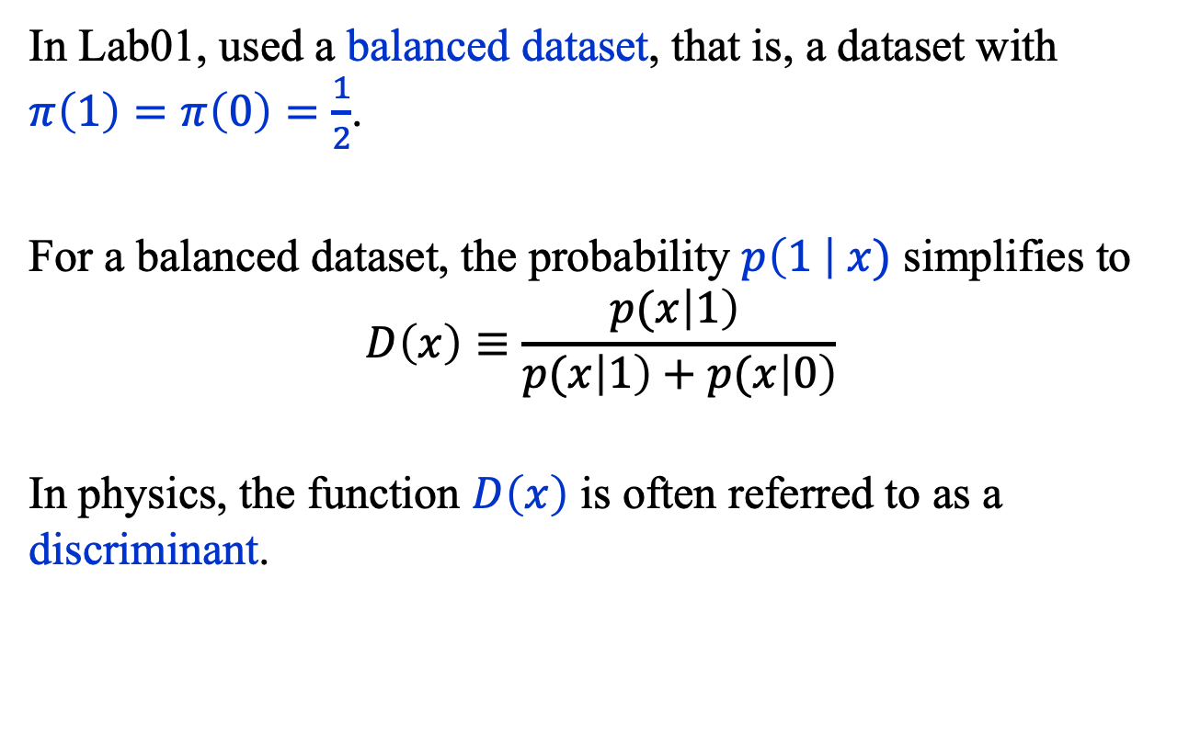
Binary Classifiers
In Lab01, used a balanced dataset, that is, a dataset with $π\left(1\right)=π\left(0\right)=\frac{1}{2}$.
For a balanced dataset, the probability $p\left(1 \right| x)$ simplifies to
$$D\left(x\right)≡\frac{p(x\left|1\right) }{p(x\left|1\right)+p(x\left|0\right)}$$
In physics, the function $D\left(x\right)$ is often referred to as a discriminant.

Slide 10
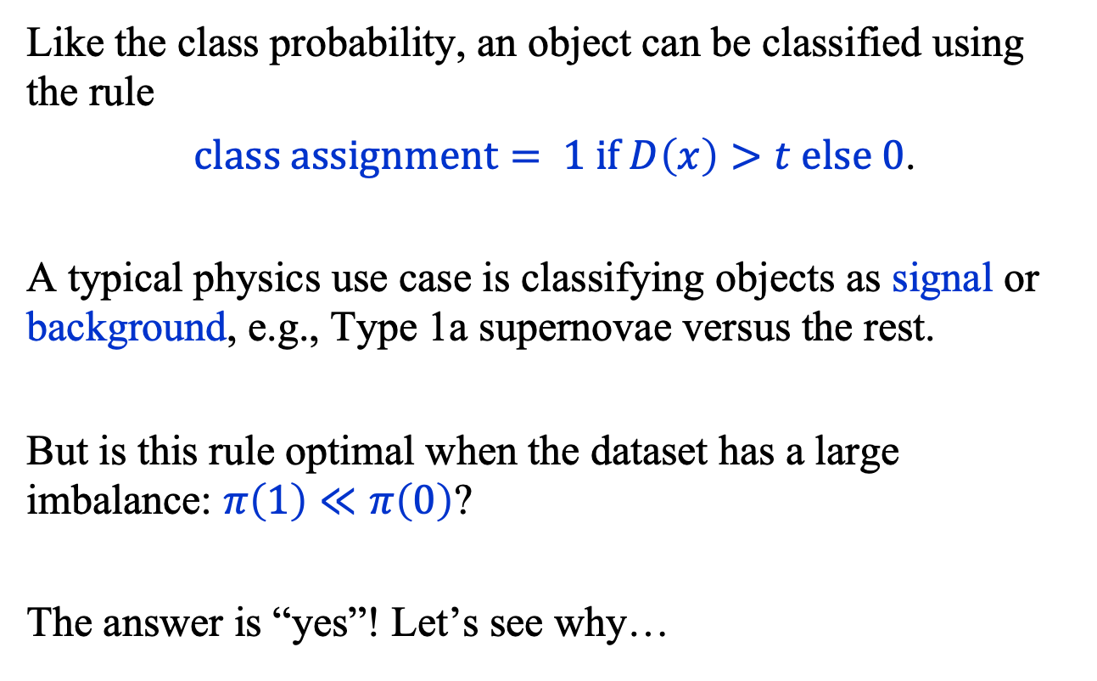
Binary Classifiers
Like the class probability, an object can be classified using the rule
$\text{class} \text{assignment}= 1 \text{if} D\left(x\right)>t \text{else} 0$.
A typical physics use case is classifying objects as signal or background, e.g., Type 1a supernovae versus the rest.
But is this rule optimal when the dataset has a large imbalance: $π\left(1\right)≪π\left(0\right)$?
The answer is “yes”! Let’s see why…

Slide 11
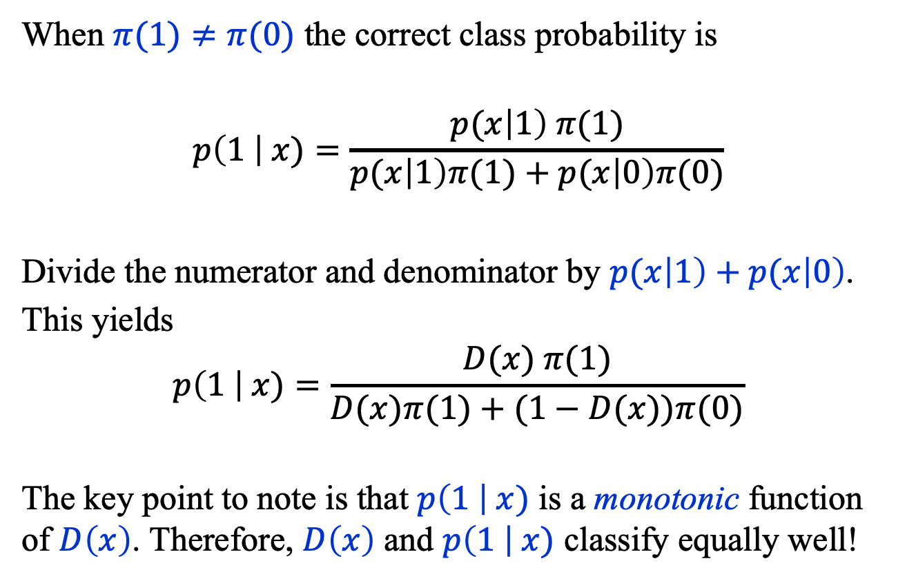
Binary Classifiers
When $π(1)≠π(0)$ the correct class probability is
$$p\left(1 \right| x)=\frac{p(x\left|1\right) π(1)}{p(x\left|1\right)π(1)+p(x\left|0\right)π(0)}$$
Divide the numerator and denominator by $p(x\left|1\right)+p(x\left|0\right)$.
This yields
$$p\left(1 \right| x)=\frac{D(x) π(1)}{D(x)π(1)+(1−D(x))π(0)}$$
The key point to note is that $p\left(1 \right| x)$ is a monotonic function of $D\left(x\right)$. Therefore, $D\left(x\right)$ and $p\left(1 \right| x)$ classify equally well!

Slide 12
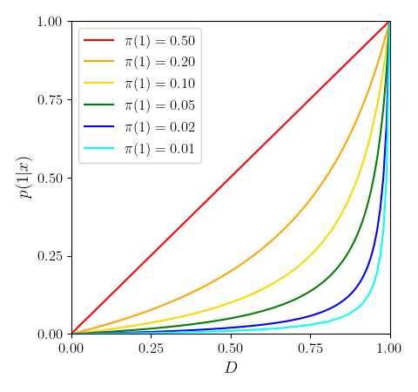

Binary Classifiers
$$p\left(1 \right| x)=\frac{D(x) π(1)}{D(x)π(1)+(1−D(x))(1−π\left(1\right))}$$
The figure shows the dependence
of $p\left(1 \right| x)$ on $D(x$) for different
values of the prior $π(1)$.
Note: when $π\left(1\right)=\frac{1}{2}$ we get $p\left(1 \right| x)=D(x)$ and, therefore, a straight line of unit slope.

Slide 13
How good is our classifier?

Slide 14
How Good Is Our Classifier?
Machine learning models typically give only point estimates. The absence of a measure of confidence in their estimates is a serious deficiency, a point we shall take up towards the end of the semester.
The other problem is that at present we rely on heuristics to judge whether a training schedule has yielded a model that is as close as it can get to the optimal solution.
The third problem is that it is very difficult to define what constitutes a fair performance comparison between models.

Slide 15
How Good Is Our Classifier?
In contemporary ML applications, model performance is typically valued a lot more than model simplicity.
Suppose that a model with 10⁶ parameters does 30% better, in some measure, than one with 5,000 parameters. If the 30% improvement is judged to be worthwhile the tendency is to favor the larger model.
For classifiers, the two most common measures of performance are:
The Receiver Operating Characteristic (ROC) curve
And the Area Under the Curve (AUC).

Slide 16
Summary
A classifier minimizes the error rate.
When created using a balanced dataset, we typically refer to the classifier as a discriminant.
Classification using a discriminant is (in principle) just as powerful as classification using the correct class probability

