Slide 1
Machine learning in physics Tutorial 4 / CNN

Slide 2
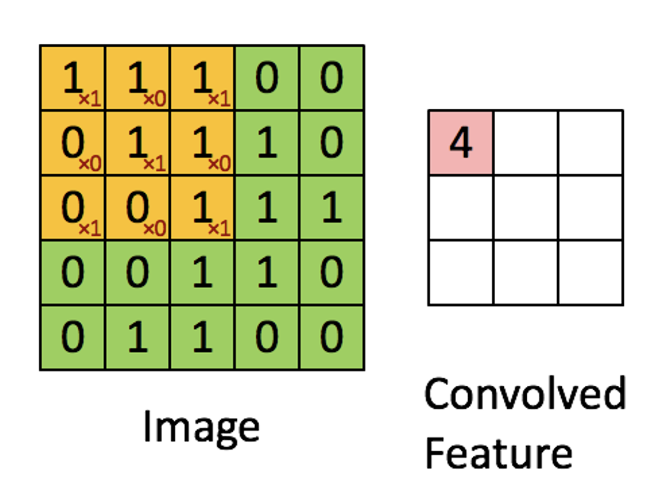
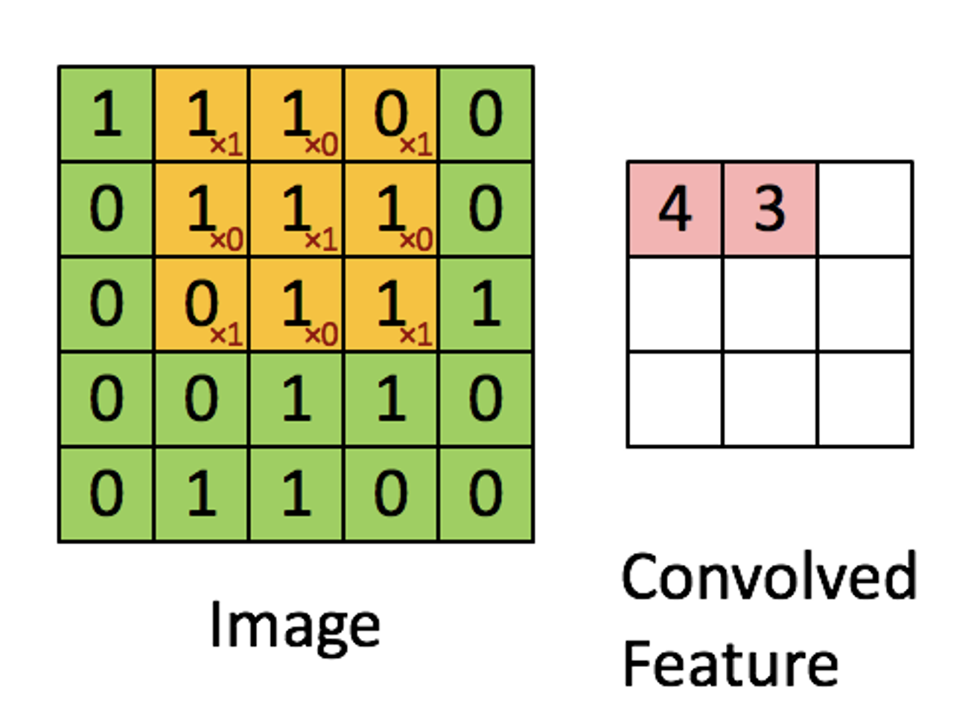
Recap
A standard CNN comprises three types of processing layers: 1. convolution, 2. pooling, and 3. classification.
1. Convolution

Slide 3
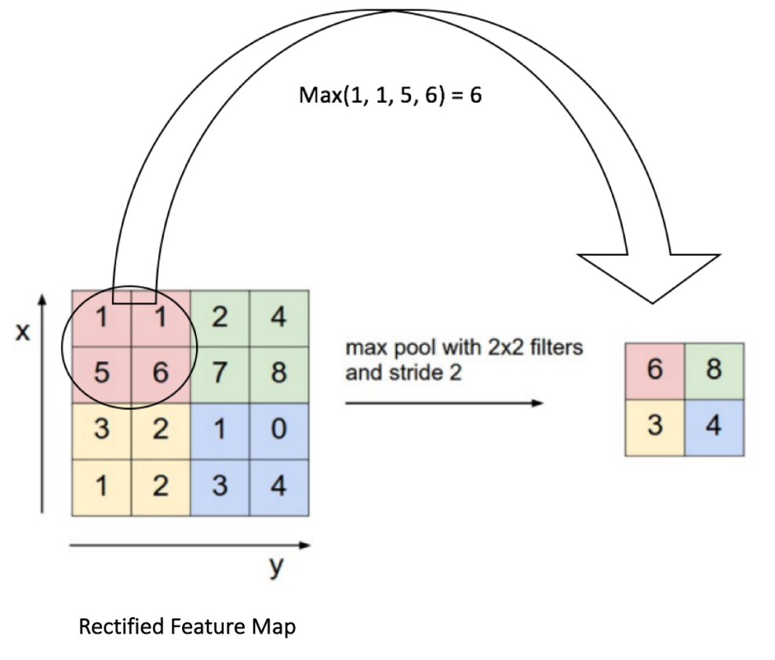
Recap
2. Pooling
MaxPool2d
AvgPool2d

Slide 4
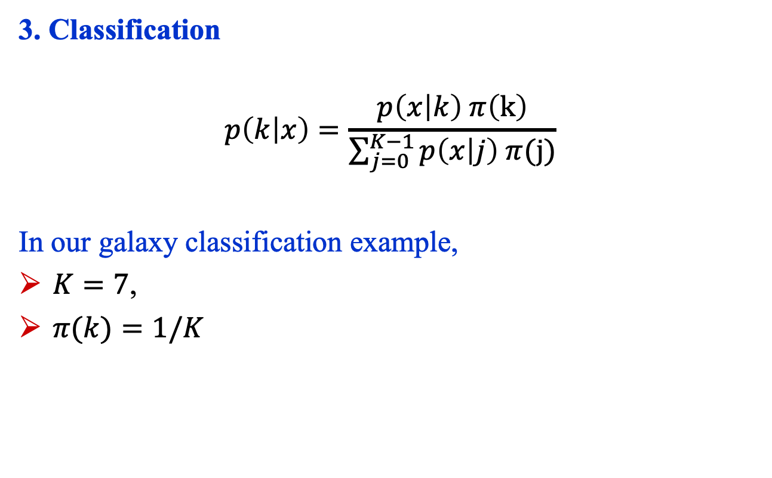
Recap
3. Classification
$$p\left(k | x\right)=\frac{p\left(x | k\right) π\left(k\right)}{\sum_{j=0}^{K−1}{p\left(x | j\right) π(\text{j})}}$$
In our galaxy classification example,
$K=7$,
$π(k)=1/K$

Slide 5
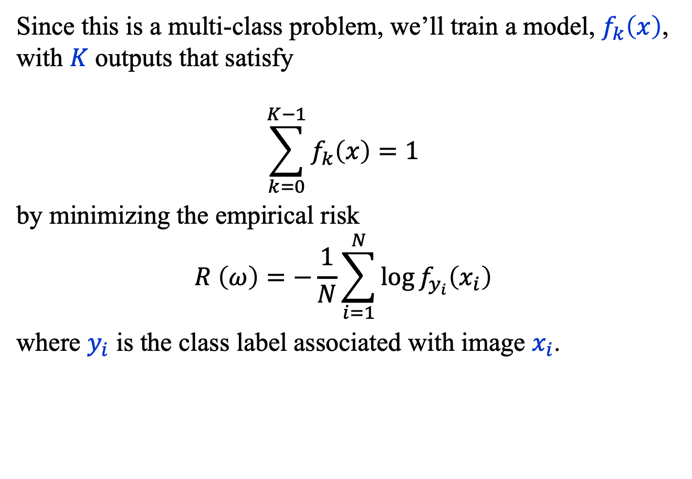
Recap
Since this is a multi-class problem, we’ll train a model, $f_{k}\left(x\right)$, with $K$ outputs that satisfy
$$\sum_{k=0}^{K−1}{f_{k}\left(x\right)=1}$$
by minimizing the empirical risk
$$R \left(ω\right)=−\frac{1}{N}\sum_{i=1}^{N}{\log{f_{y_{i}}\left(x_{i}\right)}}$$
where $y_{i}$ is the class label associated with image $x_{i}$.

Slide 6
Tutorial 4

Slide 7
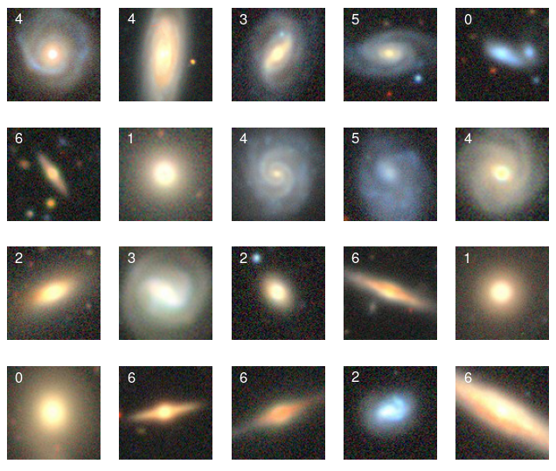
Tutorial 4
Goal: classify galaxies into 7 morphology classes using a CNN.
https://astronn.readthedocs.io/en/stable/galaxy10.html

Slide 8
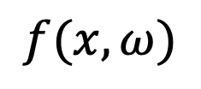

CNN Model
$$f(x, ω)$$
Our model comprises 4 layers, each
consisting of 3 operations, followed by a linear function
and a softmax.
Softmax
Linear(468,7)
ReLU()
ReLU()
MaxPool2d(2,2)
MaxPool2d(2,2)
Conv2d(9,13,3,1,1)
Conv2d(4,6,3,1,1)
ReLU()
ReLU()
MaxPool2d(2,2)
MaxPool2d(2,2)
Conv2d(6,9,3,1,1)
Conv2d(3,4,3,1,1)
$$x$$

Slide 9

CNN Model
$$g= ReLU ∘\text{AvgPool}\text{2}\text{d} ∘\text{Conv}\text{2}\text{d}$$
(13, 6, 6)
(9, 12, 12)
(6, 24, 24)
(4, 48, 48)
(3, 96, 96)

Slide 10
CNN Model: Training
Samples
Training sample size: 10,000
Validation sample size: 1,600
Testing sample size: 1,000
Training hyperparameters
Number of iterations: 10,000 (200 epochs)
Batch size: 200
Learning rate: 10⁻³

Slide 11
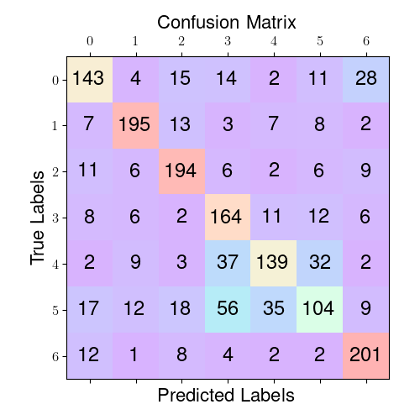
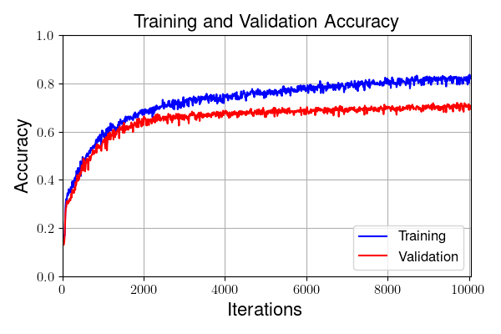
CNN Model: Results
Accuracy: 71.2%

