Slide 1
Machine learning in physics TUTORIAL 05 / Autoencoders

Slide 2

Recap
The encoder compresses the input data $x∈ℝ^{N}$
$h\left(x\right)→z$ $g\left(z\right)→x$
to a latent space
$z∈ℝ^{n}$ with $n≪N$

Slide 3
Tutorial 05 / AUtoencoder

Slide 4
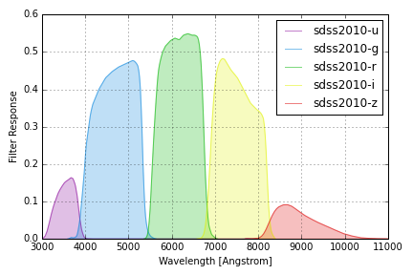
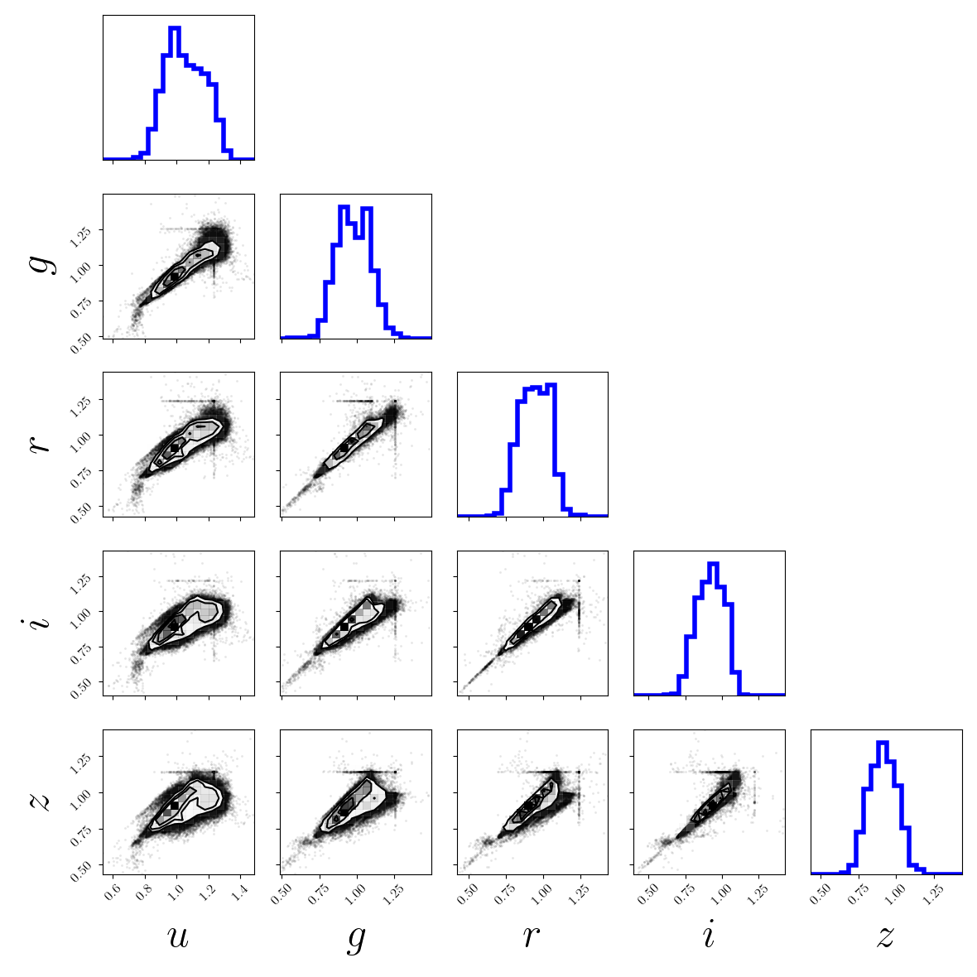
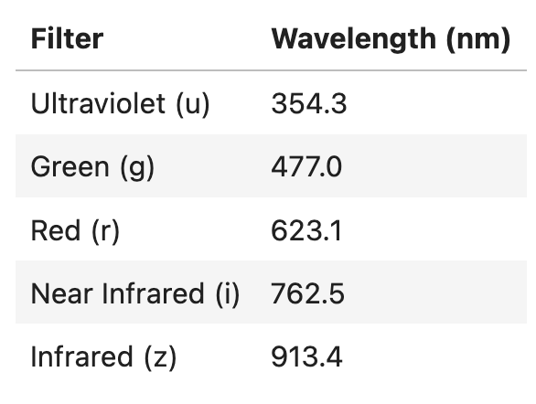
SDSS: Stellar Color Data

Slide 5
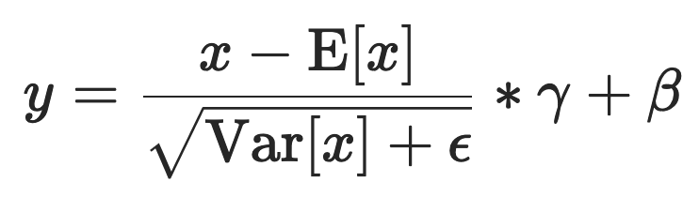


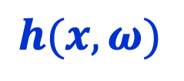
Autoencoder: Encoder
$$h(x, ω)$$
LayerNorm
$$z∈ℝ^{2}, x∈ℝ^{5}$$
Linear(40, 2)
LayerNorm(40)
LayerNorm(40)
SiLU()
SiLU()
Linear(40, 40)
Linear(40, 40)
LayerNorm(40)
LayerNorm(40)
SiLU()
SiLU()
Linear(40, 40)
Linear(5, 40)
$$x$$

Slide 6

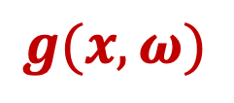
Autoencoder: Decoder
$$g(x, ω)$$
Decoder
$$z∈ℝ^{2}, x∈ℝ^{5}$$
Linear(40, 5)
LayerNorm(40)
LayerNorm(40)
SiLU()
SiLU()
Linear(40, 40)
Linear(40, 40)
LayerNorm(40)
LayerNorm(40)
SiLU()
SiLU()
Linear(40, 40)
Linear(2, 40)
$$x$$

