Slide 1
Machine learning in physics Tutorial 06 / PINN

Slide 2
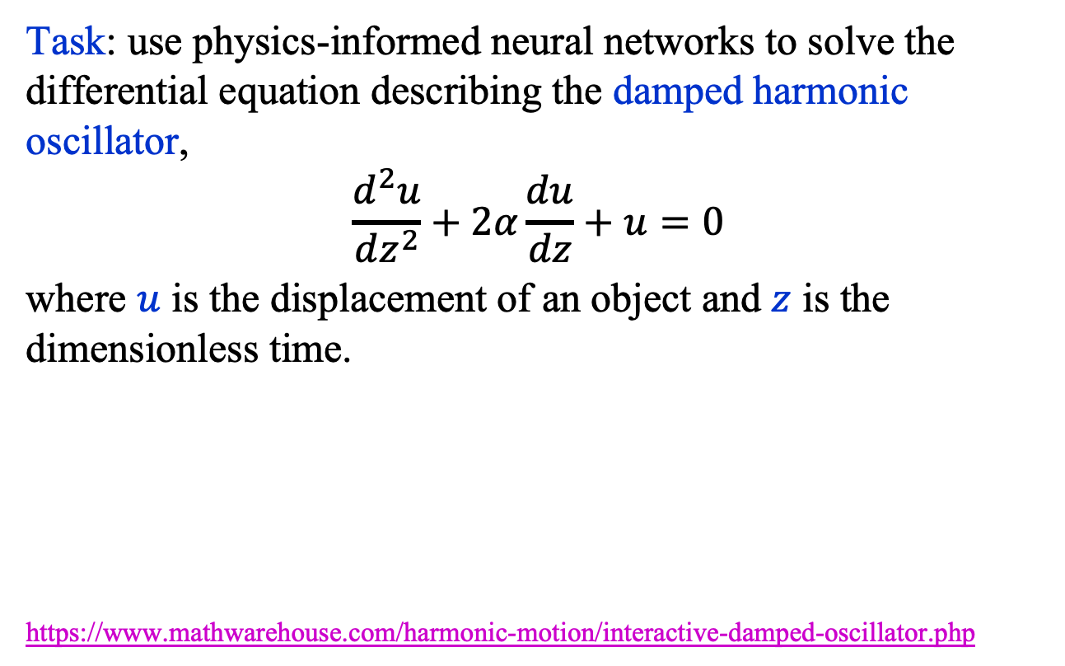
Recap: PINN
Task: use physics-informed neural networks to solve the differential equation describing the damped harmonic oscillator,
$$\frac{d^{2}u}{dz^{2}}+2α\frac{du}{dz}+u=0$$
where $u$ is the displacement of an object and $z$ is the dimensionless time.
https://www.mathwarehouse.com/harmonic-motion/interactive-damped-oscillator.php

Slide 3
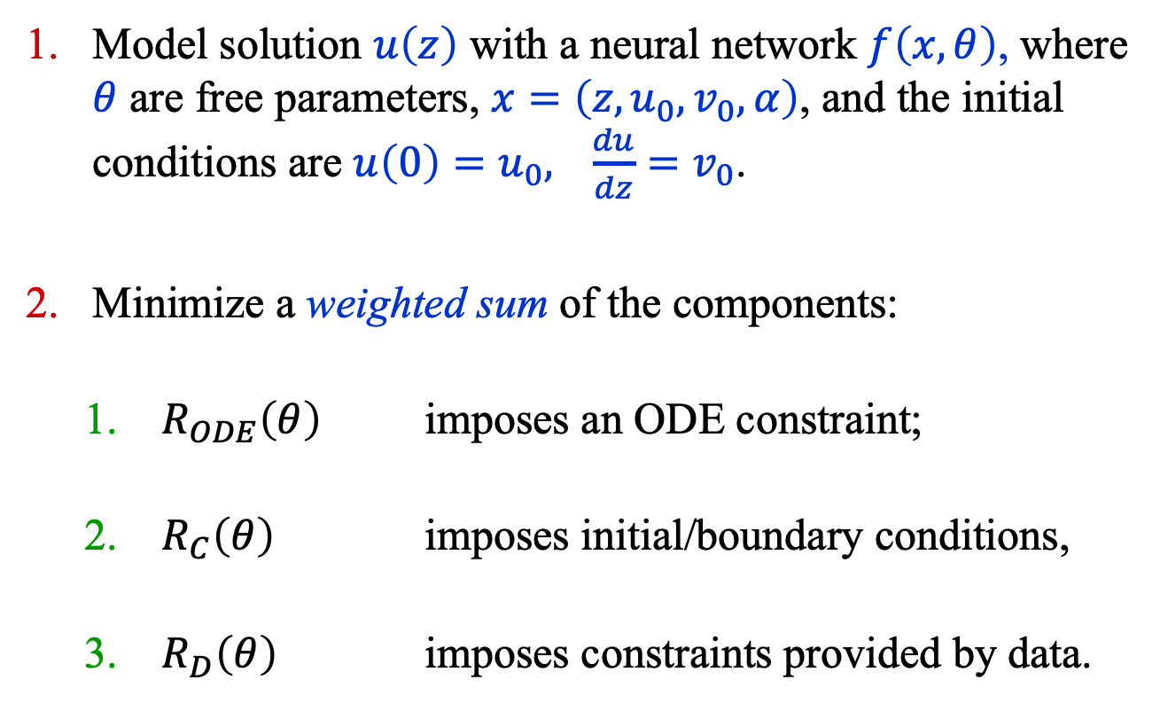
Recap: Basic Idea
Model solution $u\left(z\right)$ with a neural network $f\left(x, θ\right)$, where $θ$ are free parameters, $x=\left(z, u_{0}, v_{0}, α\right)$, and the initial conditions are ${u\left(0\right)=u}_{0},{ \frac{du}{dz}=v}_{0}$.
Minimize a weighted sum of the components:
$R_{ODE}\left(θ\right)$ imposes an ODE constraint;
$R_{C}\left(θ\right)$ imposes initial/boundary conditions,
$R_{D}\left(θ\right)$ imposes constraints provided by data.

Slide 4
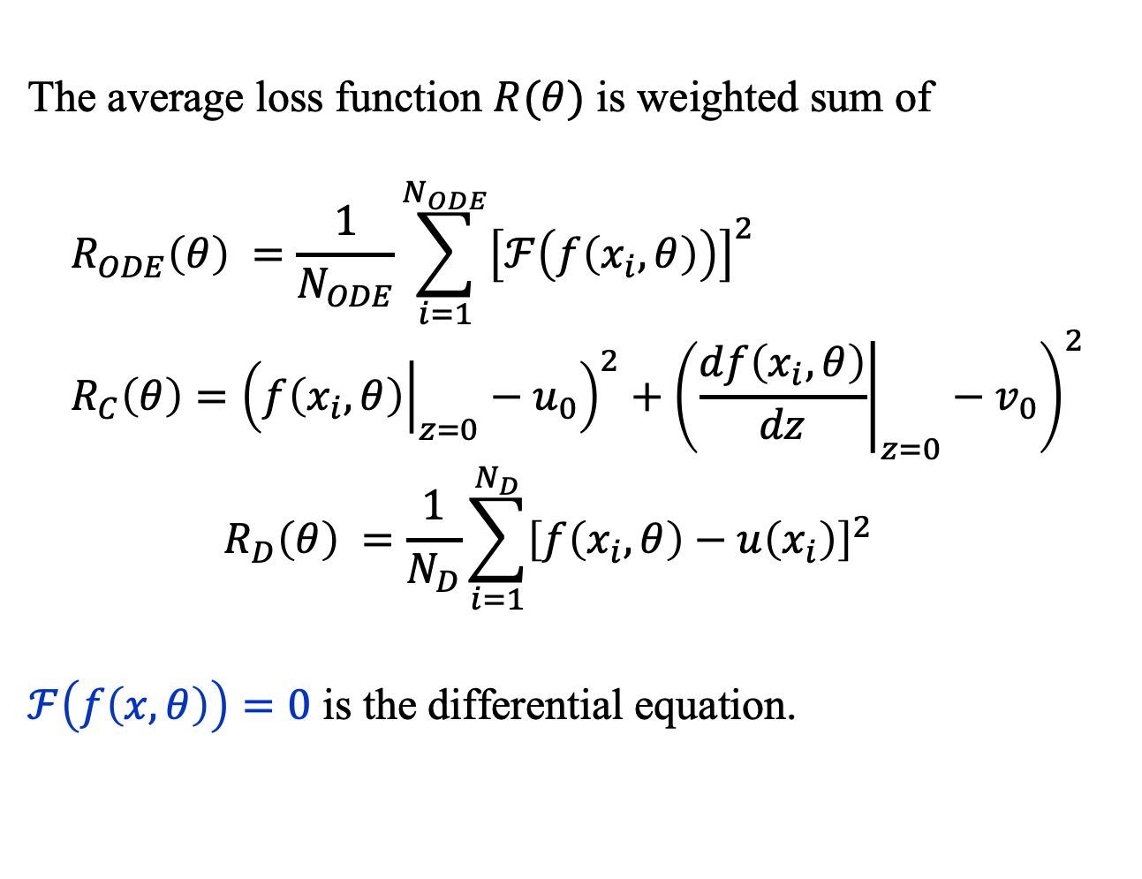
PINNs: Basic Idea
The average loss function $R(θ)$ is weighted sum of
$$R_{ODE}\left(θ\right) =\frac{1}{N_{ODE}}\sum_{i=1}^{N_{ODE}}{{\left[ℱ\left(f\left(x_{i},θ\right)\right)\right]}^{2}} \\ R_{C}\left(θ\right)={\left({\left.f\left(x_{i},θ\right)\right|}_{z=0}−u_{0}\right)}^{2}+{\left({\left.\frac{df\left(x_{i},θ\right)}{dz}\right|}_{z=0}−v_{0}\right)}^{2}$$
$$R_{D}\left(θ\right) =\frac{1}{N_{D}}\sum_{i=1}^{N_{D}}{{\left[f\left(x_{i},θ\right)−u\left(x_{i}\right)\right]}^{2}}$$
$ℱ\left(f\left(x,θ\right)\right)=0$ is the differential equation.

Slide 5
Tutorial 06 / PINN

Slide 6

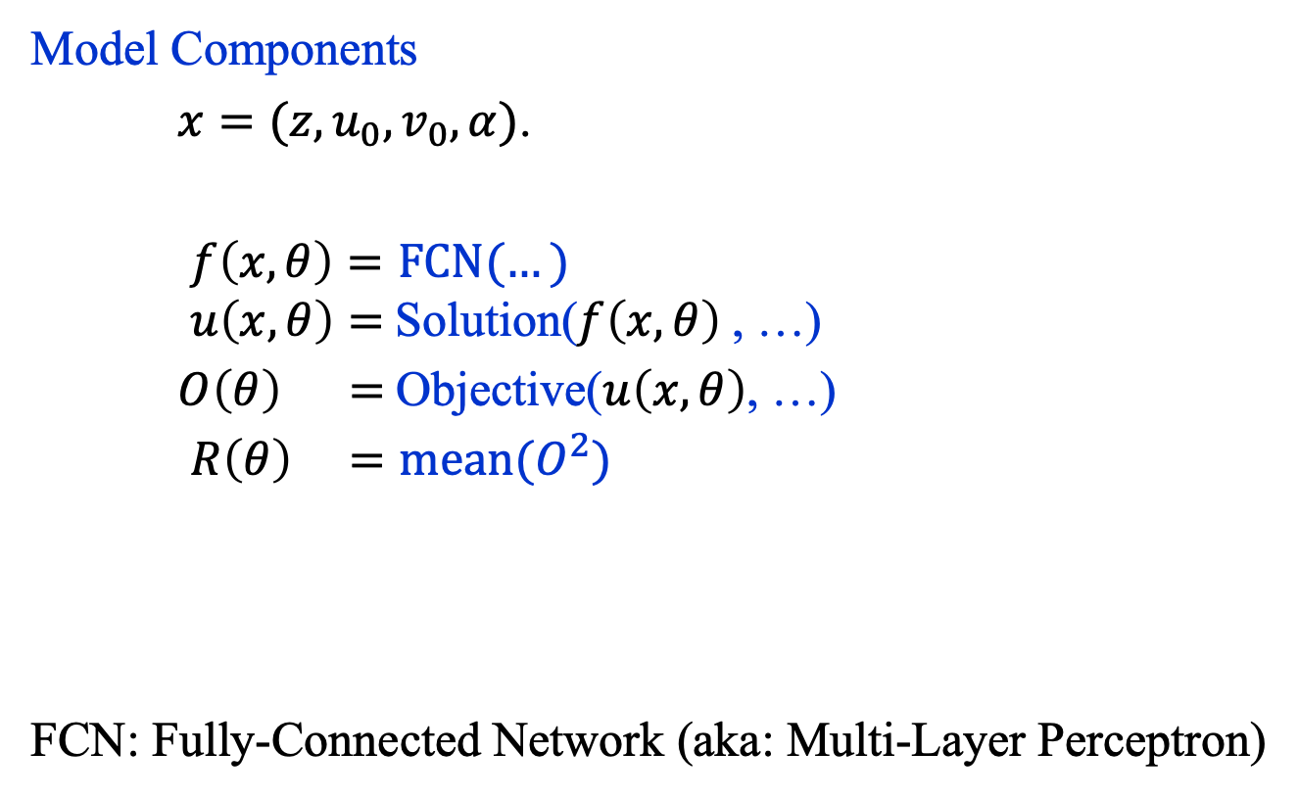
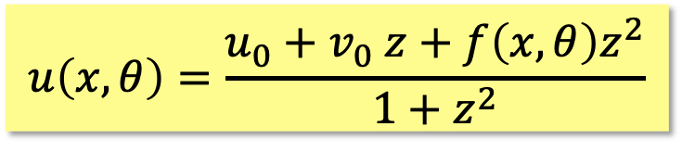
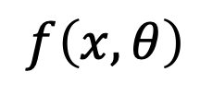

PINN: Model
Model Components
$x=(z, u_{0}, v_{0}, α)$.
$f\left(x,θ\right)=FCN(…)$ $u\left(x,θ\right)=$Solution($f\left(x,θ\right)$, …)
$O\left(θ\right) =$Objective($u\left(x,θ\right)$, …)
$R\left(θ\right) =mean(O^{2})$
FCN: Fully-Connected Network (aka: Multi-Layer Perceptron)
$$f\left(x,θ\right)$$
Linear(25, 1)
SiLU()
$$× 5$$
Linear(25, 25)
SiLU()
Linear(4, 25)
$$u\left(x,θ\right)=\frac{u_{0}+v_{0} z+f\left(x, θ\right)z^{2}}{1+z^{2}}$$
$$x$$

Slide 7
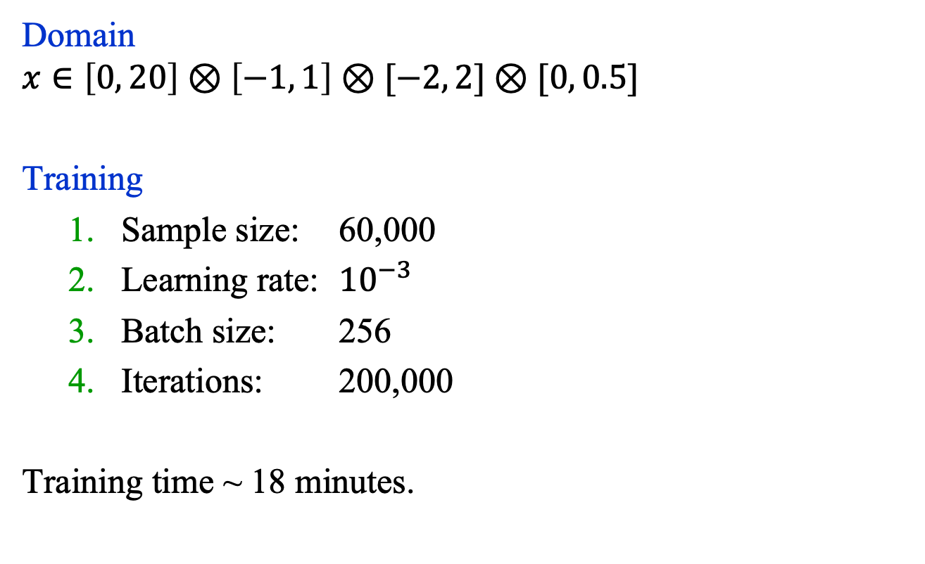
PINN: Model Training
Domain
$$x∈\left[0, 20\right]⊗\left[−1, 1\right]⊗[−2, 2]⊗[0, 0.5]$$
Training
Sample size: 60,000
Learning rate: ${10}^{−3}$
Batch size: 256
Iterations: 200,000
Training time ~ 18 minutes.
$$f\left(x,θ\right)$$
Linear(25, 1)
SiLU()
$$× 5$$
Linear(25, 25)
SiLU()
Linear(4, 25)
$$x$$

