Slide 1
Machine learning in physics Physics-informed Neural networks (PINN)

Slide 2

Recap: Autoencoder
An autoencoder compresses the input data $x$ to a latent space $z$ and then back to $x$.
$h\left(x\right)→z$ $g\left(z\right)→x$
$z∈ℝ^{n}$

Slide 3
Introduction
This week we introduce a neural network called a:
Convolutional neural networks (CNN)
Autoencoder (AE)
Physics-informed neural networks (PINN)
Flow and diffusion models
Graph neural networks (GNN)
Transformer neural networks (TNN)

Slide 4
Introduction
The method of physics-informed neural networks (PINN) is a way^{1,2} to solve ordinary and partial differential equations (ODE, PDE) using neural networks.
The method leverages the modeling flexibility of neural networks and the computational tools that have been developed to fit these enormously complicated functions.
Raissi, M., Perdikaris, P., Karniadakis, G.E., Physics-informed neural networks: A deep learning frame-work for solving forward and inverse problems involving nonlinear partial differential equations. J. Comput. Phys. 378, 686–707 (2019).
Cuomo, S et al. Journal of Scientific Computing (2022) 92:88 https://doi.org/10.1007/s10915-022-01939-z

Slide 5
Introduction
Advantages of the PINN method
Provides mesh-free solutions.
Can incorporate data to guide solutions.
Scales well with the dimensionality of the space.
Can find solutions conditioned on initial/boundary conditions. In effect, solutions can be found for infinitely many initial/boundary conditions simultaneously.
Disadvantages of PINNs
For a given set of initial/boundary conditions, much slower than traditional numerical methods.
Convergence is sensitive to the details of the average loss.

Slide 6
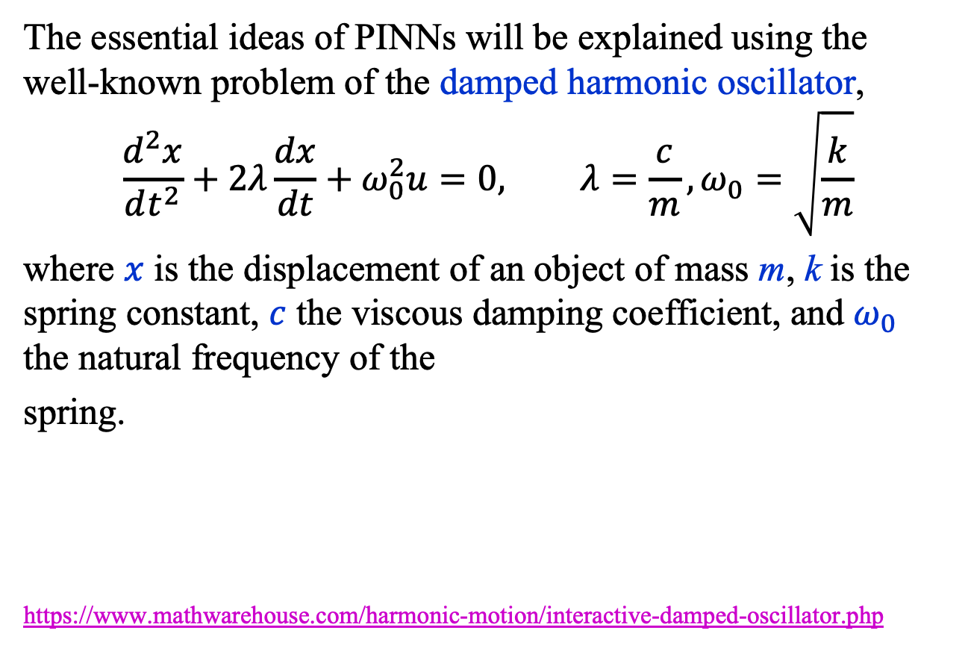
Introduction
The essential ideas of PINNs will be explained using the well-known problem of the damped harmonic oscillator,
$$\frac{d^{2}x}{dt^{2}}+2λ\frac{dx}{dt}+ω_{0}^{2}u=0, λ=\frac{c}{m}, ω_{0}=\sqrt{\frac{k}{m}}$$
where $x$ is the displacement of an object of mass m, k is the spring constant, $c$ the viscous damping coefficient, and $ω_{0}$ the natural frequency of the
spring.
https://www.mathwarehouse.com/harmonic-motion/interactive-damped-oscillator.php

Slide 7
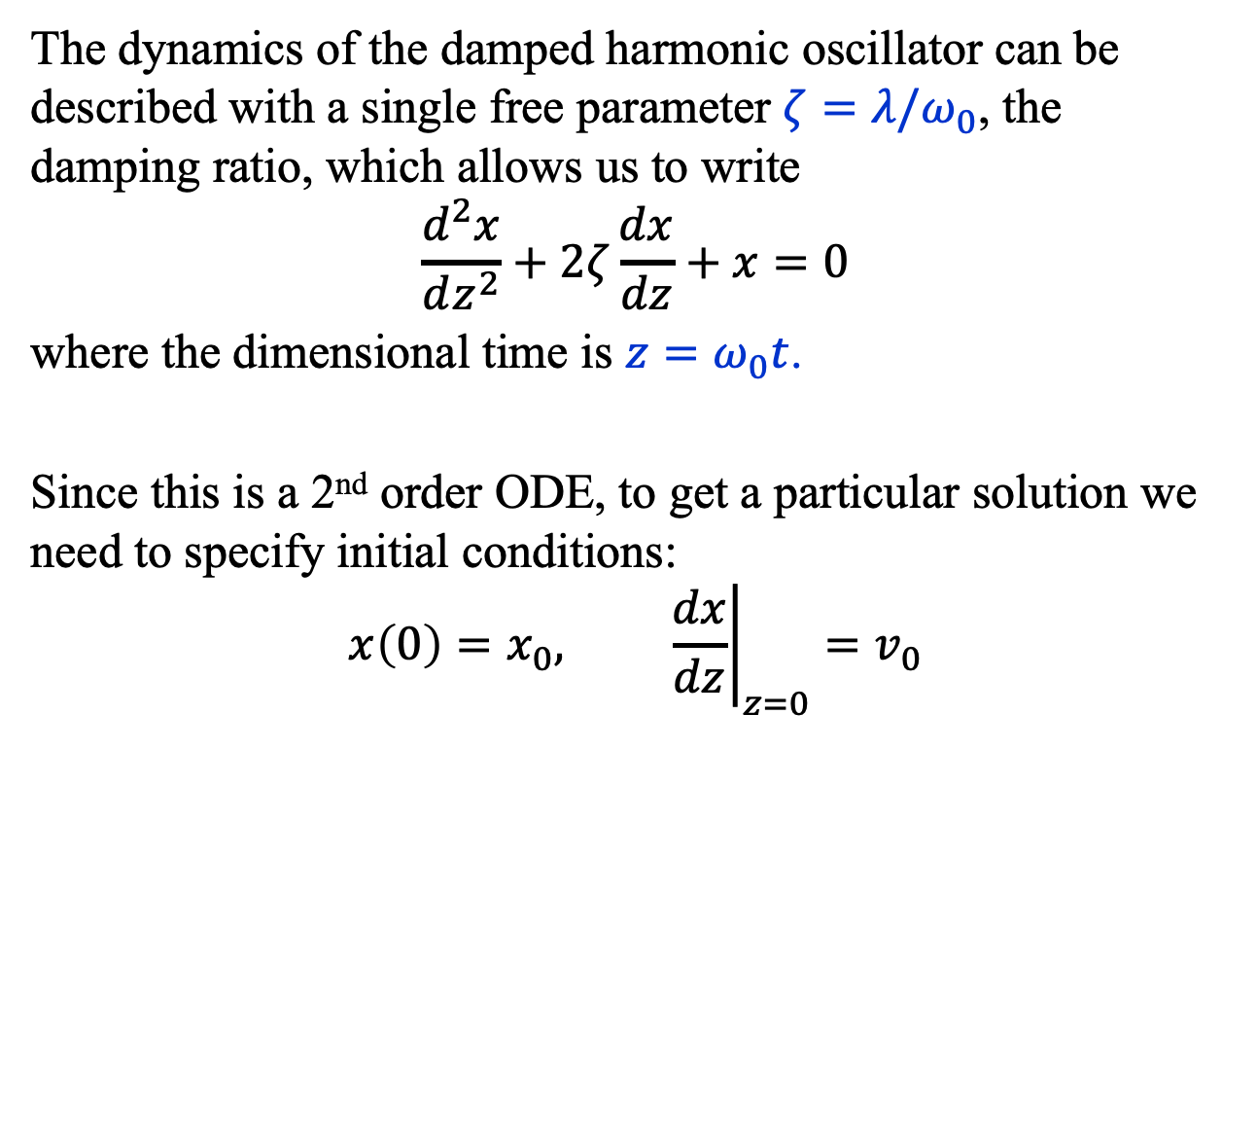
Introduction
The dynamics of the damped harmonic oscillator can be described with a single free parameter $ζ=λ/ω_{0}$, the damping ratio, which allows us to write
$$\frac{d^{2}x}{dz^{2}}+2ζ\frac{dx}{dz}+x=0$$
where the dimensional time is $z=ω_{0}t$.
Since this is a 2nd order ODE, to get a particular solution we need to specify initial conditions:
$$x\left(0\right)=x_{0}, {\left.\frac{dx}{dz}\right|}_{z=0}=v_{0}$$

Slide 8
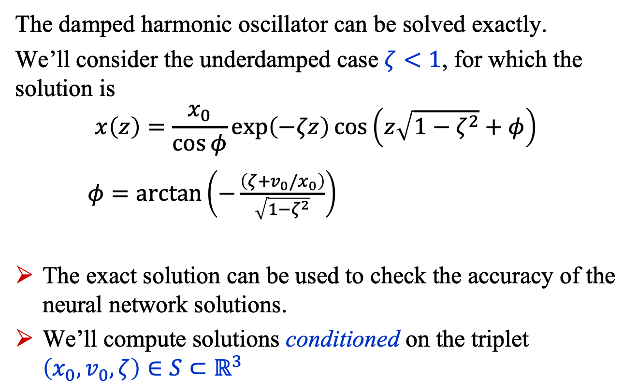
Introduction
The damped harmonic oscillator can be solved exactly.
We’ll consider the underdamped case $ζ<1$, for which the solution is
$$x\left(z\right)=\frac{x_{0}}{\cos{φ}}\exp\left(−ζz\right)\cos\left(z\sqrt{1−ζ^{2}}+φ\right)$$
$φ=\arctan\left(−\frac{\left(ζ+v_{0}/x_{0}\right)}{\sqrt{1−ζ^{2}}}\right)$
The exact solution can be used to check the accuracy of the neural network solutions.
We’ll compute solutions conditioned on the triplet $\left(x_{0}, v_{0},ζ\right)∈S⊂ℝ^{3}$

Slide 9
Physics-informed neural networks (PINN)

Slide 10
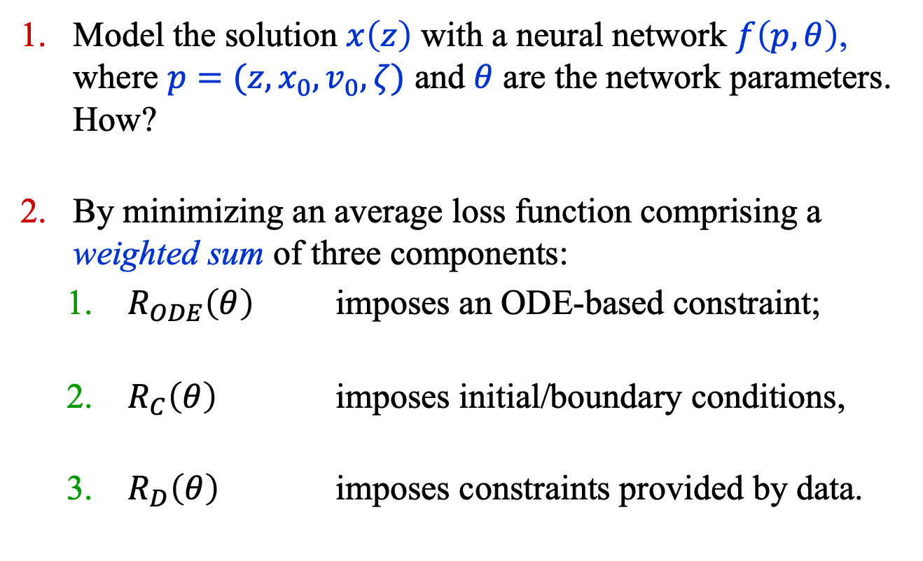
PINNs: Basic Idea
Model the solution $x\left(z\right)$ with a neural network $f\left(p, θ\right)$, where $p=(z, x_{0}, v_{0}, ζ)$ and $θ$ are the network parameters. How?
By minimizing an average loss function comprising a weighted sum of three components:
$R_{ODE}\left(θ\right)$ imposes an ODE-based constraint;
$R_{C}\left(θ\right)$ imposes initial/boundary conditions,
$R_{D}\left(θ\right)$ imposes constraints provided by data.

Slide 11
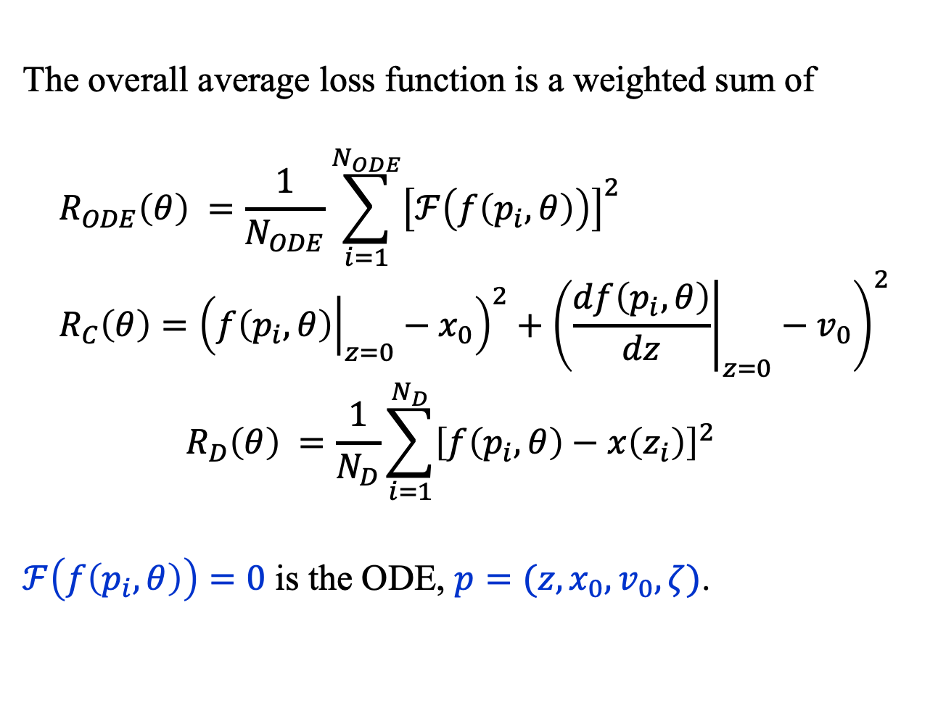
PINNs: Basic Idea
The overall average loss function is a weighted sum of
$$R_{ODE}\left(θ\right) =\frac{1}{N_{ODE}}\sum_{i=1}^{N_{ODE}}{{\left[ℱ\left(f\left(p_{i},θ\right)\right)\right]}^{2}} \\ R_{C}\left(θ\right)={\left({\left.f\left(p_{i},θ\right)\right|}_{z=0}−x_{0}\right)}^{2}+{\left({\left.\frac{df\left(p_{i},θ\right)}{dz}\right|}_{z=0}−v_{0}\right)}^{2}$$
$$R_{D}\left(θ\right) =\frac{1}{N_{D}}\sum_{i=1}^{N_{D}}{{\left[f\left(p_{i},θ\right)−x\left(z_{i}\right)\right]}^{2}}$$
$ℱ\left(f\left(p_{i},θ\right)\right)=0$ is the ODE, $p=(z, x_{0}, v_{0}, ζ)$.

Slide 12
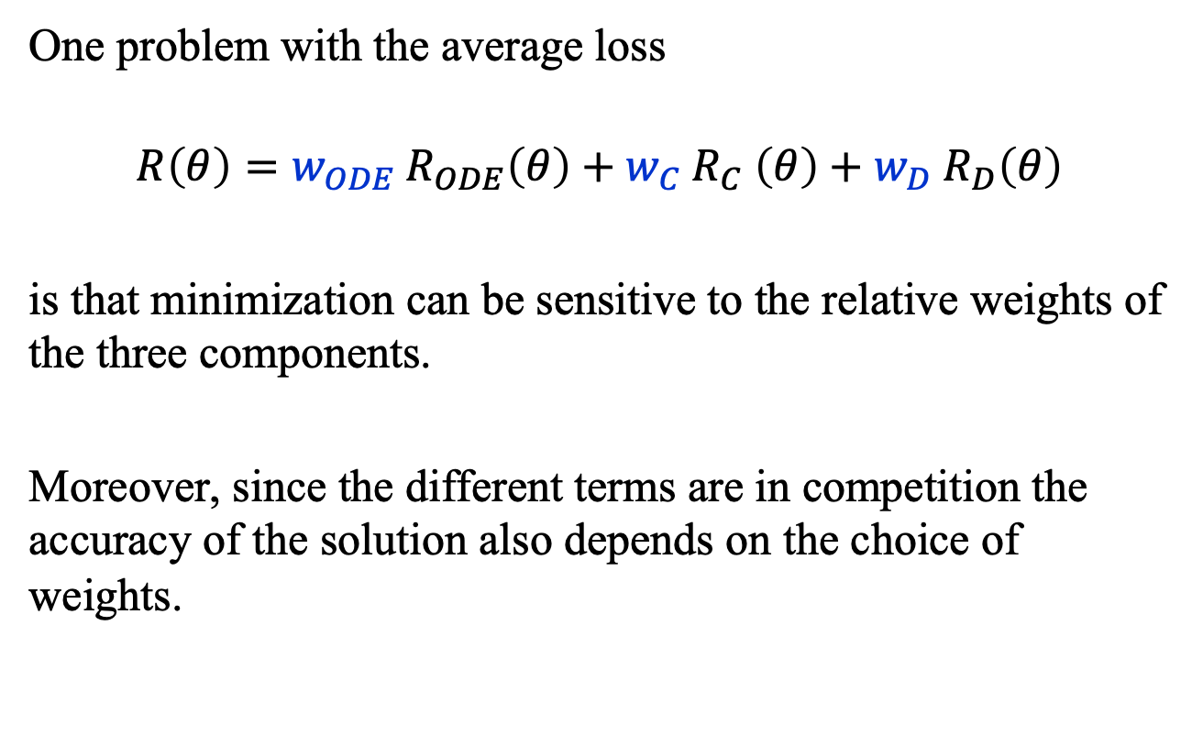
PINNs: Problem of Weights
One problem with the average loss
$${{R\left(θ\right)=w}_{ODE} R}_{ODE}\left(θ\right){+ w_{C} R}_{C}\left(θ\right)+{w_{D} R}_{D}\left(θ\right)$$
is that minimization can be sensitive to the relative weights of the three components.
Moreover, since the different terms are in competition the accuracy of the solution also depends on the choice of weights.

Slide 13
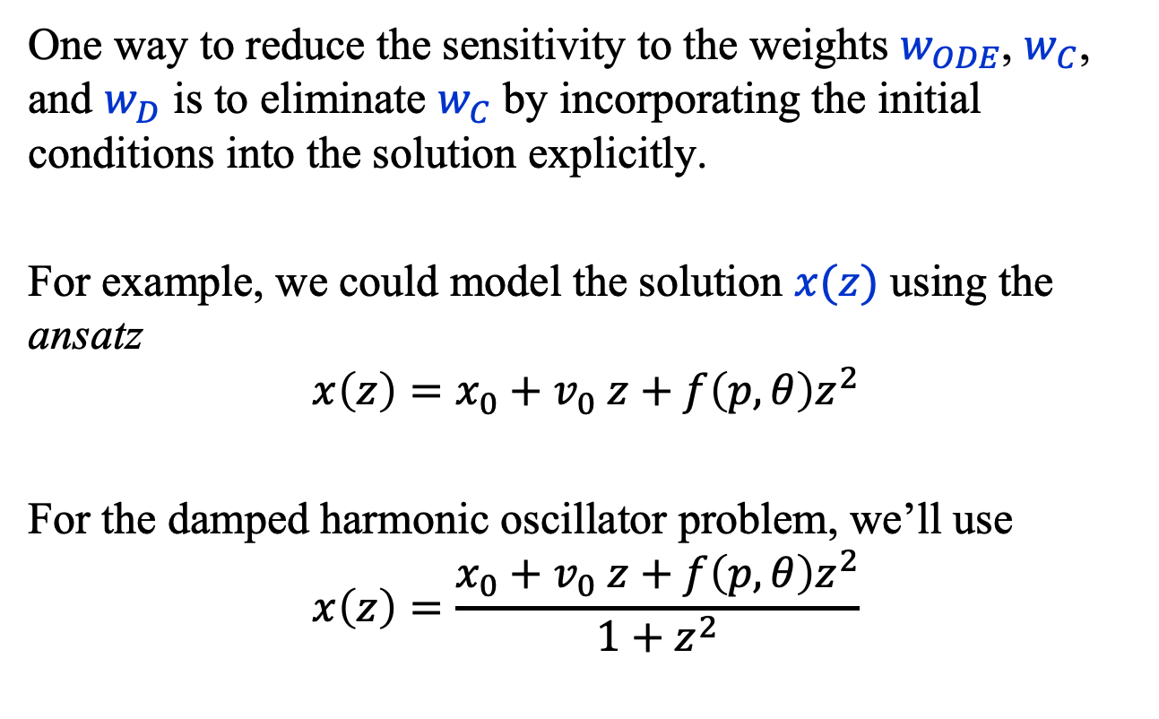
PINNs: Ansatz
One way to reduce the sensitivity to the weights $w_{ODE}$, $w_{C}$, and $w_{D}$ is to eliminate $w_{C}$ by incorporating the initial conditions into the solution explicitly.
For example, we could model the solution $x(z)$ using the ansatz
$$x\left(z\right)=x_{0}+v_{0} z+f\left(p, θ\right)z^{2}$$
For the damped harmonic oscillator problem, we’ll use
$$x\left(z\right)=\frac{x_{0}+v_{0} z+f\left(p, θ\right)z^{2}}{1+z^{2}}$$

Slide 14
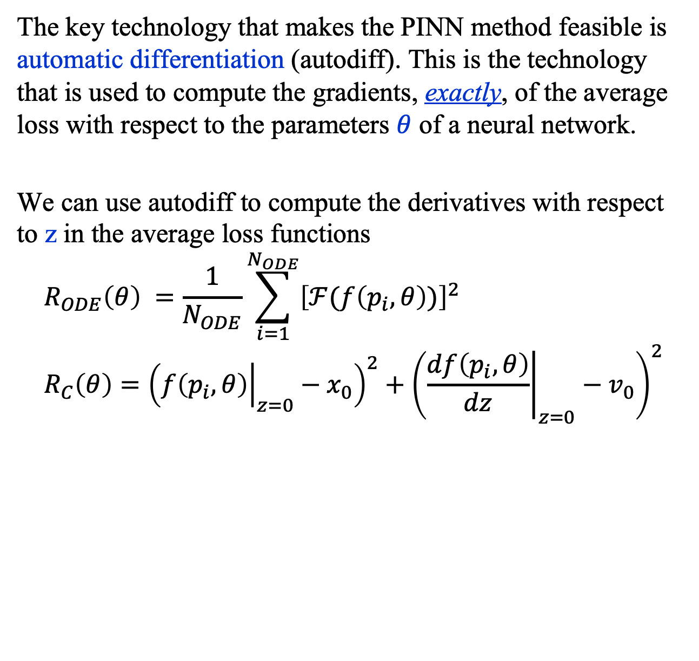
PINNs: Automatic Differentiation
The key technology that makes the PINN method feasible is automatic differentiation (autodiff). This is the technology that is used to compute the gradients, exactly, of the average loss with respect to the parameters $θ$ of a neural network.
We can use autodiff to compute the derivatives with respect to z in the average loss functions
$$R_{ODE}\left(θ\right) =\frac{1}{N_{ODE}}\sum_{i=1}^{N_{ODE}}{{\left[ℱ(f\left(p_{i},θ\right))\right]}^{2}} \\ R_{C}\left(θ\right)={\left({\left.f\left(p_{i},θ\right)\right|}_{z=0}−x_{0}\right)}^{2}+{\left({\left.\frac{df\left(p_{i},θ\right)}{dz}\right|}_{z=0}−v_{0}\right)}^{2}$$

Slide 15
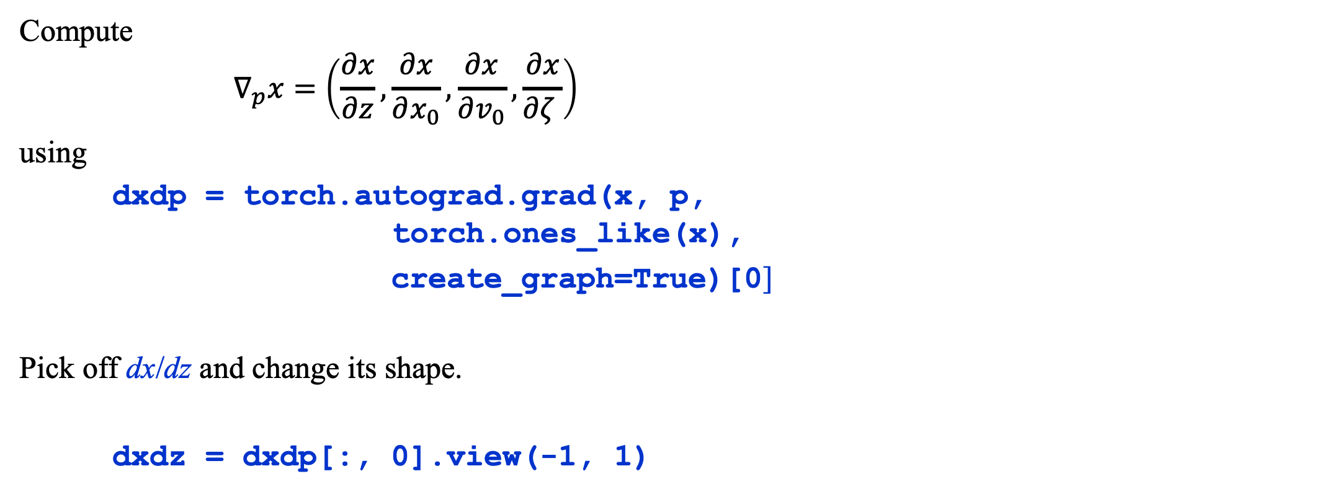
PINNs: Autodiff
Compute
$$∇_{p}x=\left(\frac{∂x}{∂z},\frac{∂x}{∂x_{0}},\frac{∂x}{∂v_{0}},\frac{∂x}{∂ζ }\right)$$
using
dxdp = torch.autograd.grad(x, p, torch.ones_like(x),
create_graph=True)[0]
Pick off dx/dz and change its shape.
dxdz = dxdp[:, 0].view(-1, 1)

Slide 16
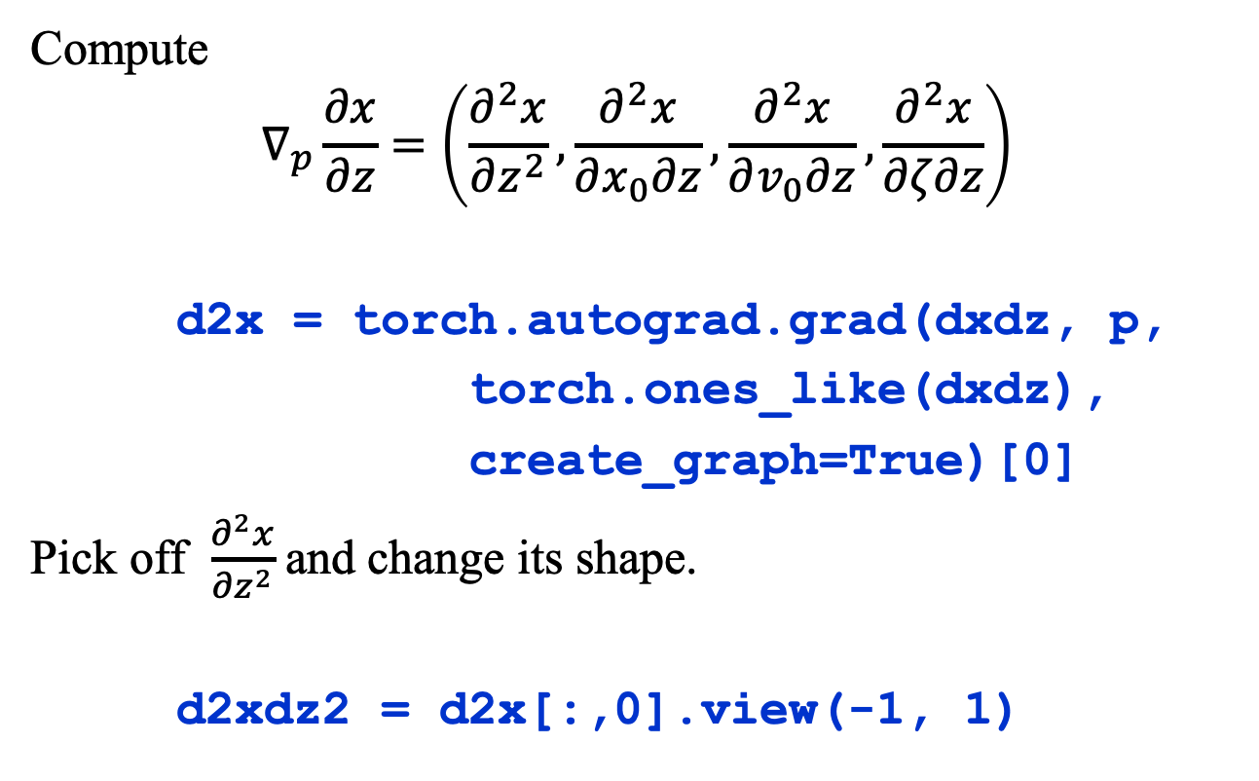
PINNs: Automatic Differentiation
Compute
$$∇_{p}\frac{∂x}{∂z}=\left(\frac{∂^{2}x}{∂z^{2}},\frac{∂^{2}x}{∂x_{0}∂z},\frac{∂^{2}x}{∂v_{0}∂z},\frac{∂^{2}x}{∂ζ∂z}\right)$$
d2x = torch.autograd.grad(dxdz, p,
torch.ones_like(dxdz),
create_graph=True)[0]
Pick off $\frac{∂^{2}x}{∂z^{2}}$and change its shape.
d2xdz2 = d2x[:,0].view(-1, 1)

Slide 17
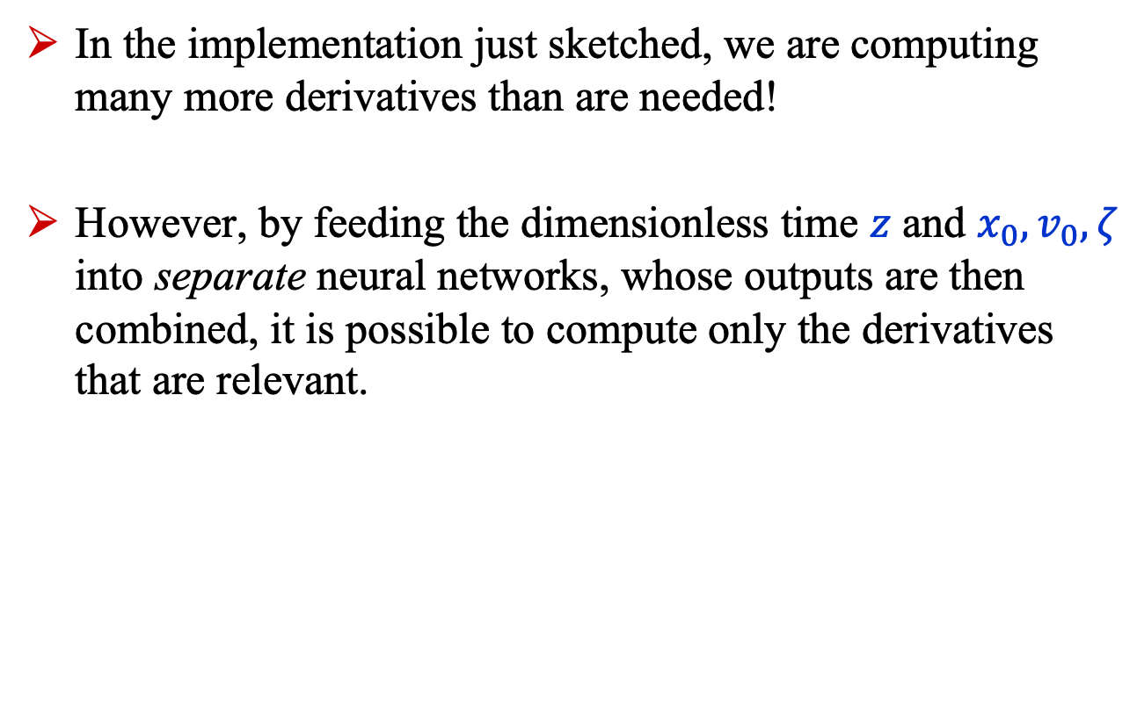
PINNs: Note on implementation
In the implementation just sketched, we are computing many more derivatives than are needed!
However, by feeding the dimensionless time $z$ and $x_{0}, v_{0}, ζ$ into separate neural networks, whose outputs are then combined, it is possible to compute only the derivatives that are relevant.

Slide 18
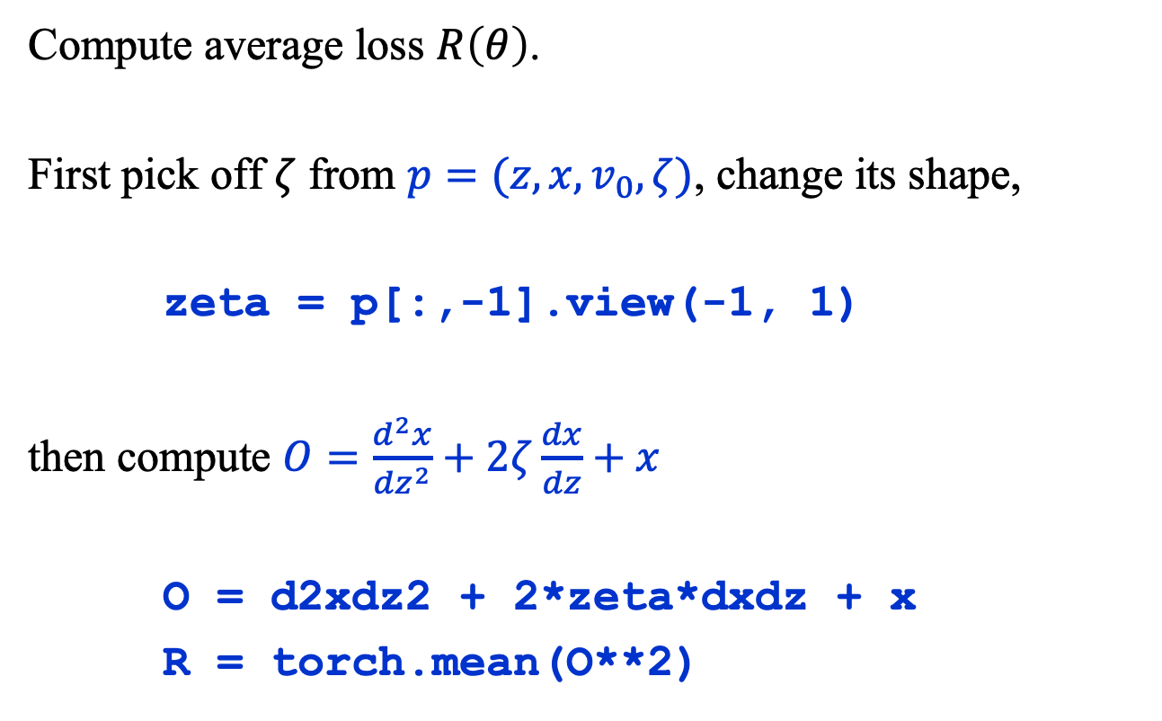
PINNs: Average Loss
Compute average loss $R\left(θ\right)$.
First pick off $ζ$ from $p=(z, x, v_{0}, ζ)$, change its shape,
zeta = p[:,-1].view(-1, 1)
then compute $O=\frac{d^{2}x}{dz^{2}}+2ζ\frac{dx}{dz}+x$
O = d2xdz2 + 2*zeta*dxdz + x
R = torch.mean(O**2)

Slide 19

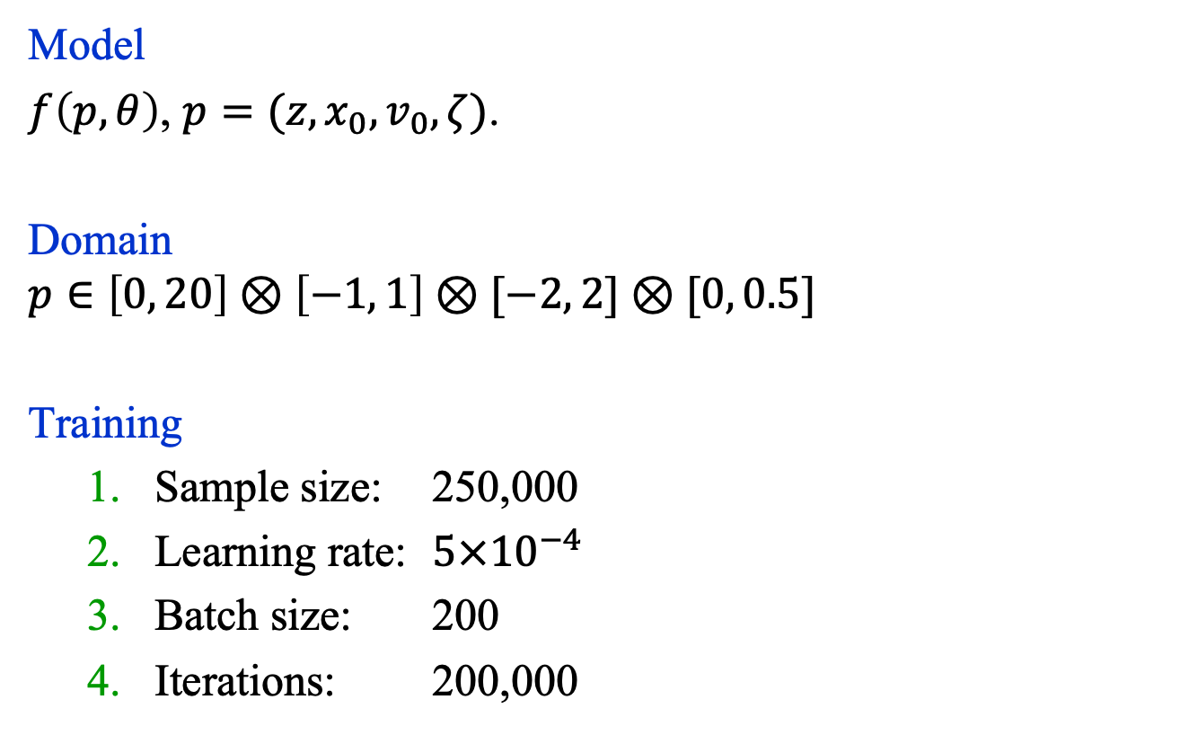
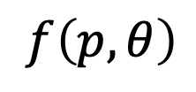

PINNs: Model / Training
Model
$f\left(p,θ\right)$, $p=(z, x_{0}, v_{0}, ζ)$.
Domain
$$p∈\left[0, 20\right]⊗\left[−1, 1\right]⊗[−2, 2]⊗[0, 0.5]$$
Training
Sample size: 250,000
Learning rate: ${5×10}^{−4}$
Batch size: 200
Iterations: 200,000
$$f\left(p,θ\right)$$
Linear(32, 1)
SiLU()
$$× 4$$
Linear(32, 32)
SiLU()
Linear(4, 32)
$$p$$

Slide 20
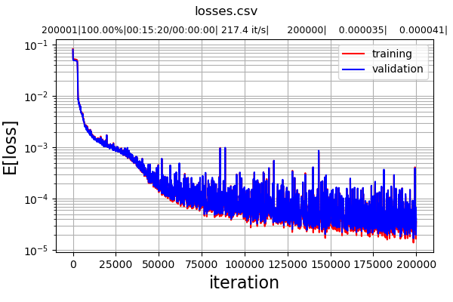
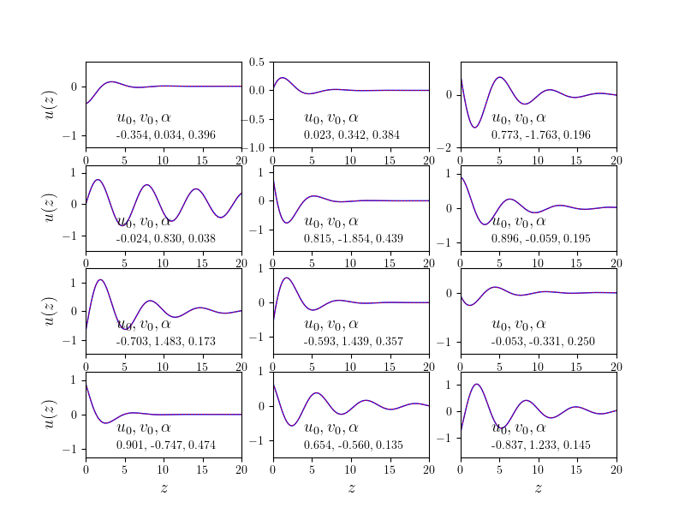


PINNs: Results
Comparisons of PINN results with exact solution for a random collection of points $\left(x_{0}, v_{0}, ζ\right)$.
Note: $u_{0}≡x_{0}$, $α=ζ$ in the plots

Slide 21
Summary
So-called physics-informed neural networks offer a new way to solve differential equations in many scientific and engineering domains.
Finding solutions with PINNs is typically more computationally demanding than with traditional numerical methods.
However, an infinite number of solutions can be found at the same time, each corresponding to a different set of initial/boundary conditions and problem parameters.

