Slide 1
Machine learning in physics Projects

Slide 2
Project Description
The project has 3 parts:
Use a machine-learning model to solve one of the following classes of problem: classification, regression, anomaly detection, or an ordinary differential equation.
Document the project in a short paper using the cernrep LaTeX package.
Give a 10-minute presentation of your project during the last week of the semester.

Slide 3
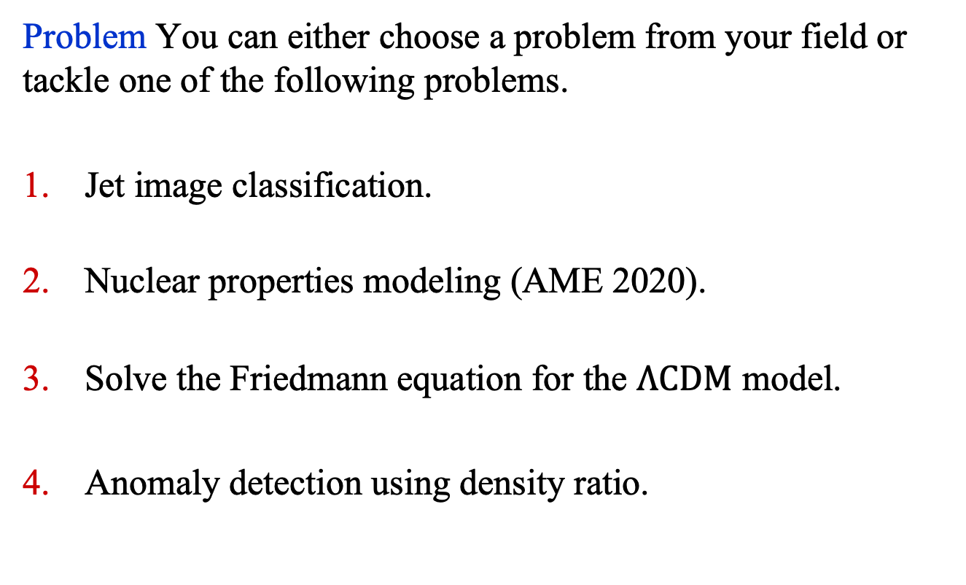
Project Description
Problem You can either choose a problem from your field or tackle one of the following problems.
Jet image classification.
Nuclear properties modeling (AME 2020).
Solve the Friedmann equation for the $Λ\text{CDM}$ model.
Anomaly detection using density ratio.

Slide 4
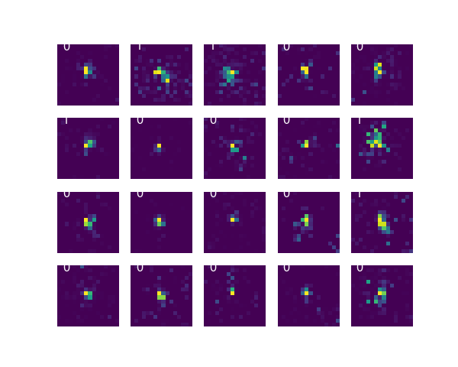
Jet Classification
Problem: Using 2D images of jets of particles, classify them into two classes: jets initiated by gluons or by quarks.
Dataset: Images of shape (1, 16, 16), which have been divided into: ['test_x', 'test_y', 'train_x', 'train_y', 'valid_x', 'valid_y’]
Filename: jets.h5
len(train_x): 50,000
len(valid_x): 5000
len(test_x): 5000

Slide 5
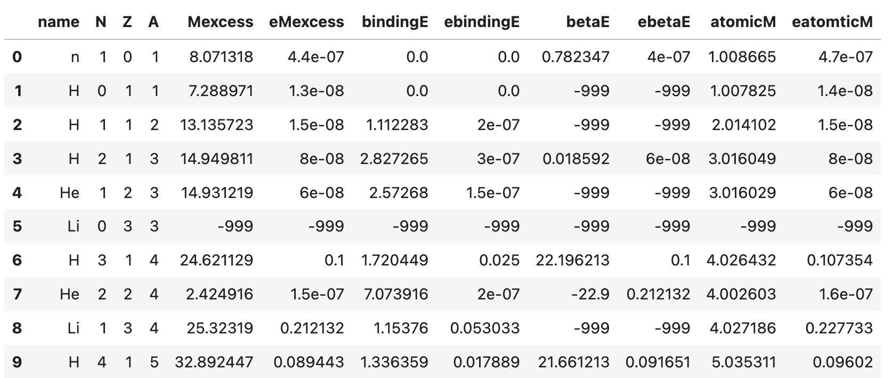
Nuclear Properties
Problem: Predict a nuclear property given N, Z, and A.
Dataset: 3,558 nuclei from the AME 2020 mass data¹.
Filename: AME2020.csv
1. The AME 2020 atomic mass evaluation, Chinese Phys. C 45, 030002 (2021) and Chinese Phys. C 45, 030003 (2021).

Slide 6
Nuclear Properties
Problem: Predict a nuclear property given N, Z, and A.
Dataset: 3,558 nuclei from the AME 2020 mass data¹.
Energy Variables:
Mexcess, bindingE, betaE: in MeV
atomicM: relative atomic mass
Note: entries in the CSV file with -999 implies missing data.

Slide 7
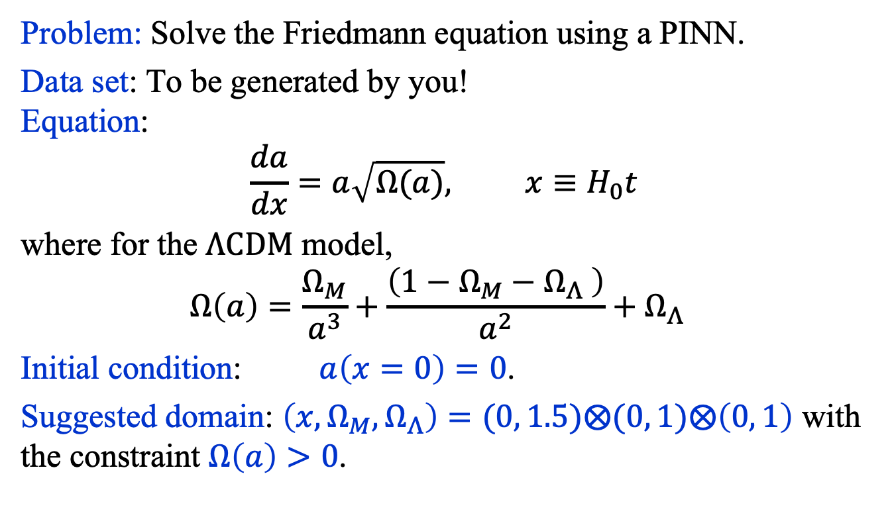
Friedmann Equation
Problem: Solve the Friedmann equation using a PINN.
Data set: To be generated by you! Equation:
$$\frac{da}{dx}=a\sqrt{Ω(a)}, x≡H_{0}t$$
where for the $Λ\text{CDM}$ model,
$$Ω\left(a\right)=\frac{Ω_{M}}{a^{3}}+\frac{\left(1−Ω_{M}−Ω_{Λ} \right)}{a^{2}}+Ω_{Λ}$$
Initial condition: $a\left(x=0\right)=0$.
Suggested domain: $\left(x, Ω_{M},Ω_{Λ}\right)=(0, 1.5)⨂(0, 1)⨂\left(0, 1\right)$ with the constraint $Ω\left(a\right)>0$.

Slide 8
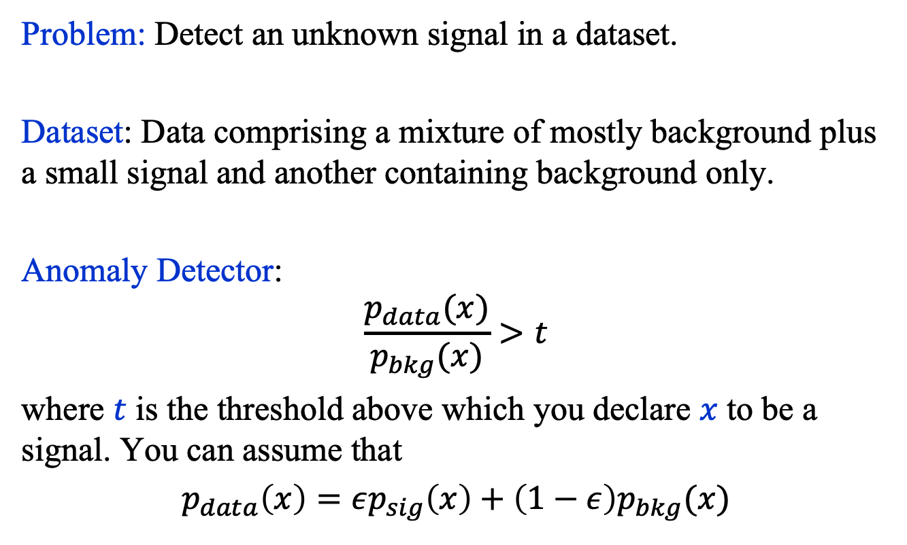
Anomaly Detection
Problem: Detect an unknown signal in a dataset.
Dataset: Data comprising a mixture of mostly background plus a small signal and another containing background only.
Anomaly Detector:
$$\frac{p_{data}(x)}{p_{bkg}(x)}>t$$
where $t$ is the threshold above which you declare $x$ to be a signal. You can assume that
$p_{data}\left(x\right)=εp_{sig}\left(x\right)+\left(1−ε\right)p_{bkg}(x)$

Slide 9
Writeup
Your Paper, which should be at most 5 pages, excluding references, must include the following elements and sections:
A Title and an Abstract
Introduction
Dataset Description
Model Description
Experiments
Summary

Slide 10
Ground Rules
Thursday class will be devoted to work on your project. You’re strongly advised to show up!
You are free to help each other, but your paper must be your own.
You are free to use any resources, but you must cite all of them.
You must document the data used, the architecture of your model, the training protocol and the results.

