Slide 1
Machine learning in physics Tutorial 1

Slide 2
Installation of miniconda3
Go to website: https://www.anaconda.com/docs/getting-started/miniconda/install
Download the installer for your operating system and follow the prompts to install miniconda3. Then…
Create a miniconda3 environment (e.g., here named mlp)
conda create -n mlp (use conda env remove –n name to remove the environment “name”.)
Activate environment conda activate mlp
Install PyTorch:
conda install pytorch

Slide 3
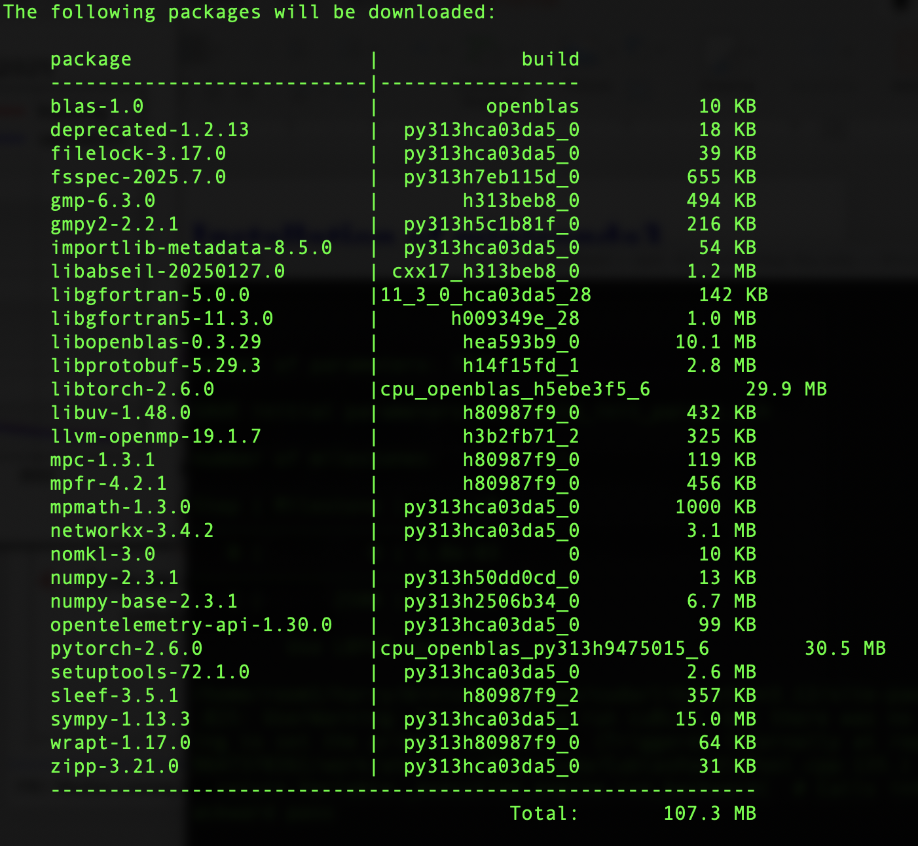
Installation of miniconda3
For
PyTorch,
check for
pytorch
numpy
sympy

Slide 4
Installation of miniconda3
Then install packages:
conda install jupyterlab
conda install matplotlib
conda install pandas
conda install scipy
conda install scikit-learn
conda install ffmpeg
conda install tqdm

Slide 5
Installation of mlinphysics
Create a folder for your work this semester (on Linux, macOS) mkdir mlprojects cd mlprojects
Download from GitHub the package mlinphysics git clone https://github.com/hbprosper/mlinphysics From your current folder (e.g., mlprojects) do source mlinphysics/setup.sh (for PYTHONPATH)
Navigate to mlprojects and launch jupyterlab, jupyter lab which should appear in your default browser. In jupyterlab, you should see the folder mlinphysics listed as a folder icon.

Slide 6
Installation of mlinphysics
Please NOTE:
Work in your own folder (e.g., mlprojects), NOT in mlinphysics!
The package mlinphysics is being restructured and improved, so code etc. could change without notice!

Slide 7
Tutorial 1
Copy the following notebooks from mlinphysics to your working folder
test.ipynb
python_minimum_part1.ipynb
python_minimum_part2.ipynb
In your jupyterlab environment:
Test your installation by executing the test.ipynb notebook.
Work through the python minimum tutorials line-by-line and try to understand what each line or set of lines does.

