Slide 1
Machine learning in physics Foundations 3

Slide 2
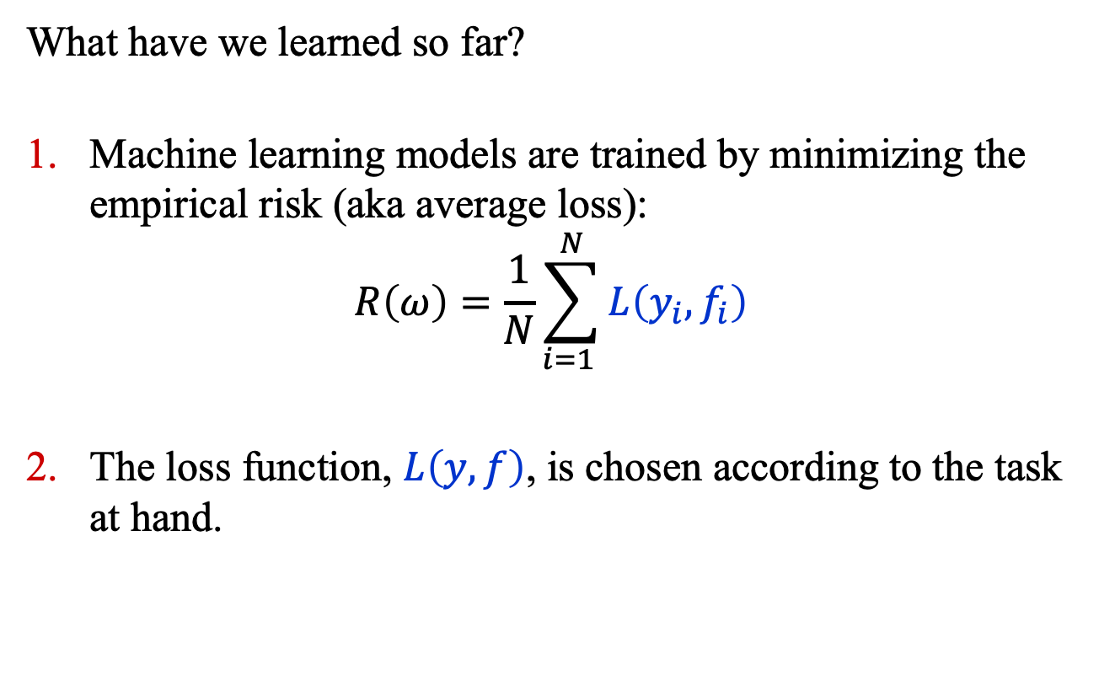
Recap
What have we learned so far?
Machine learning models are trained by minimizing the empirical risk (aka average loss):
$$R\left(ω\right)=\frac{1}{N}\sum_{i=1 }^{N}{L\left(y_{i}, f_{i}\right)}$$
The loss function, $L\left(y, f\right)$, is chosen according to the task at hand.

Slide 3
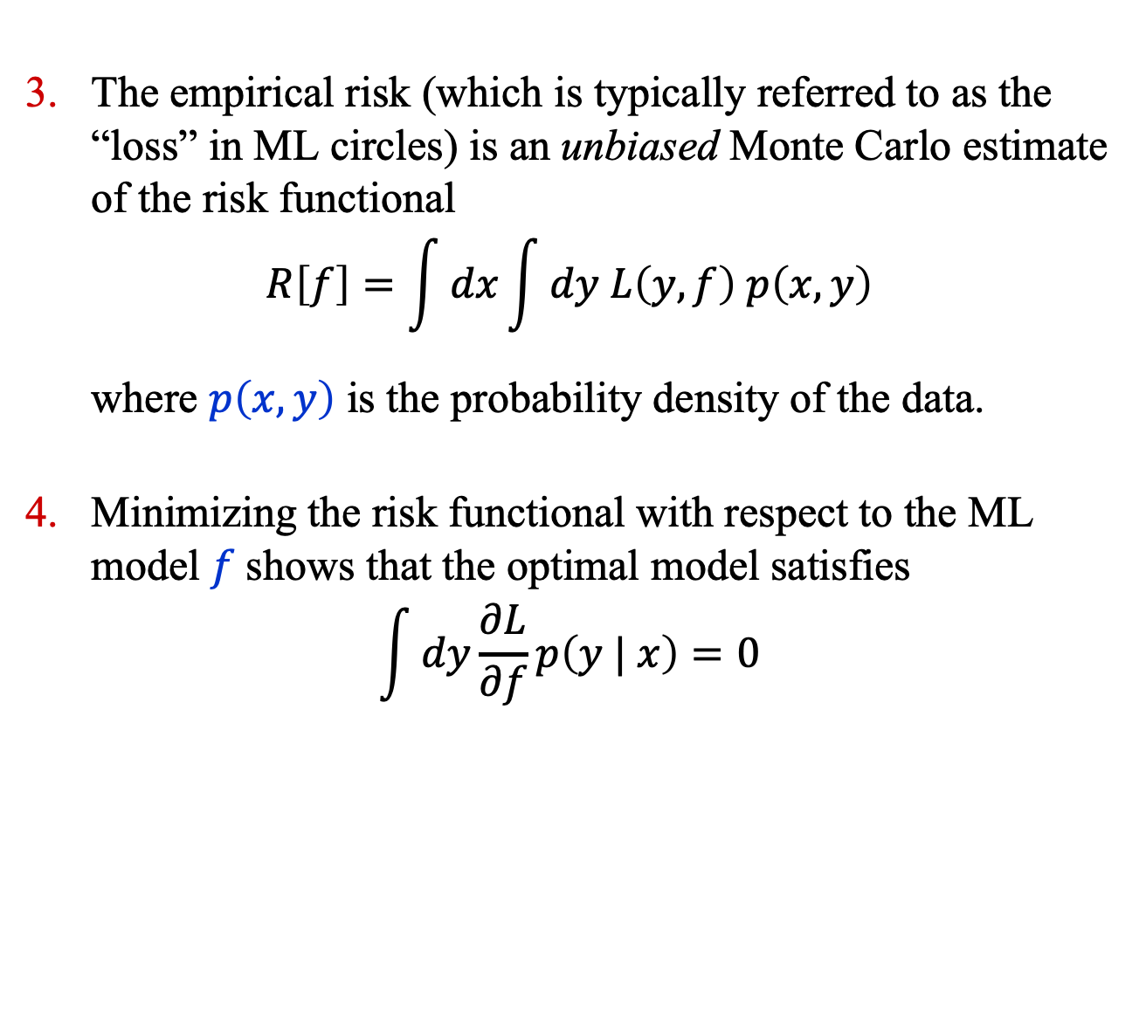
Recap
The empirical risk (which is typically referred to as the “loss” in ML circles) is an unbiased Monte Carlo estimate of the risk functional
$$R\left[f\right]=\int{dx}\int{dy L\left(y, f\right) p\left(x, y\right)}$$
where $p\left(x, y\right)$ is the probability density of the data.
Minimizing the risk functional with respect to the ML model $f$shows that the optimal model satisfies
$$\int{dy\frac{∂L}{∂f}p\left(y | x\right)=0}$$

Slide 4
Empirical RISK Minimization

Slide 5
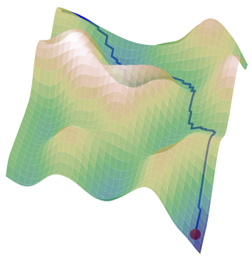
Start
Some jargon
Batch: a subset of the training data.
Iteration: a single optimization step.
Epoch: a single
pass through the training data.
Learning Rate Step: a sequence of iterations with fixed learning rate.
End

Slide 6
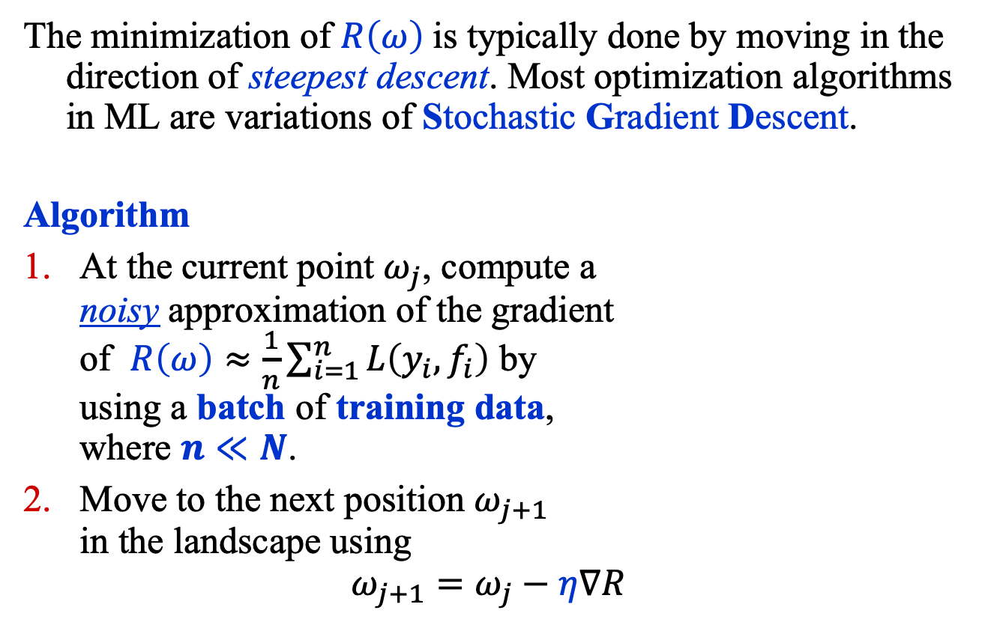
Empirical Risk Minimization (1)
The minimization of $R\left(ω\right)$is typically done by moving in the direction of steepest descent. Most optimization algorithms in ML are variations of Stochastic Gradient Descent.
Algorithm
At the current point $ω_{j}$, compute a noisy approximation of the gradient of $R\left(ω\right)≈\frac{1}{n}\sum_{i=1}^{n}{L\left(y_{i}, f_{i}\right)}$ by using a batch of training data, where $n≪N$.
Move to the next position $ω_{j+1}$ in the landscape using
$$ω_{j+1}=ω_{j}−η∇R$$

Slide 7
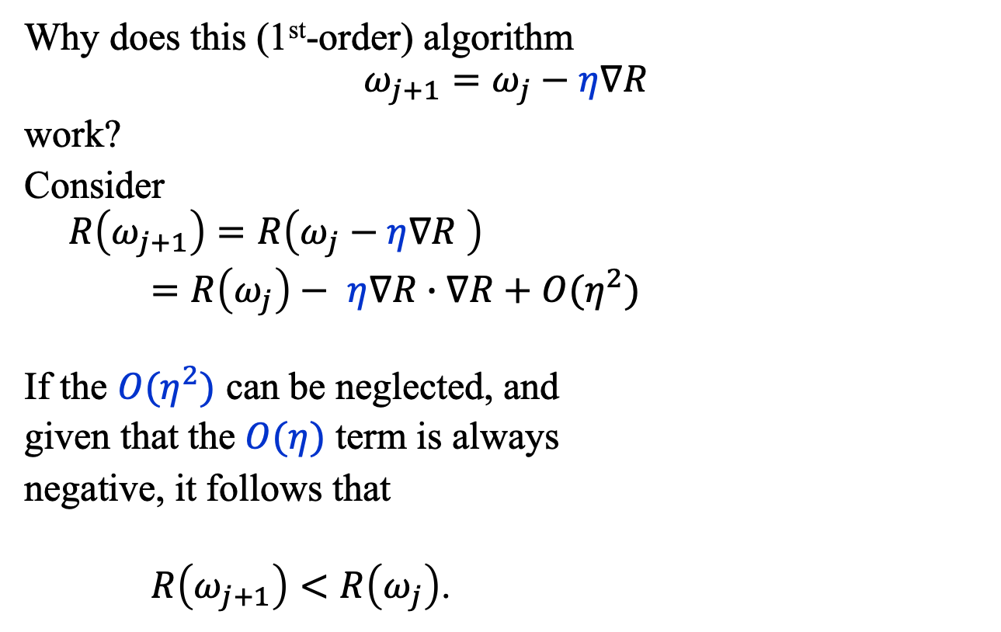
Empirical Risk Minimization (2)
Why does this (1st-order) algorithm
$$ω_{j+1}=ω_{j}−η∇R$$
work?
Consider
$$R\left(ω_{j+1}\right)=R\left(ω_{j}−η∇R \right)$$
$=R\left(ω_{j}\right)− η∇R∙∇R+O(η^{2})$
If the $O(η^{2})$ can be neglected, and
given that the $O(η)$ term is always
negative, it follows that
$R\left(ω_{j+1}\right)<R\left(ω_{j}\right)$.

Slide 8
BINARY Classifiers

Slide 9
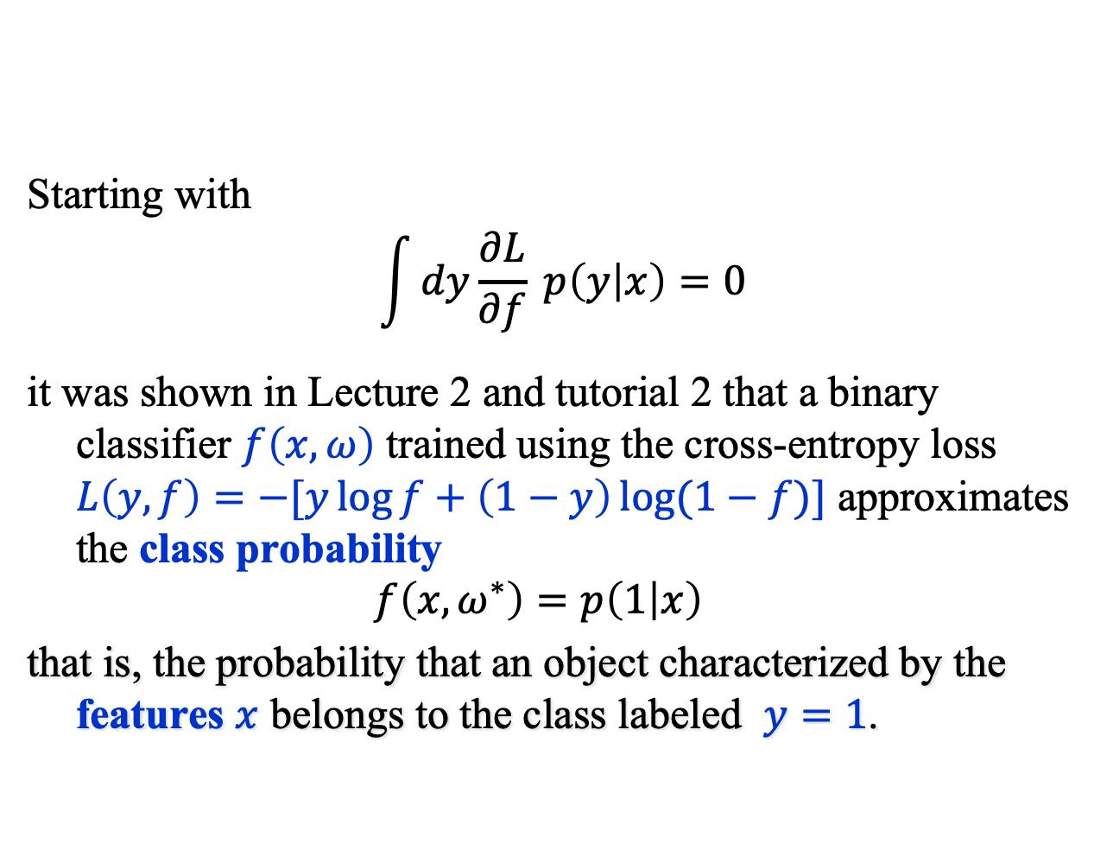
Binary Classifiers (1)
Starting with
$$\int{dy\frac{∂L}{∂f} p\left(y | x\right)=0}$$
it was shown in Lecture 2 and tutorial 2 that a binary classifier $f\left(x, ω\right)$ trained using the cross-entropy loss $L\left(y, f\right)=−[y\log{f+\left(1−y\right)\log{(1−f)}}]$ approximates the class probability
$$f\left(x, ω^{∗}\right)=p\left(1 | x\right)$$
that is, the probability that an object characterized by the features $x$ belongs to the class labeled $y=1$.

Slide 10
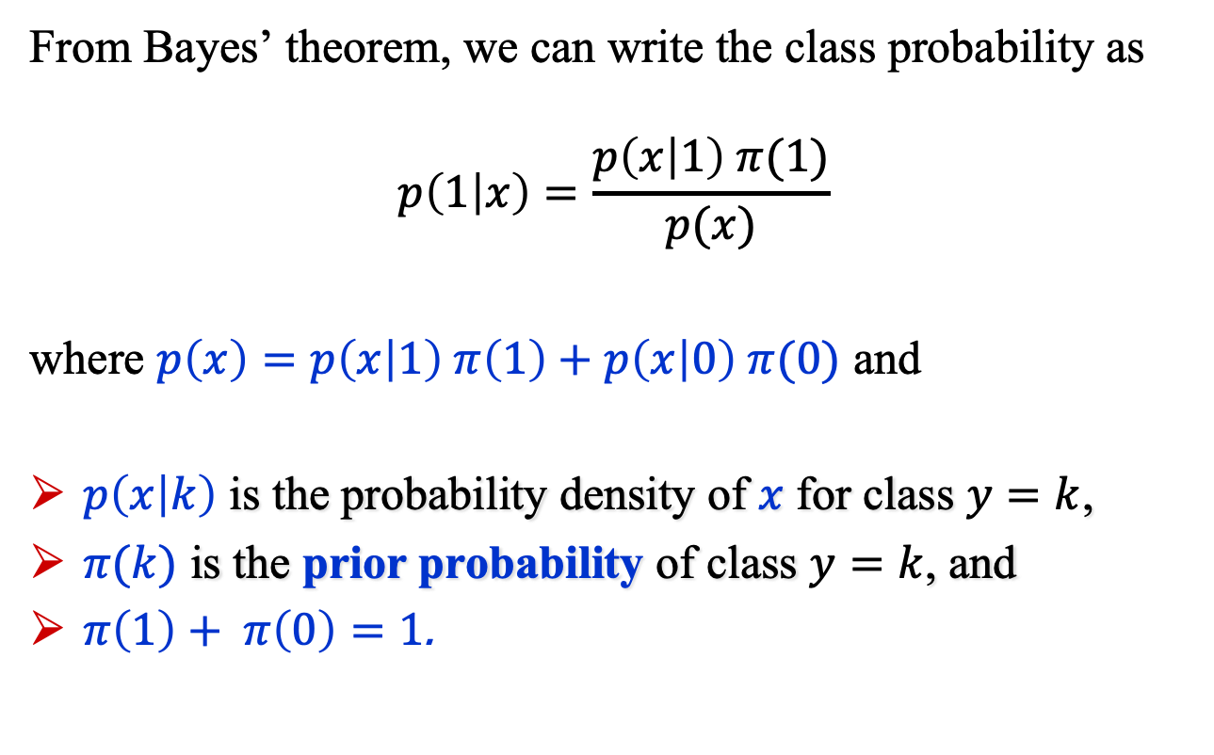
Binary Classifiers (2)
From Bayes’ theorem, we can write the class probability as
$$p\left(1 | x\right)=\frac{p\left(x | 1\right) π(1)}{p(x)}$$
where $p\left(x\right)=p\left(x | 1\right) π\left(1\right)+p\left(x | 0\right) π(0)$ and
$p\left(x | k\right)$ is the probability density of $x$ for class $y=k$,
$π(k)$ is the prior probability of class $y=k$, and
$π\left(1\right)+ π\left(0\right)=1$.

Slide 11
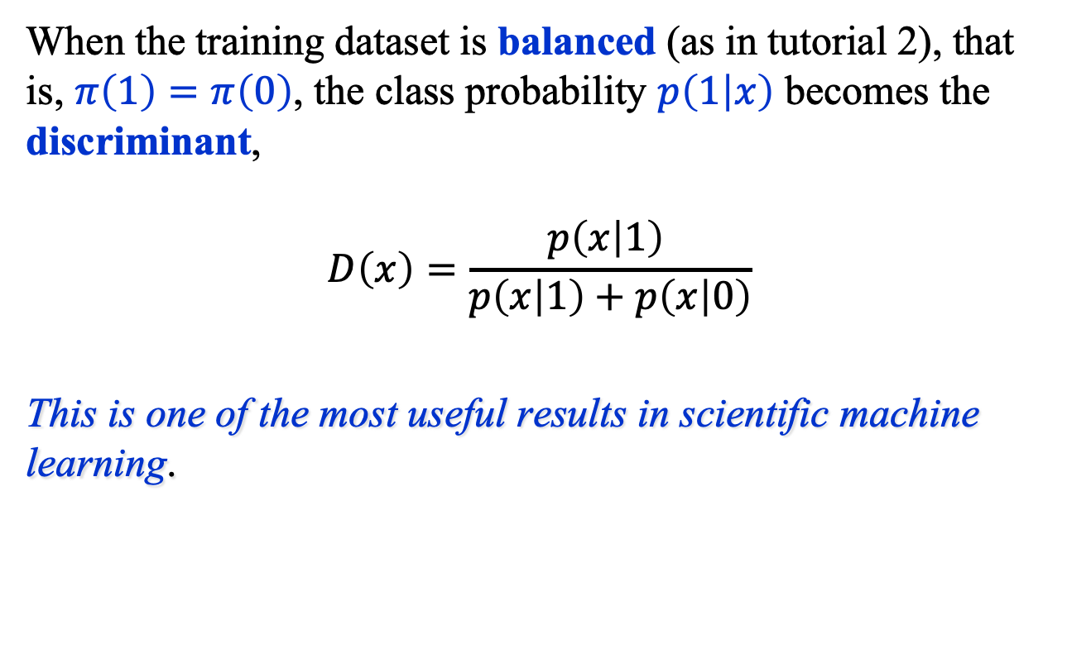
Binary Classifiers (3)
When the training dataset is balanced (as in tutorial 2), that is, $π\left(1\right)=π\left(0\right)$, the class probability $p\left(1 | x\right)$ becomes the discriminant,
$$D\left(x\right)=\frac{p\left(x | 1\right) }{p\left(x | 1\right)+p\left(x | 0\right)}$$
This is one of the most useful results in scientific machine learning.

Slide 12
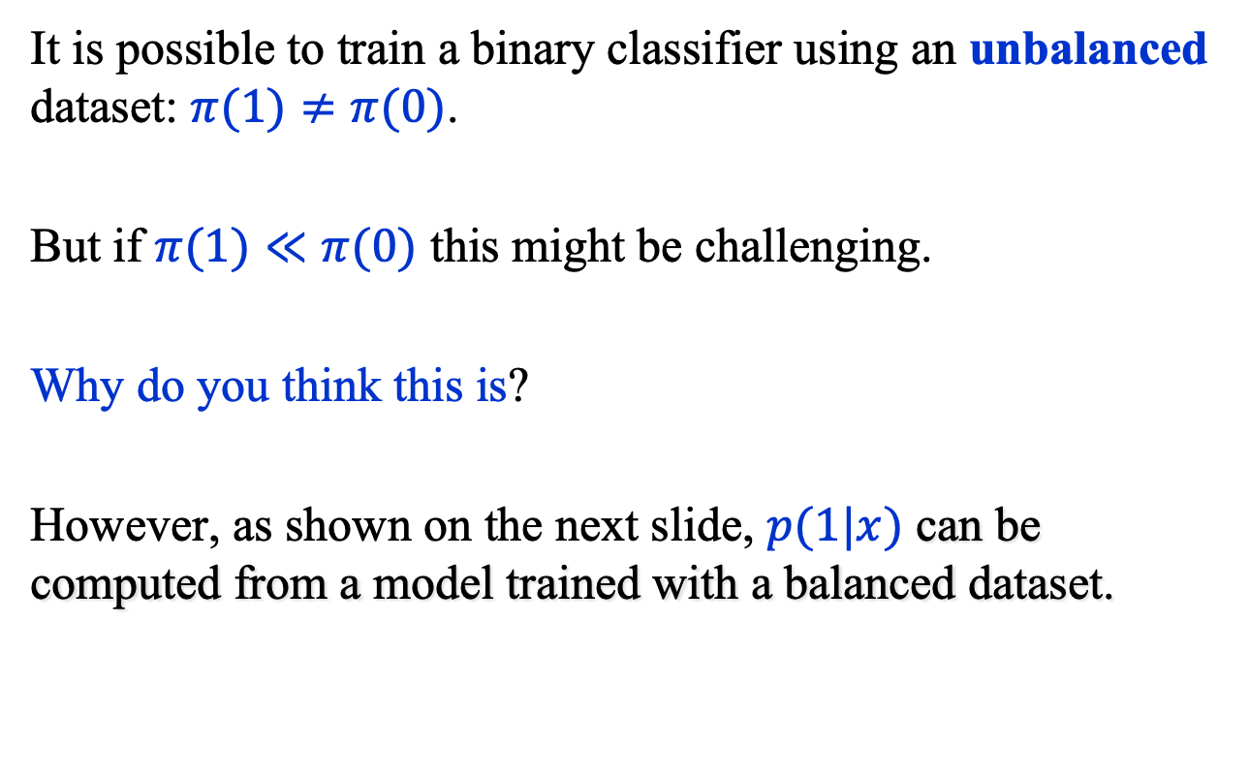
Binary Classifiers (4)
It is possible to train a binary classifier using an unbalanced dataset: $π(1)≠π(0)$.
But if $π(1)≪π(0)$ this might be challenging.
Why do you think this is?
However, as shown on the next slide, $p(1|x)$ can be computed from a model trained with a balanced dataset.

Slide 13
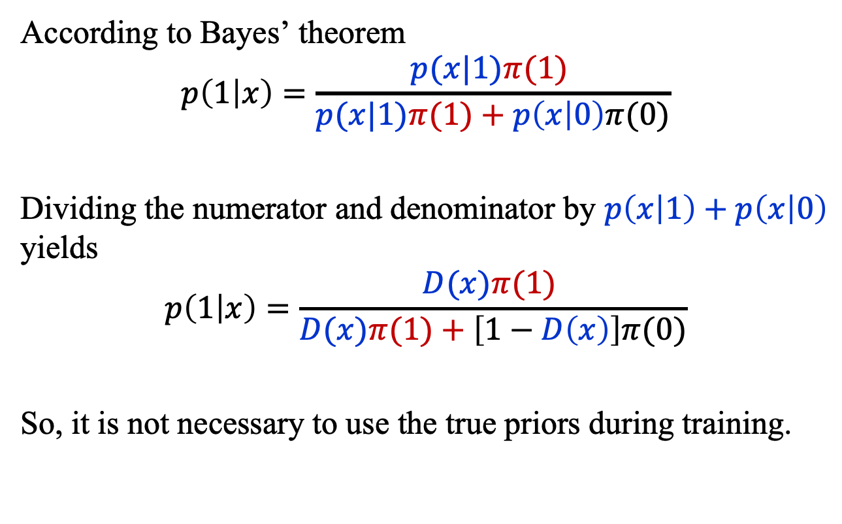
Binary Classifiers (4)
According to Bayes’ theorem
$$p\left(1 | x\right)=\frac{p(x|1)π(1) }{p(x|1)π(1)+p\left(x | 0\right)π(0)}$$
Dividing the numerator and denominator by $p\left(x | 1\right)+p\left(x | 0\right)$ yields $$p\left(1 | x\right)=\frac{D(x)π(1) }{D(x)π(1)+\left[1−D\left(x\right)\right]π(0)}$$
So, it is not necessary to use the true priors during training.

Slide 14
Classifier Performance

Slide 15
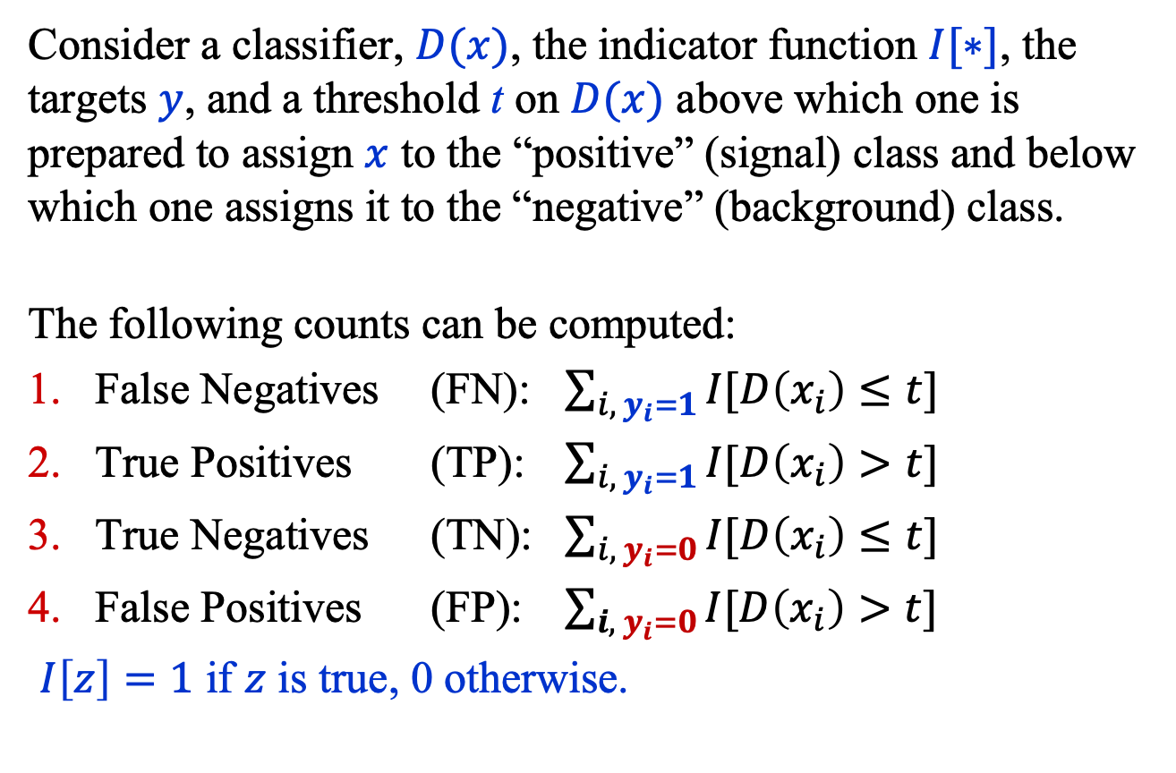
Classifier Performance (1)
Consider a classifier, $D(x)$, the indicator function $I[∗]$, the targets $y$, and a threshold t on $D(x)$ above which one is prepared to assign $x$ to the “positive” (signal) class and below which one assigns it to the “negative” (background) class.
The following counts can be computed:
False Negatives (FN): $\sum_{i, { y}_{i}=1}{I[D\left(x_{i}\right)≤t}]$
True Positives (TP): $\sum_{i, y_{i}=1}{I[D\left(x_{i}\right)>t}]$
True Negatives (TN): $\sum_{i, y_{i}=0}{I[D\left(x_{i}\right)≤t}]$
False Positives (FP): $\sum_{{i, y}_{i}=0}{I[D\left(x_{i}\right)>t}]$
$I\left[z\right]=1$ if $z$ is true, 0 otherwise.

Slide 16
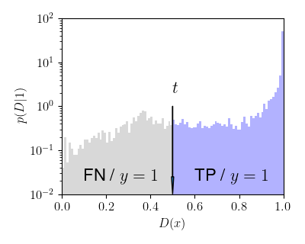
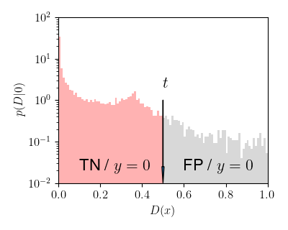
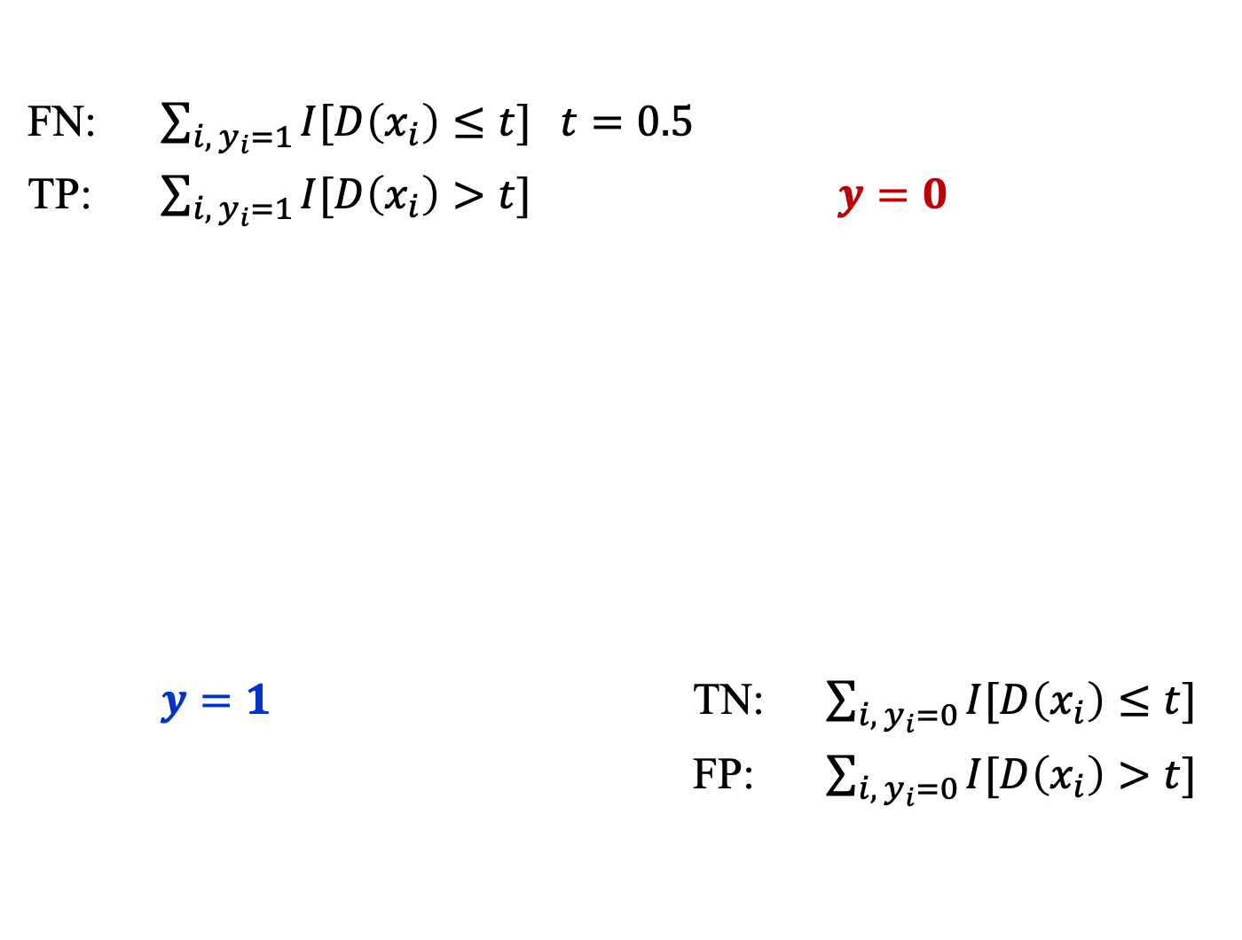
Classifier Performance (2)
FN: $\sum_{i, y_{i}=1}{I[D\left(x_{i}\right)≤t}]$ $t=0.5$
TP: $\sum_{{i, y}_{i}=1}{I[D\left(x_{i}\right)>t}]$ $y=0$
$y=1$ TN: $\sum_{i, y_{i}=0}{I[D\left(x_{i}\right)≤t}]$
FP: $\sum_{i, y_{i}=0}{I[D\left(x_{i}\right)>t}]$

Slide 17
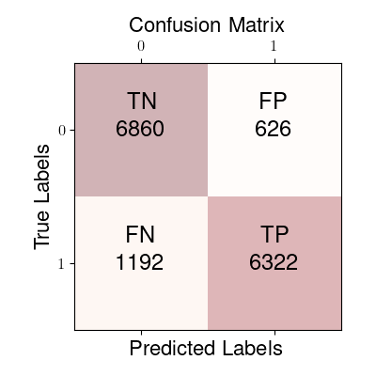
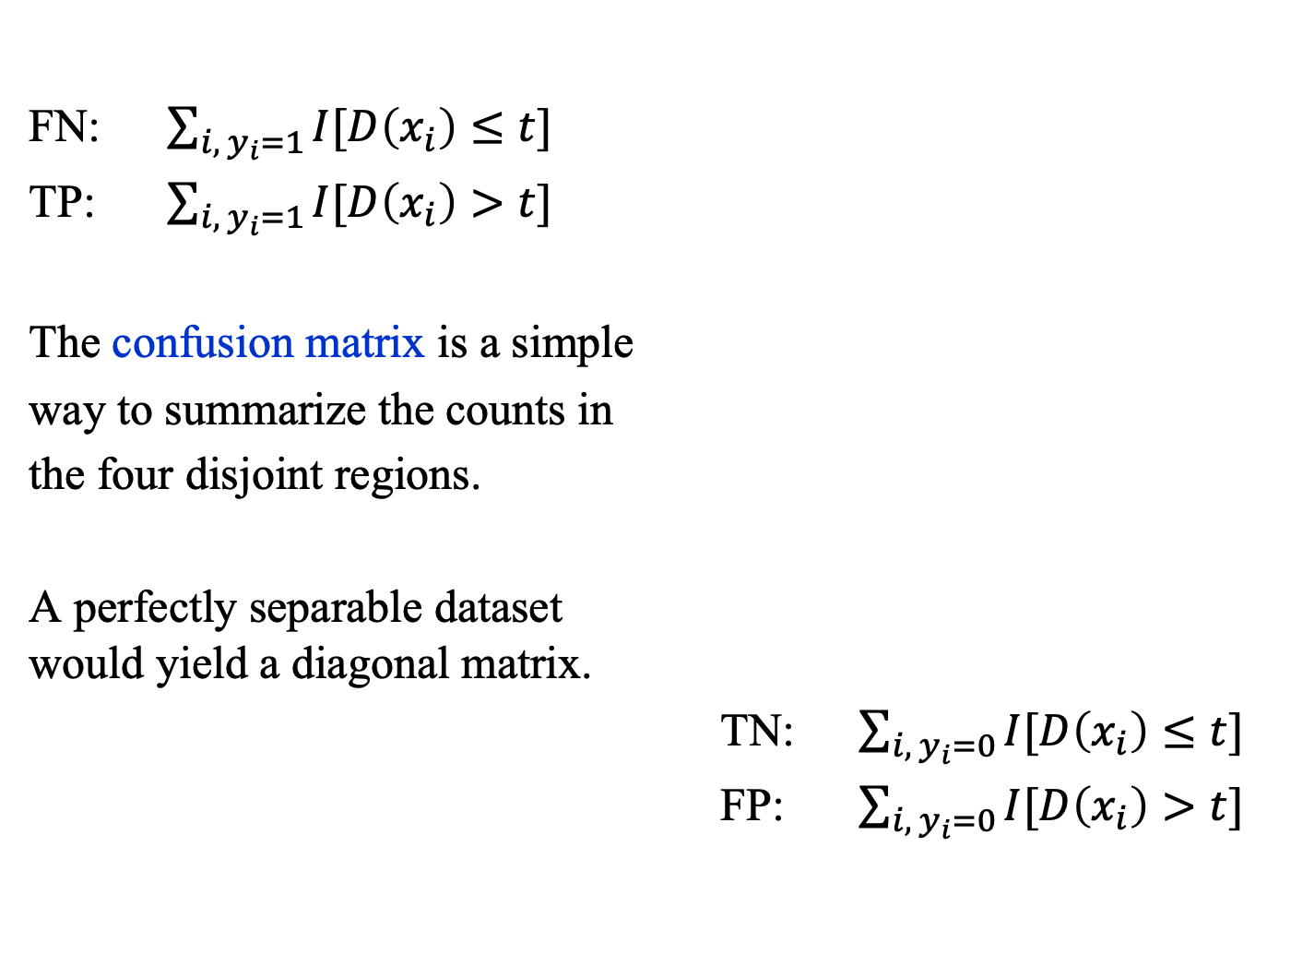
Confusion Matrix
FN: $\sum_{i, y_{i}=1}{I[D\left(x_{i}\right)≤t}]$
TP: $\sum_{{i, y}_{i}=1}{I[D\left(x_{i}\right)>t}]$
The confusion matrix is a simple
way to summarize the counts in
the four disjoint regions.
A perfectly separable dataset would yield a diagonal matrix.
TN: $\sum_{{i, y}_{i}=0}{I[D\left(x_{i}\right)≤t}]$
FP: $\sum_{{i, y}_{i}=0}{I[D\left(x_{i}\right)>t}]$

Slide 18
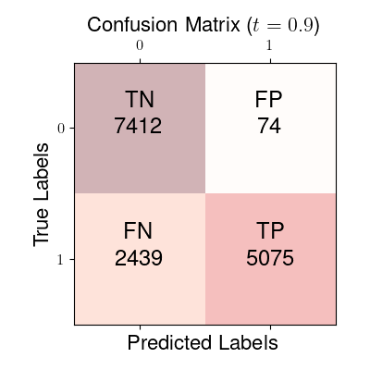
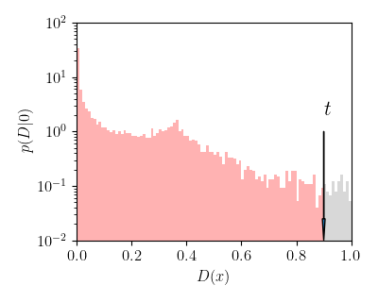
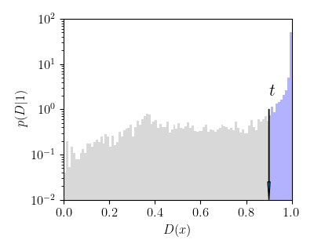

Confusion Matrix ($t=0.9$)

Slide 19

Accuracy, Precision, Recall
Accuracy = (TP + TN) / (TP + TN + FN + FP)
Precision = TP / (TP + FP) $P(y=1|D>t)$
Recall = TP / (FN + TP)
True Positive Rate (TPR) = TP / (FN + TP) $P(D>t|1)$
False Positive Rate (FPR) = FP / (TN + FP) $P(D>t|0)$

Slide 20
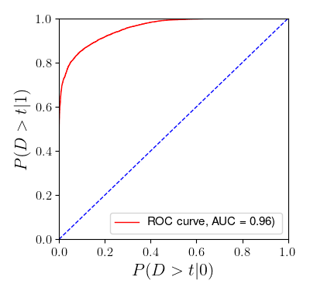

ROC and AUC
The ROC curve is a plot of TPR vs. FPR, that is,
$$P\left(D>t | 1\right) \text{vs}\text{.} P(D>t|0)$$
where (usually)
$$D(x)=\frac{p(x\left|1\right) }{p(x\left|1\right)+p(x\left|0\right)}$$

Slide 21
Beyond Classification

Slide 22
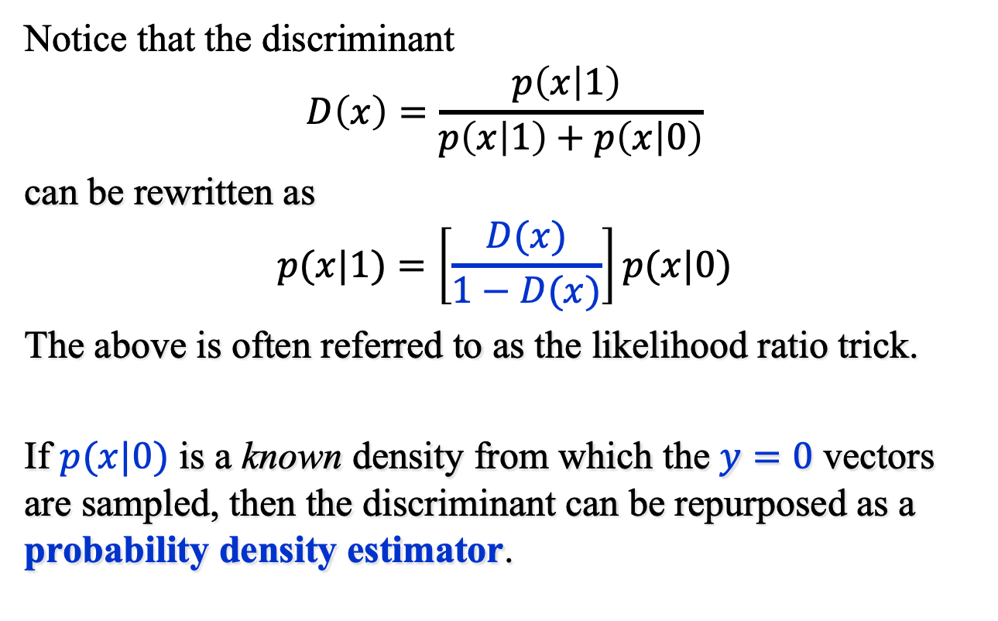
Beyond Classification (1)
Notice that the discriminant
$$D\left(x\right)=\frac{p\left(x | 1\right) }{p\left(x | 1\right)+p\left(x | 0\right)}$$
can be rewritten as
$$p(x|1)=\left[\frac{D(x)}{1−D(x)}\right]p(x|0)$$
The above is often referred to as the likelihood ratio trick.
If $p(x|0)$ is a known density from which the $y=0$ vectors are sampled, then the discriminant can be repurposed as a probability density estimator.

Slide 23
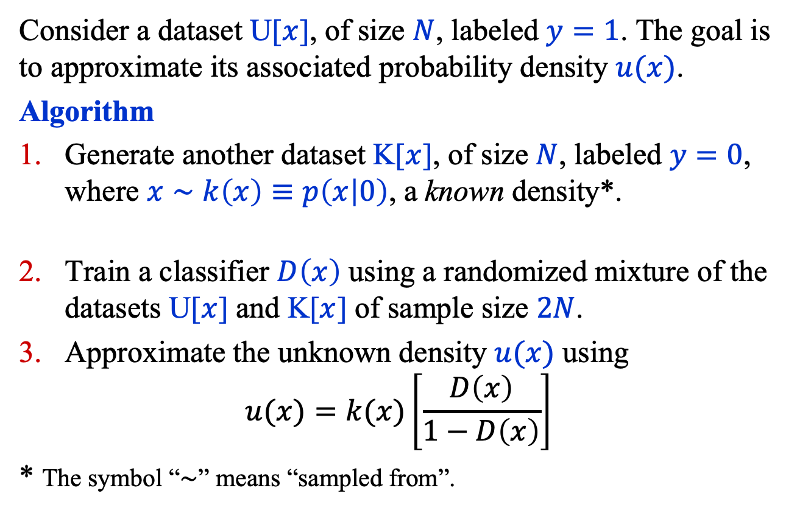
Beyond Classification (2)
Consider a dataset U[$x$], of size $N$, labeled $y=1$. The goal is to approximate its associated probability density $u(x)$.
Algorithm
Generate another dataset K[$x$], of size $N$, labeled $y=0$, where $x∼k\left(x\right)≡p\left(x | 0\right)$, a known density*.
Train a classifier $D\left(x\right)$ using a randomized mixture of the datasets U[$x$] and K[$x$] of sample size $2N$.
Approximate the unknown density $u(x)$ using
$$u(x)=k(x)\left[\frac{D\left(x\right)}{1−D\left(x\right)}\right]$$
* The symbol “$∼$” means “sampled from”.

Slide 24
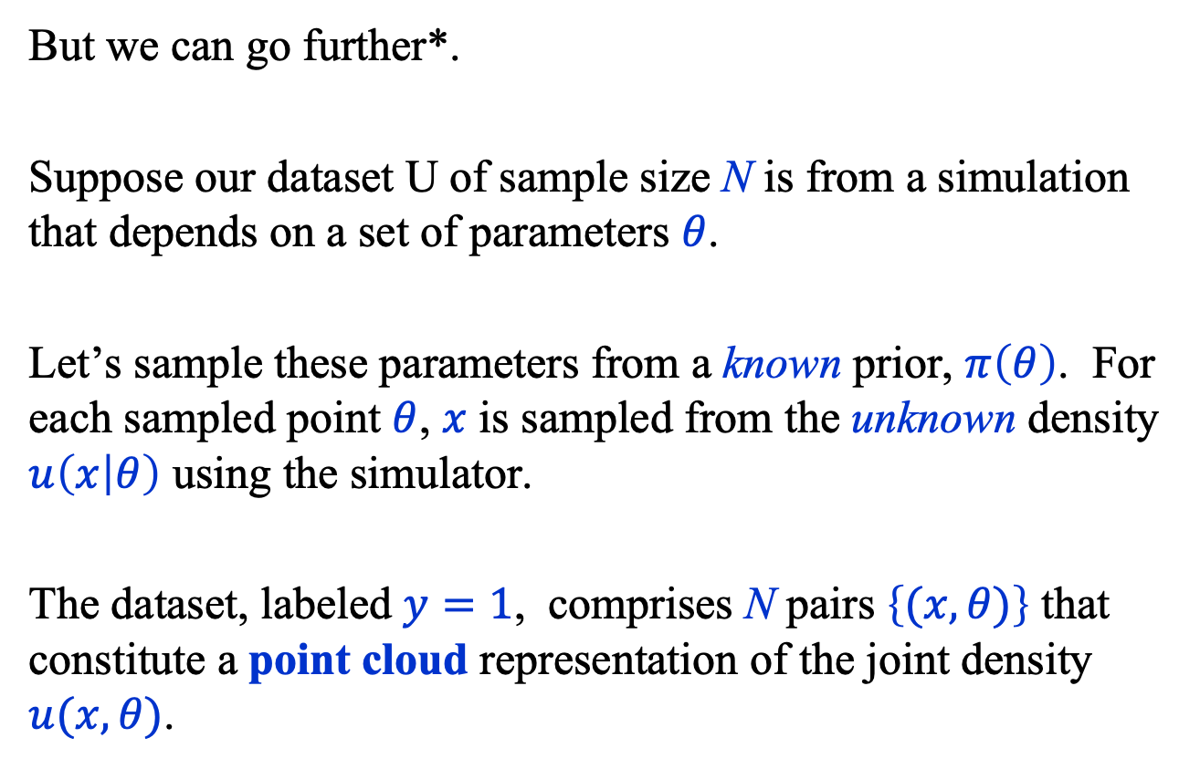
Beyond Classification (3)
But we can go further*.
Suppose our dataset U of sample size N is from a simulation that depends on a set of parameters $θ$.
Let’s sample these parameters from a known prior, $π\left(θ\right)$. For each sampled point $θ$, $x$ is sampled from the unknown density $u\left(x | θ\right)$ using the simulator.
The dataset, labeled $y=1$, comprises N pairs $\left\{(x, θ)\right\}$ that constitute a point cloud representation of the joint density $u(x, θ)$.
* Baldi, P., Cranmer, K., Faucett, T. et al.
Parameterized neural networks for high-energy physics.
Eur. Phys. J. C 76, 235 (2016).

Slide 25
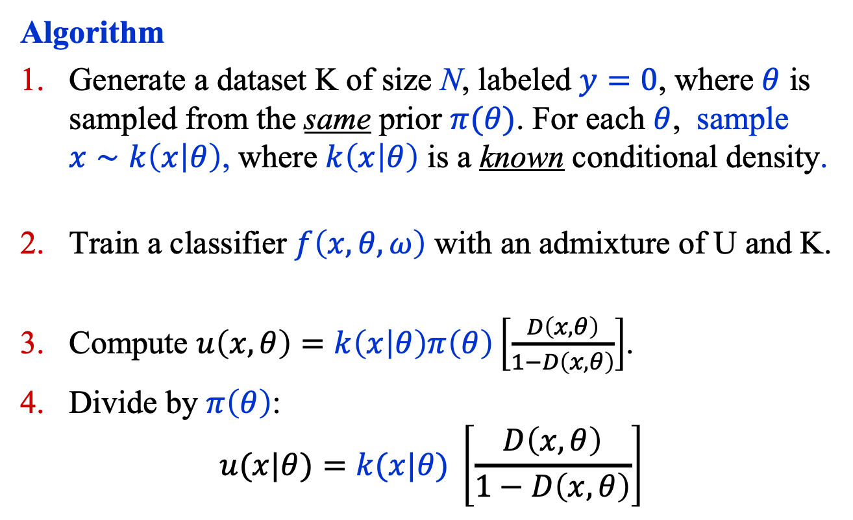
Beyond Classification (4)
Algorithm
Generate a dataset K of size N, labeled $y=0$, where $θ$ is sampled from the same prior $π(θ)$. For each $θ$, sample $x∼k\left(x | θ\right)$, where $k\left(x | θ\right)$ is a known conditional density.
Train a classifier $f\left(x, θ,ω\right)$ with an admixture of U and K.
Compute $u\left(x, θ\right)=k\left(x | θ\right)π\left(θ\right)\left[\frac{D\left(x, θ\right)}{1−D\left(x, θ\right)}\right]$.
Divide by $π\left(θ\right)$:
$$u(x|θ)=k(x|θ) \left[\frac{D\left(x, θ\right)}{1−D\left(x, θ\right)}\right]$$

Slide 26
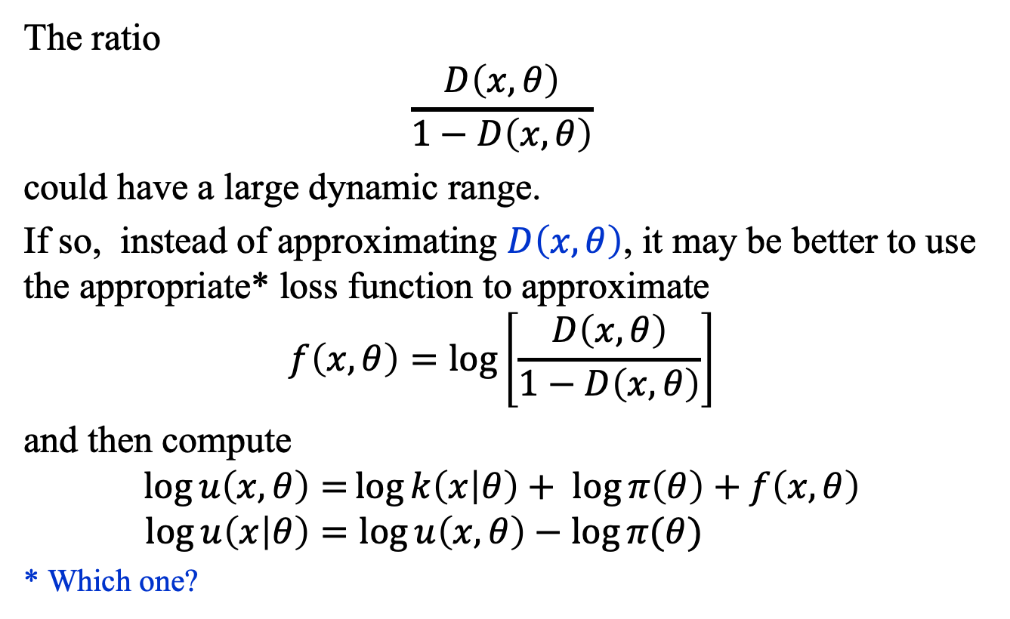
Beyond Classification (5)
The ratio
$$\frac{D\left(x, θ\right)}{1−D\left(x, θ\right)}$$
could have a large dynamic range.
If so, instead of approximating $D\left(x, θ\right)$, it may be better to use the appropriate* loss function to approximate
$$f\left(x, θ\right)=\log\left[\frac{D\left(x, θ\right)}{1−D\left(x, θ\right)}\right]$$
and then compute
$$\log{u\left(x, θ\right)=}\log{k\left(x | θ\right)}+ \log{π\left(θ\right)}+f\left(x, θ\right) \\ \log{u\left(x | θ\right)=\log{u\left(x,θ\right)−\log{π(θ)}} }$$
* Which one?

Slide 27
Summary
In addition to the ROC curve and the AUC, the performance of a classifier can be characterized with several other numbers including:
False Negatives (FN)
True Positives (TP)
True Negatives (TN)
False Positives (FP)
A classifier can be repurposed in many ways, including as a probability density estimator.

