Slide 1
Machine Learning In Physics Foundations 2

Slide 2
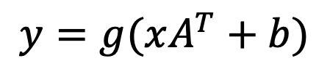
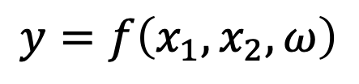
Recap
Last time we introduced the multi-node (and multi-layer) perceptron (MLP).
Layer 2
Layer 1
$$y_{1}$$
$$y=f\left(x_{1}, x_{2}, ω\right)$$
$$y_{2}$$
$$x_{1}$$
$$x_{2}$$
$$y_{3}$$
$$y_{4}$$
$$y=g(xA^{T}+b)$$

Slide 3
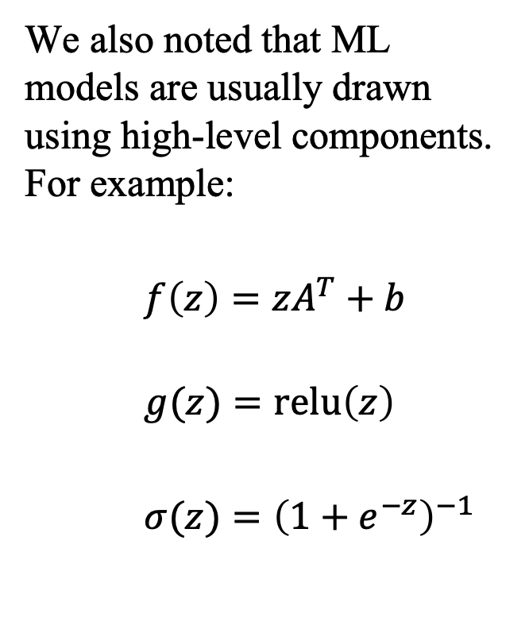
Recap
We also noted that ML models are usually drawn using high-level components. For example:
$f\left(z\right)=zA^{T}+b$
$g(z)=\text{relu}\left(z\right)$
$σ(z)={\left(1+e^{−z}\right)}^{−1}$
output
$$σ(z)$$
Layer 2
Linear(4, 1)
$$\text{relu}(z)$$
Layer 1
Linear(2, 4)
$$x$$

Slide 4
Fitting Models to data

Slide 5
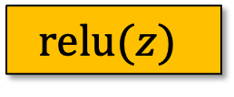
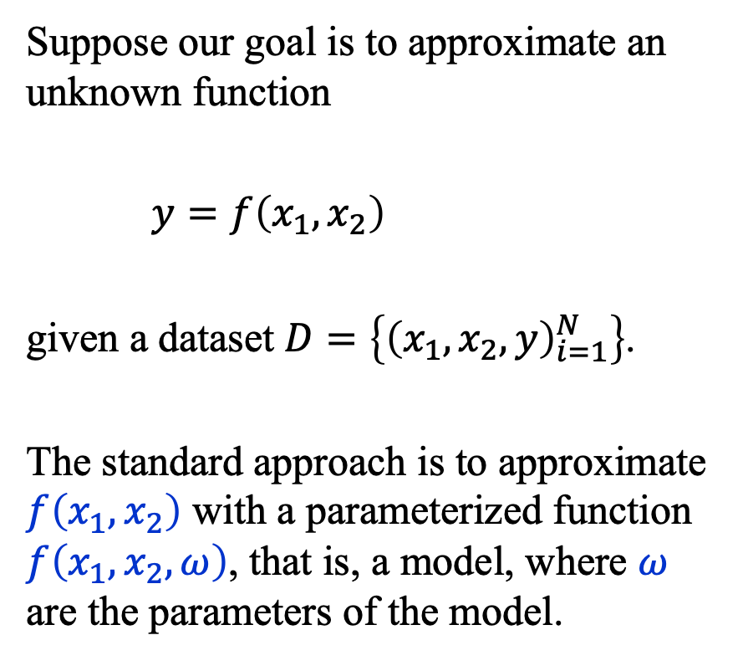


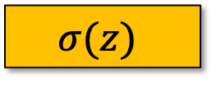
Fitting Models to Data (1)
Suppose our goal is to approximate an unknown function
$y=f\left(x_{1},x_{2}\right)$
given a dataset $D=\left\{{\left(x_{1},x_{2},y\right)}_{i=1}^{N}\right\}$.
The standard approach is to approximate $f\left(x_{1},x_{2}\right)$ with a parameterized function $f\left(x_{1},x_{2},ω\right)$, that is, a model, where $ω$ are the parameters of the model.
$$y(x)$$
$$σ(z)$$
Linear(4, 1)
$$\text{relu}(z)$$
Linear(2, 4)
$$x$$

Slide 6
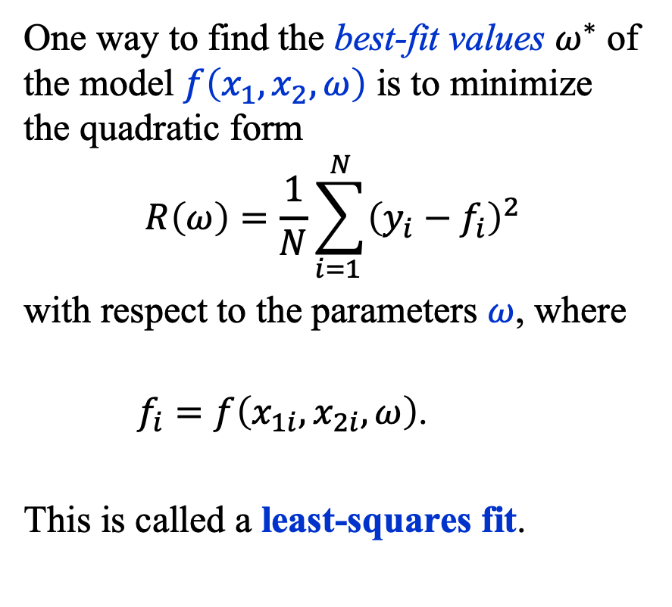
Fitting Models to Data (2)
One way to find the best-fit values $ω^{∗}$ of the model $f\left(x_{1},x_{2},ω\right)$ is to minimize the quadratic form
$$R\left(ω\right)=\frac{1}{N}\sum_{i=1 }^{N}{{\left(y_{i}−f_{i}\right)}^{2}}$$
with respect to the parameters $ω$, where
$f_{i}=f\left(x_{1i}, x_{2i},ω\right)$.
This is called a least-squares fit.
$$y(x)$$
$$σ(z)$$
Linear(4, 1)
$$\text{relu}(z)$$
Linear(2, 4)
$$x$$

Slide 7
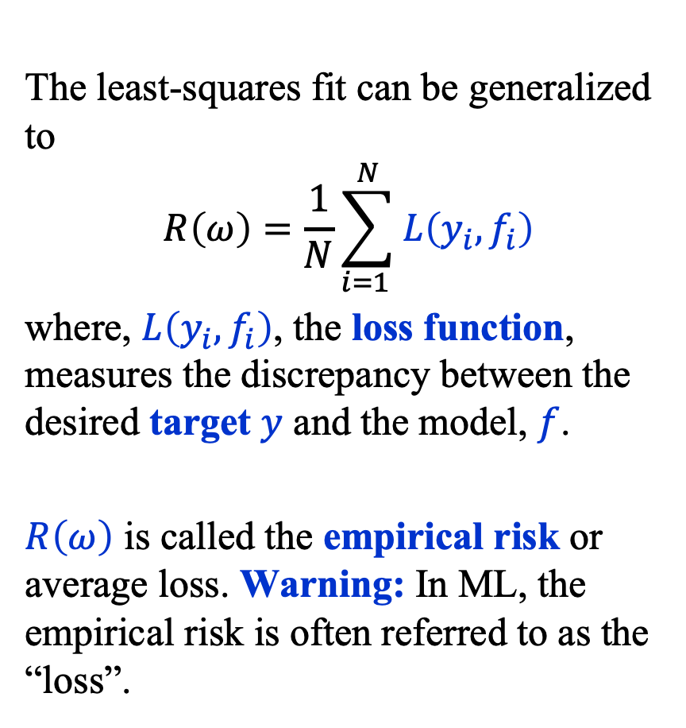
Fitting Models to Data (3)
The least-squares fit can be generalized to
$$R\left(ω\right)=\frac{1}{N}\sum_{i=1 }^{N}{L\left(y_{i}, f_{i}\right)}$$
where, $L\left(y_{i}, f_{i}\right)$, the loss function, measures the discrepancy between the desired target $y$ and the model, $f$.
$R\left(ω\right)$ is called the empirical risk or average loss. Warning: In ML, the empirical risk is often referred to as the “loss”.
$$y(x)$$
$$σ(z)$$
Linear(4, 1)
$$\text{relu}(z)$$
Linear(2, 4)
$$x$$

Slide 8
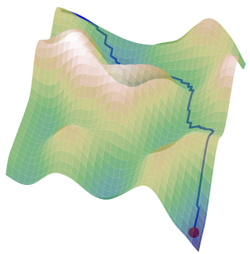
Empirical Risk Landscape (1)
The empirical risk defines a highly corrugated high-dimensional “landscape” in the space of parameters.
Our task is to navigate the empirical
risk landscape to find a good
approximation of the minimum not of
that landscape but rather of the
landscape that would be formed if
we if we had an infinite amount of data
and a model that would fit the infinite dataset exactly.
A model that approximates this ideal is said to generalize.

Slide 9
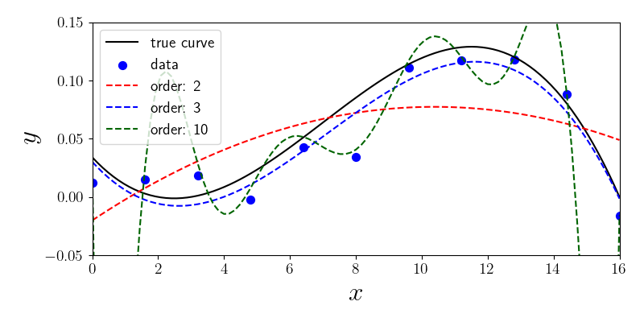
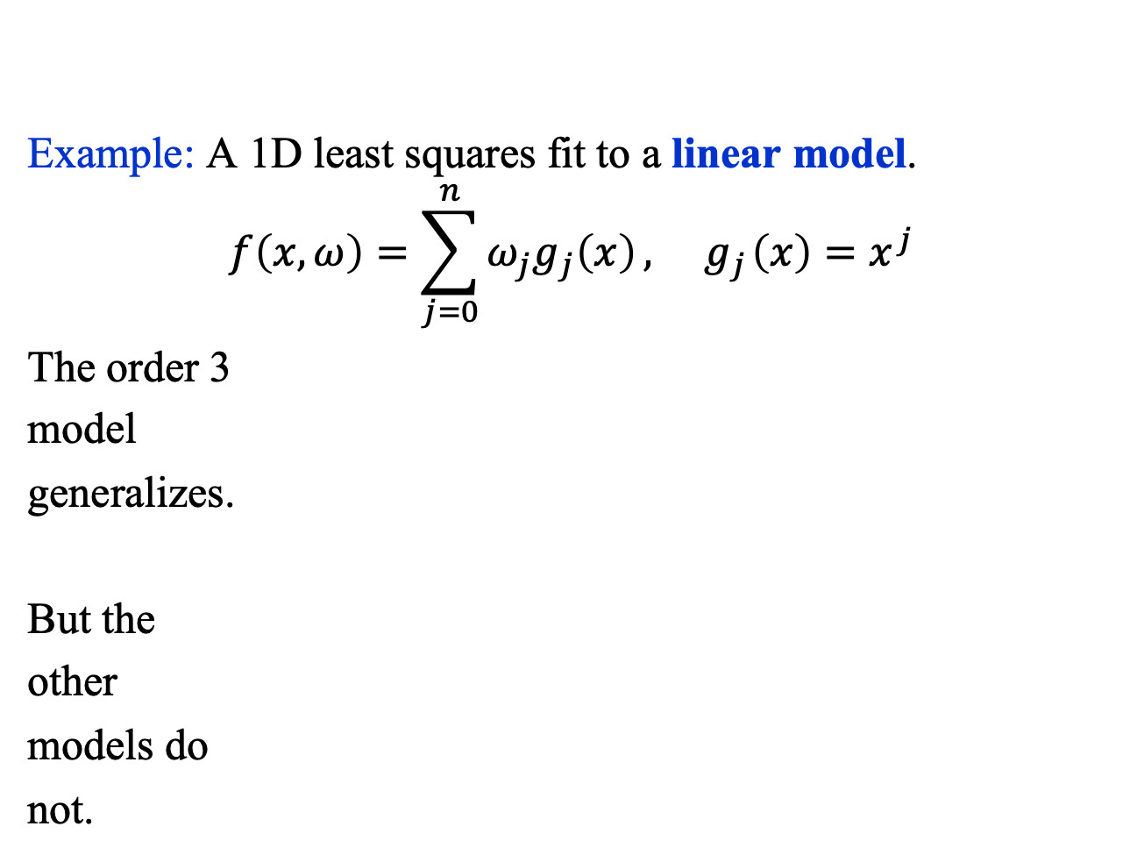
Empirical Risk Landscape (2)
Example: A 1D least squares fit to a linear model.
$$f\left(x, ω\right)=\sum_{j=0}^{n}{ω_{j}g_{j}\left(x\right)}, { g}_{j}\left(x\right)=x^{j}$$
The order 3
model
generalizes.
But the
other
models do
not.

Slide 10
Risk Functional

Slide 11
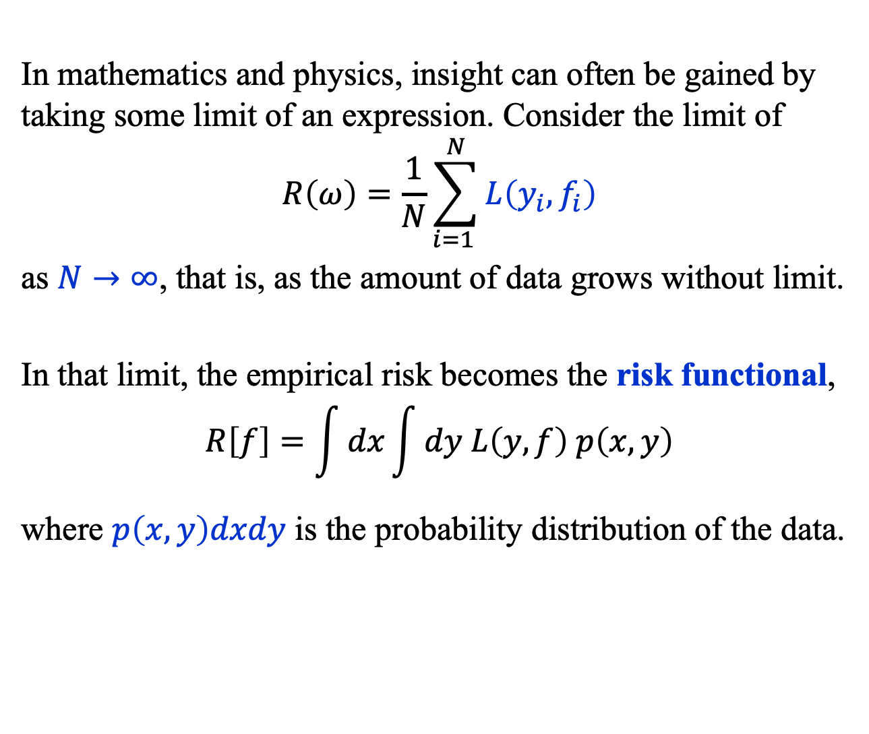
Risk Functional (1)
In mathematics and physics, insight can often be gained by taking some limit of an expression. Consider the limit of
$$R\left(ω\right)=\frac{1}{N}\sum_{i=1 }^{N}{L\left(y_{i}, f_{i}\right)}$$
as $N→∞$, that is, as the amount of data grows without limit.
In that limit, the empirical risk becomes the risk functional,
$$R\left[f\right]=\int{dx}\int{dy L\left(y, f\right) p\left(x, y\right)}$$
where $p\left(x, y\right)dxdy$ is the probability distribution of the data.

Slide 12
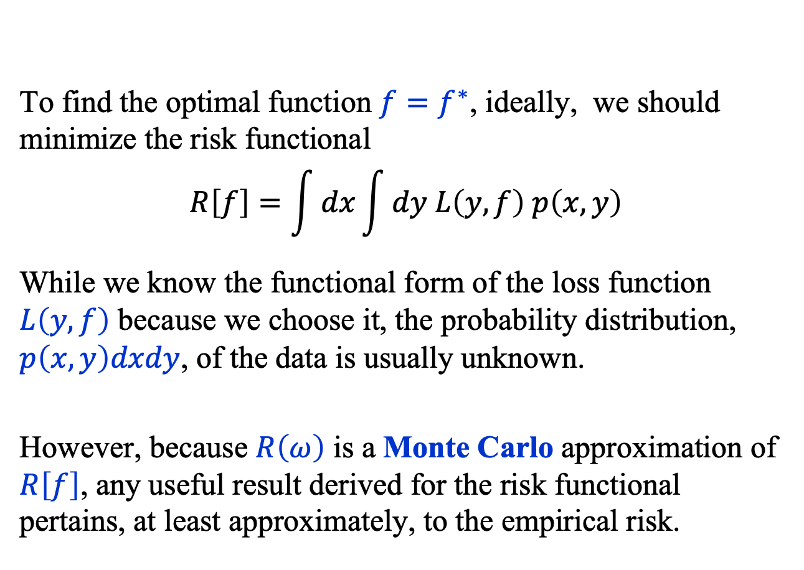
Risk Functional (2)
To find the optimal function ${f=f}^{∗}$, ideally, we should minimize the risk functional
$$R\left[f\right]=\int{dx}\int{dy L\left(y, f\right) p\left(x, y\right)}$$
While we know the functional form of the loss function $L\left(y, f\right)$ because we choose it, the probability distribution, $p\left(x, y\right)dxdy$, of the data is usually unknown.
However, because $R\left(ω\right)$ is a Monte Carlo approximation of $R\left[f\right]$, any useful result derived for the risk functional pertains, at least approximately, to the empirical risk.

Slide 13
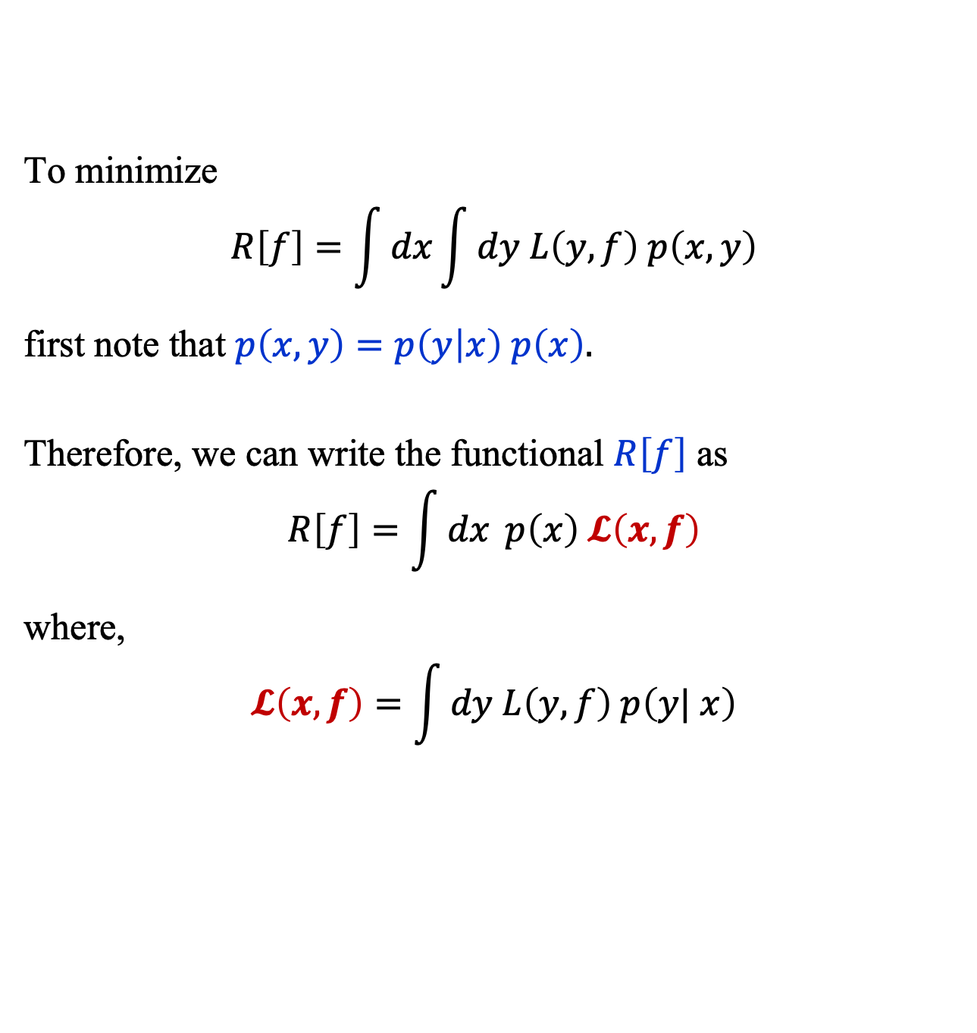
Risk Functional (3)
To minimize
$$R\left[f\right]=\int{dx}\int{dy L\left(y, f\right) p\left(x, y\right)}$$
first note that $p\left(x, y\right)=p\left(y | x\right) p\left(x\right).$
Therefore, we can write the functional $R\left[f\right]$ as
$$R\left[f\right]=\int{dx} p\left(x\right) 𝓛\left(x, f\right)$$
where,
$$𝓛\left(x, f\right)=\int{dy L\left(y, f\right) p\left(y| x\right)}$$

Slide 14
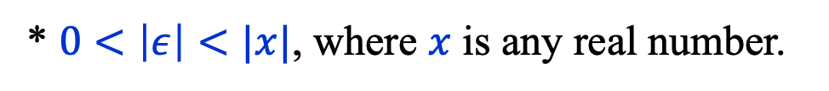
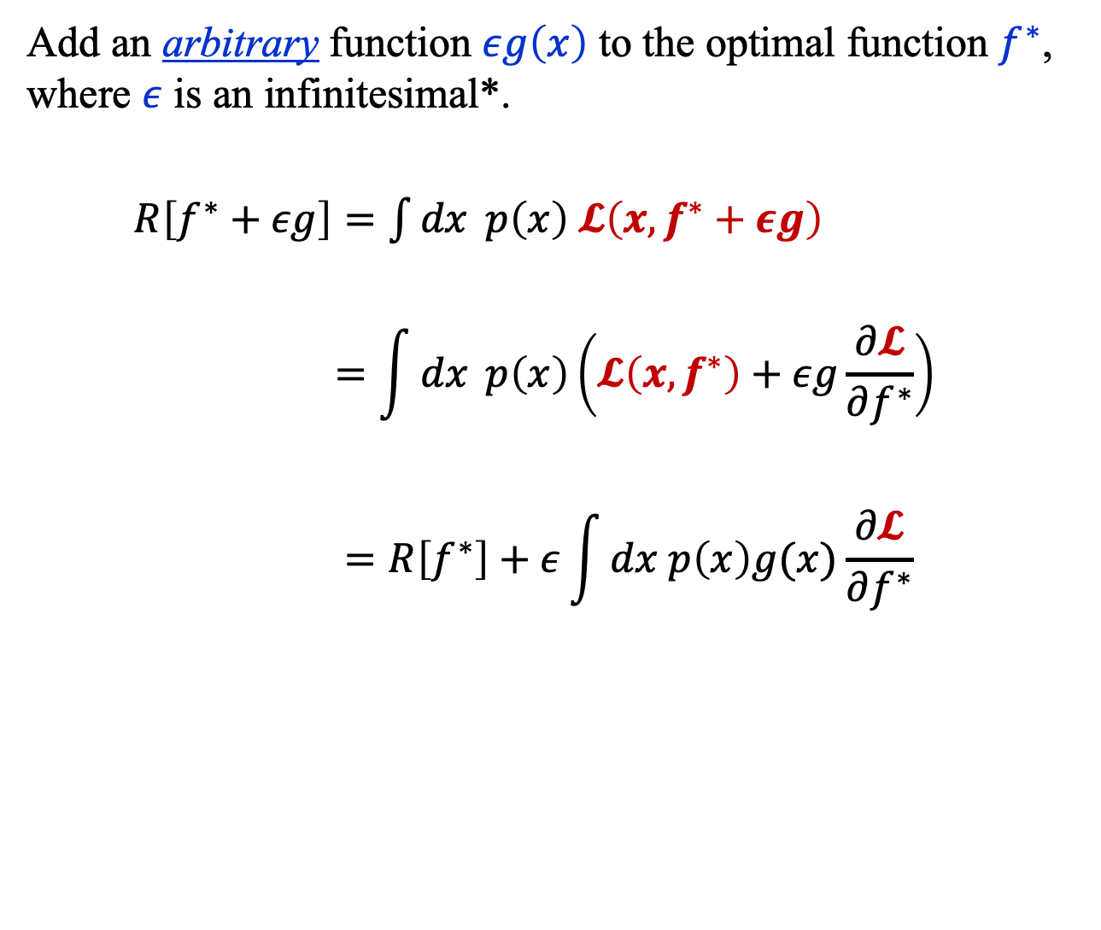
Risk Functional (4)
Add an arbitrary function $εg\left(x\right)$ to the optimal function $f^{∗}$, where $ε$ is an infinitesimal*.
$R\left[f^{∗}+εg\right]=\int{dx} p\left(x\right) 𝓛\left(x, f^{∗}+εg\right)$
$$=\int{dx} p\left(x\right)\left(𝓛\left(x, f^{∗}\right)+εg\frac{∂𝓛}{∂f^{∗}}\right)$$
$$=R\left[f^{∗}\right]+ε\int{dx p\left(x\right)g(x)\frac{∂𝓛}{∂f^{∗}}}$$
* $0<\left|ε\right|<|x|$, where $x$ is any real number.

Slide 15
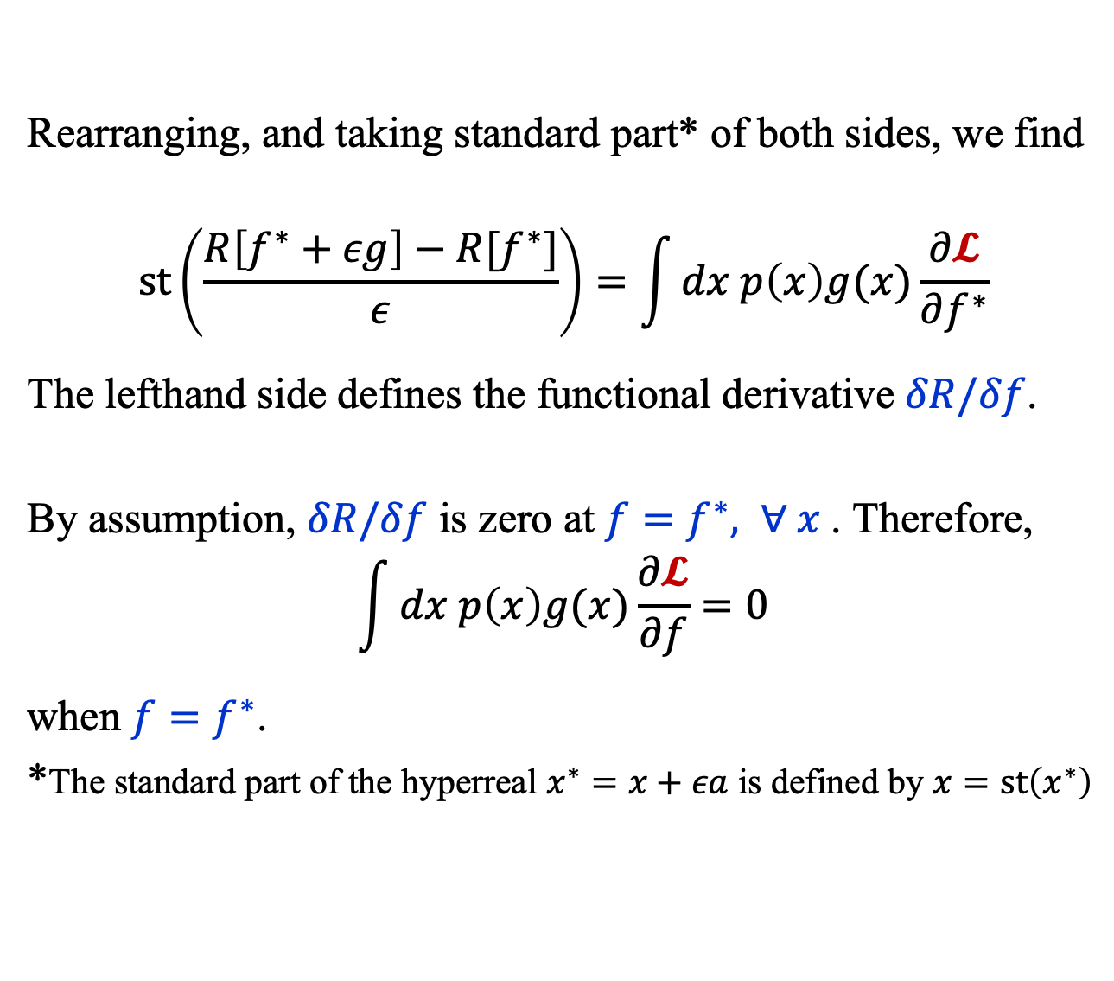
Risk Functional (5)
Rearranging, and taking standard part* of both sides, we find
$$st\left(\frac{R\left[f^{∗}+εg\right]−R[f^{∗}]}{ε}\right)=\int{dx p\left(x\right)g(x)\frac{∂𝓛}{∂f^{∗}}}$$
The lefthand side defines the functional derivative $δR/δf$.
By assumption, $δR/δf$ is zero at $f=f^{∗}, ∀ x$. Therefore,
$$\int{dx p\left(x\right)g(x)\frac{∂𝓛}{∂f}}=0$$
when $f=f^{∗}$.
*The standard part of the hyperreal $x^{∗}=x+εa$ is defined by $x=st\left(x^{∗}\right)$

Slide 16
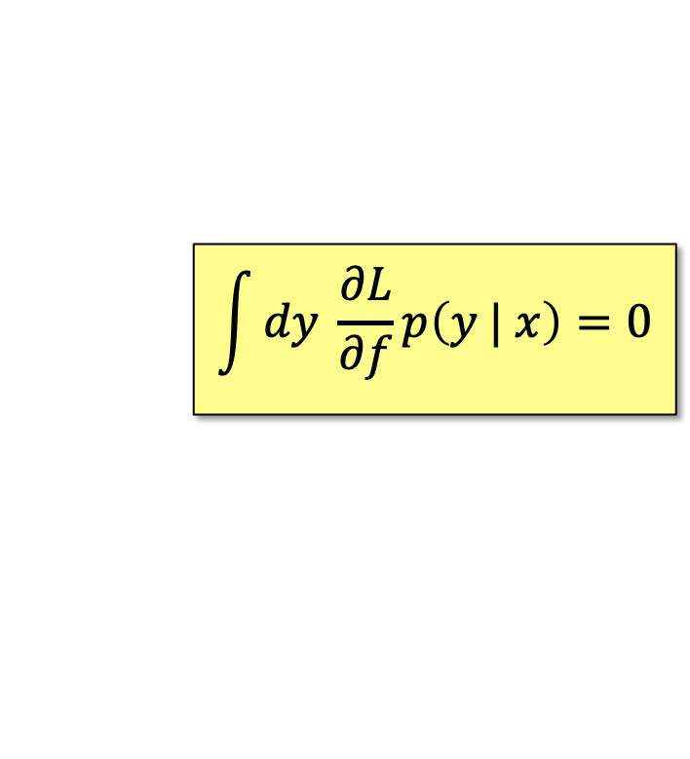
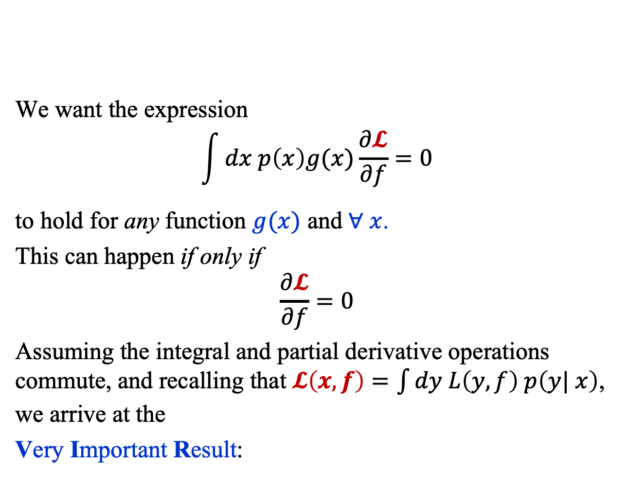
Risk Functional (6)
We want the expression
$$\int{dx p\left(x\right)g(x)\frac{∂𝓛}{∂f}}=0$$
to hold for any function $g(x)$ and $∀ x$.
This can happen if only if
$$\frac{∂𝓛}{∂f}=0$$
Assuming the integral and partial derivative operations commute, and recalling that $𝓛\left(x, f\right)=\int{dy L\left(y, f\right) p\left(y| x\right)}$, we arrive at the
Very Important Result:
$$\int{dy \frac{∂L}{∂f}p\left(y | x\right)=0}$$

Slide 17

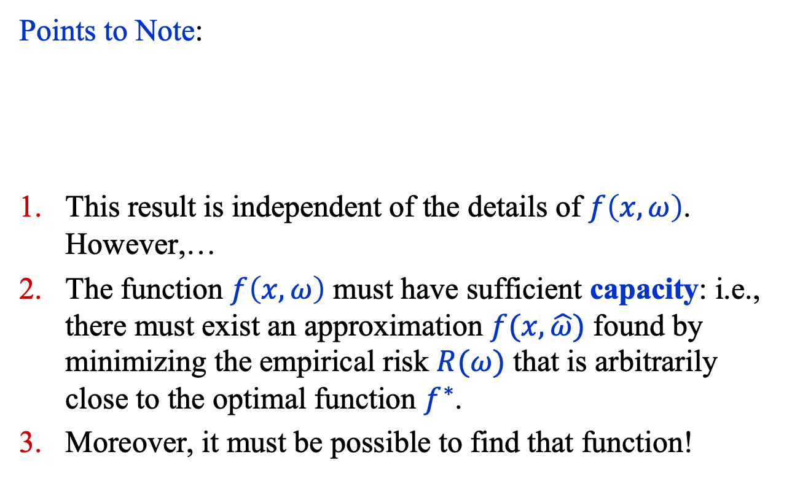
Risk Functional (7)
Points to Note:
This result is independent of the details of $f\left(x,ω\right)$. However,…
The function $f\left(x,ω\right)$ must have sufficient capacity: i.e., there must exist an approximation $f(x,\hat{ω})$ found by minimizing the empirical risk $R(ω)$ that is arbitrarily close to the optimal function $f^{∗}$.
Moreover, it must be possible to find that function!
$$\int{dy \frac{∂L}{∂f}p\left(y | x\right)=0}$$

Slide 18
Empirical RISK Minimization

Slide 19
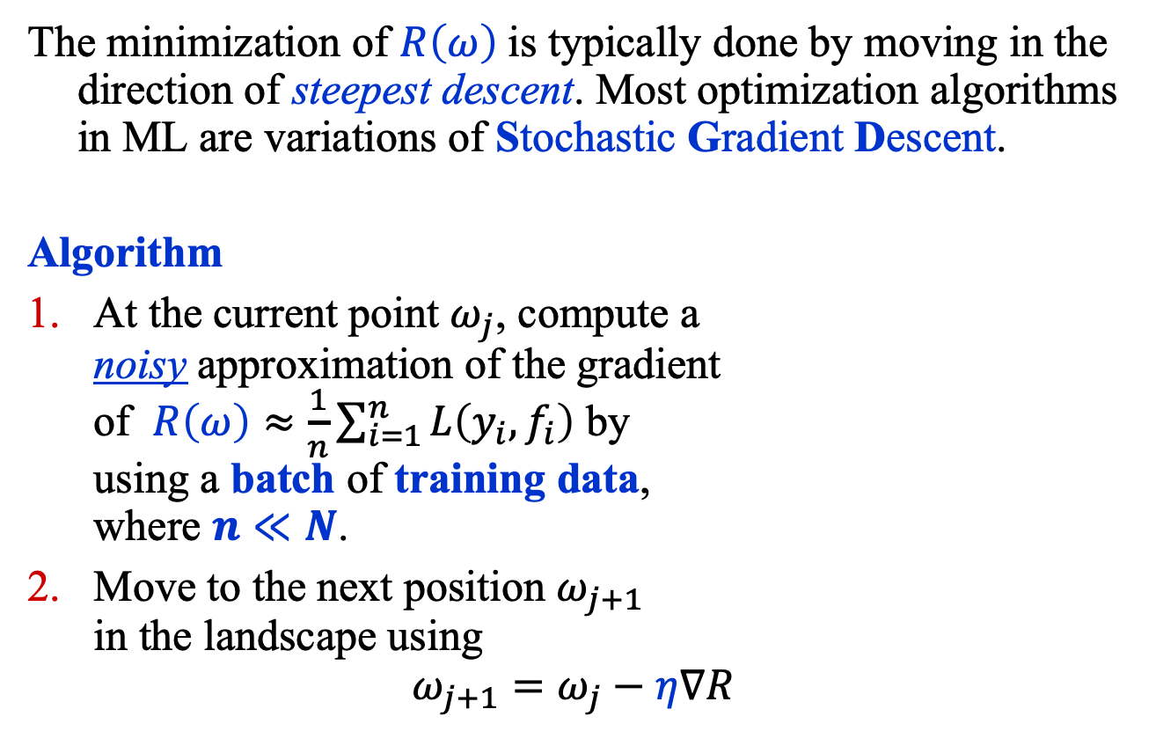
Empirical Risk Minimization (1)
The minimization of $R\left(ω\right)$is typically done by moving in the direction of steepest descent. Most optimization algorithms in ML are variations of Stochastic Gradient Descent.
Algorithm
At the current point $ω_{j}$, compute a noisy approximation of the gradient of $R\left(ω\right)≈\frac{1}{n}\sum_{i=1}^{n}{L\left(y_{i}, f_{i}\right)}$ by using a batch of training data, where $n≪N$.
Move to the next position $ω_{j+1}$ in the landscape using
$$ω_{j+1}=ω_{j}−η∇R$$

Slide 20
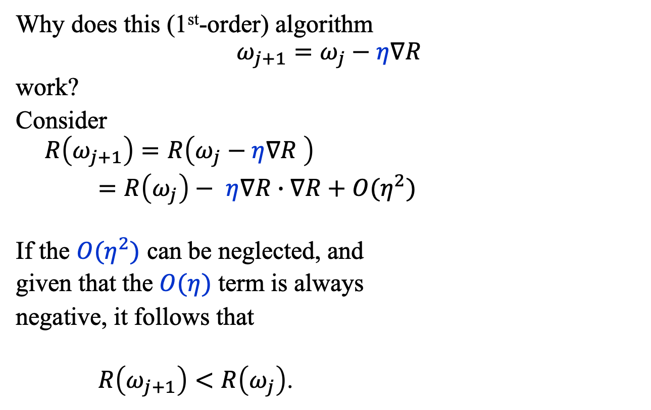
Empirical Risk Minimization (2)
Why does this (1st-order) algorithm
$$ω_{j+1}=ω_{j}−η∇R$$
work?
Consider
$$R\left(ω_{j+1}\right)=R\left(ω_{j}−η∇R \right)$$
$=R\left(ω_{j}\right)− η∇R∙∇R+O(η^{2})$
If the $O(η^{2})$ can be neglected, and
given that the $O(η)$ term is always
negative, it follows that
$R\left(ω_{j+1}\right)<R\left(ω_{j}\right)$.

Slide 21
Common loss functions

Slide 22
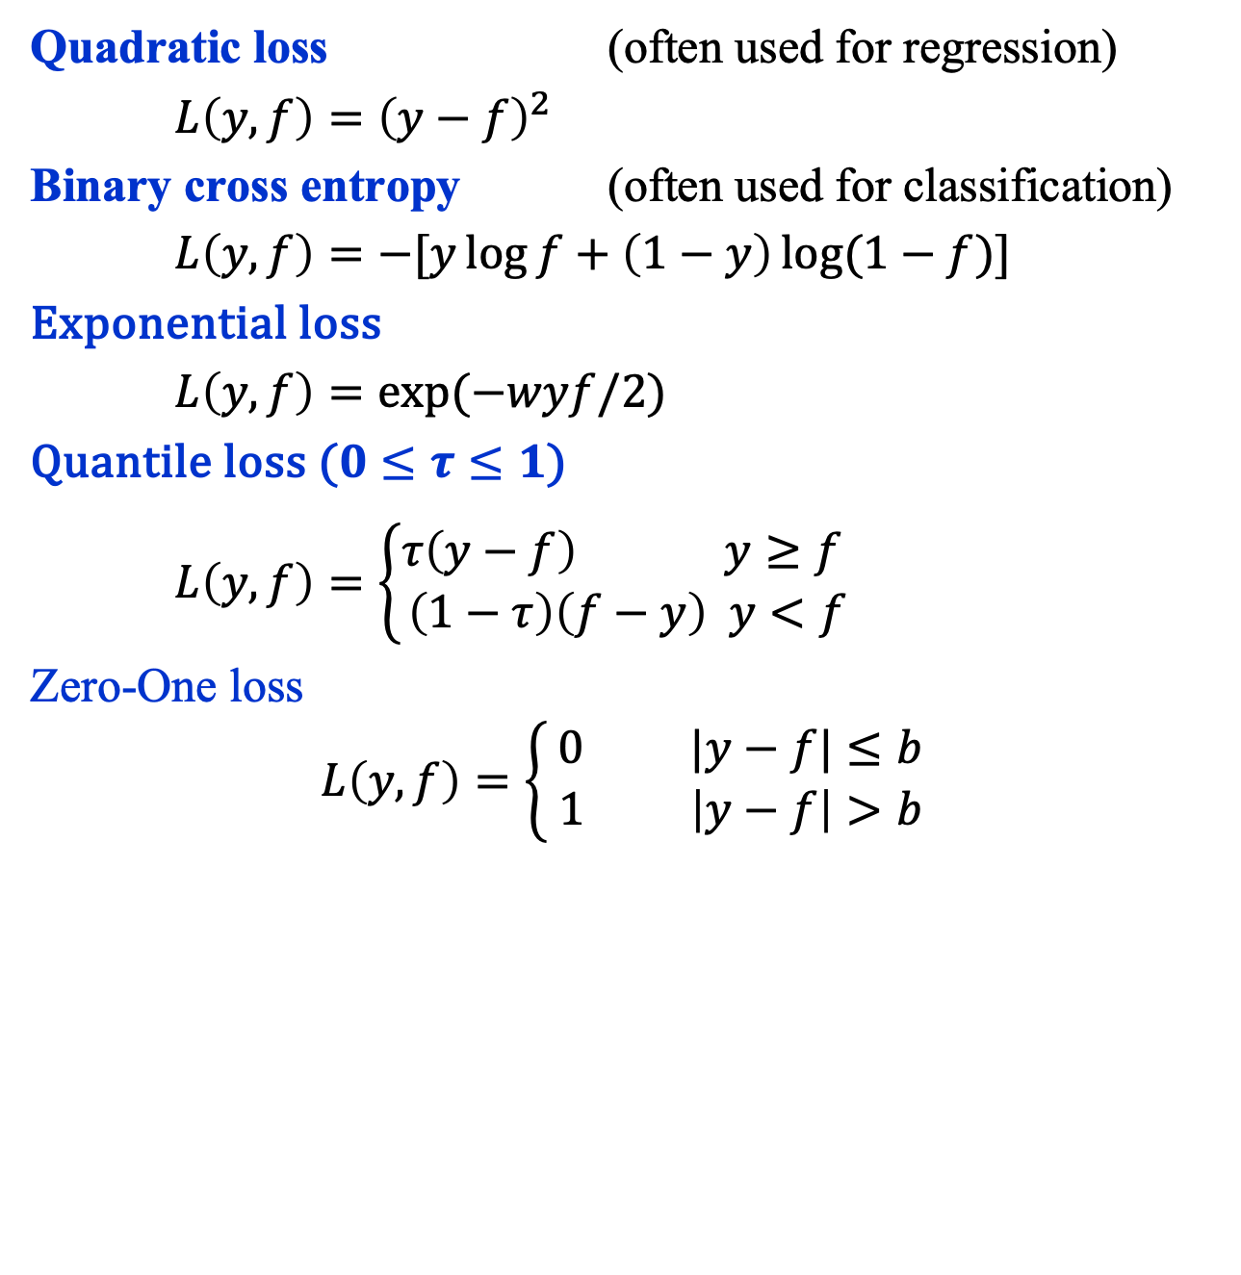
Common Loss Functions (1)
Quadratic loss (often used for regression)
$L\left(y, f\right)={\left(y−f\right)}^{2}$
Binary cross entropy (often used for classification)
$L\left(y, f\right)=−[y\log{f+\left(1−y\right)\log{(1−f)}}]$
Exponential loss
$L\left(y, f\right)=\exp{(−wyf/2)}$
Quantile loss ($0≤τ≤1$)
$L\left(y, f\right)=\left\{\begin{aligned}τ\left(y−f\right) y≥f \\ \left(1−τ\right)\left(f−y\right) y<f\end{aligned}\right.$
Zero-One loss
$$L\left(y, f\right)=\left\{\begin{aligned}0 |y−f|≤b \\ 1 \left|y−f\right|>b \end{aligned}\right.$$

Slide 23
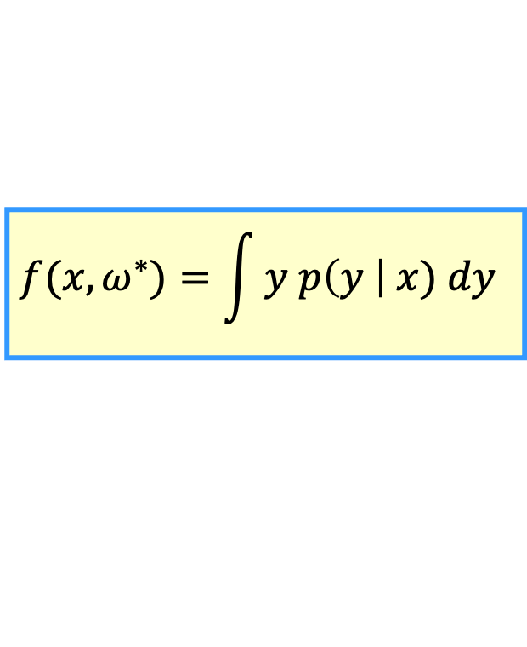
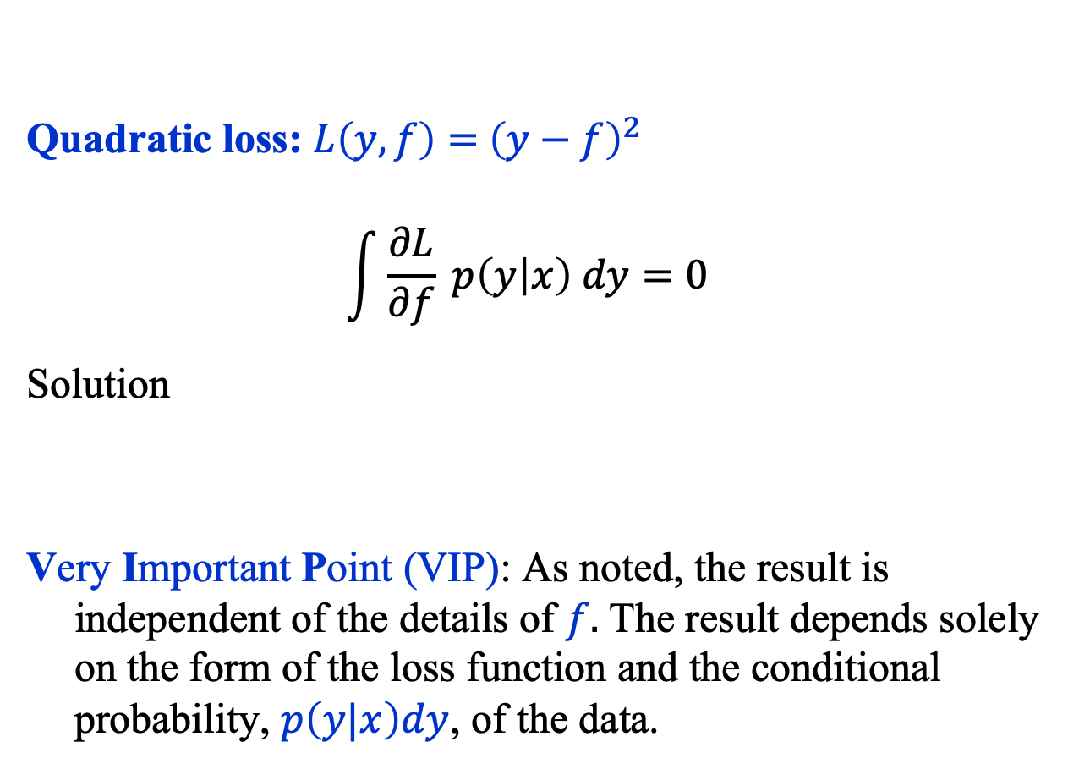
Common Loss Functions (2)
Quadratic loss: $L\left(y, f\right)={ \left(y−f\right)}^{2}$
$$\int{\frac{∂L}{∂f} p\left(y | x\right) dy=0}$$
Solution
Very Important Point (VIP): As noted, the result is independent of the details of $f.$ The result depends solely on the form of the loss function and the conditional probability, $p\left(y|x\right)dy$, of the data.
$$f(x, ω^{∗})=\int{y p\left(y \right| x) dy}$$

Slide 24

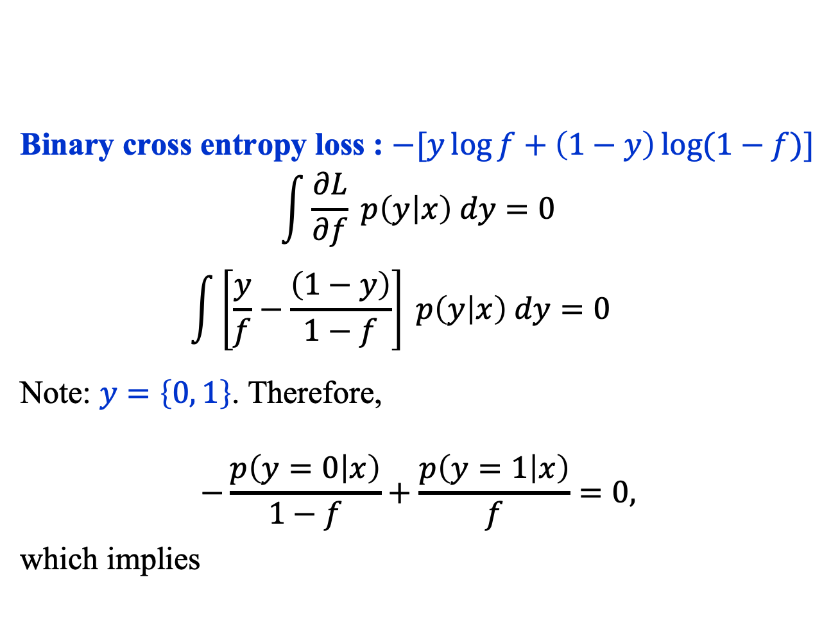
Binary Cross Entropy Loss (1)
Binary cross entropy loss : $−[y\log{f+\left(1−y\right)\log{(1−f)}}]$
$$\int{\frac{∂L}{∂f} p\left(y | x\right) dy=0}$$
$$\int{\left[\frac{y}{f}−\frac{\left(1−y\right)}{1−f}\right] p\left(y | x\right) dy=0}$$
Note: $y=\left\{0, 1\right\}$. Therefore,
$$−\frac{p\left(y=0 | x\right)}{1−f}+\frac{p\left(y=1 | x\right)}{f}=0,$$
which implies
$$f(x, ω^{∗})=p(y=1|x)$$

Slide 25
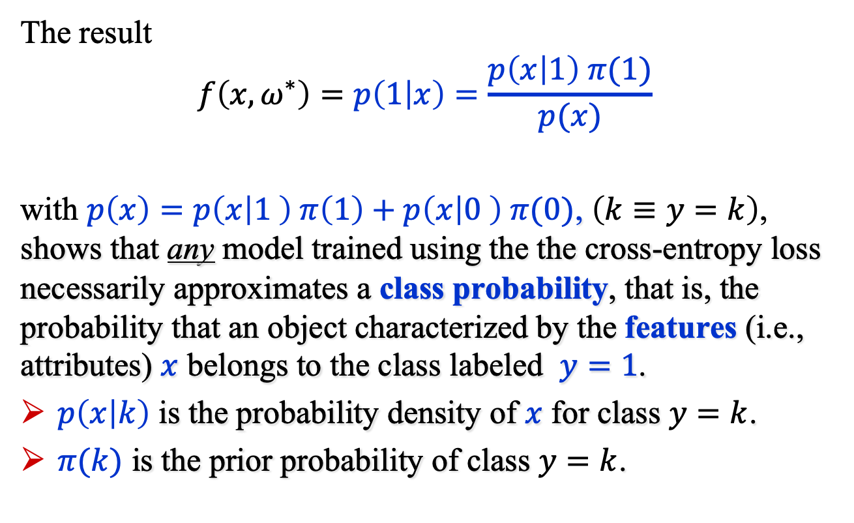
Binary Cross Entropy Loss (2)
The result
$$f\left(x, ω^{∗}\right)=p\left(1 | x\right)=\frac{p\left(x | 1\right) π(1)}{p(x)}$$
with $p\left(x\right)=p\left(x | 1 \right) π\left(1\right)+p\left(x | 0 \right) π(0)$, $\left(k≡y=k\right)$, shows that any model trained using the the cross-entropy loss necessarily approximates a class probability, that is, the probability that an object characterized by the features (i.e., attributes) $x$ belongs to the class labeled $y=1$.
$p\left(x | k\right)$ is the probability density of $x$ for class $y=k$.
$π(k)$ is the prior probability of class $y=k$.

Slide 26
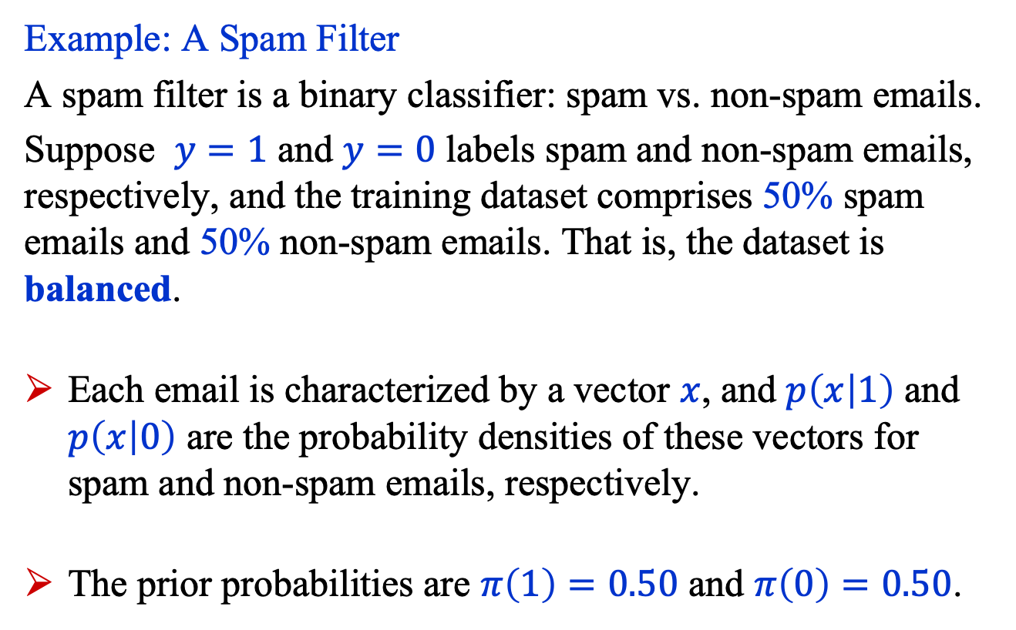
Binary Cross Entropy Loss (3)
Example: A Spam Filter
A spam filter is a binary classifier: spam vs. non-spam emails.
Suppose $y=1$ and $y=0$ labels spam and non-spam emails, respectively, and the training dataset comprises 50% spam emails and 50% non-spam emails. That is, the dataset is balanced.
Each email is characterized by a vector $x$, and $p\left(x | 1\right)$ and $p\left(x | 0\right)$ are the probability densities of these vectors for spam and non-spam emails, respectively.
The prior probabilities are $π\left(1\right)=0.50$ and $π\left(0\right)=0.50$.

Slide 27
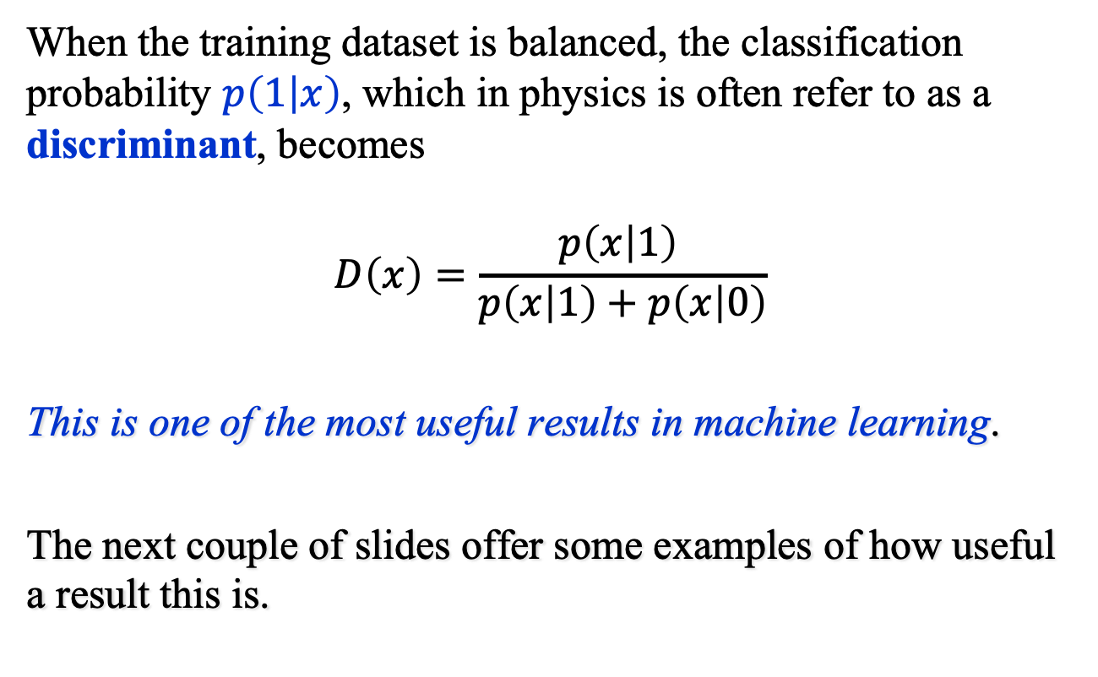
The Discriminant
When the training dataset is balanced, the classification probability $p\left(1 | x\right)$, which in physics is often refer to as a discriminant, becomes
$$D\left(x\right)=\frac{p\left(x | 1\right) }{p\left(x | 1\right)+p\left(x | 0\right)}$$
This is one of the most useful results in machine learning.
The next couple of slides offer some examples of how useful a result this is.

Slide 28
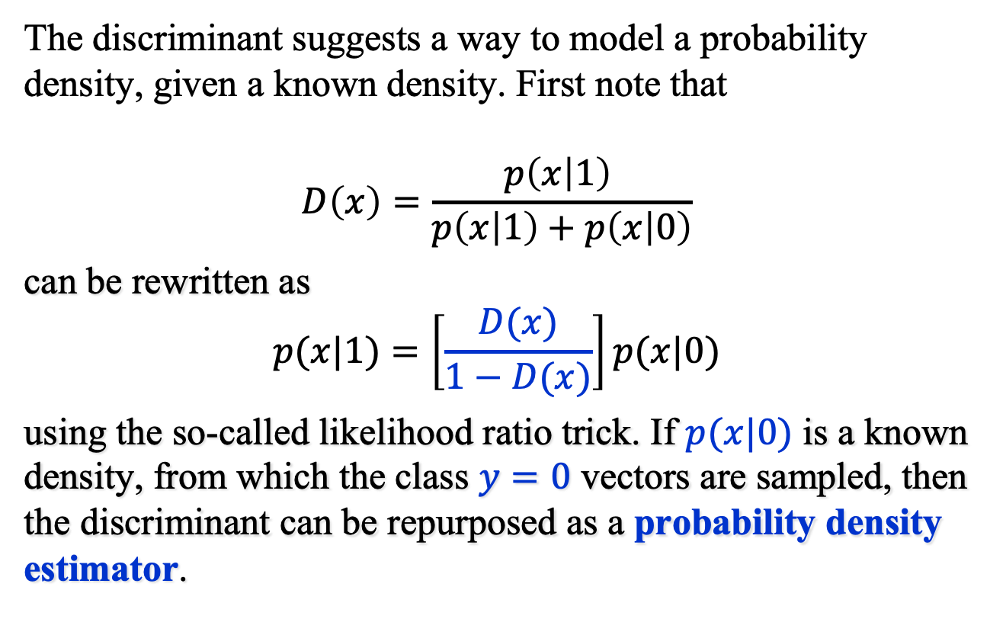
The Discriminant: Uses (1)
The discriminant suggests a way to model a probability density, given a known density. First note that
$$D\left(x\right)=\frac{p\left(x | 1\right) }{p\left(x | 1\right)+p\left(x | 0\right)}$$
can be rewritten as
$$p(x|1)=\left[\frac{D(x)}{1−D(x)}\right]p(x|0)$$
using the so-called likelihood ratio trick. If $p(x|0)$ is a known density, from which the class $y=0$ vectors are sampled, then the discriminant can be repurposed as a probability density estimator.

Slide 29
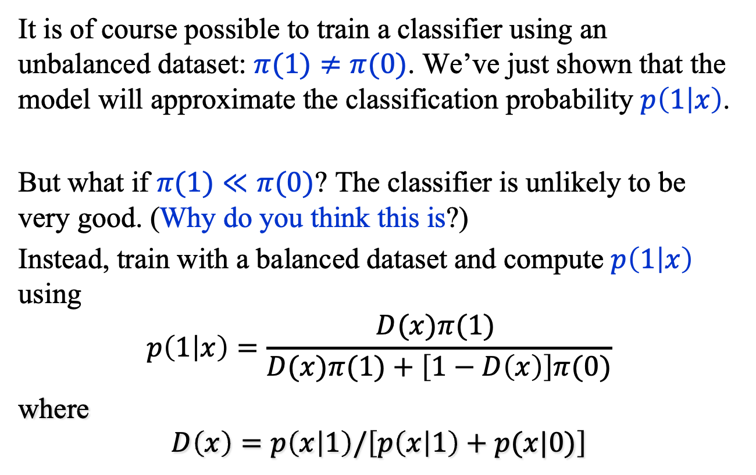
The Discriminant: Uses (2)
It is of course possible to train a classifier using an unbalanced dataset: $π(1)≠π(0)$. We’ve just shown that the model will approximate the classification probability $p\left(1 | x\right)$.
But what if $π(1)≪π(0)$? The classifier is unlikely to be very good. (Why do you think this is?)
Instead, train with a balanced dataset and compute $p\left(1 | x\right)$ using
$$p\left(1 | x\right)=\frac{D(x)π(1) }{D(x)π(1)+\left[1−D\left(x\right)\right]π(0)}$$
where
$$D\left(x\right)=p\left(x | 1\right)/\left[p\left(x | 1\right)+p(x|0)\right]$$

Slide 30
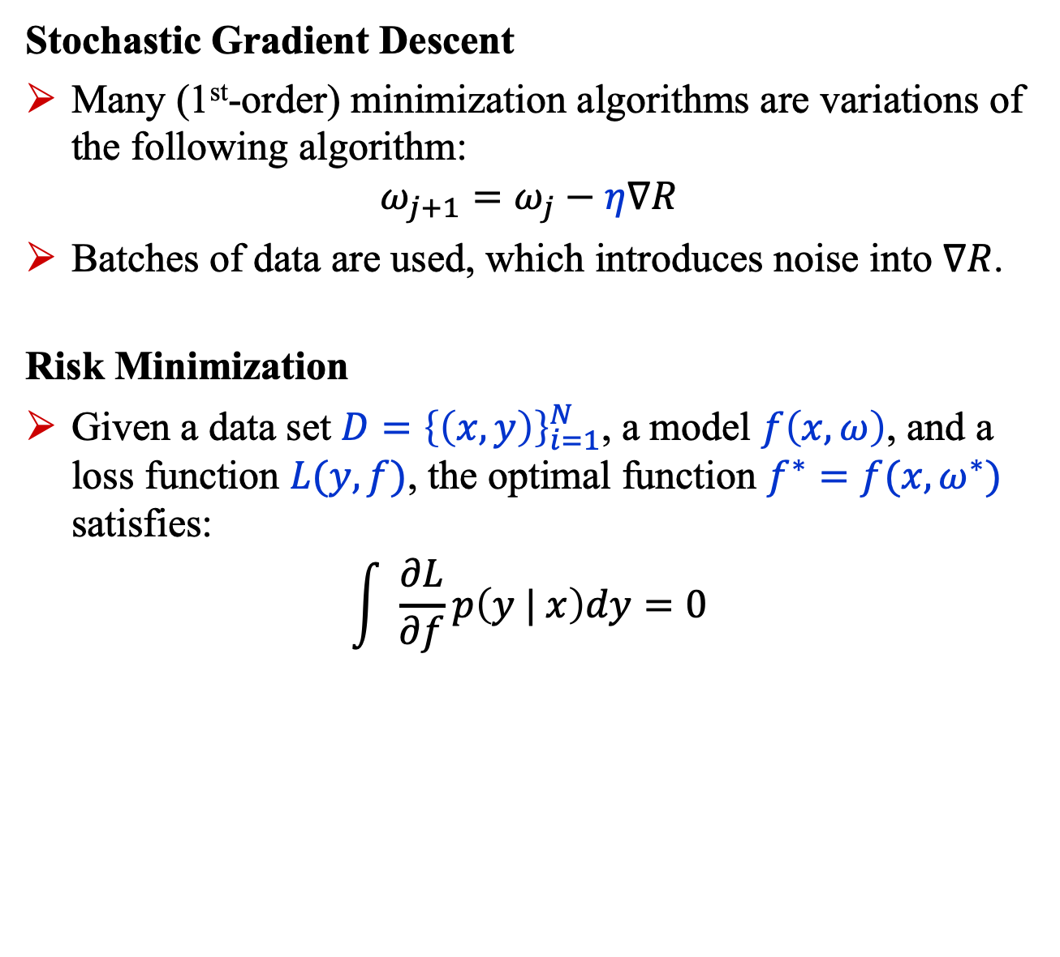
Summary (1)
Stochastic Gradient Descent
Many (1st-order) minimization algorithms are variations of the following algorithm:
$$ω_{j+1}=ω_{j}−η∇R$$
Batches of data are used, which introduces noise into $∇R$.
Risk Minimization
Given a data set $D={\left\{\left(x,y\right)\right\}}_{i=1}^{N}$, a model $f\left(x,ω\right)$, and a loss function $L(y, f)$, the optimal function $f^{∗}=f(x,ω^{∗})$ satisfies:
$$\int{ \frac{∂L}{∂f}p\left(y | x\right)dy=0}$$

Slide 31
Summary (2)
Binary Cross Entropy
Training with the binary cross entropy loss yields a classifier that approximates the class probability.
This fact can be exploited in creative ways. Two examples were given.

