Slide 1
Machine learning in physics convolutional neural networks

Slide 2
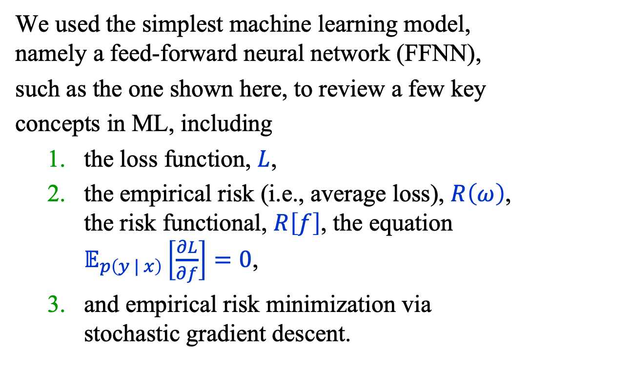



Recap
We used the simplest machine learning model,
namely a feed-forward neural network (FFNN),
such as the one shown here, to review a few key
concepts in ML, including
  the loss function, $L$,
  the empirical risk (i.e., average loss), $R\left(ω\right)$,
  the risk functional, $R\left[f\right]$, the equation
  $𝔼_{p\left(y | x\right)}\left[\frac{∂L}{∂f}\right]=0$,
  and empirical risk minimization via
  stochastic gradient descent.
output
$$σ(z)$$
Linear(H, 1)
$$\text{s}\text{i}\text{lu}()$$
Linear(2, H)
$$x$$

Slide 3
Plan
The plan for the next few lectures is to introduce a few models and methods from the following list:
Convolutional neural networks (CNN)
Physics-informed neural networks (PINN)
Graph neural networks (GNN)
Autoencoders (AE)
Flow and diffusion models
Transformer neural networks (TNN)
LLM-based agentic AI
Bayesian neural networks
Simulation-based inference

Slide 4
Outline
A Galaxy Classifier: Part 1
  Multi-Class Classification
  Convolutional Neural Networks
A Galaxy Classifier: Part 2
Summary
Appendix A, B

Slide 5
A galaxy classifier: part 1

Slide 6
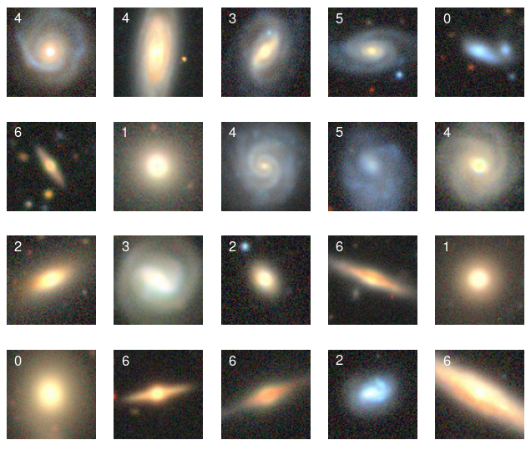
A Galaxy Classifier (1)
Goal: classify galaxies
using images like these.
The images are from the
Galaxy 10 DECals
Dataset at the
astroNN website.
https://astronn.readthedocs.io/en/stable/galaxy10.html

Slide 7
A Galaxy Classifier (2)
Dataset
The dataset comprises 12,600 images divided into 7 galaxy morphology classes with 1800 galaxies per class.
Each 3-channel image is cropped to 96 x 96 pixels.

Slide 8
A Galaxy Classifier (3)
This a multi-class problem, so we need a generalization of binary classification which reduces to the latter when there are 2 classes.

Slide 9
Multi-class classification

Slide 10
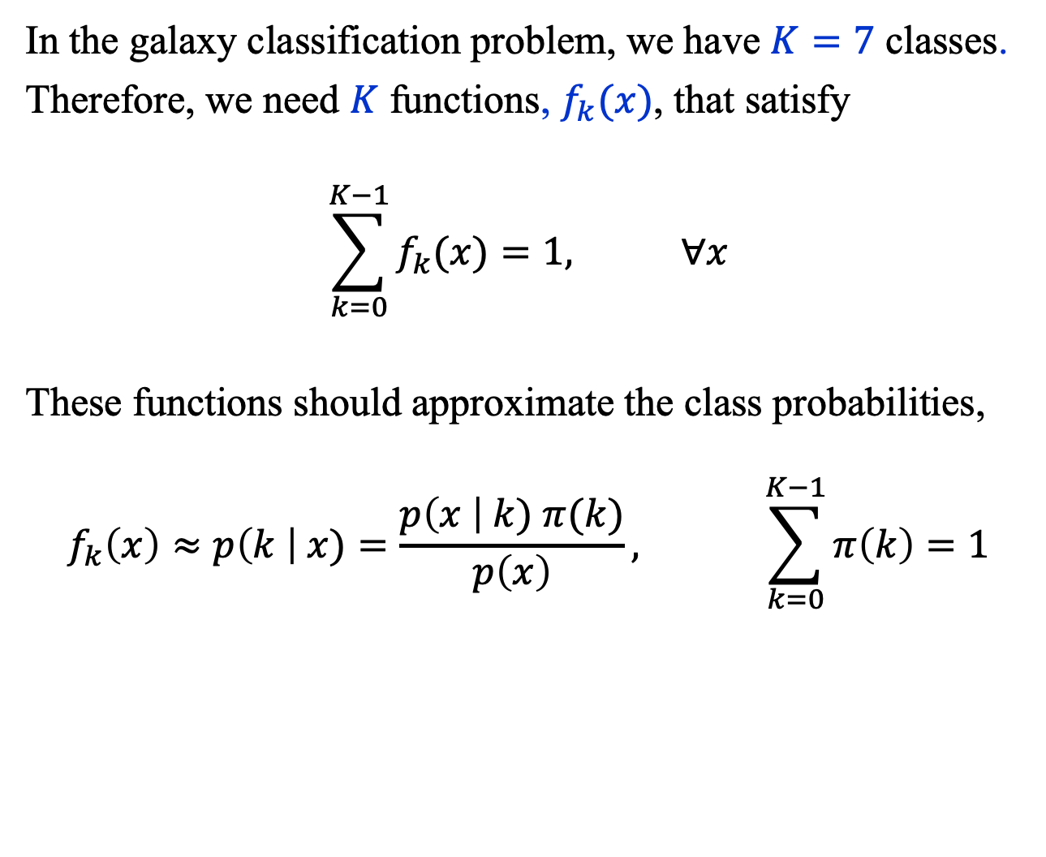
Multi-Class Classification (1)
In the galaxy classification problem, we have $K=7$ classes.
Therefore, we need $K$ functions, $f_{k}(x)$, that satisfy
$$\sum_{k=0}^{K−1}{f_{k}(x)}=1, ∀x$$
These functions should approximate the class probabilities,
$$f_{k}\left(x\right)≈p\left(k \right| x)=\frac{p\left(x \right| k) π(k)}{p\left(x\right)}, \sum_{k=0}^{K−1}{π\left(k\right)=1}$$

Slide 11
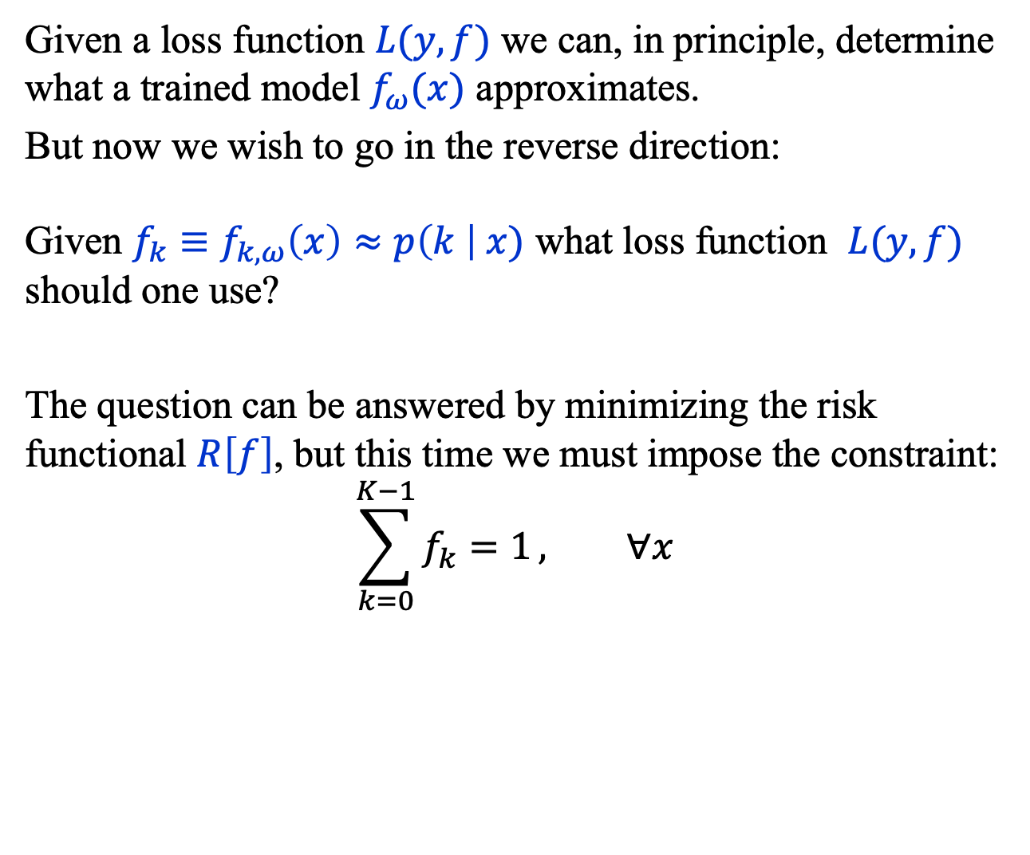
Multi-Class Classification (2)
Given a loss function $L(y, f)$ we can, in principle, determine what a trained model $f_{ω}(x)$ approximates.
But now we wish to go in the reverse direction:
Given ${f_{k}≡f}_{k,ω}\left(x\right)≈p\left(k \right| x)$ what loss function $L(y, f)$ should one use?
The question can be answered by minimizing the risk functional $R\left[f\right]$, but this time we must impose the constraint:
$$\sum_{k=0}^{K−1}{f_{k}=1}, ∀x$$

Slide 12
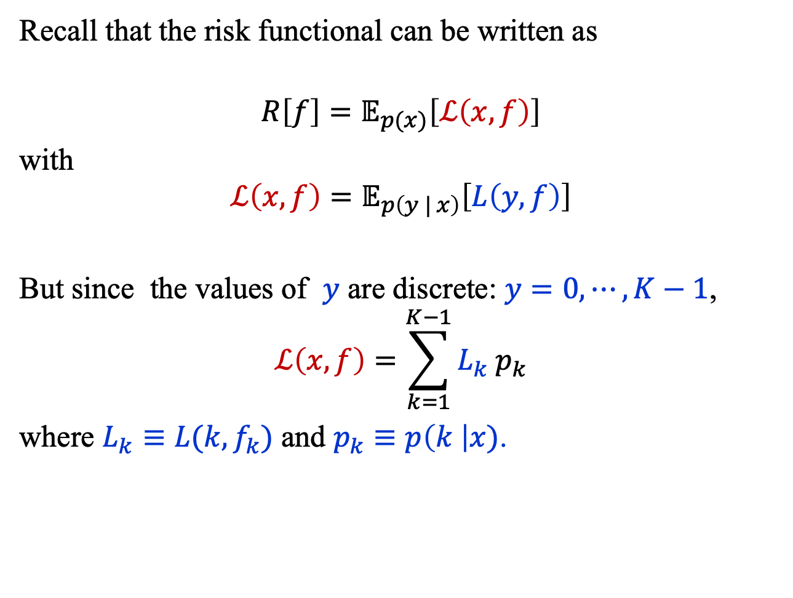
Multi-Class Classification (3)
Recall that the risk functional can be written as
$$R\left[f\right]=𝔼_{p(x)}\left[ℒ\left(x,f\right)\right]$$
with
$$ℒ\left(x,f\right)=𝔼_{p\left(y | x\right)}\left[L\left(y, f\right)\right]$$
But since the values of $y$ are discrete: $y=0,⋯, K−1$,
$$ℒ\left(x,f\right)=\sum_{k=1}^{K−1}{L_{k} p_{k}}$$
where $L_{k}≡L(k, f_{k})$ and $p_{k}≡p\left(k \right|x)$.

Slide 13
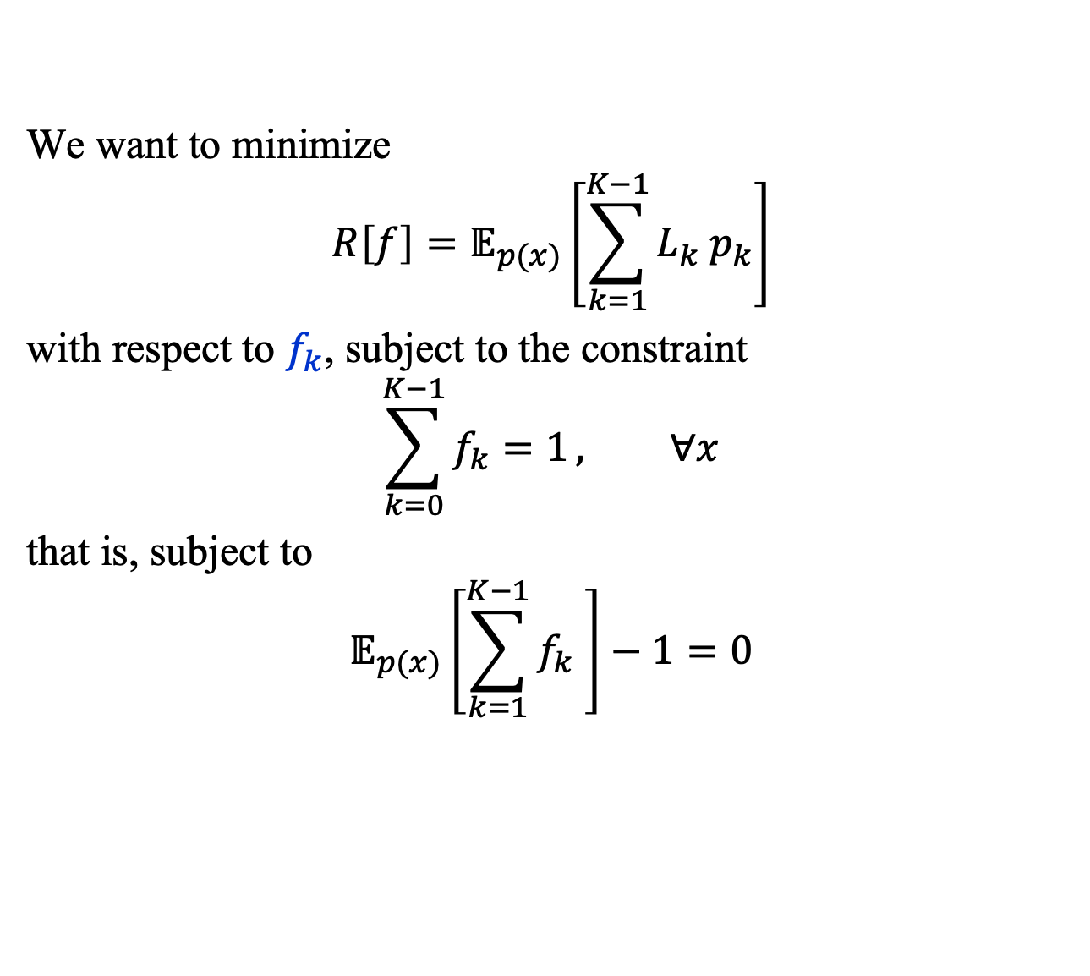
Multi-Class Classification (4)
We want to minimize
$$R\left[f\right]=𝔼_{p(x)}\left[\sum_{k=1}^{K−1}{L_{k} p_{k}}\right]$$
with respect to $f_{k}$, subject to the constraint
$$\sum_{k=0}^{K−1}{f_{k}=1}, ∀x$$
that is, subject to
$$𝔼_{p(x)}\left[\sum_{k=1}^{K−1}{f_{k} }\right]−1=0$$

Slide 14
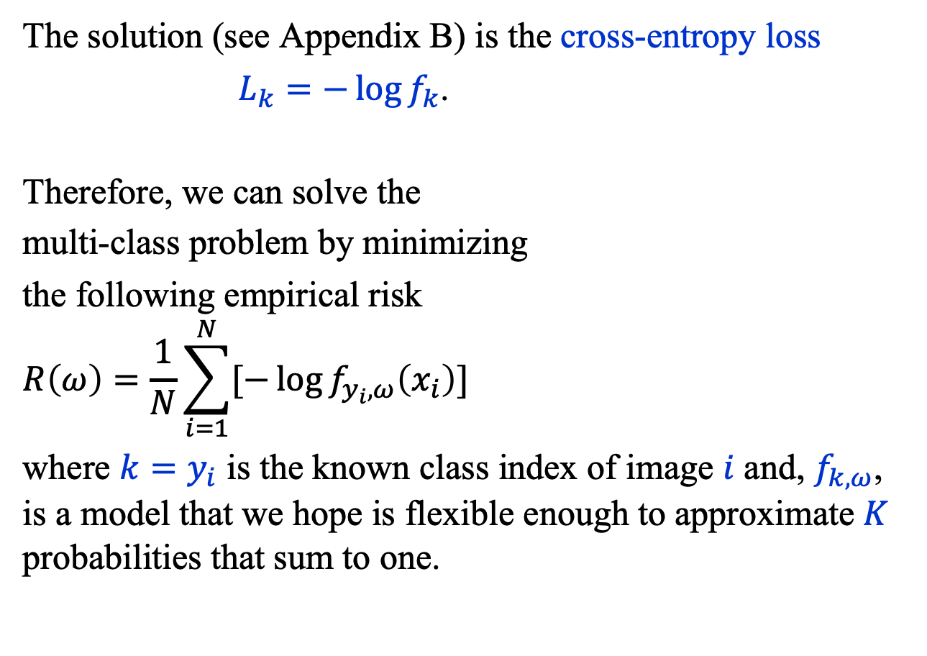
Multi-Class Classification (5)
The solution (see Appendix B) is the cross-entropy loss
$L_{k}=−\log{f_{k}}$.
Therefore, we can solve the
multi-class problem by minimizing
the following empirical risk
$$R\left(ω\right)=\frac{1}{N}\sum_{i=1}^{N}{[−\log{f_{y_{i},ω}\left(x_{i}\right)}}]$$
where ${k=y}_{i}$ is the known class index of image $i$ and, $f_{k,ω}$, is a model that we hope is flexible enough to approximate $K$ probabilities that sum to one.

Slide 15
Convolutional neural networks (CNN)

Slide 16

Convolutional Neural Networks (1)
Convolutional neural networks (CNN) are functions that extract features from 1, 2 or 3D data, and then process them with another neural network.
The insight that underpins CNNs is that many data sets, for example images, have similar patterns in different parts of the data sets.
Harrison Prosper, Dinan, France, 2025

Slide 17
Convolutional Neural Networks (2)
A standard CNN comprises three types of processing layers:
Convolution
The data, e.g., an image, is convolved with one or more filters.
Down-sampling
After applying a nonlinear map to the convolved data, the latter are down-sampled.
Classification
A feed-forward neural network classifies the convolved data.

Slide 18
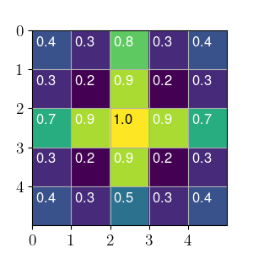
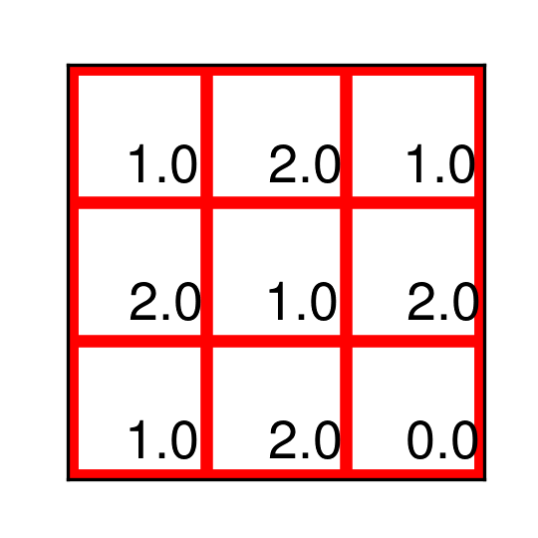
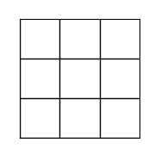
Convolutional Neural Networks (3)
Convolution
(3, 3)-filter (3, 3, 1)-image
(5, 5, 1)-image

Slide 19
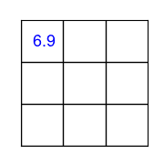
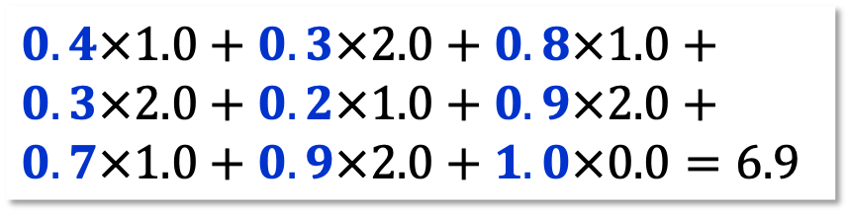
Convolutional Neural Networks (4)
Convolution
(3, 3)-filter (3, 3, 1)-image
convolved
stride = 1
(5, 5, 1)-image
$$0.4×1.0+0.3×2.0+0.8×1.0+$$
$$0.3×2.0+0.2×1.0+0.9×2.0+$$
$$0.7×1.0+0.9×2.0+1.0×0.0=6.9$$

Slide 20
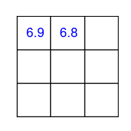
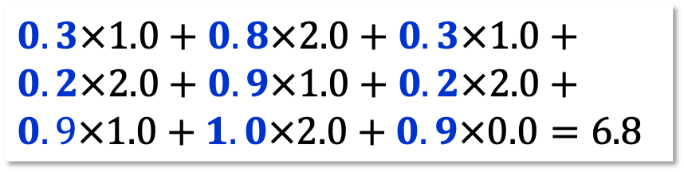
Convolutional Neural Networks (5)
Convolution
(3, 3)-filter (3, 3, 1)-image
convolved
(5, 5, 1)-image
$$0.3×1.0+0.8×2.0+0.3×1.0+$$
$$0.2×2.0+0.9×1.0+0.2×2.0+$$
$$0.9×1.0+1.0×2.0+0.9×0.0=6.8$$

Slide 21
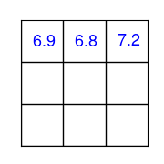
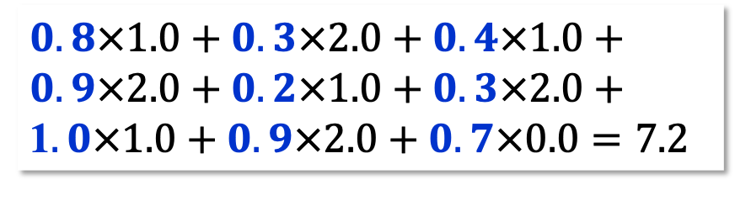
Convolutional Neural Networks (6)
Convolution
(3, 3)-filter (3, 3, 1)-image
(convolved)
(5, 5, 1)-image
$$0.8×1.0+0.3×2.0+0.4×1.0+$$
$$0.9×2.0+0.2×1.0+0.3×2.0+$$
1$.0×1.0+0.9×2.0+0.7×0.0=7.2$

Slide 22
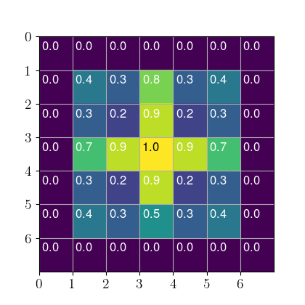
Convolutional Neural Networks (7)
Padding
Wrapping the image with a 1–pixel border makes it possible, with a (3, 3)-filter, to maintain the image size.

Slide 23
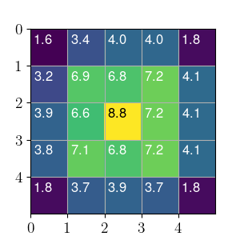
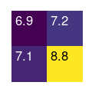
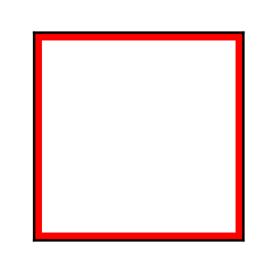
Convolutional Neural Networks (8)
Down-sampling
Stride = 2
(2, 2, 1)-image
(down-sampled)
(5, 5, 1)-image (convolved)
MaxPool2d Return the largest value within window.
AvgPool2d Return the average value within window.

Slide 24
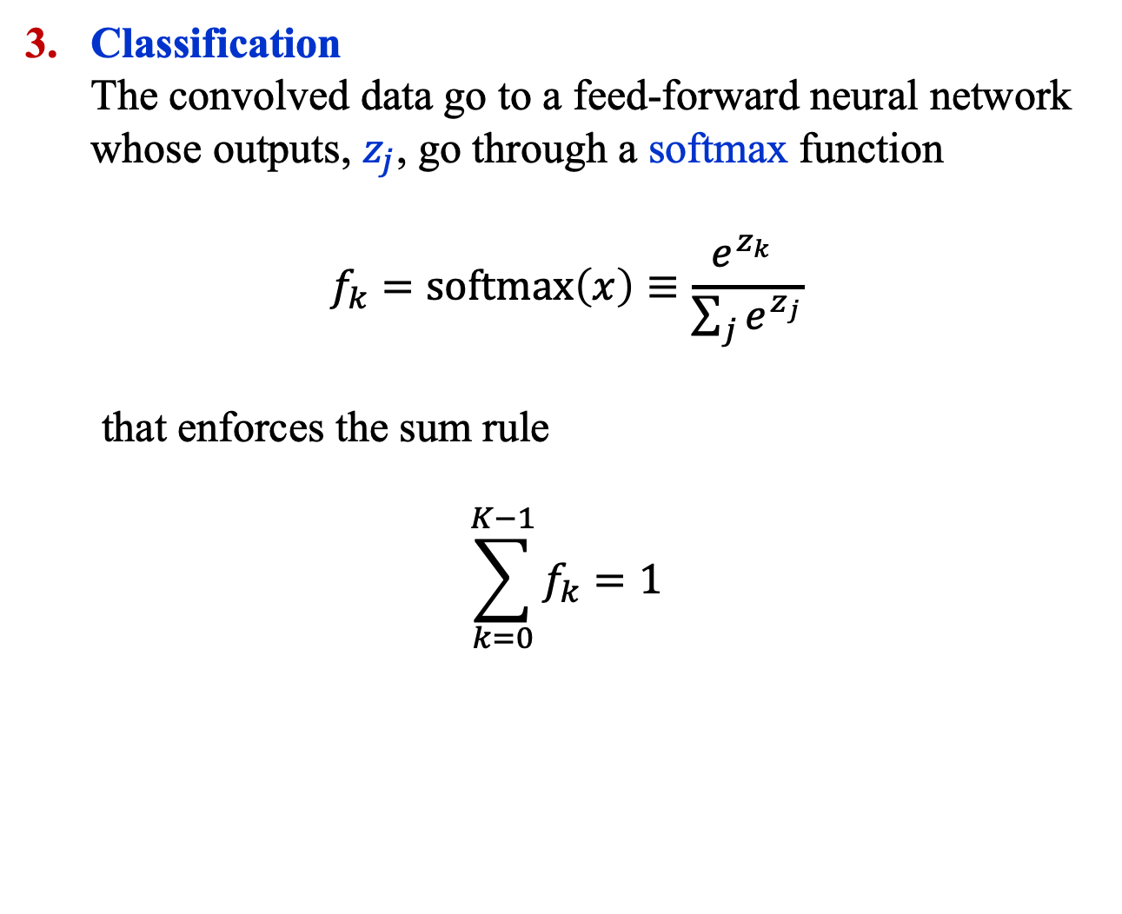
Convolutional Neural Networks (9)
Classification
The convolved data go to a feed-forward neural network whose outputs, $z_{j}$, go through a softmax function
$$f_{k}=\text{softmax}\left(x\right)≡\frac{e^{z_{k}} }{\sum_{j}{e^{z_{j}}}}$$
that enforces the sum rule
$$\sum_{k=0}^{K−1}{f_{k}=1}$$

Slide 25
A galaxy classifier: part 2

Slide 26
A Galaxy Classifier (4)
softmax()
maxpool( relu( conv2d(x) ) )
Linear(252, 7)
Flatten()
(7, 6, 6)
(6, 12, 12)
(5, 24, 24)
(4, 48, 48)
(3, 96, 96)

Slide 27
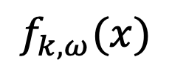

A Galaxy Classifier (5)
$$f_{k,ω}(x)$$
Softmax
Here is a more standard representation of
the proposed classifier.
Linear(252,7)
Flatten()
MaxPool2d(2,2)
MaxPool2d(2,2)
ReLU()
ReLU()
Conv2d(6,7,3,1,1)
Conv2d(4,5,3,1,1)
MaxPool2d(2,2)
MaxPool2d(2,2)
ReLU()
ReLU()
Conv2d(5,6,3,1,1)
Conv2d(3,4,3,1,1)
$$x$$

Slide 28
Summary
Convolutional neural networks have revolutionized image classification and interpretation and are now used in many applications.
The model exploits the fact that natural images are often locally approximately translation invariant.
The convolutions automatically extract features from images that can later be used to interpret them.

Slide 29
Appendix A

Slide 30
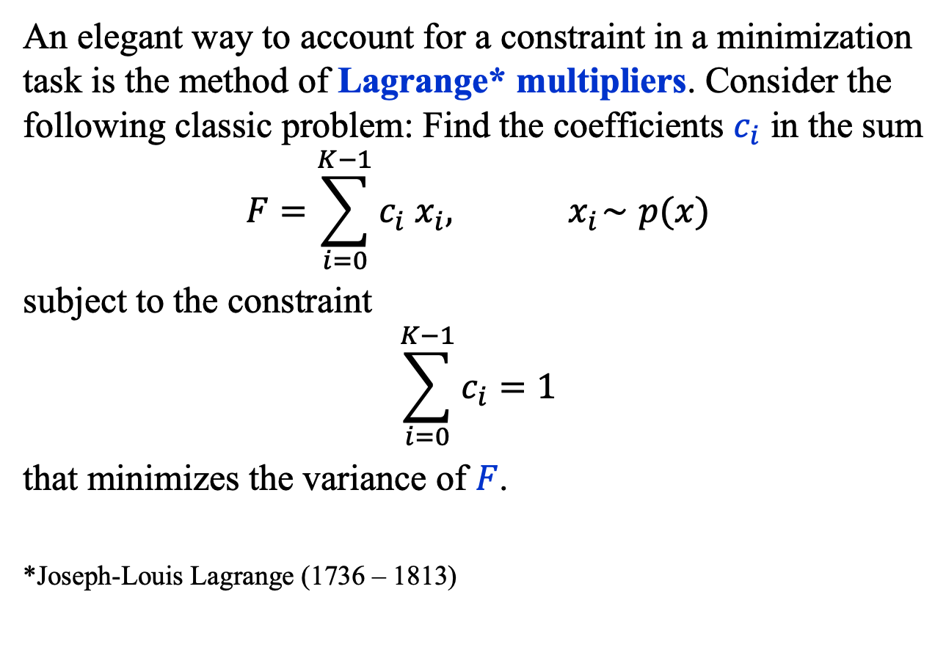
Method of Lagrange Multipliers (1)
An elegant way to account for a constraint in a minimization task is the method of Lagrange* multipliers. Consider the following classic problem: Find the coefficients $c_{i}$ in the sum
$$F=\sum_{i=0}^{K−1}{c_{i} x_{i}, { x}_{i}∼p(x)}$$
subject to the constraint
$$\sum_{i=0}^{K−1}{c_{i}=1}$$
that minimizes the variance of $F$.
*Joseph-Louis Lagrange (1736 – 1813)

Slide 31
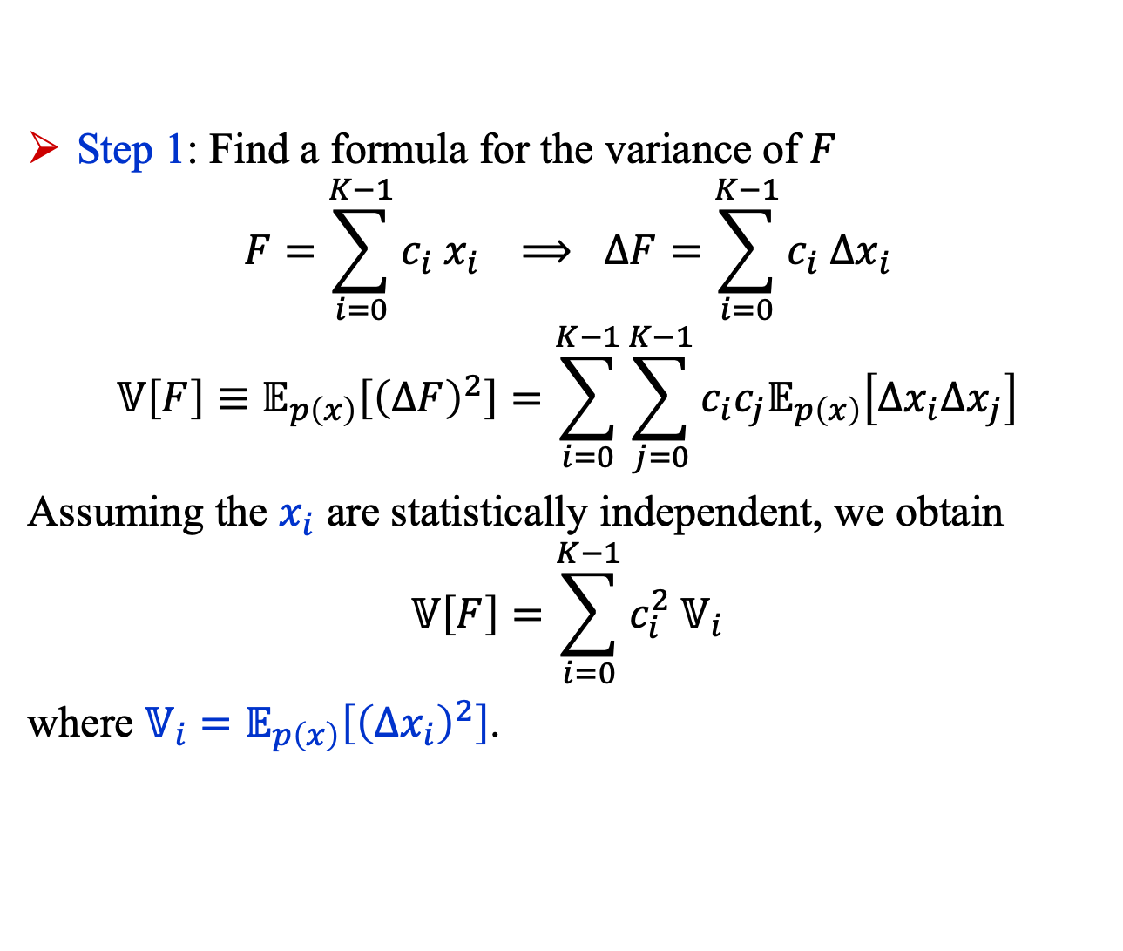
Method of Lagrange Multipliers (2)
Step 1: Find a formula for the variance of $F$
$$F=\sum_{i=0}^{K−1}{c_{i} x_{i}} ⟹ ΔF=\sum_{i=0}^{K−1}{c_{i} Δx_{i}}$$
$$𝕍\left[F\right]≡𝔼_{p\left(x\right)}\left[{\left(ΔF\right)}^{2}\right]=\sum_{i=0}^{K−1}{\sum_{j=0}^{K−1}{c_{i}c_{j}𝔼_{p\left(x\right)}\left[Δx_{i}Δx_{j}\right]}}$$
Assuming the $x_{i}$ are statistically independent, we obtain
$$𝕍\left[F\right]=\sum_{i=0}^{K−1}{c_{i}^{2} 𝕍_{i}}$$
where $𝕍_{i}=𝔼_{p\left(x\right)}\left[{\left(Δx_{i}\right)}^{2}\right]$.

Slide 32
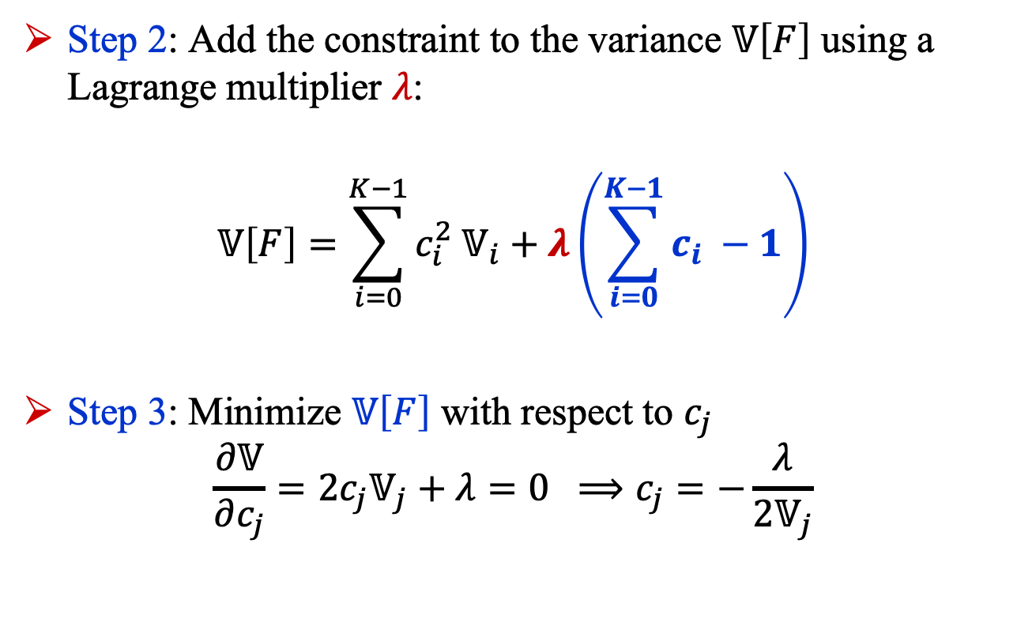
Method of Lagrange Multipliers (3)
Step 2: Add the constraint to the variance $𝕍\left[F\right]$ using a Lagrange multiplier $λ$:
$$𝕍\left[F\right]=\sum_{i=0}^{K−1}{c_{i}^{2} 𝕍_{i}}+λ\left(\sum_{i=0}^{K−1}{c_{i} }−1\right)$$
Step 3: Minimize $𝕍\left[F\right]$ with respect to $c_{j}$
$$\frac{∂𝕍}{∂c_{j}}=2c_{j}𝕍_{j}+λ=0 ⟹c_{j}=−\frac{λ}{2𝕍_{j}}$$

Slide 33
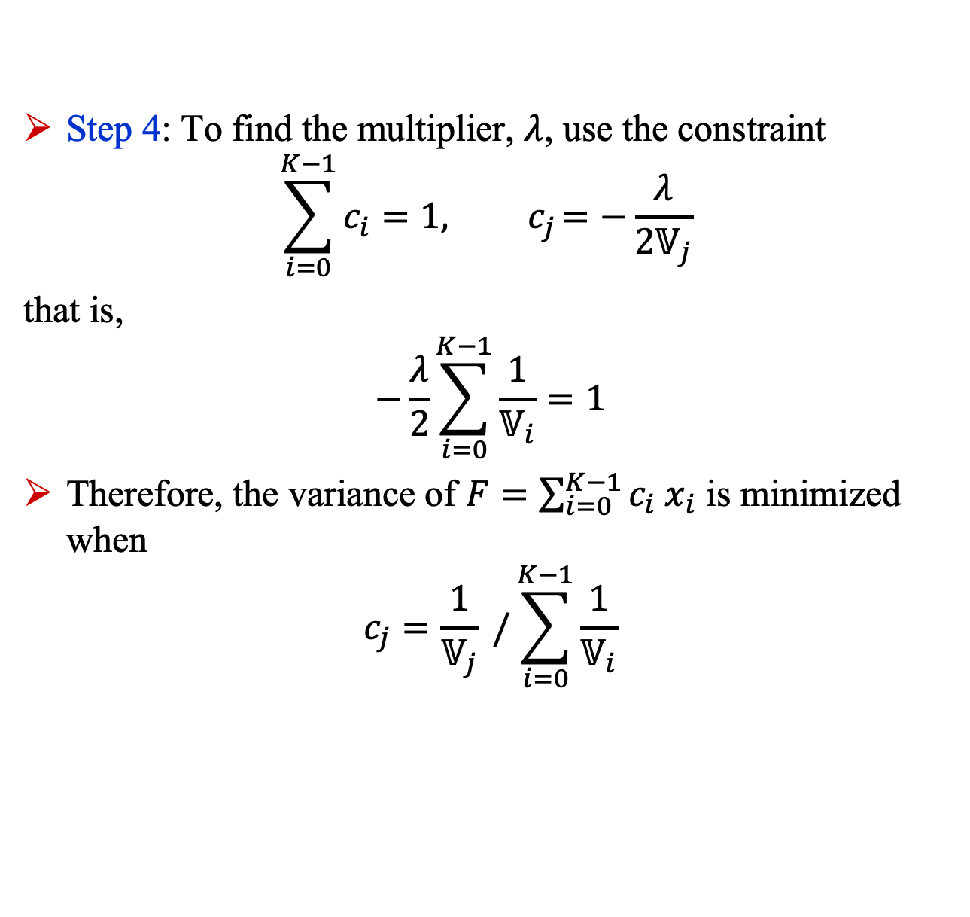
Method of Lagrange Multipliers (4)
Step 4: To find the multiplier, $λ$, use the constraint
$$\sum_{i=0}^{K−1}{c_{i}=1,}{ c}_{j}=−\frac{λ}{2𝕍_{j}}$$
that is,
$$−\frac{λ}{2}\sum_{i=0}^{K−1}{\frac{1}{𝕍_{i}}=1}$$
Therefore, the variance of $F=\sum_{i=0}^{K−1}{c_{i} x_{i}}$ is minimized when
$$c_{j}=\frac{1}{𝕍_{j}} /\sum_{i=0}^{K−1}{\frac{1}{𝕍_{i}}}$$

Slide 34
Appendix B

Slide 35
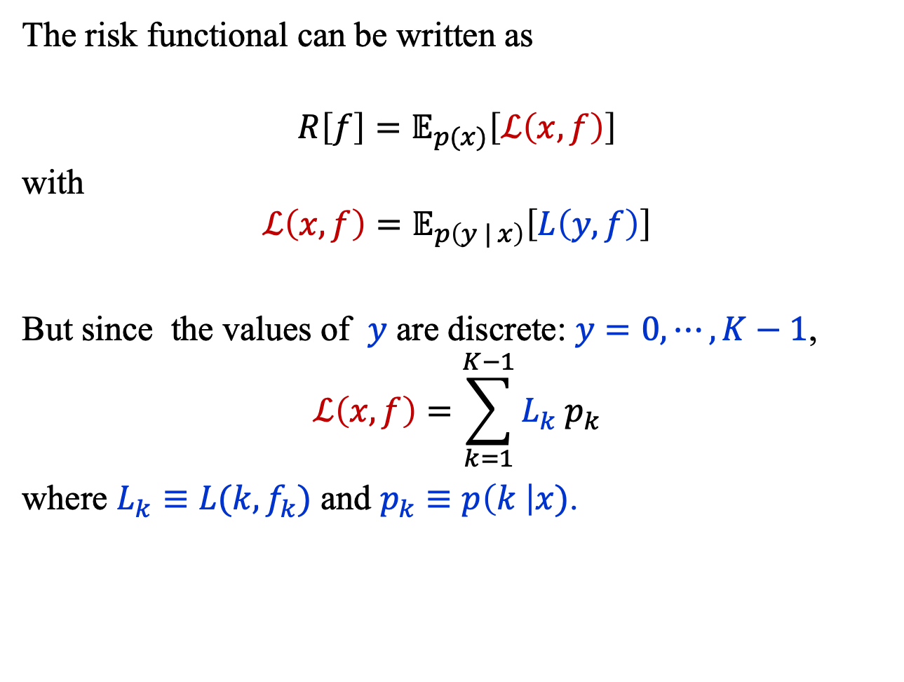
Cross Entropy Loss (1)
The risk functional can be written as
$$R\left[f\right]=𝔼_{p(x)}\left[ℒ\left(x,f\right)\right]$$
with
$$ℒ\left(x,f\right)=𝔼_{p\left(y | x\right)}\left[L\left(y, f\right)\right]$$
But since the values of $y$ are discrete: $y=0,⋯, K−1$,
$$ℒ\left(x,f\right)=\sum_{k=1}^{K−1}{L_{k} p_{k}}$$
where $L_{k}≡L(k, f_{k})$ and $p_{k}≡p\left(k \right|x)$.

Slide 36
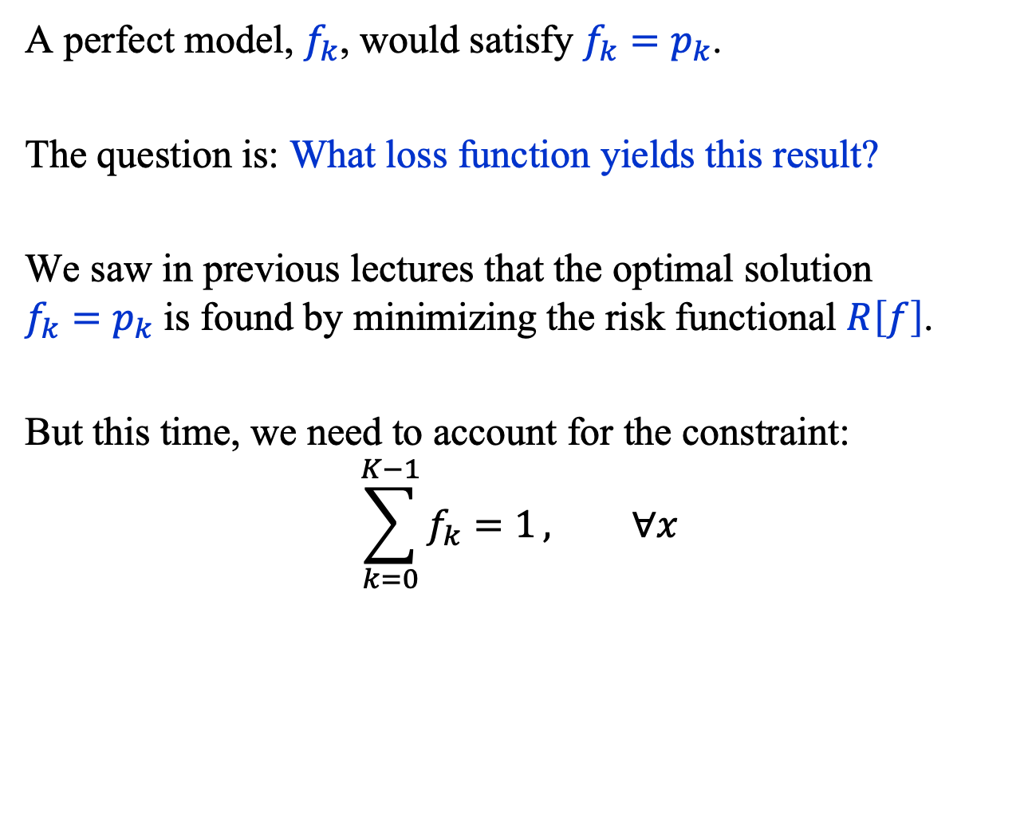
Cross Entropy Loss (2)
A perfect model, $f_{k}$, would satisfy $f_{k}=p_{k}$.
The question is: What loss function yields this result?
We saw in previous lectures that the optimal solution
$f_{k}=p_{k}$ is found by minimizing the risk functional $R\left[f\right]$.
But this time, we need to account for the constraint:
$$\sum_{k=0}^{K−1}{f_{k}=1}, ∀x$$

Slide 37
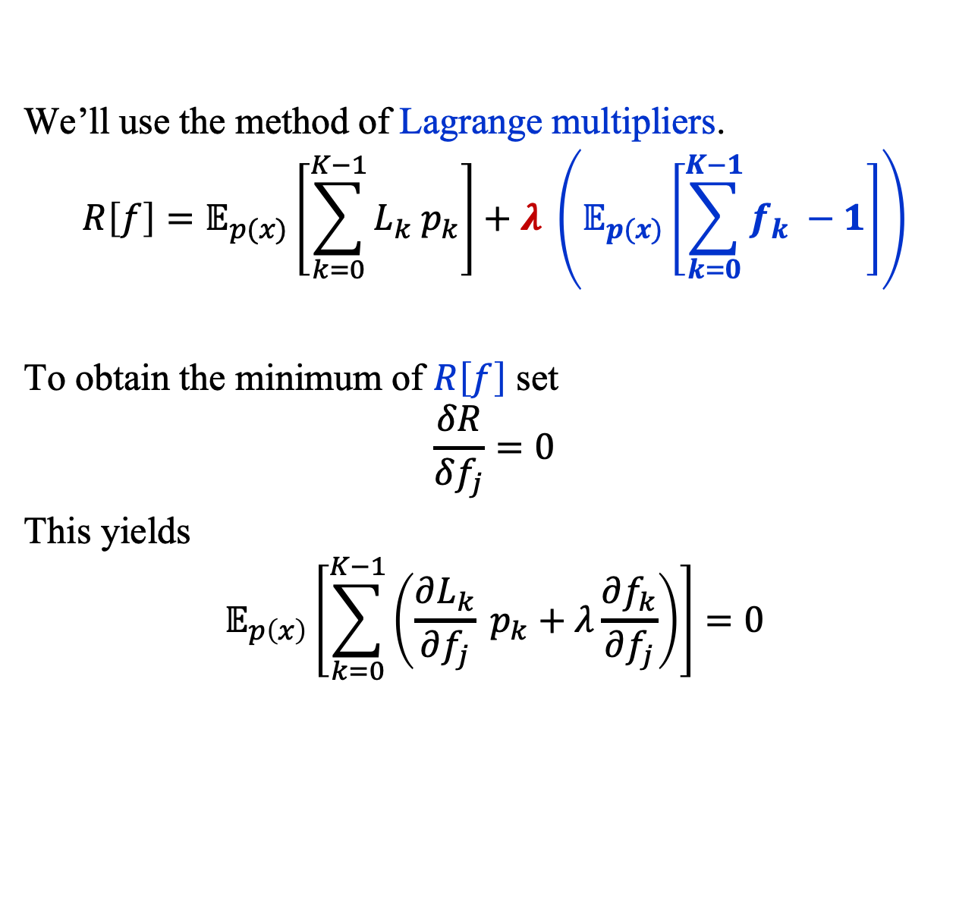
Cross Entropy Loss (3)
We’ll use the method of Lagrange multipliers.
$$R\left[f\right]=𝔼_{p(x)}\left[\sum_{k=0}^{K−1}{L_{k} p_{k}}\right]+λ \left(𝔼_{p(x)}\left[\sum_{k=0}^{K−1}{f_{k} −1}\right]\right)$$
To obtain the minimum of $R\left[f\right]$ set
$$\frac{δR}{δf_{j}}=0$$
This yields
$$𝔼_{p\left(x\right)}\left[\sum_{k=0}^{K−1}{\left(\frac{∂L_{k}}{∂f_{j}} p_{k}+λ\frac{∂f_{k}}{∂f_{j}}\right)}\right]=0$$

Slide 38
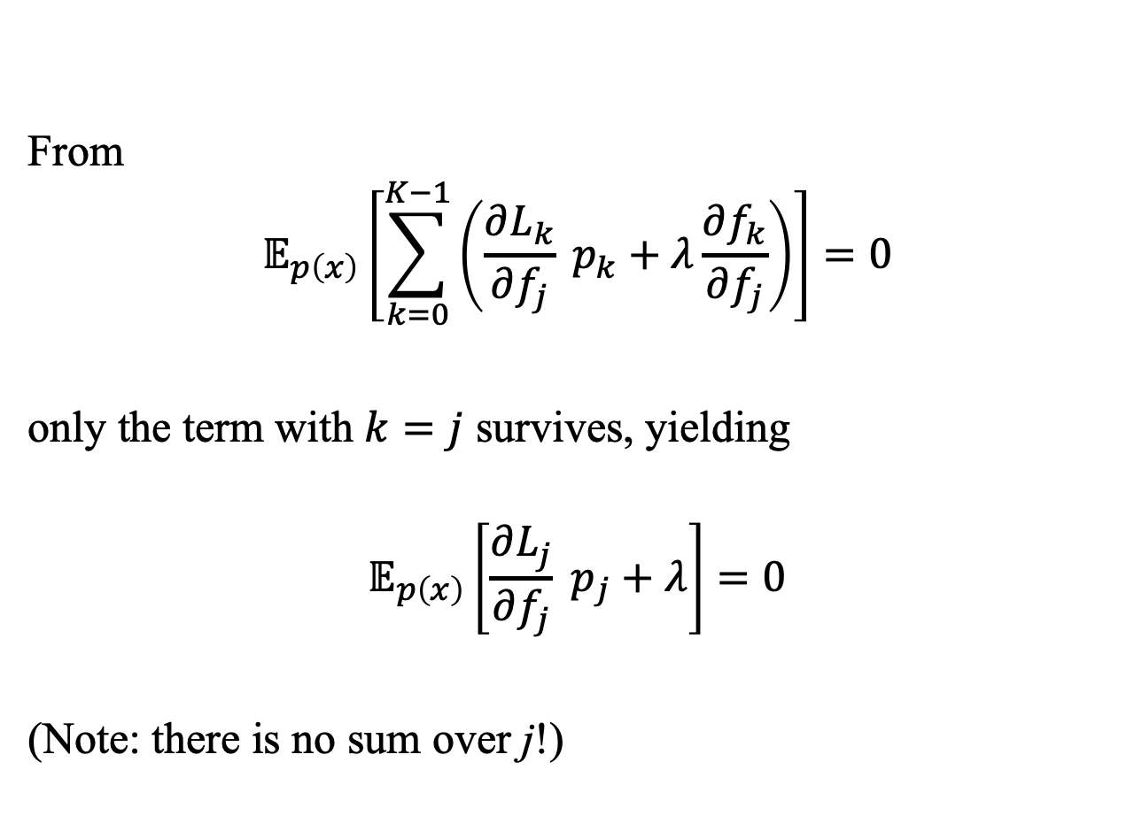
Cross Entropy Loss (4)
From
$$𝔼_{p\left(x\right)}\left[\sum_{k=0}^{K−1}{\left(\frac{∂L_{k}}{∂f_{j}} p_{k}+λ\frac{∂f_{k}}{∂f_{j}}\right)}\right]=0$$
only the term with $k=j$ survives, yielding
$$𝔼_{p\left(x\right)}\left[\frac{∂L_{j}}{∂f_{j}} p_{j}+λ\right]=0$$
(Note: there is no sum over j!)

Slide 39
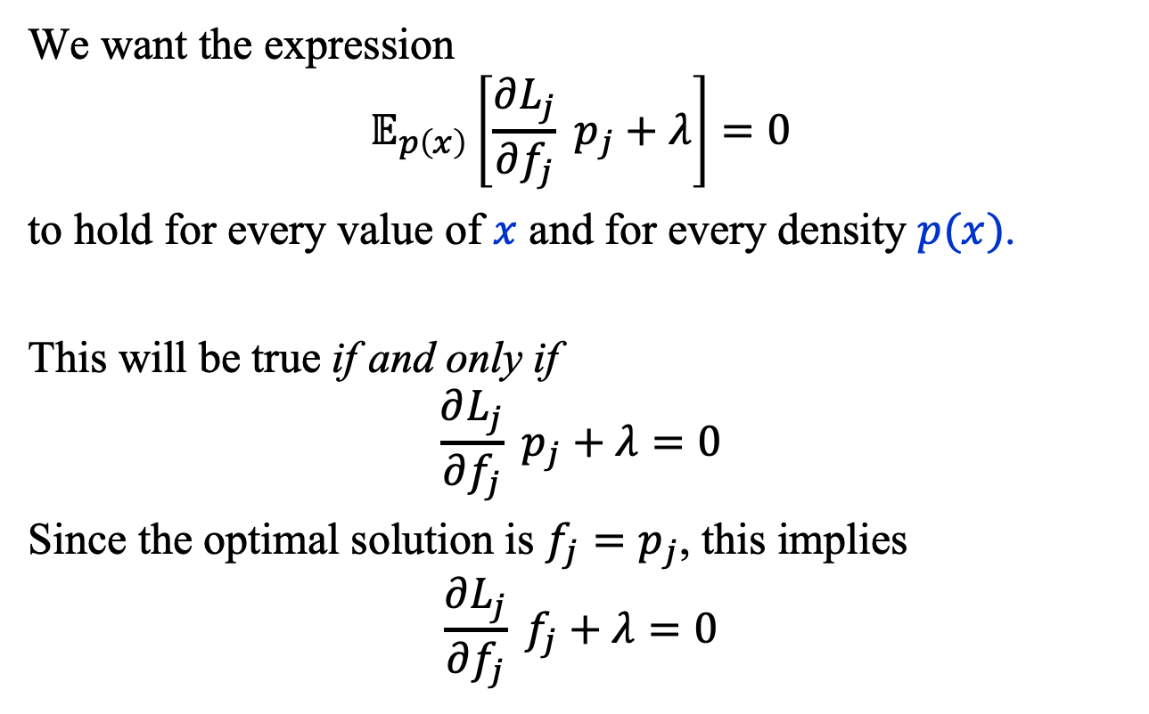
Cross Entropy Loss (5)
We want the expression
$$𝔼_{p\left(x\right)}\left[\frac{∂L_{j}}{∂f_{j}} p_{j}+λ\right]=0$$
to hold for every value of $x$ and for every density $p(x)$.
This will be true if and only if
$$\frac{∂L_{j}}{∂f_{j}} p_{j}+λ=0$$
Since the optimal solution is $f_{j}=p_{j}$, this implies
$$\frac{∂L_{j}}{∂f_{j}} f_{j}+λ=0$$

Slide 40
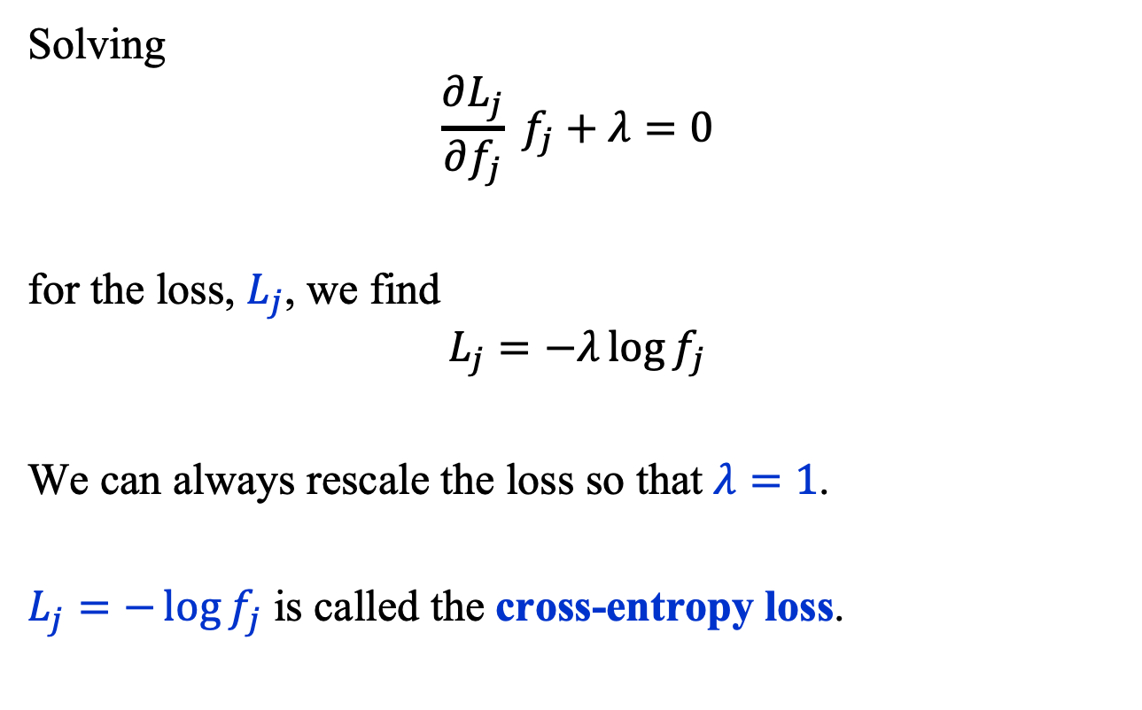
Cross Entropy Loss (6)
Solving
$$\frac{∂L_{j}}{∂f_{j}} f_{j}+λ=0$$
for the loss, $L_{j}$, we find
$$L_{j}=−λ\log{f_{j}}$$
We can always rescale the loss so that $λ=1$.
$L_{j}=−\log{f_{j}}$ is called the cross-entropy loss.

