Slide 1
Machine Learning In Physics
Foundations 2

Slide 2
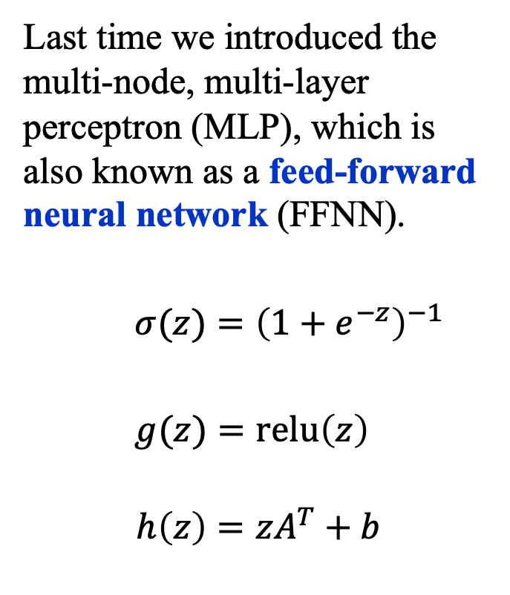

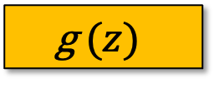
Recap
Last time we introduced the multi-node, multi-layer perceptron (MLP), which is also known as a feed-forward neural network (FFNN).
$σ(z)={\left(1+e^{−z}\right)}^{−1}$
$g(z)=\text{relu}\left(z\right)$
$$h\left(z\right)=zA^{T}+b$$
output
$$σ (z)$$
Layer 2
Linear(4, 1)
$$\text{g }(z)$$
Layer 1
Linear(2, 4)
$$x$$

Slide 3
Fitting Models to data

Slide 4
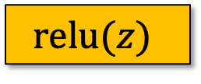
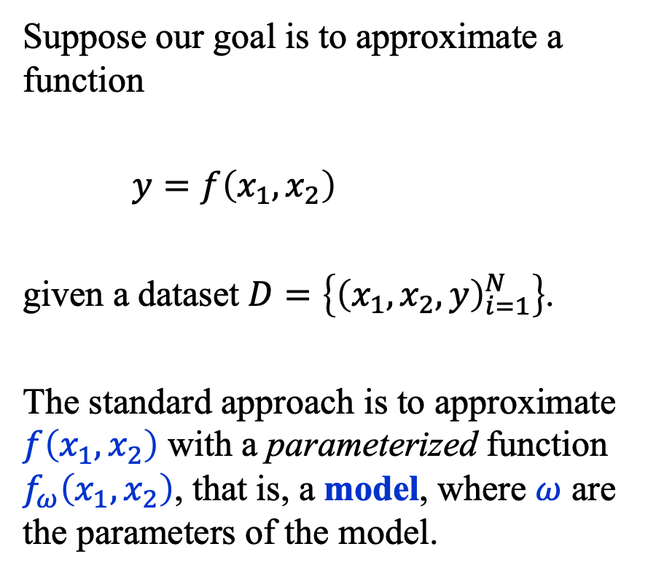


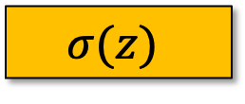
Fitting Models to Data (1)
Suppose our goal is to approximate a function
$y=f\left(x_{1},x_{2}\right)$
given a dataset $D=\left\{{\left(x_{1},x_{2},y\right)}_{i=1}^{N}\right\}$.
The standard approach is to approximate $f\left(x_{1},x_{2}\right)$ with a parameterized function $f_{ω}\left(x_{1},x_{2}\right)$, that is, a model, where $ω$ are the parameters of the model.
$$y(x)$$
$$σ(z)$$
Linear(4, 1)
$$\text{relu}(z)$$
Linear(2, 4)
$$x$$

Slide 5
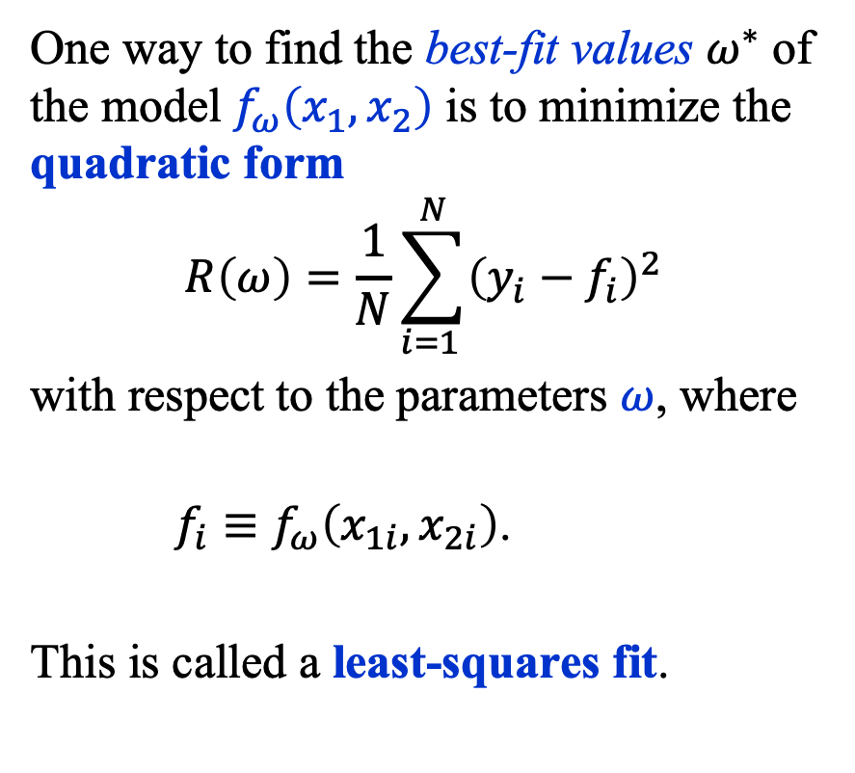
Fitting Models to Data (2)
One way to find the best-fit values $ω^{∗}$ of the model $f_{ω}\left(x_{1},x_{2}\right)$ is to minimize the quadratic form
$$R\left(ω\right)=\frac{1}{N}\sum_{i=1 }^{N}{{\left(y_{i}−f_{i}\right)}^{2}}$$
with respect to the parameters $ω$, where
$f_{i}≡f_{ω}\left(x_{1i}, x_{2i}\right)$.
This is called a least-squares fit.
$$y(x)$$
$$σ(z)$$
Linear(4, 1)
$$\text{relu}(z)$$
Linear(2, 4)
$$x$$

Slide 6
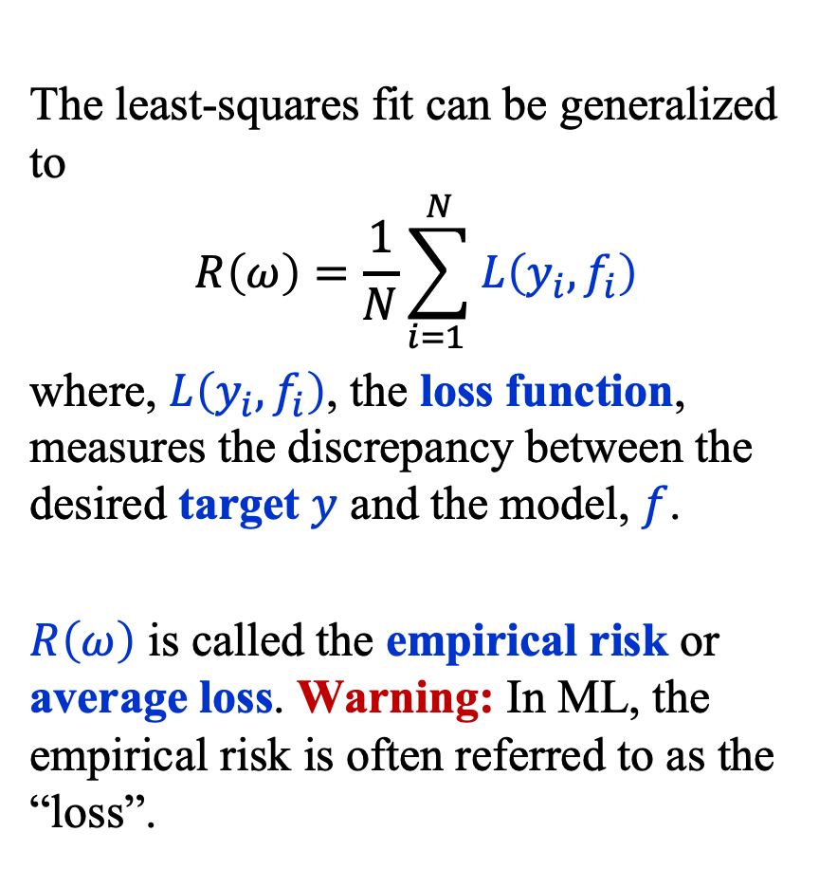
Fitting Models to Data (3)
The least-squares fit can be generalized to
$$R\left(ω\right)=\frac{1}{N}\sum_{i=1 }^{N}{L\left(y_{i}, f_{i}\right)}$$
where, $L\left(y_{i}, f_{i}\right)$, the loss function, measures the discrepancy between the desired target $y$ and the model, $f$.
$R\left(ω\right)$ is called the empirical risk or average loss. Warning: In ML, the empirical risk is often referred to as the “loss”.
$$y(x)$$
$$σ(z)$$
Linear(4, 1)
$$\text{relu}(z)$$
Linear(2, 4)
$$x$$

Slide 7
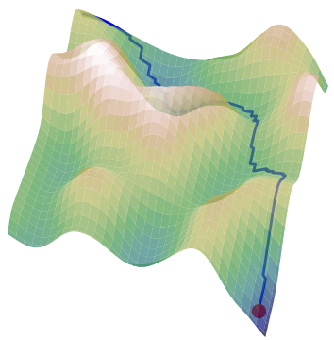
Empirical Risk Landscape (1)
The empirical risk defines a highly corrugated high-dimensional “landscape” in the space of parameters.
Our task is to navigate the empirical risk
landscape to find a good approximation
of the minimum not of that landscape
but rather of the landscape that would
be formed if we had an infinite
amount of data.
A model that approximates this ideal is said to generalize.

Slide 8
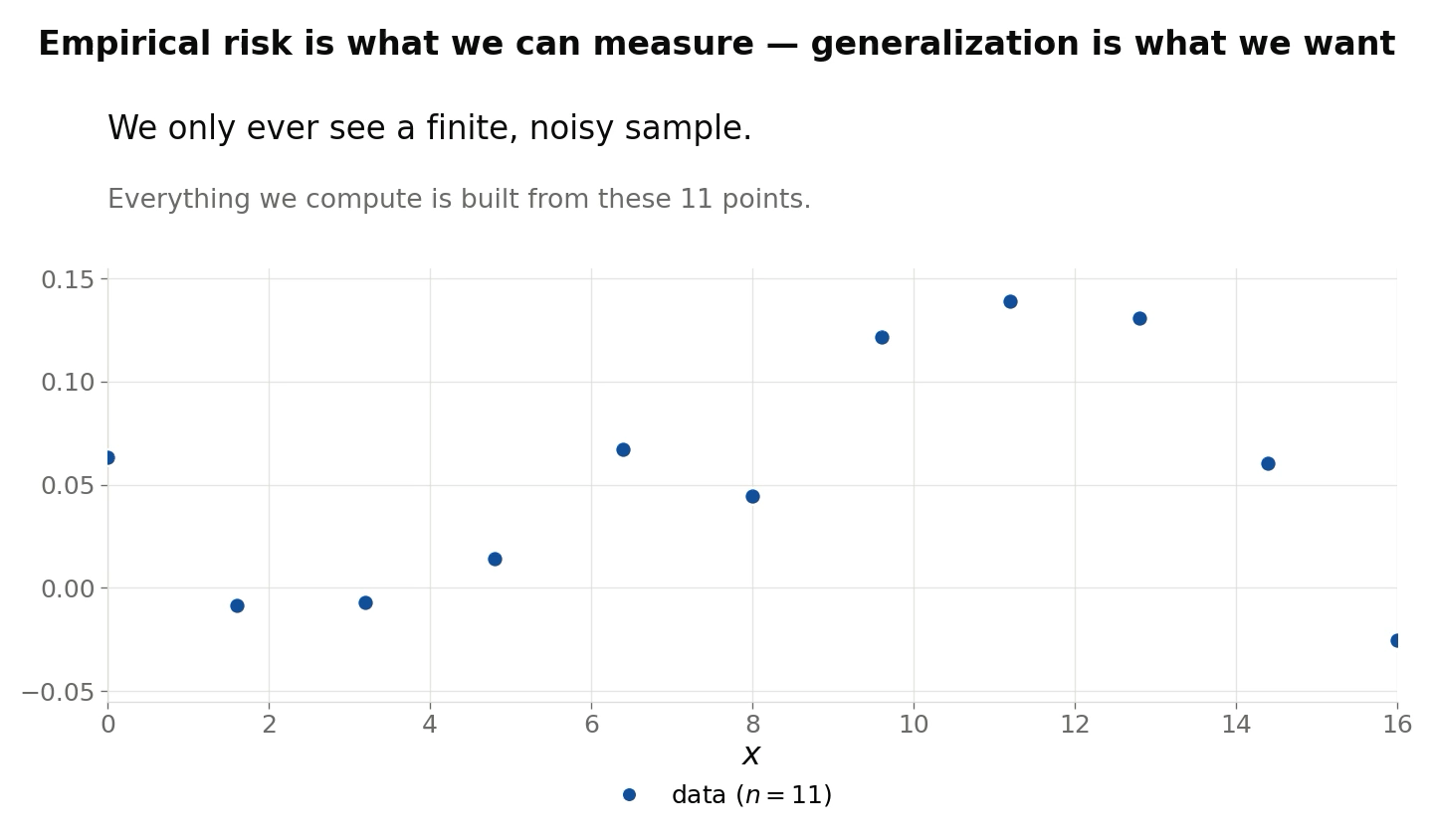
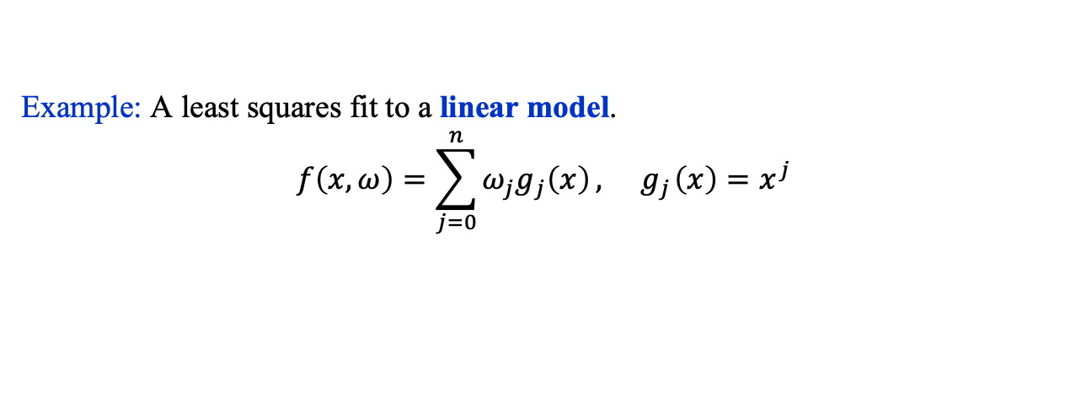
Empirical Risk Landscape (2)
Example: A least squares fit to a linear model.
$$f\left(x, ω\right)=\sum_{j=0}^{n}{ω_{j}g_{j}\left(x\right)}, { g}_{j}\left(x\right)=x^{j}$$

Slide 9
The Risk Functional

Slide 10
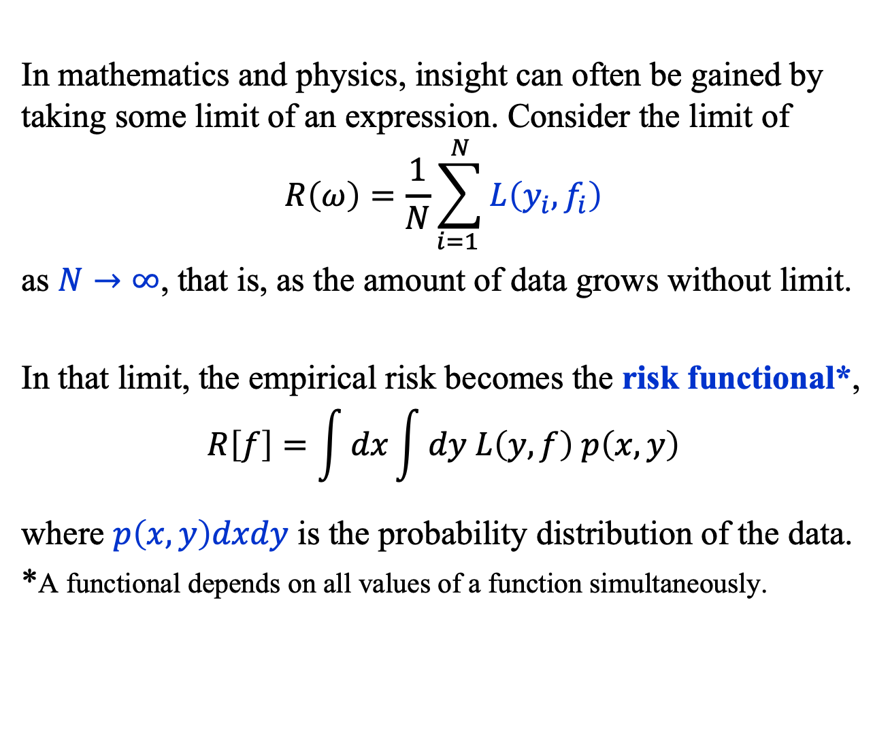
Risk Functional (1)
In mathematics and physics, insight can often be gained by taking some limit of an expression. Consider the limit of
$$R\left(ω\right)=\frac{1}{N}\sum_{i=1 }^{N}{L\left(y_{i}, f_{i}\right)}$$
as $N→∞$, that is, as the amount of data grows without limit.
In that limit, the empirical risk becomes the risk functional*,
$$R\left[f\right]=\int{dx}\int{dy L\left(y, f\right) p\left(x, y\right)}$$
where $p\left(x, y\right)dxdy$ is the probability distribution of the data.
*A functional depends on all values of a function simultaneously.

Slide 11
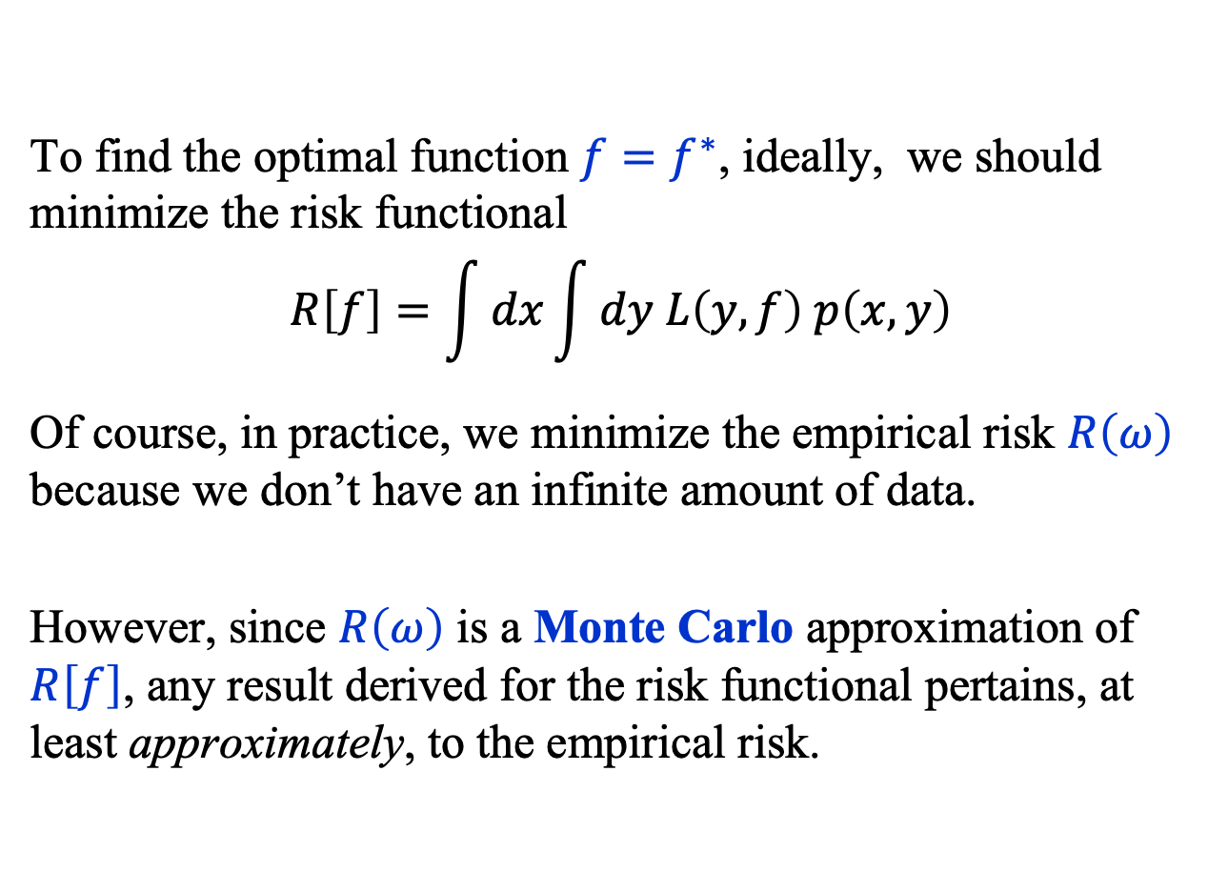
Risk Functional (2)
To find the optimal function ${f=f}^{∗}$, ideally, we should minimize the risk functional
$$R\left[f\right]=\int{dx}\int{dy L\left(y, f\right) p\left(x, y\right)}$$
Of course, in practice, we minimize the empirical risk $R\left(ω\right)$ because we don’t have an infinite amount of data.
However, since $R\left(ω\right)$ is a Monte Carlo approximation of $R\left[f\right]$, any result derived for the risk functional pertains, at least approximately, to the empirical risk.

Slide 12
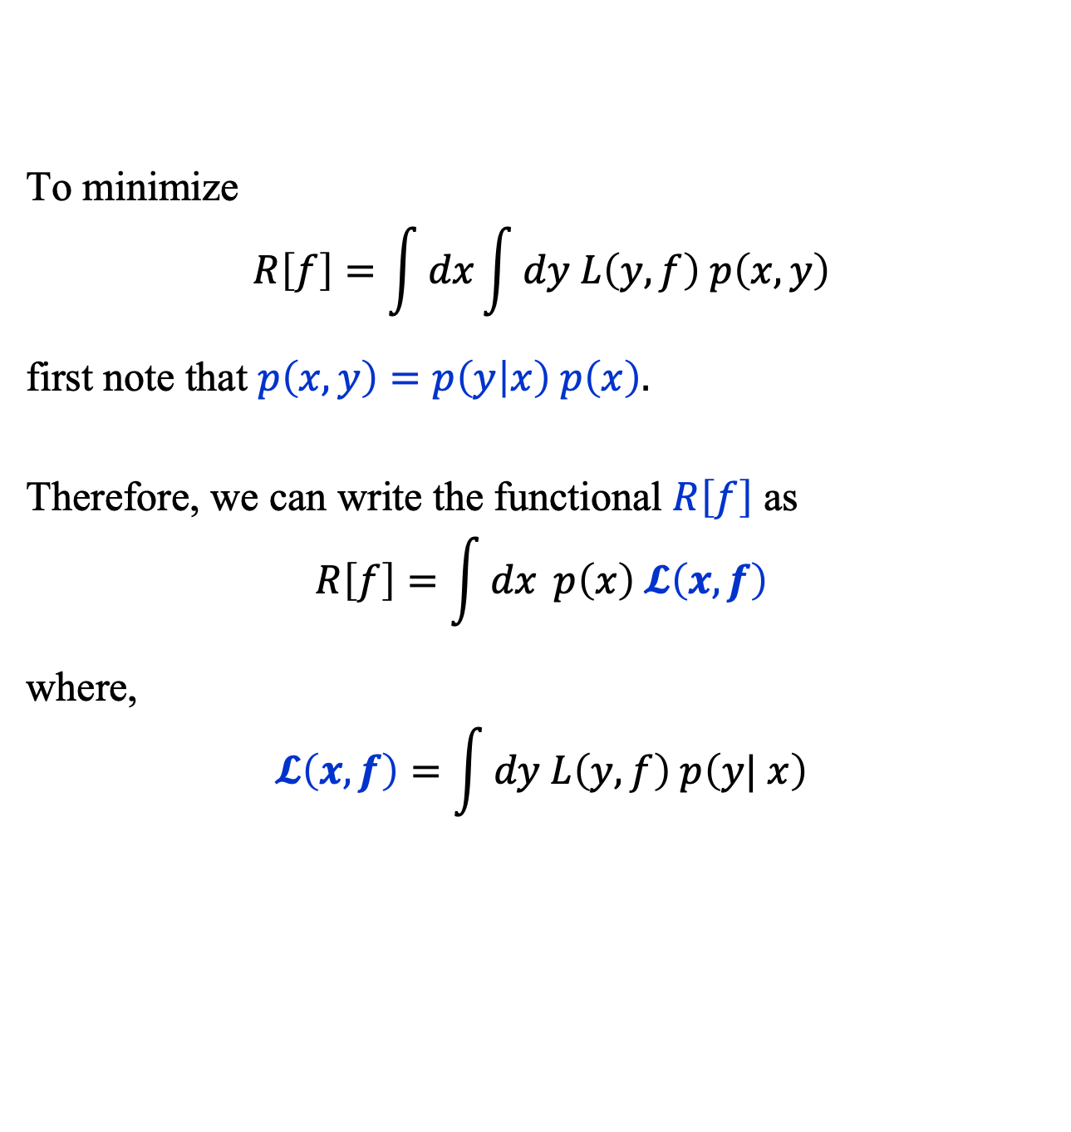
Risk Functional (3)
To minimize
$$R\left[f\right]=\int{dx}\int{dy L\left(y, f\right) p\left(x, y\right)}$$
first note that $p\left(x, y\right)=p\left(y | x\right) p\left(x\right).$
Therefore, we can write the functional $R\left[f\right]$ as
$$R\left[f\right]=\int{dx} p\left(x\right) 𝓛\left(x, f\right)$$
where,
$$𝓛\left(x, f\right)=\int{dy L\left(y, f\right) p\left(y| x\right)}$$

Slide 13
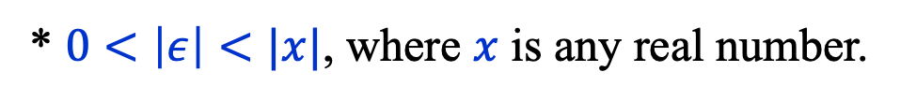
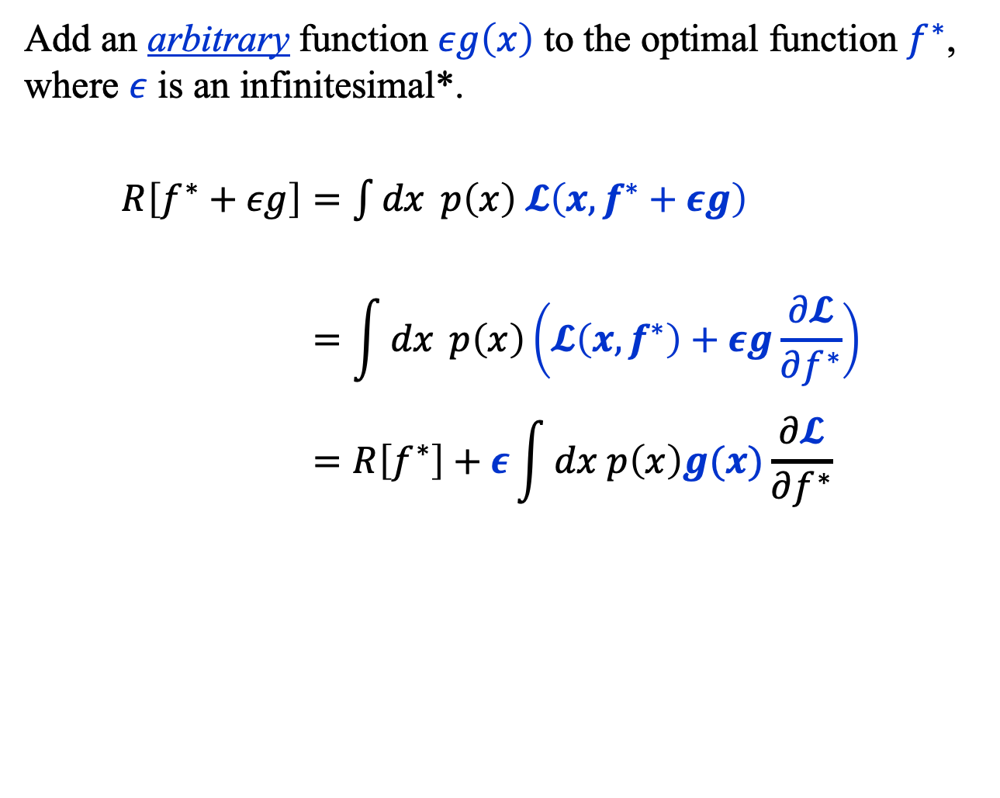
Risk Functional (4)
Add an arbitrary function $εg\left(x\right)$ to the optimal function $f^{∗}$, where $ε$ is an infinitesimal*.
$R\left[f^{∗}+εg\right]=\int{dx} p\left(x\right) 𝓛\left(x, f^{∗}+εg\right)$
$$=\int{dx} p\left(x\right)\left(𝓛\left(x, f^{∗}\right)+εg\frac{∂𝓛}{∂f^{∗}}\right)$$
$$=R\left[f^{∗}\right]+ε\int{dx p\left(x\right)g(x)\frac{∂𝓛}{∂f^{∗}}}$$
* $0<\left|ε\right|<|x|$, where $x$ is any real number.

Slide 14
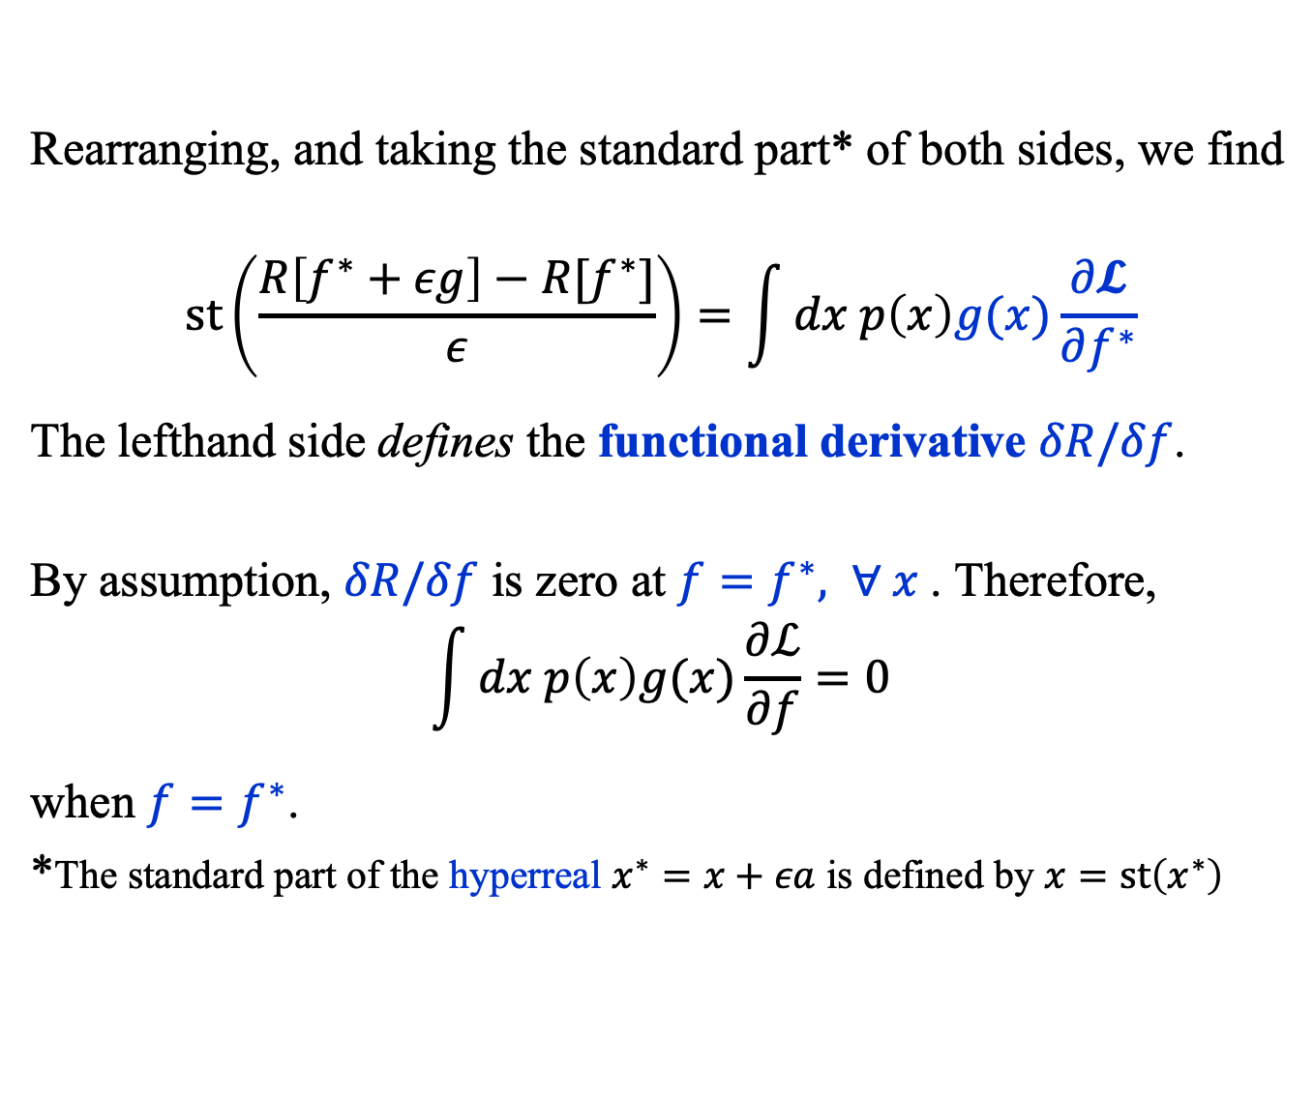
Risk Functional (5)
Rearranging, and taking the standard part* of both sides, we find
$$st\left(\frac{R\left[f^{∗}+εg\right]−R[f^{∗}]}{ε}\right)=\int{dx p\left(x\right)g(x)\frac{∂𝓛}{∂f^{∗}}}$$
The lefthand side defines the functional derivative $δR/δf$.
By assumption, $δR/δf$ is zero at $f=f^{∗}, ∀ x$. Therefore,
$$\int{dx p\left(x\right)g(x)\frac{∂ℒ}{∂f}}=0$$
when $f=f^{∗}$.
*The standard part of the hyperreal $x^{∗}=x+εa$ is defined by $x=st\left(x^{∗}\right)$

Slide 15
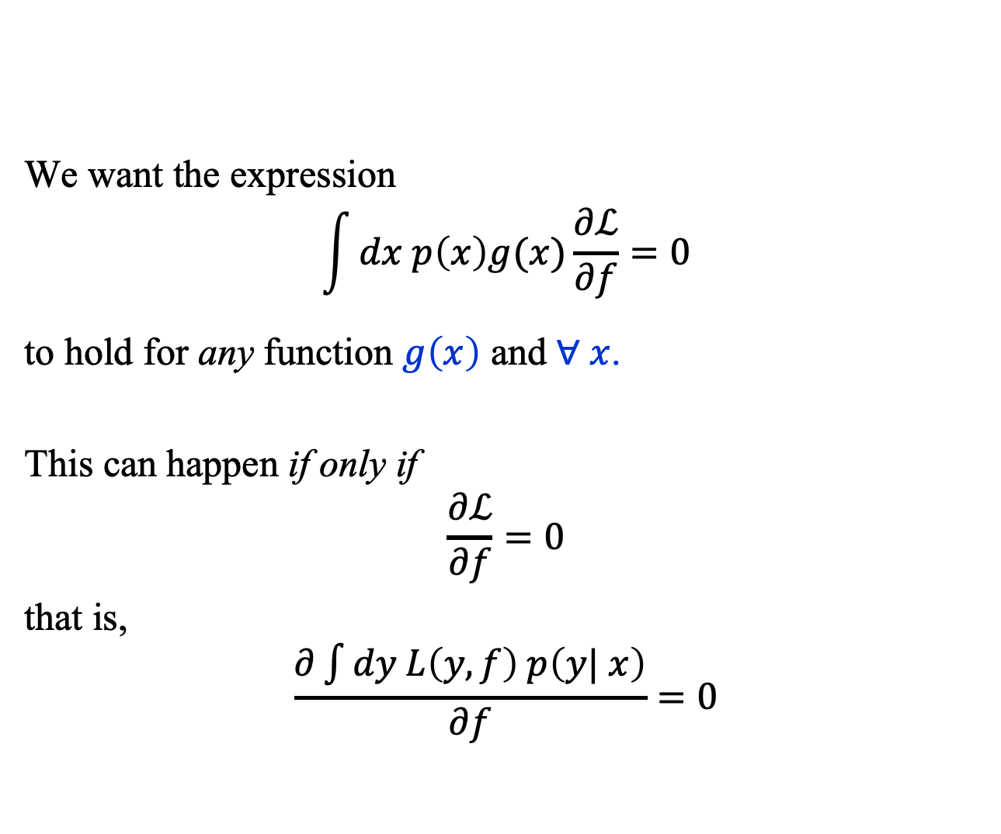
Risk Functional (6)
We want the expression
$$\int{dx p\left(x\right)g(x)\frac{∂ℒ}{∂f}}=0$$
to hold for any function $g\left(x\right)$ and $∀ x$.
This can happen if only if
$$\frac{∂ℒ}{∂f}=0$$
that is,
$$\frac{∂\int{dy L\left(y, f\right) p\left(y| x\right)}}{∂f}=0$$

Slide 16
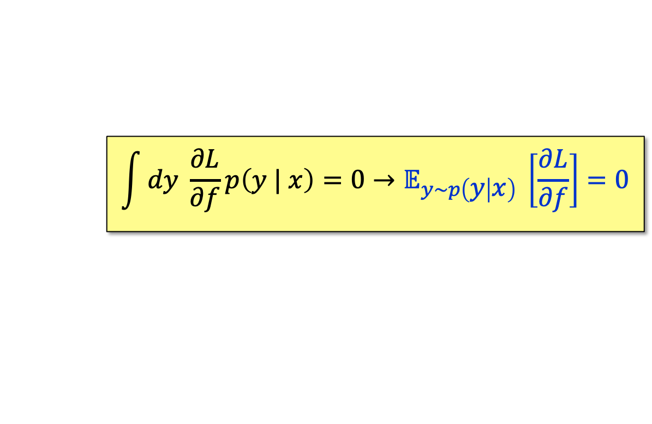
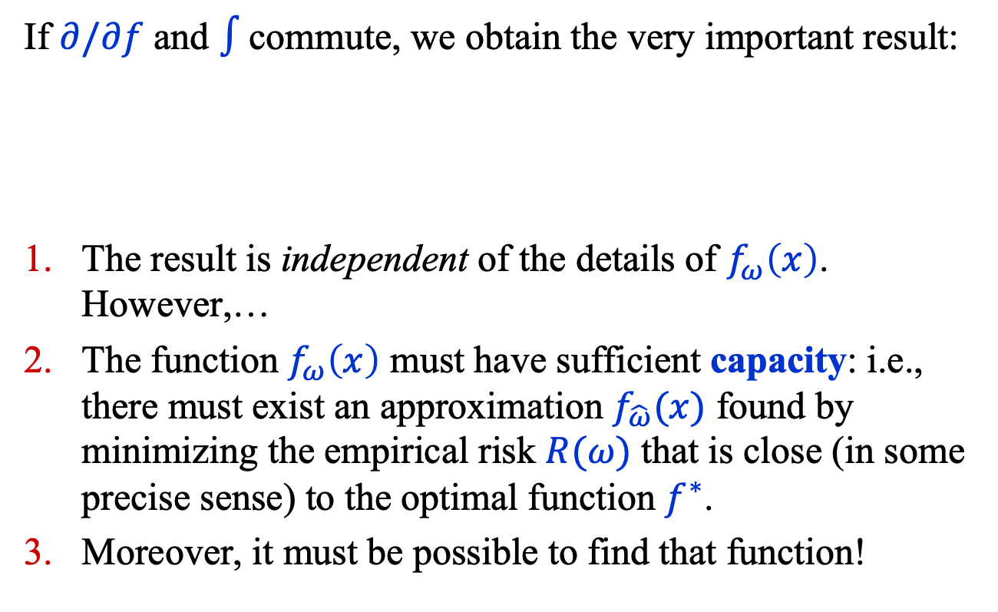
Risk Functional (7)
If $∂/∂f$ and $∫$commute, we obtain the very important result:
The result is independent of the details of $f_{ω}\left(x\right)$. However,…
The function $f_{ω}\left(x\right)$ must have sufficient capacity: i.e., there must exist an approximation $f_{\hat{ω}}(x)$ found by minimizing the empirical risk $R(ω)$ that is close (in some precise sense) to the optimal function $f^{∗}$.
Moreover, it must be possible to find that function!
$$\int{dy \frac{∂L}{∂f}p\left(y | x\right)=0→𝔼_{y∼p\left(y | x\right)} \left[\frac{∂L}{∂f}\right]=0}$$

Slide 17
Empirical RISK Minimization

Slide 18
Start
Some jargon
Train: fit a model to
(training) data.
Batch: a subset of the
training data.
Iteration: a single
optimization step.
Epoch: a single
pass through the entire training data.
End

Slide 19
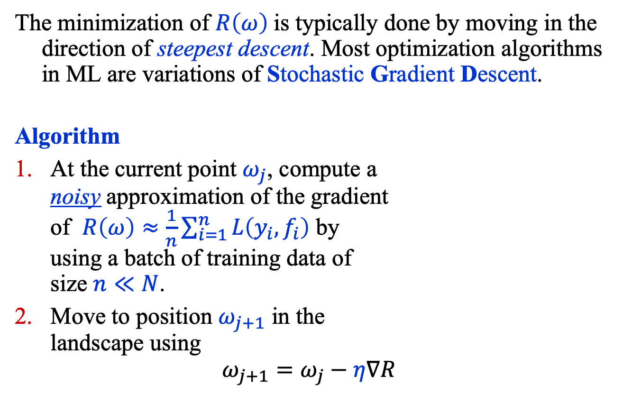
Empirical Risk Minimization (1)
The minimization of $R\left(ω\right)$is typically done by moving in the direction of steepest descent. Most optimization algorithms in ML are variations of Stochastic Gradient Descent.
Algorithm
At the current point $ω_{j}$, compute a
noisy approximation of the gradient
of $R\left(ω\right)≈\frac{1}{n}\sum_{i=1}^{n}{L\left(y_{i}, f_{i}\right)}$ by
using a batch of training data of
size $n≪N$.
Move to position $ω_{j+1}$ in the
landscape using
$$ω_{j+1}=ω_{j}−η∇R$$

Slide 20
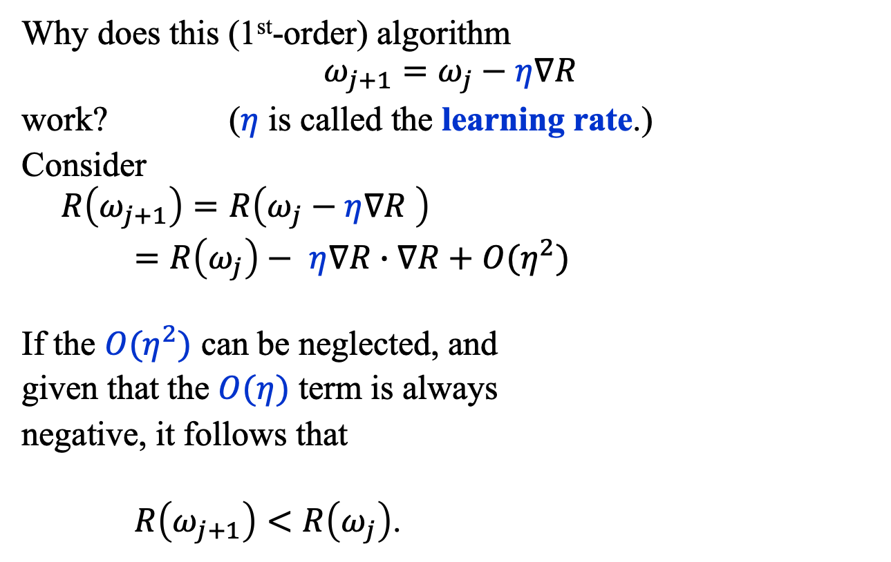
Empirical Risk Minimization (2)
Why does this (1st-order) algorithm
$$ω_{j+1}=ω_{j}−η∇R$$
work? ($η$ is called the learning rate.)
Consider
$$R\left(ω_{j+1}\right)=R\left(ω_{j}−η∇R \right)$$
$=R\left(ω_{j}\right)− η∇R∙∇R+O(η^{2})$
If the $O(η^{2})$ can be neglected, and
given that the $O(η)$ term is always
negative, it follows that
$R\left(ω_{j+1}\right)<R\left(ω_{j}\right)$.

Slide 21
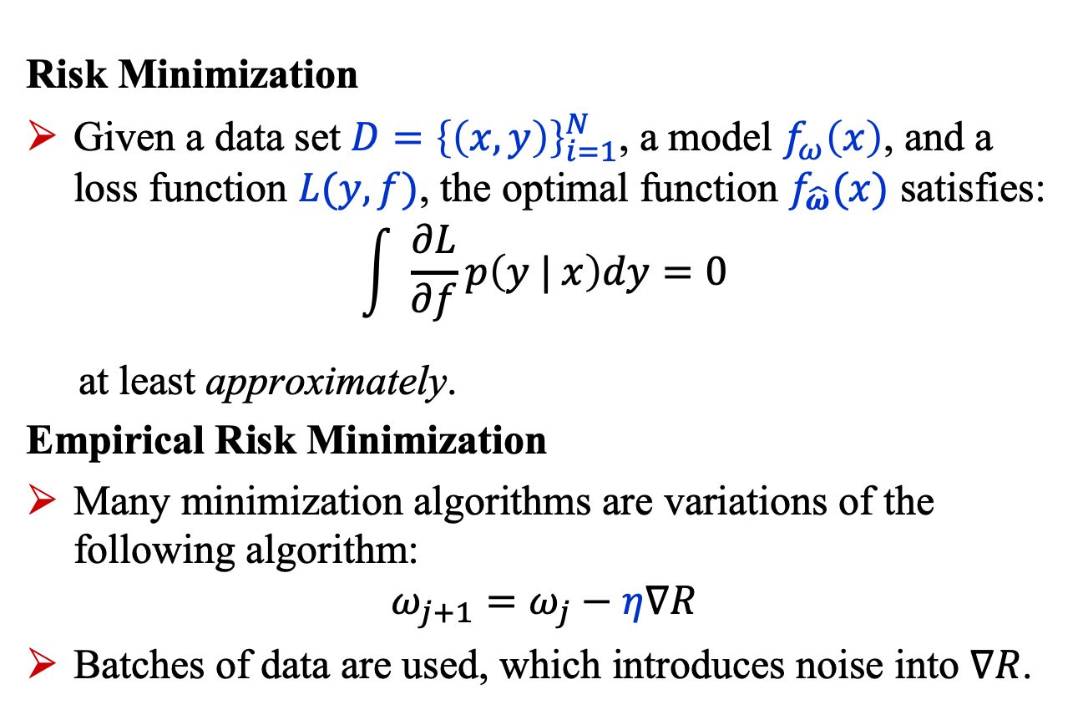
Summary
Risk Minimization
Given a data set $D={\left\{\left(x,y\right)\right\}}_{i=1}^{N}$, a model $f_{ω}\left(x\right)$, and a loss function $L(y, f)$, the optimal function $f_{\hat{ω}}(x)$ satisfies:
$$\int{ \frac{∂L}{∂f}p\left(y | x\right)dy=0}$$
at least approximately.
Empirical Risk Minimization
Many minimization algorithms are variations of the following algorithm:
$$ω_{j+1}=ω_{j}−η∇R$$
Batches of data are used, which introduces noise into $∇R$.

