Slide 1
Machine learning in physics
Foundations 3

Slide 2
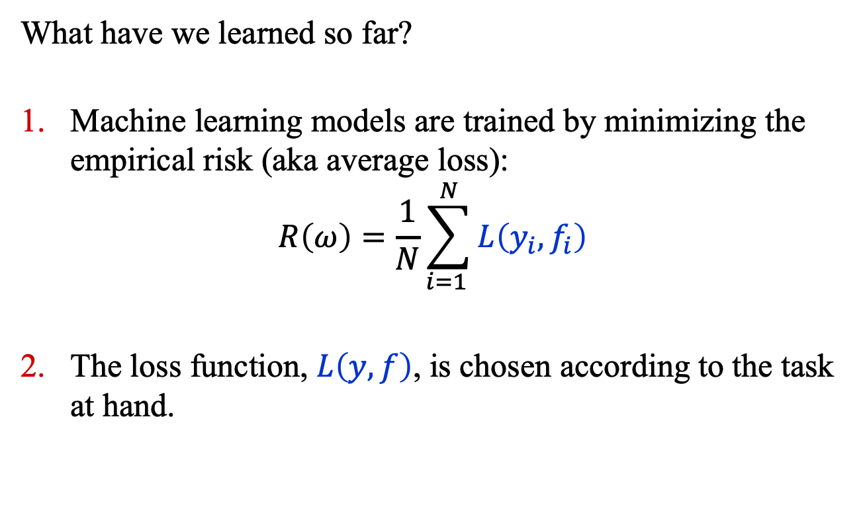
Recap
What have we learned so far?
Machine learning models are trained by minimizing the empirical risk (aka average loss):
$$R\left(ω\right)=\frac{1}{N}\sum_{i=1 }^{N}{L\left(y_{i}, f_{i}\right)}$$
The loss function, $L\left(y, f\right)$, is chosen according to the task at hand.

Slide 3
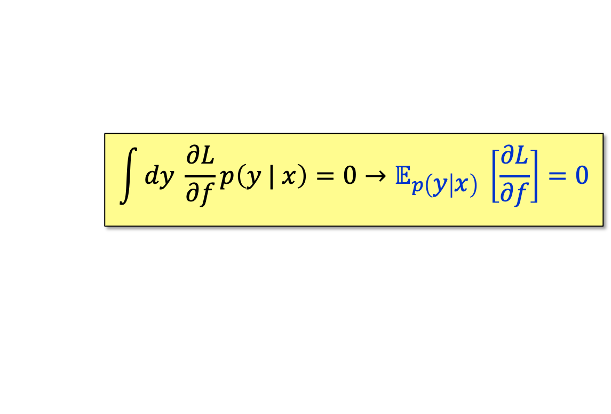
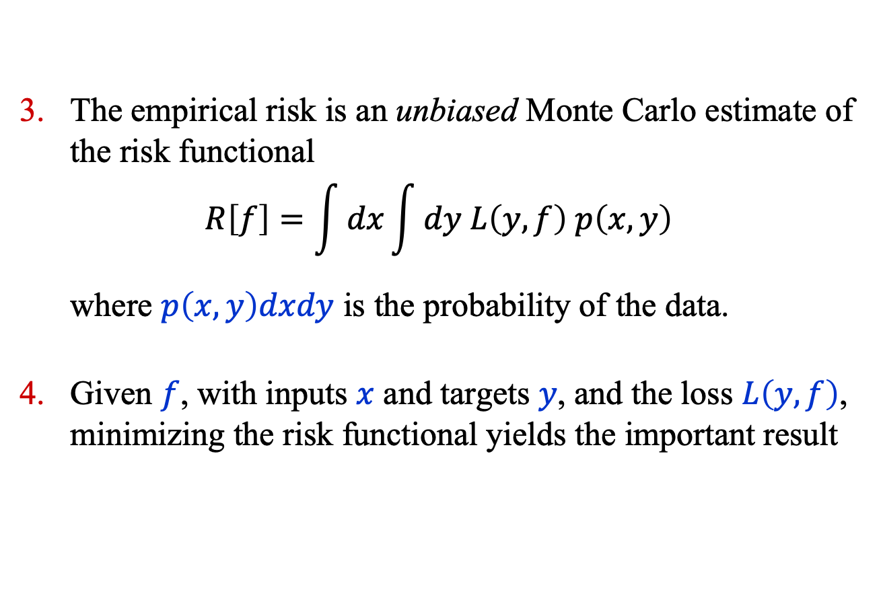
Recap
The empirical risk is an unbiased Monte Carlo estimate of the risk functional
$$R\left[f\right]=\int{dx}\int{dy L\left(y, f\right) p\left(x, y\right)}$$
where $p\left(x, y\right)dxdy$ is the probability of the data.
Given $f$, with inputs $x$ and targets $y$, and the loss $L\left(y, f\right)$, minimizing the risk functional yields the important result
$$\int{dy \frac{∂L}{∂f}p\left(y | x\right)=0→𝔼_{p\left(y | x\right)} \left[\frac{∂L}{∂f}\right]=0}$$

Slide 4
Common loss functions

Slide 5
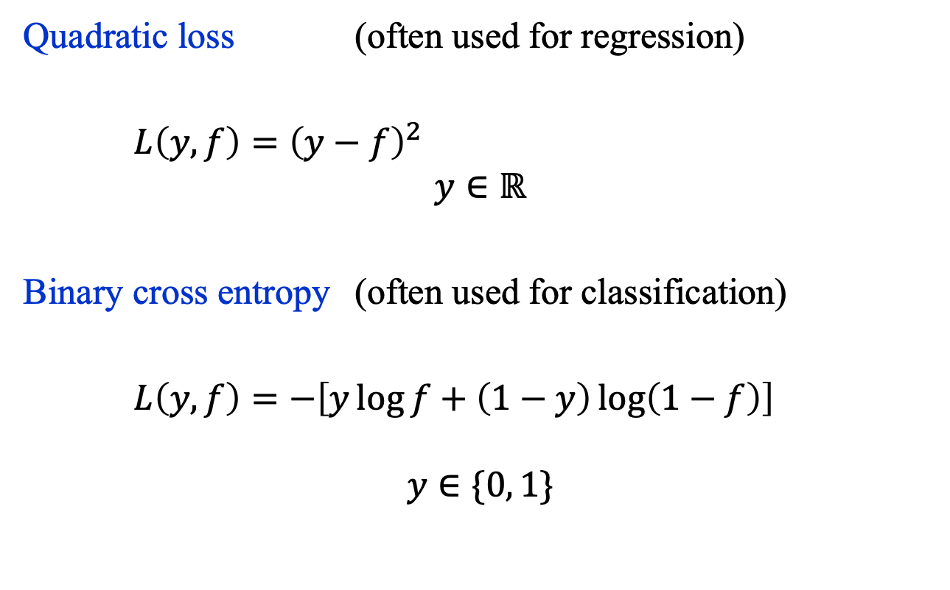
Common Loss Functions (1)
Quadratic loss (often used for regression)
$L\left(y, f\right)={\left(y−f\right)}^{2}$
$$y∈ℝ$$
Binary cross entropy (often used for classification)
$L\left(y, f\right)=−\left[y\log{f+\left(1−y\right)\log\left(1−f\right)}\right]$
$$y∈\{0, 1\}$$

Slide 6
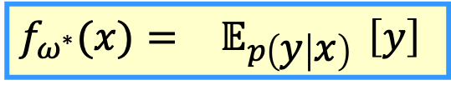
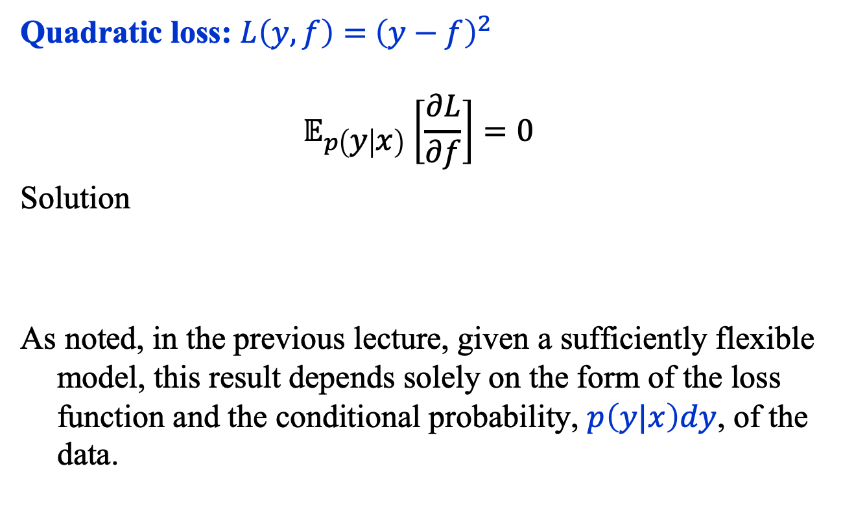
Quadratic Loss
Quadratic loss: $L\left(y, f\right)={ \left(y−f\right)}^{2}$
$${ 𝔼}_{p\left(y | x\right)} \left[\frac{∂L}{∂f}\right]=0$$
Solution
As noted, in the previous lecture, given a sufficiently flexible model, this result depends solely on the form of the loss function and the conditional probability, $p\left(y|x\right)dy$, of the data.
$$f_{ω^{∗}}(x)={ 𝔼}_{p\left(y | x\right)} \left[y\right]$$

Slide 7

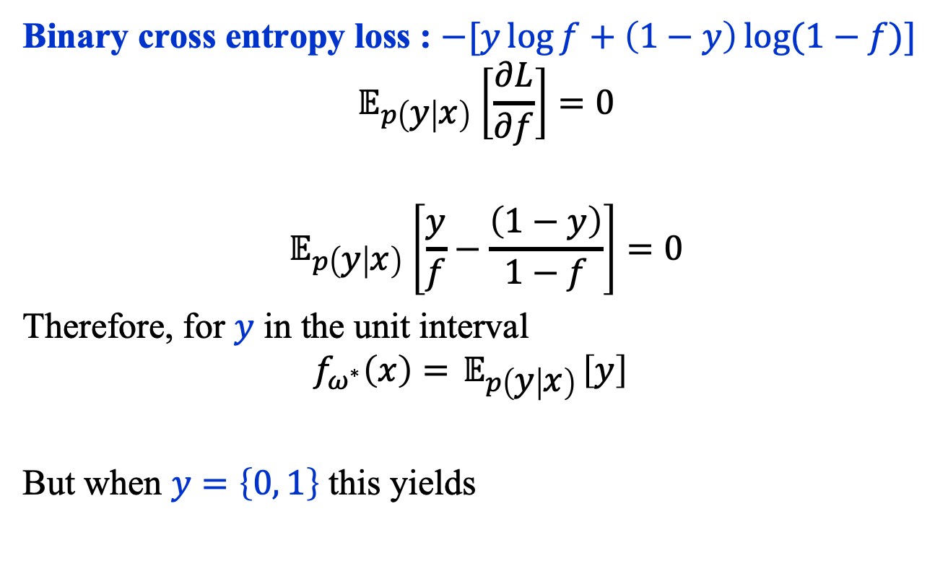
Binary Cross Entropy Loss (1)
Binary cross entropy loss : $−[y\log{f+\left(1−y\right)\log{(1−f)}}]$
$${ 𝔼}_{p\left(y | x\right)} \left[\frac{∂L}{∂f}\right]=0$$
$${ 𝔼}_{p\left(y | x\right)} \left[\frac{y}{f}−\frac{\left(1−y\right)}{1−f}\right]=0$$
Therefore, for $y$ in the unit interval
$$f_{ω^{∗}}\left(x\right)={ 𝔼}_{p\left(y | x\right)}\left[y\right]$$
But when $y=\left\{0, 1\right\}$ this yields
$$f_{ω^{∗}}(x)=p\left(1 \right| x)$$

Slide 8
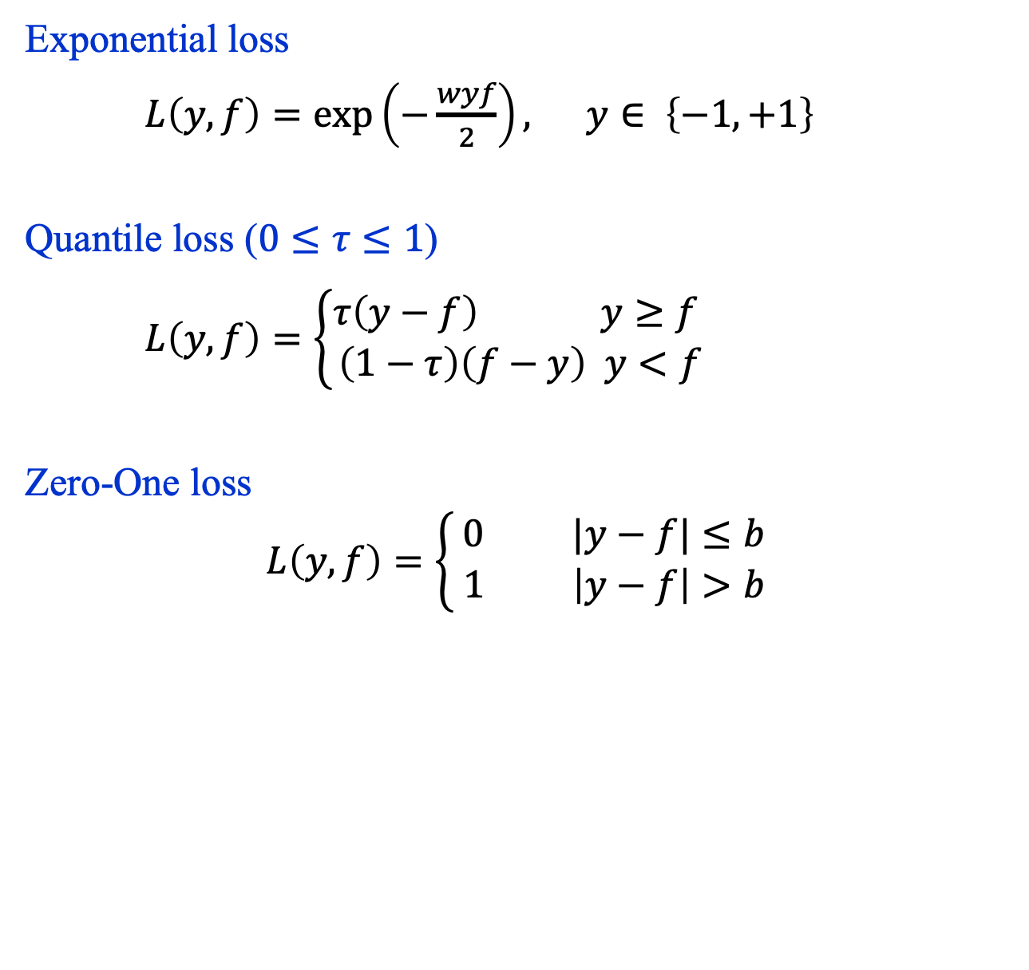
Other Loss Functions
Exponential loss
$L\left(y, f\right)=\exp\left(−\frac{wyf}{2}\right), y∈ \left\{−1, +1\right\}$
Quantile loss ($0≤τ≤1$)
$L\left(y, f\right)=\left\{\begin{aligned}τ\left(y−f\right) y≥f \\ \left(1−τ\right)\left(f−y\right) y<f\end{aligned}\right.$
Zero-One loss
$$L\left(y, f\right)=\left\{\begin{aligned}0 |y−f|≤b \\ 1 \left|y−f\right|>b \end{aligned}\right.$$

Slide 9
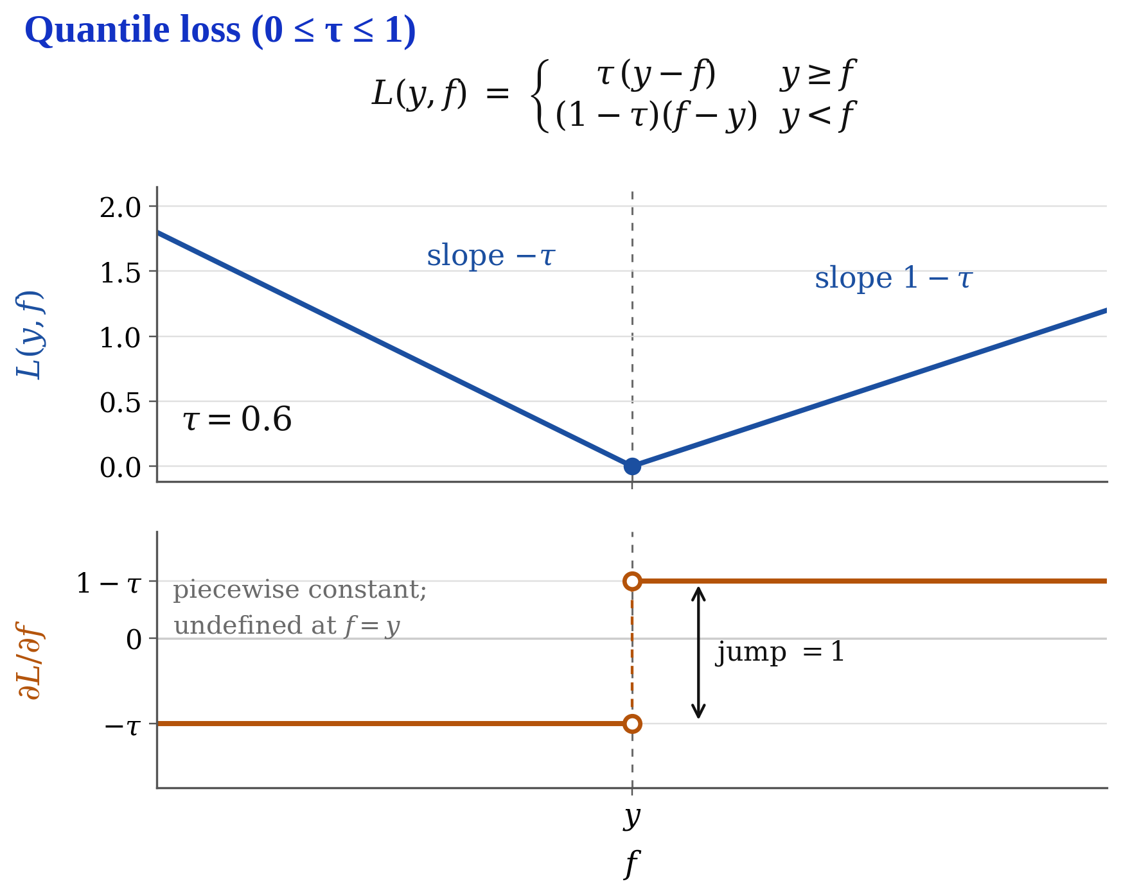

Slide 10
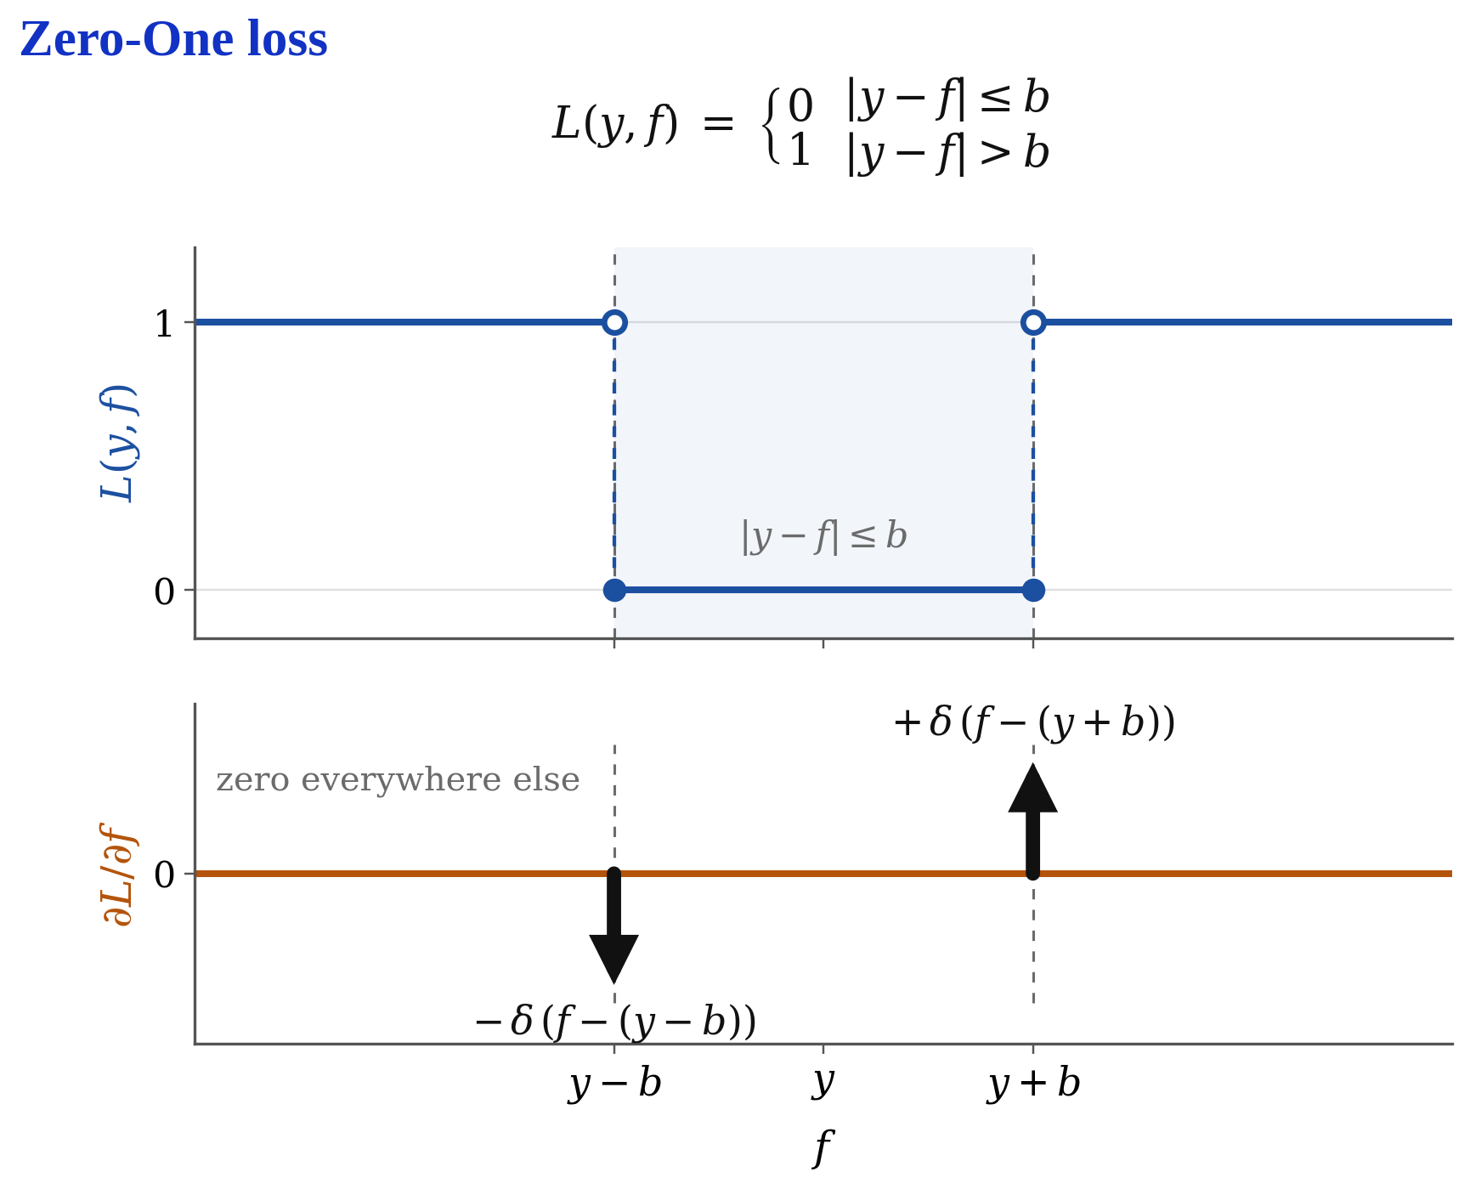

Slide 11
BINARY Classifiers

Slide 12
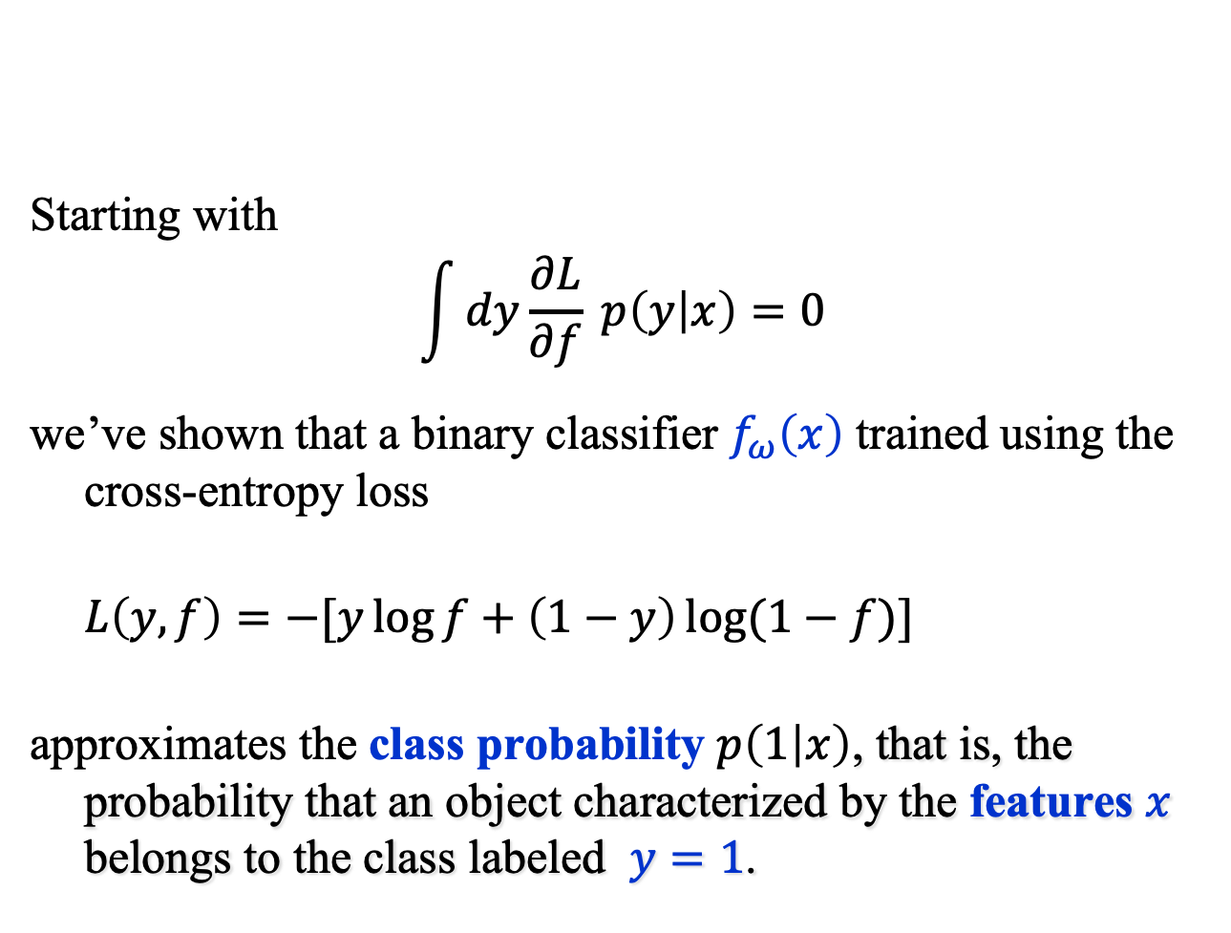
Binary Classifiers (1)
Starting with
$$\int{dy\frac{∂L}{∂f} p\left(y | x\right)=0}$$
we’ve shown that a binary classifier $f_{ω}\left(x\right)$ trained using the cross-entropy loss
$L\left(y, f\right)=−[y\log{f+\left(1−y\right)\log{(1−f)}}]$
approximates the class probability $p\left(1 | x\right)$, that is, the probability that an object characterized by the features $x$ belongs to the class labeled $y=1$.

Slide 13
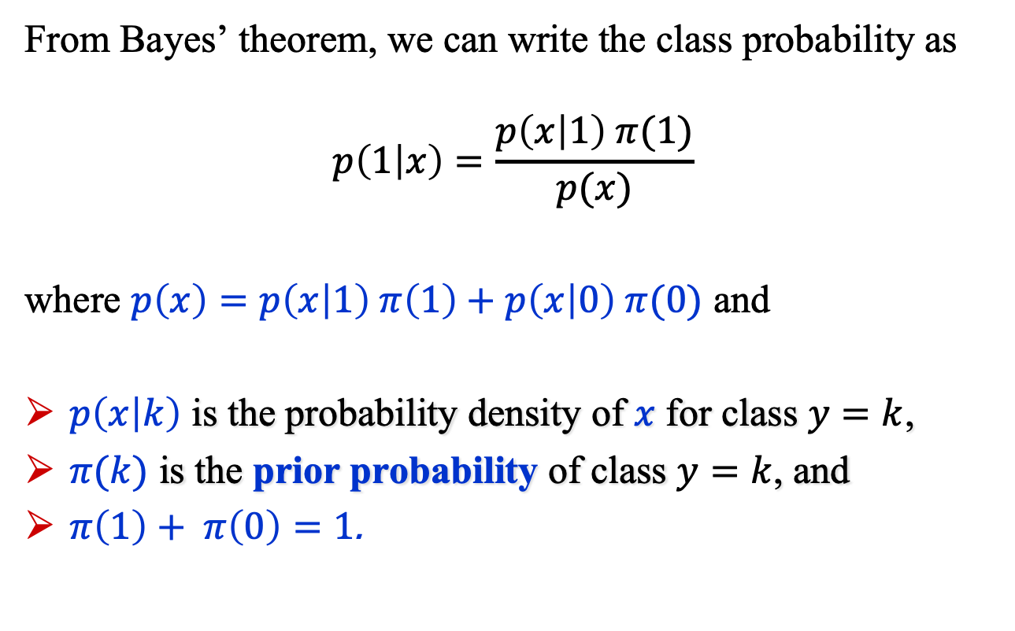
Binary Classifiers (2)
From Bayes’ theorem, we can write the class probability as
$$p\left(1 | x\right)=\frac{p\left(x | 1\right) π(1)}{p(x)}$$
where $p\left(x\right)=p\left(x | 1\right) π\left(1\right)+p\left(x | 0\right) π(0)$ and
$p\left(x | k\right)$ is the probability density of $x$ for class $y=k$,
$π(k)$ is the prior probability of class $y=k$, and
$π\left(1\right)+ π\left(0\right)=1$.

Slide 14
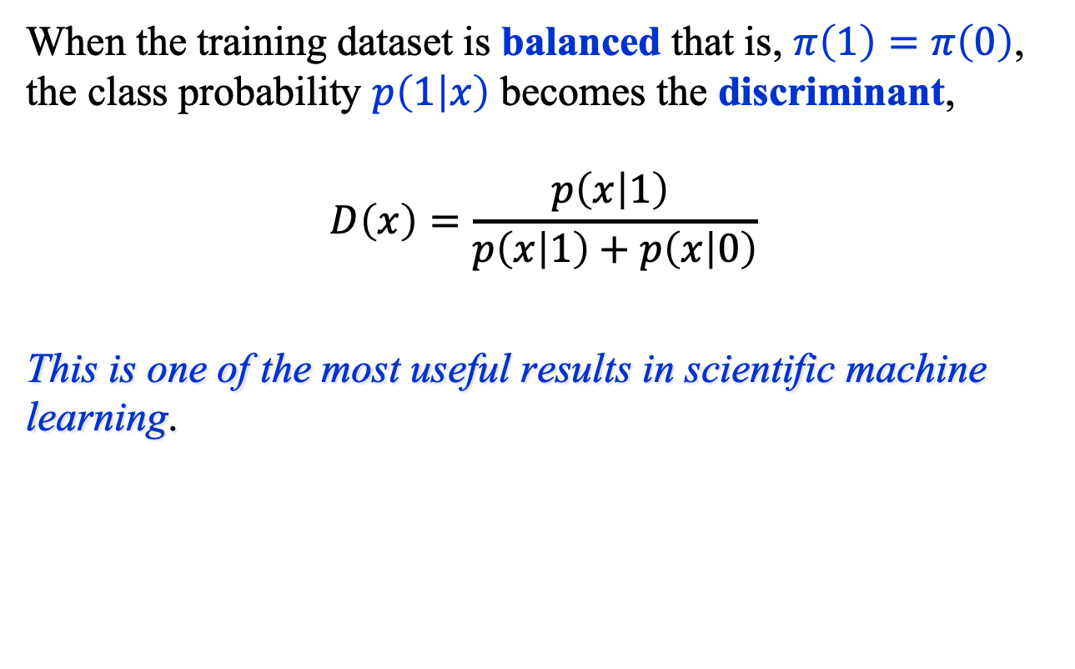
Binary Classifiers (3)
When the training dataset is balanced that is, $π\left(1\right)=π\left(0\right)$, the class probability $p\left(1 | x\right)$ becomes the discriminant,
$$D\left(x\right)=\frac{p\left(x | 1\right) }{p\left(x | 1\right)+p\left(x | 0\right)}$$
This is one of the most useful results in scientific machine learning.

Slide 15

Binary Classifiers (4)
It is possible to train a binary classifier using an unbalanced dataset: $π(1)≠π(0)$.
But if $π(1)≪π(0)$ why might this be very challenging?

Slide 16
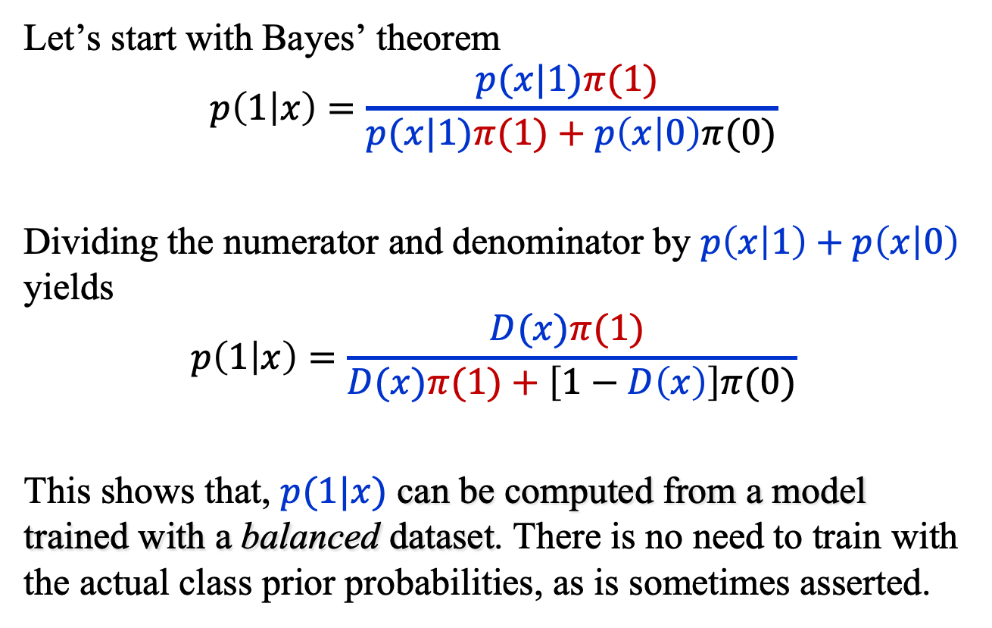
Binary Classifiers (4)
Let’s start with Bayes’ theorem
$$p\left(1 | x\right)=\frac{p(x|1)π(1) }{p(x|1)π(1)+p\left(x | 0\right)π(0)}$$
Dividing the numerator and denominator by $p\left(x | 1\right)+p\left(x | 0\right)$ yields
$$p\left(1 | x\right)=\frac{D(x)π(1) }{D(x)π(1)+\left[1−D\left(x\right)\right]π(0)}$$
This shows that, $p(1|x)$ can be computed from a model trained with a balanced dataset. There is no need to train with the actual class prior probabilities, as is sometimes asserted.

Slide 17
Classifier Performance

Slide 18
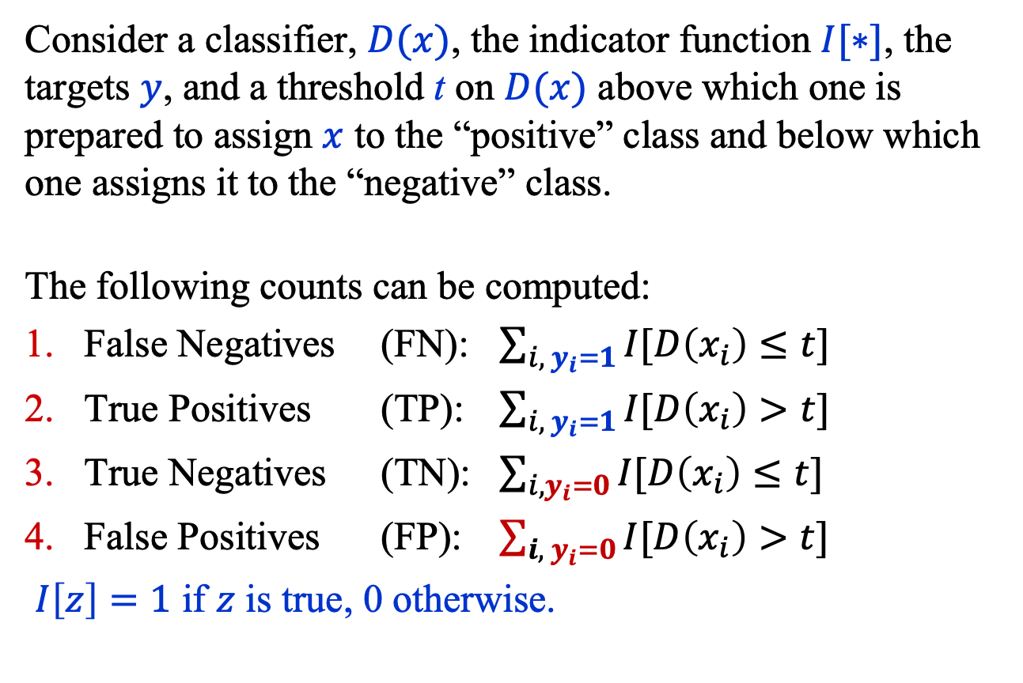
Classifier Performance (1)
Consider a classifier, $D(x)$, the indicator function $I[∗]$, the targets $y$, and a threshold t on $D(x)$ above which one is prepared to assign $x$ to the “positive” class and below which one assigns it to the “negative” class.
The following counts can be computed:
False Negatives (FN): $\sum_{i, { y}_{i}=1}{I[D\left(x_{i}\right)≤t}]$
True Positives (TP): $\sum_{i, y_{i}=1}{I[D\left(x_{i}\right)>t}]$
True Negatives (TN): $\sum_{i, y_{i}=0}{I[D\left(x_{i}\right)≤t}]$
False Positives (FP): $\sum_{{i, y}_{i}=0}{I[D\left(x_{i}\right)>t}]$
$I\left[z\right]=1$ if $z$ is true, 0 otherwise.

Slide 19
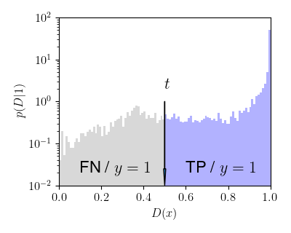
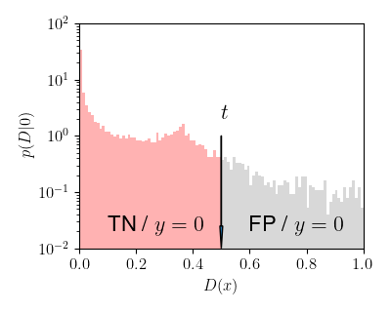
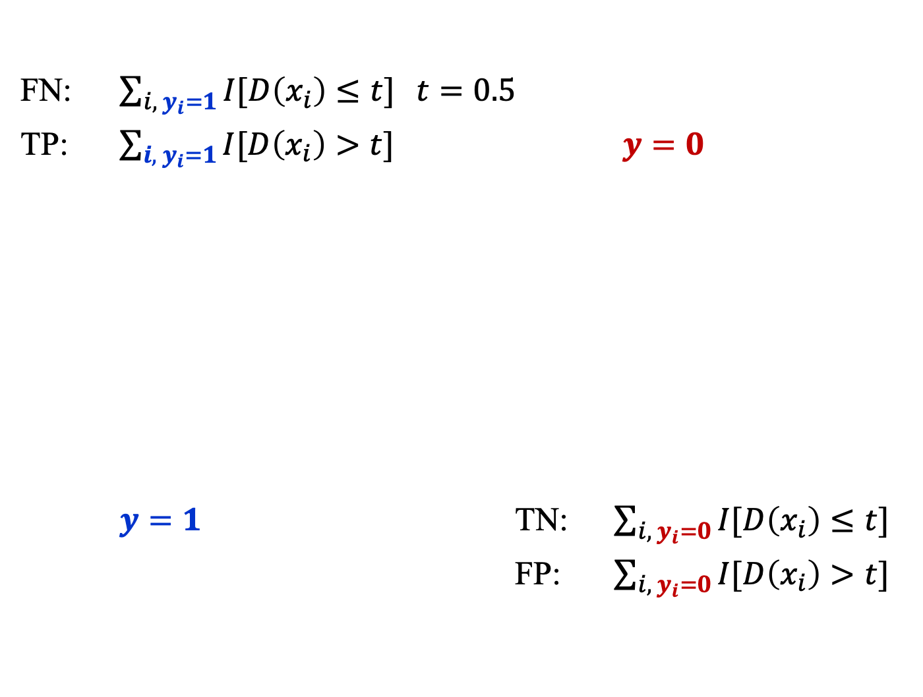
Classifier Performance (2)
FN: $\sum_{i, y_{i}=1}{I[D\left(x_{i}\right)≤t}]$ $t=0.5$
TP: $\sum_{{i, y}_{i}=1}{I[D\left(x_{i}\right)>t}]$ $y=0$
$y=1$ TN: $\sum_{i, y_{i}=0}{I[D\left(x_{i}\right)≤t}]$
FP: $\sum_{i, y_{i}=0}{I[D\left(x_{i}\right)>t}]$

Slide 20
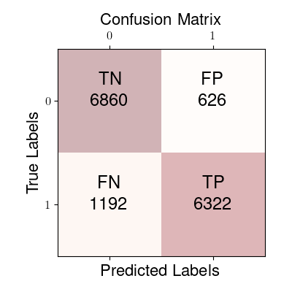
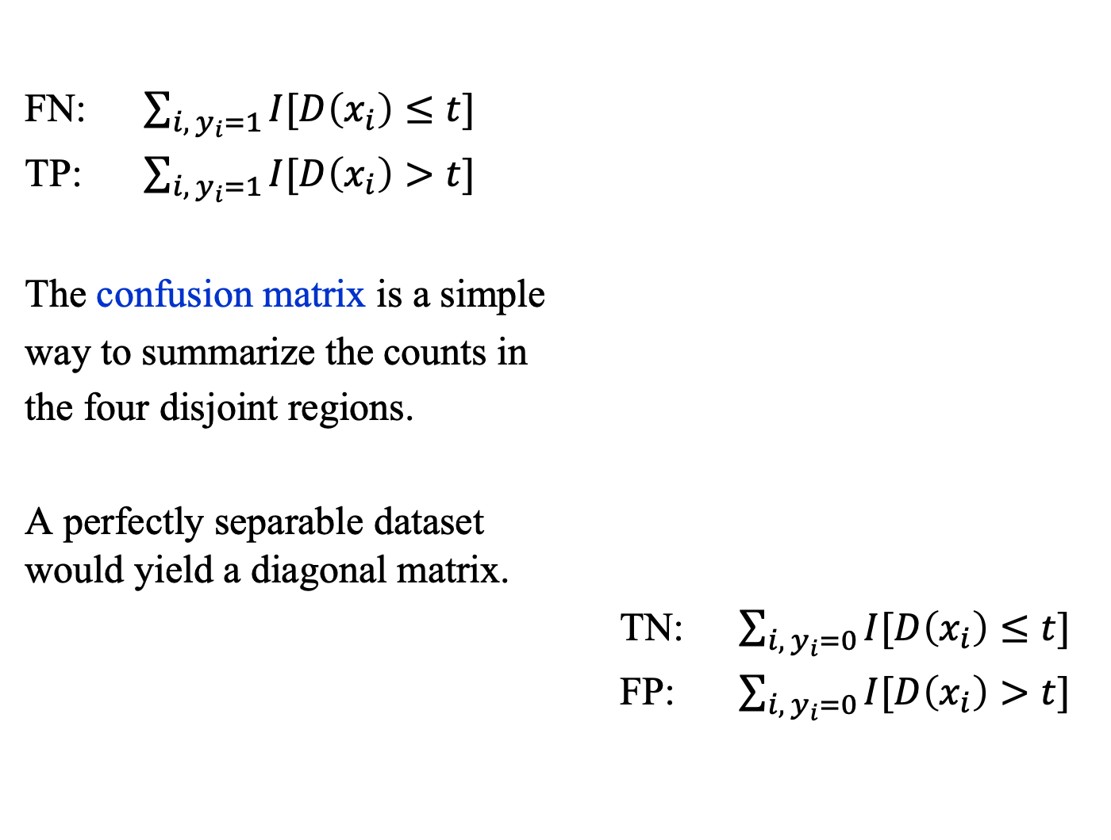
Confusion Matrix
FN: $\sum_{i, y_{i}=1}{I[D\left(x_{i}\right)≤t}]$
TP: $\sum_{{i, y}_{i}=1}{I[D\left(x_{i}\right)>t}]$
The confusion matrix is a simple
way to summarize the counts in
the four disjoint regions.
A perfectly separable dataset
would yield a diagonal matrix.
TN: $\sum_{{i, y}_{i}=0}{I[D\left(x_{i}\right)≤t}]$
FP: $\sum_{{i, y}_{i}=0}{I[D\left(x_{i}\right)>t}]$

Slide 21
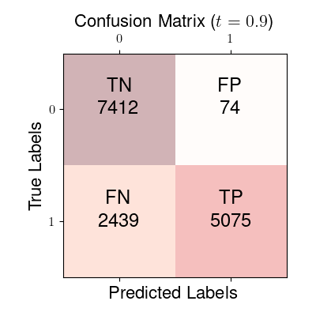
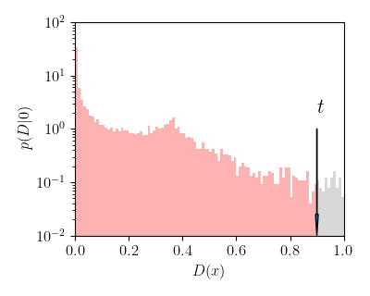
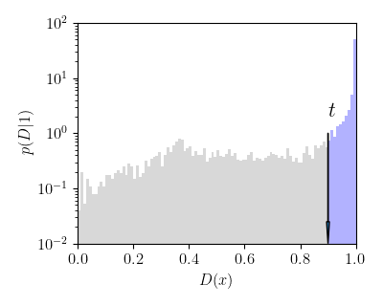

Confusion Matrix ($t=0.9$)

Slide 22

Accuracy, Precision, Recall
Accuracy = (TP + TN) / (TP + TN + FN + FP)
Precision = TP / (TP + FP) $P(y=1|D>t)$
Recall = TP / (FN + TP)
True Positive Rate (TPR) = TP / (FN + TP) $P(D>t|1)$
False Positive Rate (FPR) = FP / (TN + FP) $P(D>t|0)$

Slide 23
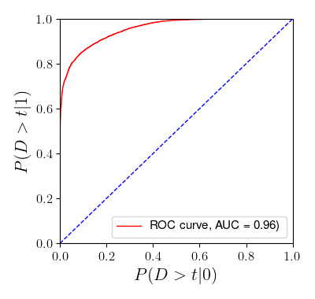

ROC and AUC
The Receiver Operating Characteristic (ROC) curve is a plot of TPR vs. FPR, that is,
$$P\left(D>t | 1\right) \text{vs.} P(D>t|0)$$
for different $t$, where
(usually)
$$D\left(x\right)=\frac{p(x\left|1\right) }{p(x\left|1\right)+p(x\left|0\right)}$$
AUC: Area Under Curve

Slide 24
Summary
The quadratic and binary cross entropy losses are the most widely used loss functions in machine learning.
In addition to the ROC curve and the AUC, the performance of a classifier can be characterized with several other numbers including:
  False Negatives (FN)
  True Positives (TP)
  True Negatives (TN)
  False Positives (FP)
  which can be represented in a confusion matrix.

Slide 25
Beyond Classification

Slide 26
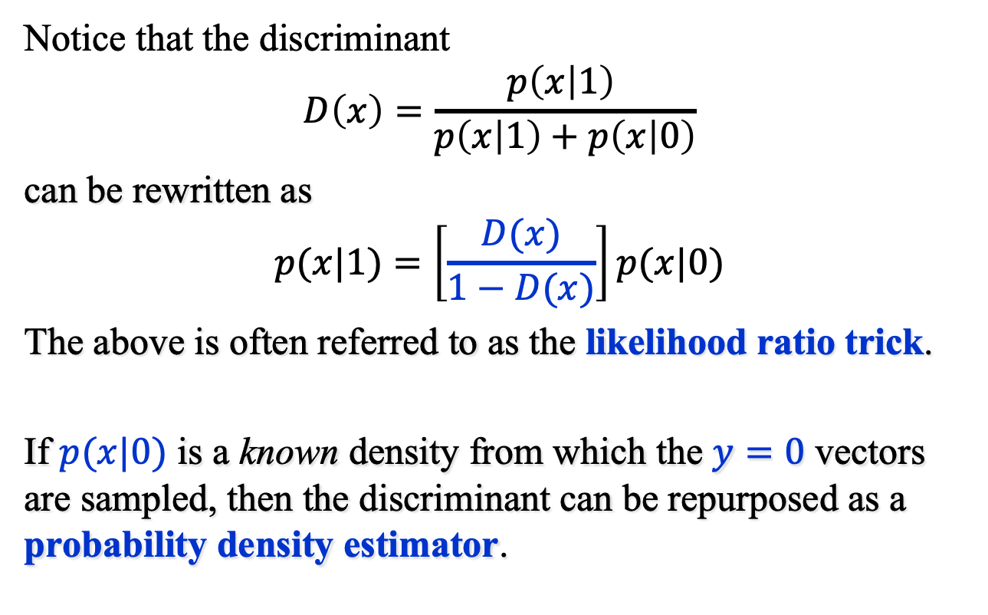
Beyond Classification (1)
Notice that the discriminant
$$D\left(x\right)=\frac{p\left(x | 1\right) }{p\left(x | 1\right)+p\left(x | 0\right)}$$
can be rewritten as
$$p(x|1)=\left[\frac{D(x)}{1−D(x)}\right]p(x|0)$$
The above is often referred to as the likelihood ratio trick.
If $p(x|0)$ is a known density from which the $y=0$ vectors are sampled, then the discriminant can be repurposed as a probability density estimator.

Slide 27
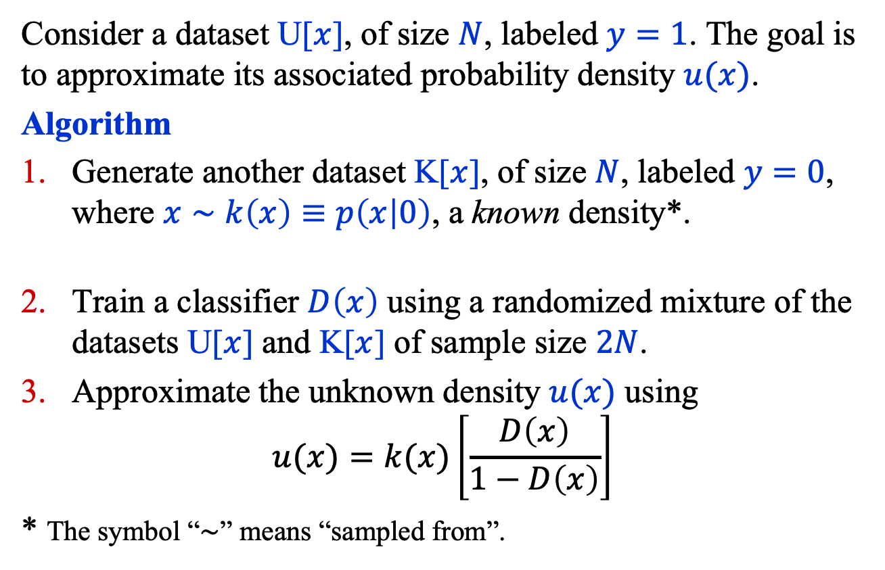
Beyond Classification (2)
Consider a dataset U[$x$], of size $N$, labeled $y=1$. The goal is to approximate its associated probability density $u(x)$.
Algorithm
Generate another dataset K[$x$], of size $N$, labeled $y=0$, where $x∼k\left(x\right)≡p\left(x | 0\right)$, a known density*.
Train a classifier $D\left(x\right)$ using a randomized mixture of the datasets U[$x$] and K[$x$] of sample size $2N$.
Approximate the unknown density $u(x)$ using
$$u(x)=k(x)\left[\frac{D\left(x\right)}{1−D\left(x\right)}\right]$$
* The symbol “$∼$” means “sampled from”.

Slide 28
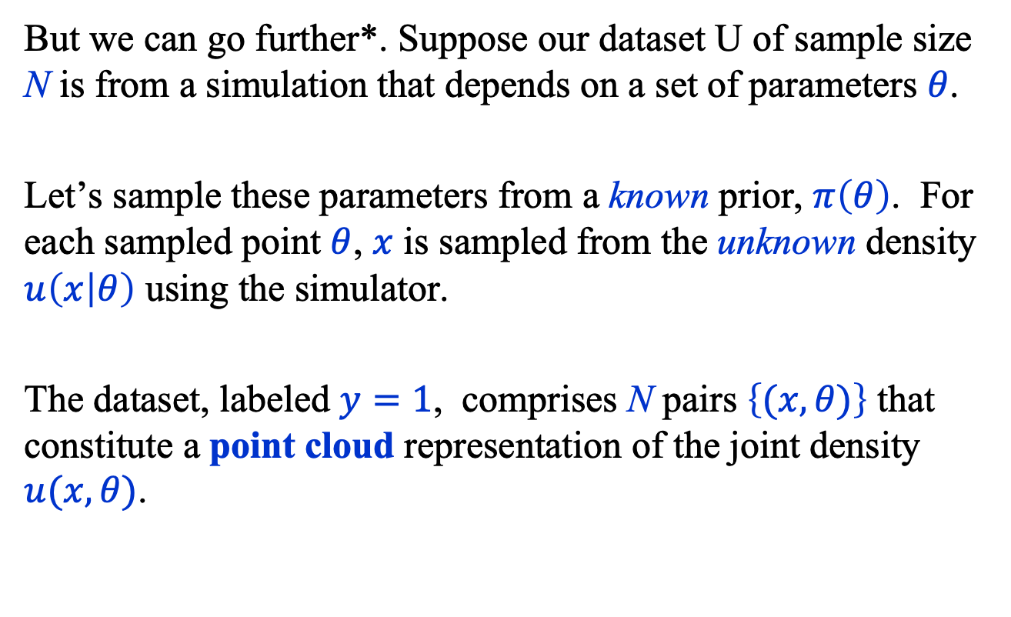
Beyond Classification (3)
But we can go further*. Suppose our dataset U of sample size N is from a simulation that depends on a set of parameters $θ$.
Let’s sample these parameters from a known prior, $π\left(θ\right)$. For each sampled point $θ$, $x$ is sampled from the unknown density $u\left(x | θ\right)$ using the simulator.
The dataset, labeled $y=1$, comprises N pairs $\left\{(x, θ)\right\}$ that constitute a point cloud representation of the joint density $u(x, θ)$.
* Baldi, P., Cranmer, K., Faucett, T. et al.
Parameterized neural networks for high-energy physics. Eur. Phys. J. C 76, 235 (2016).

Slide 29
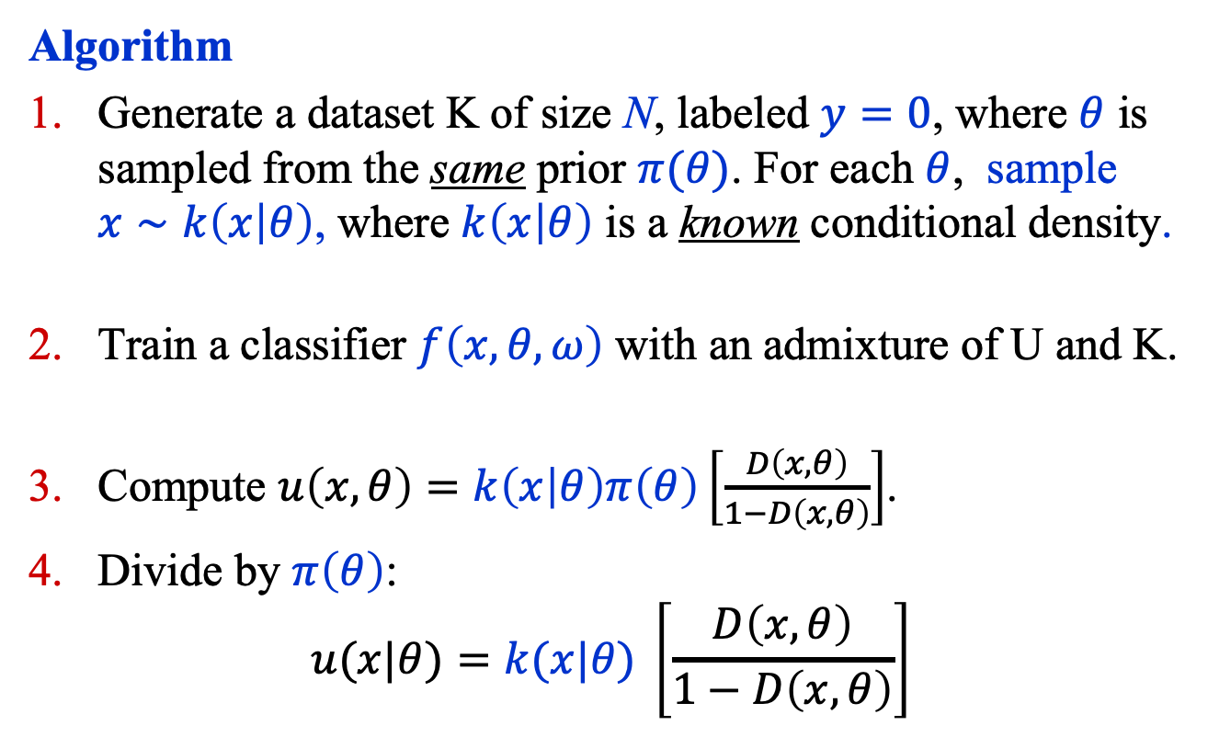
Beyond Classification (4)
Algorithm
Generate a dataset K of size N, labeled $y=0$, where $θ$ is sampled from the same prior $π(θ)$. For each $θ$, sample $x∼k\left(x | θ\right)$, where $k\left(x | θ\right)$ is a known conditional density.
Train a classifier $f\left(x, θ,ω\right)$ with an admixture of U and K.
Compute $u\left(x, θ\right)=k\left(x | θ\right)π\left(θ\right)\left[\frac{D\left(x, θ\right)}{1−D\left(x, θ\right)}\right]$.
Divide by $π\left(θ\right)$:
$$u(x|θ)=k(x|θ) \left[\frac{D\left(x, θ\right)}{1−D\left(x, θ\right)}\right]$$

Slide 30
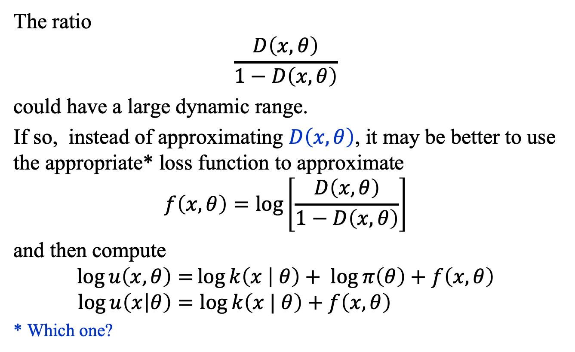
Beyond Classification (5)
The ratio
$$\frac{D\left(x, θ\right)}{1−D\left(x, θ\right)}$$
could have a large dynamic range.
If so, instead of approximating $D\left(x, θ\right)$, it may be better to use the appropriate* loss function to approximate
$$f\left(x, θ\right)=\log\left[\frac{D\left(x, θ\right)}{1−D\left(x, θ\right)}\right]$$
and then compute
$$\log{u\left(x, θ\right)=}\log{k\left(x | θ\right)}+ \log{π\left(θ\right)}+f\left(x, θ\right) \\ \log{u\left(x | θ\right)=\log{k\left(x | θ\right)+f\left(x, θ\right)} }$$
* Which one?

