Slide 1
Machine learning in physics Projects

Slide 2
Project Description
The project has 2 parts:
Use a machine-learning model of your choice to solve a problem of interest to you. This could be one of the following classes of problem: classification, regression, data compression, structure detection, or solving an ordinary differential equation.
Document the project in a jupyter notebook.

Slide 3
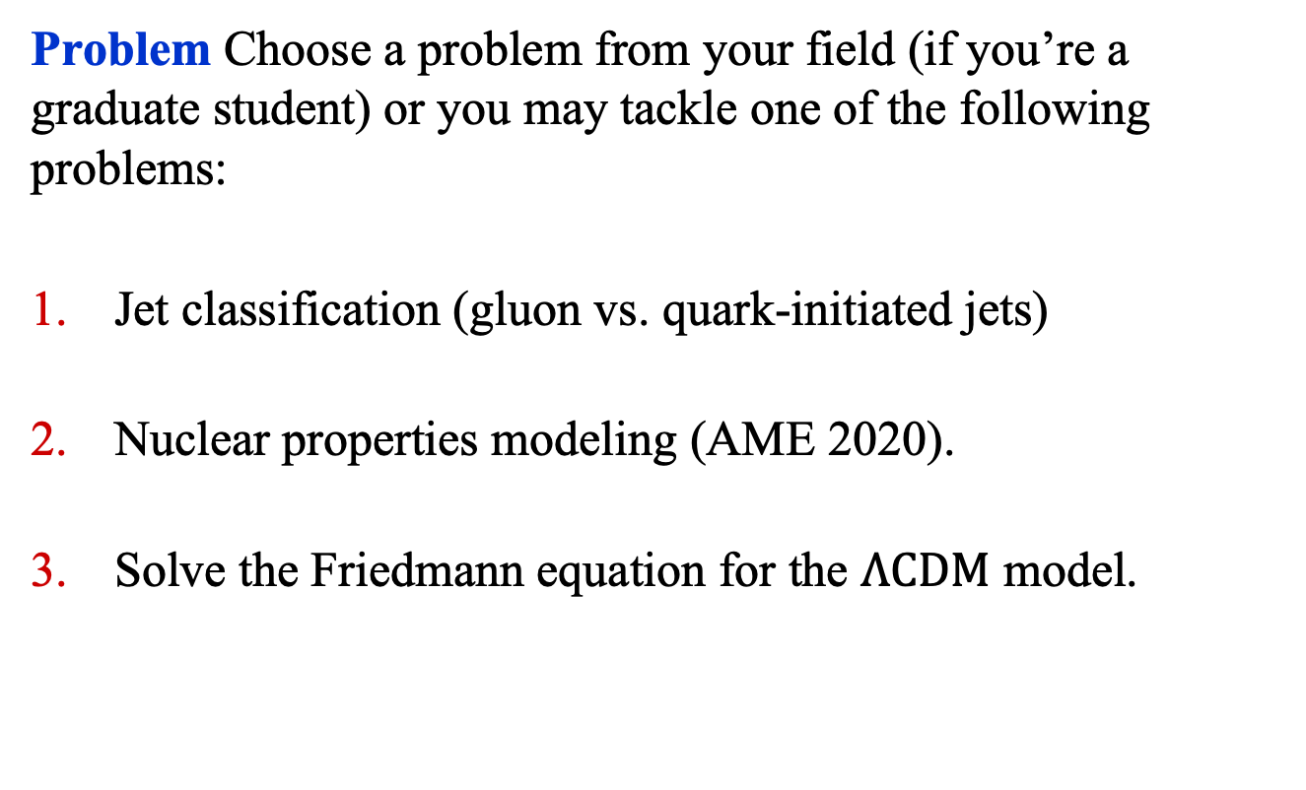
Project Description
Problem Choose a problem from your field (if you’re a graduate student) or you may tackle one of the following problems:
Jet classification (gluon vs. quark-initiated jets)
Nuclear properties modeling (AME 2020).
Solve the Friedmann equation for the $Λ\text{CDM}$ model.

Slide 4
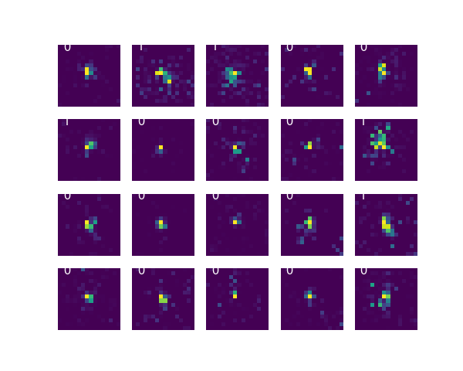
Jet Classification
Problem 1: Using 2D images of jets of particles, classify them into two classes: jets initiated by gluons or by quarks.
Dataset: Images of shape (1, 16, 16), which have been divided into: ['test_x', 'test_y', 'train_x', 'train_y', 'valid_x', 'valid_y’]
Filename: jets.h5
len(train_x): 50,000
len(valid_x): 5000
len(test_x): 5000

Slide 5
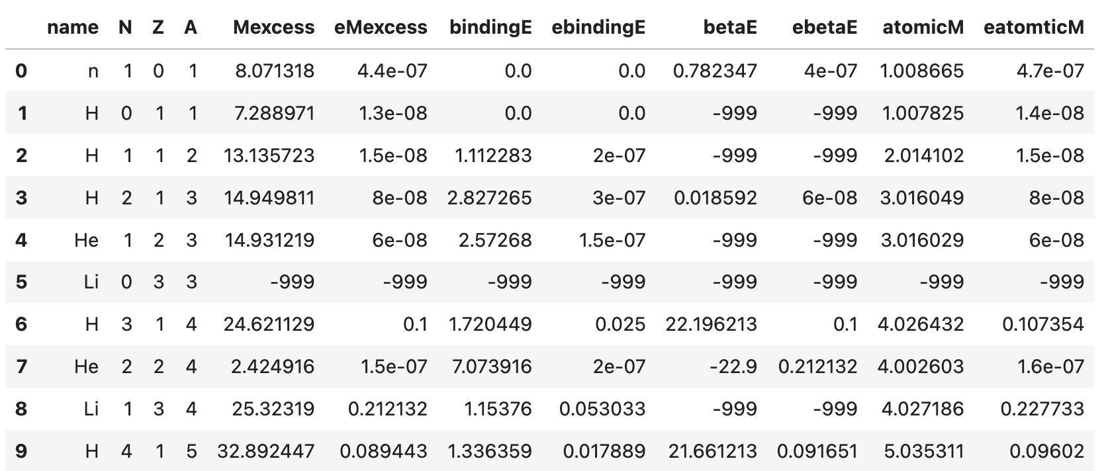
Nuclear Properties
Problem 2: Predict a nuclear property given N, Z, and A.
Dataset: 3,558 nuclei from the AME 2020 mass data¹.
Filename: AME2020.csv
1. The AME 2020 atomic mass evaluation, Chinese Phys. C 45, 030002 (2021) and Chinese Phys. C 45, 030003 (2021).

Slide 6
Nuclear Properties
Problem 2: Predict a nuclear property given N, Z, and A.
Dataset: 3,558 nuclei from the AME 2020 mass data¹.
Energy Variables:
Mexcess, bindingE, betaE: in MeV
atomicM: relative atomic mass
Note: entries in the CSV file with -999 implies missing data.

Slide 7
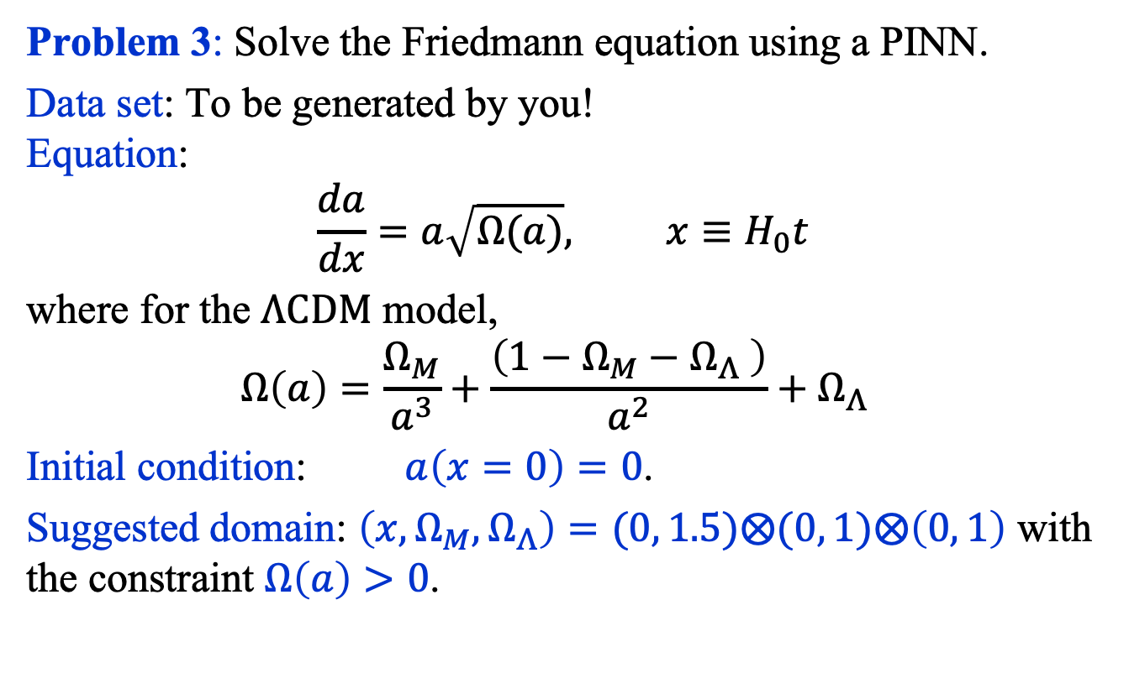
Friedmann Equation
Problem 3: Solve the Friedmann equation using a PINN.
Data set: To be generated by you! Equation:
$$\frac{da}{dx}=a\sqrt{Ω(a)}, x≡H_{0}t$$
where for the $Λ\text{CDM}$ model,
$$Ω\left(a\right)=\frac{Ω_{M}}{a^{3}}+\frac{\left(1−Ω_{M}−Ω_{Λ} \right)}{a^{2}}+Ω_{Λ}$$
Initial condition: $a\left(x=0\right)=0$.
Suggested domain: $\left(x, Ω_{M},Ω_{Λ}\right)=(0, 1.5)⨂(0, 1)⨂\left(0, 1\right)$ with the constraint $Ω\left(a\right)>0$.

Slide 8
Writeup in Jupyter Notebook
Your write-up, using markdown, in the jupyter notebook must include the following elements and sections:
A Title
An Abstract
Introduction
Dataset Description
Model Description
Experiments
Summary

Slide 9
Ground Rules
Class time (both Tuesdays and Thursdays) will be devoted your project. You’re strongly advised to show up!
You are free to help each other, but your paper must be your own.
You are free to use any resources, but you must cite all of them.
You must document the data used, the architecture of your model, the training protocol and the results.

Slide 10
Deadline
Tuesday December 2nd, 2025 @ 11:59PM

