Slide 1
Machine Learning in physics
Graph neural networks

Slide 2
Outline
Introduction
Graph Neural Networks @ IceCube
GNN Tutorial
Summary

Slide 3
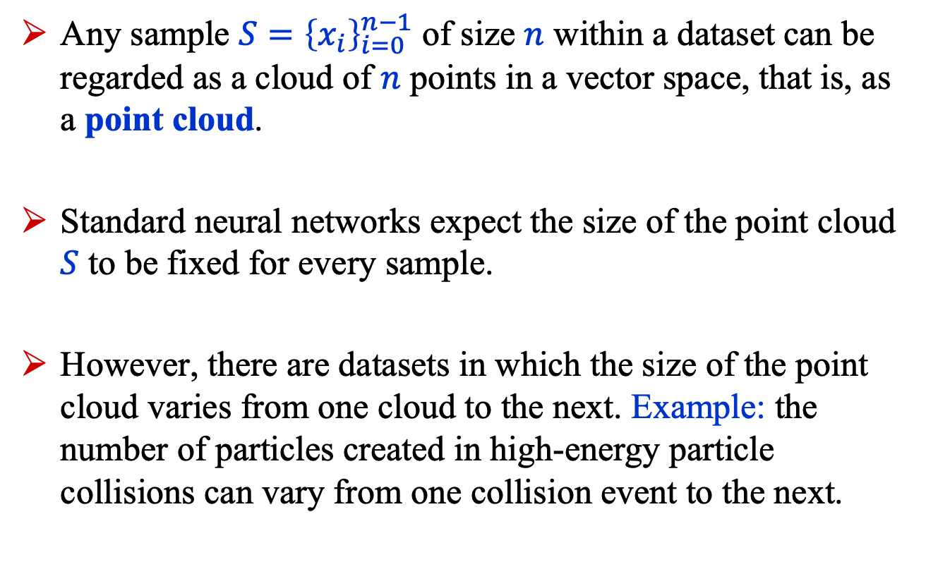
Introduction (1)
Any sample $S={\left\{x_{i}\right\}}_{i=0}^{n−1}$ of size $n$ within a dataset can be regarded as a cloud of $n$ points in a vector space, that is, as a point cloud.
Standard neural networks expect the size of the point cloud $S$ to be fixed for every sample.
However, there are datasets in which the size of the point cloud varies from one cloud to the next. Example: the number of particles created in high-energy particle collisions can vary from one collision event to the next.

Slide 4
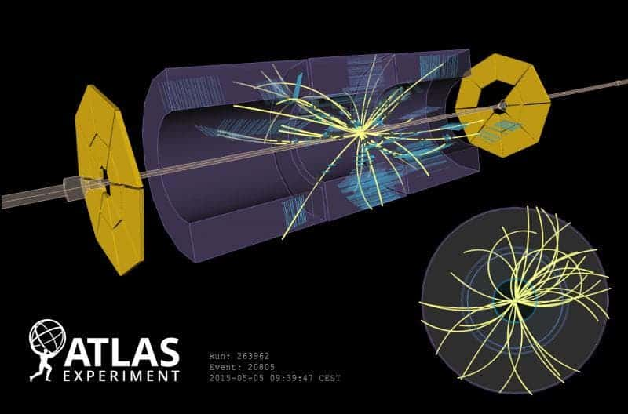

$$S={\left\{{ \left(p_{T}, η, φ\right)}_{i} \right\}}_{i=0}^{n−1}$$

Slide 5
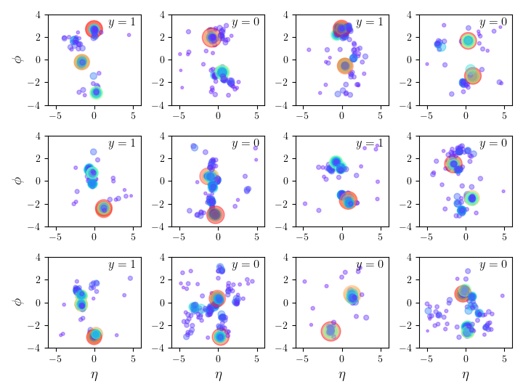
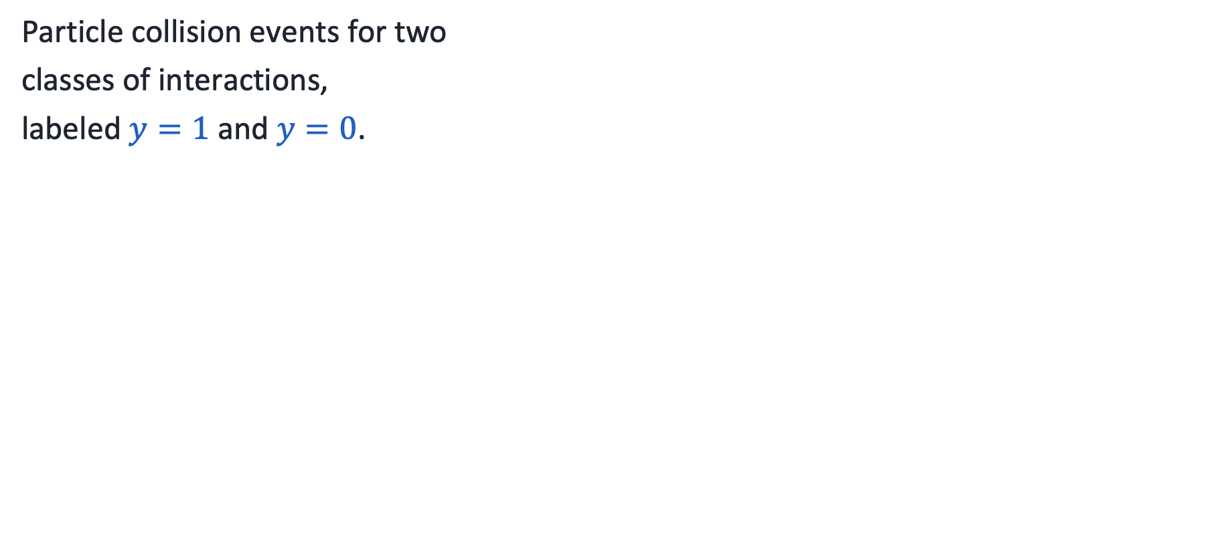
Introduction (2)
Particle collision events for two
classes of interactions,
labeled $y=1$ and $y=0$.
https://lhco2020.github.io/homepage/

Slide 6
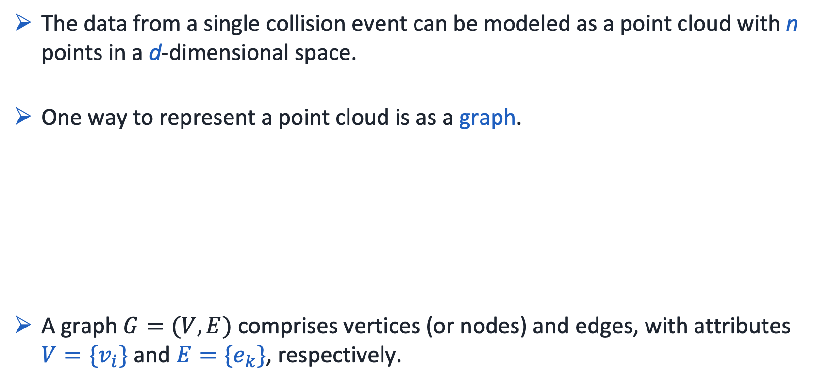
Introduction (3)
The data from a single collision event can be modeled as a point cloud with n points in a d-dimensional space.
One way to represent a point cloud is as a graph.
A graph $G=(V, E)$ comprises vertices (or nodes) and edges, with attributes ${V=\{v}_{i}\}$ and ${E=\{e}_{k}\}$, respectively.
e_{k}
v₂
v₄
v₁
v₃

Slide 7
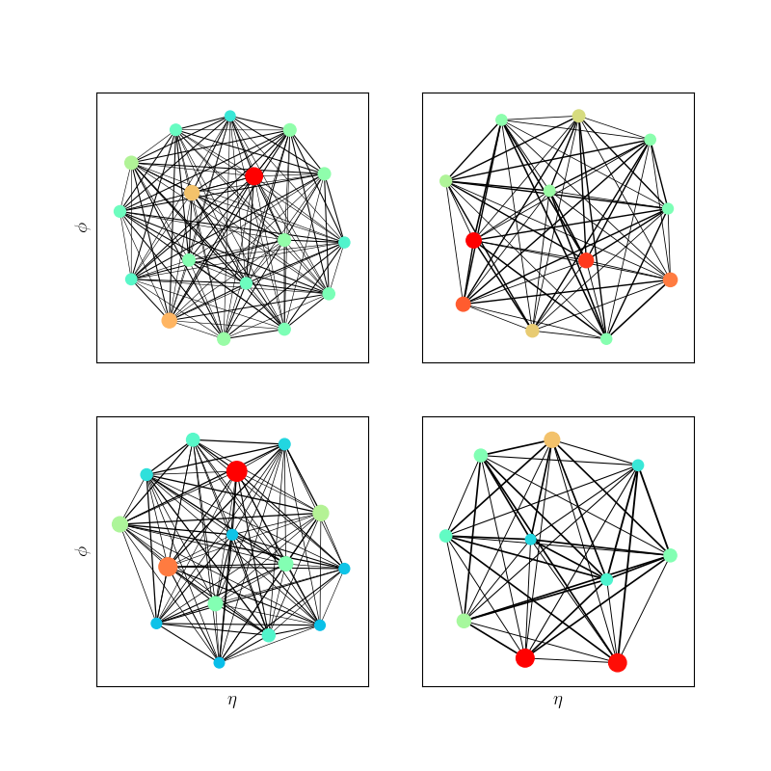
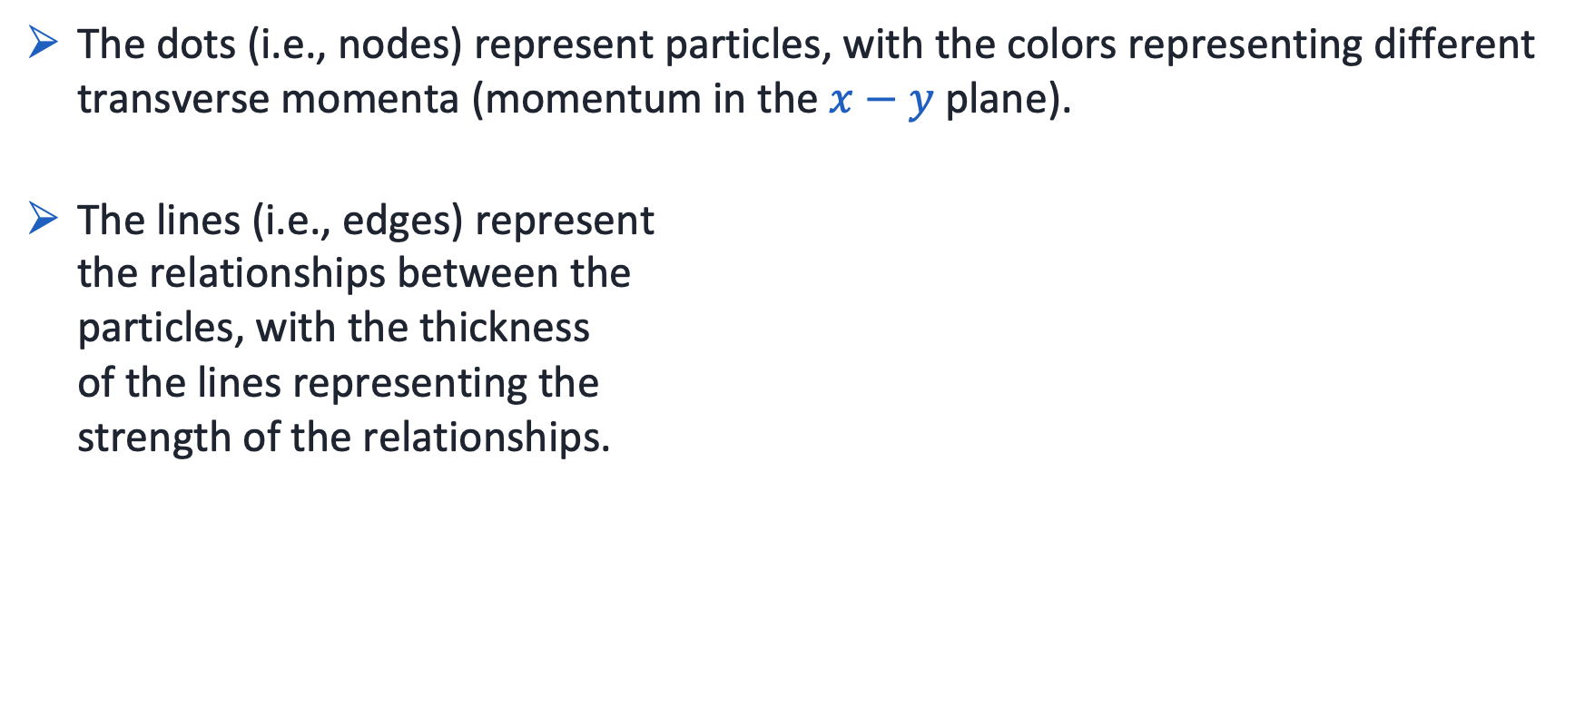
Example: Collision Events as Graphs
The dots (i.e., nodes) represent particles, with the colors representing different transverse momenta (momentum in the $x−y$ plane).
The lines (i.e., edges) represent
the relationships between the
particles, with the thickness
of the lines representing the
strength of the relationships.

Slide 8
Introduction (4)
A graph neural network is a function that operates on data represented as graphs.
A graph enters a graph processor on the left and exits the processor on the right with altered graph attributes.
u
Graph processor
u'
1 edges: e′_{k} = φ^{e}(e_{k}, v_{r(k)}, v_{s(k)}, u)
2 nodes: v′_{i} = φ^{v}(ē′_{i}, v_{i}, u)
3 global: u′ = φ^{u}(ē′, v̄′, u)
G = (u, V, E)
G' = (u', V', E')
https://arxiv.org/abs/1806.01261

Slide 9
ICEcube GNN

Slide 10
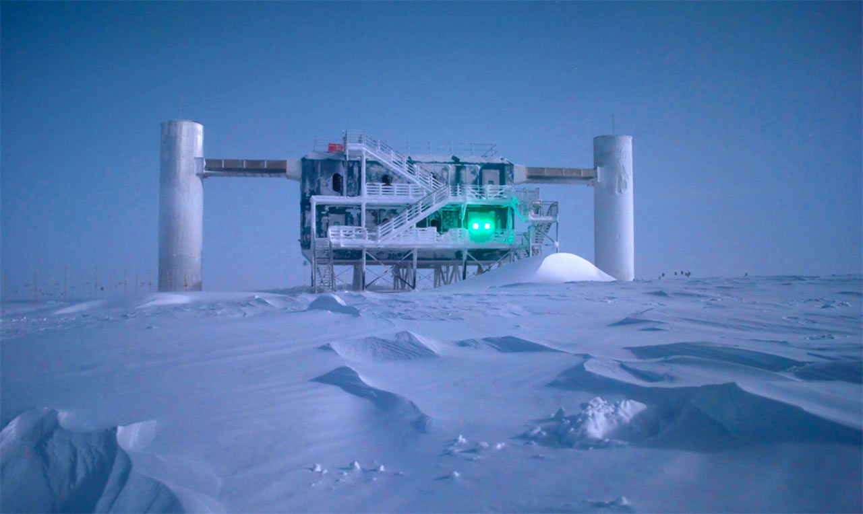
IceCube GNN (1)

Slide 11
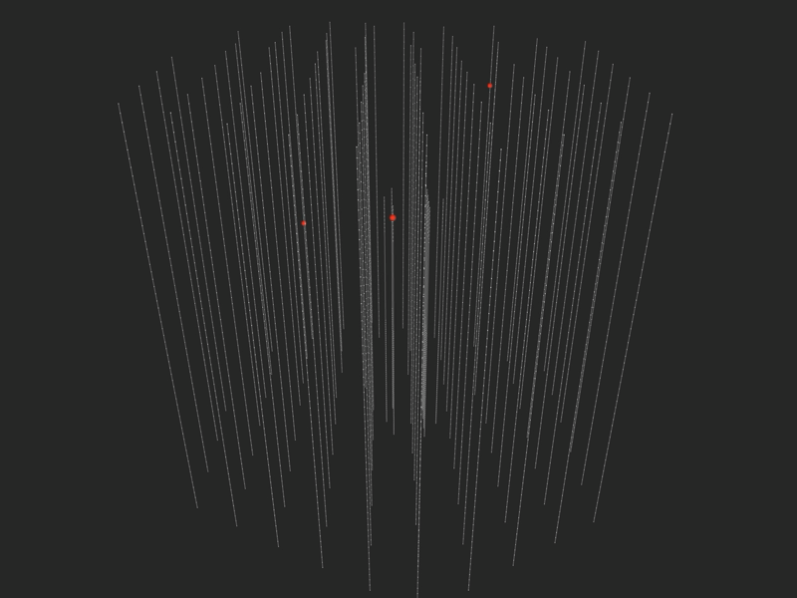
IceCube GNN (2)

Slide 12
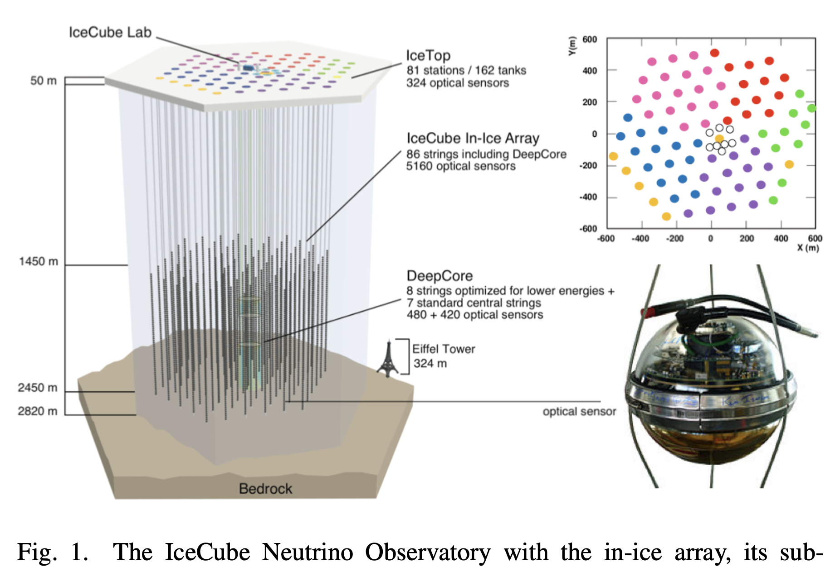
IceCube GNN: Data (1)
The data collected by the IceCube detector consists of signals from photomultipliers*.
*N. Choma et al. IceCube collaboration, Graph Neural Networks for IceCube Signal Classification, arXiv:1809.06166v1

Slide 13
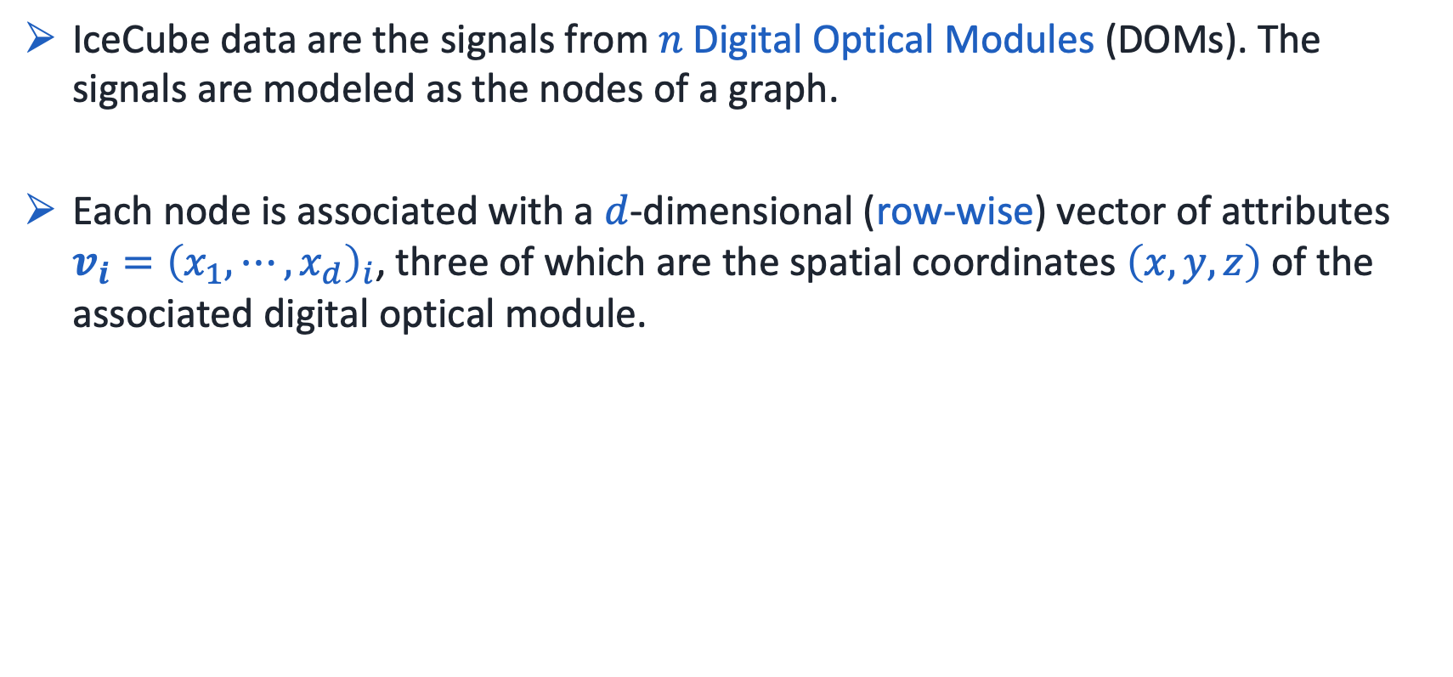
IceCube GNN : Data (2)
IceCube data are the signals from $n$ Digital Optical Modules (DOMs). The signals are modeled as the nodes of a graph.
Each node is associated with a $d$-dimensional (row-wise) vector of attributes $v_{i}={\left(x_{1},⋯,x_{d}\right)}_{i}$, three of which are the spatial coordinates $\left(x, y,z\right)$of the
associated digital optical module.
1, v₁
2, v₂
4, v₄
3, v₃

Slide 14
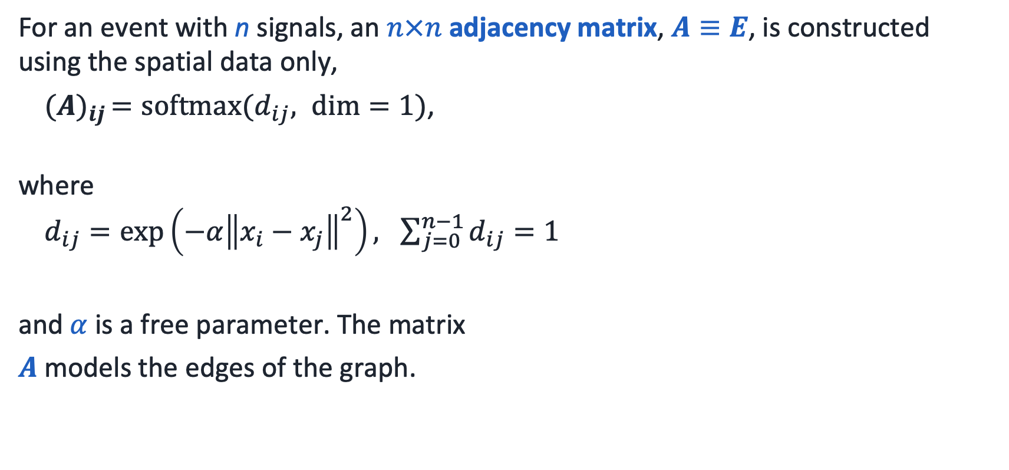
IceCube GNN: Data (3)
For an event with n signals, an $n×n$ adjacency matrix, $A≡E$, is constructed using the spatial data only,
${(A)}_{ij }=softmax(d_{ij}, dim=1)$,
where
$d_{ij}=\exp\left(−α{\left\|x_{i}−x_{j}\right\|}^{2}\right), \sum_{j=0}^{n−1}{d_{ij}=1}$
and $α$ is a free parameter. The matrix
$A$ models the edges of the graph.
1, v₁
2, v₂
4, v₄
3, v₃

Slide 15
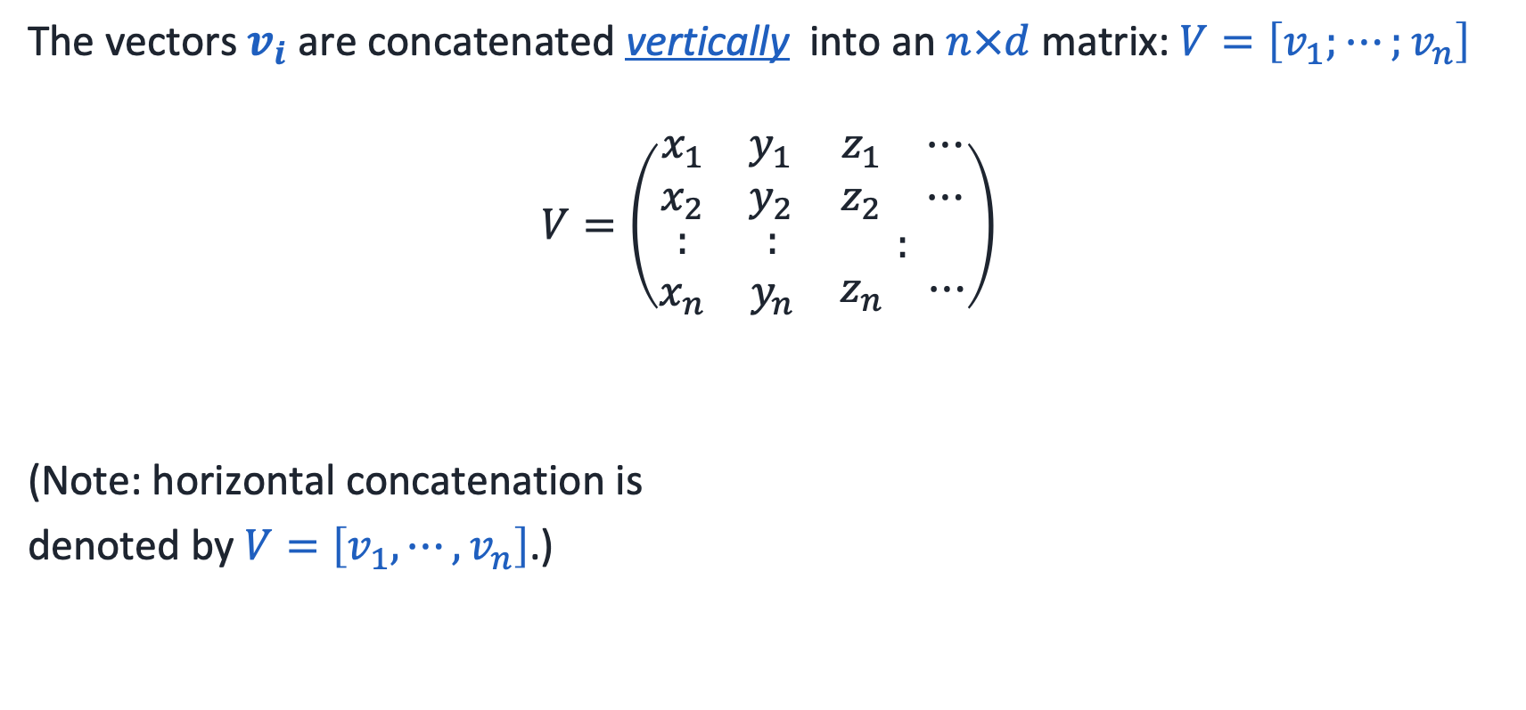
IceCube GNN: Data (4)
The vectors $v_{i}$ are concatenated vertically into an $n×d$ matrix: $V=\left[v_{1};⋯;v_{n}\right]$
$$V=\left(\begin{matrix}\begin{matrix}\begin{matrix}x_{1} & y_{1}\end{matrix} \\ \begin{matrix}x_{2} & y_{2}\end{matrix}\end{matrix} & \begin{matrix}\begin{matrix}z_{1} & ⋯\end{matrix} \\ \begin{matrix}z_{2} & ⋯\end{matrix}\end{matrix} \\ \begin{matrix}\begin{matrix}: \\ x_{n}\end{matrix} & \begin{matrix}: \\ y_{n}\end{matrix}\end{matrix} & \begin{matrix}: \\ \begin{matrix}z_{n} & ⋯\end{matrix}\end{matrix}\end{matrix}\right)$$
(Note: horizontal concatenation is
denoted by $V=\left[v_{1},⋯,v_{n}\right]$.)
1, v₁
2, v₂
4, v₄
3, v₃

Slide 16
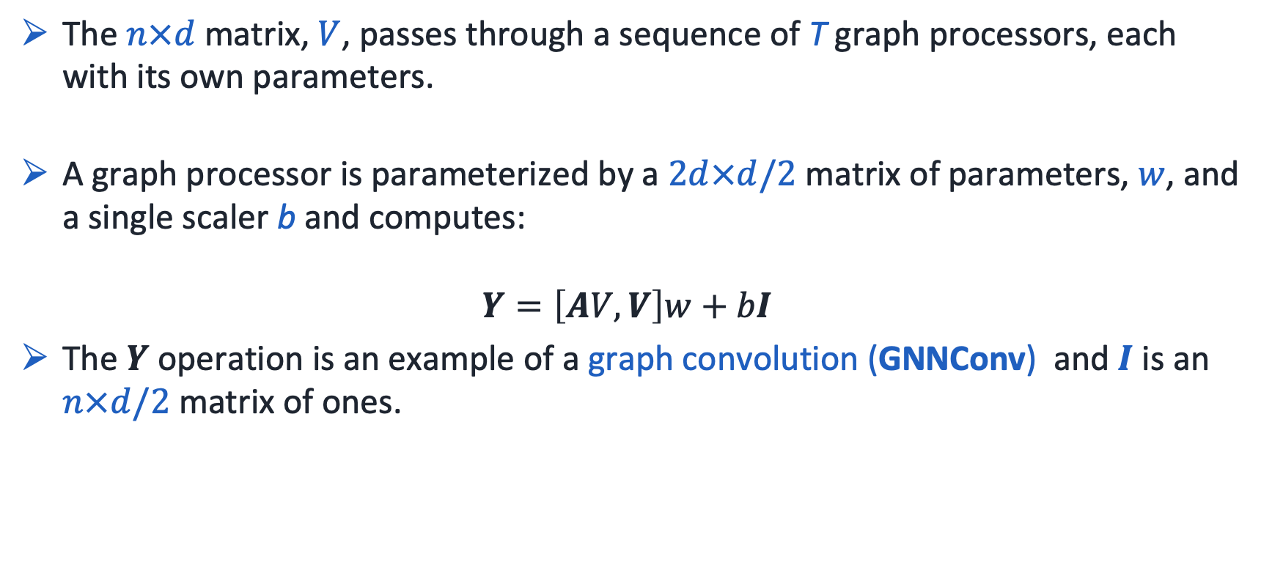
IceCube GNN: GNN (1)
The $n×d$ matrix, $V$, passes through a sequence of T graph processors, each with its own parameters.
A graph processor is parameterized by a $2d×d/2$ matrix of parameters, $w$, and a single scaler b and computes:
$$Y=\left[AV, V\right]w+bI$$
The $Y$ operation is an example of a graph convolution (GNNConv) and $I$ is an $n×d/2$ matrix of ones.
X
1
2
T
x_{k} = Σ_{j} x_{jk}
y = sigmoid(x a^{T} + b)
V
⋯
graph processors
sum over the n nodes
classifier output

Slide 17
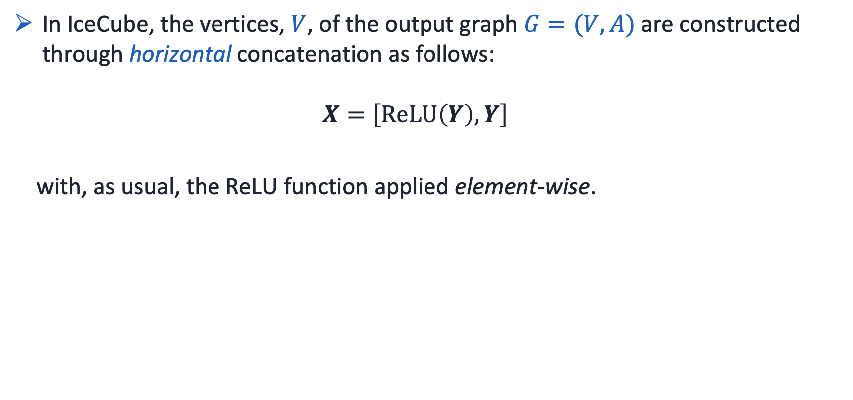
IceCube GNN: GNN (2)
In IceCube, the vertices, $V$, of the output graph $G=(V, A)$ are constructed through horizontal concatenation as follows:
$X=\left[\text{ReLU}\left(Y\right), Y\right]$
with, as usual, the ReLU function applied element-wise.
X
1
2
T
x_{k} = Σ_{j} x_{jk}
y = sigmoid(x a^{T} + b)
V
⋯
graph processors
sum over the n nodes
classifier output

Slide 18
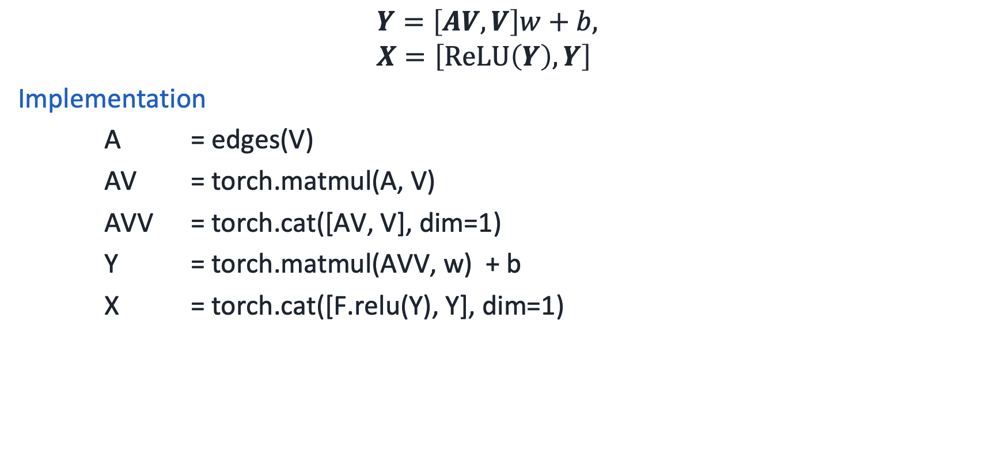
IceCube GNN: GNNConv (1)
$$Y=\left[AV, V\right]w+b, \\ X=\left[\text{ReLU}\left(Y\right), Y\right]$$
Implementation
A = edges(V)
AV = torch.matmul(A, V)
AVV = torch.cat([AV, V], dim=1)
Y = torch.matmul(AVV, w) + b
X = torch.cat([F.relu(Y), Y], dim=1)

Slide 19
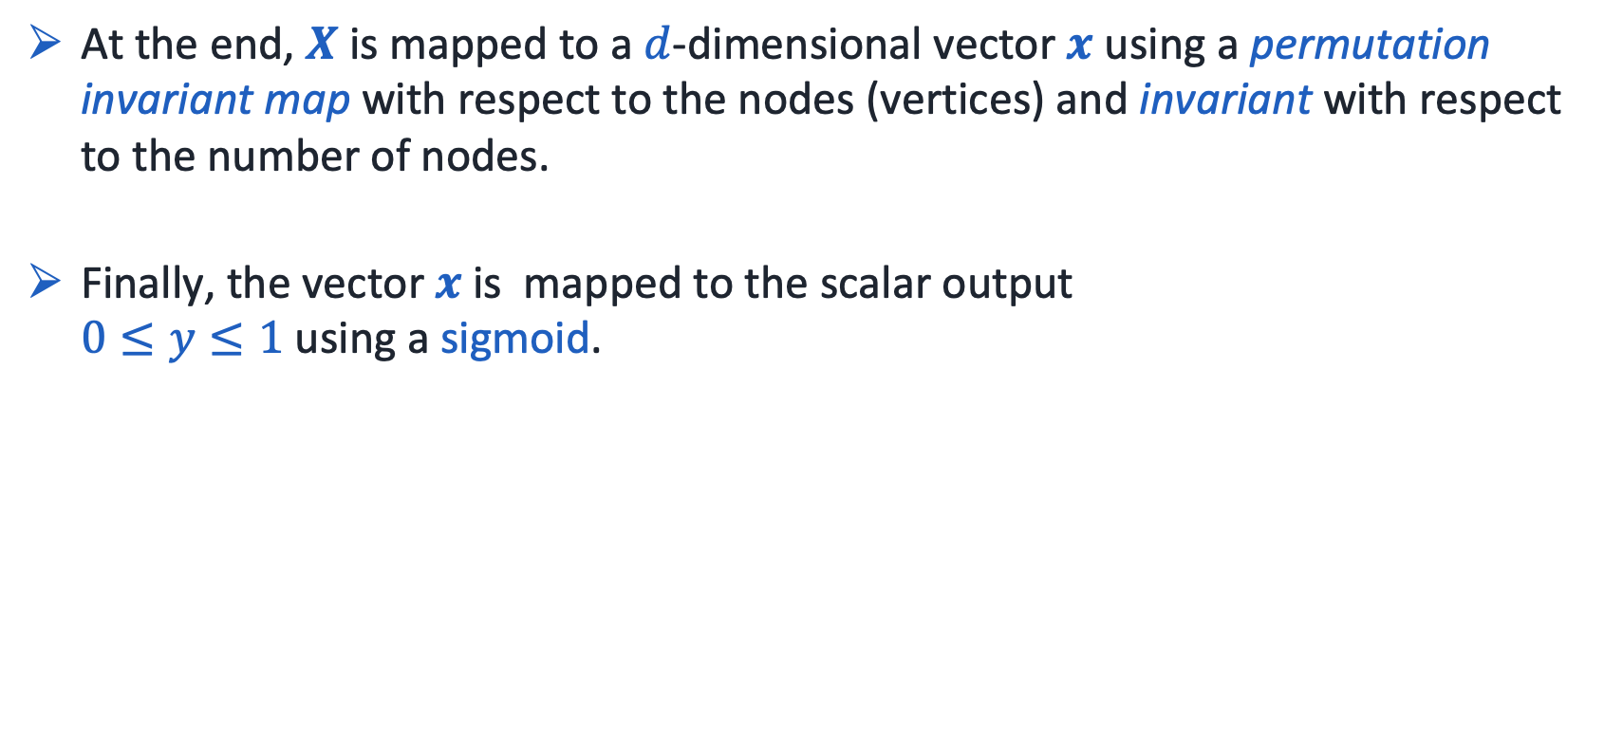
IceCube GNN: GNN (3)
At the end, $X$is mapped to a $d$-dimensional vector $x$ using a permutation invariant map with respect to the nodes (vertices) and invariant with respect to the number of nodes.
Finally, the vector $x$is mapped to the scalar output
$0≤y≤1$ using a sigmoid.
1
2
T
x_{k} = Σ_{j} x_{jk}
y = sigmoid(x a^{T} + b)
X
⋯
graph processors
sum over the n nodes
classifier output

Slide 20
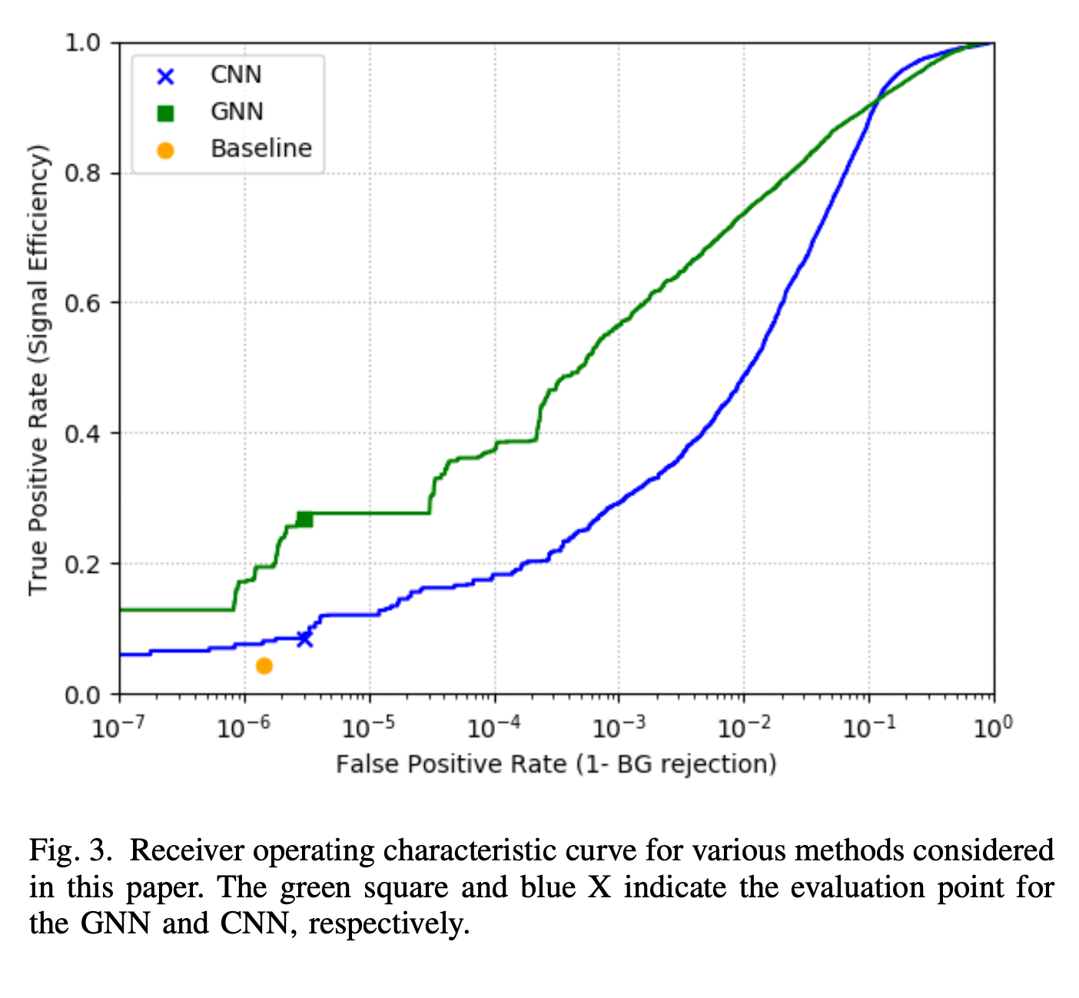
IceCube GNN: GNN Results
The GNN is 6.3 times more efficient
than the IceCube physics baseline
analysis at a signal to noise ratio
that is 3 times better.
It also outperforms a 3D CNN.

Slide 21
GNN Tutorial

Slide 22
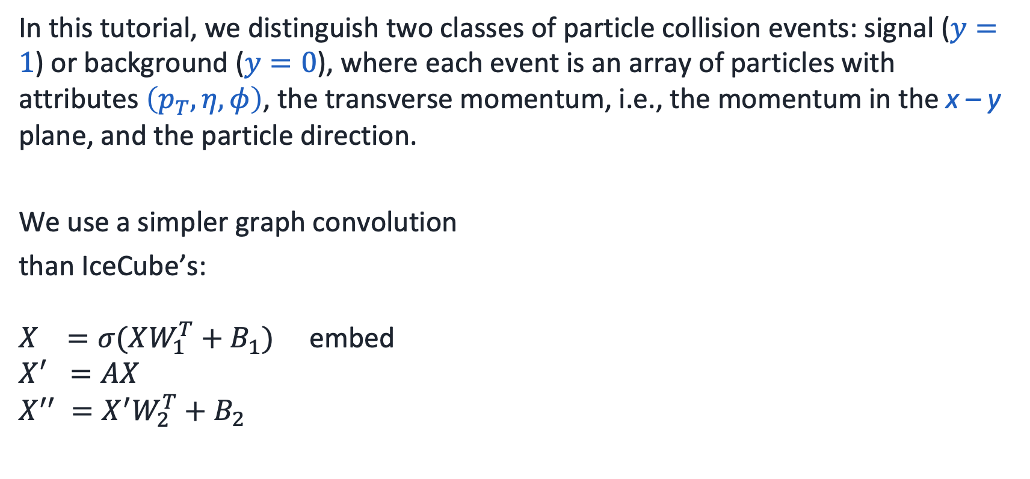
GNN Tutorial: Goal
In this tutorial, we distinguish two classes of particle collision events: signal ($y=1$) or background ($y=0$), where each event is an array of particles with attributes $\left(p_{T}, η, φ\right)$, the transverse momentum, i.e., the momentum in the x – y plane, and the particle direction.
We use a simpler graph convolution
than IceCube’s:
$X =σ(XW_{1}^{T}+B_{1})$ embed
$$X^{′} =AX$$
$$X^{′′} =X^{′}W_{2}^{T}+B_{2}$$
https://lhco2020.github.io/homepage/

Slide 23
GNN: Model
p(y = 1 | G), G = (V, A)
Sigmoid
Z
Linear
GNNConv(X, A)
mean
average over nodes
Linear
Dropout
multiply by A
·
× 2
ReLU
ReLU
GNNConv
A
embed
X
edges
X
A
V
Z = Linear(A · ReLU(embed(X)))

Slide 24
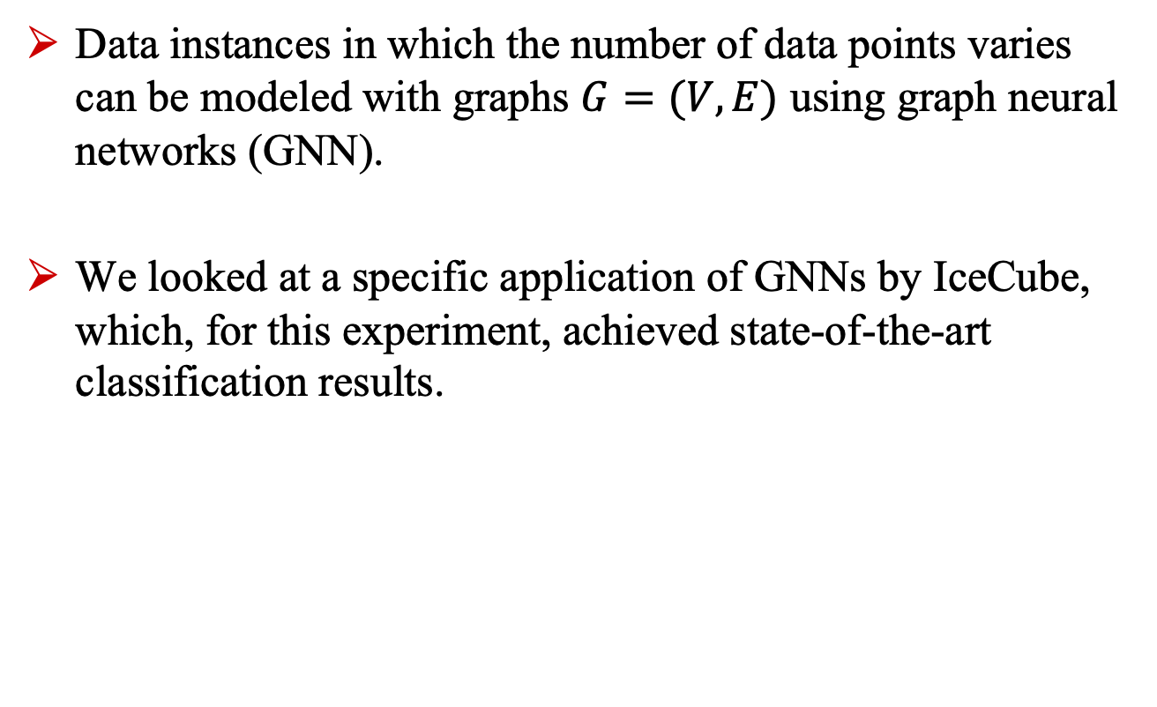
Summary
Data instances in which the number of data points varies can be modeled with graphs $G=(V, E)$ using graph neural networks (GNN).
We looked at a specific application of GNNs by IceCube, which, for this experiment, achieved state-of-the-art classification results.

