Slide 1
Machine learning in physics Flow and diffusion models

Slide 2
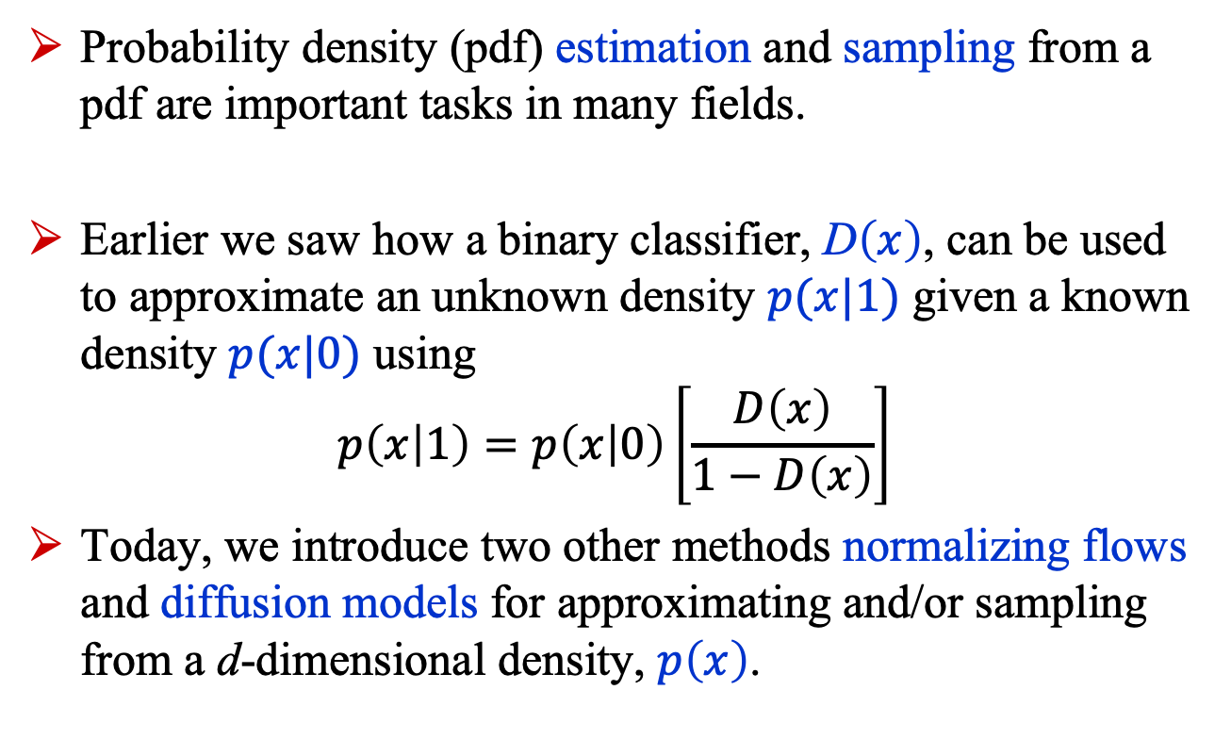
Introduction
Probability density (pdf) estimation and sampling from a pdf are important tasks in many fields.
Earlier we saw how a binary classifier, D$\left(x\right)$, can be used to approximate an unknown density $p(x|1)$ given a known density $p(x|0)$ using
$$p\left(x | 1\right)=p\left(x | 0\right)\left[\frac{D\left(x\right)}{1−D\left(x\right)}\right]$$
Today, we introduce two other methods normalizing flows and diffusion models for approximating and/or sampling from a d-dimensional density, $p\left(x\right)$.

Slide 3
Normalizing flows

Slide 4
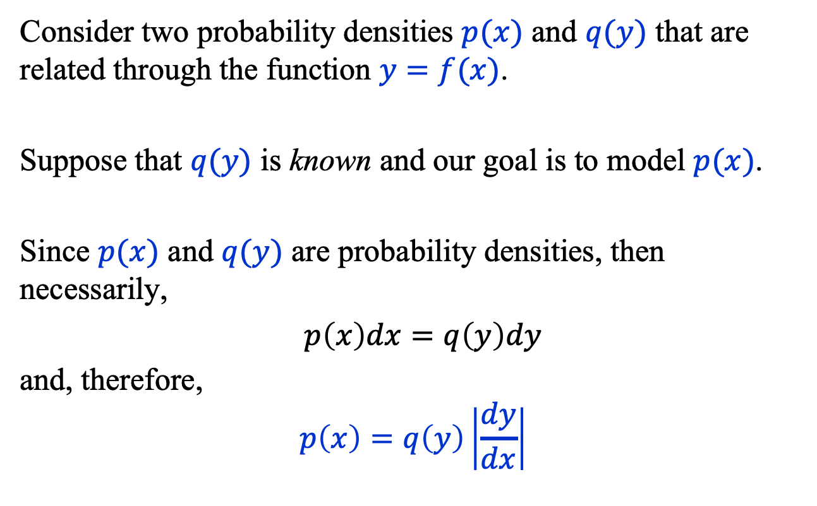
Change of Variables (1)
Consider two probability densities $p(x)$ and $q(y)$ that are related through the function $y=f(x)$.
Suppose that $q(y)$ is known and our goal is to model $p(x)$.
Since $p(x)$ and $q(y)$ are probability densities, then necessarily,
$p\left(x\right)dx=q\left(y\right)dy$
and, therefore,
$$p\left(x\right)=q\left(y\right)\left|\frac{dy}{dx}\right|$$

Slide 5
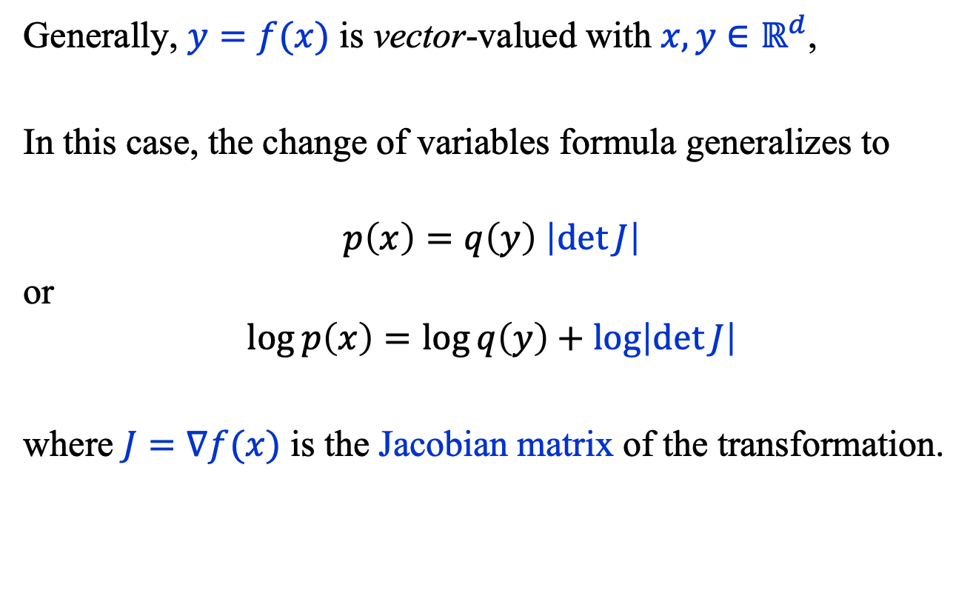
Change of Variables (2)
Generally, $y=f(x)$ is vector-valued with $x, y∈ℝ^{d}$,
In this case, the change of variables formula generalizes to
$$p\left(x\right)=q\left(y\right) \left|\det{J}\right|$$
or
$$\log{p\left(x\right)}=\log{q\left(y\right)}+\log\left|\det{J}\right|$$
where $J=∇f(x)$ is the Jacobian matrix of the transformation.

Slide 6
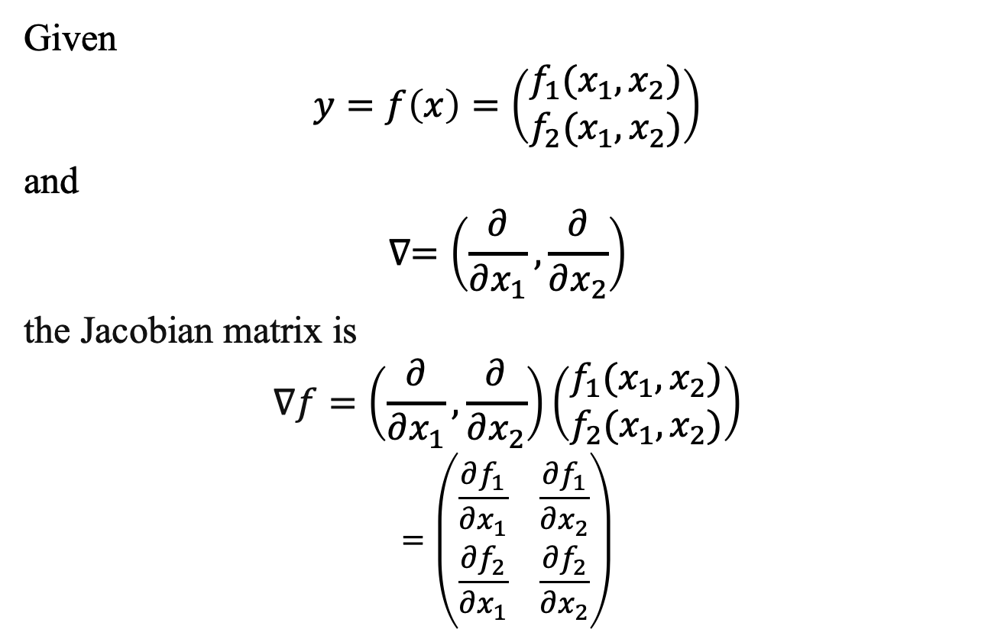
Change of Variables: Example (1)
Given
$$y=f\left(x\right)=\left(\begin{matrix}f_{1}(x_{1}, x_{2}) \\ f_{2}(x_{1},x_{2})\end{matrix}\right)$$
and
$$∇=\left(\frac{∂}{∂x_{1}}, \frac{∂}{∂x_{2}}\right)$$
the Jacobian matrix is
$$∇f=\left(\frac{∂}{∂x_{1}}, \frac{∂}{∂x_{2}}\right)\left(\begin{matrix}f_{1}(x_{1}, x_{2}) \\ f_{2}(x_{1},x_{2})\end{matrix}\right)$$
$$=\left(\begin{matrix}\frac{∂f_{1}}{∂x_{1}} & \frac{∂f_{1}}{∂x_{2}} \\ \frac{∂f_{2}}{∂x_{1}} & \frac{∂f_{2}}{∂x_{2}}\end{matrix}\right)$$

Slide 7
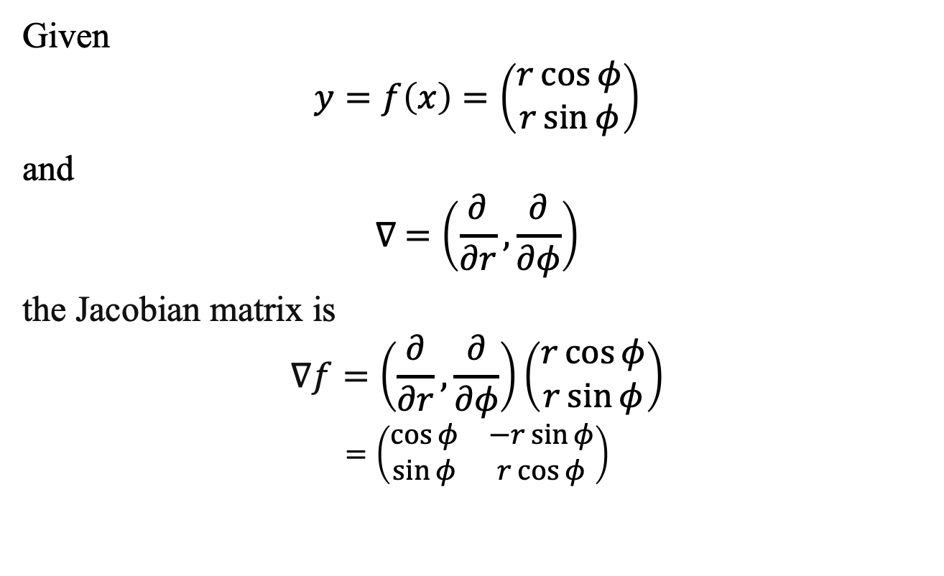
Change of Variables: Example (2)
Given
$$y=f\left(x\right)=\left(\begin{matrix}r\cos{φ} \\ r\sin{φ}\end{matrix}\right)$$
and
$$∇ =\left(\frac{∂}{∂r}, \frac{∂}{∂φ}\right)$$
the Jacobian matrix is
$$∇f=\left(\frac{∂}{∂r}, \frac{∂}{∂φ}\right)\left(\begin{matrix}r\cos{φ} \\ r\sin{φ}\end{matrix}\right)$$
$$=\left(\begin{matrix}\cos{φ} & −r\sin{φ} \\ \sin{φ} & r\cos{φ}\end{matrix}\right)$$

Slide 8



Normalizing Flows (1)
codomain $y=f(x)$ domain
A normalizing flow is a way to approximate the function $f(x)$ by modeling the latter as a composition of bijections $f_{i}$.
$$f\left(x\right)=f_{n}∘f_{n−1}∘…f_{1}$$
$=f_{n}(f_{n−1}\left(…f_{1}\left(x\right)\right)…)$
(A bijection is a one-to-one invertible function.)
$$y$$
$$x$$

Slide 9


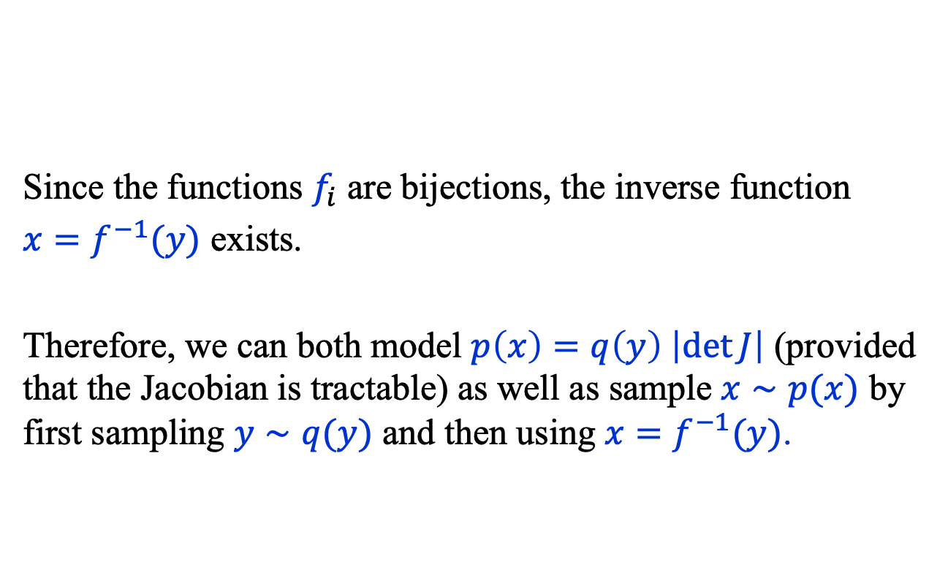



Normalizing Flows (2)
Since the functions $f_{i}$ are bijections, the inverse function
$x=f^{−1}(y)$ exists.
Therefore, we can both model $p\left(x\right)=q\left(y\right) \left|\det{J}\right|$ (provided that the Jacobian is tractable) as well as sample $x∼p(x)$ by first sampling $y∼q(y)$ and then using $x=f^{−1}(y)$.
$$y$$
…
$$x$$
$$f_{n}$$
$$f_{n−1}$$
$$f_{1}$$

Slide 10
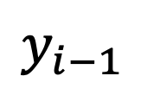
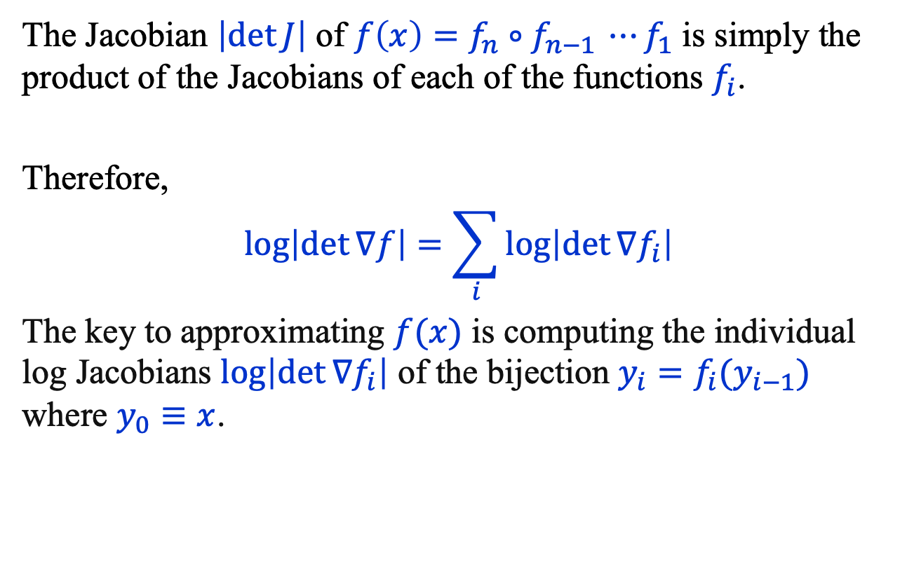
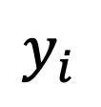

Normalizing Flows (3)
The Jacobian $\left|\det{J}\right|$ of $f\left(x\right)=f_{n}∘f_{n−1 }⋯f_{1}$ is simply the product of the Jacobians of each of the functions $f_{i}$.
Therefore,
$$\log\left|\det{∇f}\right|=\sum_{i}{\log\left|\det{∇f_{i}}\right|}$$
The key to approximating $f(x)$ is computing the individual log Jacobians $\log\left|\det{∇f_{i}}\right|$ of the bijection $y_{i}=f_{i}(y_{i−1})$ where $y_{0}≡x$.
$$y_{i}$$
$$f_{i}$$
$$y_{i−1}$$

Slide 11
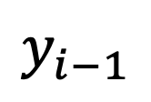
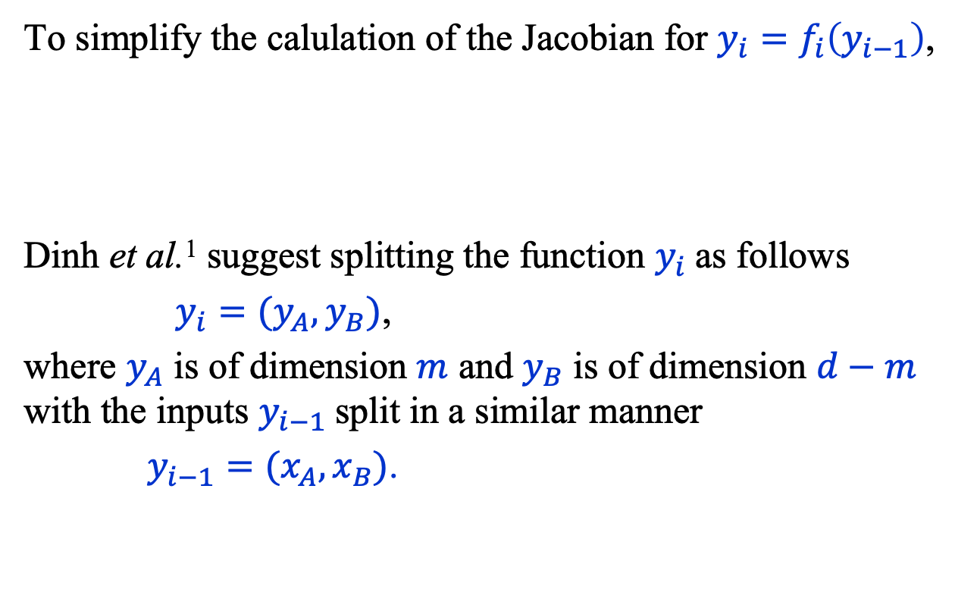
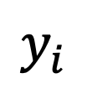

Normalizing Flows: Bijection (1)
To simplify the calulation of the Jacobian for $y_{i}=f_{i}\left(y_{i−1}\right)$,
Dinh et al.¹ suggest splitting the function $y_{i}$as follows
$y_{i}=(y_{A}, y_{B})$,
where $y_{A}$ is of dimension $m$ and $y_{B}$ is of dimension $d−m$ with the inputs $y_{i−1}$split in a similar manner
$y_{i−1}=(x_{A}, x_{B})$.
$$y_{i}$$
$$f_{i}$$
$$y_{i−1}$$
Laurent Dinh, Jascha Sohl-Dickstein, and Samy Bengio, Density Estimation using Real NVP,
https://arxiv.org/abs/1605.08803

Slide 12
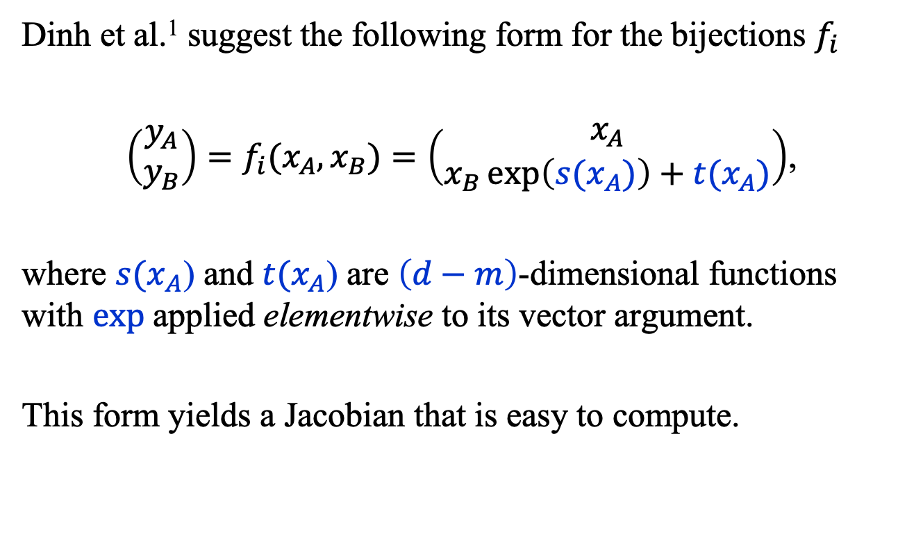
Normalizing Flows: Bijection (2)
Dinh et al.¹ suggest the following form for the bijections $f_{i}$
$\left(\begin{matrix}y_{A} \\ y_{B}\end{matrix}\right)=f_{i}(x_{A}, x_{B})=\left(\begin{matrix}x_{A} \\ x_{B}\exp\left({s(x}_{A})\right)+t(x_{A})\end{matrix}\right)$,
where ${s(x}_{A}$) and $t(x_{A}$) are $\left(d−m\right)$-dimensional functions with $exp$applied elementwise to its vector argument.
This form yields a Jacobian that is easy to compute.
Laurent Dinh, Jascha Sohl-Dickstein, and Samy Bengio, Density Estimation using Real NVP,
https://arxiv.org/abs/1605.08803

Slide 13
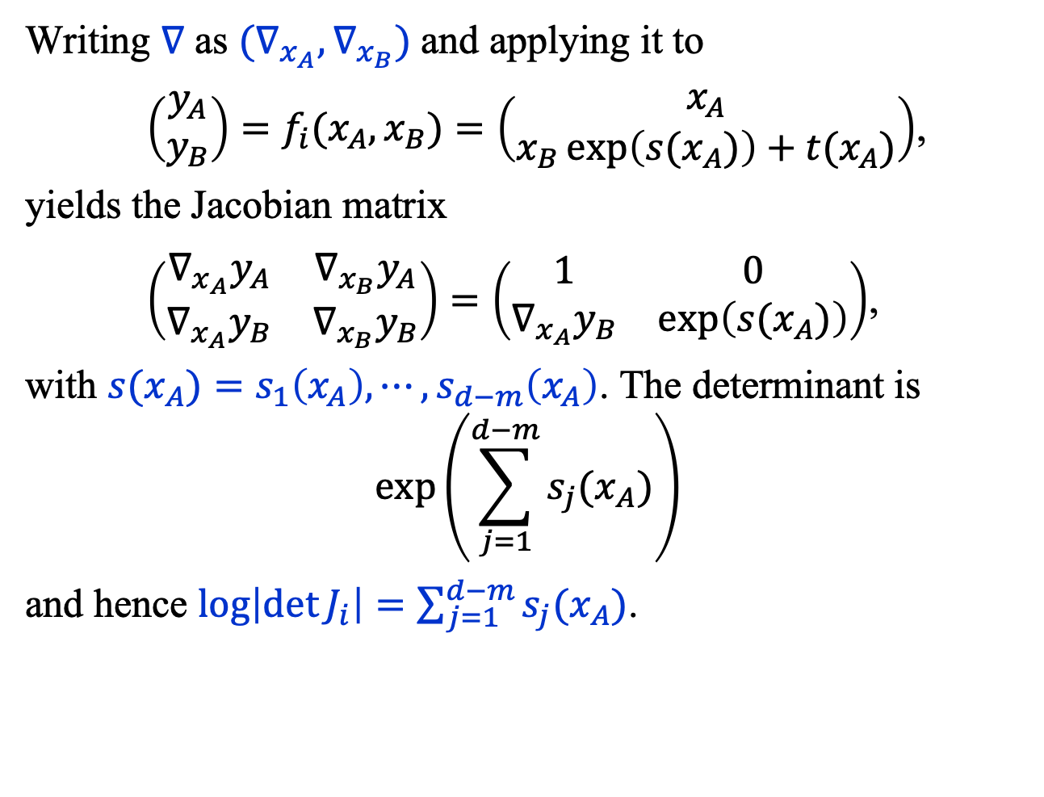
Normalizing Flows: Jacobian
Writing $∇$ as $(∇_{x_{A}}, ∇_{x_{B}})$and applying it to
$\left(\begin{matrix}y_{A} \\ y_{B}\end{matrix}\right)=f_{i}(x_{A}, x_{B})=\left(\begin{matrix}x_{A} \\ x_{B}\exp\left({s(x}_{A})\right)+t(x_{A})\end{matrix}\right)$,
yields the Jacobian matrix
$\left(\begin{matrix}∇_{x_{A}}y_{A} & ∇_{x_{B}}y_{A} \\ ∇_{x_{A}}y_{B} & ∇_{x_{B}}y_{B}\end{matrix}\right)=\left(\begin{matrix}1 & 0 \\ ∇_{x_{A}}y_{B} & \exp\left({s(x}_{A})\right)\end{matrix}\right)$,
with ${s(x}_{A})=s_{1}\left(x_{A}\right),⋯,s_{d−m}\left(x_{A}\right)$. The determinant is
$$\exp\left(\sum_{j=1}^{d−m}{{s_{j}(x}_{A}})\right)$$
and hence $\log\left|{\det{J}}_{i}\right|=\sum_{j=1}^{d−m}{{s_{j}(x}_{A}})$.

Slide 14
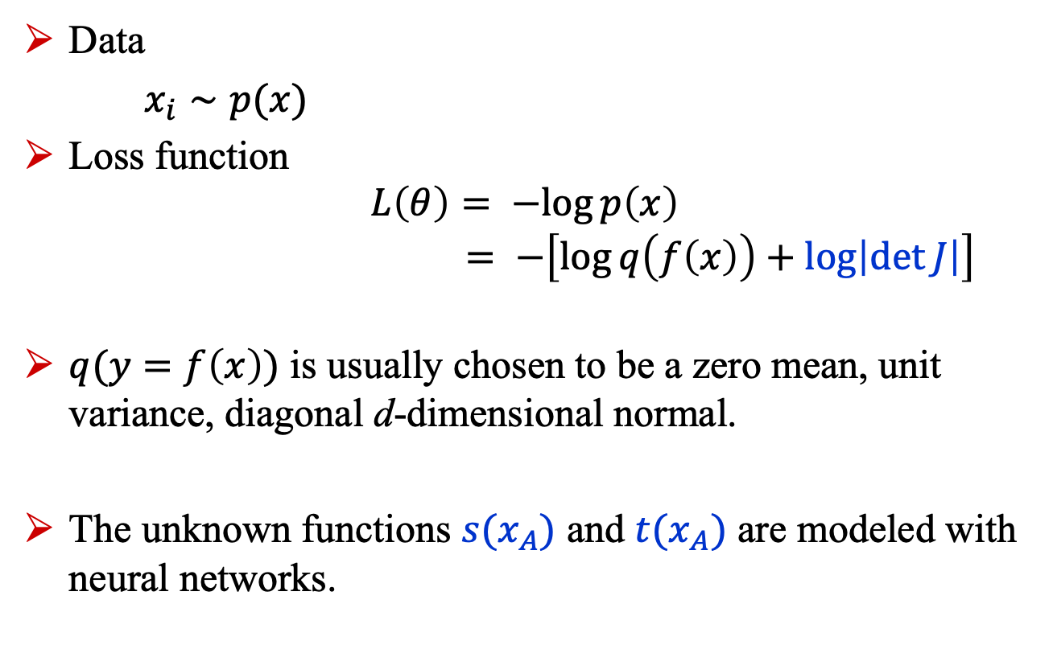
Normalizing Flows: Training
Data
$x_{i}∼p(x)$
Loss function $L\left(θ\right)= −log{p\left(x\right)}$ $= −\left[\log{q\left(f\left(x\right)\right)}+\log\left|\det{J}\right|\right]$
$q(y=f\left(x\right))$ is usually chosen to be a zero mean, unit variance, diagonal d-dimensional normal.
The unknown functions ${s(x}_{A})$ and ${t(x}_{A})$ are modeled with neural networks.

Slide 15
Diffusion models

Slide 16
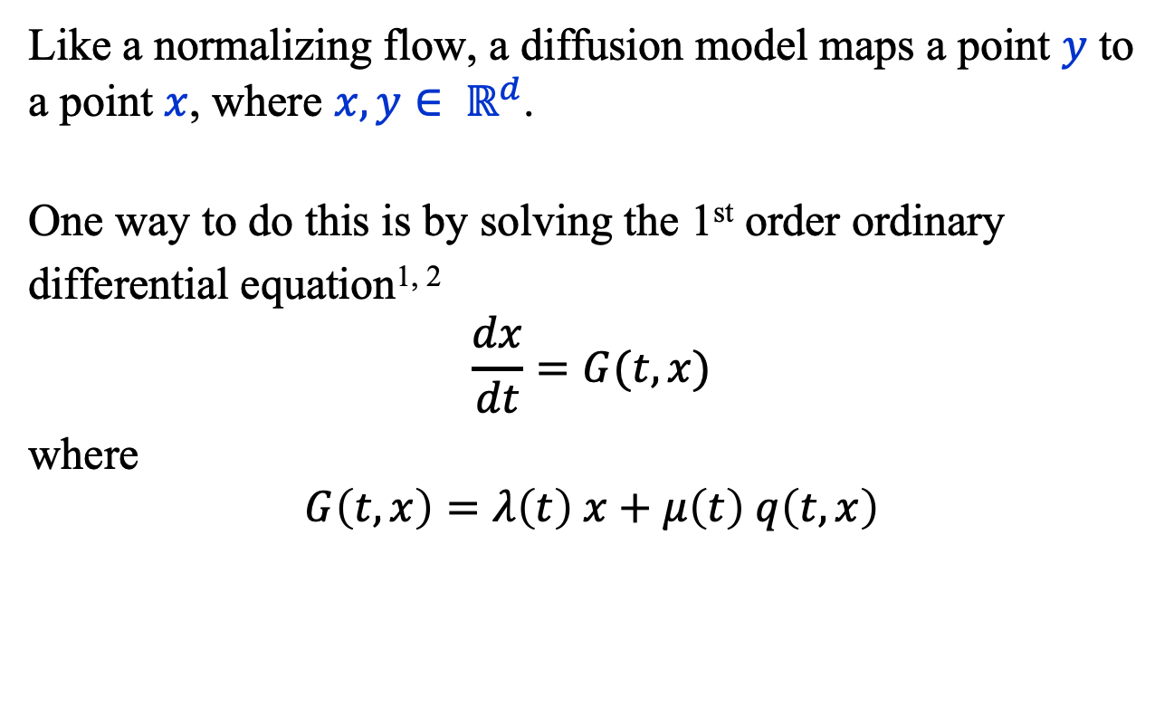
Diffusion Model (1)
Like a normalizing flow, a diffusion model maps a point $y$ to a point $x$, where $x, y∈ ℝ^{d}$.
One way to do this is by solving the 1st order ordinary
differential equation^{1, 2}
$$\frac{dx}{dt}=G(t,x)$$
where
$$G\left(t, x\right)=λ\left(t\right) x+μ\left(t\right) q\left(t, x\right)$$
Cheng Lu†, Yuhao Zhou†, Fan Bao†, Jianfei Chen†, Chongxuan Li‡, Jun Zhu, DPM-Solver: A Fast ODE Solver for Diffusion Probabilistic Model Sampling in Around 10 Steps*, arXiv:2206.00927v3, 2022.
Yanfang Lui, Minglei Yang, Zezhong Zhang, Feng Bao, Yanzhao Cao, and Guannan Zhang, Diffusion-Model-Assisted Supervised Learning of Generative Models for Density Estimation, arXiv:2310.14458v1, 2023

Slide 17
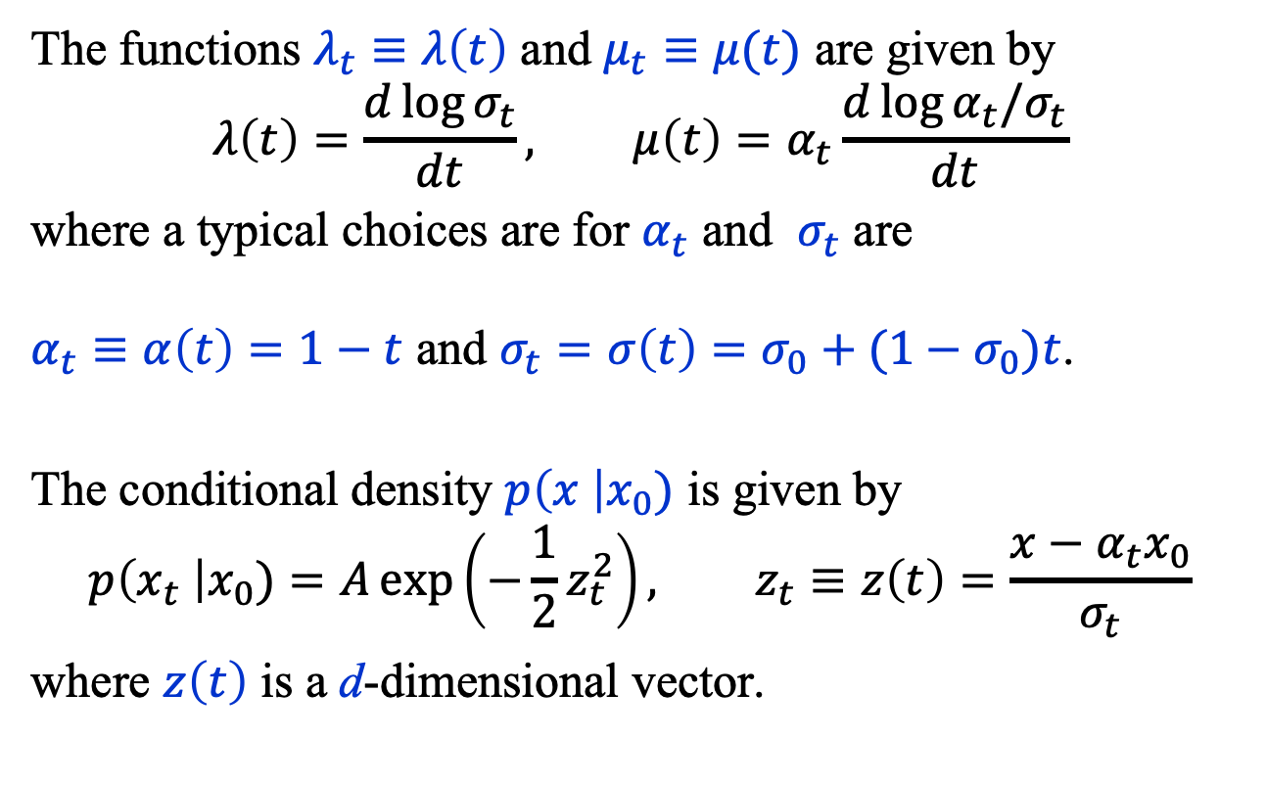
Diffusion Model (2)
The functions $λ_{t}≡λ\left(t\right)$ and $μ_{t}≡μ(t)$ are given by
$$λ\left(t\right)=\frac{d\log{σ_{t}}}{dt}, μ\left(t\right)=α_{t}\frac{d\log{{α_{t}/σ}_{t}}}{dt}$$
where a typical choices are for $α_{t}$ and $σ_{t}$ are $α_{t}≡α\left(t\right)=1−t$ and $σ_{t}=σ\left(t\right)=σ_{0}+(1−σ_{0})t$.
The conditional density $p\left(x \right|x_{0})$ is given by
$$p\left(x_{t} \right|x_{0})=A\exp\left(−\frac{1}{2}z_{t}^{2}\right), z_{t}≡z\left(t\right)=\frac{x−α_{t}x_{0}}{σ_{t}}$$
where $z\left(t\right)$ is a d-dimensional vector.

Slide 18
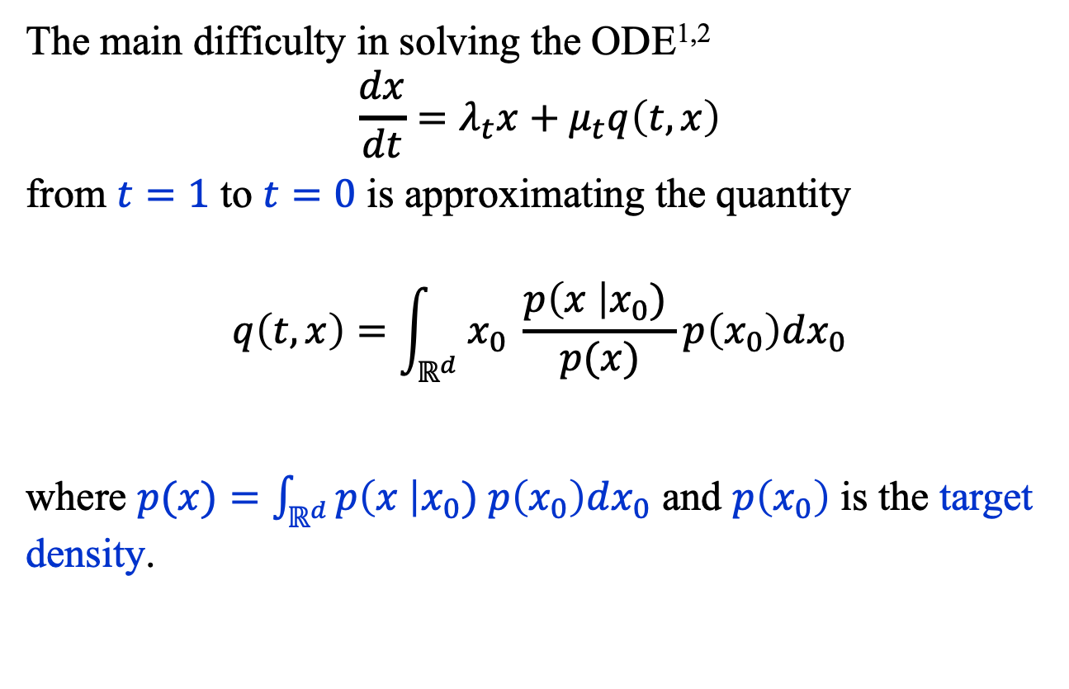
Diffusion Model (3)
The main difficulty in solving the ODE^{1,2}
$$\frac{dx}{dt}=λ_{t}x+μ_{t}q\left(t, x\right)$$
from $t=1$ to $t=0$ is approximating the quantity
$$q\left(t, x\right)=\int_{ℝ^{d}}{x_{0} \frac{p\left(x \right|x_{0}) }{p(x)}p\left(x_{0}\right)dx_{0}}$$
where $p(x)=\int_{ℝ^{d}}{p\left(x \right|x_{0}) p\left(x_{0}\right)dx_{0}}$ and $p\left(x_{0}\right)$ is the target density.

Slide 19
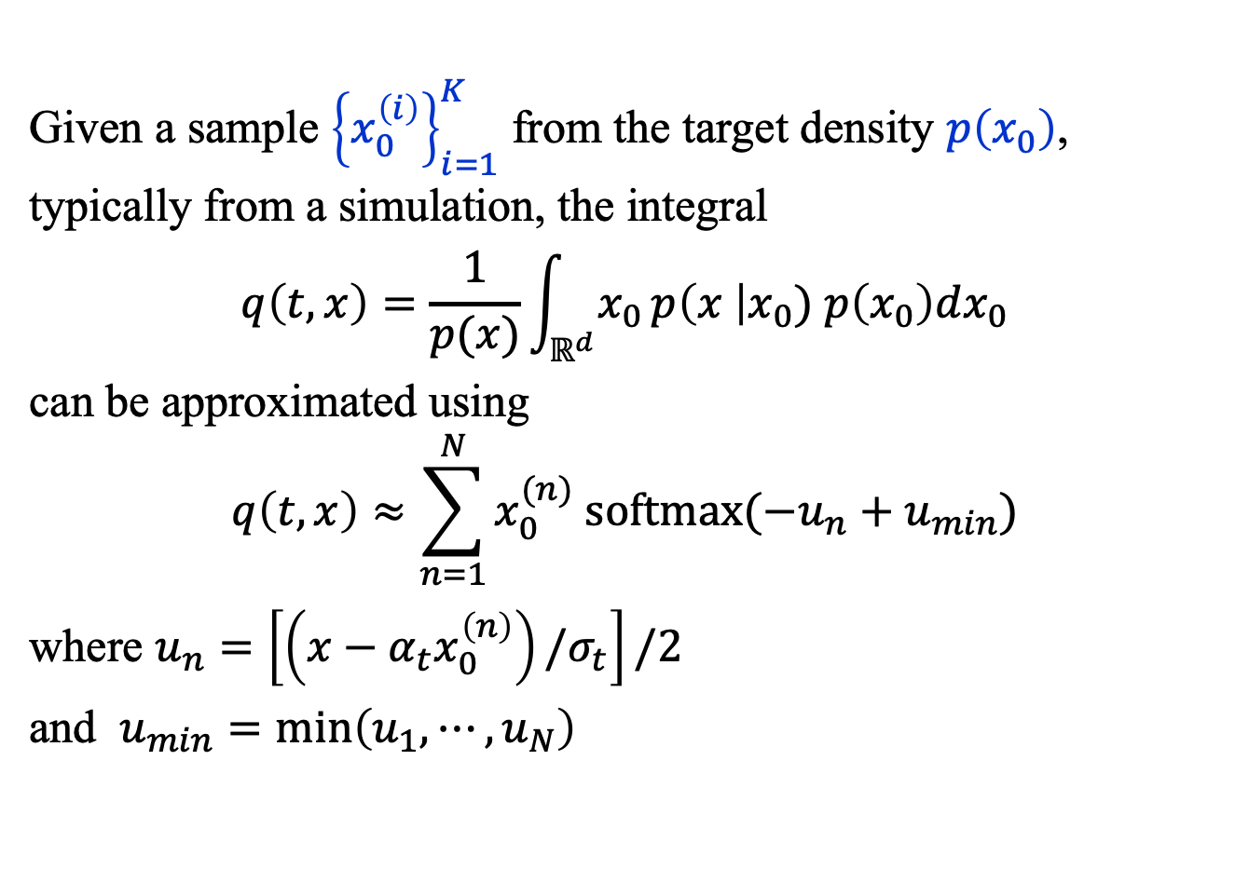
Diffusion Model (4)
Given a sample ${\left\{x_{0}^{\left(i\right)}\right\}}_{i=1}^{K}$ from the target density $p\left(x_{0}\right)$, typically from a simulation, the integral
$$q\left(t, x\right)=\frac{1}{p(x)}\int_{ℝ^{d}}{x_{0 }p\left(x \right|x_{0}) p\left(x_{0}\right)dx_{0}}$$
can be approximated using
$$q\left(t, x\right)≈\sum_{n=1}^{N}{x_{0}^{(n)} \text{softmax}(−u_{n}+u_{min})}$$
where $u_{n}=\left[\left(x−α_{t}x_{0}^{\left(n\right)}\right)/σ_{t}\right]/2$
and $u_{min}=\min\left(u_{1},⋯, u_{N}\right)$

Slide 20
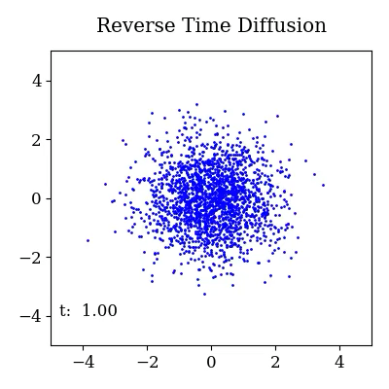
Diffusion Model (5)

Slide 21
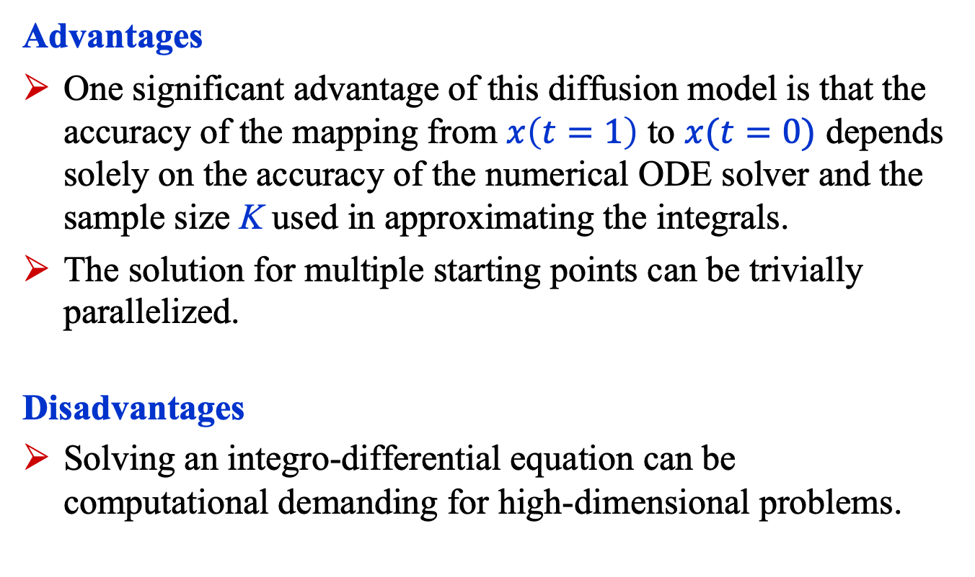
Diffusion Model
Advantages
One significant advantage of this diffusion model is that the accuracy of the mapping from $x\left(t=1\right)$ to $x(t=0)$ depends solely on the accuracy of the numerical ODE solver and the sample size K used in approximating the integrals.
The solution for multiple starting points can be trivially parallelized.
Disadvantages
Solving an integro-differential equation can be computational demanding for high-dimensional problems.

Slide 22
Summary
Finding good approximations to multidimensional probability densities is an important task in many fields.
Normalizing flows have been shown to yield satisfactory results, though they may not scale well to very high-dimensional problems.
Diffusion models can be used to map a point sampled from a Gaussian to another sampled from the desired target density. We briefly described a method that “simply” requires solving an ODE.

Slide 23
Appendix

Slide 24

Normalizing Flows: Pseudocode
The pseudocode that follows is inspired by François Fleuret’s excellent course on deep learning https://fleuret.org/dlc/, where the quantities $s$ and $t$, which are intrinsically $\left(d−m\right)$-dimensional functions, are modeled with d-dimensional tensors by using a mask, b.

Slide 25
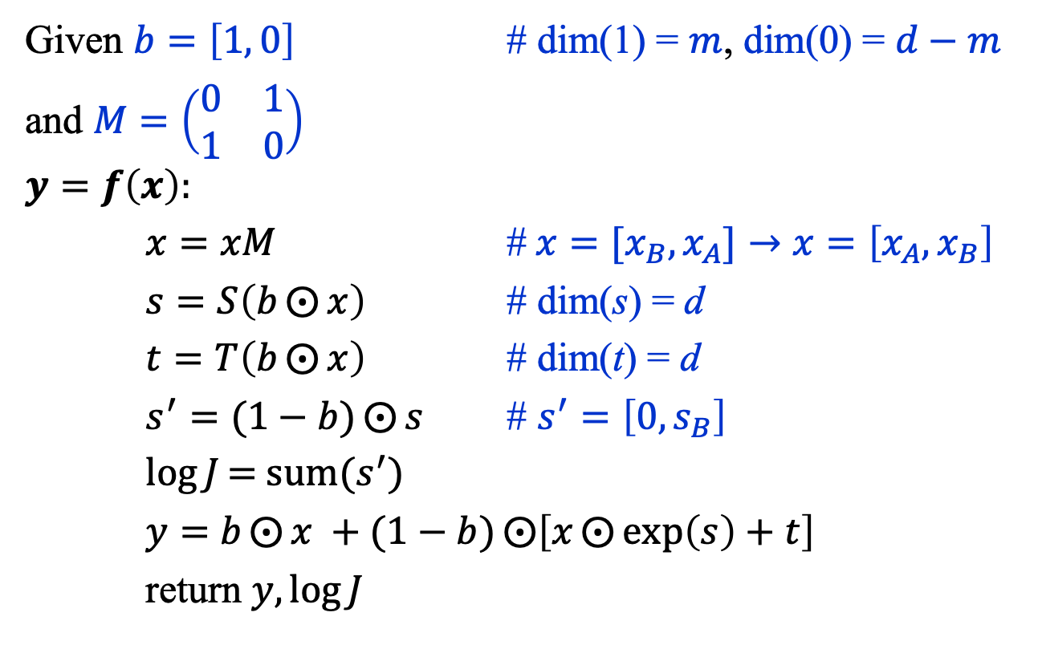

Normalizing Flows: $y=f_{i}(x)$
Given $b=\left[1, 0\right]$ # dim(1) = $m$, dim(0) = $d−m$
and $M=\left(\begin{matrix}0 & 1 \\ 1 & 0\end{matrix}\right)$
$$y=f\left(x\right):$$
$x=xM$ #${ x=[x}_{B}, x_{A}]→x=\left[x_{A}, x_{B}\right]$
$s=S\left(b⨀{x}\right)$ # dim(s) = d
$t=T\left(b⨀{x}\right)$ # dim(t) = d
$s^{′}=(1−b)⨀{s}$ # $s^{′}=\left[0, s_{B}\right]$
$\log{J}\text{= }\text{sum}(s^{′})$
$y=$ $b⨀{x} +(1−b)⨀{\left[x⨀{\exp\left(s\right)+t}\right]}$
return $y,\log{J}$
François Fleuret, https://fleuret.org/dlc/

Slide 26
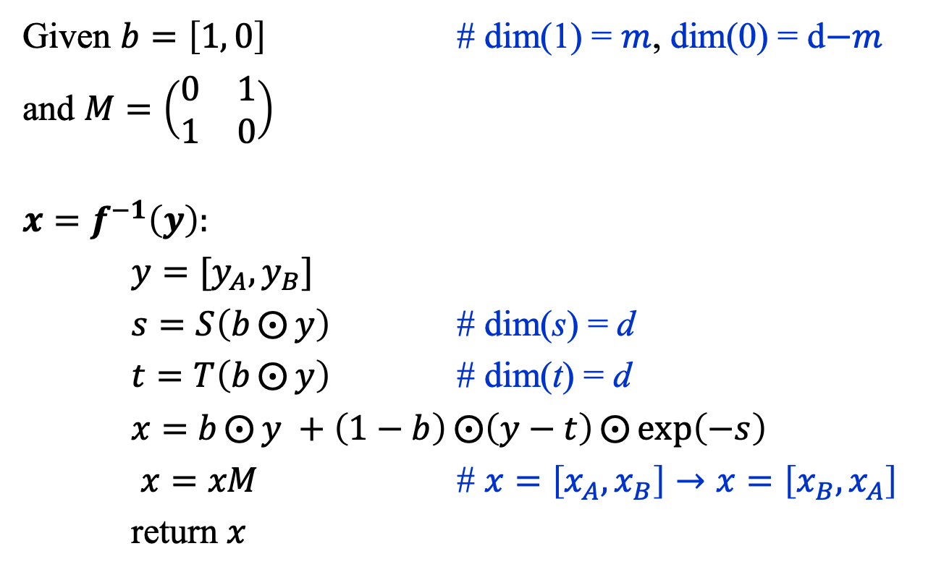

Normalizing Flows: $x=f_{i}^{−1}(y)$
Given $b=\left[1, 0\right]$ # dim(1) = $m$, dim(0) = d$−m$
and $M=\left(\begin{matrix}0 & 1 \\ 1 & 0\end{matrix}\right)$
$$x=f^{−1}\left(y\right):$$
${y=[y}_{A}, y_{B}]$
$s=S\left(b⨀{y}\right)$ # dim(s) = d
$t=T\left(b⨀{y}\right)$ # dim(t) = d
$x=$ $b⨀{y} +\left(1−b\right)⨀{\left(y−t\right)⨀{\exp\left(−s\right)}}$
$x=xM$ # $x=\left[x_{A}, x_{B}\right]→x=\left[x_{B}, x_{A}\right]$
return $x$
François Fleuret, https://fleuret.org/dlc/

