Slide 1
Machine learning in Physics Graph autoencoders Part 2

Slide 2
Outline
Recap
Graph Autoencoder – Part 2
PyTorch Geometric
Summary
Lecture based on notes by Dr. Claire David
African Institute of Mathematical Sciences, Cape Town, South Africa.

Slide 3







Recap (1)
A graph is a data structure that comprises nodes (or vertices) and edges:
Our goal is to create a function (a GAE) that takes a graph as input, encodes it, and decodes it back to the same graph.
1
0
2
3
1
0
1
0
2
Encoder
Decoder
2
3
3

Slide 4
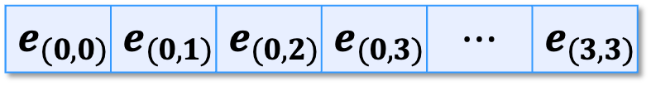
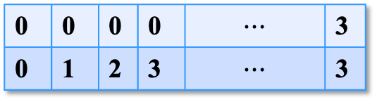
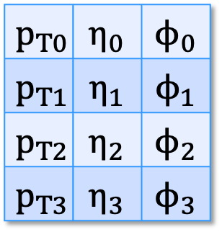
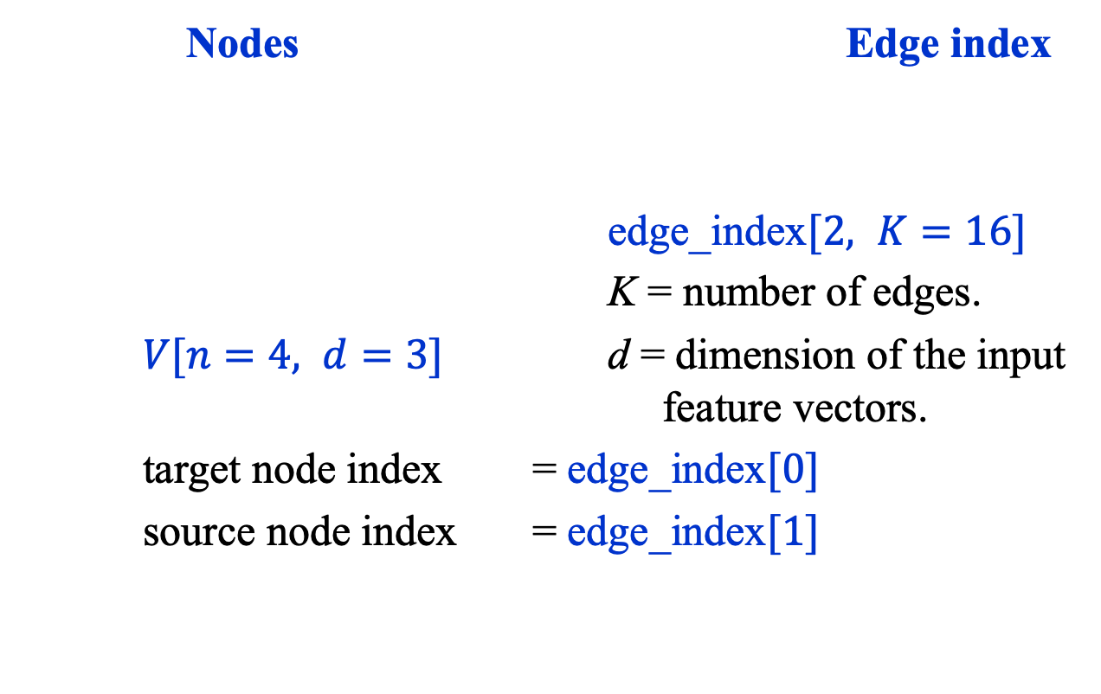
Recap (2): Data Structures
Nodes Edge index
edge_index$[2, K=16]$
K = number of edges.
$V[n=4, d=3]$ d = dimension of the input feature vectors.
target node index = edge_index$[0]$
source node index = edge_index$[1]$
$$p_{T0}$$ | $$η_{0}$$ | $$ϕ_{0}$$
$$p_{T1}$$ | $$η_{1}$$ | $$ϕ_{1}$$
$$p_{T2}$$ | $$η_{2}$$ | $$ϕ_{2}$$
$$p_{T3}$$ | $$η_{3}$$ | $$ϕ_{3}$$
0
1
0 | 0 | 0 | 0 | $$⋯$$ | 3
0 | 1 | 2 | 3 | $$⋯$$ | 3
2
3
edge features (edge_weights[K])
$$e_{(0,0)}$$ | $$e_{(0,1)}$$ | $$e_{(0,2)}$$ | $$e_{(0,3)}$$ | $$⋯$$ | $$e_{(3,3)}$$

Slide 5
Graph autoencoder Part 2

Slide 6

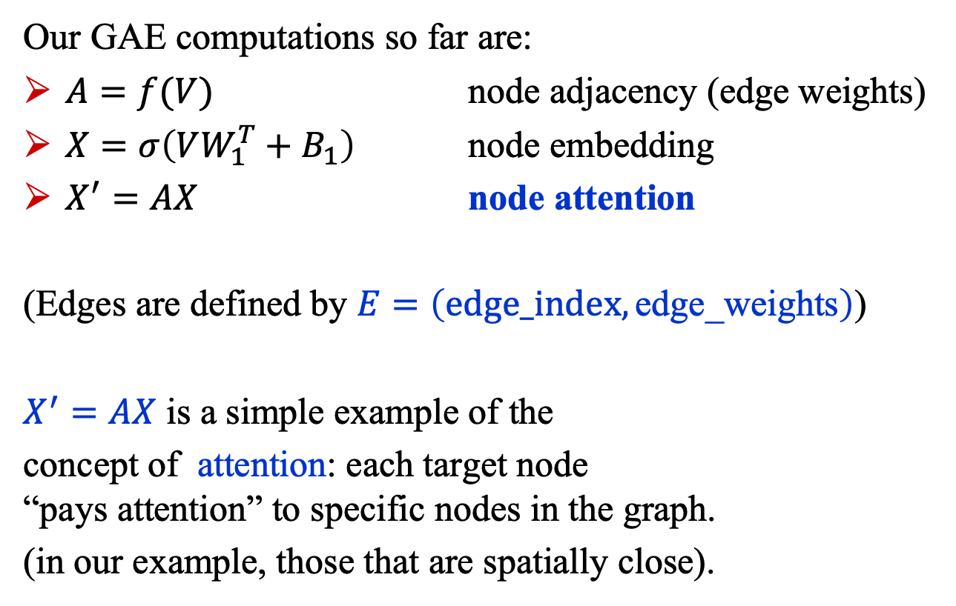




Graph Autoencoder (1)
Our GAE computations so far are:
$A=f(V)$ node adjacency (edge weights)
$X=σ\left(VW_{1}^{T}+B_{1}\right)$ node embedding
$X^{′}=AX$ node attention
(Edges are defined by $E=\left(\text{edge}\text{_}\text{index},\text{edge}\text{_}\text{weights}\right)$)
$X^{′}=AX$ is a simple example of the
concept of attention: each target node “pays attention” to specific nodes in the graph.
(in our example, those that are spatially close).
1
0
2
3

Slide 7
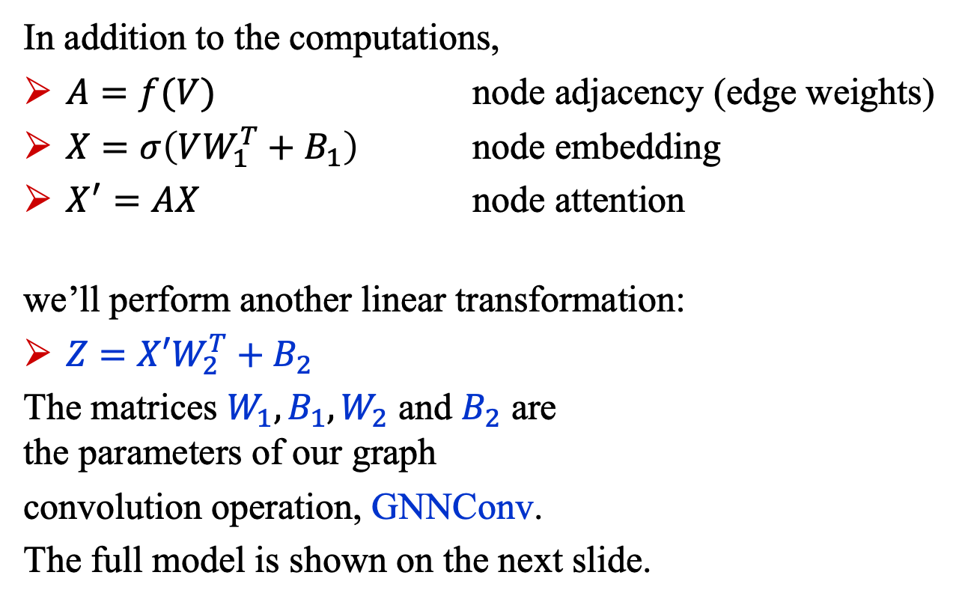
Graph Autoencoder (2)
In addition to the computations,
$A=f(V)$ node adjacency (edge weights)
$X=σ\left(VW_{1}^{T}+B_{1}\right)$ node embedding
$X^{′}=AX$ node attention
we’ll perform another linear transformation:
$Z=X′W_{2}^{T}+B_{2}$
The matrices $W_{1}, B_{1}, W_{2}$ and $B_{2}$ are the parameters of our graph
convolution operation, GNNConv.
The full model is shown on the next slide.
1
0
2
3

Slide 8

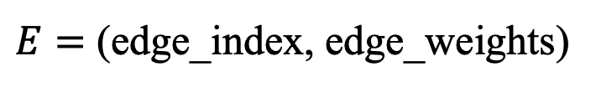

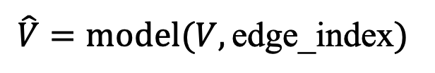

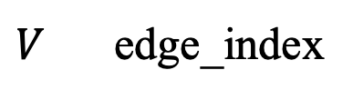



GAE: Model
(a)
dropout
relu
$$\hat{V}=model(V,\text{edge}\text{_}\text{index})$$
GNNConv
Linear
$$Z$$
encoder
$$X$$
$$E$$
dropout
decoder
dropout
relu
Linear
relu
Linear
@
relu
GNNConv
(a)
embed
$$E$$
GNNConv
edges
$$X$$
$$E$$
$V$ edge_index
$E=$ (edge_index, edge_weights)

Slide 9
Pytorch geometric (PyG)

Slide 10
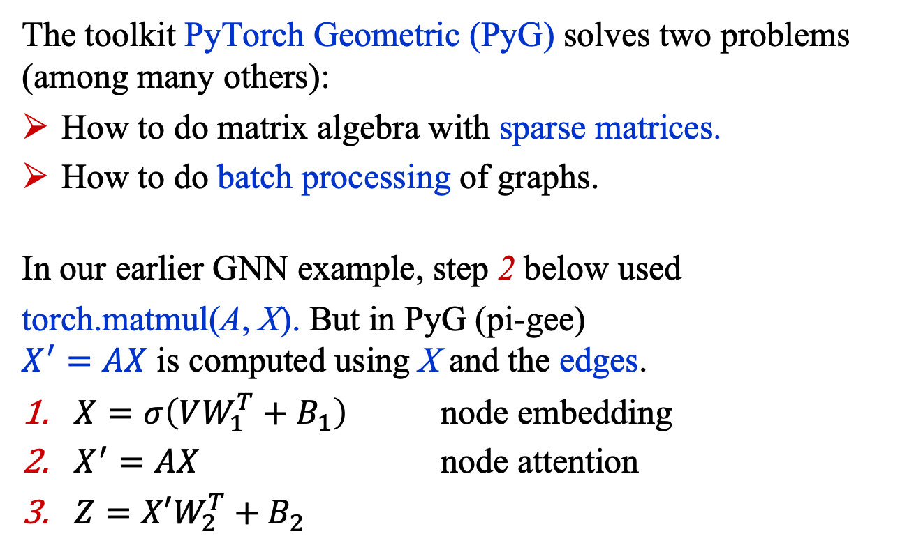
PyTorch Geometric (1)
The toolkit PyTorch Geometric (PyG) solves two problems (among many others):
How to do matrix algebra with sparse matrices.
How to do batch processing of graphs.
In our earlier GNN example, step 2 below used
torch.matmul(A, X). But in PyG (pi-gee) $X^{′}=AX$ is computed using X and the edges.
$X=σ\left(VW_{1}^{T}+B_{1}\right)$ node embedding
$X^{′}=AX$ node attention
$Z=X′W_{2}^{T}+B_{2}$
$$Z$$
Linear
@
relu
Embed
$$X$$
$$E$$
GNNConv

Slide 11
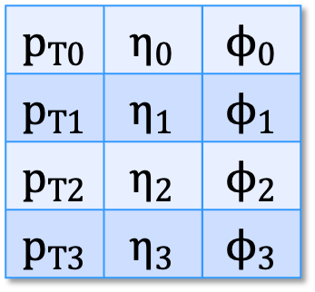

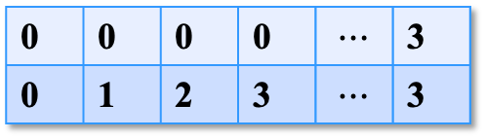
PyTorch Geometric (2)
In our 4-node graph example, PyG uses 3 data structures:
edge_index
nodes
edge_weights
$$p_{T0}$$ | $$η_{0}$$ | $$ϕ_{0}$$
$$p_{T1}$$ | $$η_{1}$$ | $$ϕ_{1}$$
$$p_{T2}$$ | $$η_{2}$$ | $$ϕ_{2}$$
$$p_{T3}$$ | $$η_{3}$$ | $$ϕ_{3}$$
0 | 0 | 0 | 0 | $$⋯$$ | 3
0 | 1 | 2 | 3 | $$⋯$$ | 3
$$Z$$
Linear
1
0
2
@
relu
3
$$e_{(0,0)}$$ | $$e_{(0,1)}$$ | $$e_{(0,2)}$$ | $$e_{(0,3)}$$ | $$⋯$$ | $$e_{(3,3)}$$
Embed
$$X$$
$$E$$
GNNConv

Slide 12


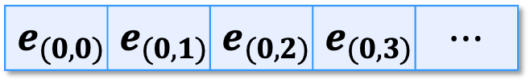
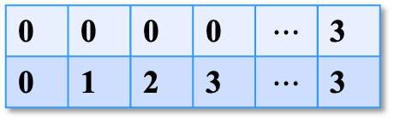




PyTorch Geometric (3)
PyG solves the two problems by serializing graphs using these data structures. Each node is viewed as an independent entity linked to source nodes via the edge_index and the associated edge_weight.
0 | 0 | 0 | 0 | $$⋯$$ | 3
0 | 1 | 2 | 3 | $$⋯$$ | 3
Source nodes
$$e_{(0,0)}$$ | $$e_{(0,1)}$$ | $$e_{(0,2)}$$ | $$e_{(0,3)}$$ | $$⋯$$
0
$$⇐$$
0
1
2
3
1
0
1
2
3
0
$$⇐$$
1
Target nodes
2
2
$$⇐$$
0
1
2
3
3
$$⇐$$
0
1
2
3
3

Slide 13
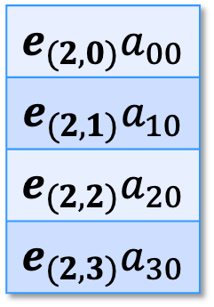

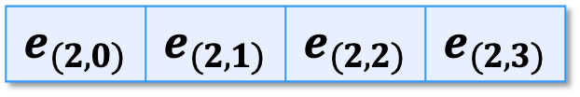
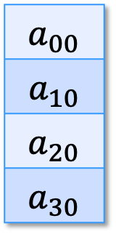
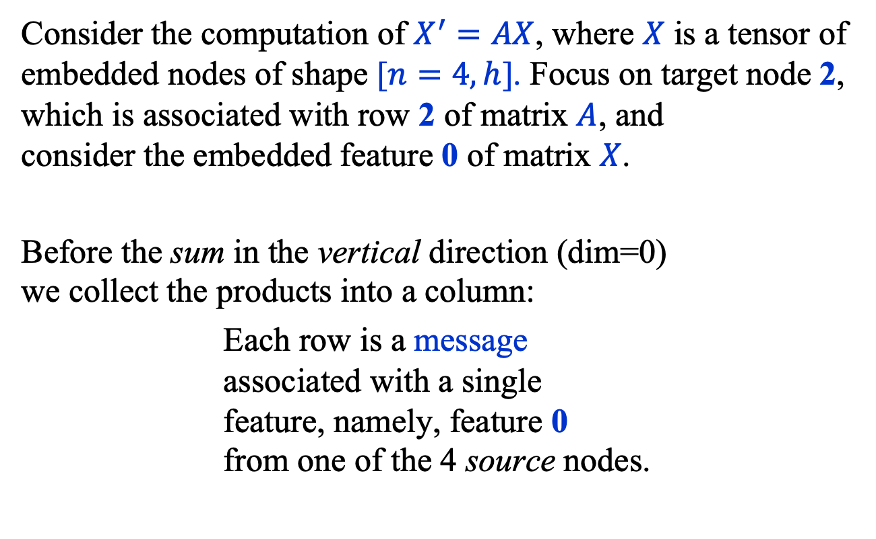
PyTorch Geometric (4)
Consider the computation of $X^{′}=AX$, where $X$ is a tensor of embedded nodes of shape [$n=4, h$]. Focus on target node 2, which is associated with row 2 of matrix $A$, and consider the embedded feature 0 of matrix $X$.
Before the sum in the vertical direction (dim=0) we collect the products into a column:
Each row is a message associated with a single feature, namely, feature 0 from one of the 4 source nodes.
$$a_{00}$$
$$a_{10}$$
$$a_{20}$$
$$a_{30}$$
$$e_{(2,0)}$$ | $$e_{(2,1)}$$ | $$e_{(2,2)}$$ | $$e_{(2,3)}$$
$$×$$
$$e_{(2,0)}a_{00}$$
$$e_{(2,1)}a_{10}$$
$$e_{(2,2)}a_{20}$$
$$e_{(2,3)}a_{30}$$
1
0
2
3

Slide 14

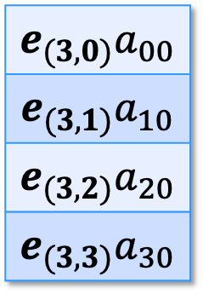
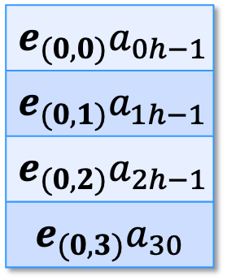
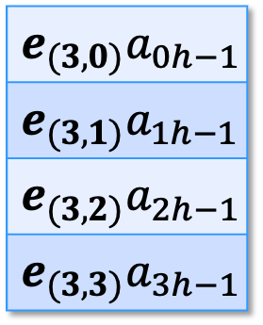




PyTorch Geometric (5)
This calculation is repeated with every other target node.
Then the columns of products are stacked vertically to form a single column whose length equals K the number of edges in the graph.
The procedure is repeated for each of the h features of the embedded nodes, and the columns are stacked horizontally.
$$e_{(0,0)}a_{00}$$
$$e_{(0,1)}a_{10}$$
$$e_{(0,2)}a_{20}$$
$$e_{(0,3)}a_{30}$$
$$e_{(0,0)}a_{0h−1}$$
$$e_{(0,1)}a_{1h−1}$$
$$e_{(0,2)}a_{2h−1}$$
$$e_{(0,3)}a_{30}$$
$$⋯$$
$$⋮$$
$$⋮$$
$$e_{(3,0)}a_{00}$$
$$e_{(3,1)}a_{10}$$
$$e_{(3,2)}a_{20}$$
$$e_{(3,3)}a_{30}$$
$$e_{(3,0)}a_{0h−1}$$
$$e_{(3,1)}a_{1h−1}$$
$$e_{(3,2)}a_{2h−1}$$
$$e_{(3,3)}a_{3h−1}$$
$$⋯$$

Slide 15
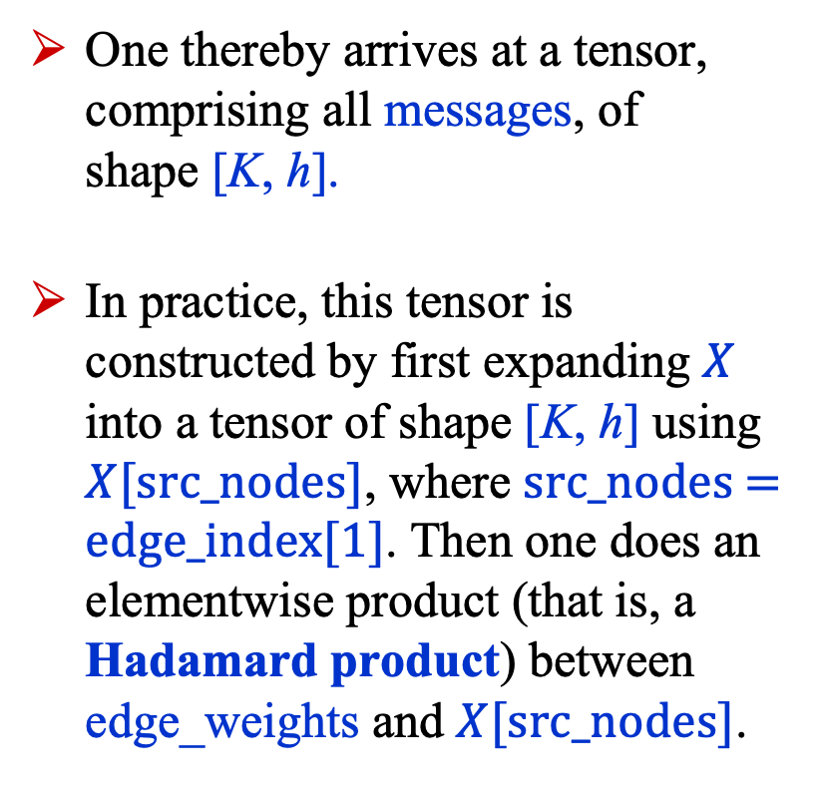

PyTorch Geometric (6)
One thereby arrives at a tensor, comprising all messages, of shape [K, h].
In practice, this tensor is constructed by first expanding $X$ into a tensor of shape [K, h] using $X[\text{src}\text{_}\text{nodes}]$, where $\text{src}\text{_}\text{nodes}\text{ = }\text{edge}\text{_}\text{index}\text{[1]}$. Then one does an elementwise product (that is, a Hadamard product) between edge_weights and $X[\text{src}\text{_}\text{nodes}]$.
$$e_{(0,0)}a_{00}$$
$$e_{(0,1)}a_{10}$$
$$e_{(0,2)}a_{20}$$
$$e_{(0,3)}a_{30}$$
$$e_{(0,0)}a_{0h−1}$$
$$e_{(0,1)}a_{1h−1}$$
$$e_{(0,2)}a_{2h−1}$$
$$e_{(0,3)}a_{30}$$
$$⋯$$
$$⋮$$
$$⋮$$
$$e_{(3,0)}a_{00}$$
$$e_{(3,1)}a_{10}$$
$$e_{(3,2)}a_{20}$$
$$e_{(3,3)}a_{30}$$
$$e_{(3,0)}a_{0h−1}$$
$$e_{(3,1)}a_{1h−1}$$
$$e_{(3,2)}a_{2h−1}$$
$$e_{(3,3)}a_{3h−1}$$
$$⋯$$

Slide 16

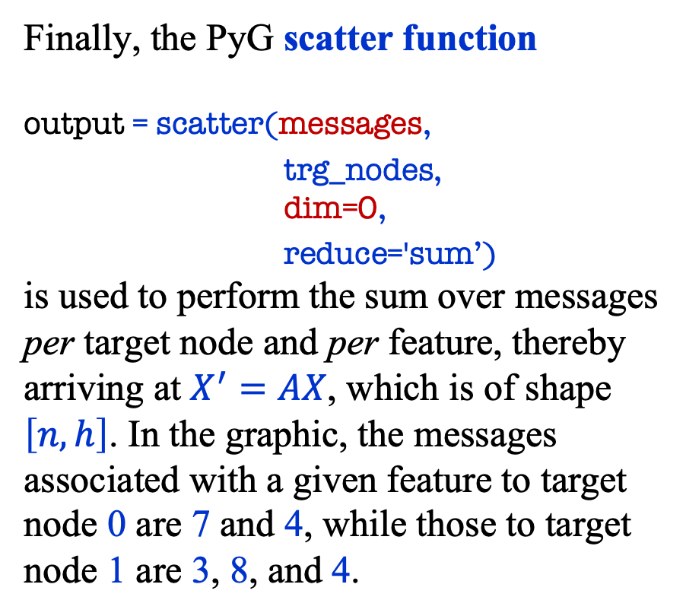

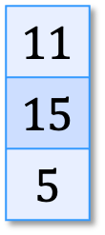




PyTorch Geometric (7)
Finally, the PyG scatter function output = scatter(messages,
trg_nodes, dim=0,
reduce='sum’) is used to perform the sum over messages per target node and per feature, thereby arriving at $X^{′}=AX$, which is of shape $\left[n, h\right]$. In the graphic, the messages associated with a given feature to target node 0 are 7 and 4, while those to target node 1 are 3, 8, and 4.
trg_nodes
output
$$0$$
$$1$$
$$0$$
$$1$$
1
2
$$7$$
$$3$$
$$4$$
$$8$$
4
5
$$11$$
$$15$$
$$5$$
messages

Slide 17
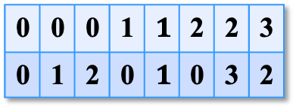

PyTorch Geometric (8): Sparsity
The power of PyG arises from its ability to handle sparse graphs. Suppose our 4-node graph is connected as shown.
The edge_index data structure of the graph is: target nodes: source nodes:
One point we didn’t emphasize but I hope was clear is that many of the links in our example graphs are bi-directional!
The fact that our graph is now sparsely connected, changes nothing about how the matrix algebra is done!
1
0
2
0 | 0 | 0 | 1 | $$1$$ | 2 | 2 | 3
0 | 1 | 2 | 0 | $$1$$ | 0 | 3 | 2
3

Slide 18
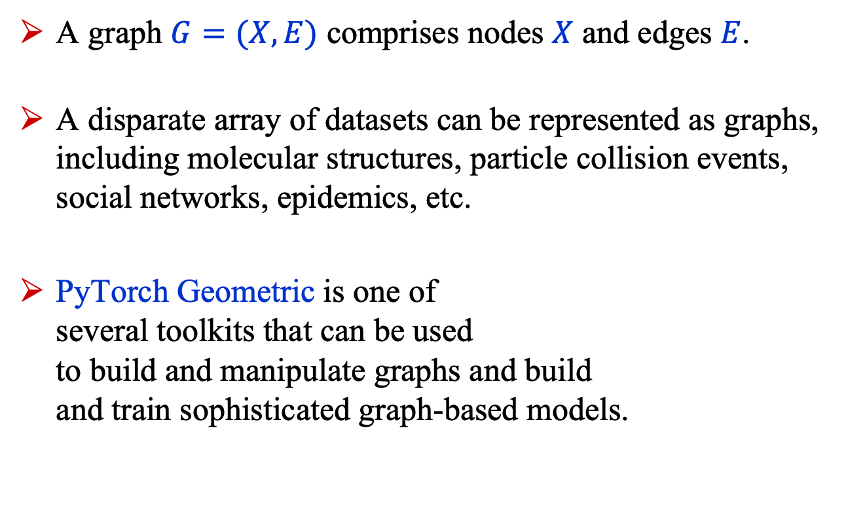
Summary
A graph $G=(X, E)$ comprises nodes $X$ and edges $E$.
A disparate array of datasets can be represented as graphs, including molecular structures, particle collision events, social networks, epidemics, etc.
PyTorch Geometric is one of several toolkits that can be used to build and manipulate graphs and build and train sophisticated graph-based models.
1
0
2
3

