Slide 1
Machine learning in physics Simulation-based inference

Slide 2
introduction

Slide 3
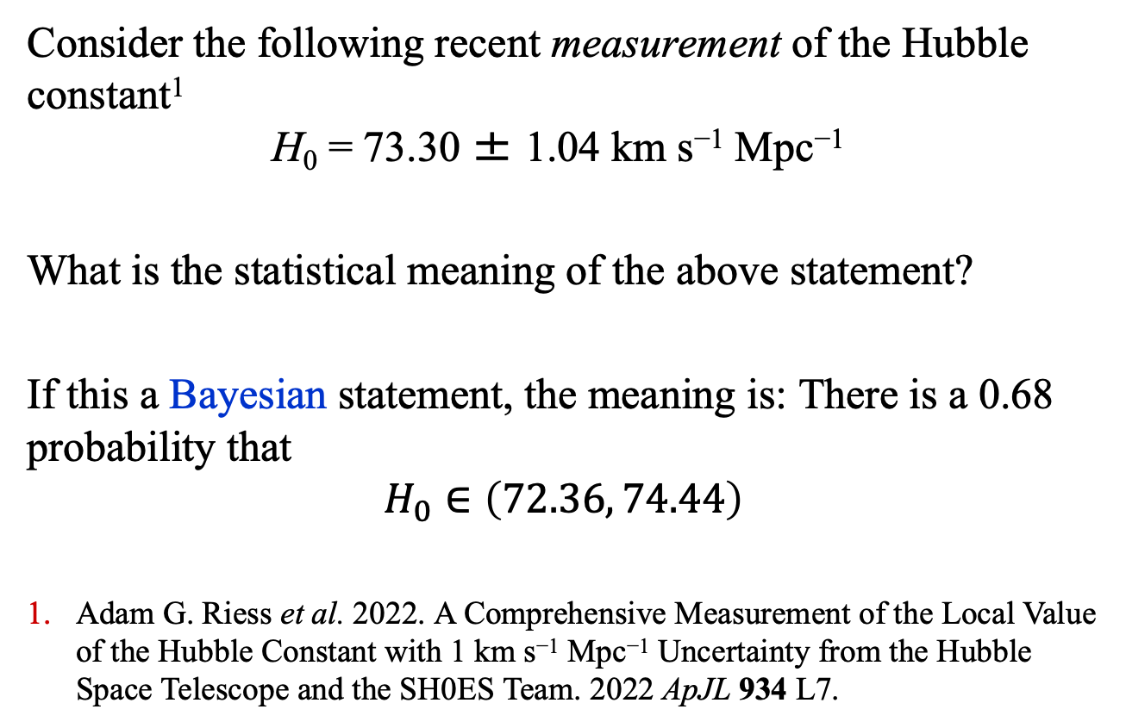
Introduction: Statistical Inference
Consider the following recent measurement of the Hubble constant¹
$$\text{H}\text{0}\text{ = 73.30 ± 1.04 }\text{km} \text{s}\text{−1} \text{Mpc}\text{−1}$$
What is the statistical meaning of the above statement?
If this a Bayesian statement, the meaning is: There is a 0.68 probability that
$$H_{0}∈\left(72.36, 74.44\right)$$
Adam G. Riess et al. 2022. A Comprehensive Measurement of the Local Value of the Hubble Constant with 1 km s⁻¹ Mpc⁻¹ Uncertainty from the Hubble Space Telescope and the SH0ES Team. 2022 ApJL 934 L7.

Slide 4
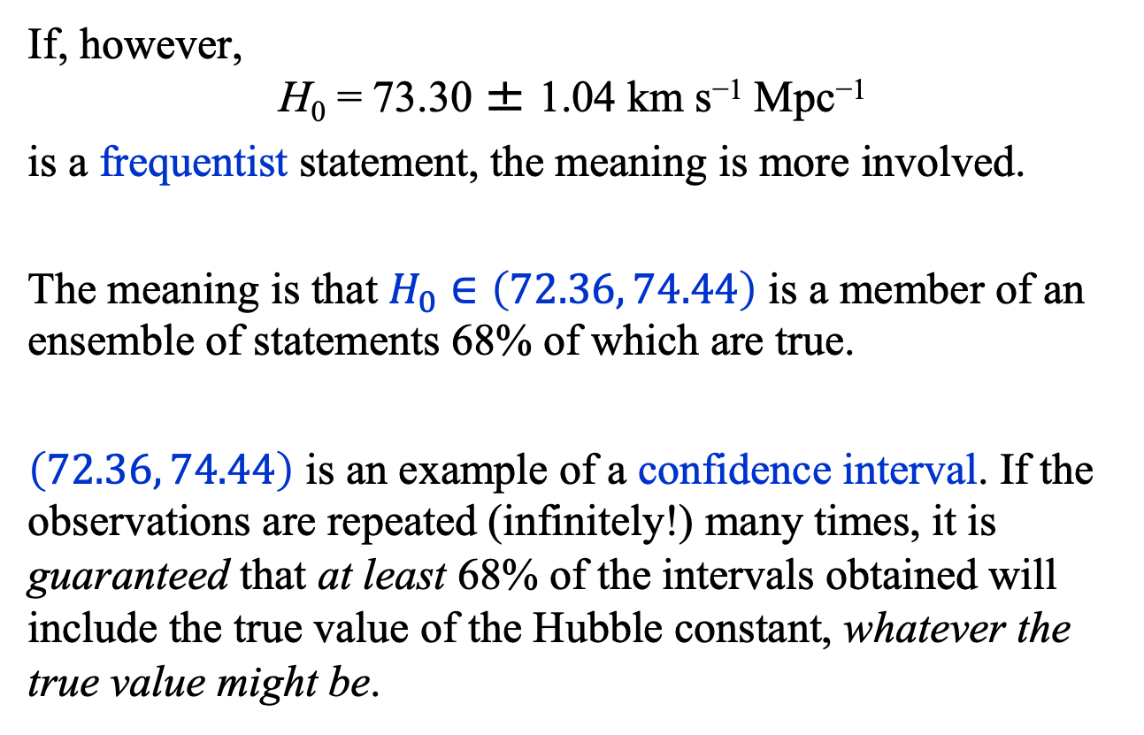
Introduction: Statistical Inference
If, however,
$$\text{H}\text{0}\text{ = 73.30 ± 1.04 }\text{km} \text{s}\text{−1} \text{Mpc}\text{−1}$$
is a frequentist statement, the meaning is more involved.
The meaning is that $H_{0}∈\left(72.36, 74.44\right)$ is a member of an ensemble of statements 68% of which are true.
$\left(72.36, 74.44\right)$ is an example of a confidence interval. If the observations are repeated (infinitely!) many times, it is guaranteed that at least 68% of the intervals obtained will include the true value of the Hubble constant, whatever the true value might be.

Slide 5
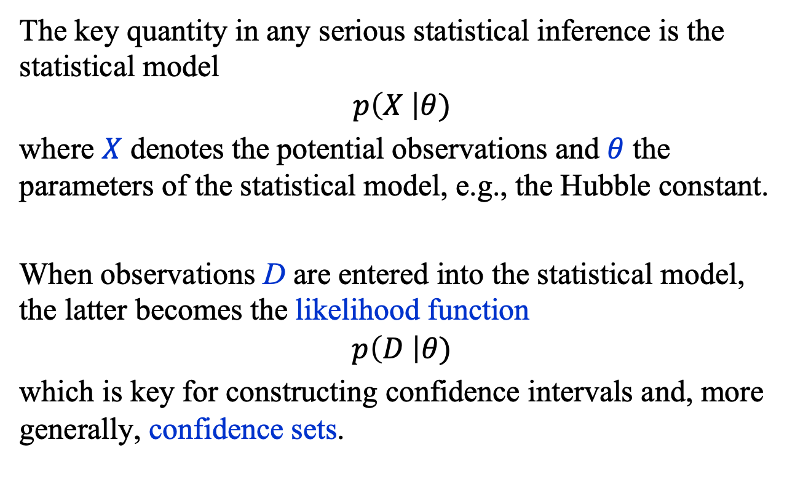
Introduction: Statistical Inference
The key quantity in any serious statistical inference is the statistical model
$$p\left(X \right|θ)$$
where $X$ denotes the potential observations and $θ$ the parameters of the statistical model, e.g., the Hubble constant.
When observations D are entered into the statistical model, the latter becomes the likelihood function
$$p\left(D \right|θ)$$
which is key for constructing confidence intervals and, more generally, confidence sets.

Slide 6
Introduction: Statistical Inference
Unfortunately, statistical models can be intractable.
However, if one has access to a high-fidelity simulator, it is possible to make inferences without explicit knowledge of the statistical model.
Simulation-based inference (SBI)^{1,2,3} are methods for making inferences from real data using a simulator.
Kyle Cranmer, Johann Brehmer, and Gille Loupes, https://doi.org/10.1073/pnas.1912789117;
Likelihood-Free Frequentist Inference: Confidence Sets with Correct Conditional Coverage Niccolo Dalmasso, Luca Masserano, David Zhao, Rafael Izbicki, Ann B. Lee, arXiv:2107.03920v6 [stat.ML] 6 Apr 2023.
A. Al Kadhim, HBP, O. F. Prosper, Mach. Learn.: Sci. Technol. 5 (2024) 015020.

Slide 7
Simulation-based inference

Slide 8
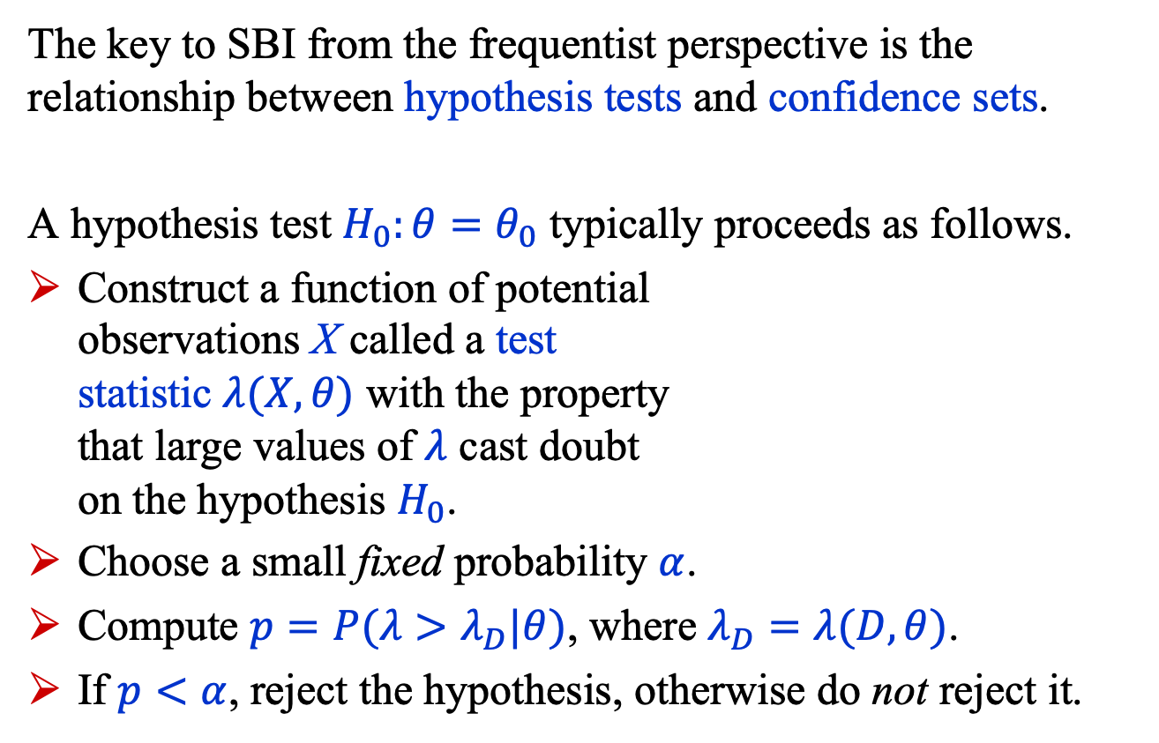
SBI: Introduction
The key to SBI from the frequentist perspective is the relationship between hypothesis tests and confidence sets.
A hypothesis test $H_{0}:θ=θ_{0}$ typically proceeds as follows.
Construct a function of potential observations X called a test statistic $λ(X, θ)$ with the property that large values of $λ$ cast doubt on the hypothesis $H_{0}$.
Choose a small fixed probability $α$.
Compute $p=P(λ>λ_{D}|θ)$, where $λ_{D}=λ(D, θ)$.
If $p<α$, reject the hypothesis, otherwise do not reject it.

Slide 9
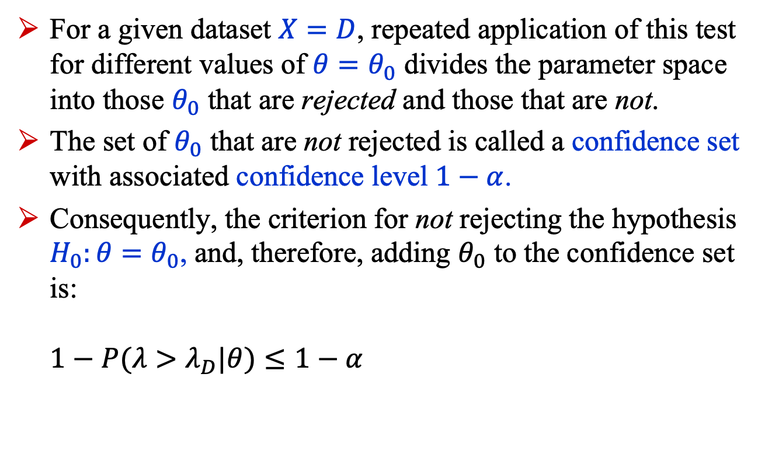
SBI: Introduction
For a given dataset $X=D$, repeated application of this test for different values of $θ=θ_{0}$ divides the parameter space into those $θ_{0}$ that are rejected and those that are not.
The set of $θ_{0}$ that are not rejected is called a confidence set with associated confidence level $1−α$.
Consequently, the criterion for not rejecting the hypothesis $H_{0}:θ=θ_{0}$, and, therefore, adding $θ_{0}$ to the confidence set is: $1−P(λ>λ_{D}|θ)≤1−α$

Slide 10
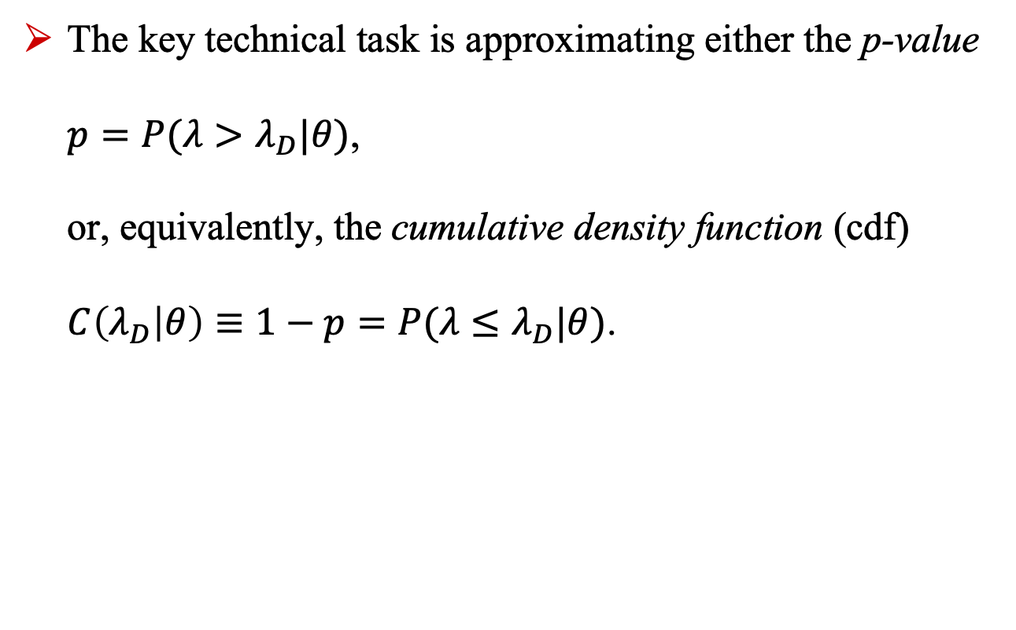
SBI: Introduction
The key technical task is approximating either the p-value $p=P(λ>λ_{D}|θ)$, or, equivalently, the cumulative density function (cdf) $C\left(λ_{D} | θ\right)≡1−p=P(λ≤λ_{D}|θ)$.

Slide 11
likelihood free frequentist inference (LF2I)

Slide 12
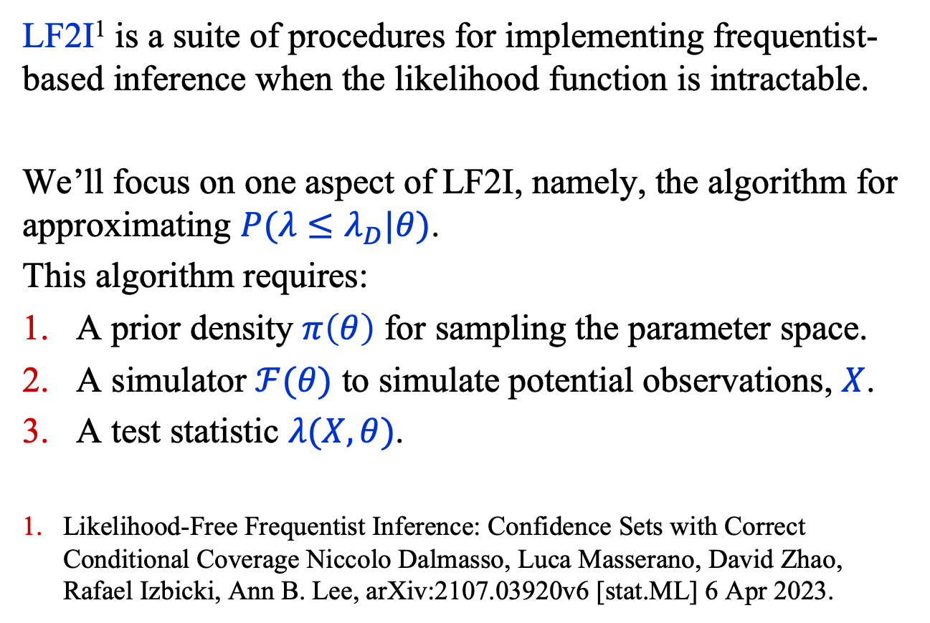
LF2I
LF2I¹ is a suite of procedures for implementing frequentist-based inference when the likelihood function is intractable.
We’ll focus on one aspect of LF2I, namely, the algorithm for approximating $P(λ≤λ_{D}|θ)$.
This algorithm requires:
A prior density $π\left(θ\right)$ for sampling the parameter space.
A simulator $ℱ(θ)$ to simulate potential observations, $X$.
A test statistic $λ(X,θ)$.
Likelihood-Free Frequentist Inference: Confidence Sets with Correct Conditional Coverage Niccolo Dalmasso, Luca Masserano, David Zhao, Rafael Izbicki, Ann B. Lee, arXiv:2107.03920v6 [stat.ML] 6 Apr 2023.

Slide 13
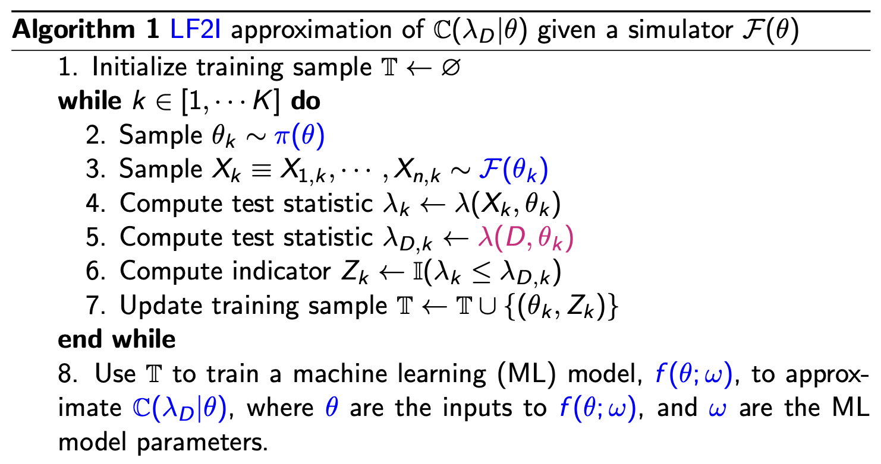
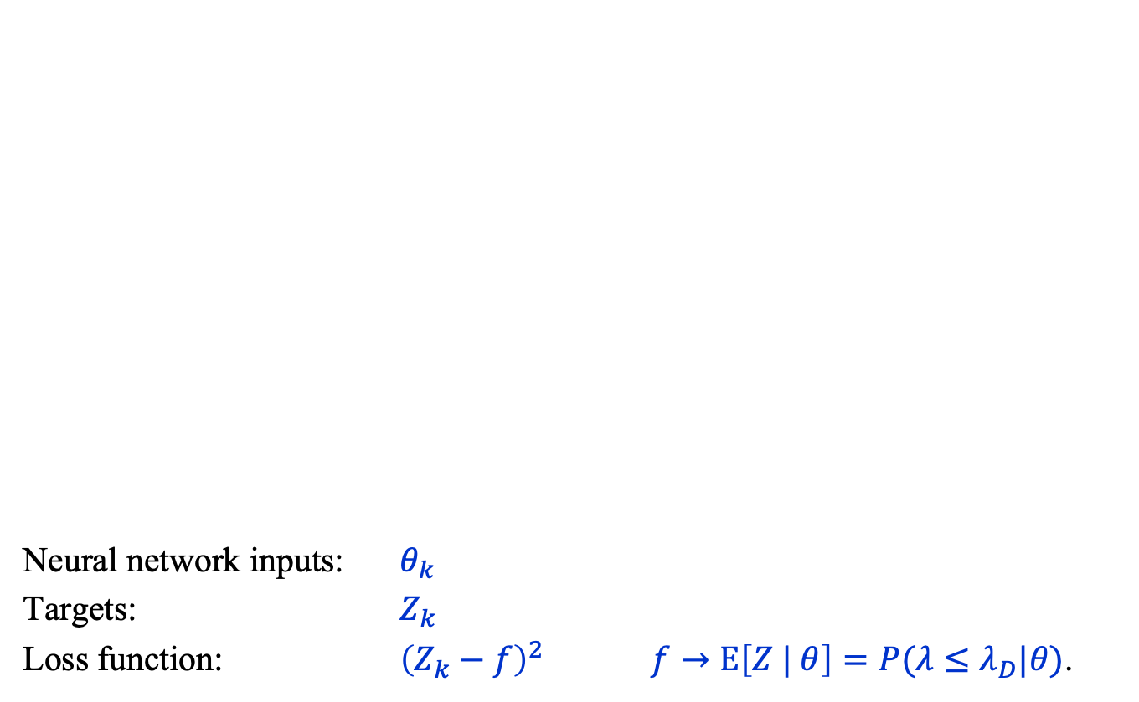
LF2I: Algorithm
Neural network inputs: $θ_{k}$
Targets: $Z_{k}$
Loss function: ${\left(Z_{k}−f\right)}^{2}$ $f→Ε\left[Z | θ\right]=P(λ≤λ_{D}|θ)\text{.}$

Slide 14
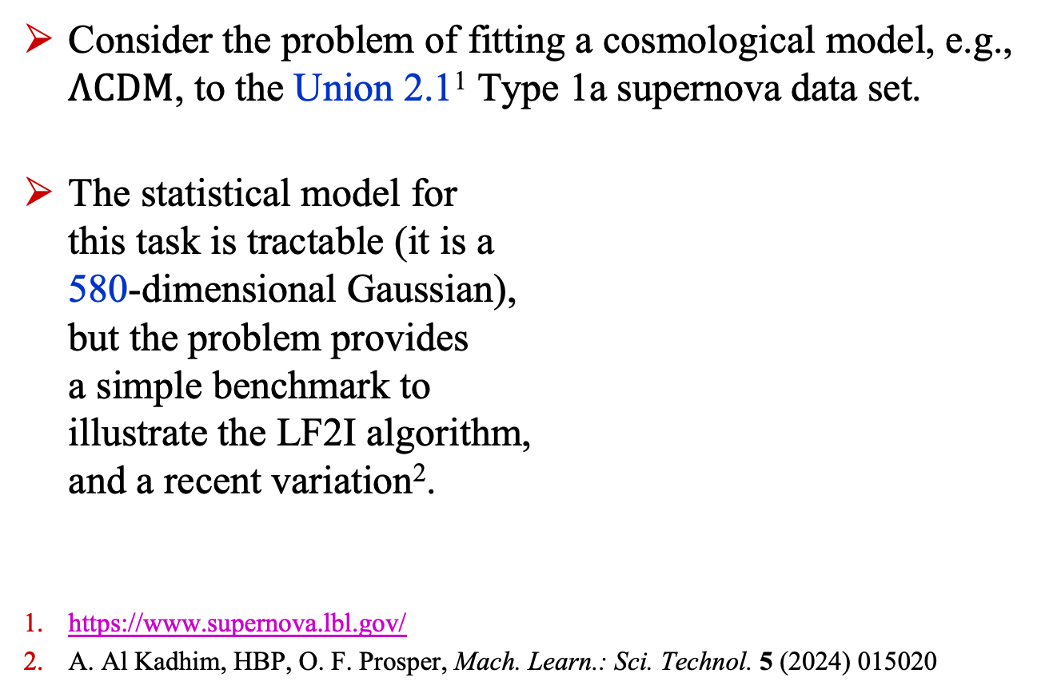
LF2I: Example – Type 1a Sne
Consider the problem of fitting a cosmological model, e.g., $Λ\text{CDM}$, to the Union 2.1¹ Type 1a supernova data set.
The statistical model for this task is tractable (it is a 580-dimensional Gaussian), but the problem provides a simple benchmark to illustrate the LF2I algorithm, and a recent variation².
https://www.supernova.lbl.gov/
A. Al Kadhim, HBP, O. F. Prosper, Mach. Learn.: Sci. Technol. 5 (2024) 015020

Slide 15
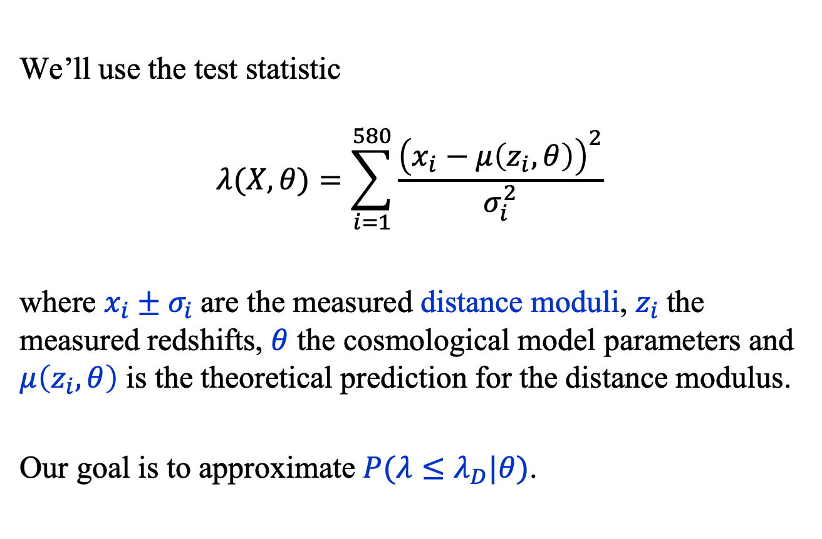
LF2I: Example – Type 1a Sne
We’ll use the test statistic
$$λ(X, θ)=\sum_{i=1}^{580}{\frac{{\left(x_{i}−μ\left(z_{i}, θ\right)\right)}^{2}}{σ_{i}^{2}}}$$
where $x_{i}±σ_{i}$are the measured distance moduli, $z_{i}$the measured redshifts, $θ$ the cosmological model parameters and $μ\left(z_{i}, θ\right)$ is the theoretical prediction for the distance modulus.
Our goal is to approximate $P(λ≤λ_{D}|θ)$.

Slide 16
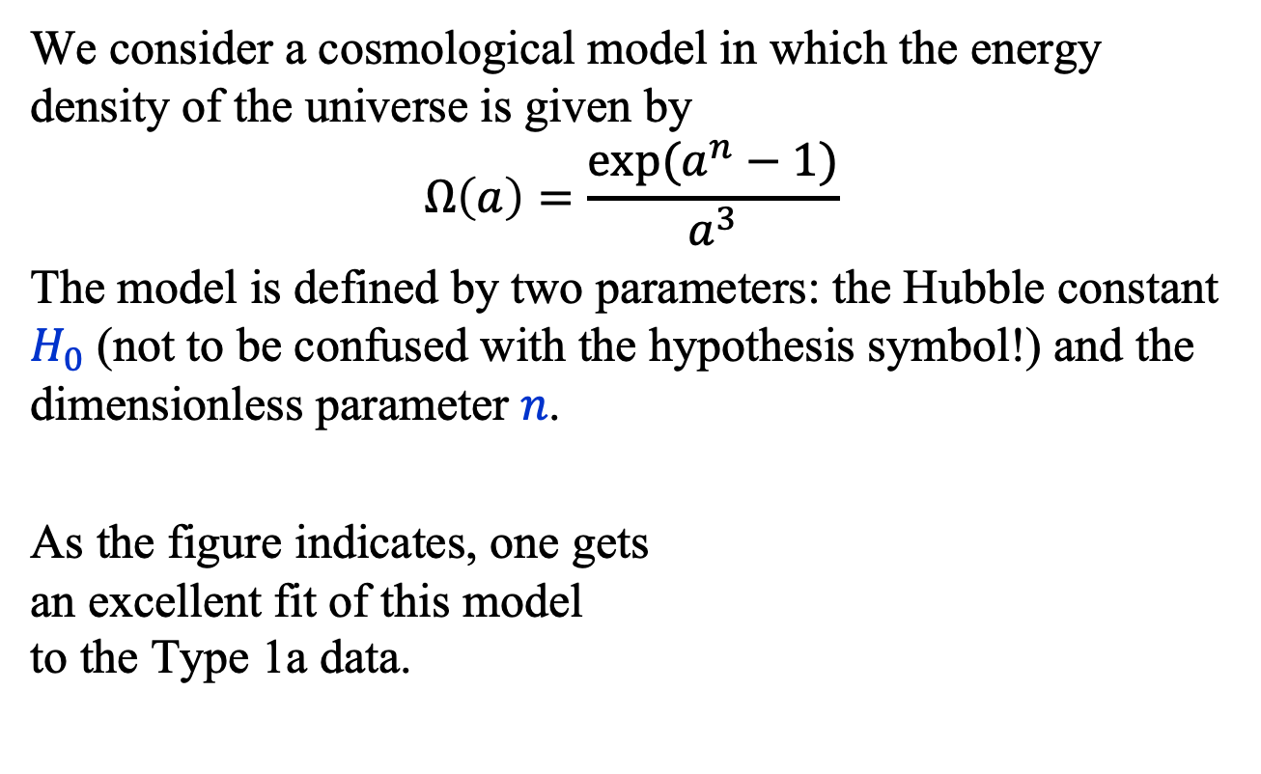
LF2I: Example – Type 1a Sne
We consider a cosmological model in which the energy density of the universe is given by
$$Ω\left(a\right)=\frac{\exp{(a^{n}−1)}}{a^{3}}$$
The model is defined by two parameters: the Hubble constant $H_{0}$ (not to be confused with the hypothesis symbol!) and the dimensionless parameter $n$.
As the figure indicates, one gets an excellent fit of this model to the Type 1a data.

Slide 17



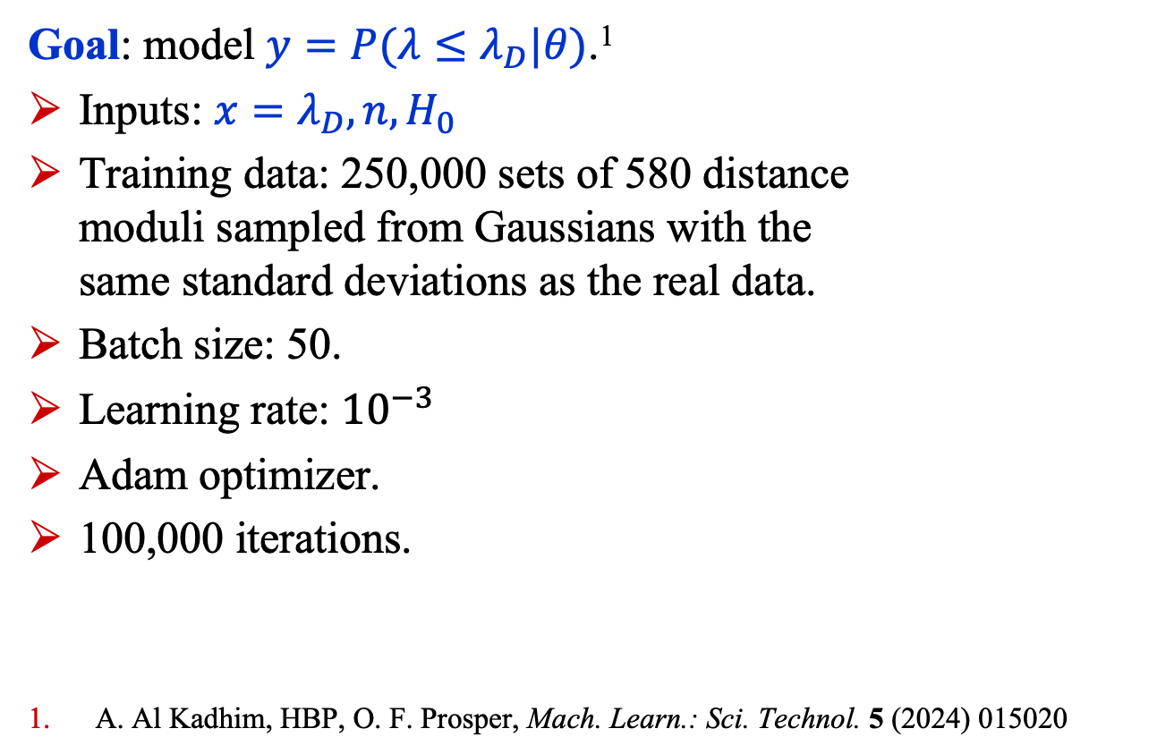




LF2I: Example – Type 1a Sne
$$y$$
sigmoid$()$
Linear(20, 1)
Goal: model $y=P(λ≤λ_{D}|θ)$.¹
Inputs: ${x=λ}_{D}, n,H_{0}$
Training data: 250,000 sets of 580 distance moduli sampled from Gaussians with the same standard deviations as the real data.
Batch size: 50.
Learning rate: ${10}^{−3}$
Adam optimizer.
100,000 iterations.
A. Al Kadhim, HBP, O. F. Prosper, Mach. Learn.: Sci. Technol. 5 (2024) 015020
$$\text{R}\text{eLU}()$$
Linear(20, 20)
$$\text{R}\text{eLU}()$$
Linear(20, 20)
$$\text{R}\text{eLU}()$$
Linear(20, 20)
$$\text{R}\text{eLU}()$$
Linear(3, 20)
$$x$$

Slide 18

LF2I: Example
Confidence set boundaries defined by $P\left(λ≤λ_{D} | θ\right)=1−α$.
Solid contours: NN.
Dashed contours: histogram approximation of $Ε\left[Z | θ\right]=P(λ≤λ_{D}|θ)\text{.}$

Slide 19
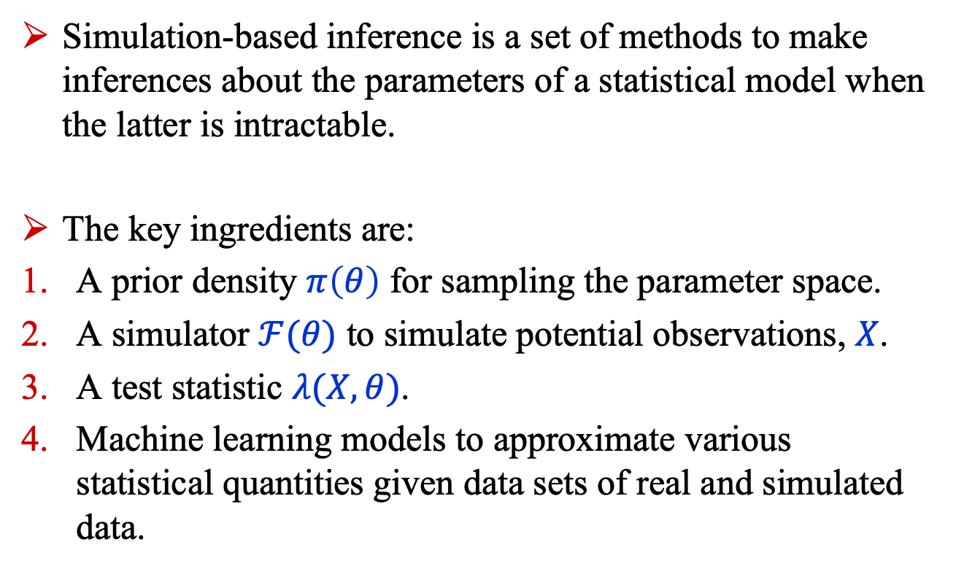
Summary
Simulation-based inference is a set of methods to make inferences about the parameters of a statistical model when the latter is intractable.
The key ingredients are:
A prior density $π\left(θ\right)$ for sampling the parameter space.
A simulator $ℱ(θ)$ to simulate potential observations, $X$.
A test statistic $λ(X,θ)$.
Machine learning models to approximate various statistical quantities given data sets of real and simulated data.

