Slide 1
Machine Learning In Physics
Autoencoders

Slide 2
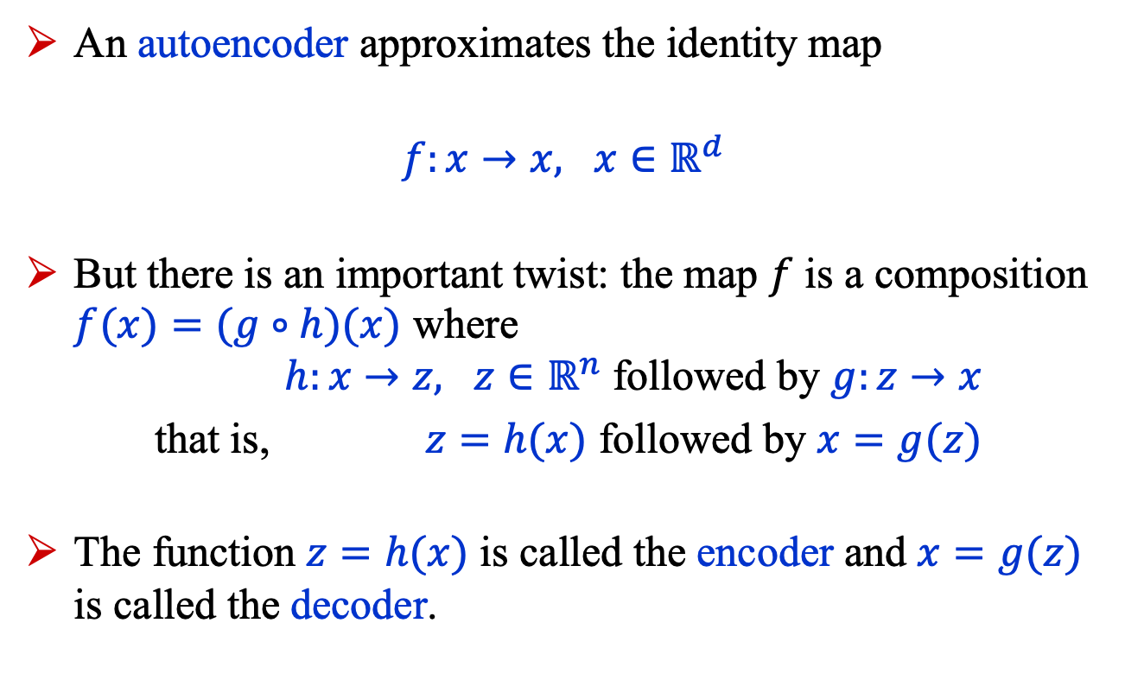
Introduction (1)
An autoencoder approximates the identity map
$f:x→x, x∈ℝ^{d}$
But there is an important twist: the map $f$ is a composition $f(x)=(g∘h)(x)$ where
$h:x→z, z∈ℝ^{n}$ followed by $g:z→x$
that is, $z=h(x)$ followed by $x=g(z)$
The function $z=h(x)$ is called the encoder and $x=g(z)$ is called the decoder.

Slide 3

Introduction (2)
The space $ℝ^{n}$ is called the latent space.
Typically, $n≪d$.
The encoder compresses the input data $x$
$z=h(x)$ $x=g(z)$
$z∈ℝ^{n}$
in an unsupervised manner, that is, the labels are the data $x$.

Slide 4
Introduction (3)
Autoencoders have multiple applications including:
Data compression
  Lossy compression
  Structure detection
Anomaly detection
Noise removal
Our example focuses on structure detection.

Slide 5
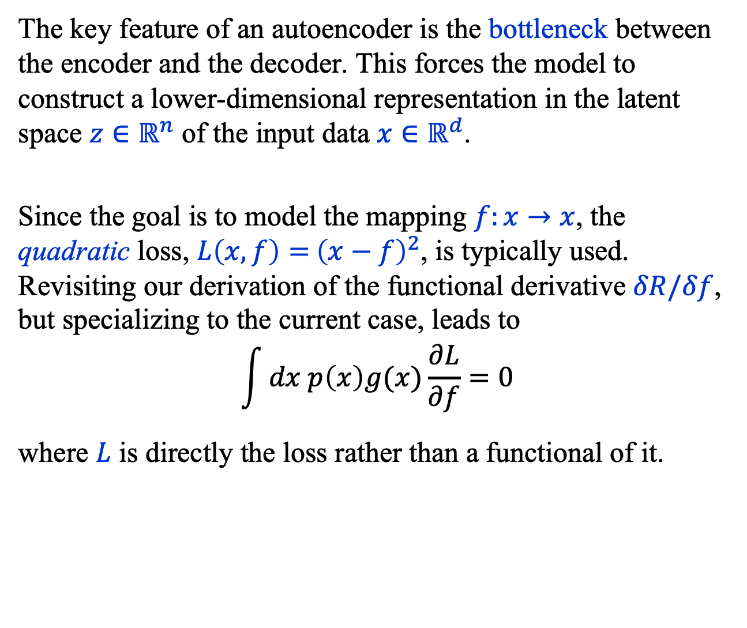
Introduction (4)
The key feature of an autoencoder is the bottleneck between the encoder and the decoder. This forces the model to construct a lower-dimensional representation in the latent space $z∈ℝ^{n}$ of the input data $x∈ℝ^{d}$.
Since the goal is to model the mapping $f:x→x$, the quadratic loss, $L\left(x, f\right)={ \left(x−f\right)}^{2}$, is typically used. Revisiting our derivation of the functional derivative $δR/δf$, but specializing to the current case, leads to
$$\int{dx p\left(x\right)g(x)\frac{∂L}{∂f}}=0$$
where $L$ is directly the loss rather than a functional of it.

Slide 6
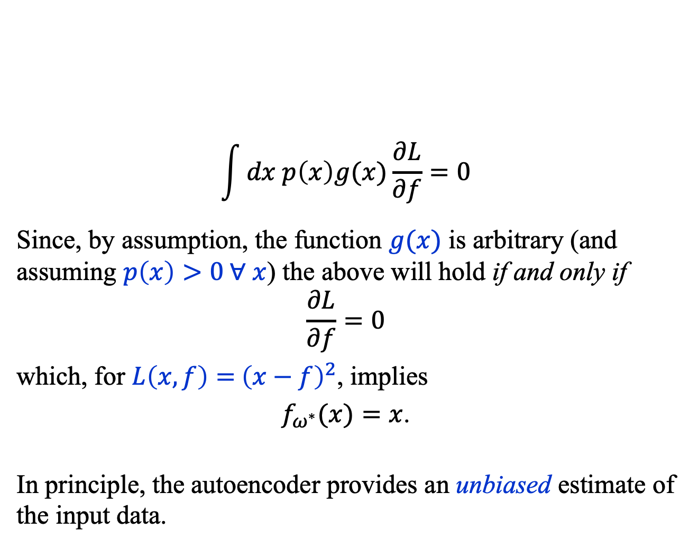
Introduction (5)
$$\int{dx p\left(x\right)g(x)\frac{∂L}{∂f}}=0$$
Since, by assumption, the function $g(x)$ is arbitrary (and assuming $p\left(x\right)>0 ∀ x$) the above will hold if and only if
$$\frac{∂L}{∂f}=0$$
which, for $L\left(x, f\right)={ \left(x−f\right)}^{2}$, implies
$f_{ω^{∗}}(x)=x$.
In principle, the autoencoder provides an unbiased estimate of the input data.

Slide 7
Introduction (6)
There are many kinds of autoencoders, but we’ll consider two of the simplest:
  (Standard) Autoencoder (AE)
  Convolutional Autoencoder (CAE)
An important class of autoencoders that we shall not discuss is Variational Autoencoders (VAE).
We’ll discuss AE and CAE using simple examples.

Slide 8
Autoencoders (AE)

Slide 9
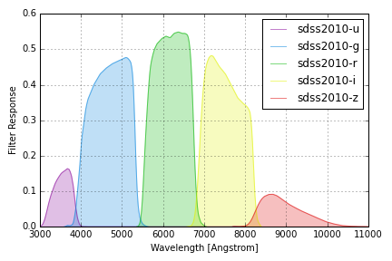
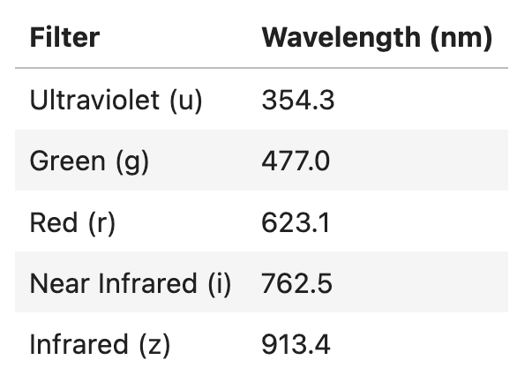
Autoencoders (1)
The autoencoder will be
used to search for structure in
stellar color data from the
Sloan Digital Sky Survey
(SDSS)*.
The data are fluxes
measured in five filters:
*https://www.sdss.org/

Slide 10
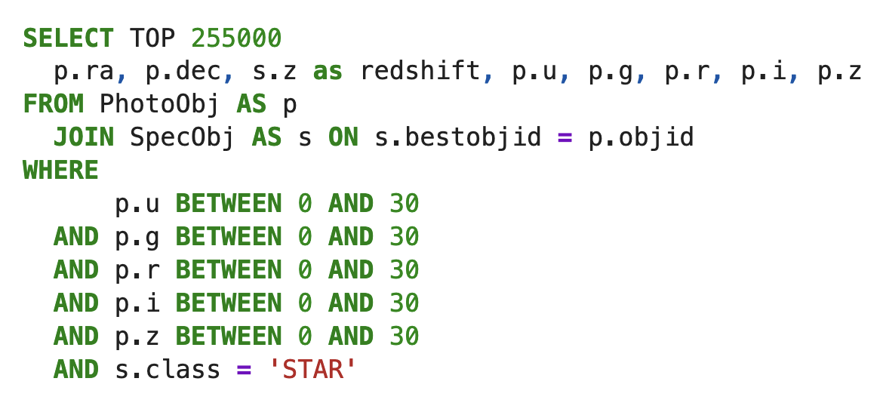
Autoencoders (2)
SDSS Dataset (https://skyserver.sdss.org/dr20/SearchTools/sql)
We use data from 255,000 stars extracted using the SQL command:

Slide 11
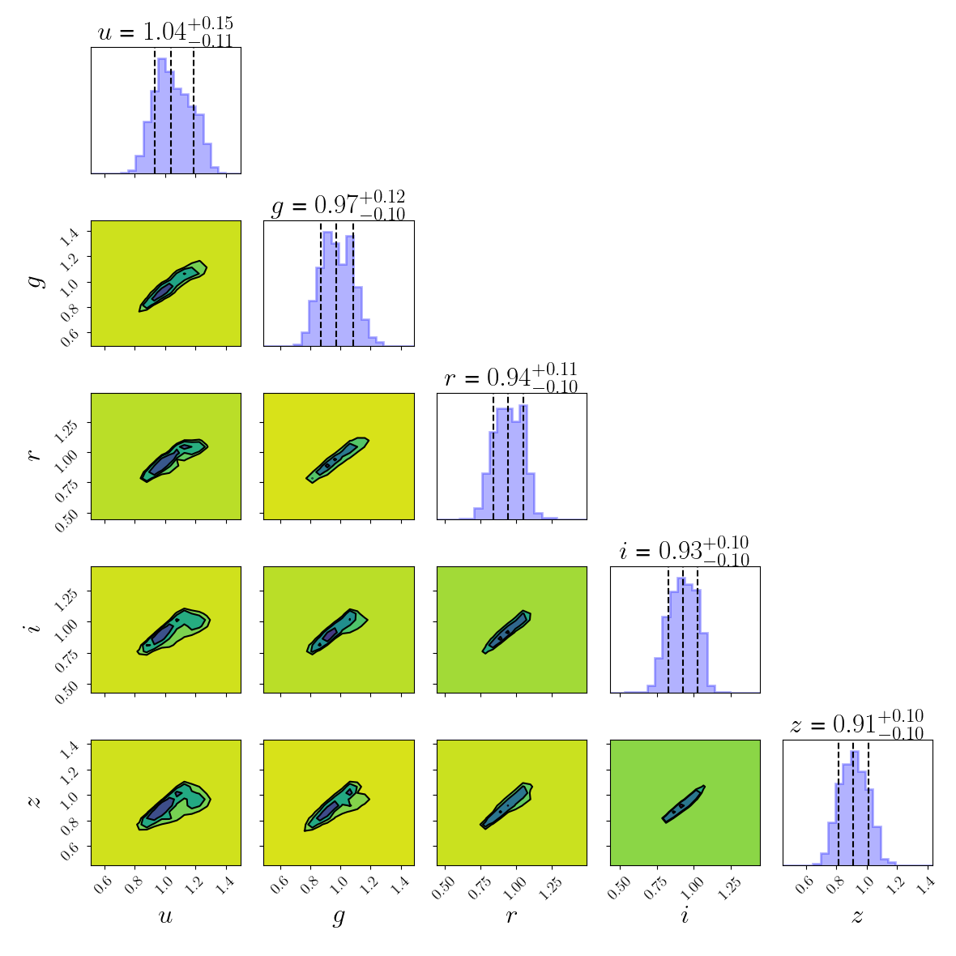
Autoencoders (3)
Beyond correlations, the plots show no obvious structure.
But the hope is that the latent space of the autoencoder will reveal any structure that may be present in the data.

Slide 12

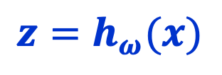

Autoencoders (4): Encoder
$$z∈ℝ^{2}, x∈ℝ^{5}$$
Sin()
$$z=h_{ω}(x)$$
Linear(24, 24)
Sin()
Linear(24, 2)
Linear(24, 24)
Sin()
Sin()
Linear(24, 24)
Linear(5, 24)
$$x$$

Slide 13

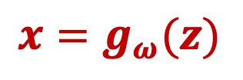
Autoencoders (5): Decoder
$$z∈ℝ^{2}, x∈ℝ^{5}$$
Sin()
$$x=g_{ω}(z)$$
Linear(24, 24)
Sin()
Linear(24, 5)
Linear(24, 24)
Sin()
Sin()
Linear(24, 24)
Linear(2, 24)
$$z$$

Slide 14
Autoencoders (6): Training
Configuration: AE_config.yaml
train_size: 150_000
batch_size: 128
n_epochs: 1000
test_size: 100_000
val_size: 5000
n_steps: 4
n_iters_per_step: 293_000
n_iterations: 1_172_000
base_lr: 0.002
gamma: 0.8

Slide 15
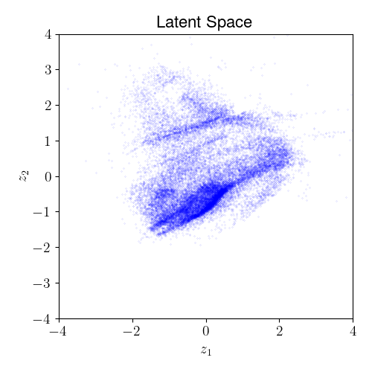
Autoencoders (7): Latent Space
There is clearly structure in the latent space, suggesting (as expected) that the color data pertains to different classes of stars.
The next step would be to identify the clusters and determine whether they correspond to stars with physically distinct characteristics.

Slide 16
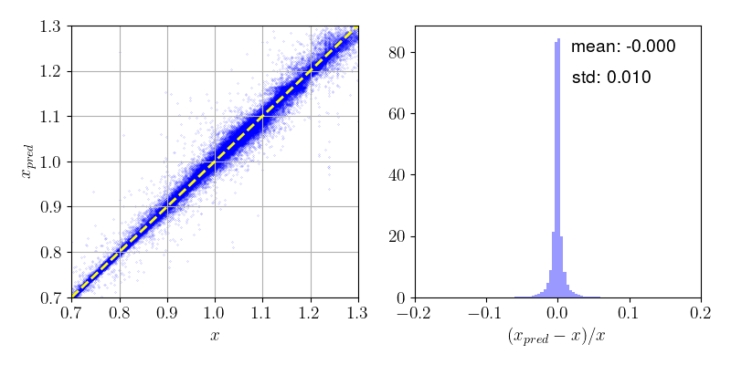

Autoencoders (8): Predictions
In the plots below $x$ is the measured flux and $x_{pred}$ the predicted flux. As anticipated, the bias in the autoencoder is small.

Slide 17
Convolutional Autoencoders (CAE)

Slide 18
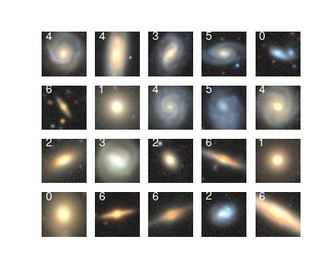
Convolutional Autoencoders (1)
A Convolutional AutoEncoder is an autoencoder that operates on 2-dimensional data, such as images.
Suppose our goal is to create a compressed representation of galaxy images.
This can be done using a CAE
with an encoder and a decoder
which, conceptually, are mirror
images of each other.

Slide 19
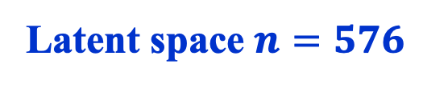
Convolutional Autoencoders (2)
MaxPool2d( ReLU( Conv2d(x) ) )
Latent space $n=576$
Encoder
(16, 6, 6)
(24, 12, 12)
(12, 24, 24)
(6, 48, 48)
Decoder
(3, 96, 96)
ReLU( Conv2dTranspose(x) ))
Sigmoid( Conv2dTranspose(x) ))

Slide 20
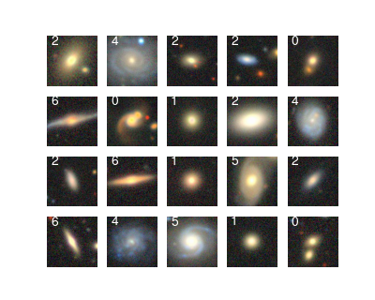
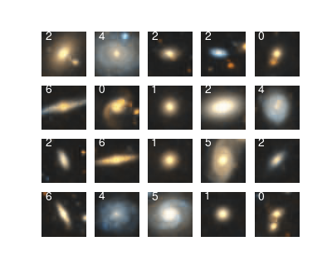
Convolutional Autoencoders (3)
Original images
Reconstructed images
tutorial_CAE.ipynb

Slide 21
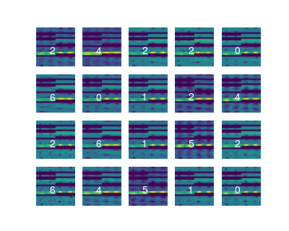
Convolutional Autoencoders (4)
The latent space consists of images of shape (16, 6, 6),
which we have mapped to
single-channel images of
shape (1, 24, 24).
Despite claims to the contrary in the literature, it seems exceedingly unlikely to me that we can ever fully interpret what we see in the latent space!
Latent space images

Slide 22
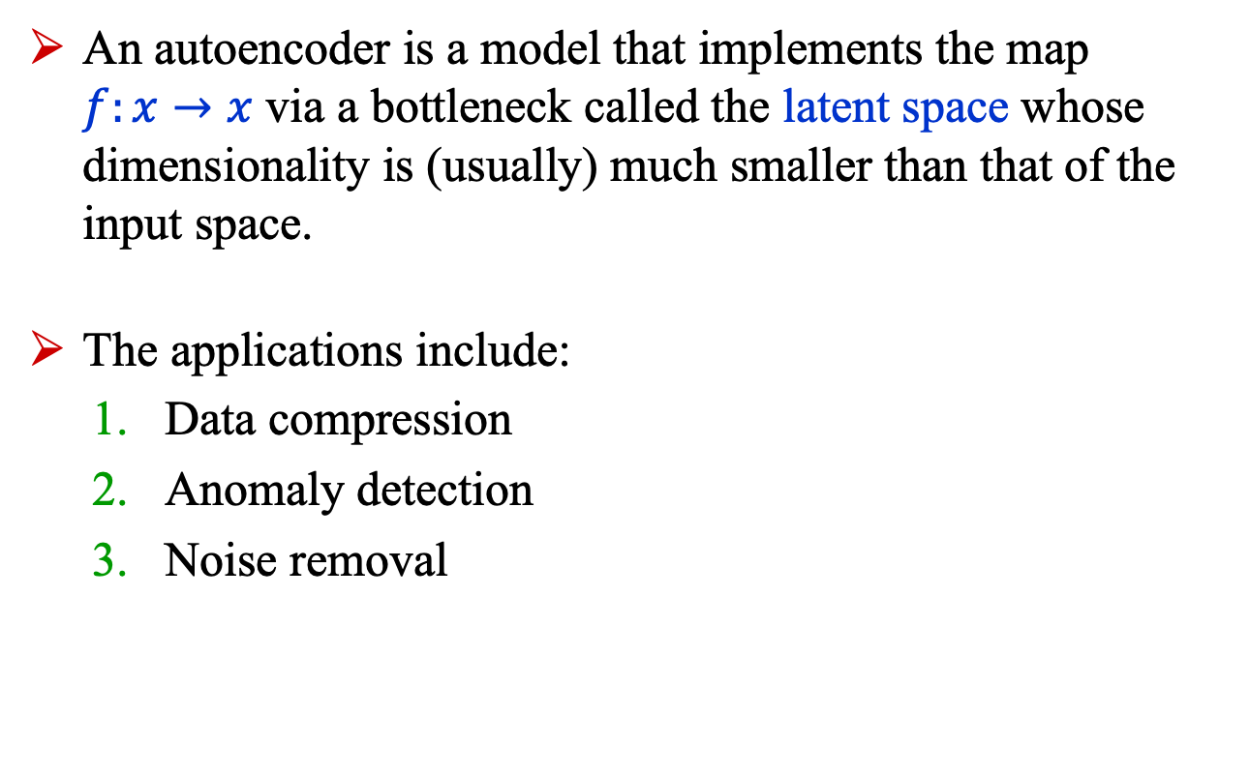
Summary
An autoencoder is a model that implements the map
$f:x→x$ via a bottleneck called the latent space whose dimensionality is (usually) much smaller than that of the input space.
The applications include:
  Data compression
  Anomaly detection
  Noise removal

