Slide 1
Machine learning in Physics Graph autoencoders

Slide 2
Outline
Graphs Revisited
Graph Autoencoder – Part 1
Lecture based on notes by Dr. Claire David
African Institute of Mathematical Sciences, Cape Town, South Africa.

Slide 3
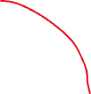







Graphs Revisited (1): Graph
A graph $G=\left(V, E\right)$ comprises nodes (or vertices) $V$ and edges $E$ that model the connections between nodes.
Here is fully-connected graph containing 4 nodes and 16 edges.
1
0
2
3

Slide 4



Graphs Revisited (2): Message
A message is data passed from a source node and received by a target node.
Example: Node 2 is a target node, which receives messages from the source nodes 0, 1, 3, and from itself.
1
0
2
3

Slide 5
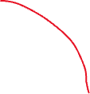

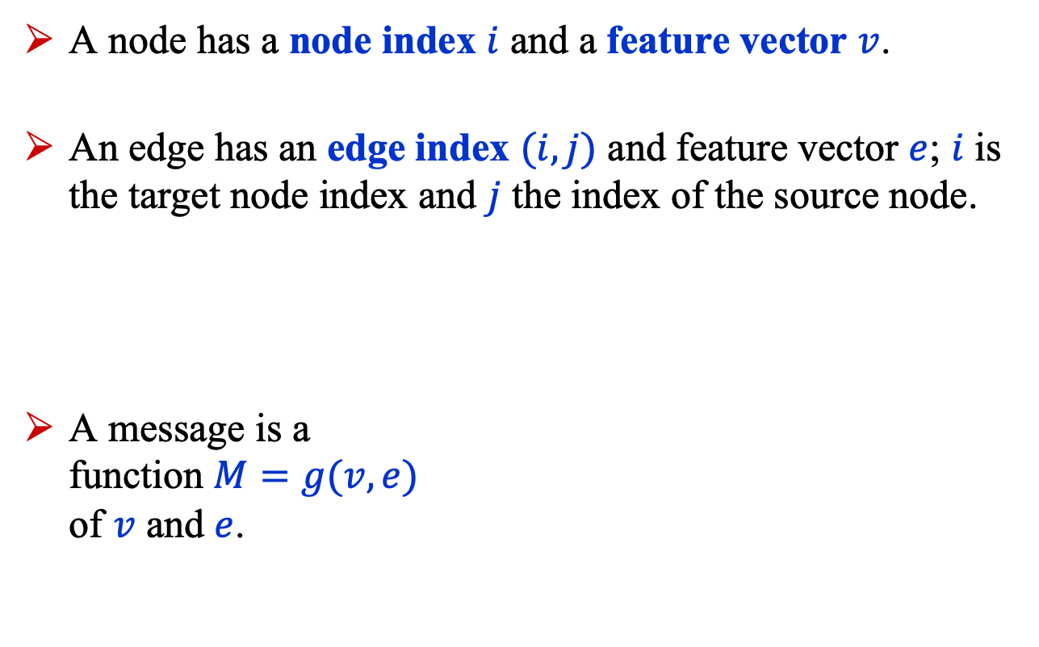




Graphs Revisited (3): Index
A node has a node index $i$ and a feature vector $v$.
An edge has an edge index $(i, j)$ and feature vector $e$; $i$ is the target node index and $j$ the index of the source node.
A message is a function $M=g(v, e)$ of $v$ and $e$.
1
0
2
3

Slide 6
Graphs Revisited (4): Aggregation
The messages received are processed through an aggregation function, which outputs a vector of attributes that replace the existing attributes of the target node.
Consider node 2. It receives messages from nodes 0, 1, 3 and from itself and uses these messages to update its own attributes.
A typical aggregation is just a vectorial sum of the messages.
1
0
2
3

Slide 7
Graphs Revisited (5): Graph Conv
Aggregation in graphs is the analog of convolution in convolutional neural networks and, therefore, it is referred to as graph convolution.
In a CNN, the analog of the source nodes are the nearest neighbor pixels of a given pixel, while the given pixel is the analog of the target node.
1
0
2
3

Slide 8
Graph autoencoder Part 1

Slide 9
Graph Autoencoder (1)
A graph autoencoder (GAE) is a function that encodes a graph in a latent space and decodes the latent space representation of the graph back to the original graph.
A typical application is detecting anomalies in a graph: if a GAE fails to reconstruct the input graph correctly, this may indicate an anomaly. However, that this claim has recently been called into question¹. 1. Autoencoders for Anomaly Detection are Unreliable, Roel Bouman, Tom Heskes, https://arxiv.org/abs/2501.13864
1
0
1
0
2
Encoder
Decoder
2
3
3

Slide 10
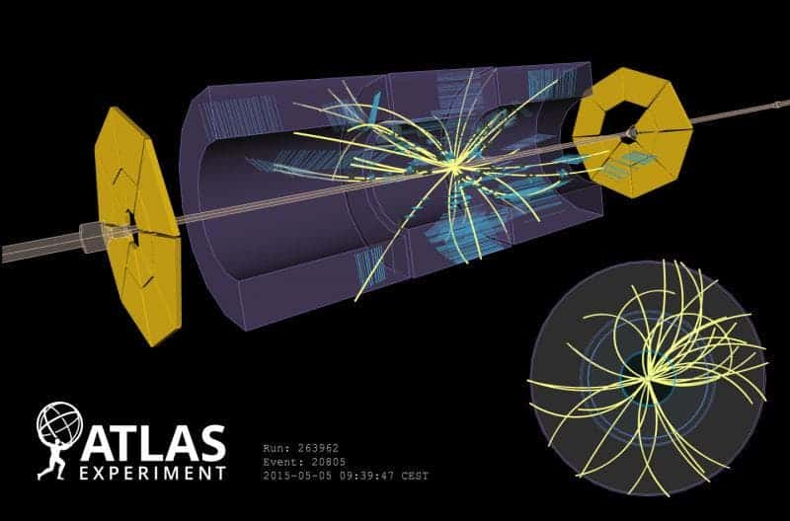
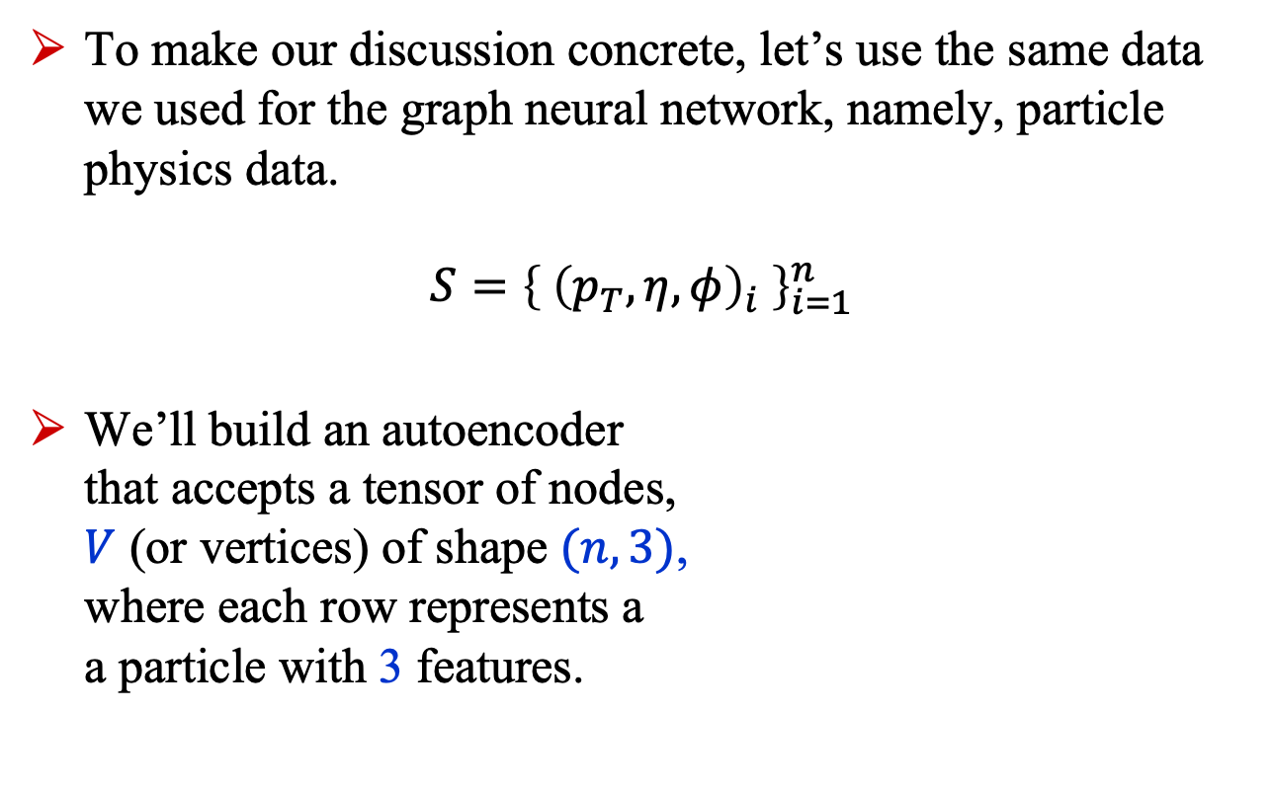
Graph Autoencoder (2)
To make our discussion concrete, let’s use the same data we used for the graph neural network, namely, particle physics data.
$$S={\left\{{ \left(p_{T}, η, φ\right)}_{i} \right\}}_{i=1}^{n}$$
We’ll build an autoencoder that accepts a tensor of nodes, $V$ (or vertices) of shape $(n, 3)$, where each row represents a a particle with 3 features.

Slide 11
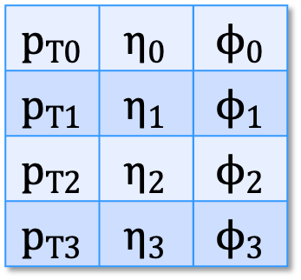
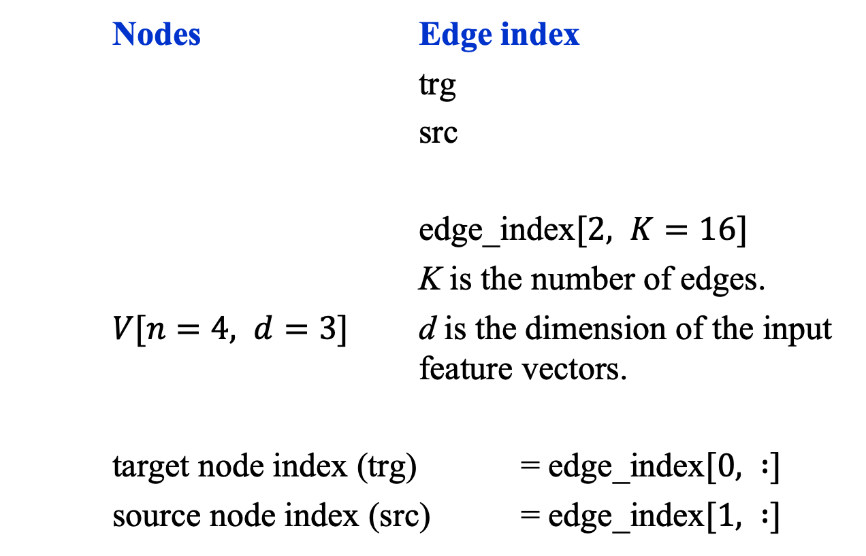
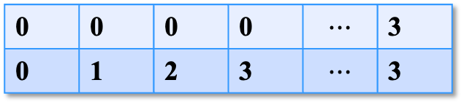
Graph Autoencoder (3): Dataset
Nodes Edge index
trg
src
edge_index$[2, K=16]$
K is the number of edges.
$V[n=4, d=3]$ d is the dimension of the input feature vectors.
target node index (trg) = edge_index$[0, :]$
source node index (src) = edge_index$[1, :]$
$$p_{T0}$$ | $$η_{0}$$ | $$ϕ_{0}$$
$$p_{T1}$$ | $$η_{1}$$ | $$ϕ_{1}$$
$$p_{T2}$$ | $$η_{2}$$ | $$ϕ_{2}$$
$$p_{T3}$$ | $$η_{3}$$ | $$ϕ_{3}$$
0 | 0 | 0 | 0 | $$⋯$$ | 3
0 | 1 | 2 | 3 | $$⋯$$ | 3

Slide 12


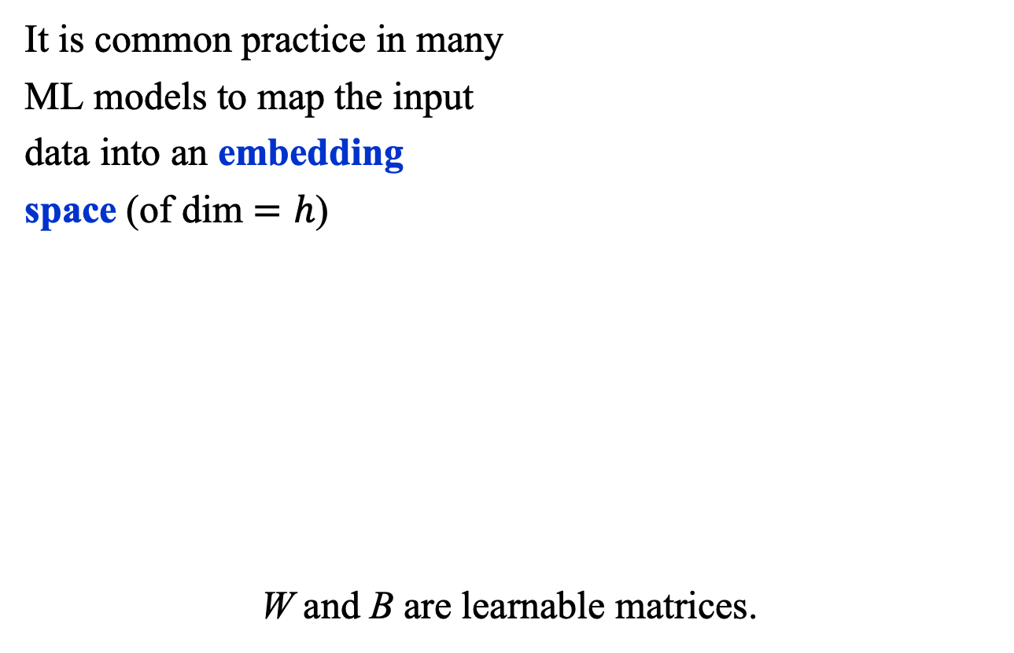

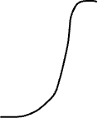

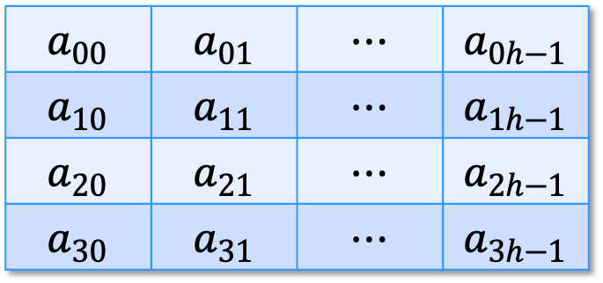

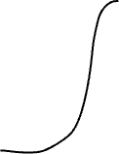
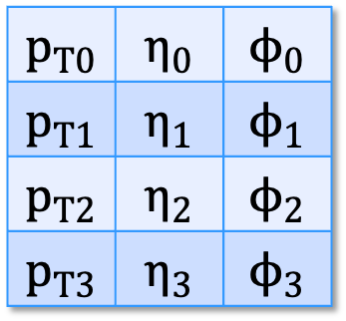
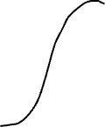

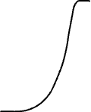
Graph Autoencoder (4): Embedding
It is common practice in many
ML models to map the input
data into an embedding
space (of dim $=h$)
W and B are learnable matrices.
X (embedded nodes)
$$a_{00}$$ | $$a_{01}$$ | $$⋯$$ | $$a_{0h−1}$$
$$a_{10}$$ | $$a_{11}$$ | $$⋯$$ | $$a_{1h−1}$$
$$a_{20}$$ | $$a_{21}$$ | $$⋯$$ | $$a_{2h−1}$$
$$a_{30}$$ | $$a_{31}$$ | $$⋯$$ | $$a_{3h−1}$$
V input nodes
$$p_{T0}$$ | $$η_{0}$$ | $$ϕ_{0}$$
$$p_{T1}$$ | $$η_{1}$$ | $$ϕ_{1}$$
$$p_{T2}$$ | $$η_{2}$$ | $$ϕ_{2}$$
$$p_{T3}$$ | $$η_{3}$$ | $$ϕ_{3}$$
1
0
2
$$X=σ\left(VW_{1}^{T}+B_{1}\right)$$
3

Slide 13

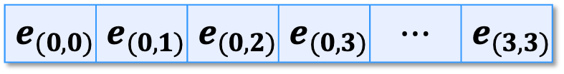
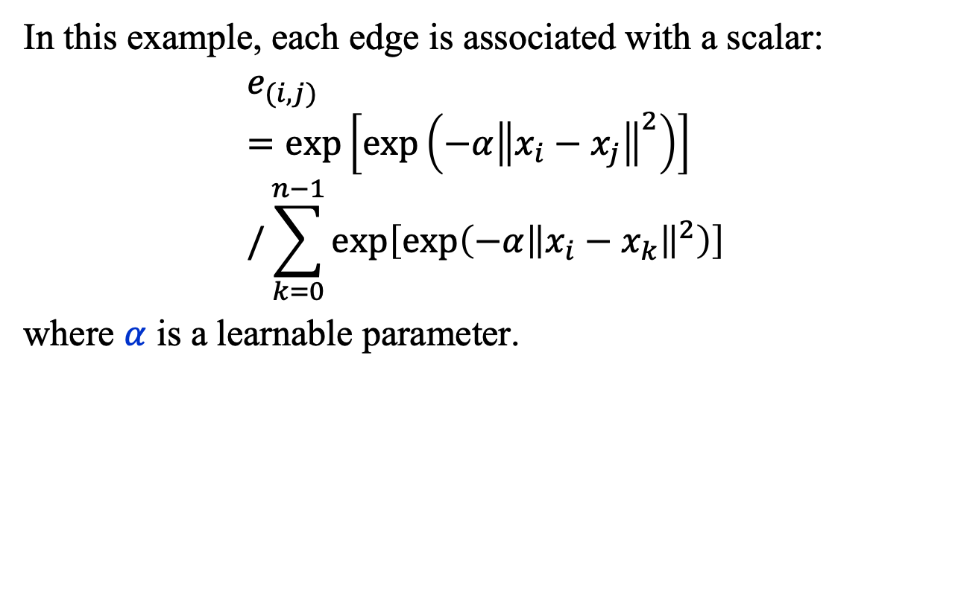
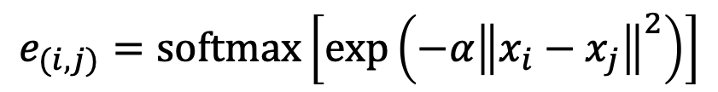
Graph Autoencoder (5): Edge Feature
In this example, each edge is associated with a scalar:
$$e_{(i,j)}=\exp\left[\exp\left(−α{\left\|x_{i}−x_{j}\right\|}^{2}\right)\right]/\sum_{k=0}^{n−1}{\exp\left[\exp\left(−α{\left\|x_{i}−x_{k}\right\|}^{2}\right)\right]}$$
where $α$ is a learnable parameter.
$$x_{i}=\left(η_{i}, φ_{i}\right)$$
$$e_{(i,j)}=\text{softmax}\left[\exp\left(−α{\left\|x_{i}−x_{j}\right\|}^{2}\right)\right]$$
1
0
2
edge features
$$e_{(0,0)}$$ | $$e_{(0,1)}$$ | $$e_{(0,2)}$$ | $$e_{(0,3)}$$ | $$⋯$$ | $$e_{(3,3)}$$
3

Slide 14
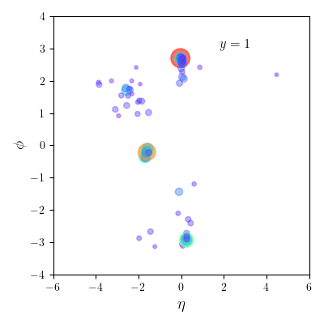
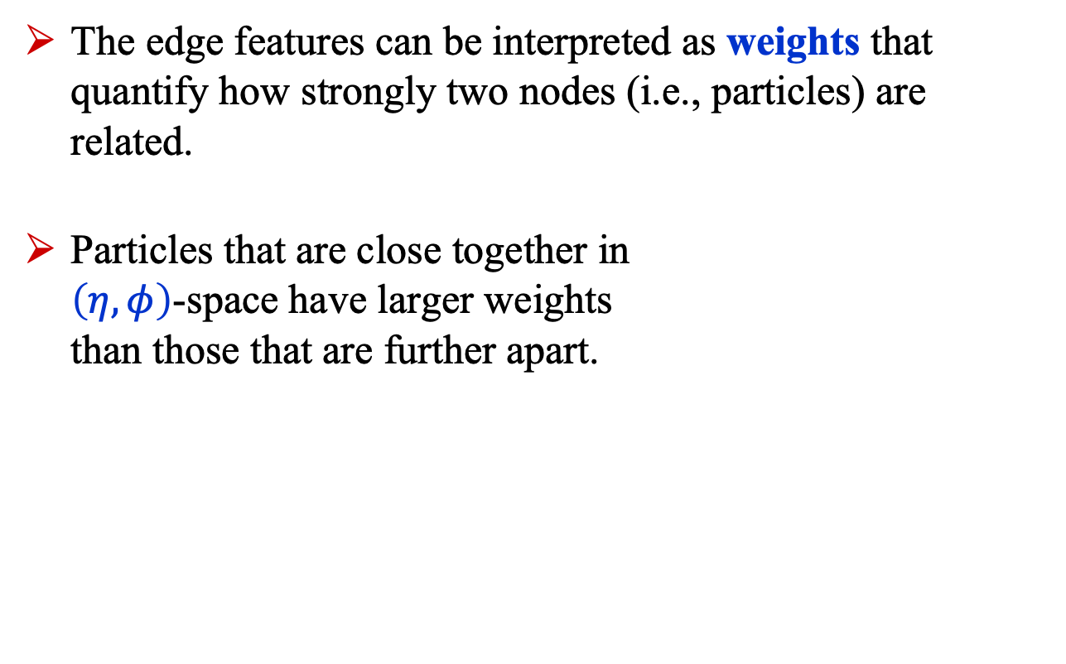
Graph Autoencoder (6): Edge Feature
The edge features can be interpreted as weights that quantify how strongly two nodes (i.e., particles) are related.
Particles that are close together in $\left(η, φ\right)$-space have larger weights than those that are further apart.

Slide 15

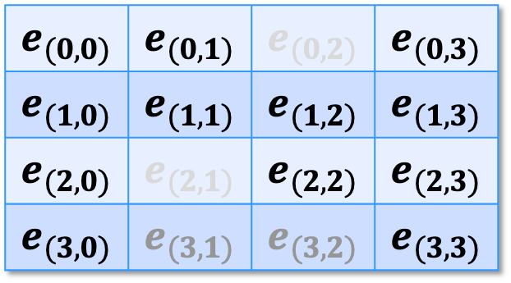
Graph Autoencoder (7): Adjacency
The weights can be thought of as an $n×n$ adjacency matrix $A$ that defines the neighborhood structure of the graph. Each row corresponds to a target node and each column to a source node.
Example: target node 0 is strongly related to source nodes 1 and 3 but not to source node 2.
$$e_{(0,0)}$$ | $$e_{(0,1)}$$ | $$e_{(0,2)}$$ | $$e_{(0,3)}$$
$$e_{(1,0)}$$ | $$e_{(1,1)}$$ | $$e_{(1,2)}$$ | $$e_{(1,3)}$$
$$e_{(2,0)}$$ | $$e_{(2,1)}$$ | $$e_{(2,2)}$$ | $$e_{(2,3)}$$
$$e_{(3,0)}$$ | $$e_{(3,1)}$$ | $$e_{(3,2)}$$ | $$e_{(3,3)}$$

Slide 16
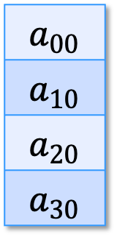
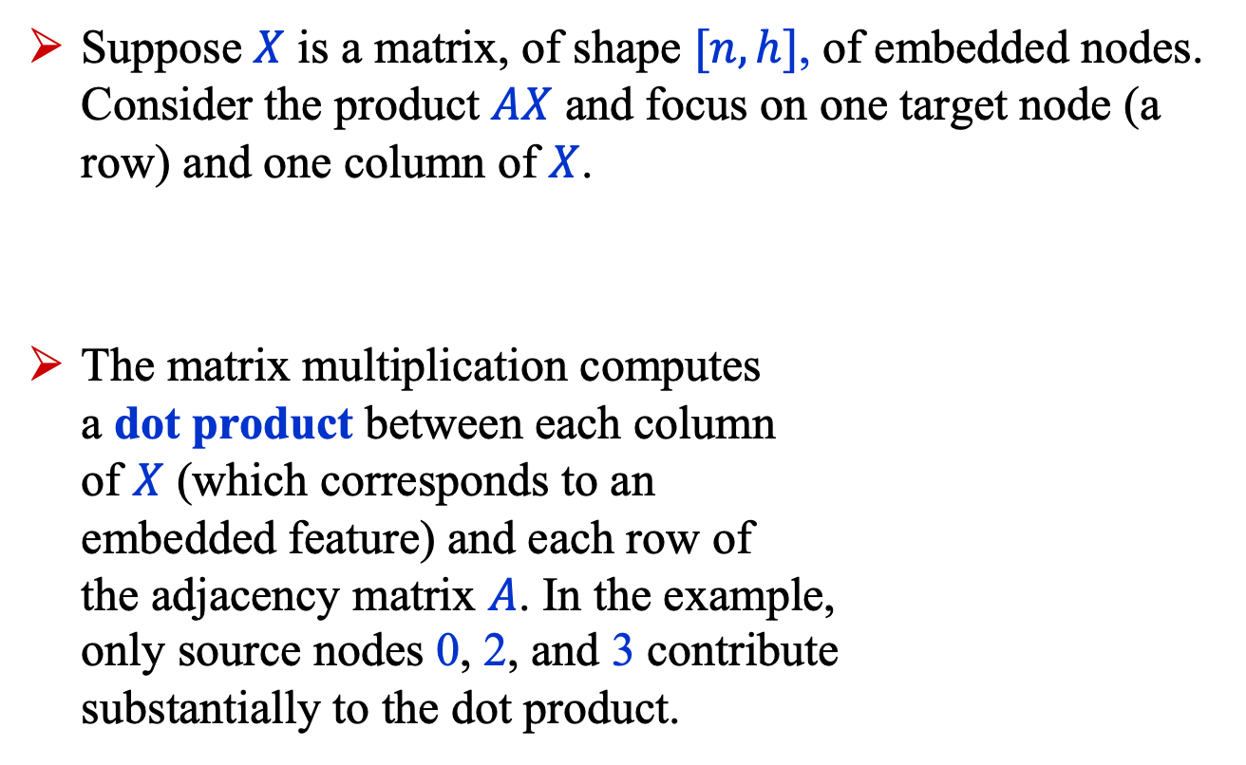
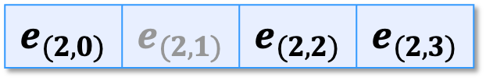
Graph Autoencoder (8): Adjacency
Suppose $X$ is a matrix, of shape $[n, h]$, of embedded nodes. Consider the product $AX$ and focus on one target node (a row) and one column of $X$.
The matrix multiplication computes a dot product between each column of $X$ (which corresponds to an embedded feature) and each row of the adjacency matrix $A$. In the example, only source nodes 0, 2, and 3 contribute substantially to the dot product.
$$a_{00}$$
$$a_{10}$$
$$a_{20}$$
$$a_{30}$$
$$e_{(2,0)}$$ | $$e_{(2,1)}$$ | $$e_{(2,2)}$$ | $$e_{(2,3)}$$
1
0
2
3

Slide 17





Graph Autoencoder
To be continued…!
1
0
2
3

Slide 18
Graph autoencoder Part 2

Slide 19
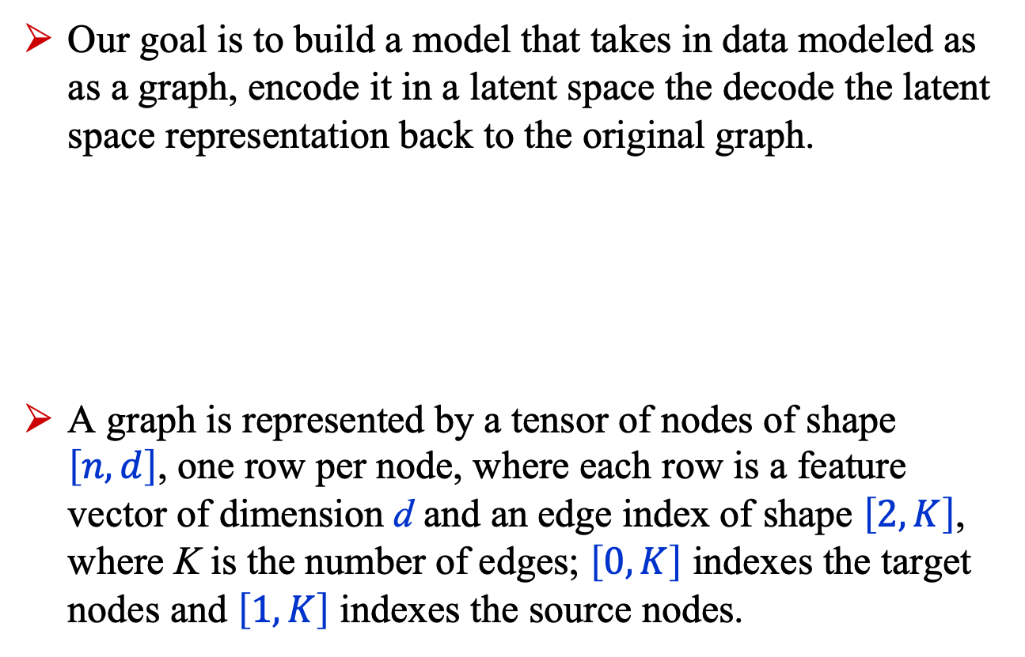
Recap
Our goal is to build a model that takes in data modeled as as a graph, encode it in a latent space the decode the latent space representation back to the original graph.
A graph is represented by a tensor of nodes of shape $\left[n, d\right]$, one row per node, where each row is a feature vector of dimension d and an edge index of shape $\left[2, K\right]$, where K is the number of edges; $\left[0, K\right]$ indexes the target nodes and $\left[1, K\right]$ indexes the source nodes.
1
0
1
0
2
Encoder
Decoder
2
3
3

Slide 20
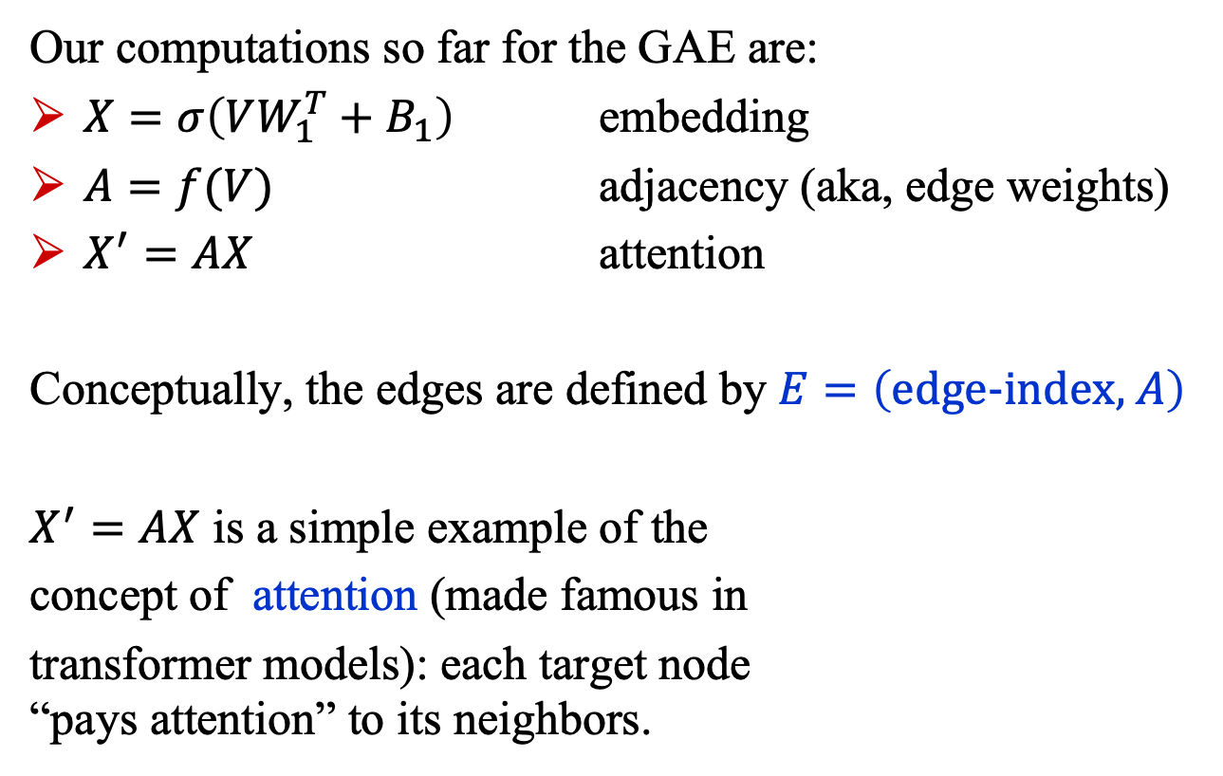
Graph Autoencoder
Our computations so far for the GAE are:
$X=σ\left(VW_{1}^{T}+B_{1}\right)$ embedding
$A=f(V)$ adjacency (aka, edge weights)
$X^{′}=AX$ attention
Conceptually, the edges are defined by $E=\left(\text{edge}\text{-}\text{index}\text{,} A\right)$
$X^{′}=AX$ is a simple example of the
concept of attention (made famous in
transformer models): each target node “pays attention” to its neighbors.
1
0
2
3

