Slide 1
Machine learning in physics Bayesian Neural networks

Slide 2
Outline
Introduction
Standard Approach
Bayesian Approach
Hamiltonian Monte Carlo
Summary

Slide 3
introduction

Slide 4
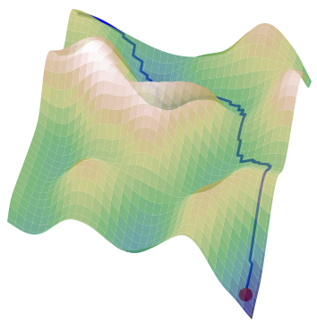
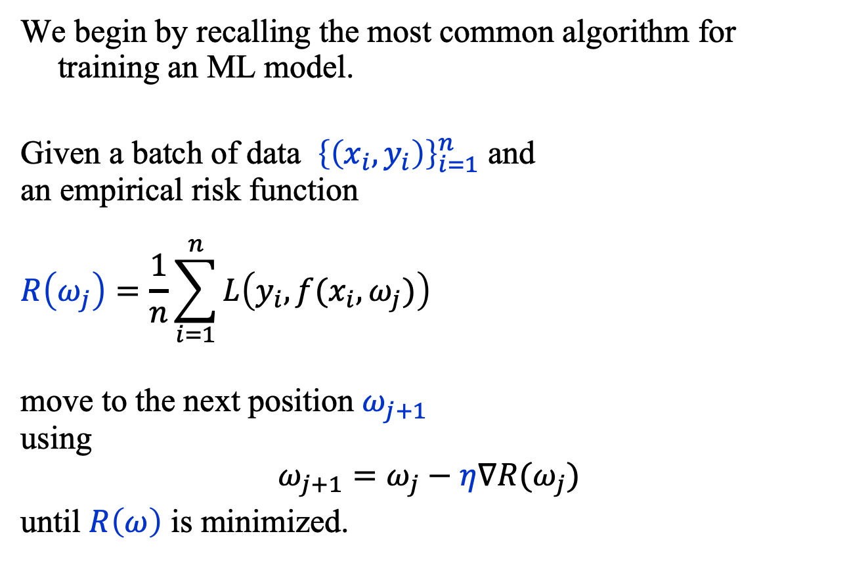
Introduction: Standard Approach
We begin by recalling the most common algorithm for training an ML model.
Given a batch of data ${\left\{\left(x_{i}, y_{i}\right)\right\}}_{i=1}^{n}$ and an empirical risk function
$$R\left(ω_{j}\right)=\frac{1}{n}\sum_{i=1}^{n}{L\left(y_{i},f(x_{i},ω_{j})\right)}$$
move to the next position $ω_{j+1}$ using
$$ω_{j+1}=ω_{j}−η∇R(ω_{j})$$
until $R\left(ω\right)$ is minimized.

Slide 5
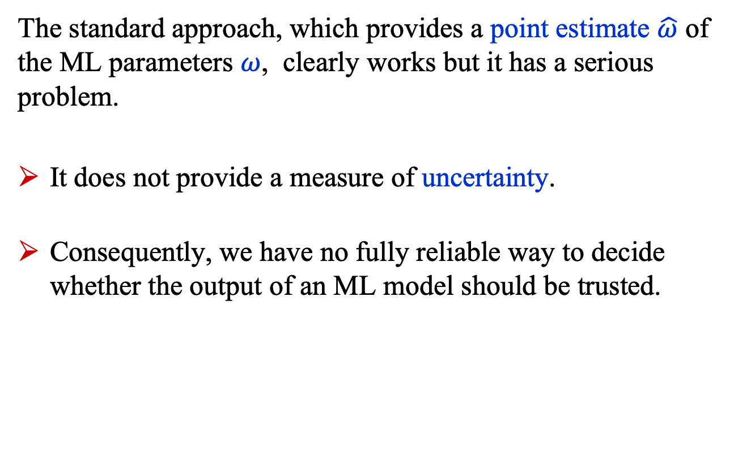
Introduction: Standard Approach
The standard approach, which provides a point estimate $\hat{ω}$ of the ML parameters $ω$, clearly works but it has a serious problem.
It does not provide a measure of uncertainty.
Consequently, we have no fully reliable way to decide whether the output of an ML model should be trusted.

Slide 6
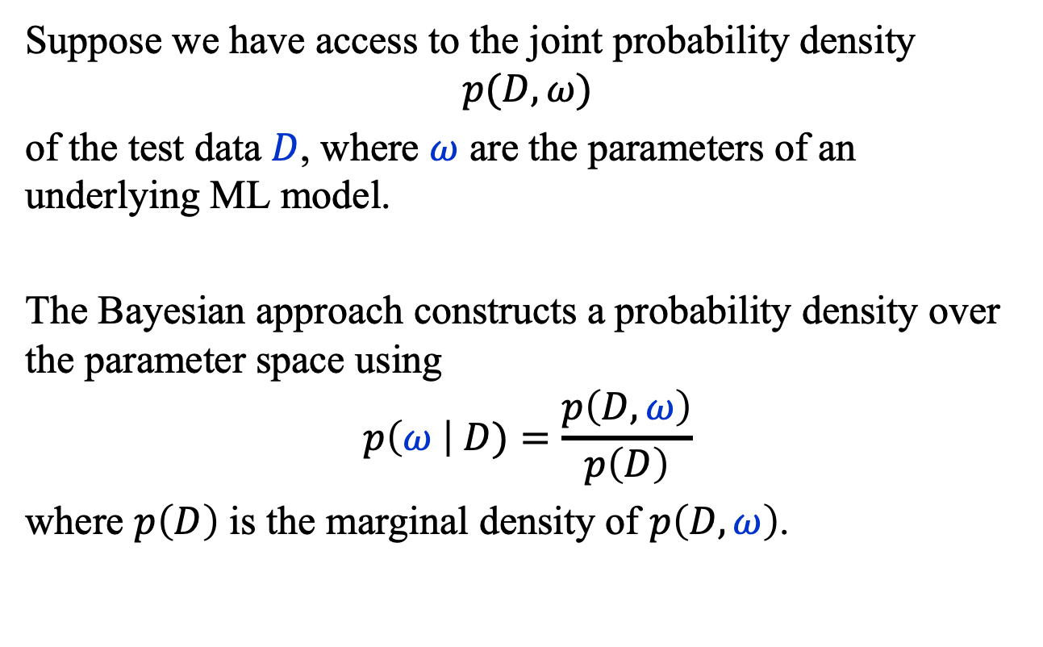
Introduction: Bayesian Approach
Suppose we have access to the joint probability density
$$p(D, ω)$$
of the test data $D$, where $ω$ are the parameters of an underlying ML model.
The Bayesian approach constructs a probability density over the parameter space using
$$p\left(ω \right| D)=\frac{p\left(D, ω\right)}{p\left(D\right)}$$
where $p\left(D\right)$ is the marginal density of $p\left(D, ω\right)$.

Slide 7
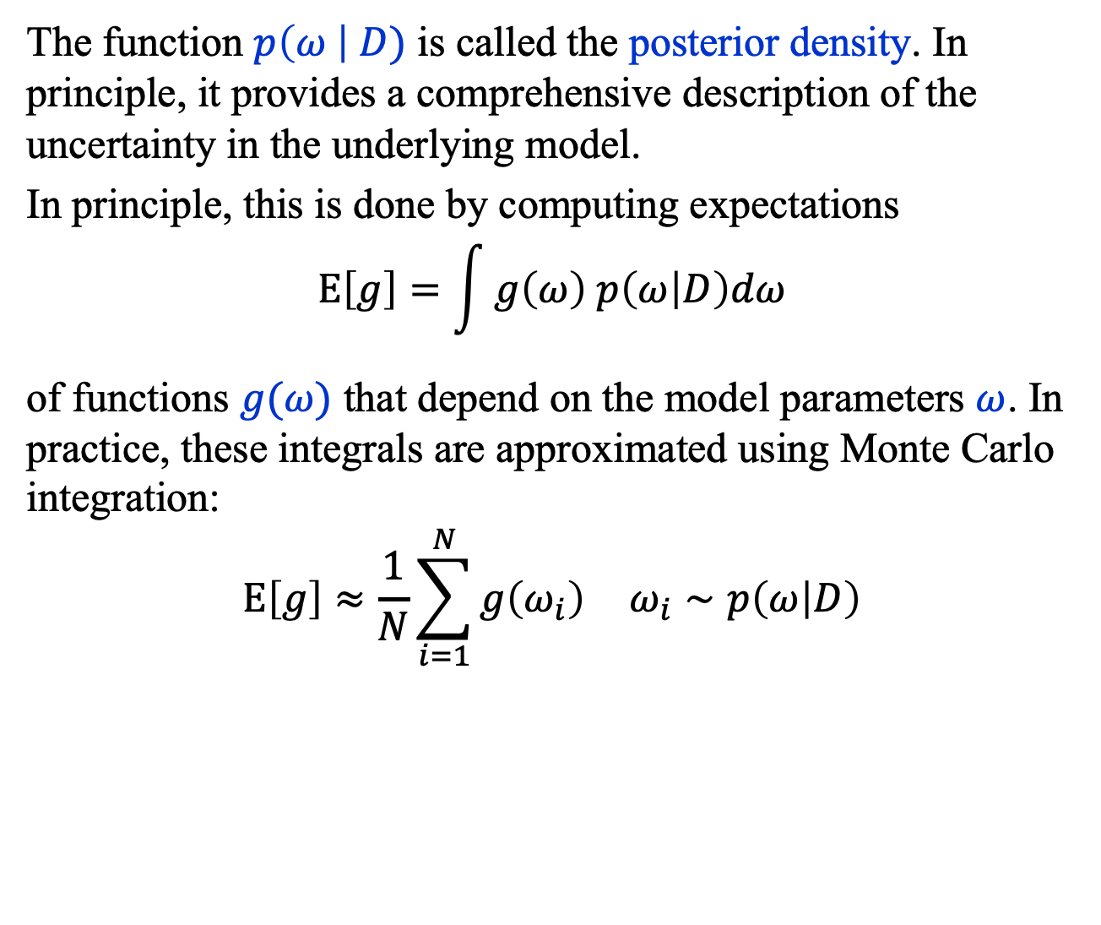
Introduction: Bayesian Approach
The function $p\left(ω \right| D)$ is called the posterior density. In principle, it provides a comprehensive description of the uncertainty in the underlying model.
In principle, this is done by computing expectations
$$Ε\left[g\right]=\int{g\left(ω\right) p\left(ω | D\right)dω}$$
of functions $g(ω)$ that depend on the model parameters $ω$. In practice, these integrals are approximated using Monte Carlo integration:
$$Ε\left[g\right]≈\frac{1}{N}\sum_{i=1}^{N}{g\left(ω_{i}\right)} ω_{i}∼p\left(ω | D\right)$$

Slide 8
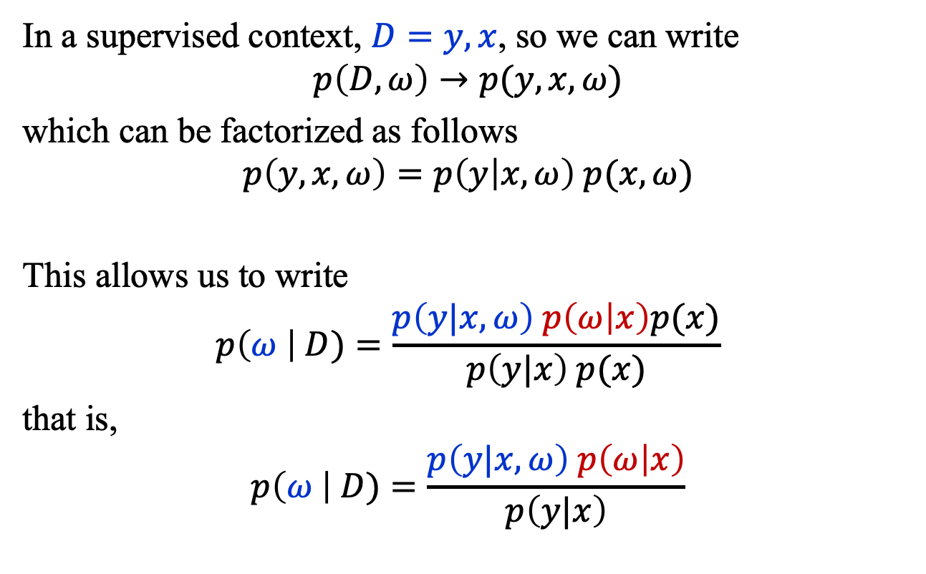
Introduction: Bayesian Approach
In a supervised context, $D=y, x$, so we can write
$$p\left(D, ω\right)→p(y, x, ω)$$
which can be factorized as follows
$$p\left(y, x, ω\right)=p\left(y | x, ω\right) p(x, ω)$$
This allows us to write
$$p\left(ω \right| D)=\frac{p\left(y|x, ω\right) p\left(ω | x\right)p(x)}{p\left(y|x\right) p(x)}$$
that is,
$$p\left(ω \right| D)=\frac{p\left(y|x, ω\right) p\left(ω | x\right)}{p\left(y|x\right)}$$

Slide 9
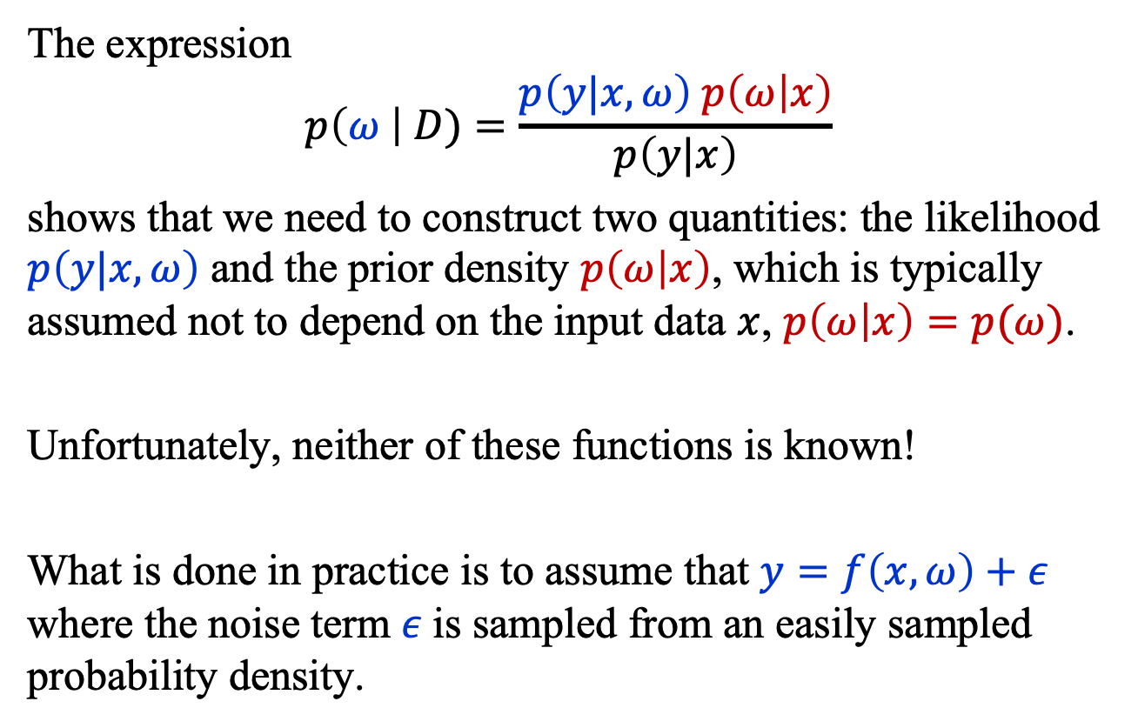
Introduction: Bayesian Approach
The expression
$$p\left(ω \right| D)=\frac{p\left(y|x, ω\right) p\left(ω | x\right)}{p\left(y|x\right)}$$
shows that we need to construct two quantities: the likelihood $p\left(y|x, ω\right)$ and the prior density $p\left(ω | x\right)$, which is typically assumed not to depend on the input data $x$, $p\left(ω | x\right)=p(ω)$.
Unfortunately, neither of these functions is known!
What is done in practice is to assume that $y=f\left(x, ω\right)+ε$ where the noise term $ε$is sampled from an easily sampled probability density.

Slide 10
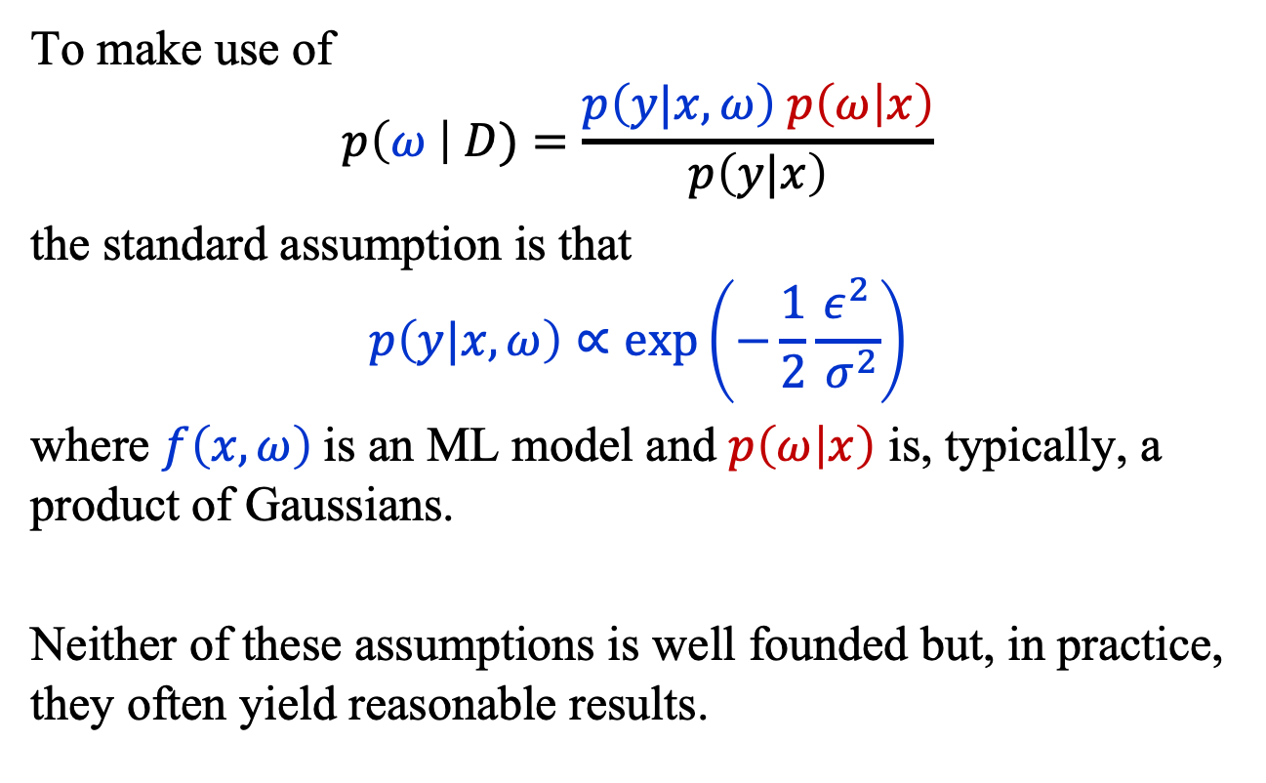
Introduction: Bayesian Approach
To make use of
$$p\left(ω \right| D)=\frac{p\left(y|x, ω\right) p\left(ω | x\right)}{p\left(y|x\right)}$$
the standard assumption is that
$$p\left(y|x, ω\right)∝\exp\left(−\frac{1}{2}\frac{ε^{2}}{ σ^{2}}\right)$$
where $f\left(x,ω\right)$is an ML model and $p\left(ω | x\right)$ is, typically, a product of Gaussians.
Neither of these assumptions is well founded but, in practice, they often yield reasonable results.

Slide 11
Hamiltonian monte Carlo

Slide 12
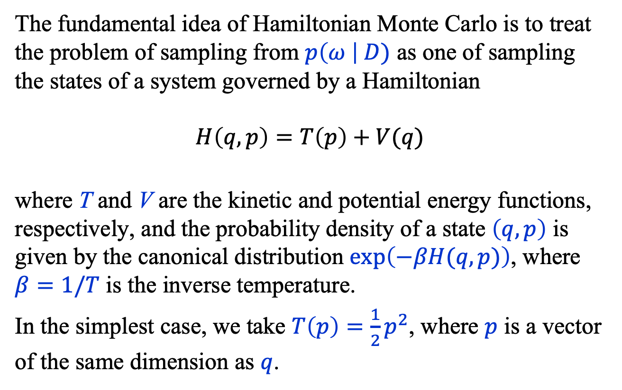
Hamiltonian Monte Carlo
The fundamental idea of Hamiltonian Monte Carlo is to treat the problem of sampling from $p\left(ω \right| D)$ as one of sampling the states of a system governed by a Hamiltonian
$$H\left(q,p\right)=T\left(p\right)+V(q)$$
where T and V are the kinetic and potential energy functions, respectively, and the probability density of a state $\left(q, p\right)$ is given by the canonical distribution $\exp\left(−βH(q, p)\right)$, where $β=1/T$ is the inverse temperature.
In the simplest case, we take $T\left(p\right)=\frac{1}{2}p^{2}$, where $p$ is a vector of the same dimension as $q$.

Slide 13
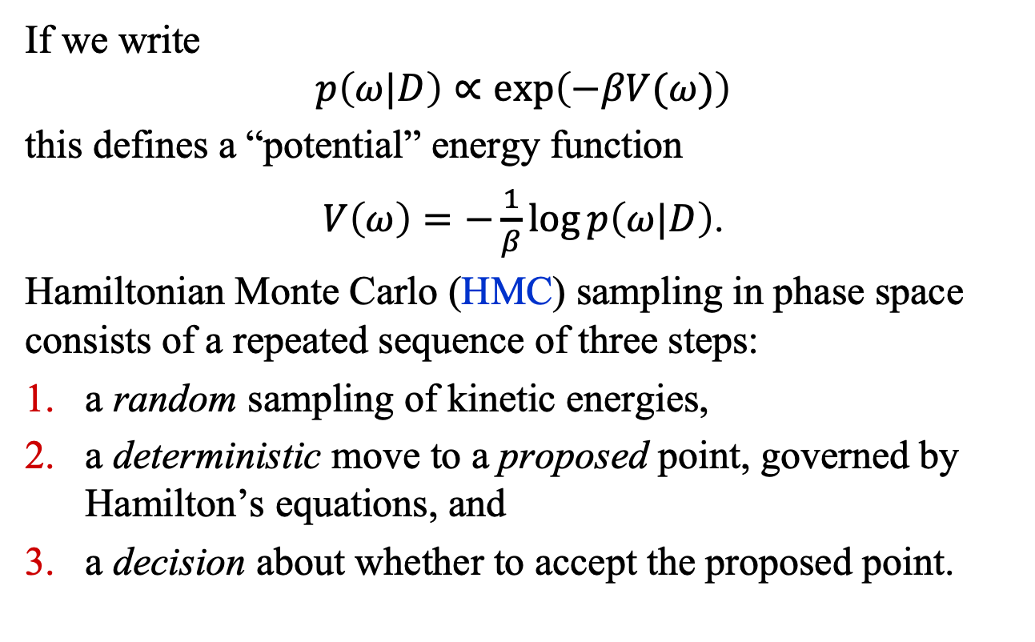
Hamiltonian Monte Carlo
If we write
$$p\left(ω|D\right)∝\exp\left(−βV(ω)\right)$$
this defines a “potential” energy function
$V\left(ω\right)=−\frac{1}{β}\log{p\left(ω|D\right)}$.
Hamiltonian Monte Carlo (HMC) sampling in phase space consists of a repeated sequence of three steps:
a random sampling of kinetic energies,
a deterministic move to a proposed point, governed by Hamilton’s equations, and
a decision about whether to accept the proposed point.

Slide 14
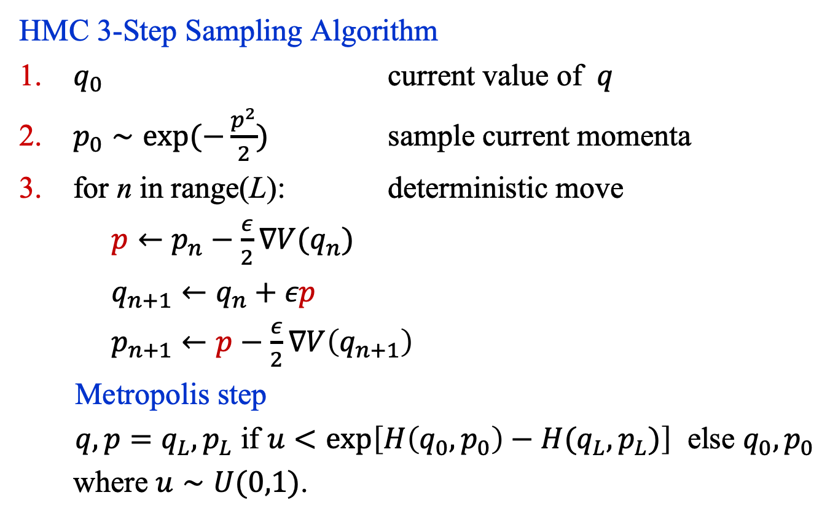
Hamiltonian Monte Carlo
HMC 3-Step Sampling Algorithm
$q_{0}$ current value of $q$
$p_{0}∼\exp{(−\frac{p^{2}}{2})}$ sample current momenta
for n in range(L): deterministic move
$p←p_{n}−\frac{ε}{2}∇V(q_{n})$
$q_{n+1}←q_{n}+εp$
$p_{n+1}←p−\frac{ε}{2}∇V\left(q_{n+1}\right)$
Metropolis step
$q, p=q_{L},p_{L}$ if $u<\exp\left[H\left({q_{0},p}_{0}\right)−H(q_{L}, p_{L})\right]$ else $q_{0},p_{0}$
where $u∼U(0,1)$.

Slide 15
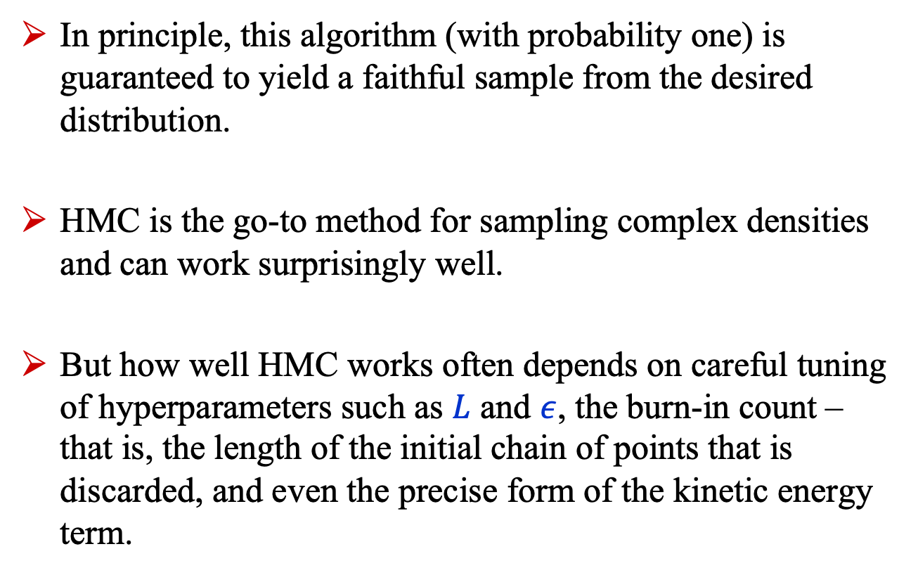
Hamiltonian Monte Carlo
In principle, this algorithm (with probability one) is guaranteed to yield a faithful sample from the desired distribution.
HMC is the go-to method for sampling complex densities and can work surprisingly well.
But how well HMC works often depends on careful tuning of hyperparameters such as $L$ and $ε$, the burn-in count – that is, the length of the initial chain of points that is discarded, and even the precise form of the kinetic energy term.

Slide 16
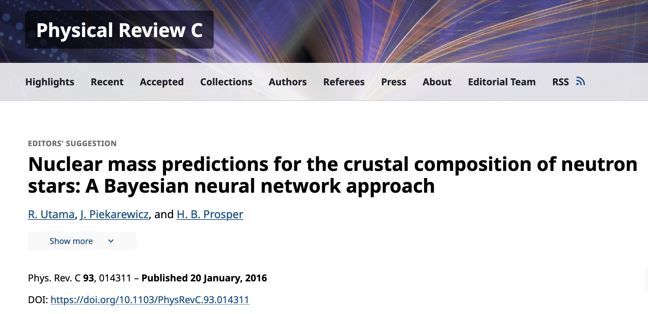
HMC Example: Nuclear Star Crusts

Slide 17
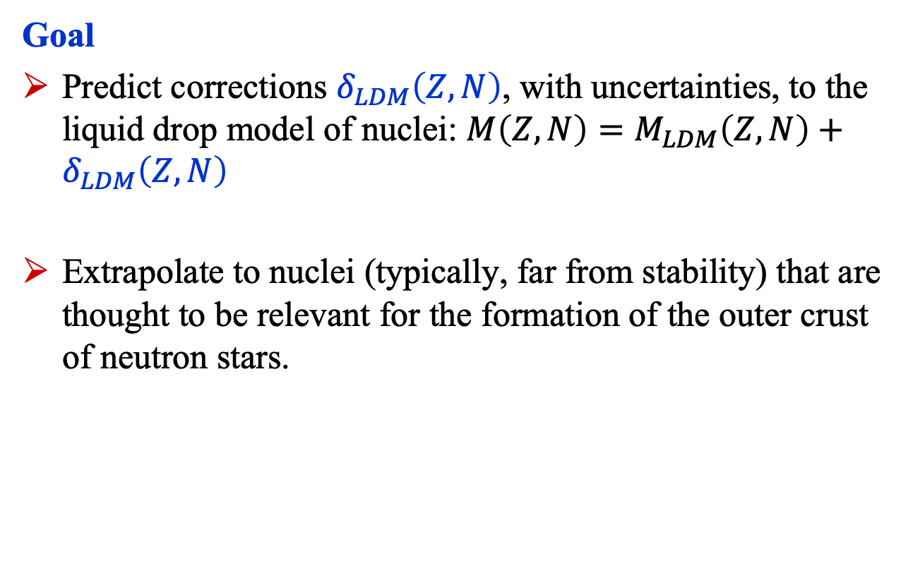
HMC Example: Nuclear Star Crusts
Goal
Predict corrections $δ_{LDM}\left(Z, N\right)$, with uncertainties, to the liquid drop model of nuclei: $M\left(Z, N\right)=M_{LDM}\left(Z, N\right)+δ_{LDM}\left(Z, N\right)$
Extrapolate to nuclei (typically, far from stability) that are thought to be relevant for the formation of the outer crust of neutron stars.

Slide 18
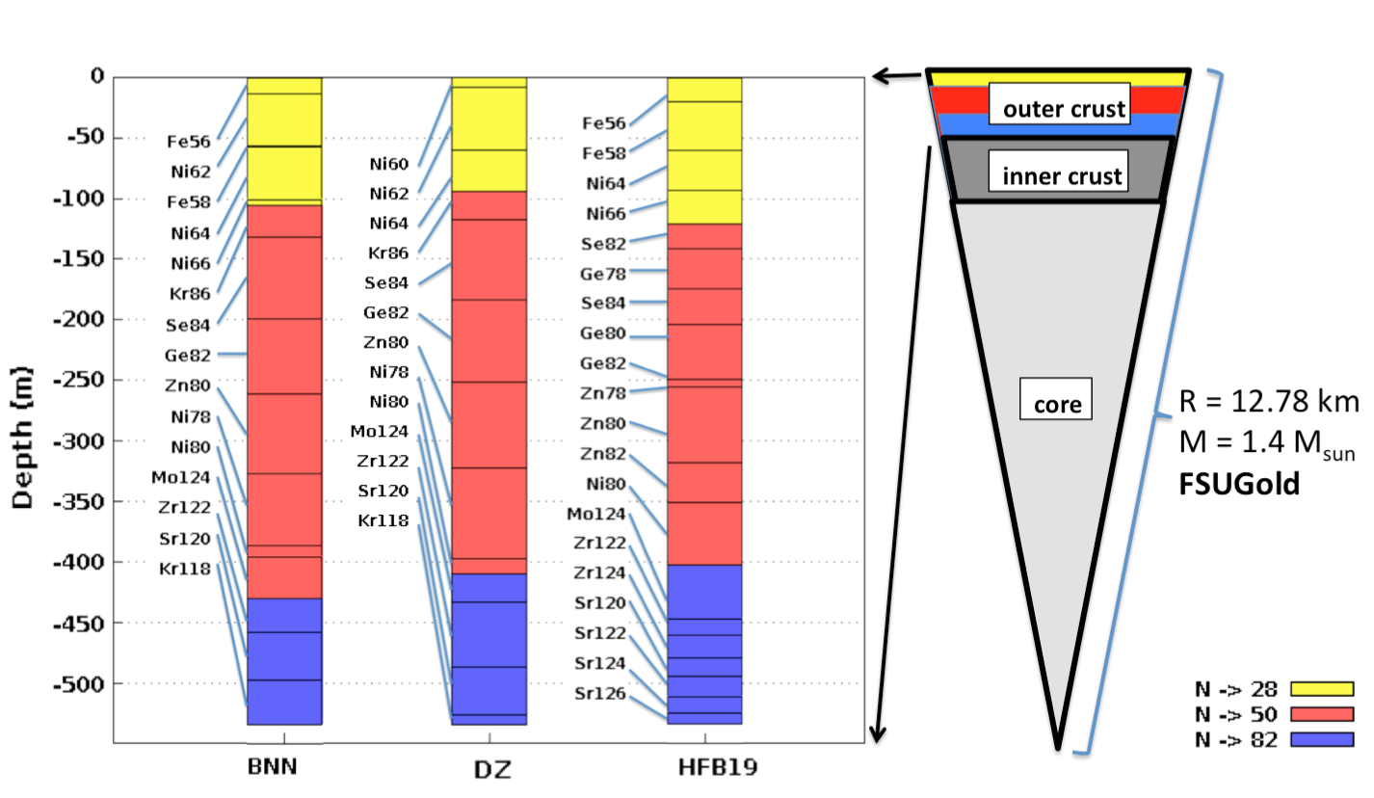
HMC Example: Nuclear Star Crusts

Slide 19
Summary
Standard training methods in ML do not provide a measure of uncertainty, which is a serious deficiency.
In principle, the Bayesian approach provides a principled way to handle uncertainty in all its forms, but the high-dimensional integrals encountered are intractable.
Hamiltonian Monte Carlo, first developed by physicists to solve Lattice QCD, has proven to be an effective, albeit computationally demanding, method to approximate these integrals.
Unfortunately, while there now exist many methods of uncertainty quantification, none, including Bayesian methods, is completely satisfactory.

