Slide 1
Machine Learning In Physics Foundations 2

Slide 2
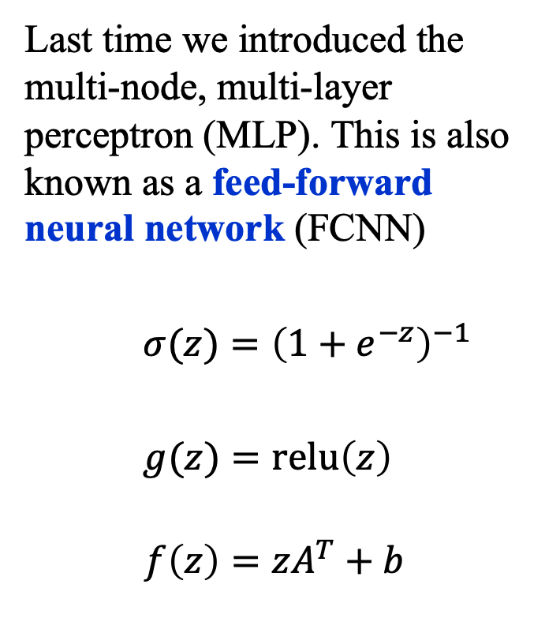

Recap
Last time we introduced the multi-node, multi-layer perceptron (MLP). This is also known as a feed-forward neural network (FCNN)
$σ(z)={\left(1+e^{−z}\right)}^{−1}$
$g(z)=\text{relu}\left(z\right)$
$$f\left(z\right)=zA^{T}+b$$
output
$$σ(z)$$
Layer 2
Linear(4, 1)
$$\text{g }(z)$$
Layer 1
Linear(2, 4)
$$x$$

Slide 3
Fitting Models to data

Slide 4
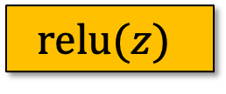
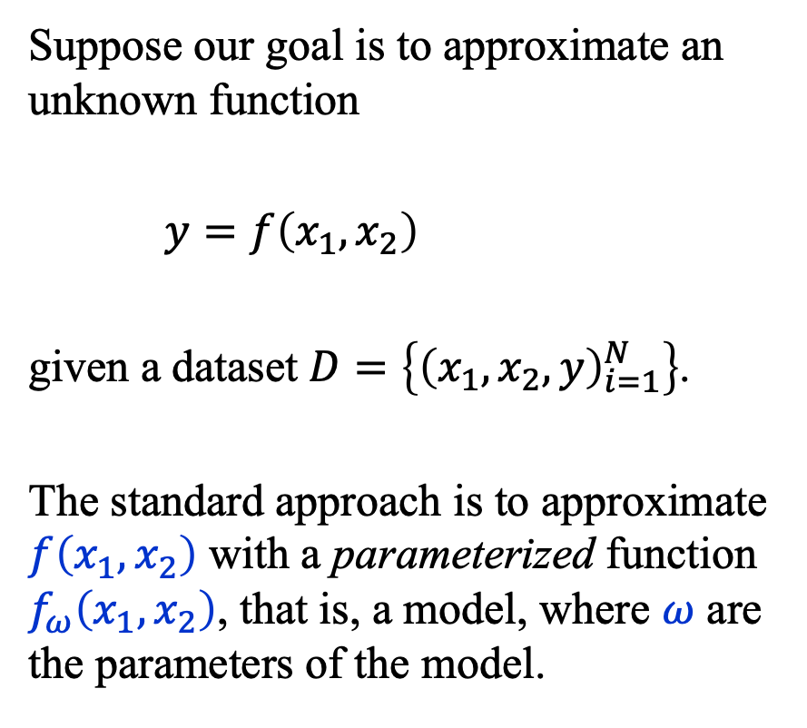


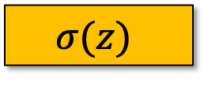
Fitting Models to Data (1)
Suppose our goal is to approximate an unknown function
$y=f\left(x_{1},x_{2}\right)$
given a dataset $D=\left\{{\left(x_{1},x_{2},y\right)}_{i=1}^{N}\right\}$.
The standard approach is to approximate $f\left(x_{1},x_{2}\right)$ with a parameterized function $f_{ω}\left(x_{1},x_{2}\right)$, that is, a model, where $ω$ are the parameters of the model.
$$y(x)$$
$$σ(z)$$
Linear(4, 1)
$$\text{relu}(z)$$
Linear(2, 4)
$$x$$

Slide 5
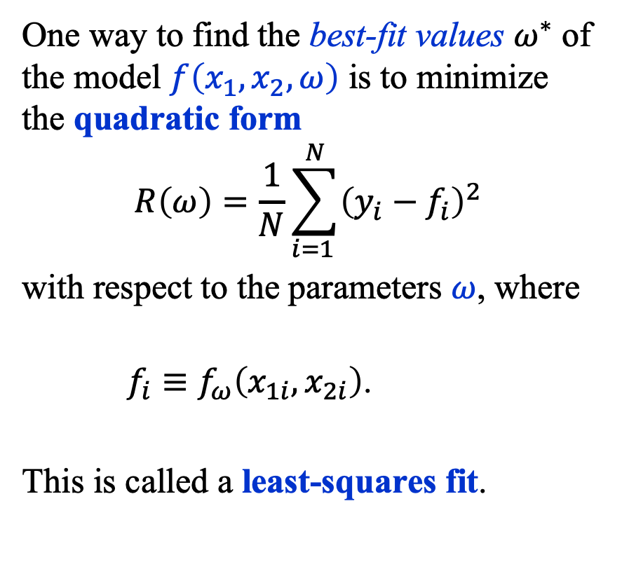
Fitting Models to Data (2)
One way to find the best-fit values $ω^{∗}$ of the model $f\left(x_{1},x_{2},ω\right)$ is to minimize the quadratic form
$$R\left(ω\right)=\frac{1}{N}\sum_{i=1 }^{N}{{\left(y_{i}−f_{i}\right)}^{2}}$$
with respect to the parameters $ω$, where
$f_{i}≡f_{ω}\left(x_{1i}, x_{2i}\right)$.
This is called a least-squares fit.
$$y(x)$$
$$σ(z)$$
Linear(4, 1)
$$\text{relu}(z)$$
Linear(2, 4)
$$x$$

Slide 6
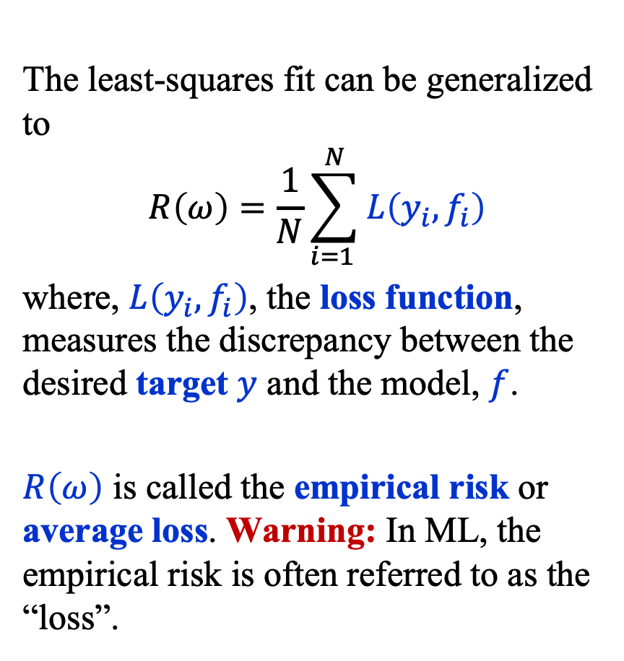
Fitting Models to Data (3)
The least-squares fit can be generalized to
$$R\left(ω\right)=\frac{1}{N}\sum_{i=1 }^{N}{L\left(y_{i}, f_{i}\right)}$$
where, $L\left(y_{i}, f_{i}\right)$, the loss function, measures the discrepancy between the desired target $y$ and the model, $f$.
$R\left(ω\right)$ is called the empirical risk or average loss. Warning: In ML, the empirical risk is often referred to as the “loss”.
$$y(x)$$
$$σ(z)$$
Linear(4, 1)
$$\text{relu}(z)$$
Linear(2, 4)
$$x$$

Slide 7
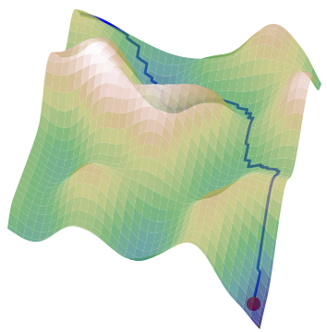
Empirical Risk Landscape (1)
The empirical risk defines a highly corrugated high-dimensional “landscape” in the space of parameters.
Our task is to navigate the empirical
risk landscape to find a good
approximation of the minimum not of
that landscape but rather of the
landscape that would be formed if
we if we had an infinite amount of data
and a model that would fit the infinite dataset exactly.
A model that approximates this ideal is said to generalize.

Slide 8
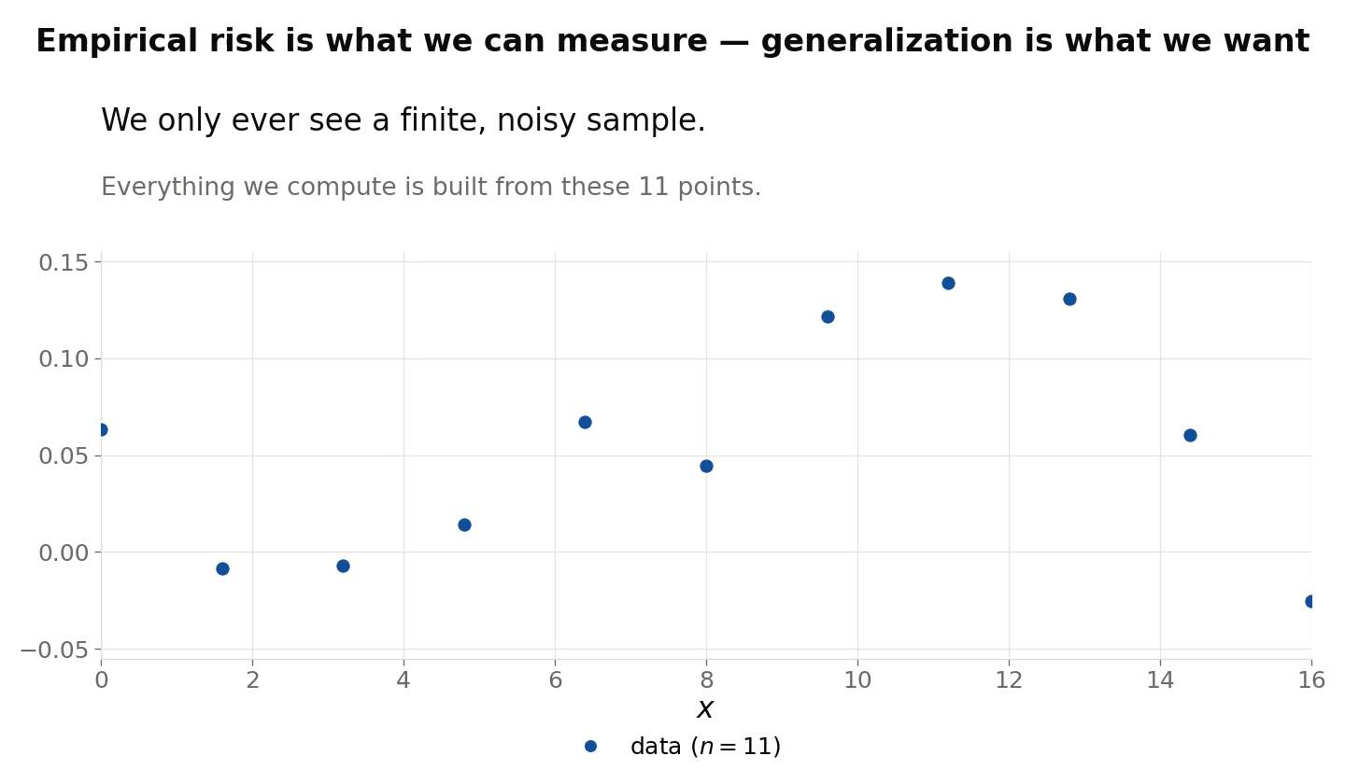
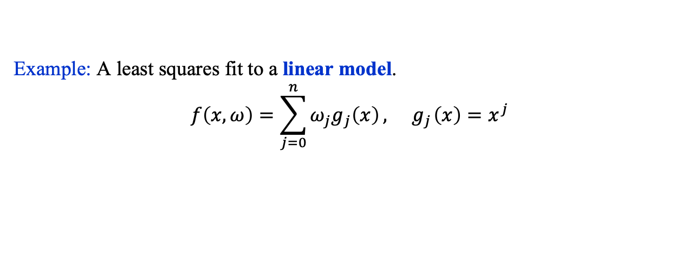
Empirical Risk Landscape (2)
Example: A least squares fit to a linear model.
$$f\left(x, ω\right)=\sum_{j=0}^{n}{ω_{j}g_{j}\left(x\right)}, { g}_{j}\left(x\right)=x^{j}$$

Slide 9
Risk Functional

Slide 10
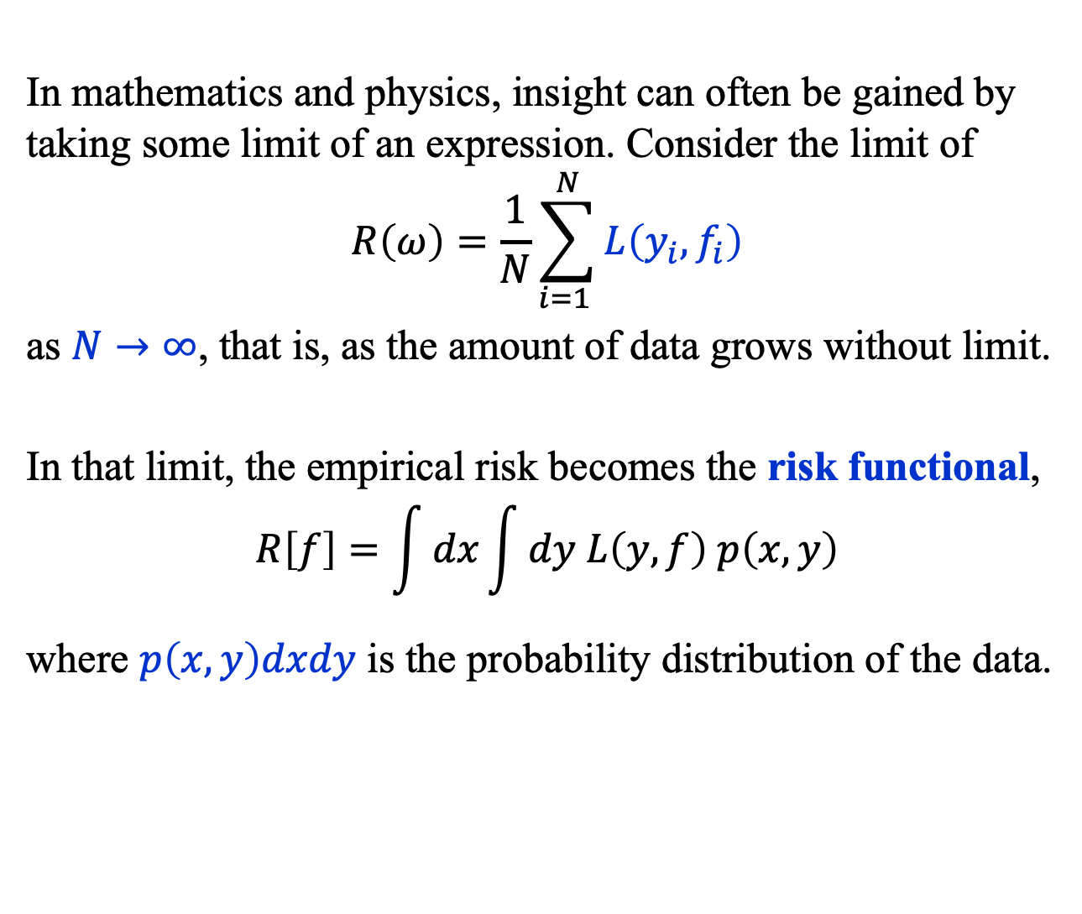
Risk Functional (1)
In mathematics and physics, insight can often be gained by taking some limit of an expression. Consider the limit of
$$R\left(ω\right)=\frac{1}{N}\sum_{i=1 }^{N}{L\left(y_{i}, f_{i}\right)}$$
as $N→∞$, that is, as the amount of data grows without limit.
In that limit, the empirical risk becomes the risk functional,
$$R\left[f\right]=\int{dx}\int{dy L\left(y, f\right) p\left(x, y\right)}$$
where $p\left(x, y\right)dxdy$ is the probability distribution of the data.

Slide 11
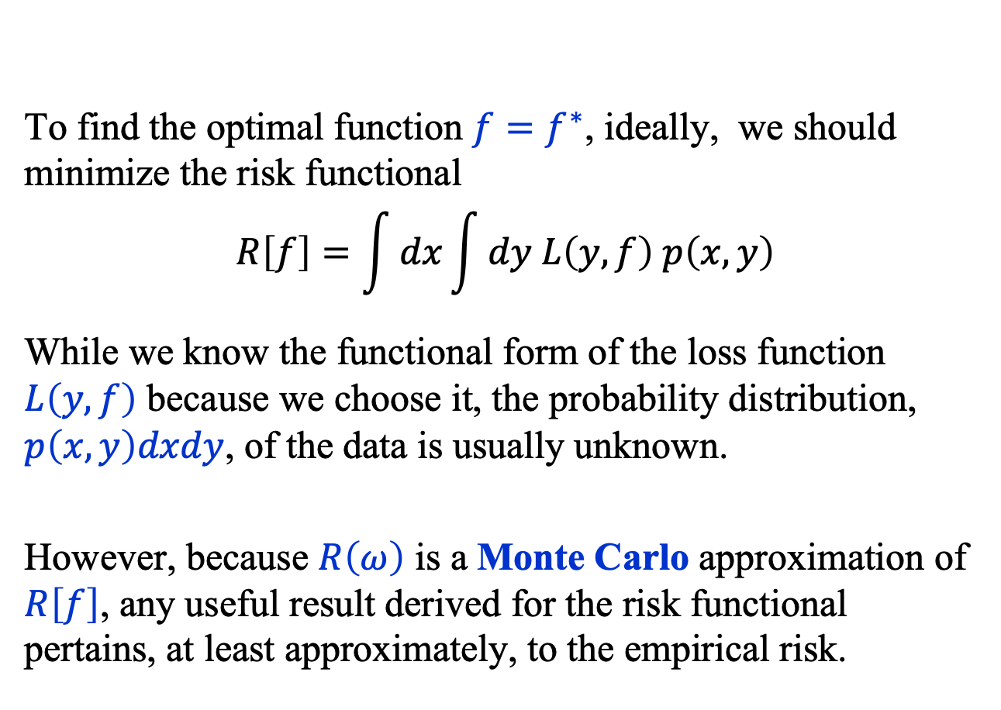
Risk Functional (2)
To find the optimal function ${f=f}^{∗}$, ideally, we should minimize the risk functional
$$R\left[f\right]=\int{dx}\int{dy L\left(y, f\right) p\left(x, y\right)}$$
While we know the functional form of the loss function $L\left(y, f\right)$ because we choose it, the probability distribution, $p\left(x, y\right)dxdy$, of the data is usually unknown.
However, because $R\left(ω\right)$ is a Monte Carlo approximation of $R\left[f\right]$, any useful result derived for the risk functional pertains, at least approximately, to the empirical risk.

Slide 12
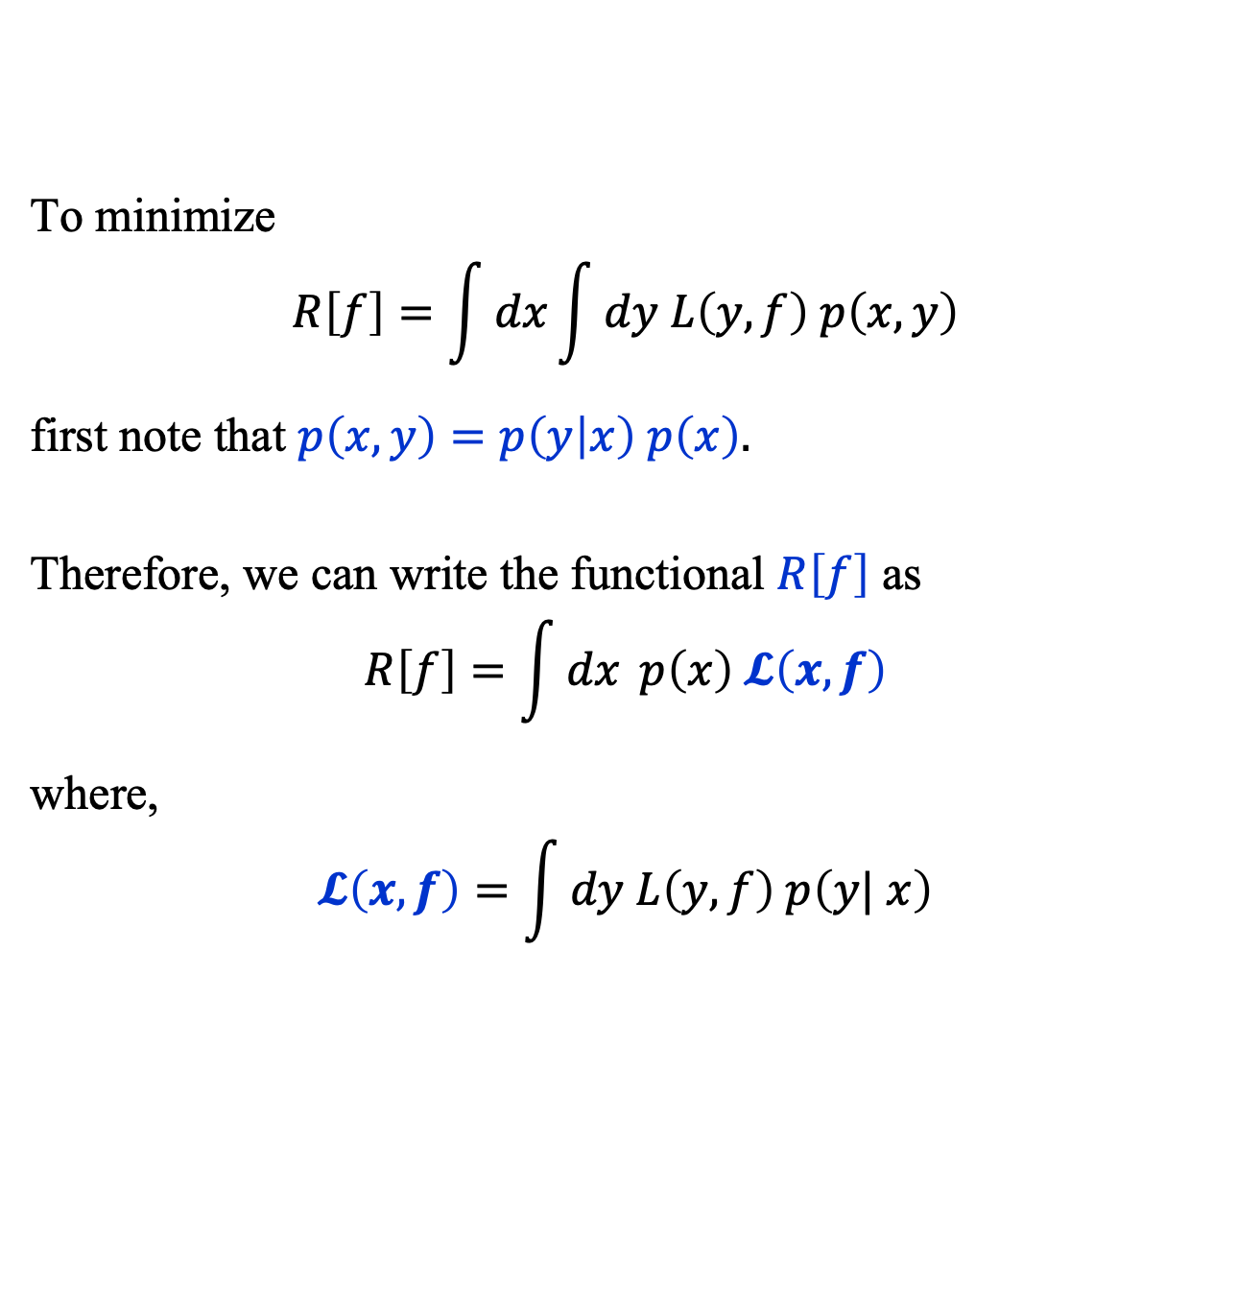
Risk Functional (3)
To minimize
$$R\left[f\right]=\int{dx}\int{dy L\left(y, f\right) p\left(x, y\right)}$$
first note that $p\left(x, y\right)=p\left(y | x\right) p\left(x\right).$
Therefore, we can write the functional $R\left[f\right]$ as
$$R\left[f\right]=\int{dx} p\left(x\right) 𝓛\left(x, f\right)$$
where,
$$𝓛\left(x, f\right)=\int{dy L\left(y, f\right) p\left(y| x\right)}$$

Slide 13
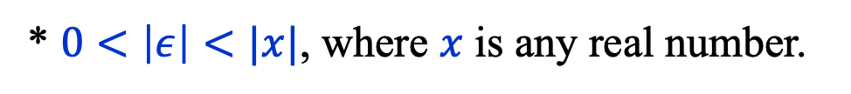
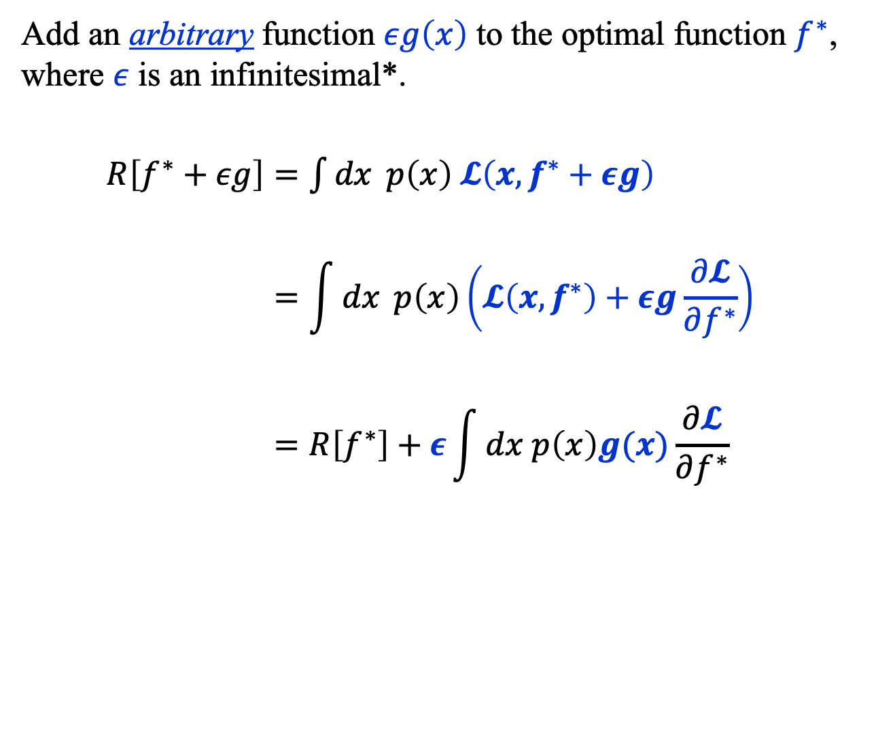
Risk Functional (4)
Add an arbitrary function $εg\left(x\right)$ to the optimal function $f^{∗}$, where $ε$ is an infinitesimal*.
$R\left[f^{∗}+εg\right]=\int{dx} p\left(x\right) 𝓛\left(x, f^{∗}+εg\right)$
$$=\int{dx} p\left(x\right)\left(𝓛\left(x, f^{∗}\right)+εg\frac{∂𝓛}{∂f^{∗}}\right)$$
$$=R\left[f^{∗}\right]+ε\int{dx p\left(x\right)g(x)\frac{∂𝓛}{∂f^{∗}}}$$
* $0<\left|ε\right|<|x|$, where $x$ is any real number.

Slide 14
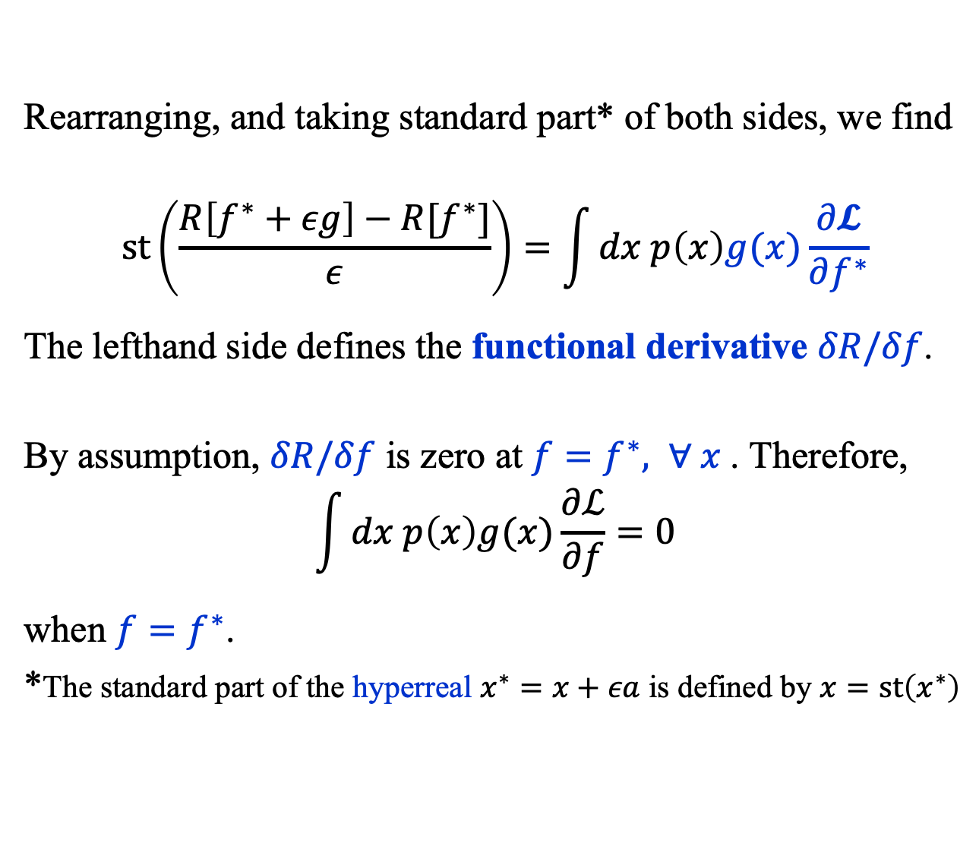
Risk Functional (5)
Rearranging, and taking standard part* of both sides, we find
$$st\left(\frac{R\left[f^{∗}+εg\right]−R[f^{∗}]}{ε}\right)=\int{dx p\left(x\right)g(x)\frac{∂𝓛}{∂f^{∗}}}$$
The lefthand side defines the functional derivative $δR/δf$.
By assumption, $δR/δf$ is zero at $f=f^{∗}, ∀ x$. Therefore,
$$\int{dx p\left(x\right)g(x)\frac{∂ℒ}{∂f}}=0$$
when $f=f^{∗}$.
*The standard part of the hyperreal $x^{∗}=x+εa$ is defined by $x=st\left(x^{∗}\right)$

Slide 15
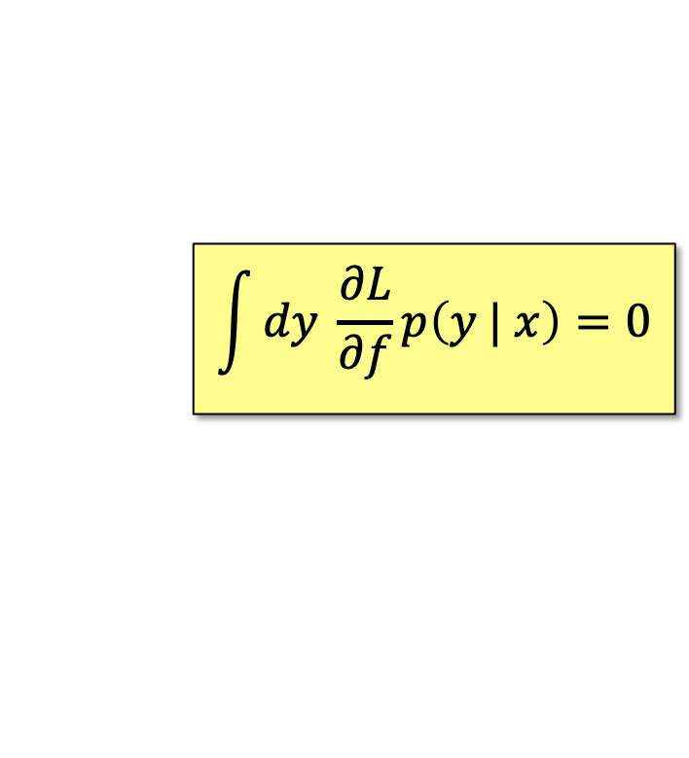
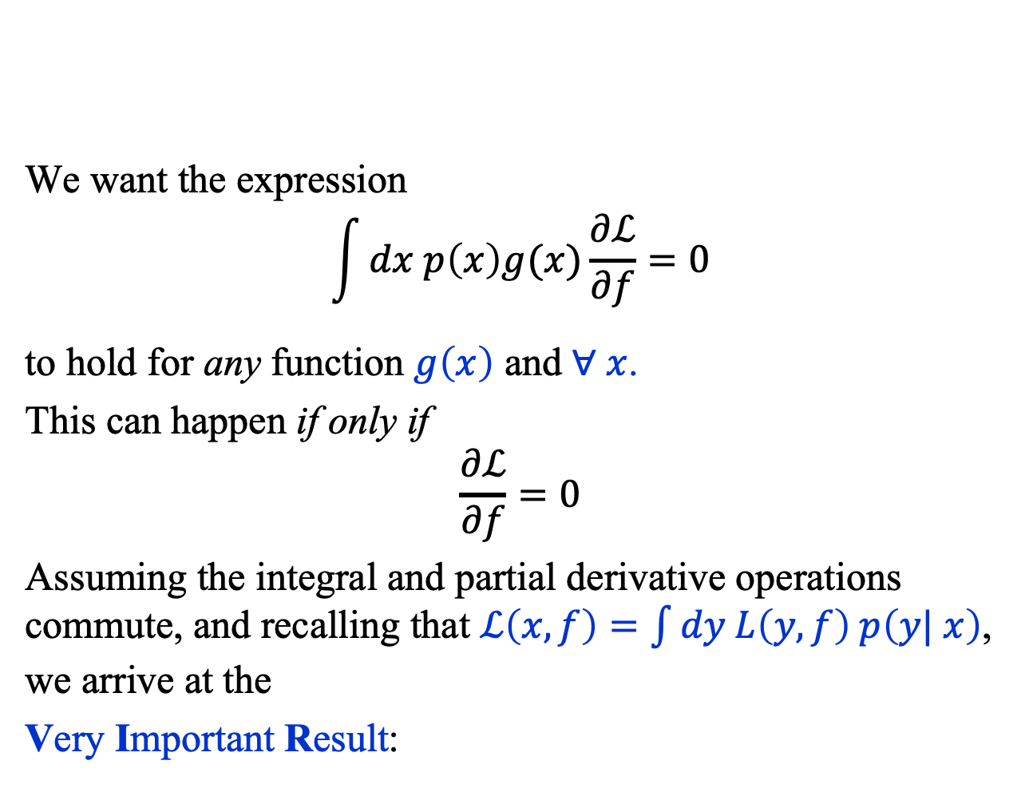
Risk Functional (6)
We want the expression
$$\int{dx p\left(x\right)g(x)\frac{∂ℒ}{∂f}}=0$$
to hold for any function $g\left(x\right)$ and $∀ x$.
This can happen if only if
$$\frac{∂ℒ}{∂f}=0$$
Assuming the integral and partial derivative operations commute, and recalling that $ℒ\left(x, f\right)=\int{dy L\left(y, f\right) p\left(y| x\right)}$, we arrive at the
Very Important Result:
$$\int{dy \frac{∂L}{∂f}p\left(y | x\right)=0}$$

Slide 16

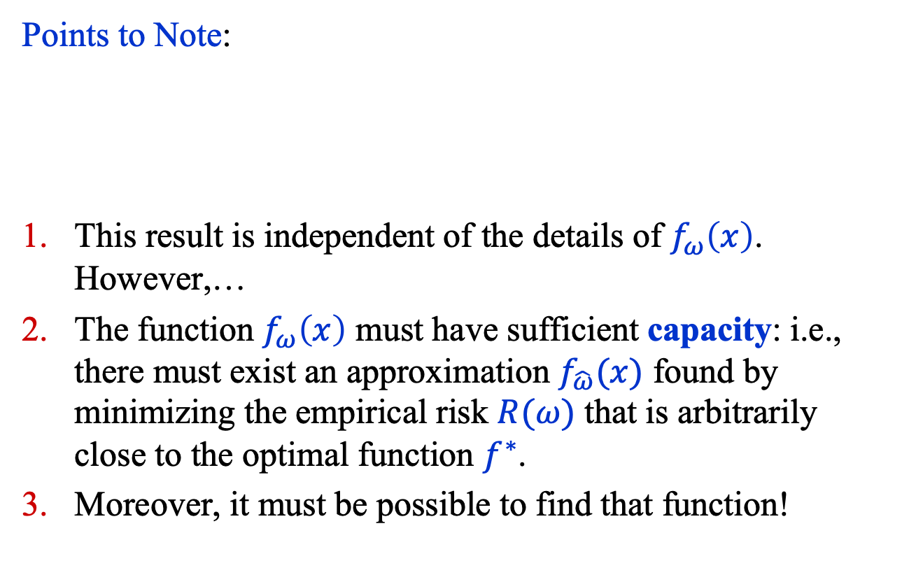
Risk Functional (7)
Points to Note:
This result is independent of the details of $f_{ω}\left(x\right)$. However,…
The function $f_{ω}\left(x\right)$ must have sufficient capacity: i.e., there must exist an approximation $f_{\hat{ω}}(x)$ found by minimizing the empirical risk $R(ω)$ that is arbitrarily close to the optimal function $f^{∗}$.
Moreover, it must be possible to find that function!
$$\int{dy \frac{∂L}{∂f}p\left(y | x\right)=0}$$

Slide 17
Common loss functions

Slide 18
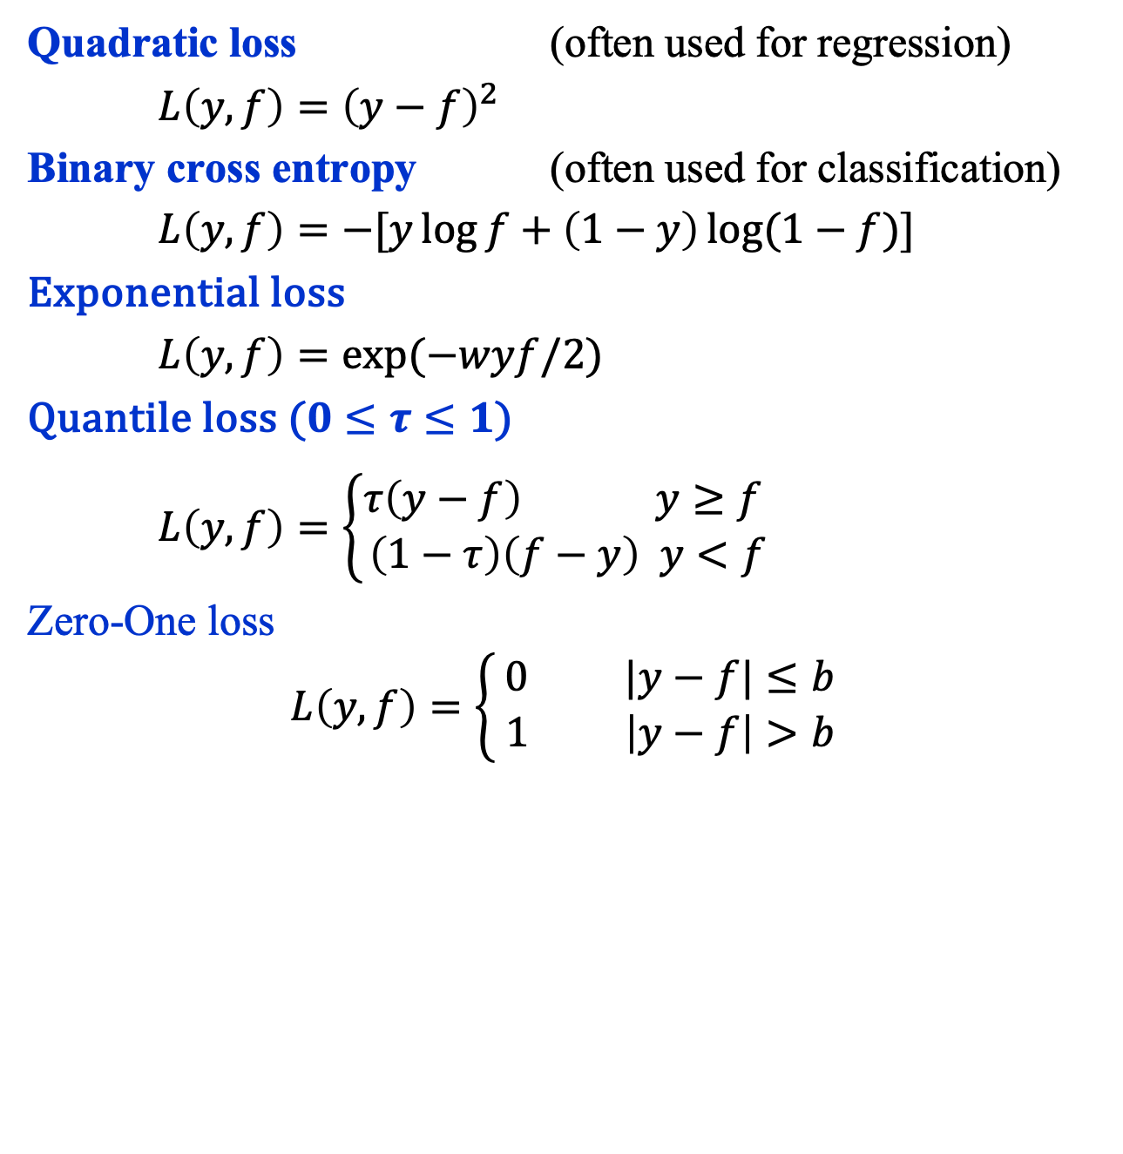
Common Loss Functions (1)
Quadratic loss (often used for regression)
$L\left(y, f\right)={\left(y−f\right)}^{2}$
Binary cross entropy (often used for classification)
$L\left(y, f\right)=−[y\log{f+\left(1−y\right)\log{(1−f)}}]$
Exponential loss
$L\left(y, f\right)=\exp{(−wyf/2)}$
Quantile loss ($0≤τ≤1$)
$L\left(y, f\right)=\left\{\begin{aligned}τ\left(y−f\right) y≥f \\ \left(1−τ\right)\left(f−y\right) y<f\end{aligned}\right.$
Zero-One loss
$$L\left(y, f\right)=\left\{\begin{aligned}0 |y−f|≤b \\ 1 \left|y−f\right|>b \end{aligned}\right.$$

Slide 19
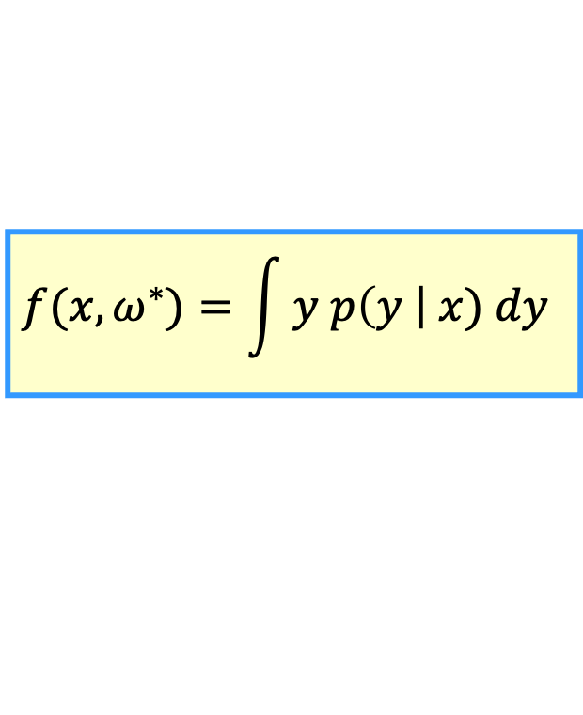
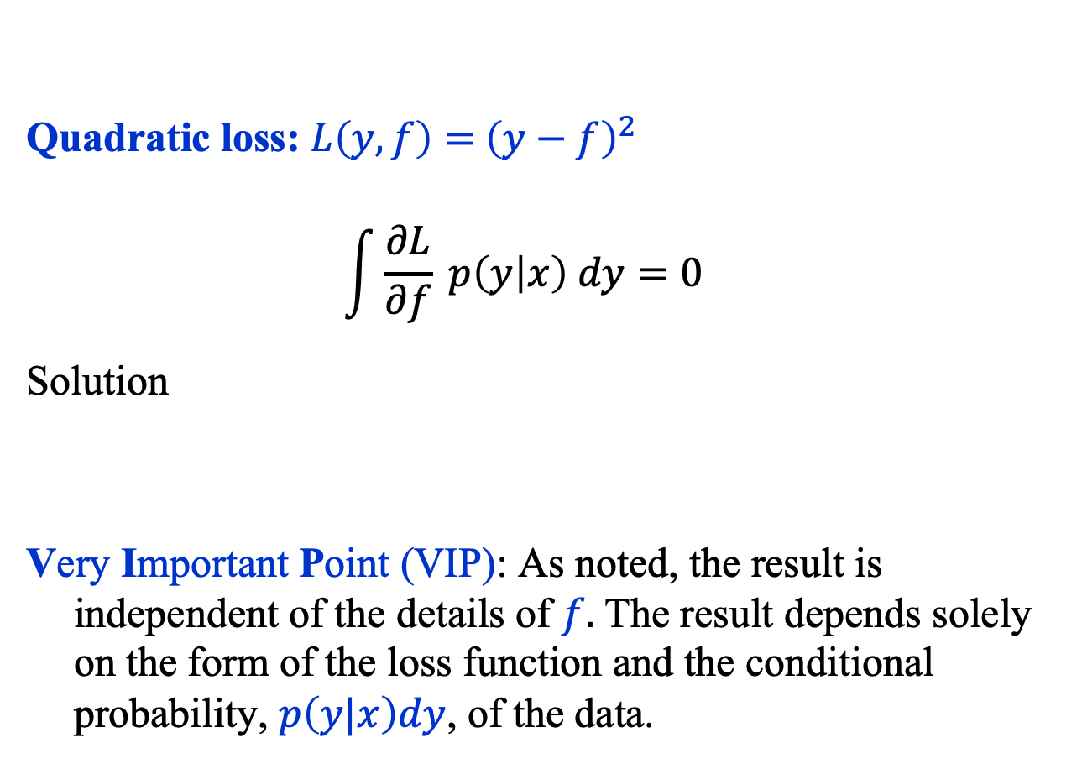
Common Loss Functions (2)
Quadratic loss: $L\left(y, f\right)={ \left(y−f\right)}^{2}$
$$\int{\frac{∂L}{∂f} p\left(y | x\right) dy=0}$$
Solution
Very Important Point (VIP): As noted, the result is independent of the details of $f.$ The result depends solely on the form of the loss function and the conditional probability, $p\left(y|x\right)dy$, of the data.
$$f(x, ω^{∗})=\int{y p\left(y \right| x) dy}$$

Slide 20

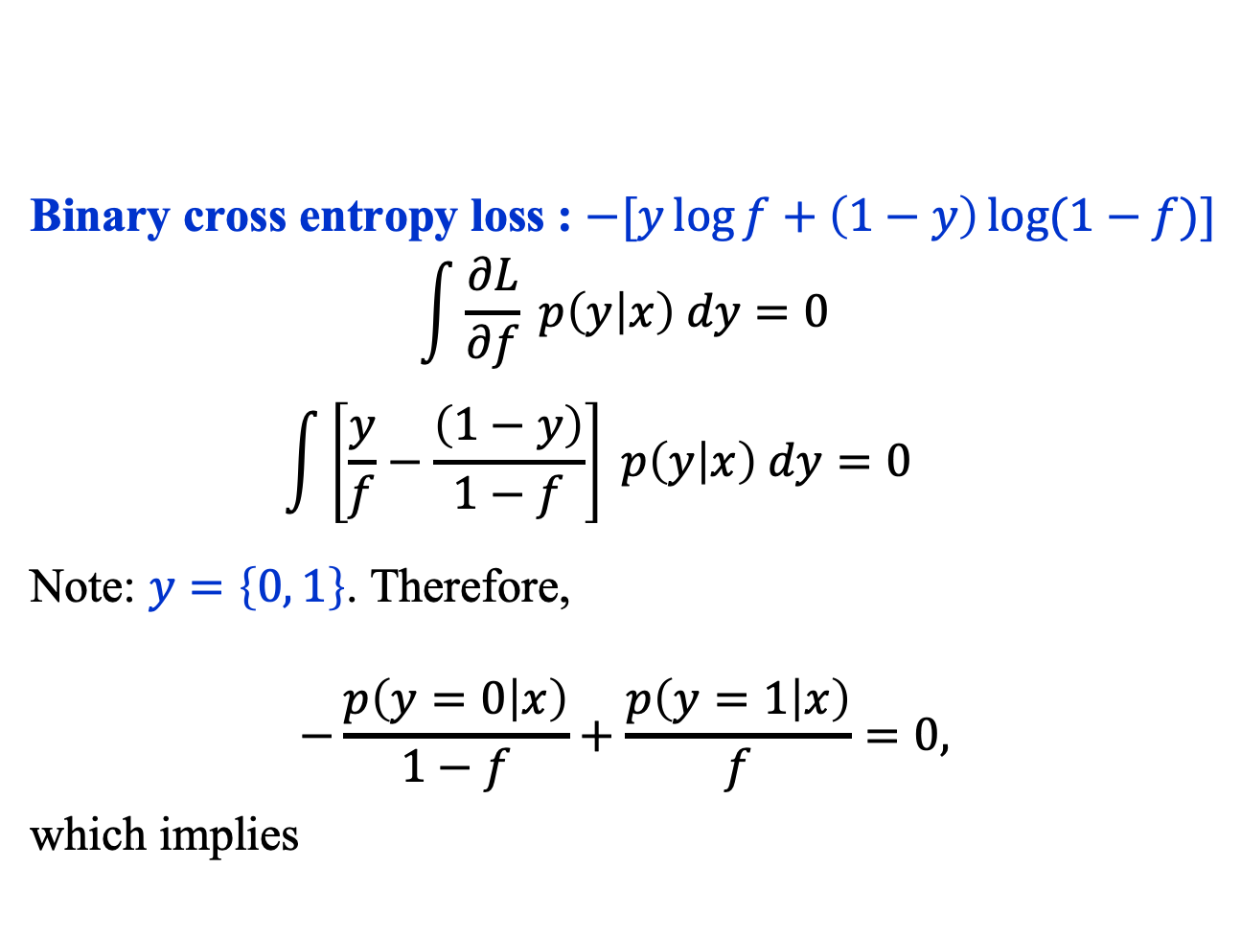
Binary Cross Entropy Loss (1)
Binary cross entropy loss : $−[y\log{f+\left(1−y\right)\log{(1−f)}}]$
$$\int{\frac{∂L}{∂f} p\left(y | x\right) dy=0}$$
$$\int{\left[\frac{y}{f}−\frac{\left(1−y\right)}{1−f}\right] p\left(y | x\right) dy=0}$$
Note: $y=\left\{0, 1\right\}$. Therefore,
$$−\frac{p\left(y=0 | x\right)}{1−f}+\frac{p\left(y=1 | x\right)}{f}=0,$$
which implies
$$f(x, ω^{∗})=p(y=1|x)$$

Slide 21
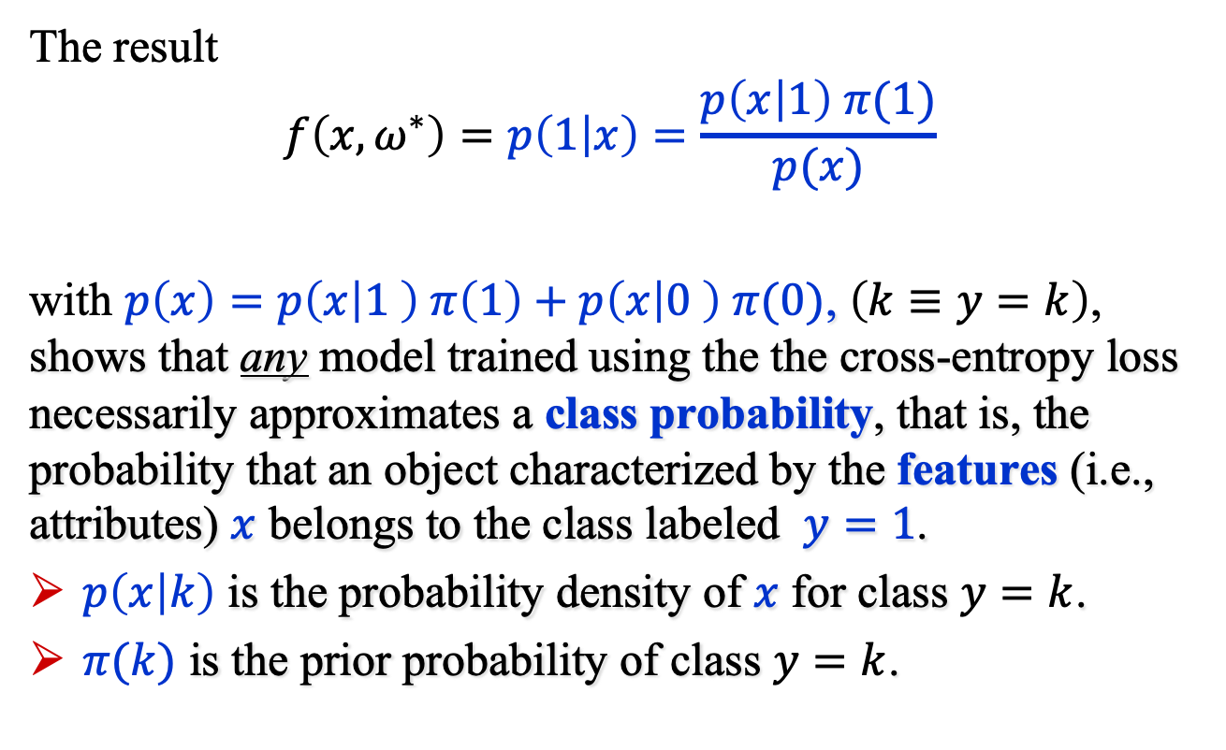
Binary Cross Entropy Loss (2)
The result
$$f\left(x, ω^{∗}\right)=p\left(1 | x\right)=\frac{p\left(x | 1\right) π(1)}{p(x)}$$
with $p\left(x\right)=p\left(x | 1 \right) π\left(1\right)+p\left(x | 0 \right) π(0)$, $\left(k≡y=k\right)$, shows that any model trained using the the cross-entropy loss necessarily approximates a class probability, that is, the probability that an object characterized by the features (i.e., attributes) $x$ belongs to the class labeled $y=1$.
$p\left(x | k\right)$ is the probability density of $x$ for class $y=k$.
$π(k)$ is the prior probability of class $y=k$.

Slide 22
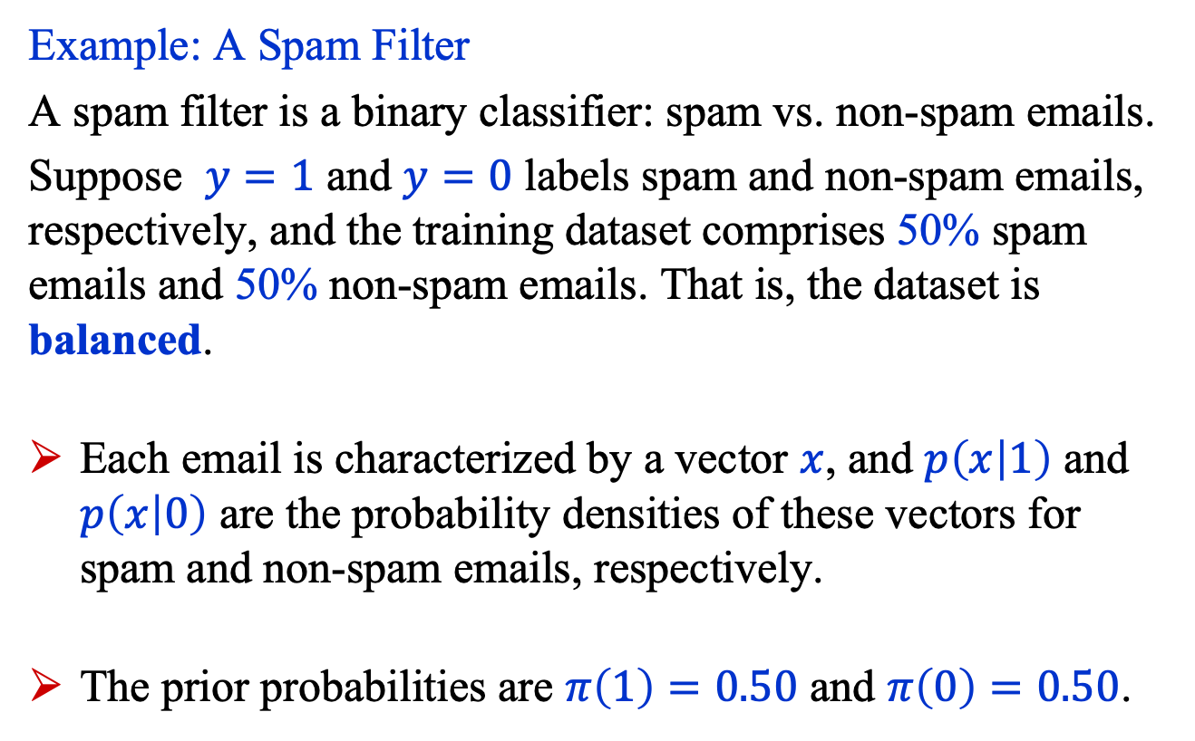
Binary Cross Entropy Loss (3)
Example: A Spam Filter
A spam filter is a binary classifier: spam vs. non-spam emails.
Suppose $y=1$ and $y=0$ labels spam and non-spam emails, respectively, and the training dataset comprises 50% spam emails and 50% non-spam emails. That is, the dataset is balanced.
Each email is characterized by a vector $x$, and $p\left(x | 1\right)$ and $p\left(x | 0\right)$ are the probability densities of these vectors for spam and non-spam emails, respectively.
The prior probabilities are $π\left(1\right)=0.50$ and $π\left(0\right)=0.50$.

Slide 23
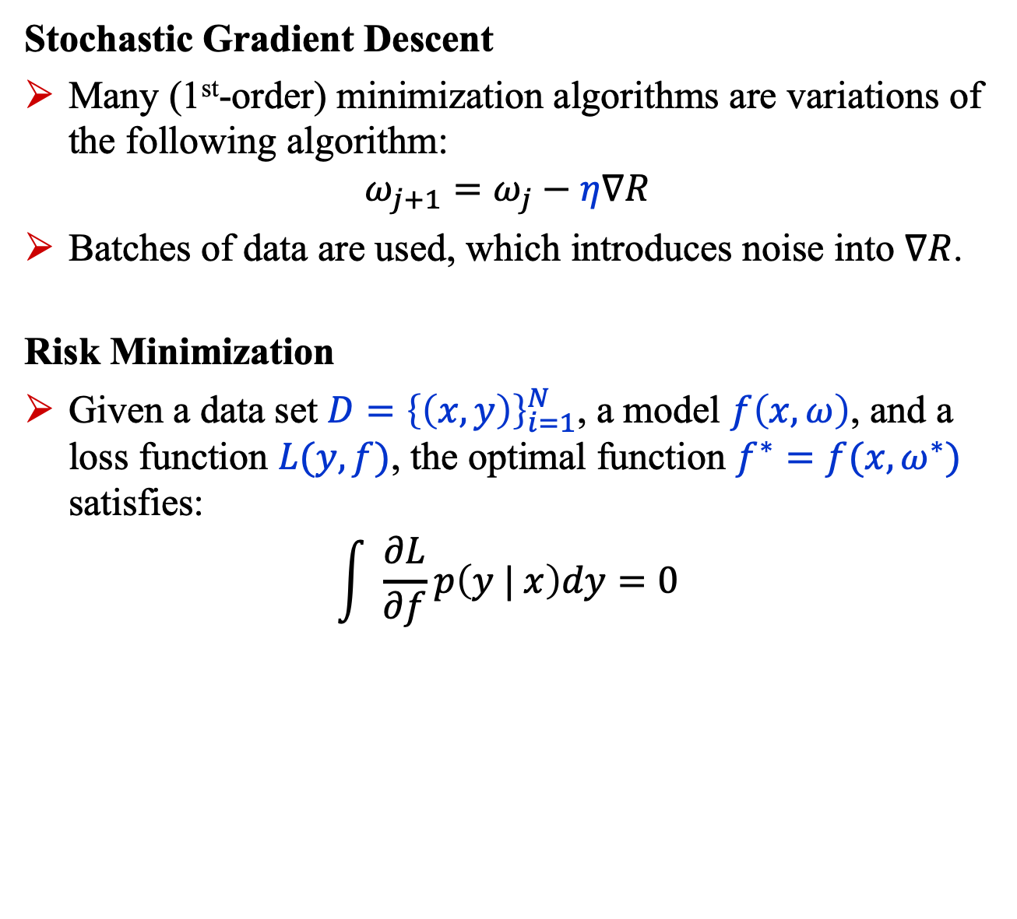
Summary
Stochastic Gradient Descent
Many (1st-order) minimization algorithms are variations of the following algorithm:
$$ω_{j+1}=ω_{j}−η∇R$$
Batches of data are used, which introduces noise into $∇R$.
Risk Minimization
Given a data set $D={\left\{\left(x,y\right)\right\}}_{i=1}^{N}$, a model $f\left(x,ω\right)$, and a loss function $L(y, f)$, the optimal function $f^{∗}=f(x,ω^{∗})$ satisfies:
$$\int{ \frac{∂L}{∂f}p\left(y | x\right)dy=0}$$

