Slide 1
Machine Learning In PHYsics FoundationS 1
Harrison B. Prosper
PHY6937 / PHY4936

Slide 2
Goals of this Course
Gain a good understanding of the mathematical basis of machine learning (ML), which is a foundational component of artificial intelligence (AI).
Gain experience building ML models using PyTorch to solve data science problems in physics.
Gain experience with different ML models.
Gain an understanding of AI agents.

Slide 3
Course Evaluation
In addition to your Course Participation (attending, asking questions, contributing to discussions), your course grade will be based on:
In-class Assignments
Project with a write-up and a brief presentation
Graduates: A project related to your research area.
Undergraduates: A project selected from a few options.
Presentations: Last week of the semester.
Grade: Graduates (S/U), Undergraduates (Letter Grade).

Slide 4
What is Artificial Intelligence?
Artificial Intelligence
Algorithms that cause machines to exhibit human- or superhuman-level intelligence.

Slide 5
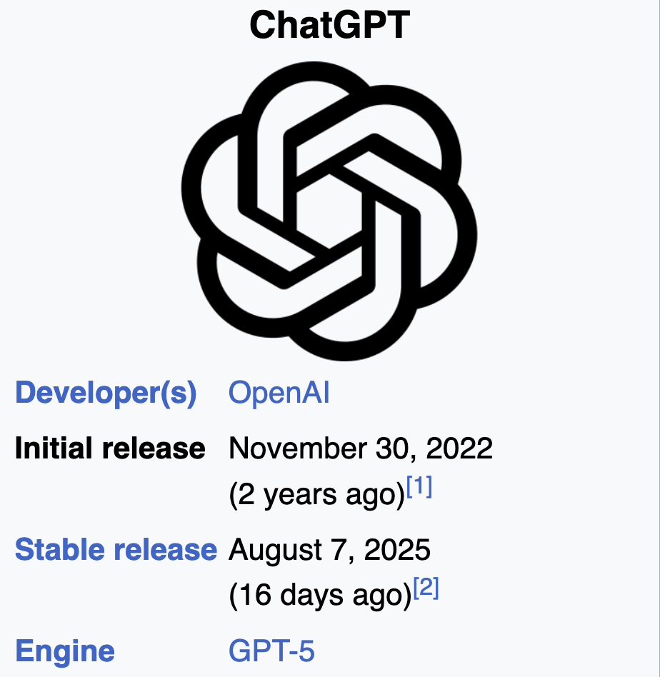
Large Language Model (LLM)

Slide 6

Large Language Model (LLM)

Slide 7
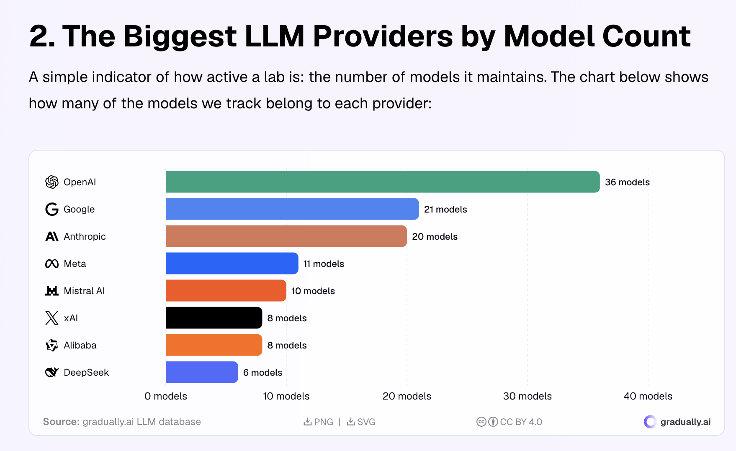
https://www.gradually.ai/en/llm-statistics/

Slide 8
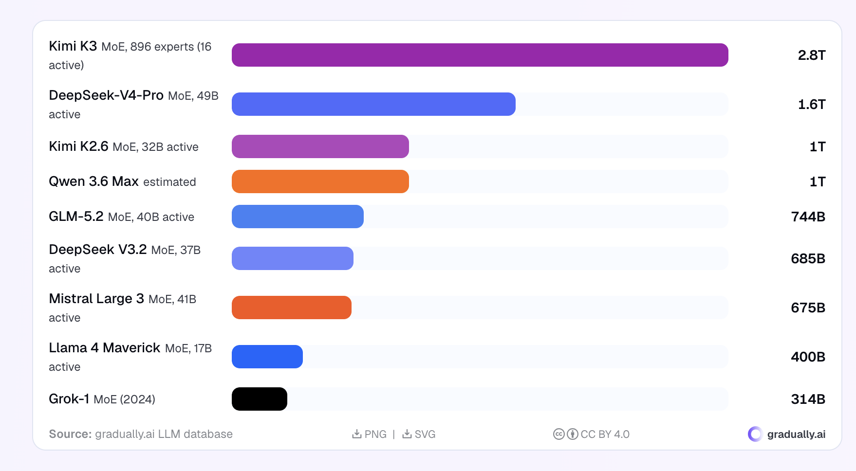
Model sizes: Number of parameters
https://www.gradually.ai/en/llm-statistics/

Slide 9
Claude Demo

Slide 10
What is Machine Learning?
Artificial Intelligence
Algorithms that cause machines to exhibit human- or super-human level intelligence.
Machine Learning
Algorithms for modeling data.

Slide 11
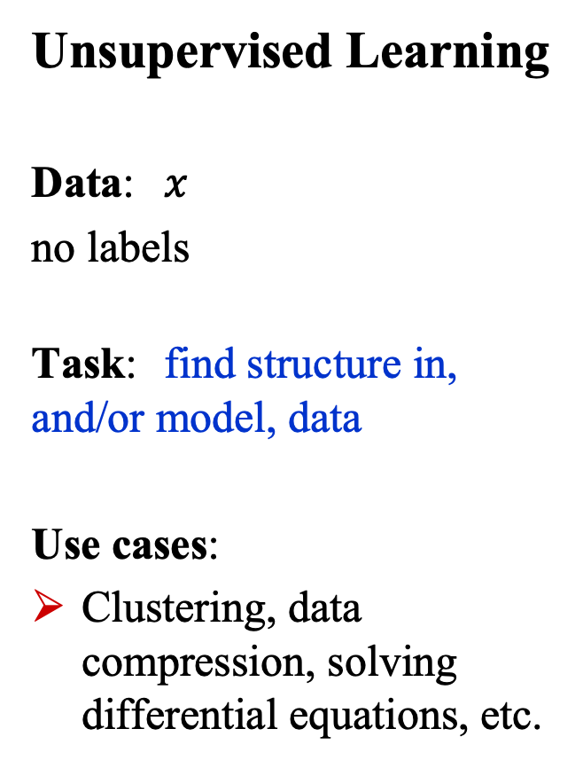
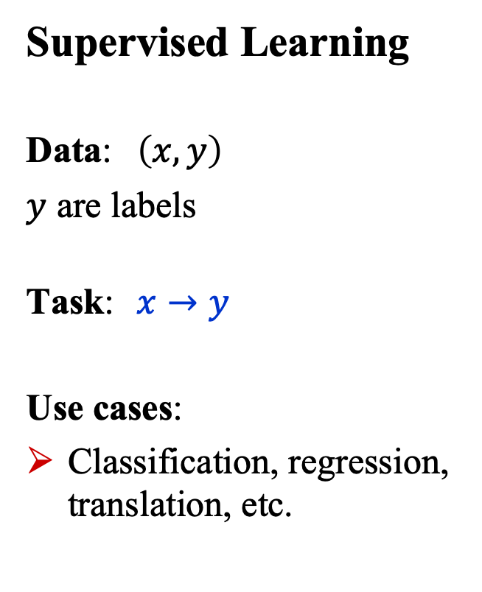
What is Machine Learning?
Supervised Learning
Data: $\left(x, y\right)$
$y$ are labels
Task: $x→y$
Use cases:
Classification, regression, translation, etc.
Unsupervised Learning
Data: $x$
no labels
Task: find structure in, and/or model, data
Use cases:
Clustering, data compression, solving differential equations, etc.

Slide 12
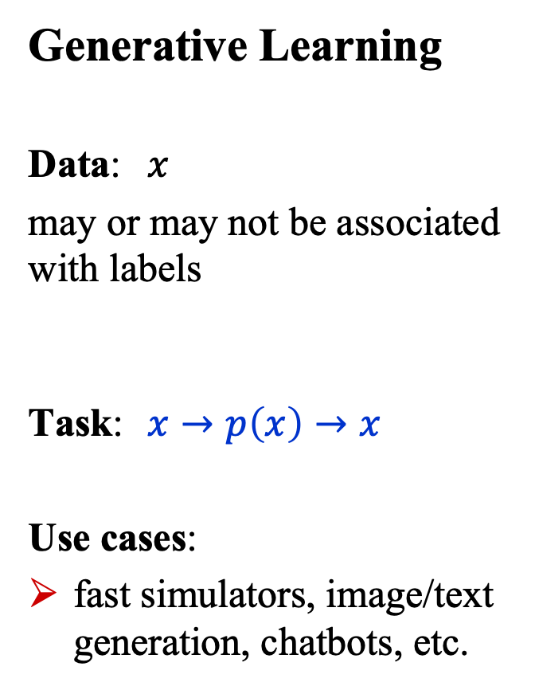
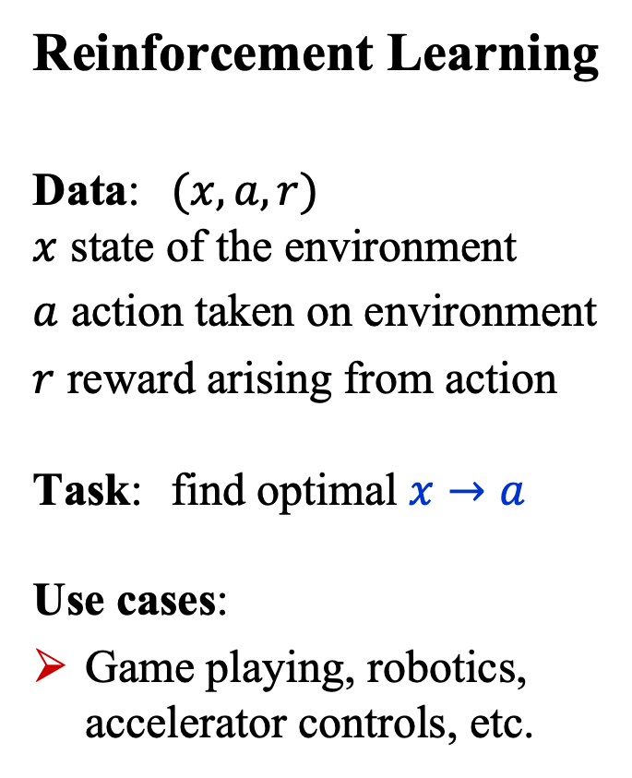
What is Machine Learning?
Generative Learning
Data: $x$
may or may not be associated with labels
Task: $x→p\left(x\right)→x$
Use cases:
fast simulators, image/text generation, chatbots, etc.
Reinforcement Learning
Data: $(x,a,r)$ $x$ state of the environment
$a$ action taken on environment
$r$ reward arising from action Task: find optimal $x→a$ Use cases:
Game playing, robotics, accelerator controls, etc.

Slide 13
What is Deep Learning?
Artificial Intelligence
Algorithms that cause machines to exhibit human- or super-human-level intelligence.
Machine Learning
Algorithms for modeling data
Deep Learning
ML using (large) neural networks

Slide 14
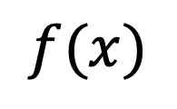

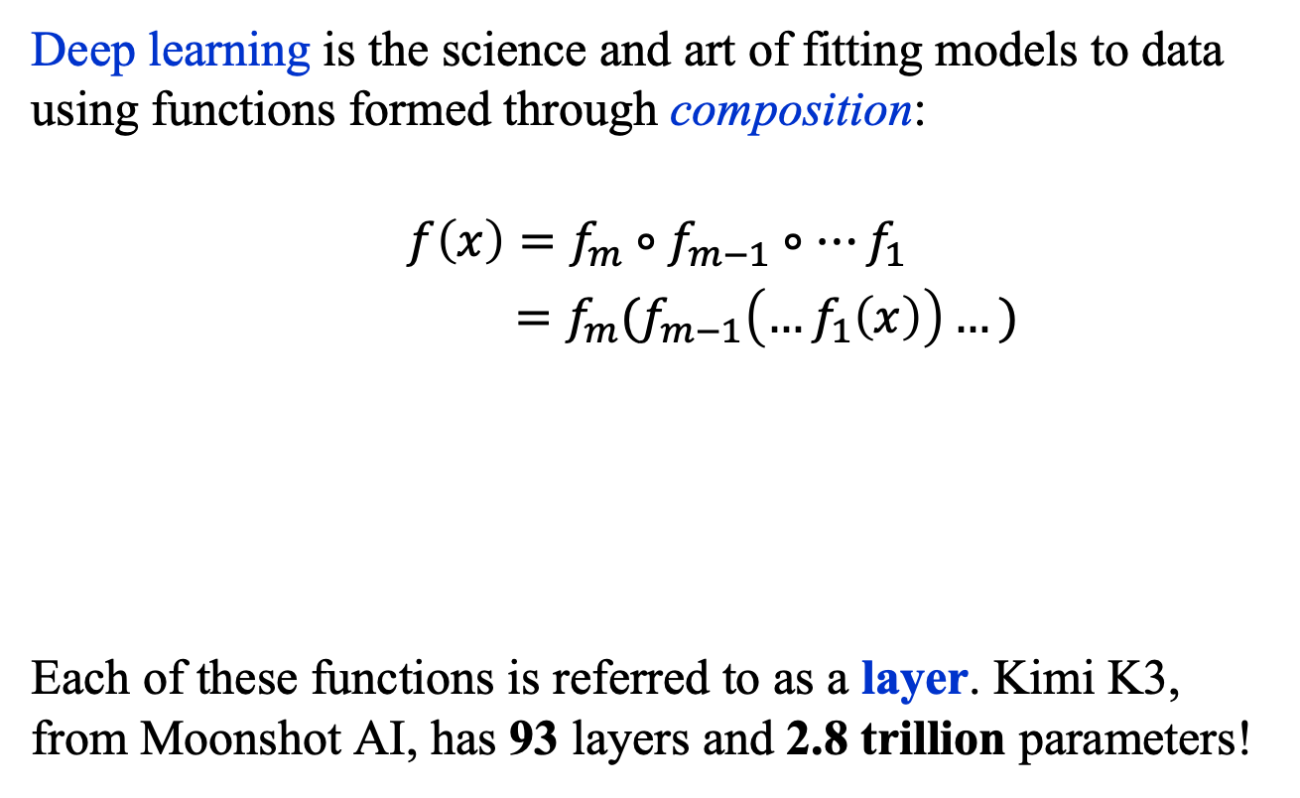



What is Deep Learning?
Deep learning is the science and art of fitting models to data using functions formed through composition:
$$f\left(x\right)=f_{m}∘f_{m−1}∘…f_{1}$$
$=f_{m}(f_{m−1}\left(…f_{1}\left(x\right)\right)…)$
Each of these functions is referred to as a layer. Kimi K3, from Moonshot AI, has 93 layers and 2.8 trillion parameters!
$$f(x)$$
…
$$x$$
$$f_{m}$$
$$f_{m−1}$$
$$f_{1}$$

Slide 15
Basic building block: The perceptron

Slide 16
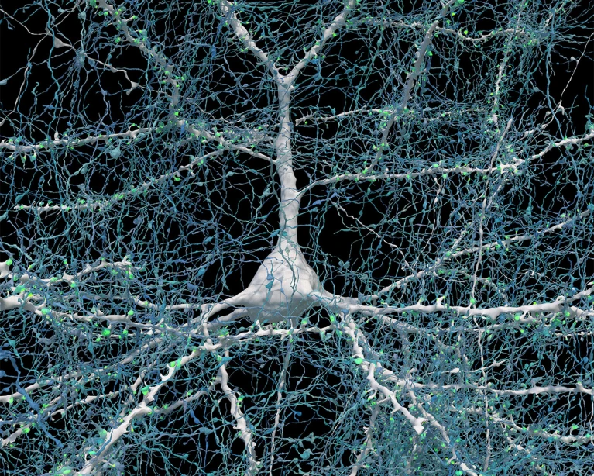
The Brain’s Computational Unit
https://www.nature.com/articles/d41586-024-01387-9

Slide 17
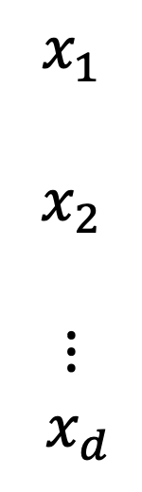
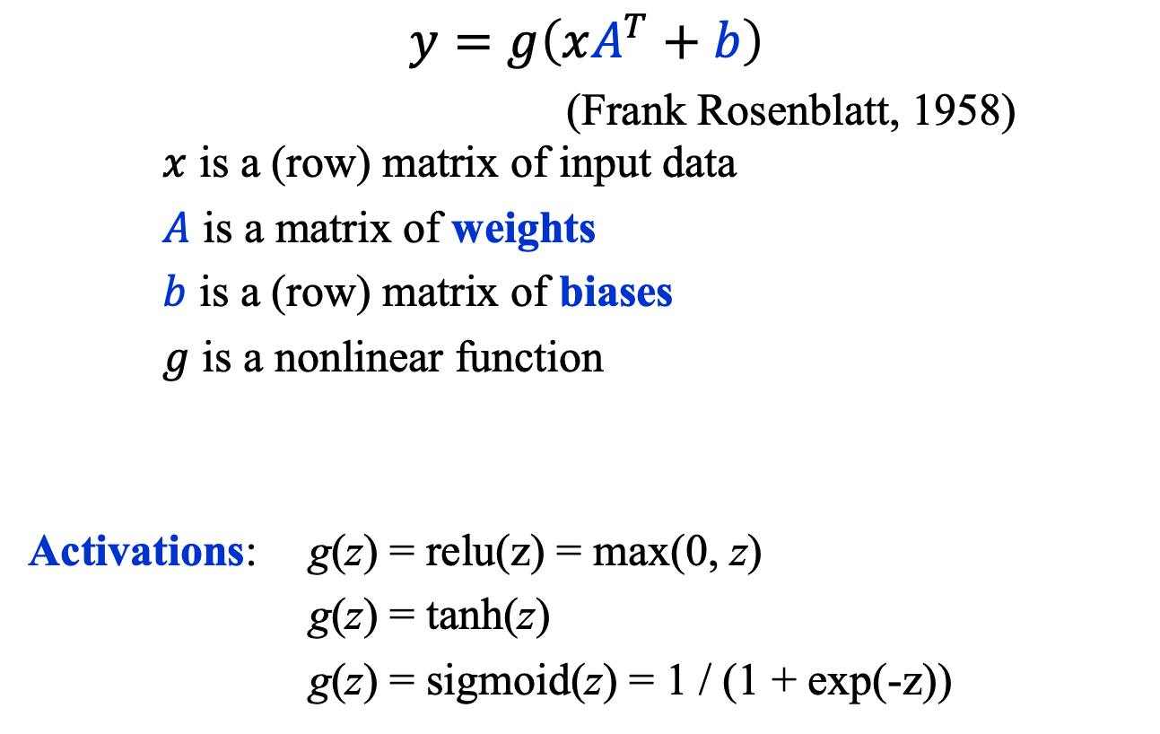



Basic AI Comp. Unit: The Perceptron
$$y=g\left(xA^{T}+b\right)$$
(Frank Rosenblatt, 1958) $x$ is a (row) matrix of input data
$A$ is a matrix of weights
$b$ is a (row) matrix of biases
$g$ is a nonlinear function
Activations: g(z) = relu(z) = max(0, z)
g(z) = tanh(z)
g(z) = sigmoid(z) = 1 / (1 + exp(-z))
$$x_{1}$$
$$x_{2}$$
$$⋮$$
$${ x}_{d}$$
$$y$$
$$g$$
$$A, b$$
https://news.cornell.edu/stories/2019/09/professors-perceptron-paved-way-ai-60-years-too-soon

Slide 18
Multi-Node perceptron

Slide 19

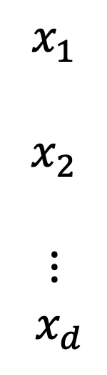
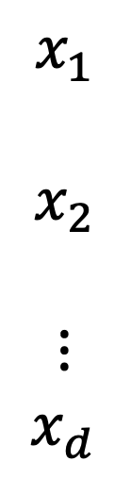






Multi-Node Perceptron
$$x_{1}$$
$$x_{2}$$
$$⋮$$
$${ x}_{d}$$
$$g\left(z\right)=\text{relu}(z)$$
$$y_{1}=g\left(xA_{1}^{T}+b_{1}\right)$$
Example:
$$A_{1}=\left(2,−3, 1\right), b_{1}=−5$$
$$y_{2}=g\left(xA_{2}^{T}+b_{2}\right)$$
$$A_{2}=\left(1, 2, 3\right), b_{2}=−4$$
$$y_{1}$$
$$g$$
$$A_{1}, b_{1}$$
$$x_{1}$$
$$x_{2}$$
$$⋮$$
$x_{d}$
$$y_{2}$$
$$g$$
$$A_{2}, b_{2}$$

Slide 20
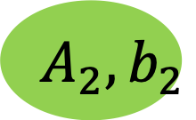



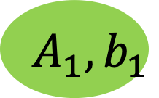

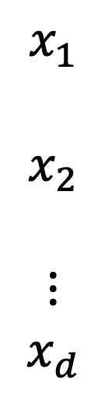

Multi-Node Perceptron
A multi-node perceptron is often drawn as follows,
Written as: $z=xA^{T}+b$
with $y =g\left(z\right)$, usually, the applied elementwise, that is, to every element of its matrix input.
$$x_{1}$$
$$x_{2}$$
$$⋮$$
$$x_{d}$$
$$y_{1}$$
$$g$$
$$A_{1}, b_{1}$$
$$y_{2}$$
$$g$$
$$A_{2}, b_{2}$$

Slide 21

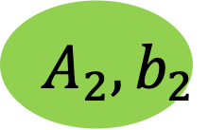


Multi-Node Perceptron: Example
$$x=\left(−2, 1, 4\right), A=\left(\begin{matrix}2 \\ 1\end{matrix}\begin{matrix} −3 \\ 2\end{matrix}\begin{matrix}1 \\ 3\end{matrix}\right), b=\left(−5,−4\right)$$
$y=g\left(\left(−2,1,4\right) {\left(\begin{matrix}2 \\ 1\end{matrix}\begin{matrix} −3 \\ 2\end{matrix}\begin{matrix}1 \\ 3\end{matrix}\right)}^{T}+\left(−5,−4\right)\right)$
$$x_{1}$$
$$x_{2}$$
$$⋮$$
$$x_{d}$$
$$y_{1}$$
$$g$$
$$A_{1}, b_{1}$$
$$y_{2}$$
$$g$$
$$A_{2}, b_{2}$$

Slide 22
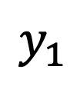


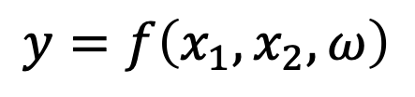






Multi-Node Perceptron
Consider modeling the data triplets $D=\left\{{\left(x_{1},x_{2},y\right)}_{i=1}^{N}\right\}$ with a function of the form $y=f\left(x_{1},x_{2},ω\right)$.
Layer 2
Layer 1
$$y_{1}$$
$$y=f\left(x_{1}, x_{2}, ω\right)$$
$$y_{2}$$
$$x_{1}$$
$$x_{2}$$
$$y_{3}$$
$$y_{4}$$
$$g$$
$$A, b$$
$$≡$$

Slide 23
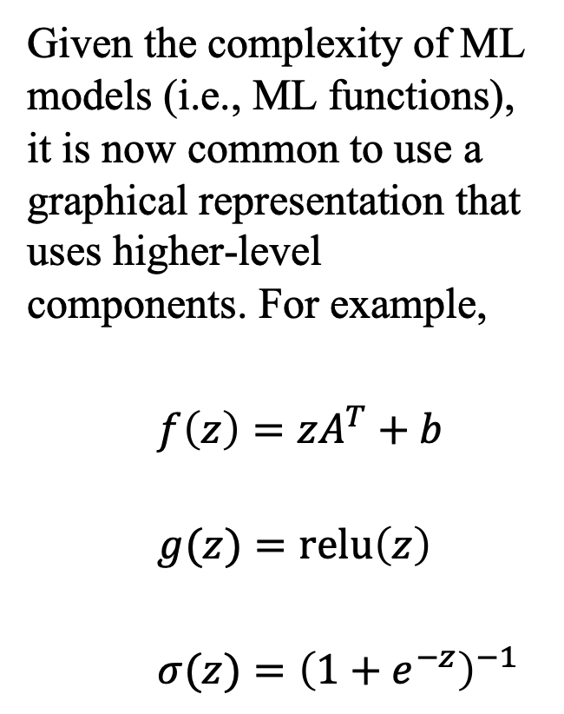

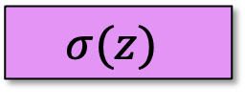
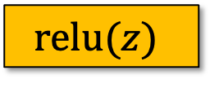
Multi-Node Perceptron
Given the complexity of ML models (i.e., ML functions), it is now common to use a graphical representation that uses higher-level components. For example,
$f\left(z\right)=zA^{T}+b$
$g(z)=\text{relu}\left(z\right)$
$σ(z)={\left(1+e^{−z}\right)}^{−1}$
output
$$σ(z)$$
Layer 2
Linear(4, 1)
$$\text{relu}(z)$$
Layer 1
Linear(2, 4)
$$x$$

Slide 24
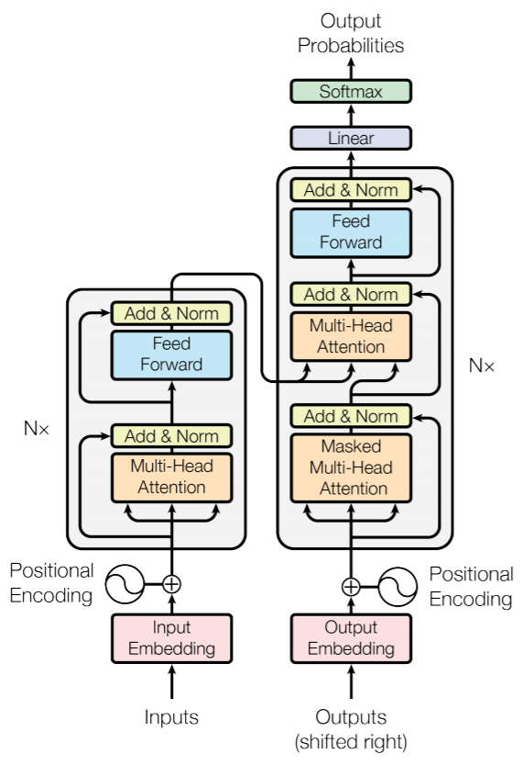
Large Language Model
Here, for example, is high-level graphical representation of an ML model called a transformer.
In ChatGPT 3, there are 96 layers with the same architecture, an instance of which is depicted as the two vertical grey boxes.
(Notice, the color-coding differs from ours!)

Slide 25
Summary
General Approaches
Supervised, unsupervised, generative, and reinforcement learning.
Deep Learning
Uses functions constructed through deep composition.
The Perceptron
Basic computational unit: matrix multiplication and addition followed by a nonlinear map.
We described the multi-node perceptron and how machine learning models are represented graphically.

