Slide 1
Machine learning in physics convolutional neural networks

Slide 2


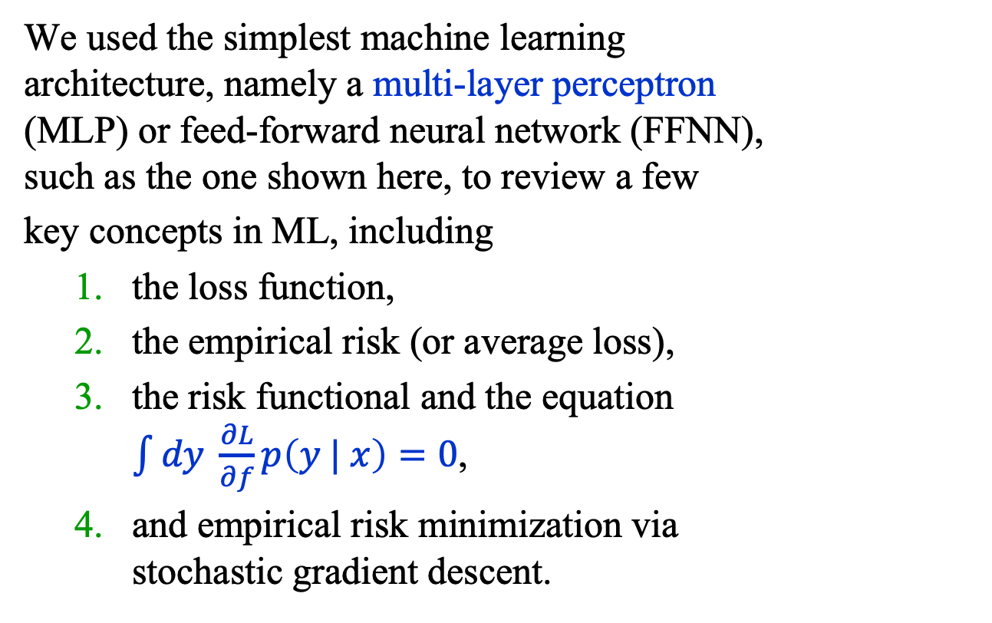






Recap
output
$$σ(z)$$
We used the simplest machine learning architecture, namely a multi-layer perceptron (MLP) or feed-forward neural network (FFNN), such as the one shown here, to review a few
key concepts in ML, including
the loss function,
the empirical risk (or average loss),
the risk functional and the equation $\int{dy \frac{∂L}{∂f}p\left(y | x\right)=0}$,
and empirical risk minimization via stochastic gradient descent.
Linear(15, 1)
$$\text{L}\text{ayerNorm}(15)$$
$$\text{s}\text{i}\text{lu}()$$
Linear(15, 15)
$$\text{L}\text{ayerNorm}(15)$$
$$\text{s}\text{i}\text{lu}()$$
Linear(15, 15)
$$\text{L}\text{ayerNorm}(15)$$
$$\text{s}\text{i}\text{lu}()$$
Linear(2, 15)
$$x$$

Slide 3
The plan for the next several lectures is to introduce the following machine learning models:
Convolutional neural networks (CNN)
Physics-informed neural networks (PINN)
Graph neural networks (GNN)
Autoencoders (AE)
Boosted decision trees (BDT)
Flow and diffusion models
Transformer neural networks (TNN)

Slide 4
Outline
Introduction
Multi-Class Classification
Convolutional Neural Networks
A Galaxy Classifier
Summary

Slide 5
Introduction (1)
A great deal of our behavior is guided by our ability to interpret visual data, an ability that is now available in handheld devices.
The breakthrough that has made this possible is the convolutional neural network (CNN) and its many, many, variations.
Today, we’ll discuss CNNs using the classification of galaxies as an example.

Slide 6
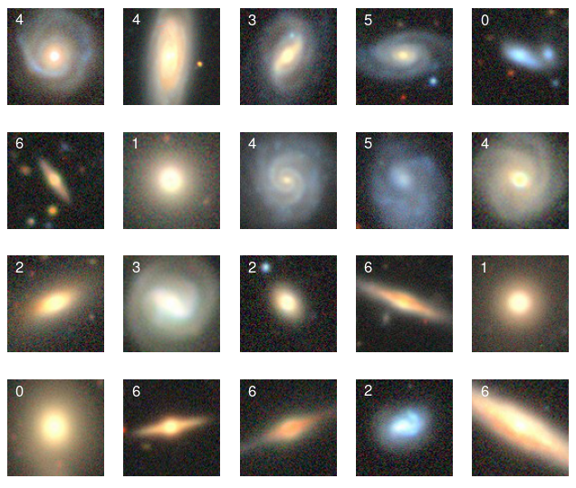
Introduction (2)
We shall use the images
from the Galaxy 10 DECals Dataset at the
astroNN website.
Goal: classify galaxies using images like these.
https://astronn.readthedocs.io/en/stable/galaxy10.html

Slide 7
Introduction (3)
Data set
The data set comprises 12,600 images divided into 7 galaxy morphology classes with 1800 galaxies per class.
Each 3-channel image is cropped to 96 x 96 pixels.

Slide 8
Introduction (4)
This a multi-class problem, so we need a generalization of binary classification.

Slide 9
Multi-class classification

Slide 10
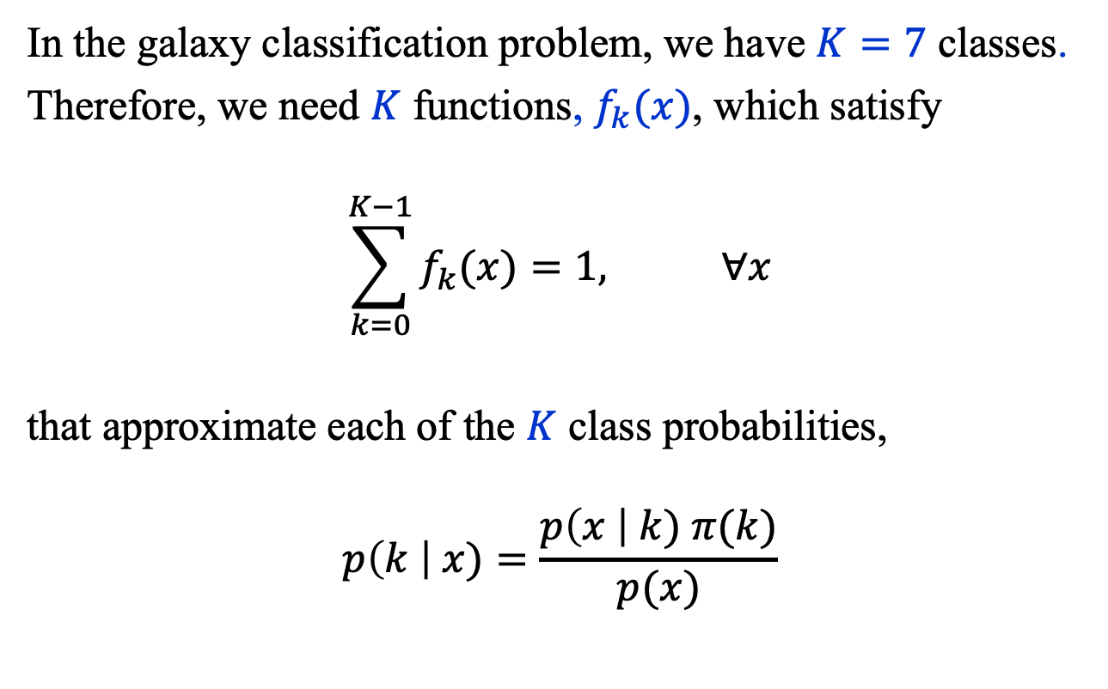
Multi-Class Classification (1)
In the galaxy classification problem, we have $K=7$ classes.
Therefore, we need $K$ functions, $f_{k}(x)$, which satisfy
$$\sum_{k=0}^{K−1}{f_{k}(x)}=1, ∀x$$
that approximate each of the $K$ class probabilities,
$$p\left(k \right| x)=\frac{p\left(x \right| k) π(k)}{p(x)}$$

Slide 11
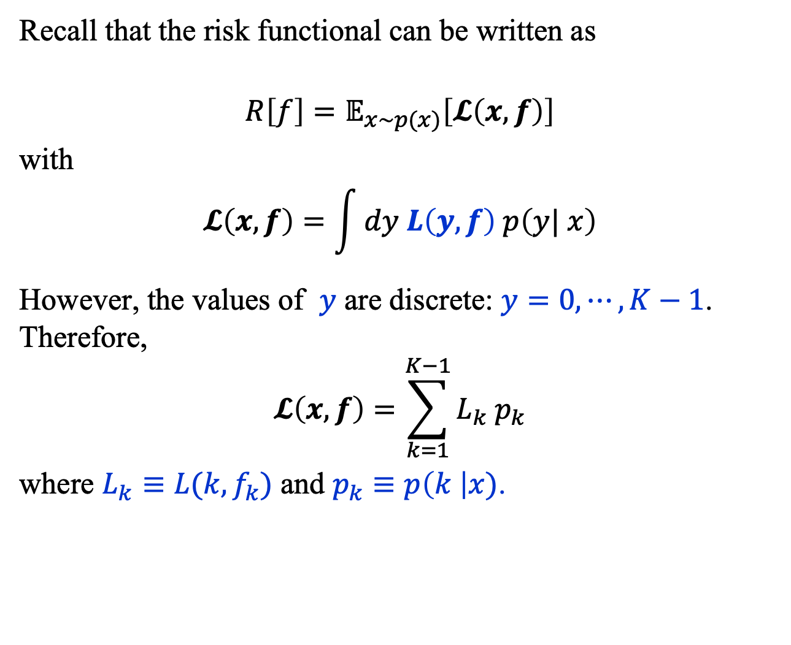
Multi-Class Classification (2)
Recall that the risk functional can be written as
$$R\left[f\right]=𝔼_{x∼p(x)}\left[𝓛\left(x,f\right)\right]$$
with
$$𝓛\left(x,f\right)=\int{dy L\left(y, f\right) p\left(y| x\right)}$$
However, the values of $y$ are discrete: $y=0,⋯, K−1$. Therefore,
$$𝓛\left(x,f\right)=\sum_{k=1}^{K−1}{L_{k} p_{k}}$$
where $L_{k}≡L(k, f_{k})$ and $p_{k}≡p\left(k \right|x)$.

Slide 12
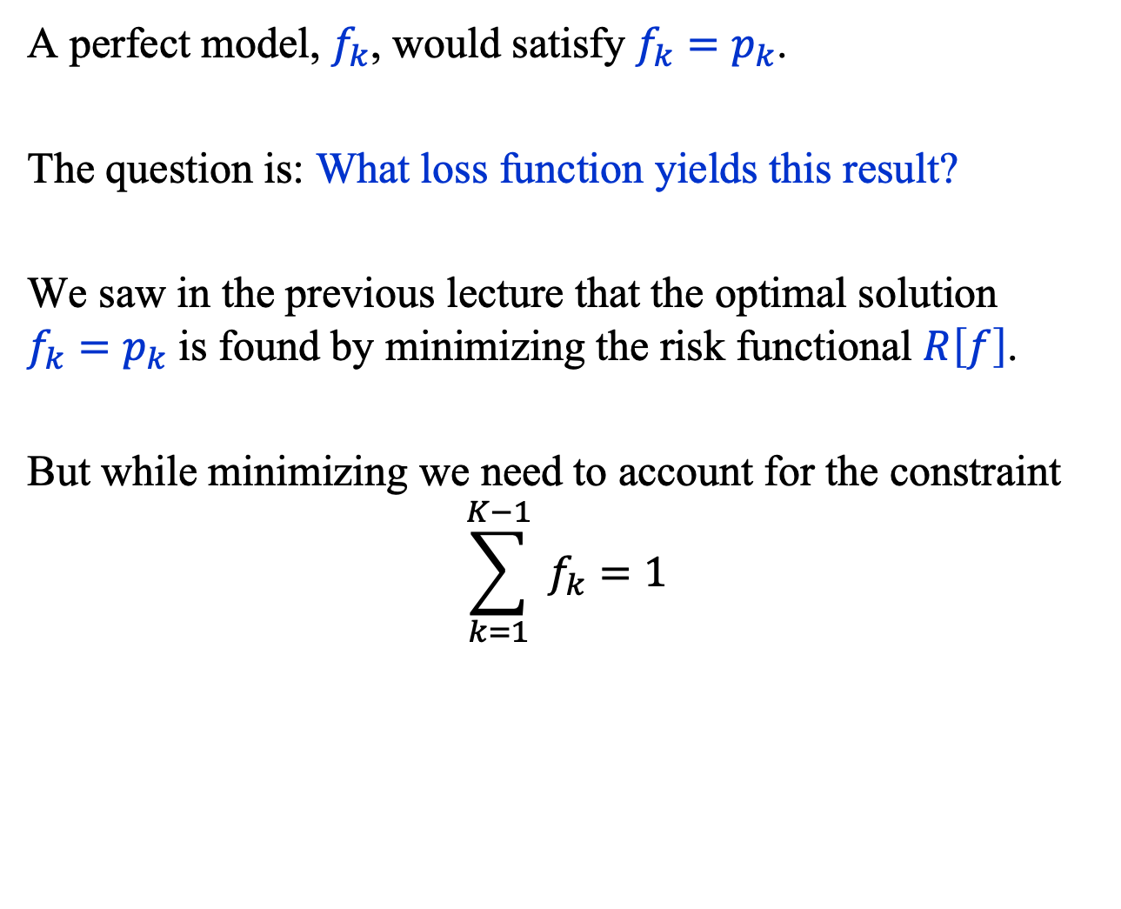
Multi-Class Classification (3)
A perfect model, $f_{k}$, would satisfy $f_{k}=p_{k}$.
The question is: What loss function yields this result?
We saw in the previous lecture that the optimal solution $f_{k}=p_{k}$ is found by minimizing the risk functional $R\left[f\right]$.
But while minimizing we need to account for the constraint
$$\sum_{k=1}^{K−1}{ f_{k}}=1$$

Slide 13
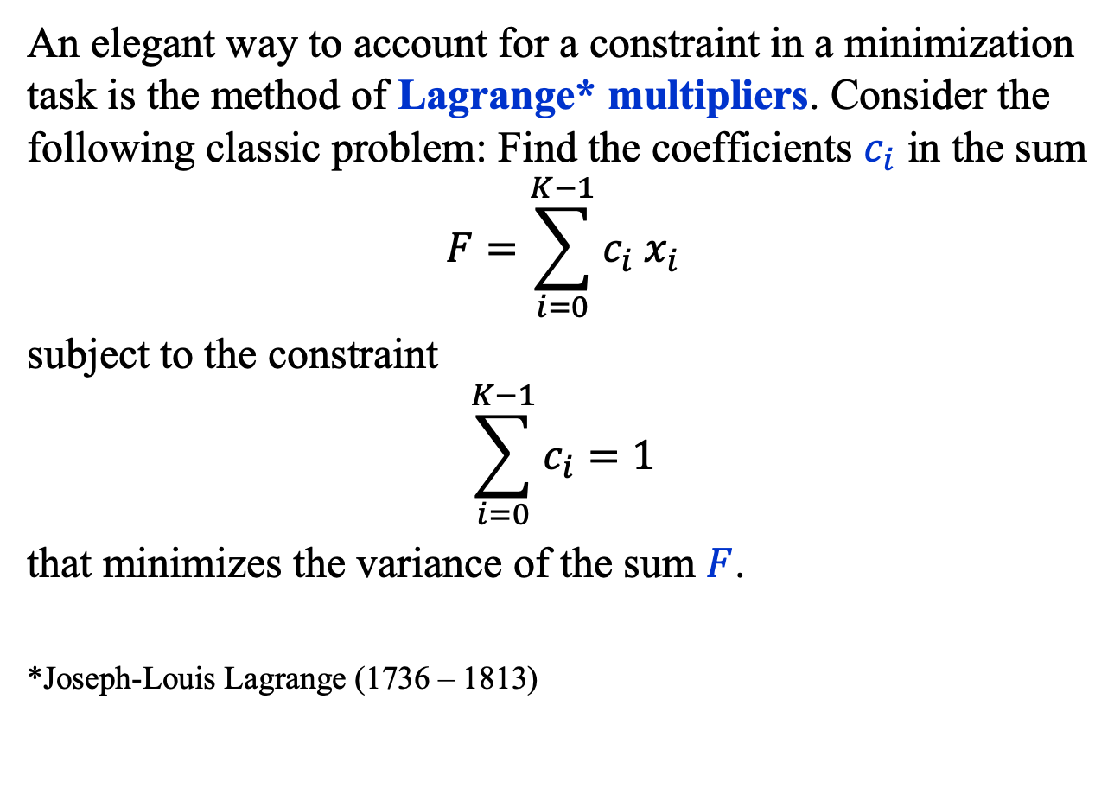
An Aside (1)
An elegant way to account for a constraint in a minimization task is the method of Lagrange* multipliers. Consider the following classic problem: Find the coefficients $c_{i}$ in the sum
$$F=\sum_{i=0}^{K−1}{c_{i} x_{i}}$$
subject to the constraint
$$\sum_{i=0}^{K−1}{c_{i}=1}$$
that minimizes the variance of the sum $F$.
*Joseph-Louis Lagrange (1736 – 1813)

Slide 14
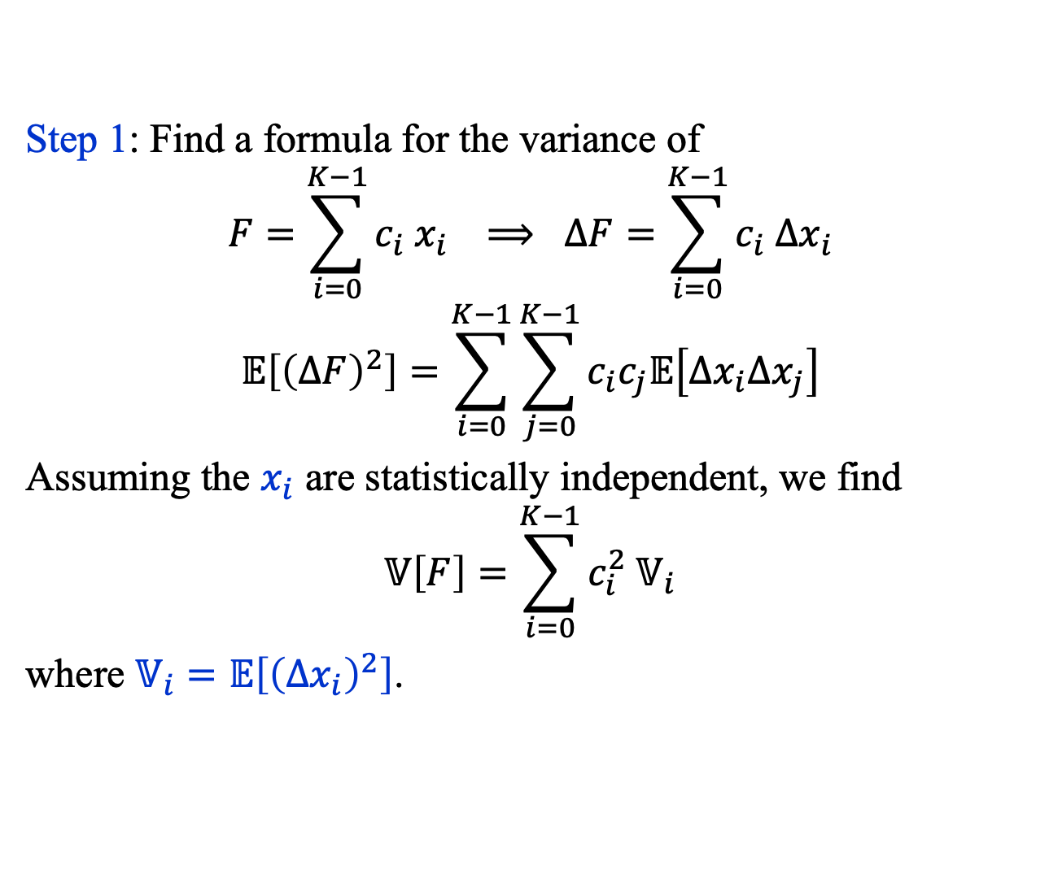
An Aside (2)
Step 1: Find a formula for the variance of
$$F=\sum_{i=0}^{K−1}{c_{i} x_{i}} ⟹ ΔF=\sum_{i=0}^{K−1}{c_{i} Δx_{i}}$$
$$𝔼\left[{\left(ΔF\right)}^{2}\right]=\sum_{i=0}^{K−1}{\sum_{j=0}^{K−1}{c_{i}c_{j}𝔼\left[Δx_{i}Δx_{j}\right]}}$$
Assuming the $x_{i}$ are statistically independent, we find
$$𝕍\left[F\right]=\sum_{i=0}^{K−1}{c_{i}^{2} 𝕍_{i}}$$
where $𝕍_{i}=𝔼\left[{\left(Δx_{i}\right)}^{2}\right]$.

Slide 15
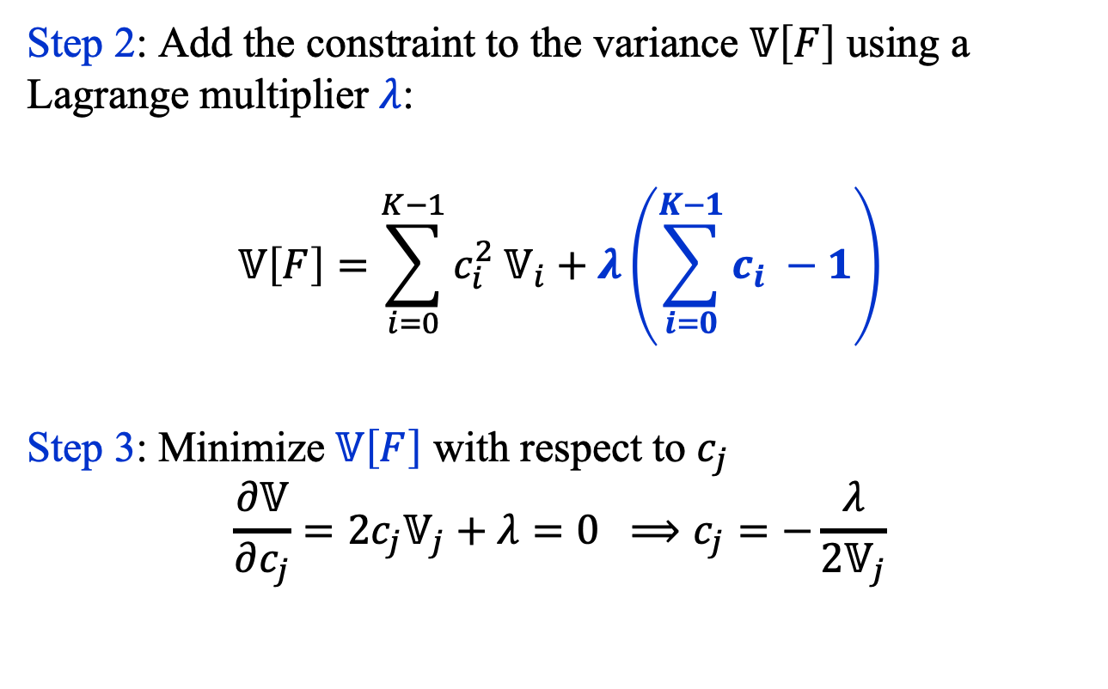
An Aside (3)
Step 2: Add the constraint to the variance $𝕍\left[F\right]$ using a Lagrange multiplier $λ$:
$$𝕍\left[F\right]=\sum_{i=0}^{K−1}{c_{i}^{2} 𝕍_{i}}+λ\left(\sum_{i=0}^{K−1}{c_{i} }−1\right)$$
Step 3: Minimize $𝕍\left[F\right]$ with respect to $c_{j}$
$$\frac{∂𝕍}{∂c_{j}}=2c_{j}𝕍_{j}+λ=0 ⟹c_{j}=−\frac{λ}{2𝕍_{j}}$$

Slide 16
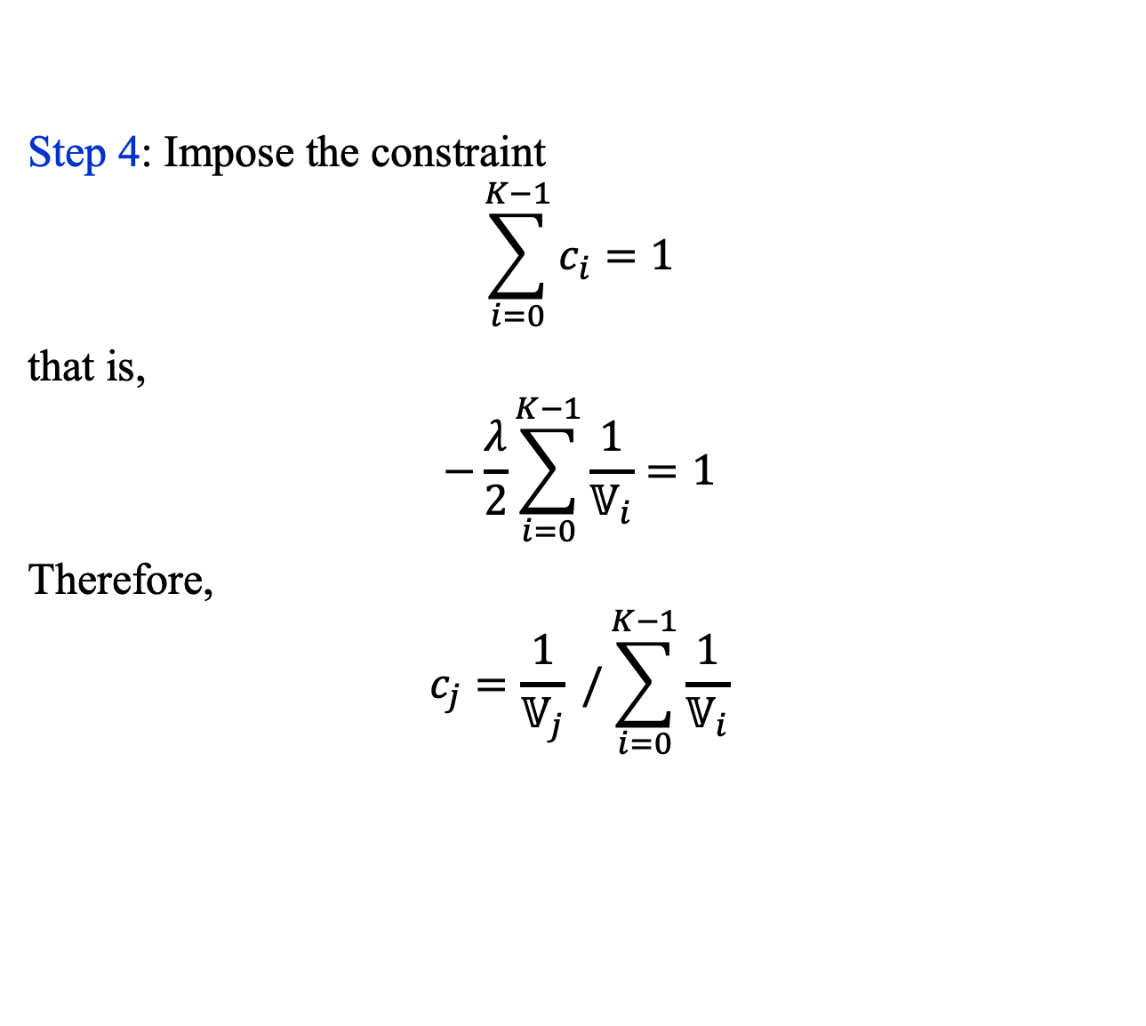
An Aside (4)
Step 4: Impose the constraint
$$\sum_{i=0}^{K−1}{c_{i}=1}$$
that is,
$$−\frac{λ}{2}\sum_{i=0}^{K−1}{\frac{1}{𝕍_{i}}=1}$$
Therefore,
$$c_{j}=\frac{1}{𝕍_{j}} /\sum_{i=0}^{K−1}{\frac{1}{𝕍_{i}}}$$

Slide 17
Break

Slide 18
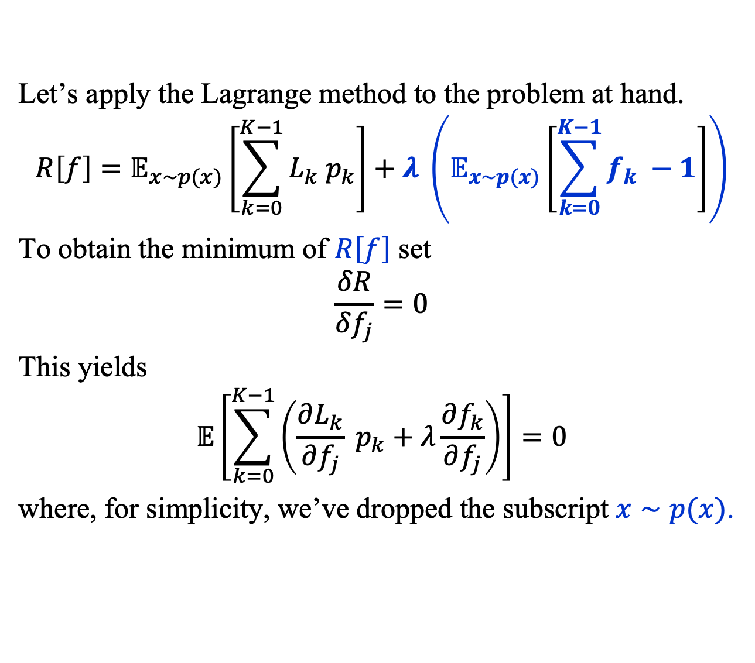
Multi-Class Classification (4)
Let’s apply the Lagrange method to the problem at hand.
$$R\left[f\right]=𝔼_{x∼p(x)}\left[\sum_{k=0}^{K−1}{L_{k} p_{k}}\right]+λ \left(𝔼_{x∼p(x)}\left[\sum_{k=0}^{K−1}{f_{k} −1}\right]\right)$$
To obtain the minimum of $R\left[f\right]$ set
$$\frac{δR}{δf_{j}}=0$$
This yields
$$𝔼\left[\sum_{k=0}^{K−1}{\left(\frac{∂L_{k}}{∂f_{j}} p_{k}+λ\frac{∂f_{k}}{∂f_{j}}\right)}\right]=0$$
where, for simplicity, we’ve dropped the subscript $x∼p(x)$.

Slide 19
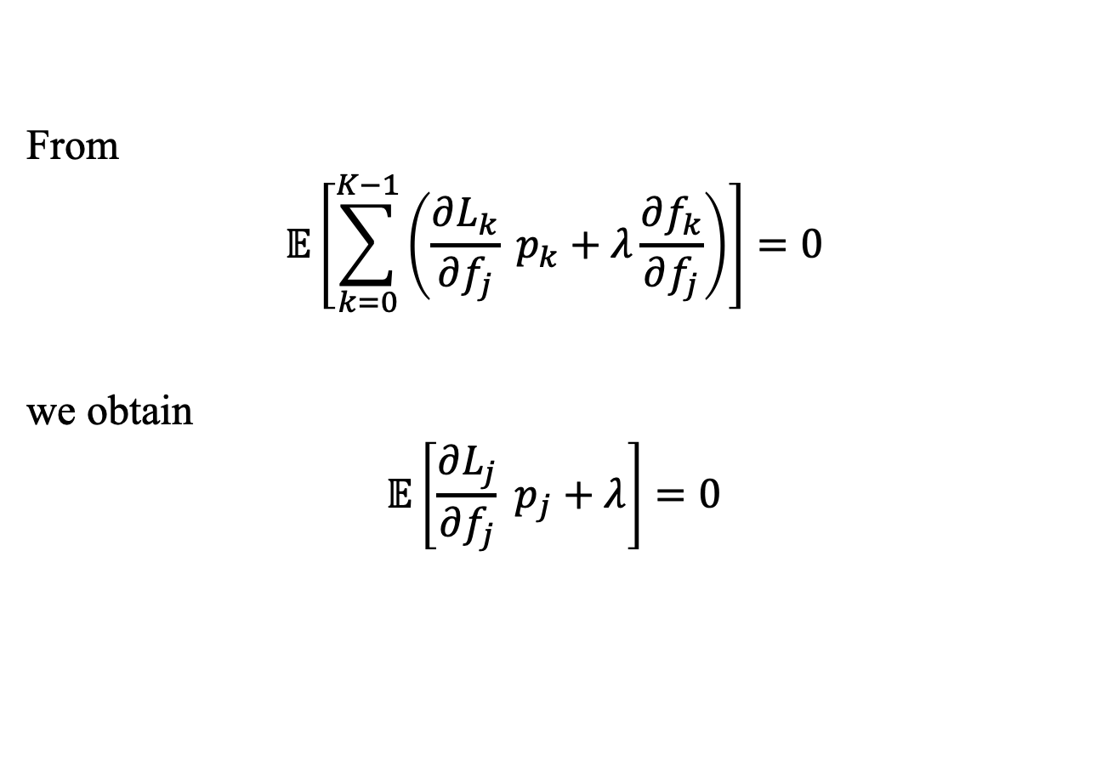
Multi-Class Classification (4)
From
$$𝔼\left[\sum_{k=0}^{K−1}{\left(\frac{∂L_{k}}{∂f_{j}} p_{k}+λ\frac{∂f_{k}}{∂f_{j}}\right)}\right]=0$$
we obtain
$$𝔼\left[\frac{∂L_{j}}{∂f_{j}} p_{j}+λ\right]=0$$

Slide 20
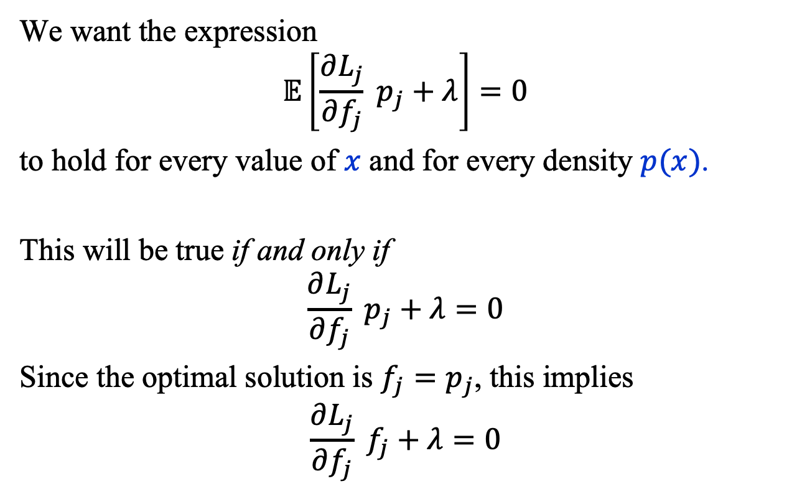
Multi-Class Classification (5)
We want the expression
$$𝔼\left[\frac{∂L_{j}}{∂f_{j}} p_{j}+λ\right]=0$$
to hold for every value of $x$ and for every density $p(x)$.
This will be true if and only if
$$\frac{∂L_{j}}{∂f_{j}} p_{j}+λ=0$$
Since the optimal solution is $f_{j}=p_{j}$, this implies
$$\frac{∂L_{j}}{∂f_{j}} f_{j}+λ=0$$

Slide 21
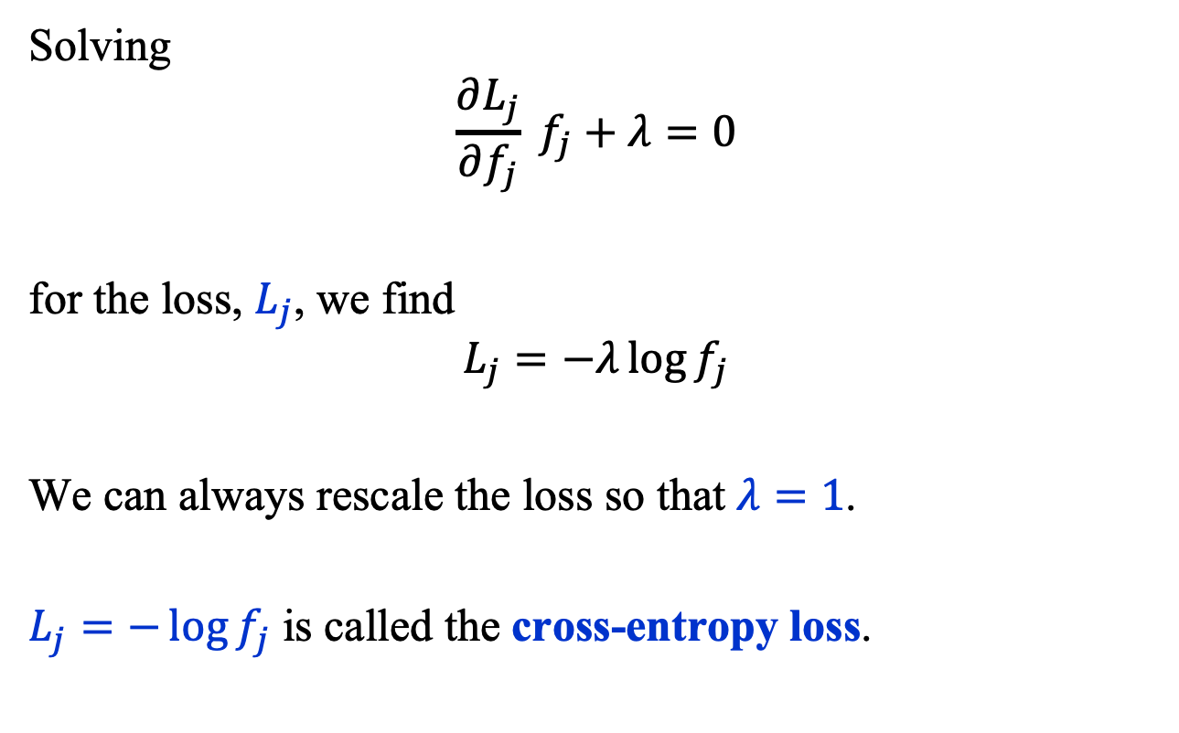
Multi-Class Classification (6)
Solving
$$\frac{∂L_{j}}{∂f_{j}} f_{j}+λ=0$$
for the loss, $L_{j}$, we find
$$L_{j}=−λ\log{f_{j}}$$
We can always rescale the loss so that $λ=1$.
$L_{j}=−\log{f_{j}}$ is called the cross-entropy loss.

Slide 22
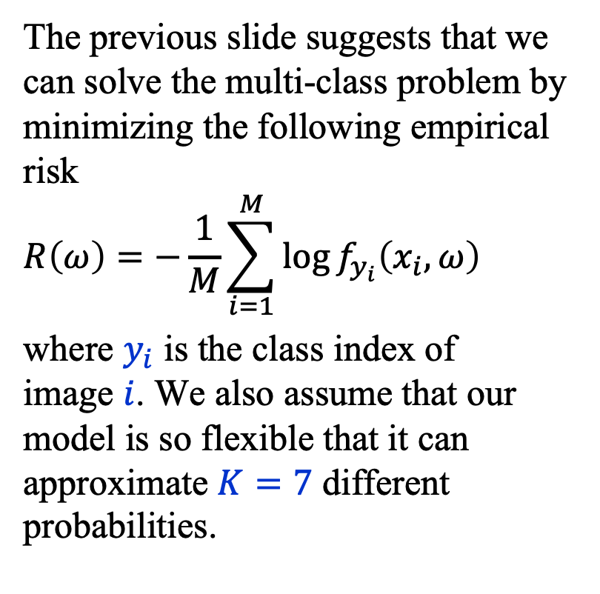
Cross Entropy Loss
The previous slide suggests that we can solve the multi-class problem by minimizing the following empirical risk $$R\left(ω\right)=−\frac{1}{M}\sum_{i=1}^{M}{\log{f_{y_{i}}\left(x_{i}, ω\right)}}$$
where $y_{i}$ is the class index of image $i$. We also assume that our model is so flexible that it can approximate $K=7$ different probabilities.

Slide 23
Convolutional neural networks (CNN)

Slide 24
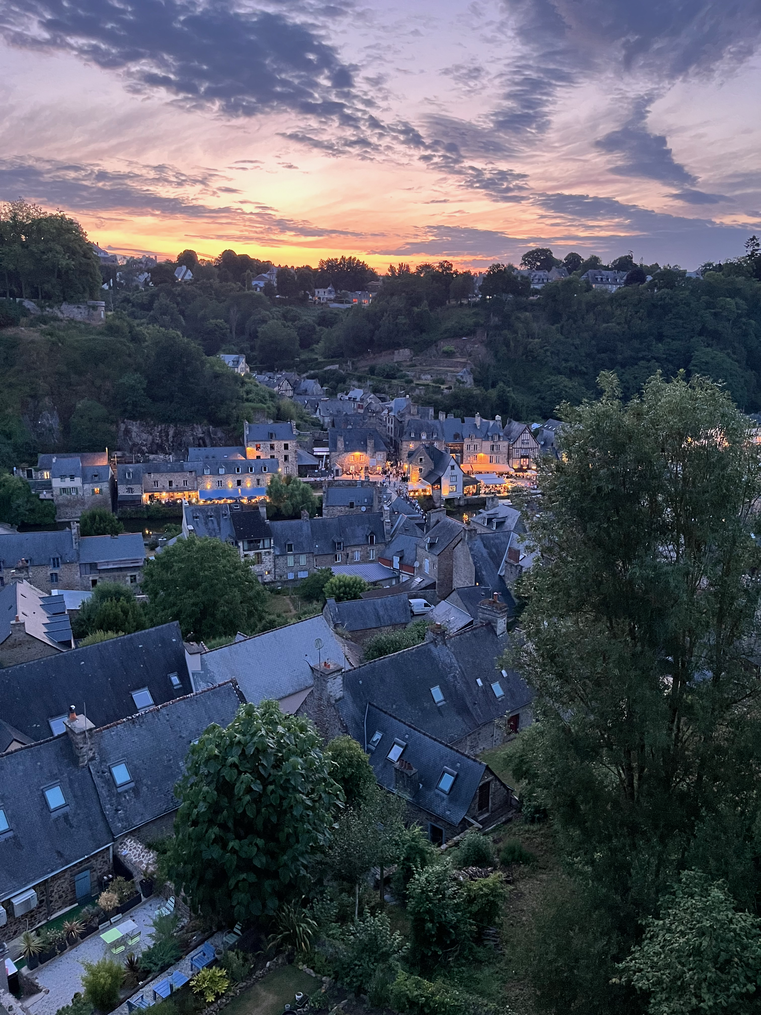
Convolutional Neural Networks (1)
Convolutional neural networks (CNN) are functions that extract features from 1, 2 or 3D data, which are then processed with another neural network.
The key insight that underpins CNNs is that many data sets, for example images, contain periodicities that connect different parts of the data sets.
Harrison Prosper, Dinan, France, 2025

Slide 25
Convolutional Neural Networks (2)
A standard CNN comprises three types of processing layers:
Convolution The data, e.g., an image, is convolved with one or more filters.
Down-sampling After applying a non-linear map to the convolved data, the latter are down-sampled.
Classification A standard neural network classifies the convolved data.

Slide 26
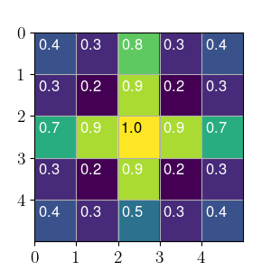
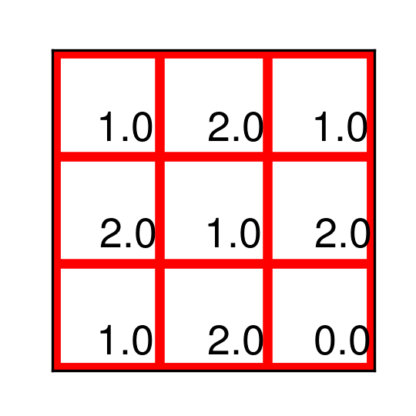
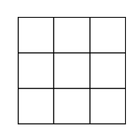
Convolutional Neural Network
Convolution
(3, 3)-filter (3, 3, 1)-image
(5, 5, 1)-image

Slide 27
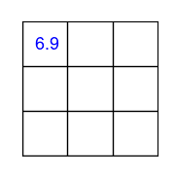
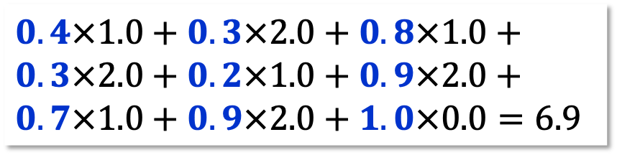
Convolutional Neural Network
Convolution
(3, 3)-filter (3, 3, 1)-image
convolved
stride = 1
(5, 5, 1)-image
$$0.4×1.0+0.3×2.0+0.8×1.0+$$
$$0.3×2.0+0.2×1.0+0.9×2.0+$$
$$0.7×1.0+0.9×2.0+1.0×0.0=6.9$$

Slide 28
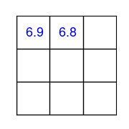
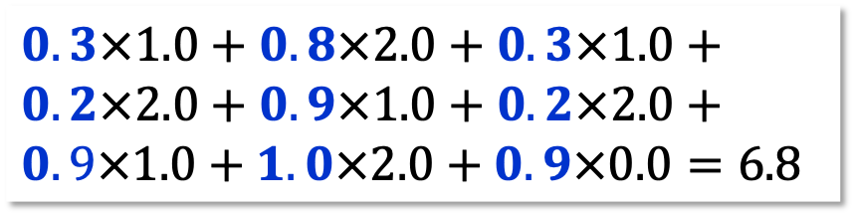
Convolutional Neural Network
Convolution
(3, 3)-filter (3, 3, 1)-image
convolved
(5, 5, 1)-image
$$0.3×1.0+0.8×2.0+0.3×1.0+$$
$$0.2×2.0+0.9×1.0+0.2×2.0+$$
$$0.9×1.0+1.0×2.0+0.9×0.0=6.8$$

Slide 29
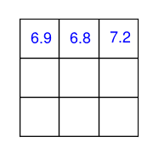
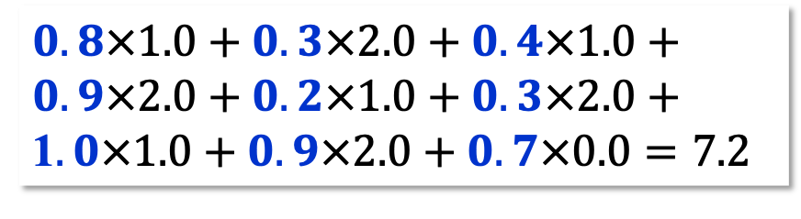
Convolutional Neural Network
Convolution
(3, 3)-filter (3, 3, 1)-image
(convolved)
(5, 5, 1)-image
$$0.8×1.0+0.3×2.0+0.4×1.0+$$
$$0.9×2.0+0.2×1.0+0.3×2.0+$$
1$.0×1.0+0.9×2.0+0.7×0.0=7.2$

Slide 30
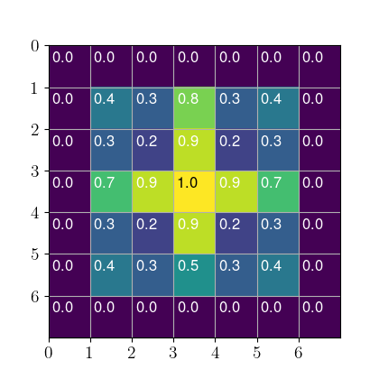
Convolutional Neural Network
Padding
Wrapping the image with a 1–pixel border makes it possible, with a (3, 3)-filter, to maintain the image size.

Slide 31
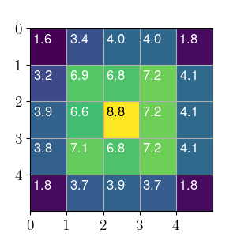
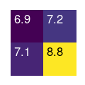
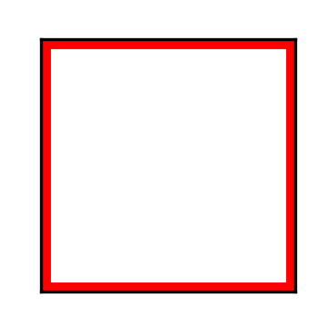
Convolutional Neural Network
Down-sampling
Stride = 2
(2, 2, 1)-image
(down-sampled)
(5, 5, 1)-image (convolved)
MaxPool2d Return the largest value within window.
AvgPool2d Return the average value within window.

Slide 32

Convolutional Neural Network
Classification The convolved data go to a fully-connected neural network whose outputs approximate the class probabilities:
$$p\left(k | x\right)=\frac{p\left(x | k\right) π\left(k\right)}{p(x)}$$

Slide 33
A galaxy classifier

Slide 34
A Galaxy Classifier (1)
softmax()
maxpool( relu( conv2d(x) ) )
Linear(252, 7)
Flatten()
(7, 6, 6)
(6, 12, 12)
(5, 24, 24)
(4, 48, 48)
(3, 96, 96)

Slide 35
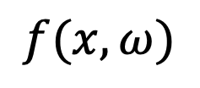

A Galaxy Classifier (2)
$$f(x, ω)$$
Softmax
Here is a more standard representation of
the proposed classifier.
Linear(252,7)
Flatten()
MaxPool2d(2,2)
MaxPool2d(2,2)
ReLU()
ReLU()
Conv2d(6,7,3,1,1)
Conv2d(4,5,3,1,1)
MaxPool2d(2,2)
MaxPool2d(2,2)
ReLU()
ReLU()
Conv2d(5,6,3,1,1)
Conv2d(3,4,3,1,1)
$$x$$

Slide 36
Summary
Convolutional neural networks have revolutionized image classification and interpretation and are now used in many applications.
The model exploits the fact that natural images are often locally approximately translation invariant.
The convolutions automatically extract features from images that can later be used to interpret them.

